Slide 1
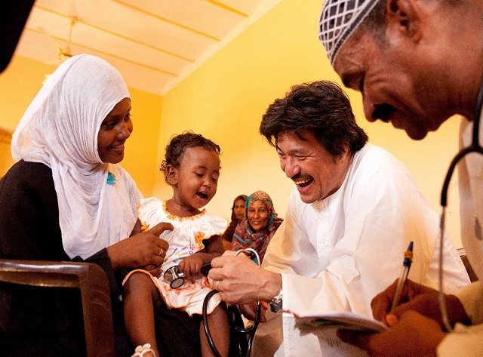
Photo by Junji Naito
ROCINANTES
SHICHIJO Takashi

Slide 2
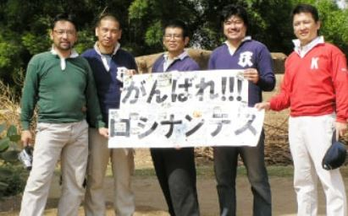
ROCINANTES
・ Established in 2006
・ Director Dr. KAWAHARA Naoyuki
・ Based in Kita Kyushu city, Fukuoka, JAPAN

Slide 3
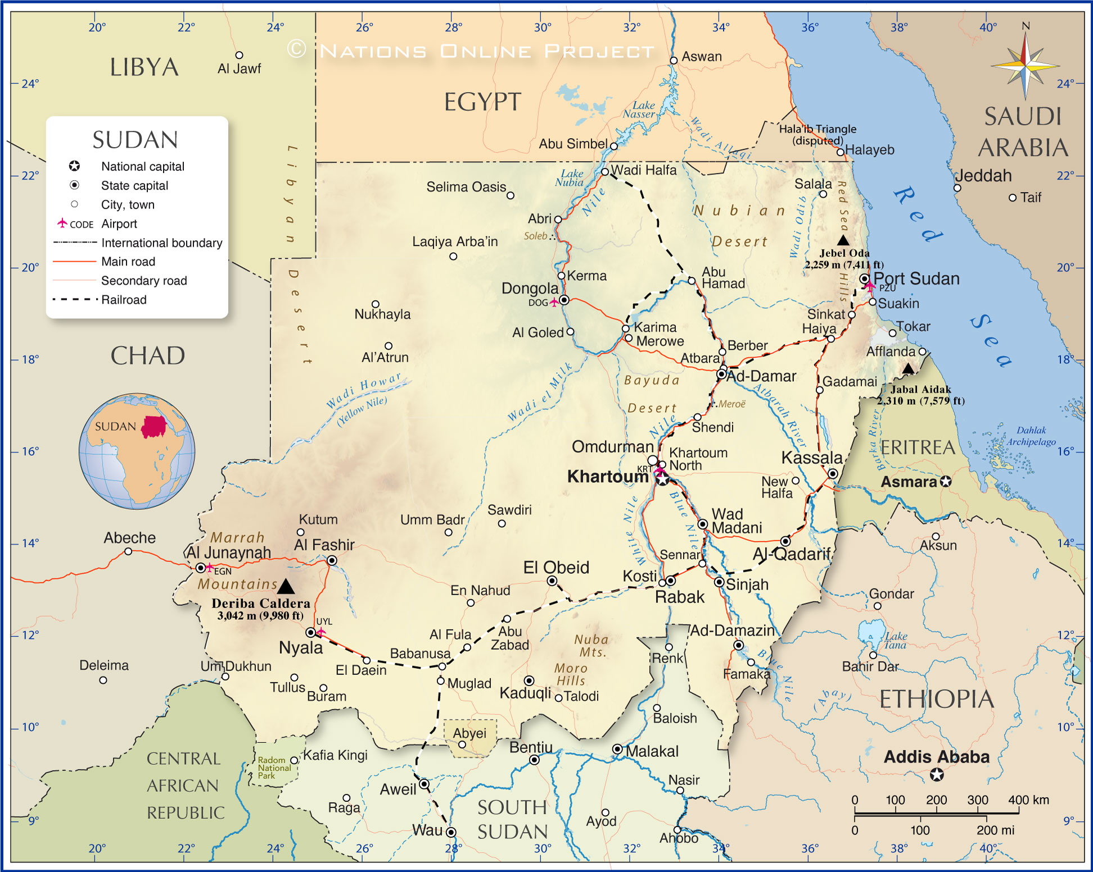
ROCINANTES in Sudan
Khartoum
North Kordfan
Gadarif

Slide 4
ROCINANTES in Sudan
Mobile Medical Clinic Project
Health Clinic Construction Project
Water Supply Project
School Construction Project

Slide 5
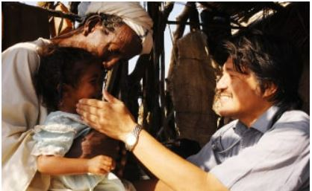
ROCINANTES in Sudan
Mobile Medical Clinic Project
@Gadarif @Khartoum

Slide 6
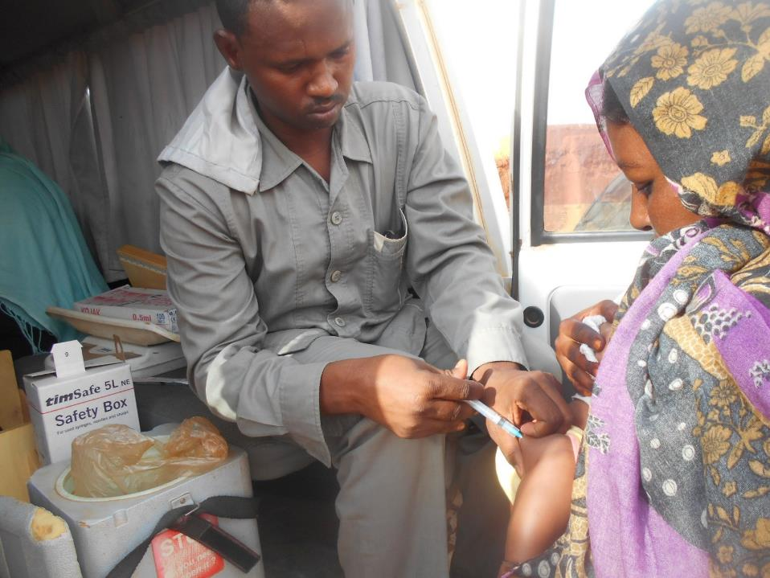
ROCINANTES in Sudan
Mobile Medical Clinic Project
@Gadarif @Khartoum

Slide 7
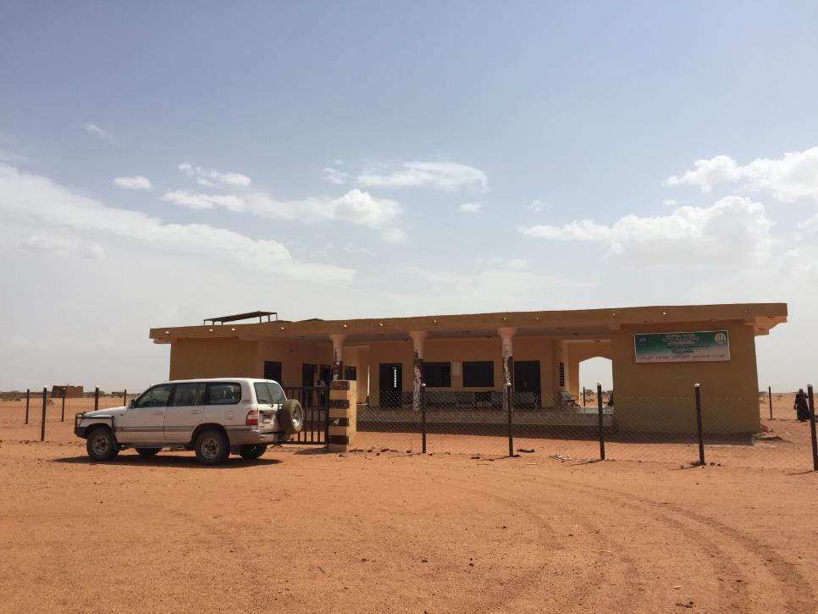
ROCINANTES in Sudan
Health Clinic Construction Project
@Gadarif @Khartoum

Slide 8
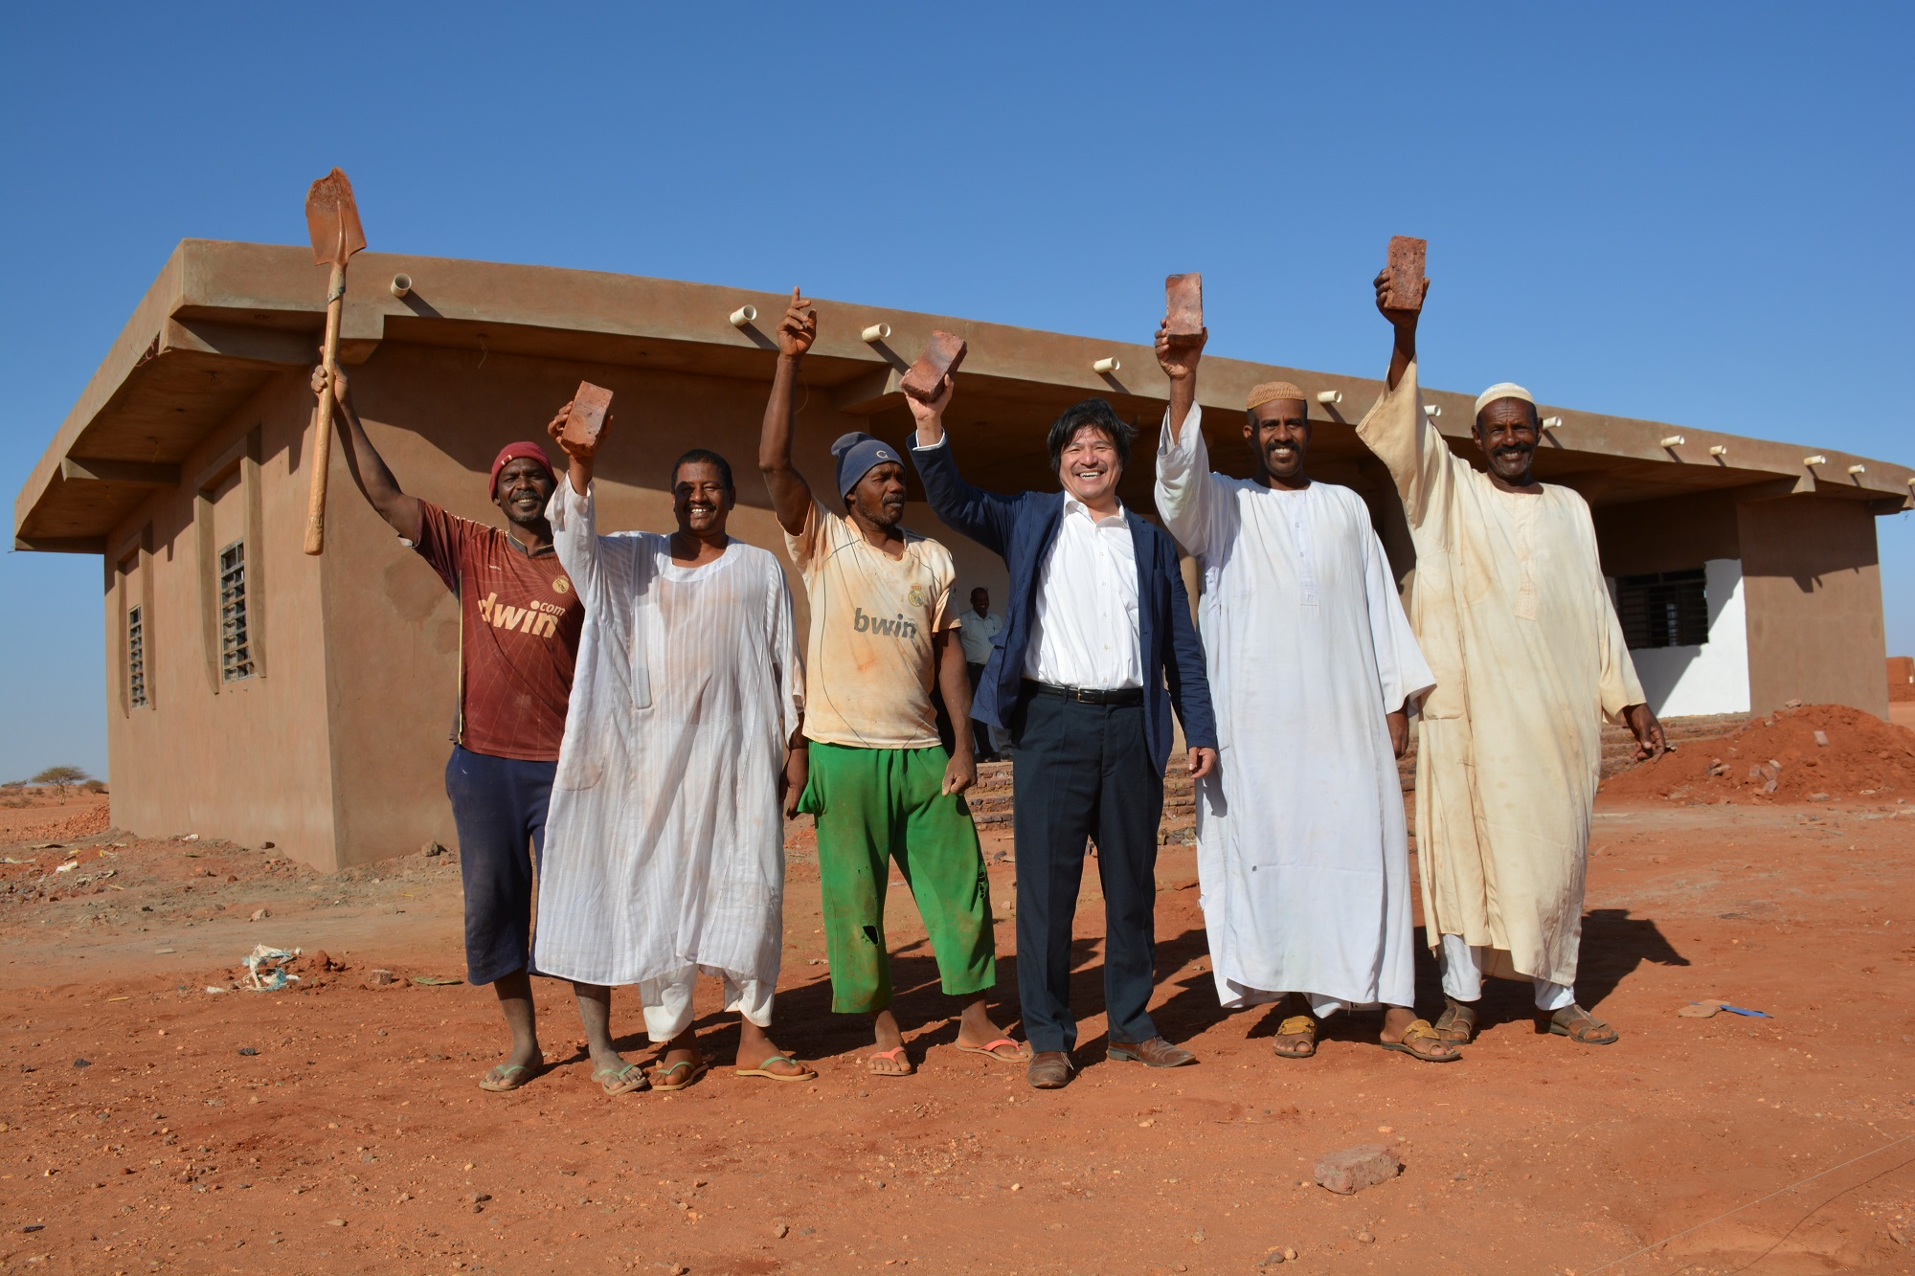
ROCINANTES in Sudan
Health Clinic Construction Project
@Gadarif @Khartoum

Slide 9
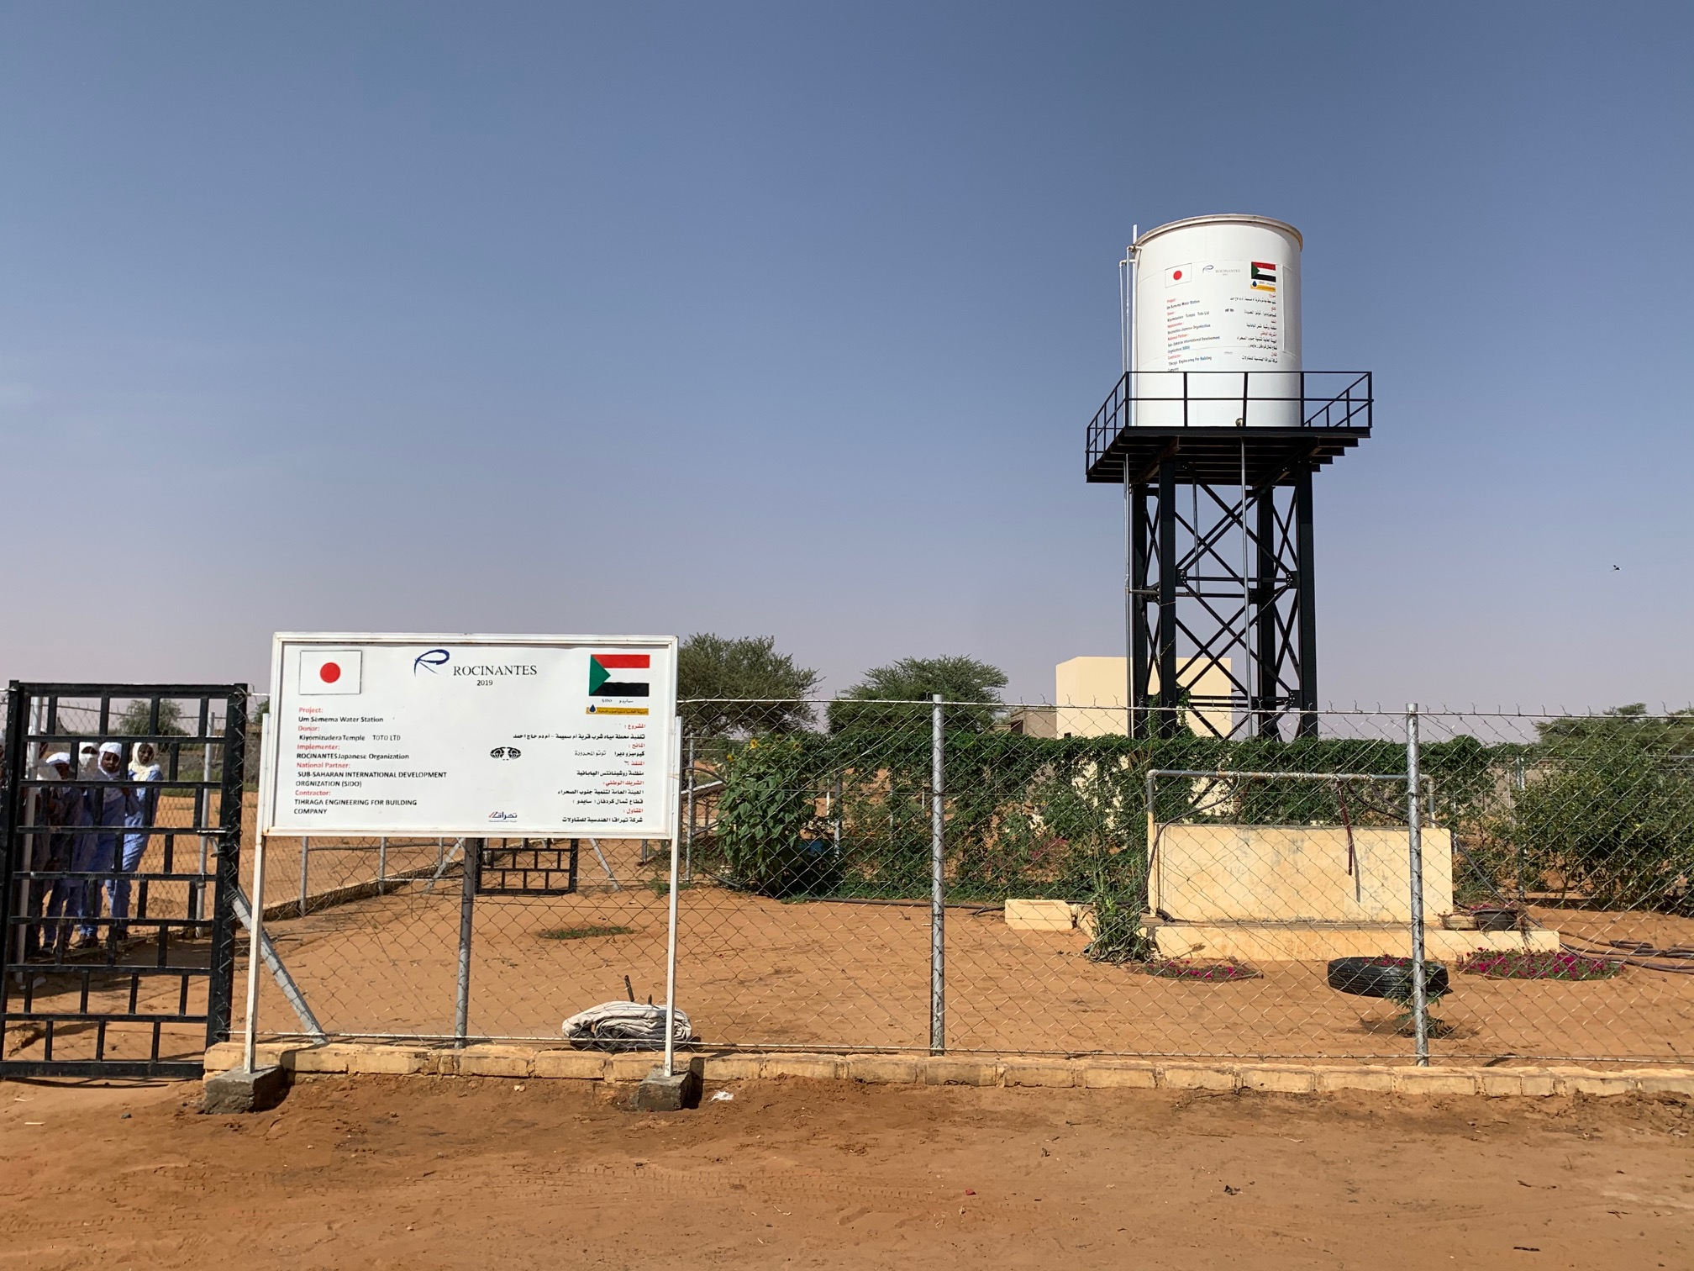
ROCINANTES in Sudan
Water Supply Project
@Gadarif @North Kordfan
@Khartoum

Slide 10
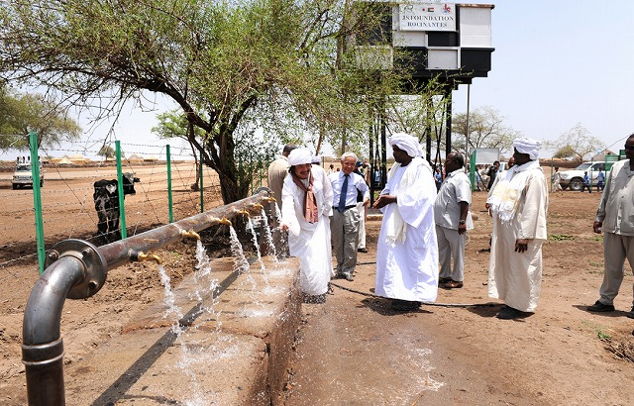
ROCINANTES in Sudan
Water Supply Project
@Gadarif @North Kordfan
@Khartoum

Slide 11
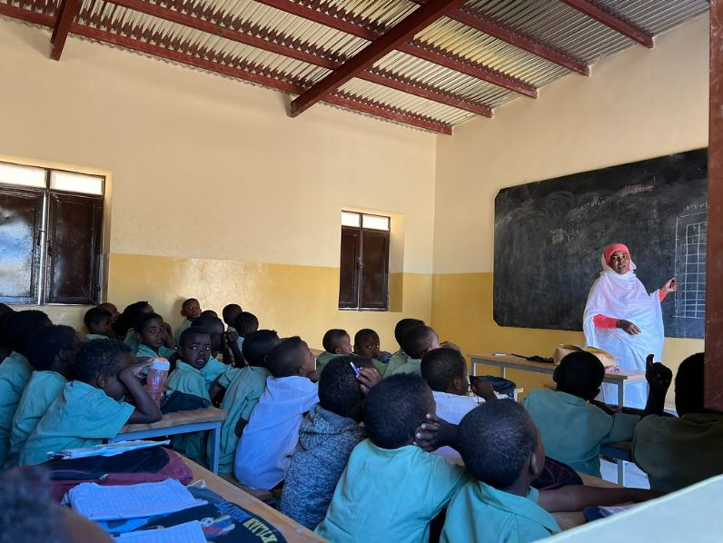
ROCINANTES in Sudan
School Construction Project
@Gadarif @North Kordfan

Slide 12
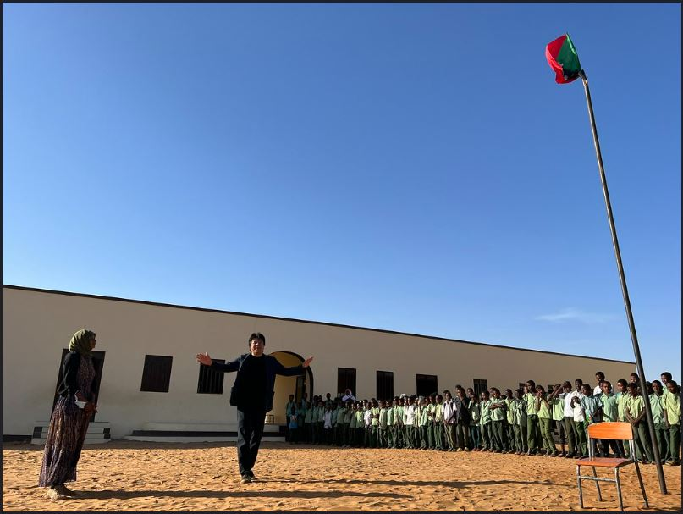
ROCINANTES in Sudan
School Construction Project
@Gadarif @North Kordfan

Slide 13
ROCINANTES in Sudan
Wad Medani

Slide 14
ROCINANTES in Zambia
Maternal and Child Health Projects
Tuberculosis Projects
Sudan
Zambia

Slide 15
ROCINANTES in Zambia
Maternal and Child Health Projects
Mother Shelter Construction
Installation Mobile Ultrasound

Slide 16
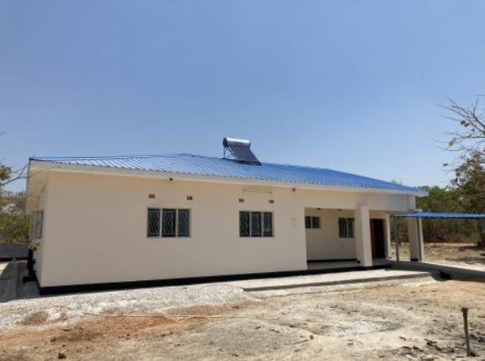
ROCINANTES in Zambia
Maternal and Child Health Projects
Mother Shelter Construction

Slide 17
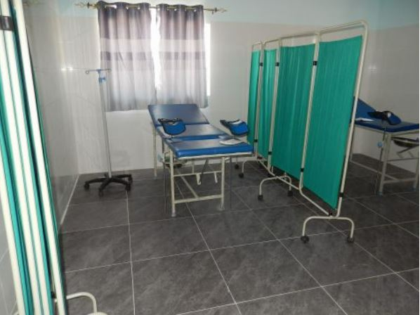
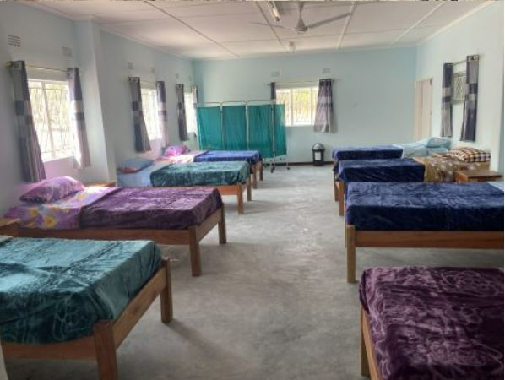
ROCINANTES in Zambia
Maternal and Child Health Projects
Mother Shelter Construction

Slide 18
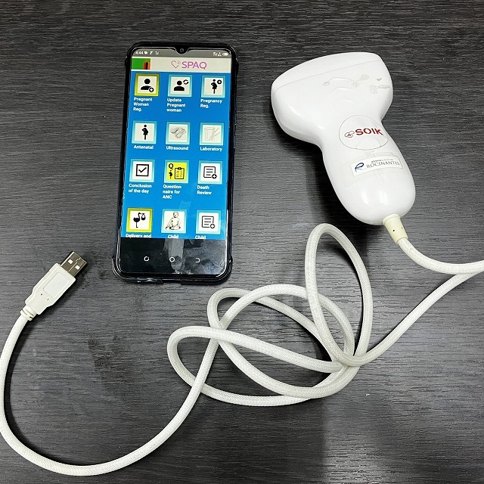
ROCINANTES in Zambia
Maternal and Child Health Projects
Installation Mobile Ultrasound

Slide 19
ROCINANTES in Zambia
Maternal and Child Health Projects
Installation Mobile Ultrasound

Slide 20
ROCINANTES
MU-TOZAI – 無東西…

Slide 21
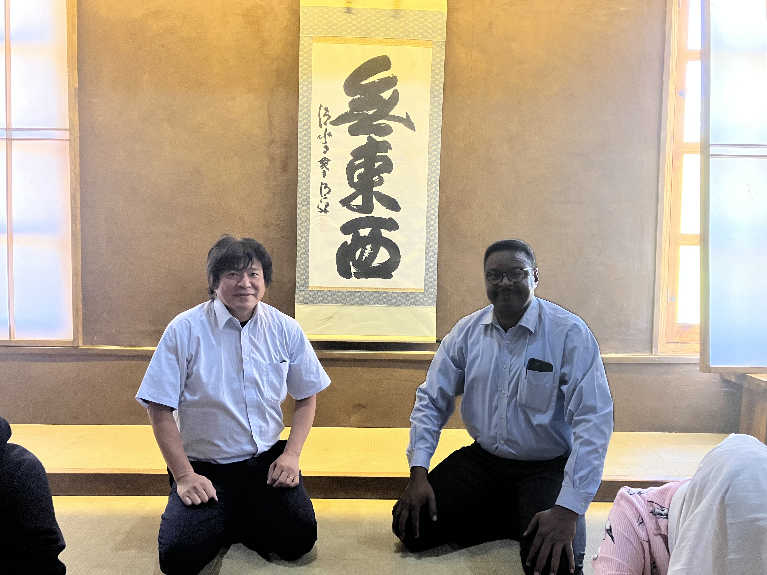
ROCINANTES
MU-TOZAI
@University of Khartoum

