Slide 1
INCEPTION REPORT
JICA Knowledge Co-Creation Program
Water Related Disaster Risk Reduction
May 2024
Name, Country

Slide 2
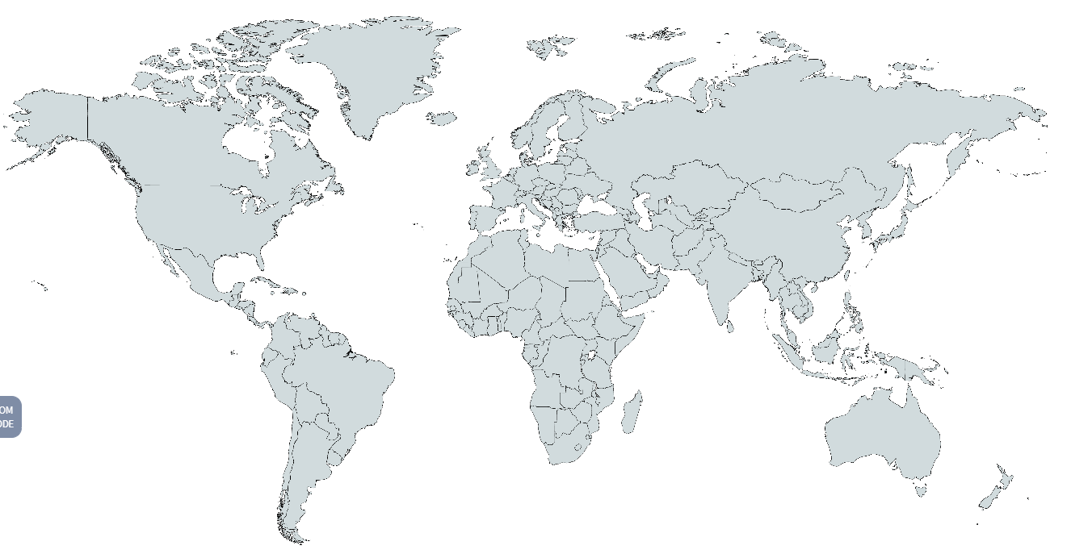
1. Introduction of myself and my country
Name | (Full Name & Common name)
Country name
Career after graduation until present.
Location | (Mark the map below)

Slide 3
1. Introduction of myself and my country
Capital city
Surface Area
Population
Currency
Nominal GDP | (in USD)
Per capita GDP | (in USD)
Natural Conditions | (climate, precipitation, geology, topography, rivers)

Slide 4
2. Introduction of my organization
Name
Objectives
Organization chart | (Paste here)
My position in it＆daily work

Slide 5
2. Introduction of my organization
Challenges in my current work

Slide 6
3. Overview of water related disasters in my country
Characteristics, estimated damage, comparison with other disasters
Recent water related disasters and emergency responses

Slide 7
3. Overview of water related disasters in my country
Flood control measures and disaster management and its budget amount
Implementation status on flood fighting drills

Slide 8
4. Current/future projects for flood control and disaster management in my country and supports from international/ foreign organizations*
* World Bank, ADB: Asian Development Bank, AIIB: Asian Infrastructure Investment Bank, JICA, KOICA: Korea International Cooperation Agency, USAID etc.

Slide 9
5-1. Overview of meteorological and hydrological observation system in my country. (including the organizations to manage the observation system and to store the past observation data, if possible)
Discuss only the duties which your organization and you are responsible for.

Slide 10
5-2. Implementation status on river management measures. (Inspections and maintenance of dams and levees)
Discuss only the duties which your organization and you are responsible for.

