Slide 1








Theme1-2
Water Rights
Establishing the Order of Water Use Based on Regional Practices and Characteristics

Slide 2
Contents
      Introduction
      The Change of Water Use
      Building a Water Use Order through the Water Right System
      Water Distribution during Drought according to Historical Practices in Each Basin
      Operation and Maintenance of Irrigation Facility
      Lessons Learned
Notes:
このテーマの鋼製は、1～５のとおり。

Slide 3
1. Introduction (1)
Each country, region, and river basin has different water issues, distinctive and individual circumstances, and practices and history of water use. Thus, they should build a water rights system to establish an order for water use based on this background.
Water Resources Utilization
Water use by human
Irrigation, Domestic water supply, Industrial water supply, Hydroelectric power generation
Navigation, Dilution of domestic wastewater, Recreation
Preservation of ecosystem

Slide 4
1. Introduction (2)
Water shortage
Disorderly water intake by individual users
Water does not reach downstream
Impact to ecosystem
Disorderly intake should be regulated to establish effective and appropriate use by controlling the amount of water intake

Slide 5
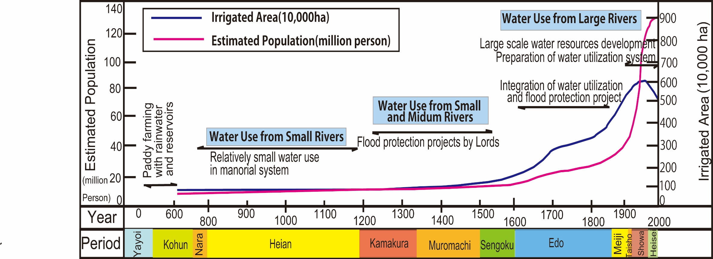
2. The Change of Water Use (1)
Source: Partial excerpt and revision of ”Farm Land and Water in Japan, Ministry of Agriculture, Forestry and Fisheries
Irrigation water
Irrigation, D&I, Hydropower
Water Demand

Slide 6
2. The Change of Water Use (2)
Before 19th century
Farmers and agriculture-based communities managed the irrigation water for a long time.
Water right
1896 Old River Law
1964 New River Law

Slide 7
3. Water Right System (1)
(1) Water Rights Licensing System
Applicant
Licensee
(River Management Office)
Submission of Required Documents
(Newly applied intake water discharge) < (Standard drought discharge)-(Normal function flow discharge)
Applicant may take required water.

Slide 8
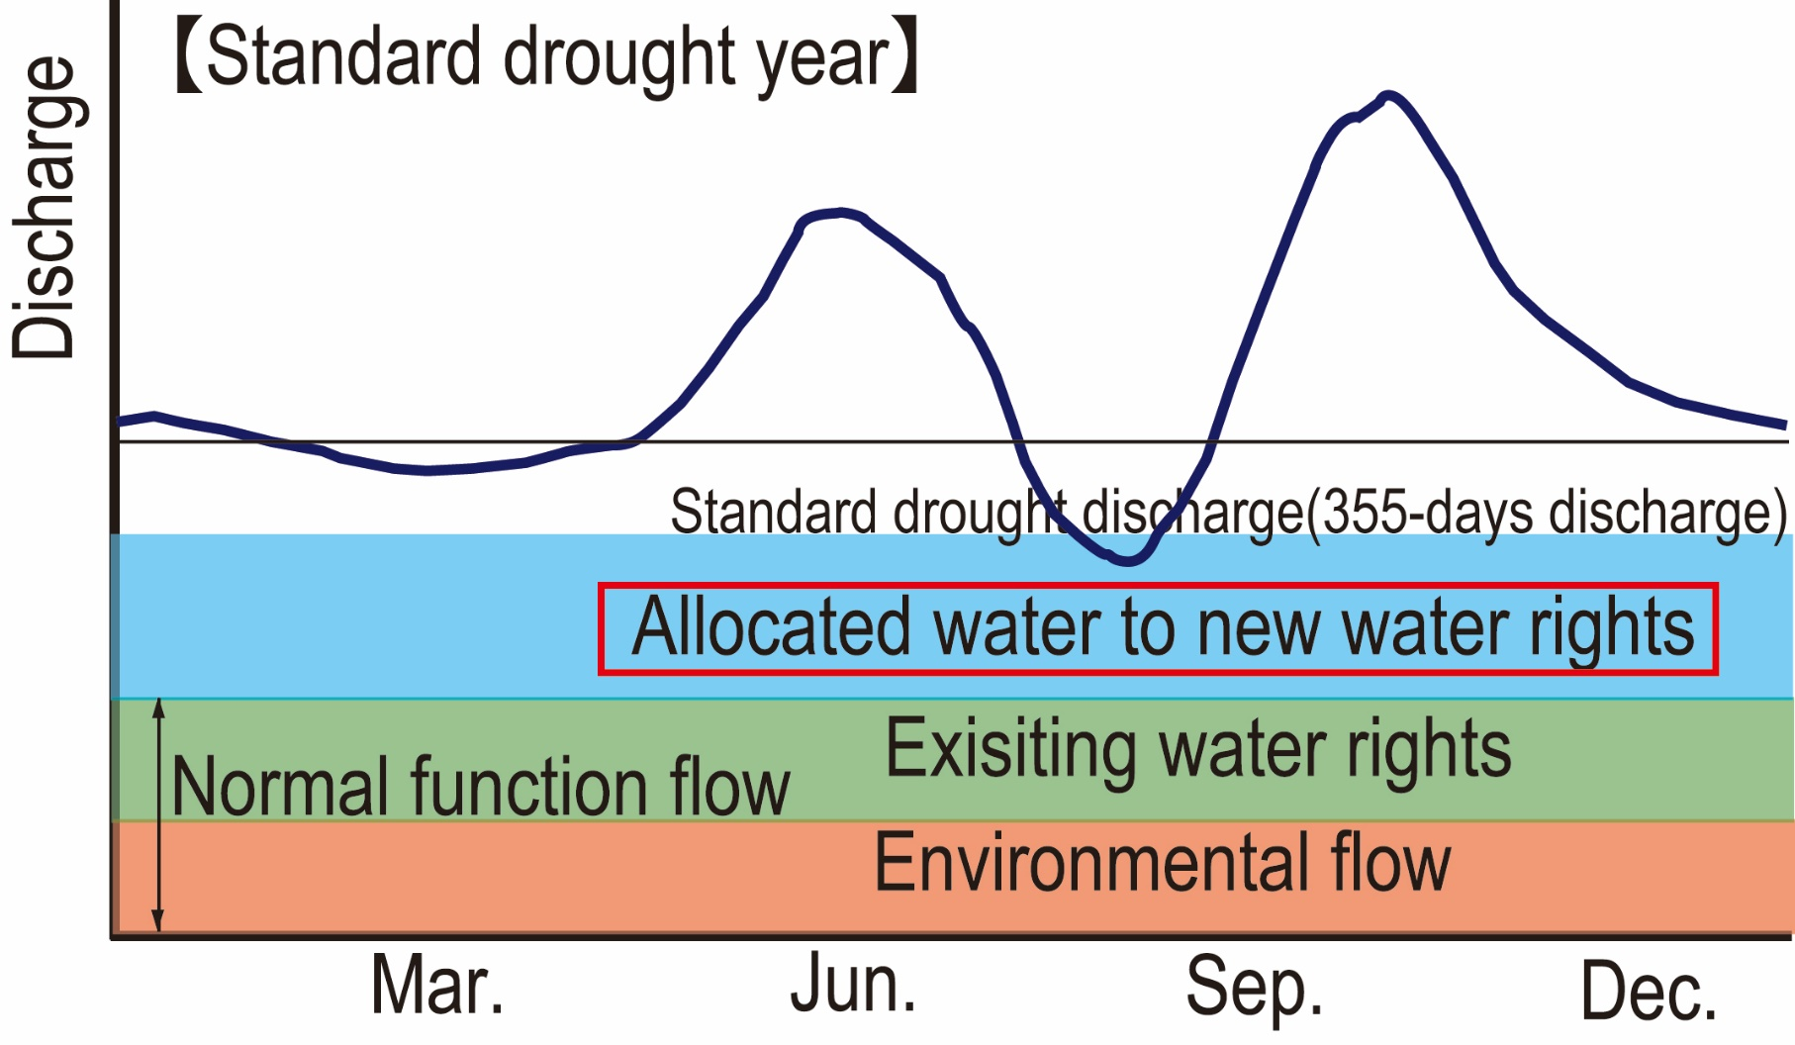
3. Water Right System (2)
(1) Water Rights Licensing System
Source: PRT

Slide 9
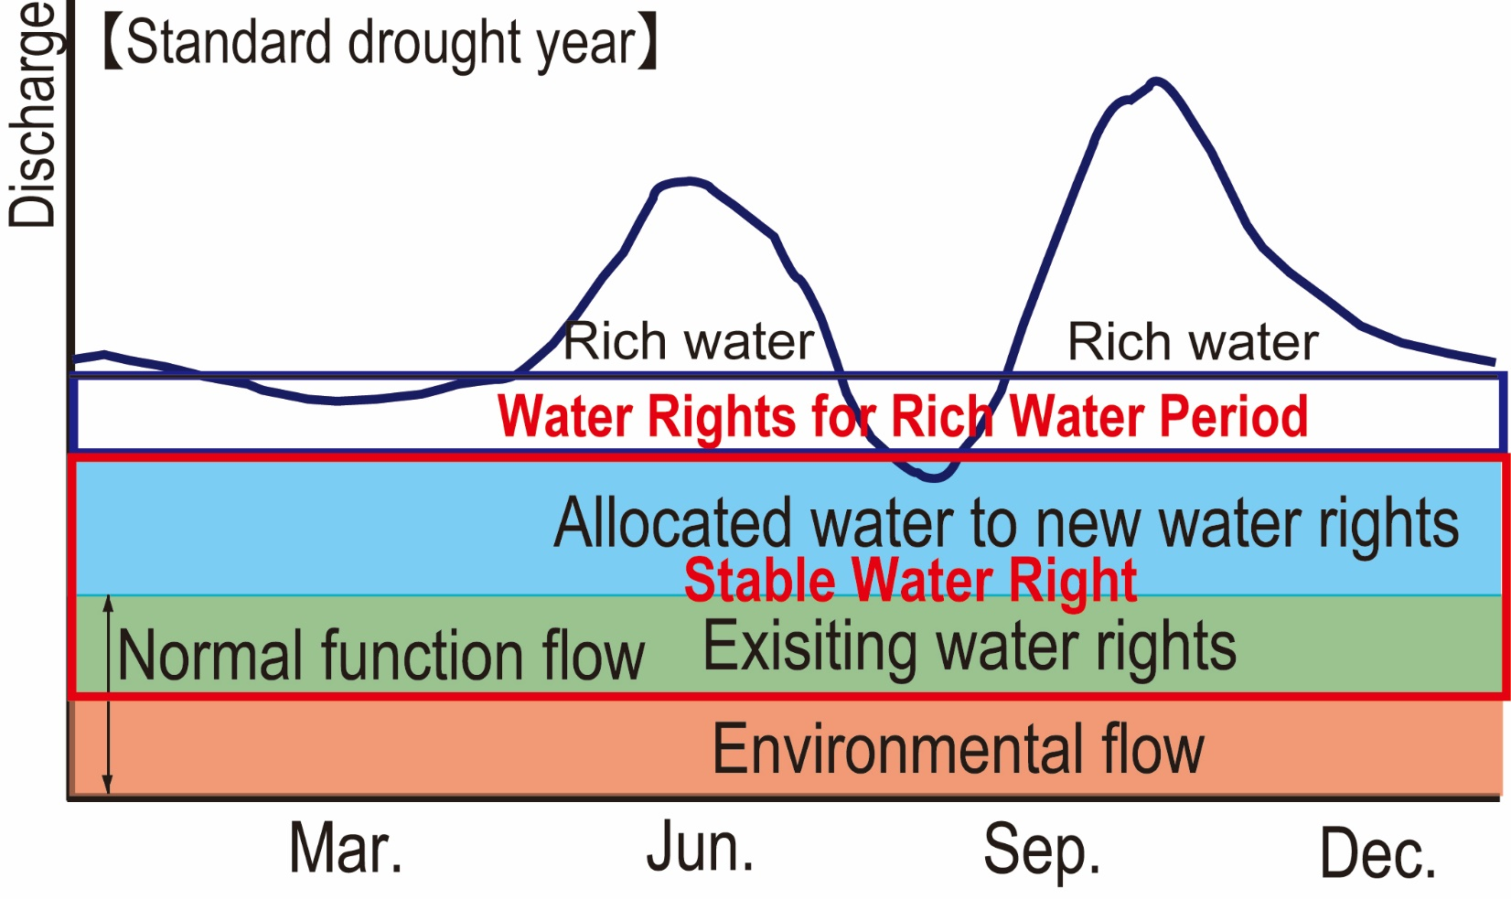
3. Water Right System(3)
(1) Water Rights Licensing System
1) Classification of Water Right
Run-off type Hydropower generation
Provisional water right during rich water period
Source: PRT

Slide 10
3. Water Right System (4)
(1) Water Rights Licensing System
2) Required Documents and Actions by the Applicant to Obtain Water Rights
Requirement: To obtain the consent of other river water users by taking measures as necessary
Application documents
Outline of implementation program
Evidence for water demands
Evidence for the amount of water used from the river
Records of river water level and runoff discharge for the past 10 years
Explanation of the predicted impacts on other users and necessary countermeasures

Slide 11
3. Water Right System (5)
(1) Water Rights Licensing System
Estimation method, if there is no record of actual discharge measurement
  The discharge was estimated using data from other river basins where topography, geology, and rainfall characteristics are most similar to those of the intake basin.
  If the discharge data are available in the river basin, where the rainfall conditions are very similar to the intake basin, simultaneous discharge observation at the existing observation point and the planned water intake point is carried out throughout the year.
  The discharge is estimated by applying a simulation model

Slide 12
3. Water Right System (6)
(1) Water Rights Licensing System
3) Criteria for Granting the Water Rights
  Promotion of public welfare
  Certainty of execution
  Relation between discharge of river flow and water intake
  Hindrance to the public interest
4) Valid Period of Permission
  Hydropower generation: approx. 20 years
  Other water use: approx. 10 years

Slide 13
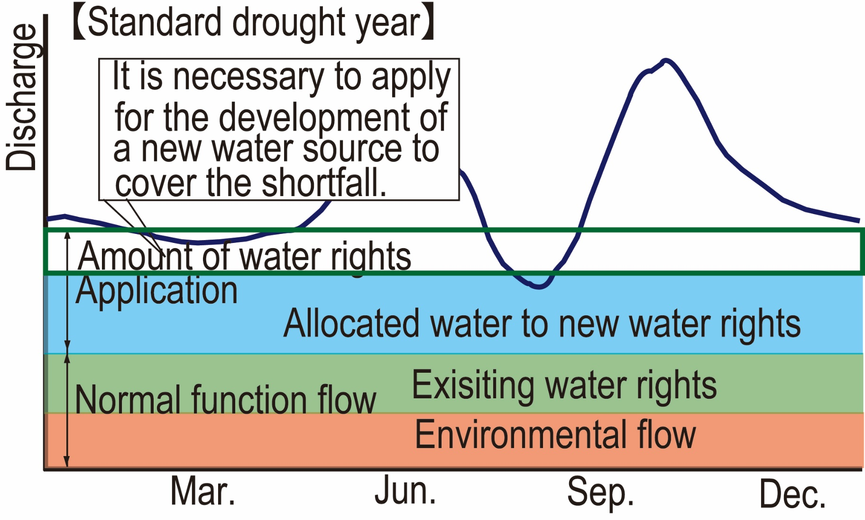
3. Water Right System (7)
(1) Water Rights Licensing System
Source: PRT

Slide 14
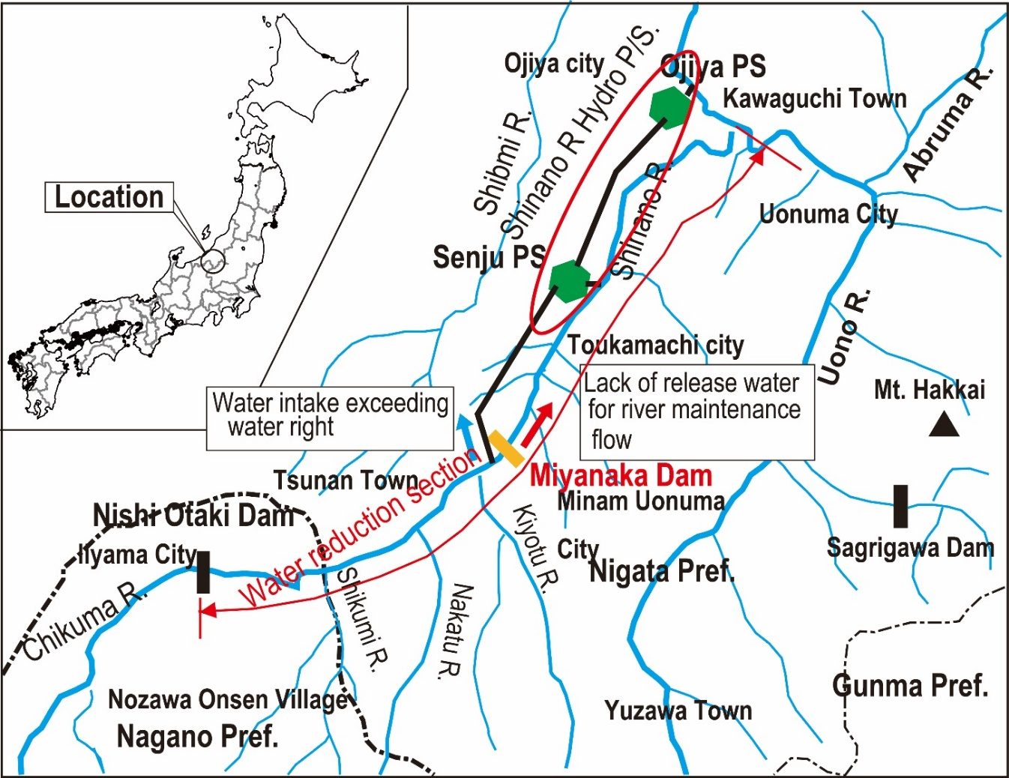
3. Water Right System (8)
(1) Water Rights Licensing System
4) Penalties for Illegal Water Intake
Violation of
Water intake exceeding the water right
Insufficient minimum environmental flow discharge released from Miyanaka Dam
Revoking water right
Source: PRT

Slide 15
3. Water Right System (9)
(2) Prioritized Customary Water Rights
Japan has given the customary water rights to the traditional water uses made before establishing water right system.
Source: Fourth Study group on the sophistication of river use as a resource, Document No.2 Customary water right MLIT
Total Number of Water Right
Total Maximum Intake Water

Slide 16
3. Water Right System (10)
(3) Transfer and Trade of Water Rights
1965 to 2017: 78 nos. transfer water about 46m3/s
Urbanization
Decreasing irrigation water demand
Decreasing paddy field
Domestic water allocates from irrigation water.
To change land use
Housing land
and other lands
Increasing domestic water demand

Slide 17
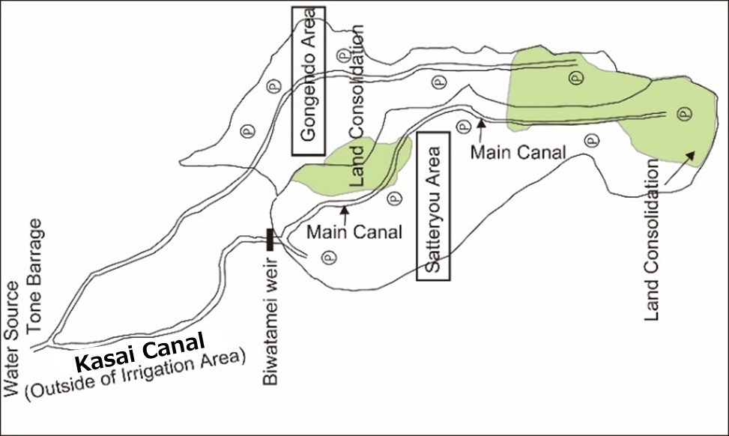
3. Water Right System (11)
(3) Transfer and Trade of Water Rights
Example: Irrigation Water Rationalization Project in Saitama Pref.
Renovation of Irrigation Facilities in the Gongendo-Satteryou Area
Installation of Pumping Station
Pipeline of irrigation water supply
Location Map
Source: “Reallocation of water resources between water uses and cost sharing (I) -Case study on agricultural water rationalization project in Saitama Prefecture” Takeda Mari, Water Science

Slide 18
3. Water Right System (12)
(3) Transfer and Trade of Water Rights
Allocation of Costs in Irrigation Water Rationalization Project and Actual Share after Negotiations

Slide 19
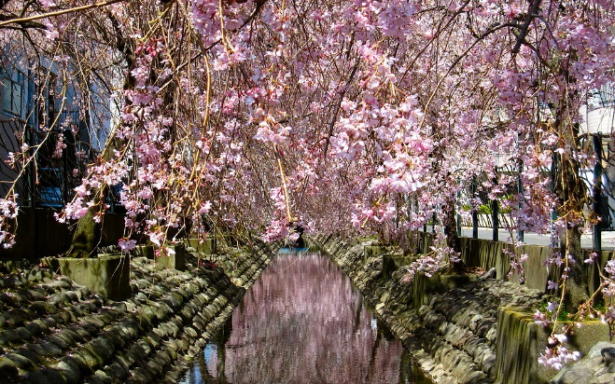
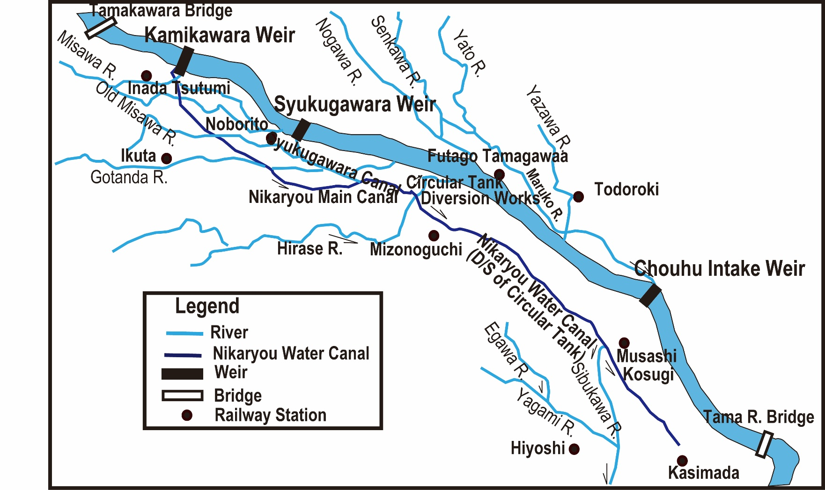
3. Water Right System(13)
(3) Transfer and Trade of Water Rights
Nikaryo Canal
Cherry Blossom along Nikaryou Canal
Location Map of Nikaryou Water Canal

Slide 20
3. Water Right System(14)
(3) Transfer and Trade of Water Rights
Nikaryo Canal
Changing Water Intake (Unit: m3/s)
Year | Industry | Irrigation | Environment | Total
1957 | 0.00 | 9.35 | 0.00 | 9.35
1958 | 2.35 | 7.00 | 0.00 | 9.35
1982 | 2.35 | 3.50 | 0.00 | 5.85
1991 | 2.35 | 1.30 | 0.00 | 3.65
1995 | 2.35 | 1.30 | 1.40 | 5.05
Source: Corrected location map of History of Nikaryou Canal from agricultural water to environmental water from the viewpoint of water quality survey Takagi Masahiro, Komazawa Geography No.47”

Slide 21
3. Water Right System (15)
(3) Transfer and Trade of Water Rights
Nikaryo Canal (Lessons Learned)
Water resources development facilities are valuable community assets that can contribute to society by changing their roles, and the environment in the midst of social changes.
The transfer of water rights for irrigation use and required coordination among related stakeholders were promoted by ensuring the order of water use.
Short-term measures such as the use of irrigation canals for roads and sewers do not always lead to long-term benefits
Community participation is essential for improving and protecting the water environment.

Slide 22
3. Water Right System (16)
Local governments (prefectures) collect water rights fee from hydropower generation and industrial water.
Hydropower generation: MLIT established a calculation formula for water right fee.
Water right fee of industrial water are decided by each local government.
Industrial Water Fee
Local Government | Tokyo | Nagano | Saga | Fukui | Tochigi
Unit Price (Japanese Yen) per litter/s) | 6,288 | 3,900 | 1,550 | 2,970 | 3,800
Source: The River Law Enforcement Ordinance at each prefecture

Slide 23
4. Water Distribution during Drought (1)
(1) Drought Coordinating Committee
Drought Coordination Committee
River Management Office
Water User
Water User
Water User
Water User
Information necessary for discussion
Draft drought adjustment proposal
Water User
Water User
“Everyone decides a rule and uses river water according to the rule”
Each River Basin

Slide 24
4. Water Allocation during Drought (2)
(2) Example of Drought Adjustment
1) Drought Adjustment in 1994
Case2: Fixing Priority
Case1: Constant rate
Source: a table in “Agricultural Water Management during Abnormal Drought, especially the Actual Condition of Water Distribution-Case of Drought in Western Japan in 1994” Nakagiri Takao, Ando Taichi, Hirayama Syusaku, Ishikawa Sigeo, Mauyama Syoich, Journal of Japan Society of Hydrology and Water Resources Vol.12, No.3(1999)
Case3: Changing Priority

Slide 25
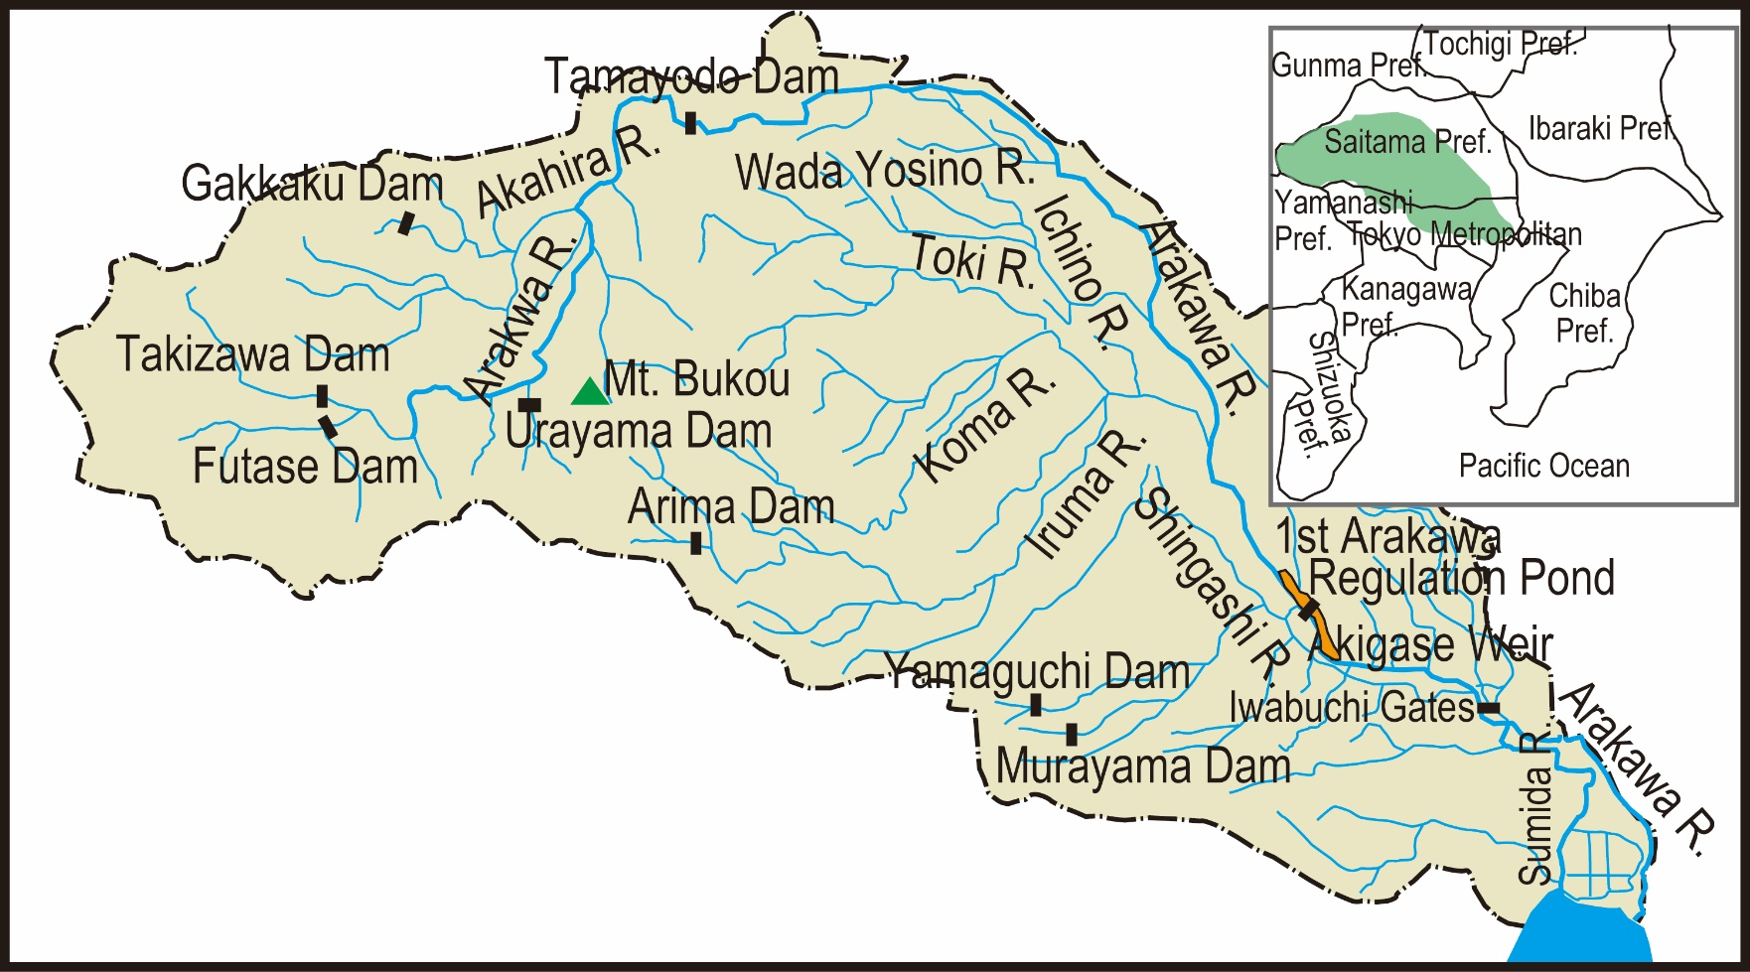
4. Water Allocation during Drought (3)
(2) Example of Drought Adjustment
2) Response to Drought in the Metropolitan Area in 2017
Source: Prepared from “Outline of Arakawa River Basin and Rivers,” MLIT
Arakawa River is located at Tokyo and Saitama

Slide 26
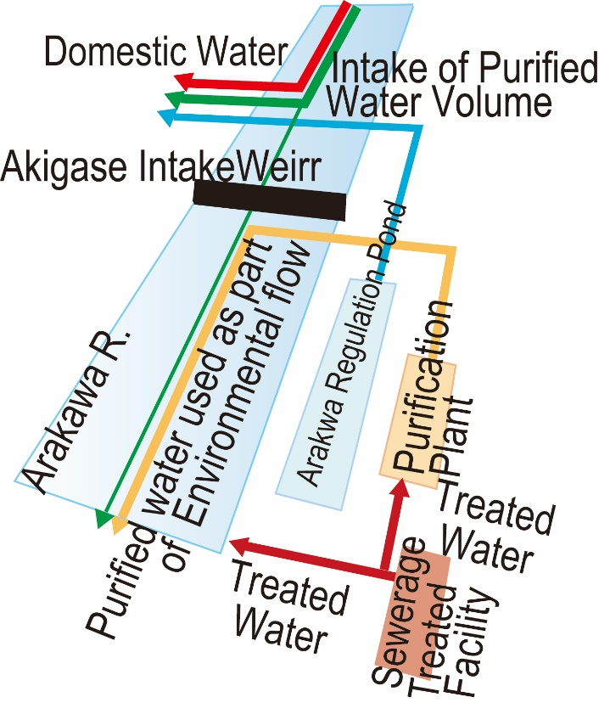
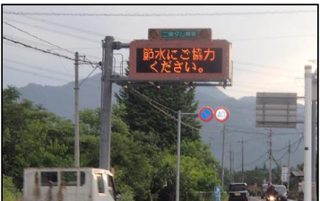
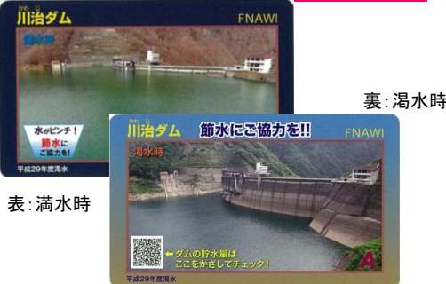
4. Water Allocation during Drought (4)
(2) Case Study of Drought Adjustment
Countermeasure for Drought
Operation of purification facility
Increasing amount of stored water (4.7 times)
Multiplex of water sources by wide area network (Tone River, Tama River)
PR to promote water saving (Dam Card, Banner, display board, public car, TV show)
Source: Prepared based on “Outline of Arakawa Reservoir MLIT”
Operation of Purification Facility
Display Board
Dam Card

Slide 27
6. Operation and Maintenance of Irrigation Facility (1)
(1) History of Irrigation Water Management
Edo Era
After 1908
After 1949
Irrigation Association
Irrigation Association based on Irrigation Association Act.
Agricultural Irrigation Area Improvement and Management Association based on Land Improvement Act
Management of irrigation water distribution
Maintenance of Irrigation facilities
Execution of Irrigation and flood protection projects
Management of irrigation water distribution
O&M of irrigation canal
Agricultural Irrigation Area Improvement and Management Association: 5,040 nos. (2010)

Slide 28
6. Operation and Maintenance of Irrigation Facility(2)
(2) Operation and Maintenance of Irrigation Facilities and Water Distribution by the Farmers’ Association
To manage Irrigation facilities
To perform facility and maintenance and renovation
Member: farmers in the irrigation area
Required Cost: Levy from the members
Projects by the Farmers’ Association: subsidies from governments and some cost pay by farmers
Tax exempted due to highly public organization

Slide 29
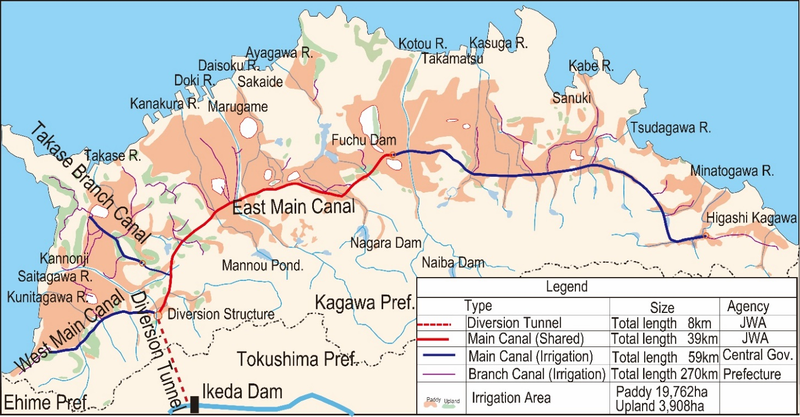
6. Operation and Maintenance of Irrigation Facility(3)
(3) Distribution of Irrigation Water
Example: Farmer’s Association of Kagawa Canal
Role :
Maintenance of Levy system
Collection of Levey
Water distribution management
Facility management
Implementation of contracted projects
Coordination of state-owned land improvement project
Source: Project Research Team prepared based on “Yoshino River Comprehensive Development, Location Map of Kagawa Canal, Kagawa Prefecture”
Location Map of Beneficiary Area of the Kagawa Canal

Slide 30
6. Operation and Maintenance of Irrigation Facility(4)
(3) Water Distribution of Irrigation Water
Example: Farmer’s Association of Kagawa Canal
Management area is a wide area and number of patrol staff is not enough.
Patrol system was introduced in 2007 (Provision of information from residents)
Registered Patrol group: 17 groups
(164 local residents, 12 agricultural civil engineering design associations, 5 fire-fighting organizations)

Slide 31
7. Lessons Learned (1)
  (1) To ensure an orderly water use based on the history and practices of water resource management, each country should establish a water rights system.
  Water distribution could induce an increase in tension and conflict between areas and users. In the past, Japan had experienced violent disputes over the distribution of irrigation water. At the time of the establishment of the modern legal system, the government recognized irrigation water as a customary water right and permitted it continue as before. A new licensed water right was granted according to the potential of the water resources. If new water is not available, development of a storage facility is required to acquire new water rights.

Slide 32
7. Lessons Learned (2)
  (2) Institutions should be developed to manage the water rights.
  It is ideal for one organization to manage the water for the entire river basin. Management organizations must formulate procedures, criteria, and guidelines for permitting water rights. The organization also needs to monitor licensed water intake. The Minister of Land, Infrastructure, Transport and Tourism and prefectural governors are responsible for managing water rights in Japan.
  (3) Governments should manage the water rights for water use that change over time.
  Water use changes by increasing domestic and industrial water due to urbanization and industrialization and by decreasing irrigation water. In addition, people’s concerns have changed from development to environmental conservation. Governments must revise policies to respond to these changes.

Slide 33
7. Lessons Learned (3)
  (4) Water resources can be used effectively by establishing a system for the transfer of water rights.
  The demand for irrigation water is decreasing, and urban water use is increasing as the economy develops. Water rights can be transferred from irrigation users to urban users, expecting the efficient use of water resources. Water rights trading with financial compensation is not practiced in Japan because river water is treated as a public good.
  (5) To adjust water intake during drought, coordinating mechanisms are required.
  In Japan, a coordinating committee composed of water users was established for each river basin. This committee determines the rules of intake reduction rates for every user based on the consensus formed among water users with the spirit of mutual concession. The rules vary by river basin, depending on the history and practices of water management. River management offices can provide the necessary information on meteorological and hydrological data and storage facilities, as well as facilitate discussions among water users.

Slide 34
7. Lessons Learned (4)
  (6) Farmers’ associations are indispensable to distribute irrigation water and maintain irrigation facilities.
  Members of farmers’ associations decide the rules for water distribution in the irrigation area and carry out maintenance and management activities independently in Japan. Farmers’ associations also spend their money on maintaining and developing facilities, in addition to subsidies from the national and local governments.

