Slide 1
Khartoum University Students’Associations (Medicine, Dentistry, and Pharmacy)

Slide 2
Within our campus, we house three prestigious faculties:
The Faculty of Medicine Khartoum Medical Students Association
The Faculty of Dentistry Association of Dental Students University of Khartoum
The Faculty of Pharmacy Faculty of Pharmacy Students Association
These associations serve as pillars of support for our students; providing a range of services through their various sub-offices.
‹#›

Slide 3
From the External Affairs Office fostering external relations to the Academic Office driving scientific research and academic excellence, and the Therapeutic Office offering vital consultations to underserved communities, our associations are committed to making a difference.
Furthermore, the Sports Office encourages physical well-being and organizes exciting camps and tournaments, while the Social Office strengthens the bonds between our students, fostering a sense of community and belonging.
Together, we strive to bridge gaps, ignite passions, and create a vibrant and inclusive environment where every student can thrive.
‹#›

Slide 4
Definition, Vision, and Mission :-
Definition :-
Student-led organizations that aim to support, empower and represent the students pursuing degrees in medicine, dentistry and pharmacy.
Vision :-
To cultivate a community of future healthcare professionals who are driven by excellence, compassion and innovation and who are committed to making a positive impact on society through their knowledge, skills and leadership
Mission :
To deliver a series of activities that aim to empower students to play a role on maintaining their communities health, and developing students skills and knowledge in all the medical aspects.
Khartoum Students Association :-
‹#›

Slide 5
?
؟
?
What do you know about us?
؟
‹#›

Slide 6
Science, leadership, and excellence
1924-2024
‹#›

Slide 7
1
Exchange Program (late 1970s - now)
MedSIN-KMSA
‹#›

Slide 8
Exchange Programs:
Research Exchange:-
The Research Exchange Program provides medical students with the opportunity to deepen their knowledge in the specific area of their research interest.
Professional Exchange:-
The Professional Exchange program is a full educational program offering clerkships to medical students abroad.
STEP Project Exchange:-
STEP program aims to provide medical students worldwide with the unique chance to participate in high-standard scientific programs focusing on Tropical Diseases, as well as to invest in medical students’ capabilities in helping the population at risk of Tropical Diseases.
‹#›

Slide 9
‹#›

Slide 10
‹#›

Slide 11
‹#›

Slide 12
9

Slide 13
‹#›

Slide 14
2
Research and Medical Education
Students Association of medical education and research (SAMER)
‹#›

Slide 15
Medical Research:
We aim to equip our students with necessary research skills and knowledge that will help them in the research field and to support them in building their future career.
Medical Education:
We aim to capacitate our students With needed medical education skills and knowledge that will help them in lifting up our medical school level in all the aspects.
‹#›

Slide 16
‹#›

Slide 17
‹#›

Slide 18
Mandatory attendance Policies between pros and cons: A qualitative study from Sudan.
An unplanned shift: online learning and medical student's perspectives during the COVID-19 pandemic, a qualitative study from Sudan.
Clinical learning expedition: from hospital wards to online platforms, Sudan experience.
What's the Ideal? Sudanese medical students perceptions about the perfect ward round experience.
A much needed checkpoint: medical students assess their assessment system for a change.
Let's complain scientifically: The feedback project’s experience in training Medical Students to be medical education researchers to generate evidence for improvement.
At the heart of well-being counseling: a most needed psychological intervention among Sudanese medical students.
7
8
You can read the full manuscripts in AMEE 2022 Abstracts book online.
‹#›

Slide 19
3
Community and healthcare delivery
Medical Missions, Health Education, WASH project
‹#›

Slide 20
Medical Missions:
The primary goal of a medical mission trip is to improve access to healthcare services for people who do not have regular access to medical care. This can include providing medical treatment and education on disease prevention and health promotion.
Health Education:
is a profession of educating people about health. Areas within this profession encompass environmental health, physical health, social health, emotional health, intellectual health, and spiritual health, as well as sexual and reproductive health education.
WASH Project:
Is a set of evidence-based practices for the sustained provision of safe water, dignified sanitation and good hygiene practice across a variety of contexts.in all Sudan regions.
‹#›

Slide 21
‹#›

Slide 22
‹#›

Slide 23
‹#›

Slide 24
‹#›

Slide 25
‹#›

Slide 26
We have a YouTube Channel too!
‹#›

Slide 27
‹#›

Slide 28
External Affairs
‹#›

Slide 29
The prophylaxis office:
Aims to raise awareness about various oral diseases.
Key Achievement: World Oral Health Day Campaign (WOHD).
‹#›

Slide 30
World Oral Health Day Campaign 2023
Targets:
1- Two primary schools
2- A Hospital
3- A medical campus
Impact: 300 individuals
‹#›

Slide 31
Other Campaigns:
Mental Health Day:
Oral Cancer awareness campaign:
Oral Cancer Conference:
‹#›

Slide 32
Training Office:
Capacity building and empowering students with soft skills.
‹#›

Slide 33
Exchange Office:
The program offers dental students the opportunity to gain international experience by participating in dental education and practice in different countries thus enhancing clinical skills, learning new techniques and technologies.
‹#›

Slide 34
Student exchange programs:
Poland 2016
Malaysia 2018
‹#›

Slide 35
International Dental Course Program 2022
‹#›

Slide 36
Impact on the international association of dental students:
-Africa’s Regional Ambassador
-African Dental Student Association’s President
-Health Events Manager
‹#›

Slide 37
DentAid initiative:
A digital dental clinic that serves displaced people and people in war-torn areas by providing free online dental consultations.
‹#›

Slide 38
Health education and Therapeutic services:

Slide 39
The Office is dedicated to implement dental convoys and health days to various rural areas.
Providing quality access to vital dental treatment and raising oral health awareness.
Targeting underserved populations.
We aim to make a lasting impact on the lives of those in need.
‹#›

Slide 40
White Nile State Convoy:
Impact: 3500 pts.
‹#›

Slide 41
The Northern State convoy:
Impact: 5000 pts.
‹#›

Slide 42
El-Gazera State Convoy:
Impact: 3880 pts.
‹#›

Slide 43
The Red Sea State Convoy:
Impact: 3310 pts.
‹#›

Slide 44
‹#›

Slide 45
Academic office:

Slide 46
The academic office is committed to delivering educational resources to students and facilitating a seamless learning experience for them ,while fostering scientific research.
Key achievement: Dental students research association “DSRA”.
‹#›

Slide 47
DSRA
-Launched june 2022.
-Aims to foster highly qualified dental students in the research field and bridging the gap of knowledge in medical research
-Executed a series of research methodology workshops in order to equip our students with research skills
‹#›

Slide 48
DSRA’s Launching Event:
‹#›

Slide 49
‹#›

Slide 50
1.
FPSA
(FACULTY OF PHARMACY STUDENTS ASSOCIATION)
‹#›

Slide 51
FPSA
Definition:
FPSA is an organization empowering student to address issues in our society while passing on the values of public participation.
It aims to qualify students to build their skill capacity for change and is dedicated to enhance community health through public campaigns and initiatives that target rural areas with limited access to health facilities and education
Mission:
To provide free medical services while raising awareness and addressing primary health issues all over Sudan. Keeping in mind the epidemiological nature of each region and catering to specifics such as cultural norms and local taboos.
Our latest mission targeted the state of Kassala, covering 15 towns and villages in rural areas that lacked basic health services. The convoy service covers free doctor appointments, lab tests, and medications to over 5000 patients while raising awareness about dangerous outbreaks such as dengue fever.
‹#›

Slide 52
Community impact and achievements
MEDICAL CONVOYS
‹#›

Slide 53
COMMUINTY IMPACT:
As we mentioned earlier The Association organizes convoys and periodic treatment days, knowing the significant impact of these activities on public health.
our latest mission targeted the state of Kassala, covering the 15 towns and villages in rural areas that lacked basic health services. providing free doctor appointments, lab tests, and medications to over 5000 patients while raising awareness about dangerous outbreaks such as dengue fever.
‹#›

Slide 54
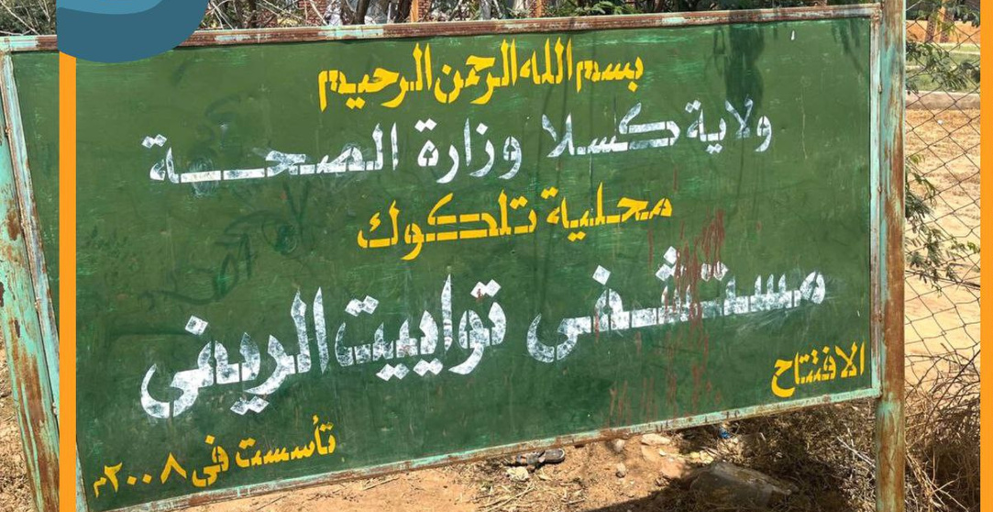
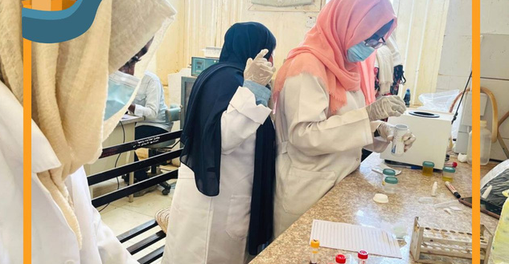
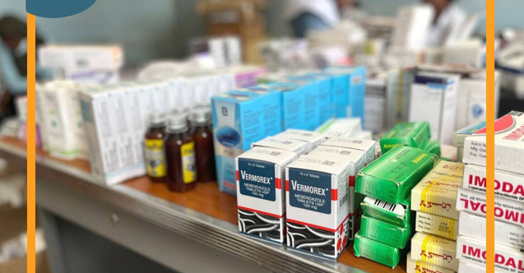
MEDICAL CONVOYS
KASSALA
MEDICAL
CONVOY
5000 Patients
‹#›

Slide 55
MEDICAL CONVOYS
North Kordofan
Medical
Convoy
3500 Patient
‹#›

Slide 56
MEDICAL CONVOYS
South Kordofan
Medical
Convoy
4700 Patient
‹#›

Slide 57
MEDICAL CONVOYS
Red Sea
Medical
Convoy
4200 Patient
‹#›

Slide 58
MEDICAL CONVOYS
River Nile
Medical
Convoy
3800 Patient
‹#›

Slide 59
DIFFERENT HEALTH CAMPAIGNS:
BLOOD DONATION:
‹#›

Slide 60
Mental HEALTH CAMPAIGNS:
‹#›

Slide 61
DIFFERENT HEALTH CAMPAIGNS:
KIDNEY AWARNESS CAMPAIGN :
‹#›

Slide 62
STUDENT EXCHANGE PROFRAM
IPSF-FPSA
‹#›

Slide 63
STUDENT EXCHANGE PROGRAM (SEP)
Overview :
The student exchange programme (SEP) is the IPSF's (International pharmaceutical student federation) largest
project, offering professional pharmacy internships.
During exchange, participants can share and develop pharmaceutical knowledge and skills. In the same time, this is an unique opportunity to experience new cultures, try different food, meet friends, learn n e w language, visit beautiful places and enjoy
‹#›

Slide 64
STUDENT EXCHANGE PROGRAM (SEP)
2. International Partnerships:
Showcase the partnerships and collaborations FPSA has established with universities and institutions abroad.
Highlight the countries or regions where student exchanges are offered through the program.
‹#›

Slide 65
STUDENT EXCHANGE PROGRAM (SEP)
3. Exchange Opportunities:
.
- Emphasize the diversity of academic disciplines and cultural experiences offered through the exchange program.
- Describe the various exchange opportunities available to students, such as semester exchanges, short-term programs, or internships abroad.
‹#›

Slide 66
STUDENT EXCHANGE PROGRAM (SEP)
4. Areas of training :
• Community Pharmacy
• clinical Pharmacy
•Industrial Pharmacy
•Research
the program also includes cultural programs that allow students to immerse themselves in the local culture and traditions of the host country. Also, a new concept of virtual SEP, IPSF has expanded its reach and now offers students the flexibility to participate in exchanges remotely, allowing for a more inclusive and accessible experience.
‹#›

Slide 67
Our students in SEP
Glance through the years
‹#›

Slide 68
‹#›

Slide 69
‹#›

Slide 70
Orientation Event :
2022 - 2023 Mandate
‹#›

Slide 71
‹#›

Slide 72
Any Questions ?!
kmsa.external@gmail.com
Adsuofk@gmail.com
Uofk.fpsa@gmail.com
‹#›

