Slide 1

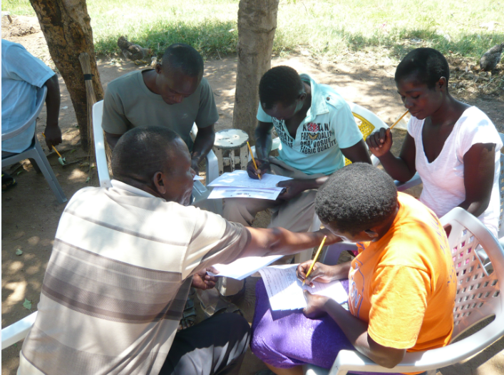

Participatory Baseline Survey
Methods of Implementation
Type the name of your organization here.

Slide 2
WHERE ARE WE?: Participatory Baseline Survey in SHEP’s 4 Steps
4 Steps | Activities
1. Share goal with farmers. | Sensitization Workshop
2. Farmers’ awareness is raised. | Participatory Baseline Survey (optional) Stakeholder Forum Market Survey
3 . Farmers make decisions. | Target Crop Selection Crop Calendar Making
4. Farmers acquire skills. | In-field trainings
Follow-up and monitoring (including Participatory Endline Survey)
Baseline Survey as a way to raise farmers’ awareness.

Slide 3
PART 1: CONCEPT

Slide 4


WHY?: Objectives of Participatory Baseline Survey
Baseline Survey has dual purposes.
  For the farmers
    Understanding their current situations to identify areas for improvement
    Understanding the importance of record keeping
  For the implementers
    Gathering data on the target farmers’ situations in order to assess improvements after SHEP activities (Comparison between “before” and “after”)

Slide 5
WHAT?: Outline of Participatory Baseline Survey
Ask the farmers to fill out two kinds of survey sheets
  (1) Baseline Survey Part 1- Production, Income and Cost
  (2) Baseline Survey Part 2- Agricultural Techniques
The farmers themselves fill out the forms (Offer help where necessary)
Data is collected and analyzed by the implementers
Feedback is given to the farmers at a later day

Slide 6
FORMAT: Baseline Survey Questionnaire Forms
Baseline Survey Part 1- Production, Income and Cost

Slide 7
FORMAT: Baseline Survey Questionnaire Forms
Baseline Survey Part 2- Agricultural Techniques

Slide 8
FORMAT: Baseline Survey Questionnaire Forms
The two forms are just examples. Questions can be modified (deleted, added, changed, etc.) in accordance with local situations.
When modifying, especially when adding questions, carefully consider farmers’ capacity levels (their memory, literacy skills, etc.) and required time. Do not make it too demanding.

Slide 9
HOW?: Key Implementation Tips
The survey should be more for farmers’ benefit than for implementers’ benefit

Slide 10
HOW?: Key Implementation Tips
The target farmers should be the main actors of the survey, rather than the extension staff.
The extension staff help farmers calculate basic figures such as crop yield, cost, profit, etc. which are important for farm management.
Raising Motivation
Raising Motivation

Slide 11
PART 2: PRACTICE

Slide 12
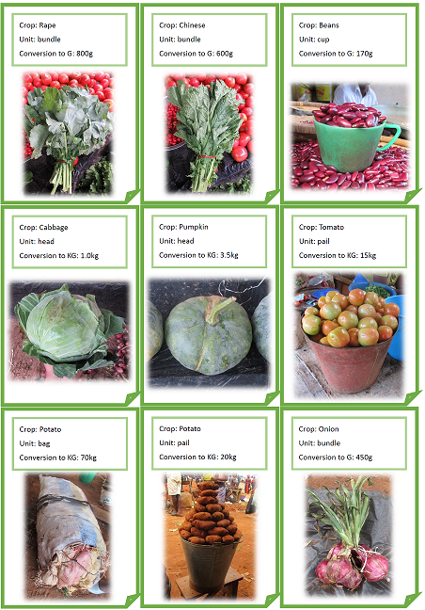
STEP: Implementation Procedures
Prepare a conversion table (local units into kilograms).
Organize a meeting and instruct the farmers how to fill out the two forms.
Let the farmers fill out the forms by themselves. Let them take the forms home and complete them with their family members if necessary. [Tip!] Ask literate farmers to assist illiterate farmers.
Malawi’s conversion table with pictures

Slide 13
STEP: Implementation Procedures
After completing the forms, discuss new findings.
  How can record keeping help us (farmers) manage our farming business?
  Are we making enough profits as we have hoped?
  Do we have sufficient cultivation skills? What are our weaknesses?
Submit the completed forms to the designated office. (Change this to an appropriate section -e.g. Project Unit, central ministry office, etc. where analysis will be made) [Note] Make sure to correct obvious mistakes and errors before submitting.
Give feedback to the farmers when analyzed data is sent back to the extension staff.

Slide 14
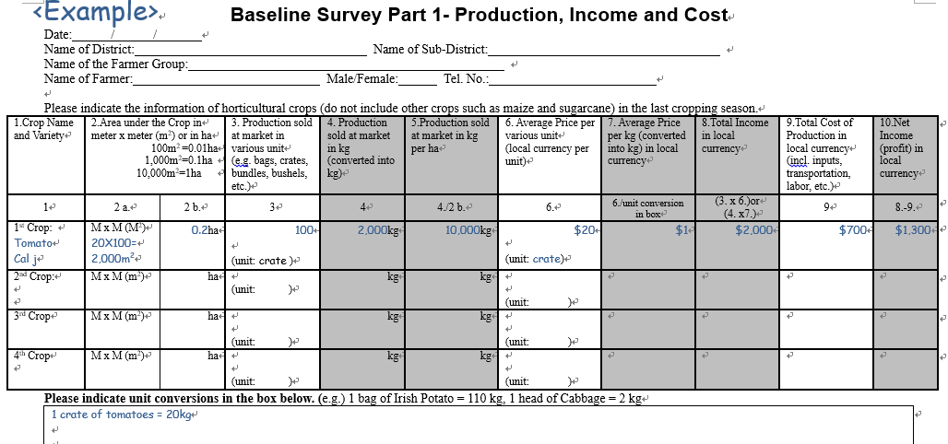
Completing Production, Income & Cost Sheet
Basic information of the farmer
Production, income & cost
Unit conversion

Slide 15
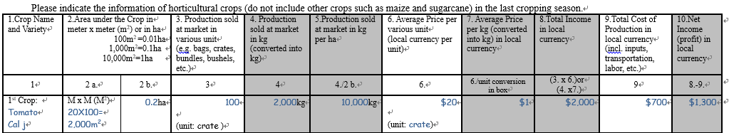
Completing Production, Income & Cost Sheet
1 Crop Name and Variety
→Indicate name of the horticultural crop and variety grown in the last cropping season.
2 (2a. & 2b.) Area under the Crop in meter X meter (m²) or ha
→Pacing can be used to estimate area under the crop

Slide 16
Completing Production, Income & Cost Sheet
3 Production sold at market in various unit (e.g. bags, crates, bundles, bushels, etc.)
→Total quantity sold at markets.
4 [Automatic calculation- no need to write in this column as long as conversion is indicated] Production sold at market in kg
→Farmers can write in kg in this column instead of writing in column 3.

Slide 17
Completing Production, Income & Cost Sheet
5 (4/2b.) [Automatic calculation- no need to write in this column] Production sold at market in kg per ha
→Analyzing productivity. Farmers do not need to write in this column.
6 Average Price per various unit (local currency per unit)
→ Marketed price per unit

Slide 18
Completing Production, Income & Cost Sheet
7 (6/unit conversion in box) [Automatic calculation- no need to write in this column] Average Price per kg in local currency
→Farmers do not need to write in this column if they do not know the price per kg.
8 (3X6) or (4X7) [Automatic calculation- no need to write in this column] Total Income in local currency
→ This is the total income from the crop.

Slide 19
Completing Production, Income & Cost Sheet
9 Total Cost of Production in local currency
→Cost of seed, planting materials, fertilizers/manures, pesticides, posts/stakes, labor costs, transportation & marketing costs,etc.
10 (8-9) [Automatic calculation- no need to write in this column] Net income (profit) in local currency
→ This is the total profit from the crop.

Slide 20
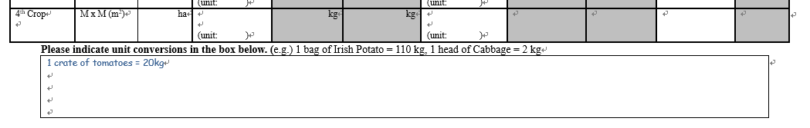
Completing Production, Income & Cost Sheet
In the box, indicate unit conversions
  <example>
  1 bag of Irish Potato 110kg
  1 head of cabbage = 2kg
  1 crate of tomatoes = 20kg
A conversion table like this will be useful.

Slide 21
Completing Production, Income & Cost Sheet
Let’s Exercise !
Calculate cabbage production, income & cost for this farmer.
Last cropping season, we grew cabbages. The name of the variety was Gloria. We set aside about 40 meters x 5 meters near here and 12 meters x 10 meters over the other side for cabbage production. We harvested 160 heads. Our family ate 10 heads and sold the rest of the cabbages to a middleman. Our cabbages were fairly big and each head weighed around 1.5kg. The middleman bought the cabbages for 40 cents per head. The total cost of production was around $20 which included costs of tomato production. The amount of tomato production was about the same as that of cabbages.

Slide 22
Useful Data: Productivity Comparison
(Cabbages and other brassicas – Year 2014)
Country | kg/ha
South Africa | 56,808
Japan | 42,651
U.S.A. | 39,824
Namibia | 33,282
Kenya | 30,917
Niger | 27,914
Madagascar | 21,437
D.R. Congo | 17,057
Zimbabwe | 12,800
Rwanda | 12,134
Ethiopia | 9,900
World | 29,082
Souｒce: UN Data (http://data.un.org/Data.aspx?d=FAO&f=itemCode%3A358)

Slide 23
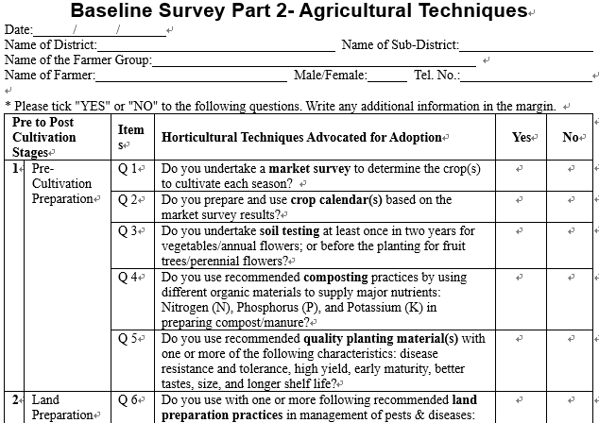
Completing Agricultural Techniques Sheet
Basic information of the farmer
Questions to assess farmer’s agricultural techniques

Slide 24
Completing Agricultural Techniques Sheet
If the answer is “Yes”, simply check (✓) the left box marked “Yes”.
If the answer is “No”, simply check (✓) the left box marked “No”.
We expect that the number of “Yes” will increase after the farmers’ participation in SHEP activities.
During In-field Training, try to emphasize the techniques which had many “No” answers.

Slide 25
CHECKLIST: Points to be Confirmed after Participatory Baseline Survey
The target farmers understand their current production and sales situation and identify gaps that need to be filled.
The target farmers understand their current technical levels in terms of production and marketing and identify gaps that need to be filled.
The target farmers understand the importance of farm record keeping, both in terms of bookkeeping and farm activity records and become willing to start keeping records.
The male-female ratio of the participants is balanced.
Gender-disaggregated data is collected and analyzed.
(optional) The members’ spouses are involved.

Slide 26
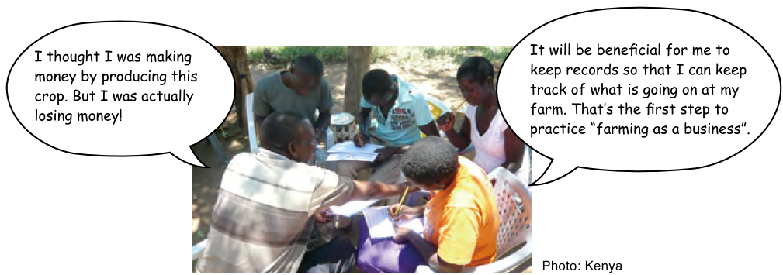
Participatory Baseline Survey in Action

Slide 27

TROUBLESHOOTING
What if farmers do not have written records on income & expenditure? → Encourage farmers to make is a habit to keep a record from now on.
Can illiterate farmers do it? → Yes. Assist them or ask literate farmers or family members to help them.
What if data is not so reliable? → Usually it is difficult to obtain data accurate enough for statistical purpose. Still, encourage farmers to provide as accurate data as possible (Such data will still be a powerful tool to inform policy and decision-makers).
What if farmers do not want to disclose/submit data? →Do no force them. Try to find someone who is willing to do so.

Slide 28
Way Forward: Implementation Schedule, Reporting, add any other necessary info. here

