Slide 1
Banana

Slide 2
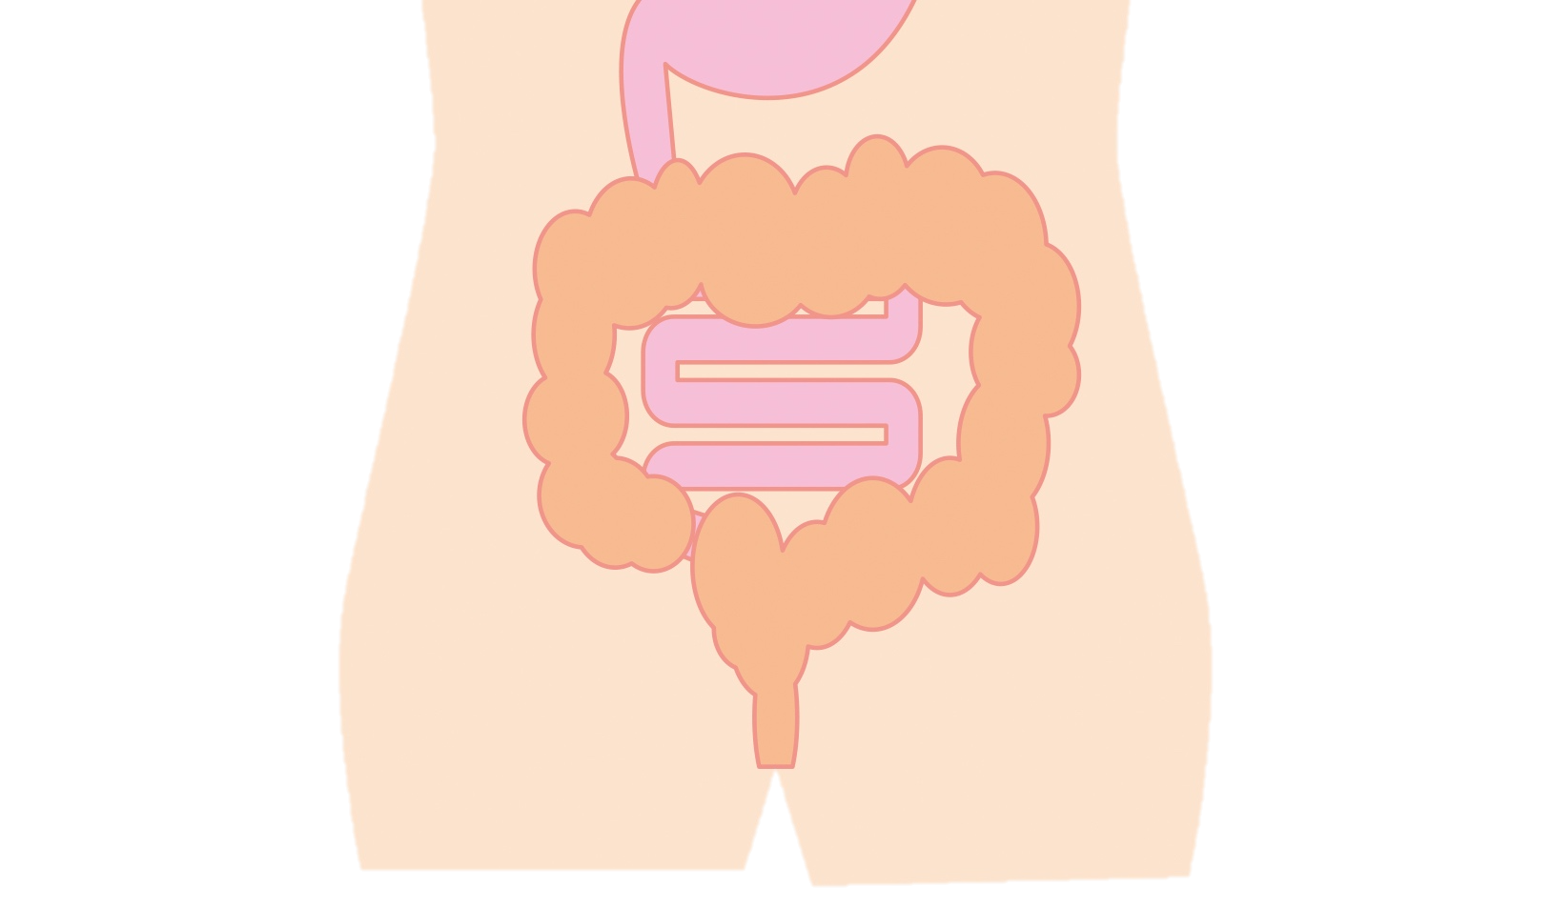
Example of key message:
Bananas : Quick and easy source of nutrition
“
”
Represents a good source of energy
Keeps bowels in good condition
Assist maintenance of normal BP

Slide 3
Health effects of bananas
Q
Why are bananas a good source of energy?
They contain a nutrient that turns into energy immediately and slowly.
A
Why does it keep bowels in good condition?
It contains nutrients (fiber and sugar) that improve the environment of the bowels and stimulate bowels movements.
Q
A
Comparison of calories
Q
Why does it help to maintain normal blood pressure?
It contains a nutrient (potassium) that helps to reduce a rise in blood pressure.
A

Slide 4
Tips for eating bananas
Important to eat with a variety of foods
The nutritional value changes depending on when you eat them
Example

Slide 5
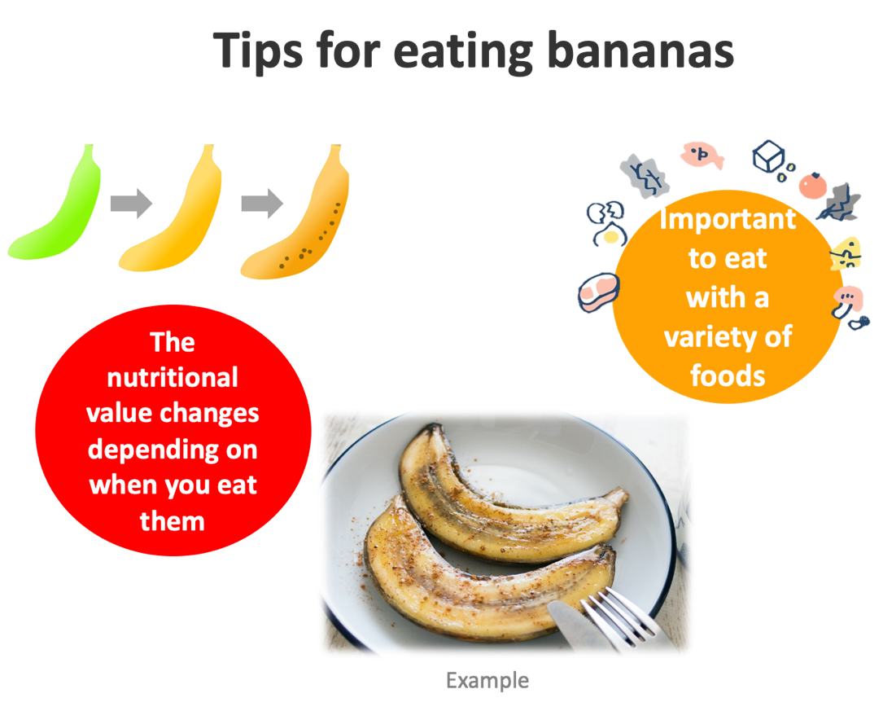
Tips for eating bananas
The brown spots are called "sugar spots.” They appear when the banana is ripe and sweet.
The nutritional value of bananas changes depending on when you eat them.
Green(unripe) bananas are more effective in keeping bowels in good condition
Yellow(ripe) bananas are more nutritious than green ones. They are rich in vitamins.
Eat a combination of different foods, including staple foods (e.g., cereals such as wheat, barley, rye, maize, or rice), or starchy tubers or roots (e.g., potatoes, yams, taro or cassava), legumes (e.g., lentils, beans), vegetables, fruit, and foods from animal sources (e.g., meat, fish, eggs, and milk).
Eat a variety of whole (i.e., unprocessed) and fresh foods every day to help obtain the right amounts of essential nutrients.

