Slide 1
Black Nightshade

Slide 2
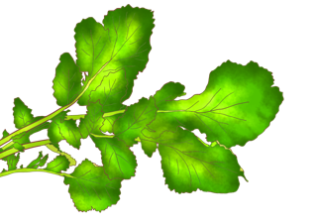
”
“
Example of key message:
Black nightshade: Promotes blood production
Improves skin tone
Prevents anemia
Protects from infections

Slide 3
Health effect of black nightshade
Q
Why does it prevent anemia?
It contains nutrients (iron and folate) that are necessary for production of red blood cells.
A
Q
Why does it protect us from infections?
It contains nutrients (vitamin C and beta- carotene) that boost the immune system.
A
Q
Why is it good for the skin?
It contains nutrients (vitamin C and beta-carotene) that improve skin condition.
50g of fresh black nightshade leaves contain the same amount of iron as chicken liver.
A

Slide 4
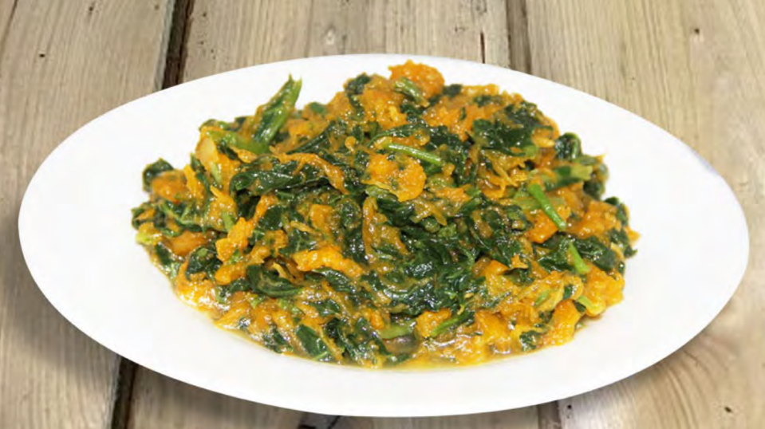
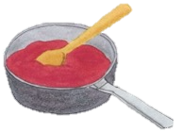
Tips for cooking and eating black nightshade
Food processing improves some of its nutritional value
Important to eat with a variety of foods
Avoid overheating
©︎FAO/Collins Ogutu
Source: http://www.fao.org/3/i9056en/I9056EN.pdf
Example

Slide 5
Tips for cooking and eating black nightshade
Food processing (fermentation, drying) improves some of its nutritional value (phytochemical).
Avoid overheating. The longer a food is cooked, the greater the loss of nutrients(vitamins).
Eat a variety of whole (i.e., unprocessed) and fresh foods every day to help obtain the right amounts of essential nutrients.
Eat a combination of different foods, including staple foods (e.g., cereals such as wheat, barley, rye, maize, or rice), or starchy tubers or roots (e.g., potatoes, yams, taro or cassava), legumes (e.g., lentils, beans), vegetables, fruit, and foods from animal sources (e.g., meat, fish, eggs, and milk).

