Slide 1
Bulb Onion

Slide 2
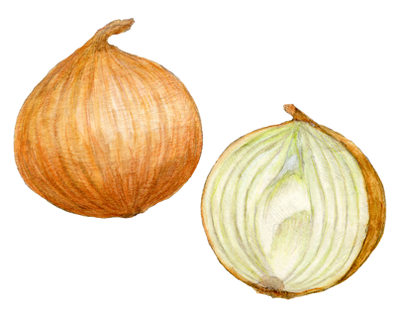
“
Bulb onions:
Not only make you cry, but also help blood circulation
”
Helps recovery from fatigue
Smooth the circulation of the blood
Assist maintenance of normal BP

Slide 3
Health effects of bulb onions
Why is it good for blood circulation?
It contains a nutrient (allicin) that helps smooth blood circulation. This nutrient makes you cry when you cut an onion.
Q
A
Q
Why is it good for recovery from fatigue?
It contains a nutrient (allicin) that
promotes the absorption of vitamin B1 and helps to relieve fatigue.
A
Q
Why does it help to maintain normal blood pressure?
It contains a nutrient (quercetin) that helps to reduce blood pressure elevation(BPE).
A

Slide 4
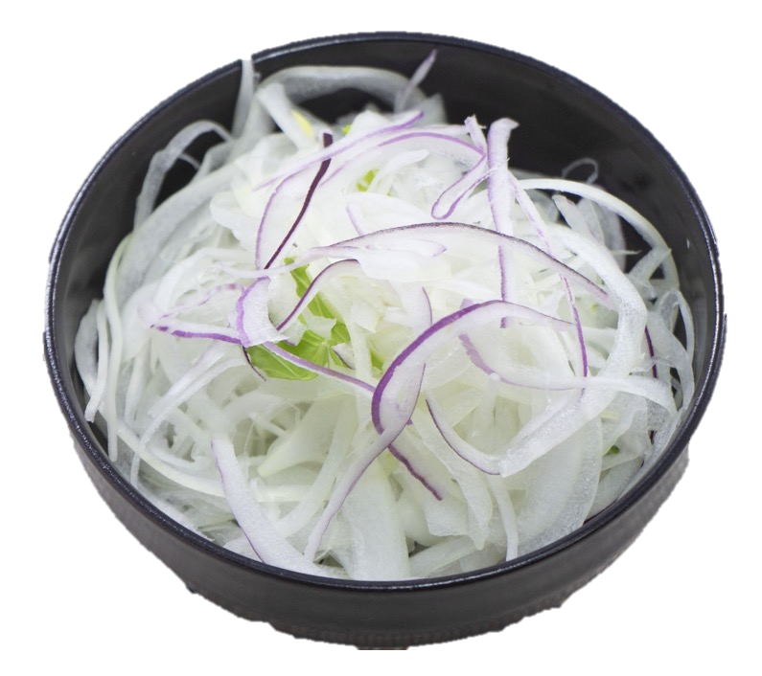
Tips for cooking and eating bulb onions
Nutritional values increases when onions are exposed to air after cutting
Eat with Vitamin B1-rich foods
Important to eat with a variety of foods
Avoid overheating
Example

Slide 5
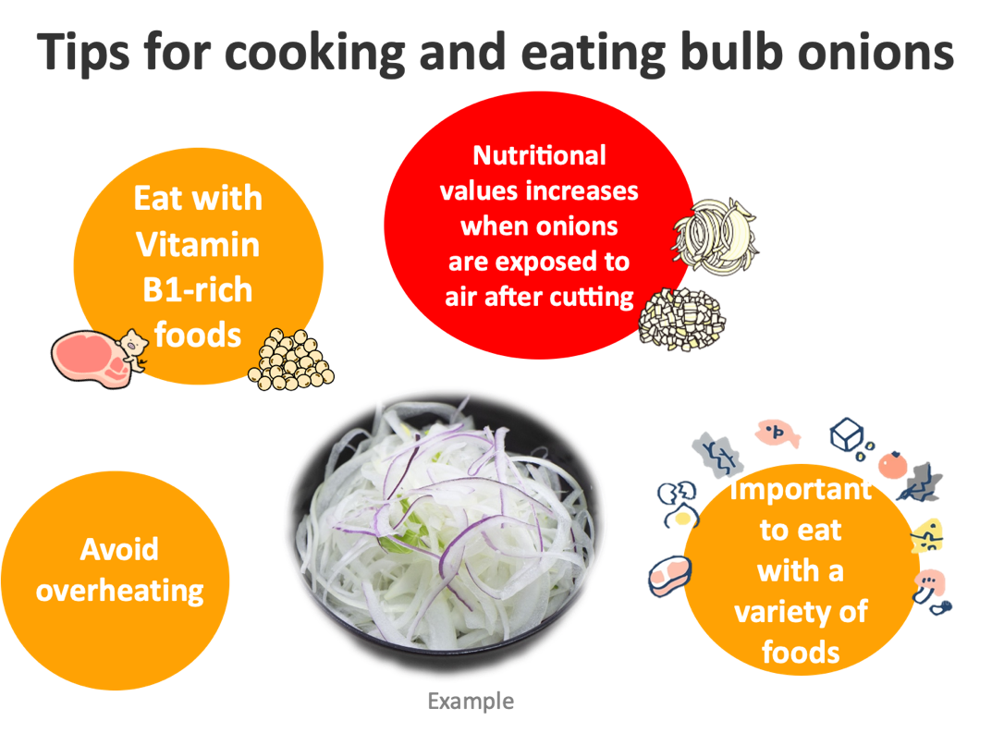
Tips for cooking and eating bulb onions
After slicing or chopping a bulb onion, expose it to the air about 10-15 mins. Doing so increases nutrient’s(allicin) value.
Avoid overheating.
The longer a food is cooked, the greater the loss of nutrients.
When you cook, fry it quickly or eat with some soup that dissolves the nutrients.
Eat a combination of different foods, including staple foods (e.g., cereals such as wheat, barley, rye, maize, or rice), or starchy tubers or roots (e.g., potatoes, yams, taro or cassava), legumes (e.g., lentils, beans), vegetables, fruit, and foods from animal sources (e.g., meat, fish, eggs, and milk).
The nutrient (allicin) helps absorption of vitamin B1. Good to eat with vitamin B1-rich foods(e.g., pork, soy beans, eel, etc.).
Eat a variety of whole (i.e., unprocessed) and fresh foods every day to help obtain the right amounts of essential nutrients.

