Slide 1
Cabbage

Slide 2
Example of key message:
“
Cabbage prevent gastritis and stomach ulcers
”
Improves skin tone
Makes your stomach strong
Makes bones and
teeth strong

Slide 3
Health effects of cabbage
Q
Why does it make your gastric strong?
It contains a nutrient (vitamin U) that protects and repairs the stomach lining.
A
Q
Why is it good for the skin?
It contains nutrient (Vitamin C) which improves skin condition.
A
Q
Why does it strengthen bones and teeth?
It contains a nutrient (calcium) that is the main component of bones and teeth.
A

Slide 4
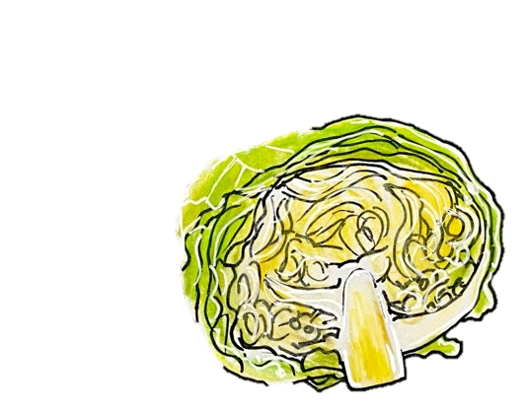
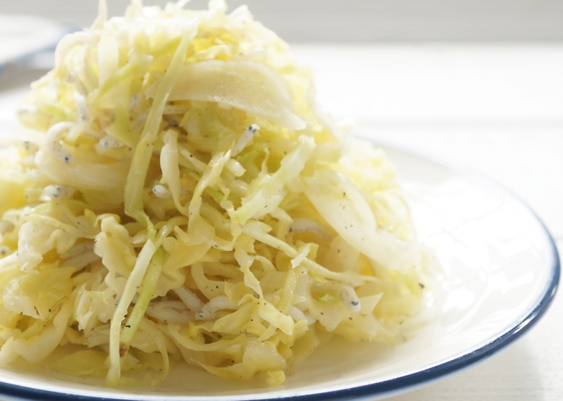
Tips for cooking and eating cabbage
Eat the cabbage core(center) as well.
It is high in vitamin C
Important to eat with a variety of foods
Avoid overheating
Example

Slide 5
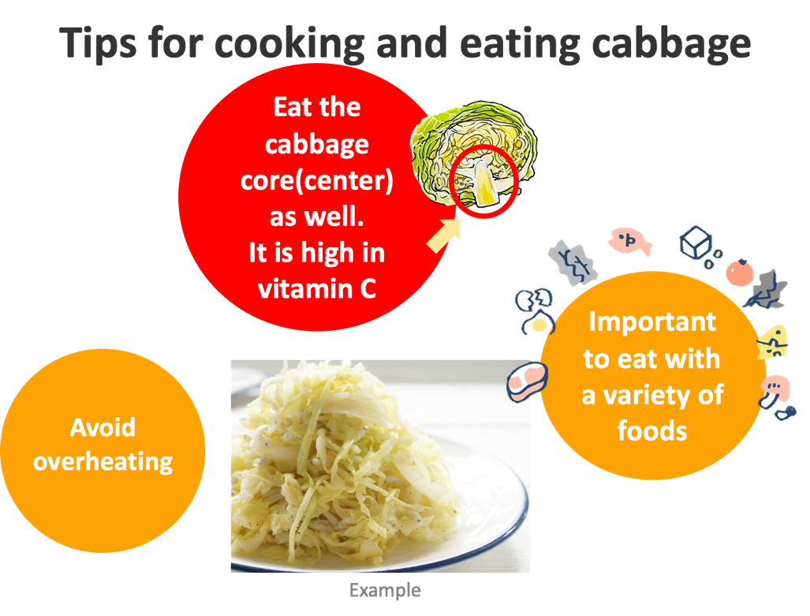
Tips for cooking and eating cabbage
Eat the cabbage core(center) as well.
It is high in vitamin C.
Avoid overheating cabbage.
The longer a food is cooked, the greater the loss of nutrients.
When you cook, fry it quickly with some soup that dissolves the nutrients.
Eat a variety of whole (i.e., unprocessed) and fresh foods every day to help obtain the right amounts of essential nutrients.
Eat a combination of different foods, including staple foods (e.g., cereals such as wheat, barley, rye, maize, or rice), or starchy tubers or roots (e.g., potatoes, yams, taro or cassava), legumes (e.g., lentils, beans), vegetables, fruit, and foods from animal sources (e.g., meat, fish, eggs, and milk).

