Slide 1
Capsicum

Slide 2
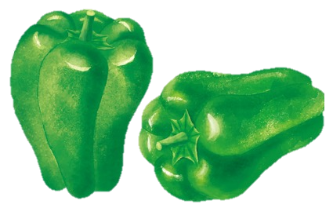
Example of key message:
“
Capsicums:
A bitter component helps smooth blood flow
”
Protects from infections
Promotes smooth circulation of the blood
Improves skin tone

Slide 3
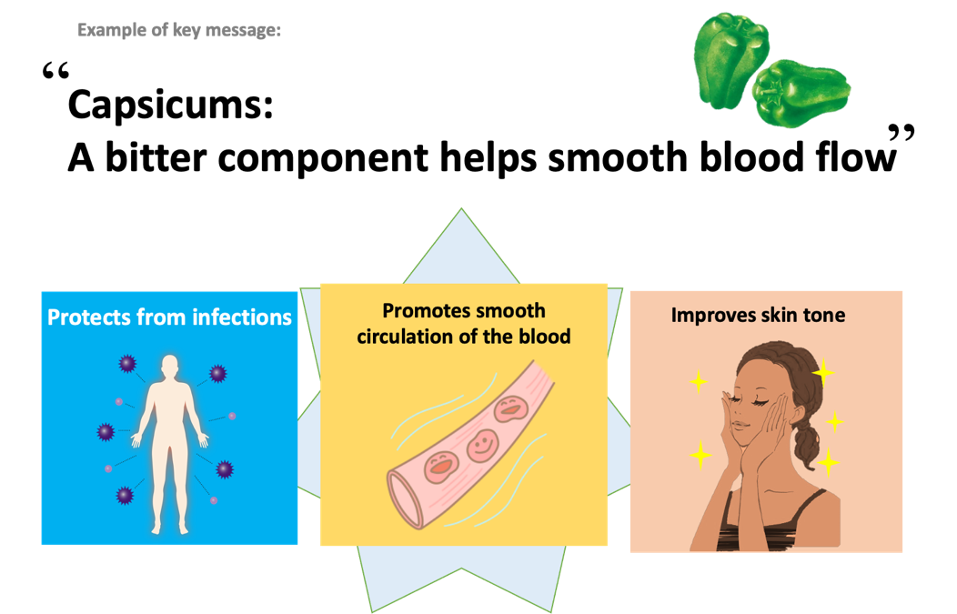
Health effects of capsicums
Q
Why is it good for the skin?
It contains nutrients (vitamin C and beta-carotene) that improve skin condition.
A
Q
Why does it protect us from infections?
It contains nutrients(vitamin C and beta- carotene) that boost the immune system.
A
One capsicum contains one-thirds of an adult’s daily requirement of vitamin C
Q
Why is it good for blood circulation?
It contains nutrient (vitamin P [flavonoids] and pyrazine) that help smooth blood circulation.
A
1
3

Slide 4
Tips for cooking and eating capsicums
Suitable for cooking at high temperatures
Eat with seeds and flesh
Important to eat with a variety of foods
Example

Slide 5
Tips for cooking and eating capsicums
Capsicums’ vitamin C is resistant to heating.
Suitable for cooking at heat temperatures. This reduces the bitter taste.
Eat with seeds and flesh. It contains a nutrient (pyrazine) .
Eat a variety of whole (i.e., unprocessed) and fresh foods every day to help obtain the right amounts of essential nutrients.
Eat a combination of different foods, including staple foods (e.g., cereals such as wheat, barley, rye, maize, or rice), or starchy tubers or roots (e.g., potatoes, yams, taro or cassava), legumes (e.g., lentils, beans), vegetables, fruit, and foods from animal sources (e.g., meat, fish, eggs, and milk).

