Slide 1
Cowpea leaves

Slide 2
Example of key message:
Cowpea leaves:
Support production of blood
“
”
Prevents anemia
Improves skin tone
Protects from infections
Makes bones and
teeth strong

Slide 3
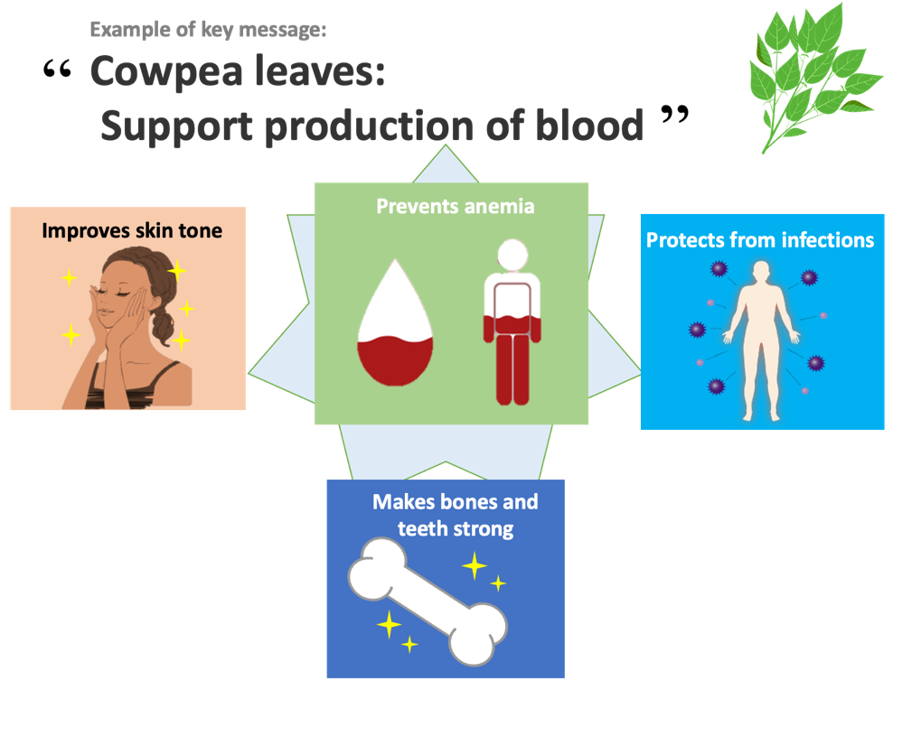
Health effects of cowpea leaves
Q
Why does it prevent anemia?
It contains nutrients (iron and folate) that are necessary for production of red blood cells.
A
Q
Why does it protect us from infections?
It contains nutrients (vitamin C and beta-carotene) that boost the immune system.
A
Q
Why is it good for the skin?
It contains nutrient (vitamin C and beta-carotene) that improve skin condition.
A
Q
Why does it strengthen bones and teeth?
It contains a nutrient (calcium) that is the main component of bones and teeth.
100g of fresh cowpea leaves contain the same amount of calcium as half a glass of milk.
A

Slide 4
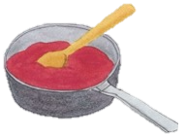
Tips for cooking and eating cowpea leaves
Processing techniques reduce antinutrients in foods
Important to eat with a variety of foods
Avoid overheating
©︎FAO/Collins Ogutu
Source: http://www.fao.org/3/i9056en/I9056EN.pdf
Example

Slide 5
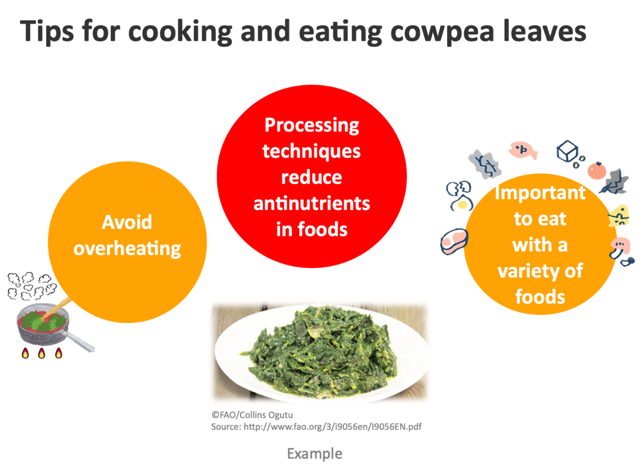
Tips for cooking and eating cowpea leaves
Some processing techniques (e.g., fermentation and soaking) reduce anti nutrients in cowpea leaves.
Avoid overheating. The longer a food is cooked, the greater the loss of nutrients.
Eat a combination of different foods, including staple foods (e.g., cereals such as wheat, barley, rye, maize, or rice), or starchy tubers or roots (e.g., potatoes, yams, taro or cassava), legumes (e.g., lentils, beans), vegetables, fruit, and foods from animal sources (e.g., meat, fish, eggs, and milk).
Eat a variety of whole (i.e., unprocessed) and fresh foods every day to help obtain the right amounts of essential nutrients.

