Slide 1
Kale

Slide 2
“
Example of key message:
Kales: Rich in various vitamins and minerals
”
Makes bones and
teeth strong
Promotes blood production
Protects from infections
Improves skin tone
Prevents eye diseases

Slide 3
Health effects of kales
Q
Why does it protect us from infections?
It contains nutrients (vitamin C and beta- carotene) that boost the immune system.
A
Q
Why is it good for the skin?
It contains a nutrient (vitamin C) that improves skin condition.
A
Q
Why does it strengthen bones and teeth?
It contains a nutrient (calcium) that is the main component of bones and teeth.
A
Q
Why does it promote blood production?
It contains a nutrient (folate) that helps to produce blood.
100g of flesh kales of kale(100g) contains 2 times of adult’s daily requirement of vitamin C.
A
Q
Why is it good for the eyes?
It contains a nutrient (vitamin A) that is necessary for visual functions.
A

Slide 4
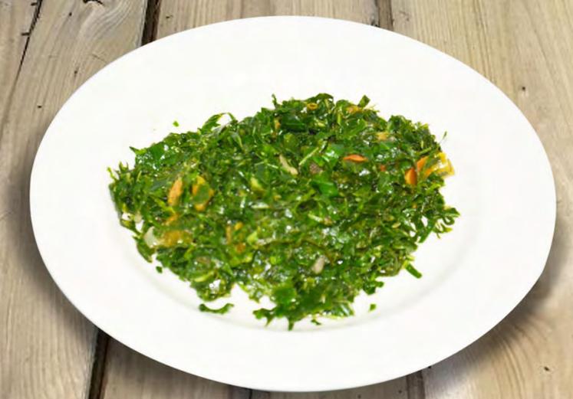
Tips for cooking and eating kales
Eat with oil
Important to eat with a variety of foods
Avoid overheating
©︎FAO/Collins Ogutu
Source: http://www.fao.org/3/i9056en/I9056EN.pdf
Example

Slide 5
Tips for cooking and eating kale
Eat with oil to help with the absorption of nutrients.
Avoid overheating. The longer a food is cooked, the greater the loss of nutrients.
Eat a variety of whole (i.e., unprocessed) and fresh foods every day to help obtain the right amounts of essential nutrients.
Eat a combination of different foods, including staple foods (e.g., cereals such as wheat, barley, rye, maize, or rice), or starchy tubers or roots (e.g., potatoes, yams, taro or cassava), legumes (e.g., lentils, beans), vegetables, fruit, and foods from animal sources (e.g., meat, fish, eggs, and milk).

