Slide 1
Potato

Slide 2
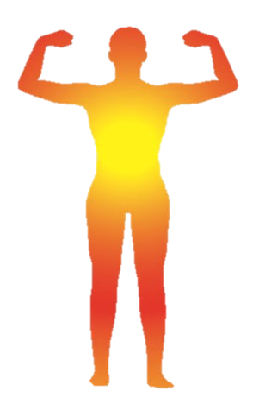
“
Potatoes:
Their vitamin C is not easily destroyed even if heated
”
Improves skin tone
Protects from infections
Represents a good source of energy

Slide 3
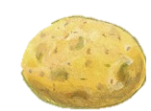
Health effects of potatoes
Q
Why does it protect us from infections?
It contains a nutrient (vitamin C) that boosts the immune system.
A
Q
Why is it good for the skin?
It contains a nutrient (vitamin C) that improves skin condition.
A
Q
Why are potatoes a good source of energy?
They contain a nutrient (starch) that turns into energy.
A potato contains five times more vitamin C than an apple.
A

Slide 4
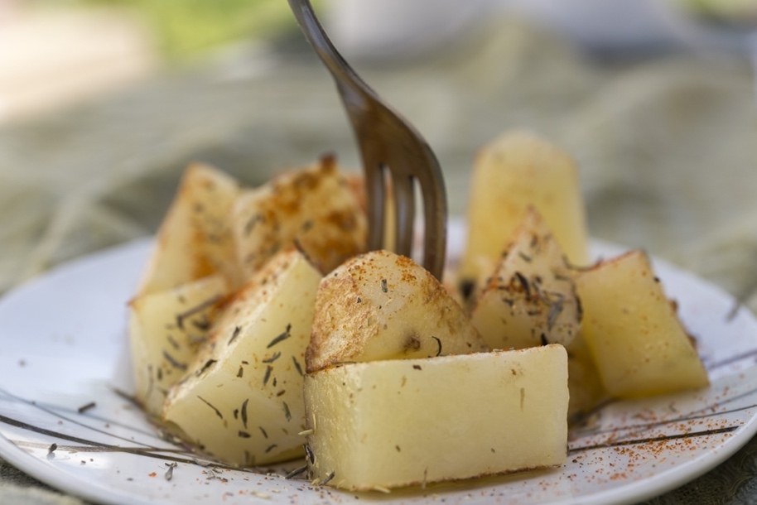
Tips for cooking and eating potatoes
Suitable for cooking with heat
Eat potatoes with iron-rich foods
Important to eat with a variety of foods
Be careful with potato sprouts and where the skins turns green
Wash well and eat with the skins
Example

Slide 5
Tips for cooking and eating potatoes
Potatoes‘ vitamin C is resistant to heating. It is not easily destroyed even after cooking.
Eat potatoes with iron-rich foods(e.g., meat, spinach) because potatoes help the absorption of iron.
Vitamin C is found near the skins, so wash them well and cook the skin to get the most nutrients.
Eat a combination of different foods, including staple foods (e.g., cereals such as wheat, barley, rye, maize, or rice), or starchy tubers or roots (e.g., potatoes, yams, taro or cassava), legumes (e.g., lentils, beans), vegetables, fruit, and foods from animal sources (e.g., meat, fish, eggs, and milk).
Be careful with potato sprouts and where the skin turns green. They contain a toxin called solanine, which causes poisoning.
Eat a variety of whole (i.e., unprocessed) and fresh foods every day to help obtain the right amounts of essential nutrients.

