Slide 1
Tomato

Slide 2
Example of key message:
“
”
Tomatoes make your skin more beautiful
Protects from infections
Prevents anemia
Improves skin tone
Assist maintenance of normal BP
Prevents eye diseases

Slide 3
Health effects of tomatoes
Q
Why is it good for the skin?
It contains a nutrient (vitamin C) that improves skin condition.
A
Q
Why does it protect us from infections?
It contains a nutrient (lycopene) that boosts the immune system.
A
Q
Why does it prevent anemia?
Tomatoes help to produce blood and prevents anemia.
A
Q
Why does it help to maintain normal blood pressure?
It contains a nutrient (potassium) that helps to reduce blood pressure elevation(BPE).
One tomato contains two-thirds of an adult’s daily requirement of vitamin C
A
2
3
Q
Why is it good for the eyes?
It contain a nutrient (vitamin A) that is necessary for visual functions.
A

Slide 4
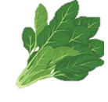
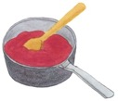
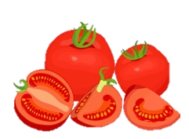
Tips for cooking and eating tomatoes
Suitable for cooking at high temperatures
Eat with iron-rich foods
Important to eat with a variety of foods
...but avoid overheating for too long
Eat with the skin and seeds
Example

Slide 5
Tips for cooking and eating tomato
Eat with iron-rich foods (e.g., meat, spinach) to help the absorption of iron.
Processing and cooking tomatoes can increase nutritional value, but after 2, 15, and 30 min. of heating at 88 ℃, the vitamin C content dropped 11, 16, and 28%, respectively.
The longer a food is cooked, the greater the loss of nutrients.
The skin and seeds of tomatoes have more anti-aging effects than that of fruits.
Eat a combination of different foods, including staple foods (e.g., cereals such as wheat, barley, rye, maize, or rice), or starchy tubers or roots (e.g., potatoes, yams, taro or cassava), legumes (e.g., lentils, beans), vegetables, fruit, and foods from animal sources (e.g., meat, fish, eggs, and milk).
Eat a variety of whole (i.e., unprocessed) and fresh foods every day to help obtain the right amounts of essential nutrients.

