Slide 1

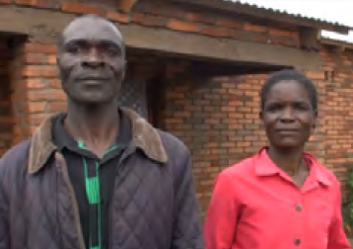

Gender Awareness Training
Type the name of your organization here.

Slide 2
WHERE ARE WE?: Gender Awareness Training in SHEP’s 4 Steps
Gender Awareness Training should be conducted some time before “Step 3-Farmers make decisions” because gender-balanced decision-making is critical for success of the group/household work.
4 Steps | Activities
1. Share goal with farmers. | Sensitization Workshop
2. Farmers’ awareness is raised. | Participatory Baseline Survey (optional) Stakeholder Forum Market Survey
3 . Farmers make decisions. | Target Crop Selection Crop Calendar Making
4. Farmers acquire skills. | In-field trainings
Follow-up and monitoring (including Participatory Endline Survey)

Slide 3
PART 1: CONCEPT

Slide 4
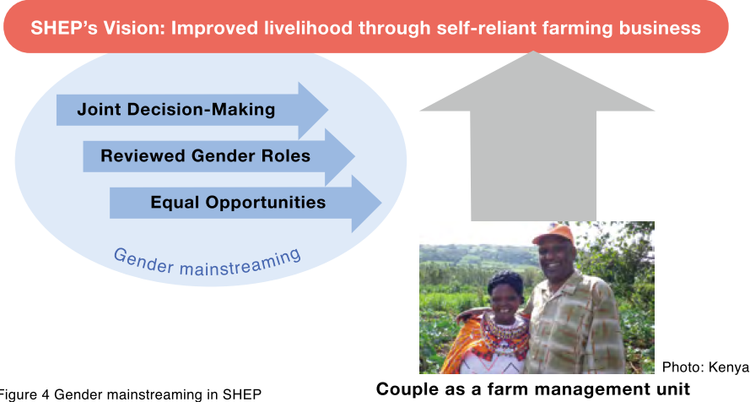
WHY?: Objectives of Gender Awareness Training
SHEP considers
  gender as an integral and essential part of farm business management.
  a husband and wife a “farm management unit” which should work together in harmony.

Slide 5
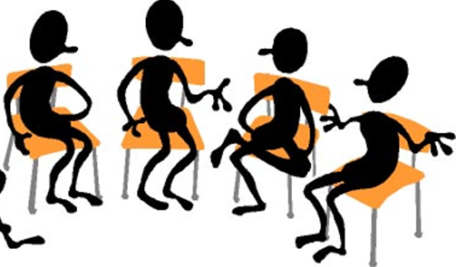
WHAT?: Outline of Gender Awareness Training
Gender Awareness Training is an integral part of SHEP trainings.
It should be conducted before the farmers’ decision-making stage, i.e. Target Crop Selection and Crop Calendar Making.
4 Steps | Activities
1. Share goal with farmers. | Sensitization Workshop
2. Farmers’ awareness is raised. | Participatory Baseline Survey (optional) Stakeholder Forum Market Survey
3 . Farmers make decisions. | Target Crop Selection Crop Calendar Making
4. Farmers acquire skills. | In-field trainings
Follow-up and monitoring (including Participatory Endline Survey)

Slide 6
WHAT?: Outline of Gender Awareness Training
The training is not theoretical but practical and participatory.
The training is conducted by undertaking four different types of exercises.
  Roles and Responsibilities
  Access to & Control of Resources
  Daily Activity Calendar
  Farm Family Budgeting
Through participation in various exercises, farming couples will come to a number of realizations on their gender issues at the household level.

Slide 7

HOW?: Key Implementation Tips
The members’ spouses should be invited to take part in the training.
Create a friendly environment. Don’t let the participants play the blame game! Rather, help them to understand each other’s positions, concerns, problems.
If it is difficult to talk about gender issues openly due to local social norms, consider inviting local opinion leaders (e.g. religious leaders, school teachers, etc. who are supportive of the gender training)

Slide 8
PART 2: PRACTICE

Slide 9
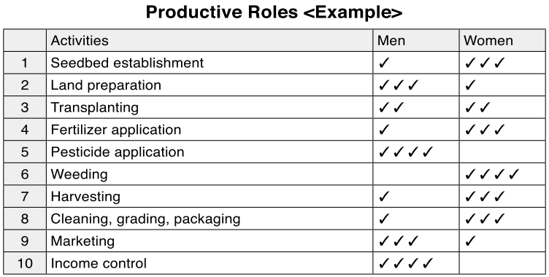
Exercise: Roles and Responsibilities
Male group and female group work separately on “Productive Roles” and “Reproductive Roles” sheets.
Both groups present their discussion results.
List major productive tasks (crop production) under “Activities”.
Distribute a total of four ticks per row, indicating who plays more roles in, and has more responsibilities for, each one of the “Activities” listed.

Slide 10
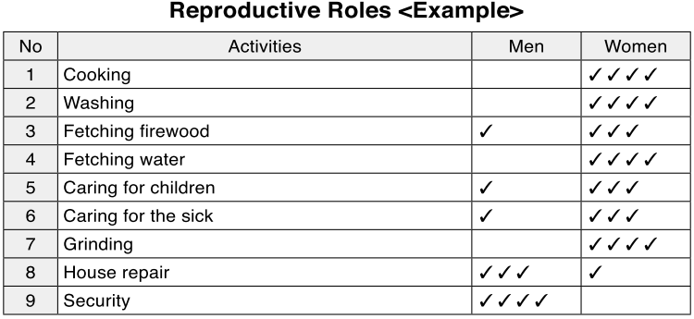
Exercise: Roles and Responsibilities
Distribute a total of four ticks per row, indicating who plays more roles in, and has more responsibilities for, each one of the “Activities” listed.
These are major reproductive activities. Modify them if necessary
Compare how the sheets of the male group and female group are different.
Discuss what changes in gender roles can be made for more efficient farm and household management.

Slide 11
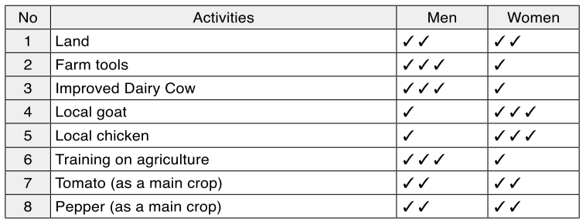
Exercise: Access to & Control of Resources
Male group and female group work separately on “Access to Resources” and “Control of Resources” sheets.
    Resources: Anything that can be owned and used by farmers to obtain a benefit from it.
    Access: The opportunity to make use of a resource
    Control: The power to decide how a resource is used.
Access to Resources <Example>
Resources
List major resources relevant to farming under “Resources”.
Distribute a total of four ticks per row, indicating who has more access to each one of the “Resources” listed.
List two major horticultural crops

Slide 12
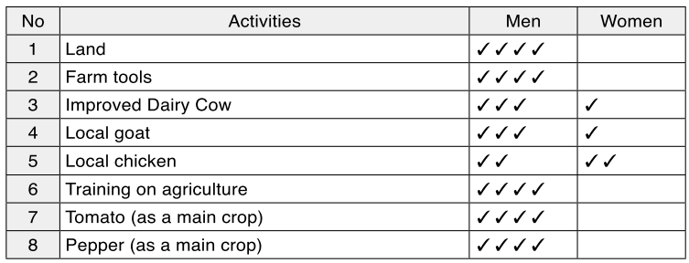
Exercise: Access to & Control of Resources
Control of Resources <Example>
Resources
Distribute a total of four ticks per row, indicating who has control of each one of the “Resources” listed.
These should be the same as “Access” Sheet.
Both groups present their discussion results.
Compare how the sheets of the male group and female group are different.
Discuss how gender-specific restriction on access to, and/or control over resources can sometimes pose negative impact on the farm life.

Slide 13
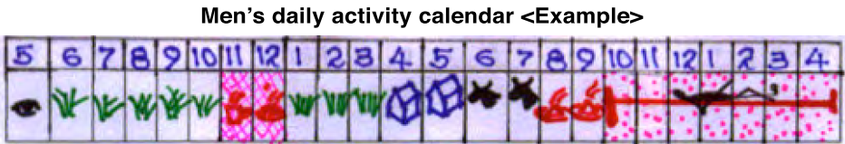
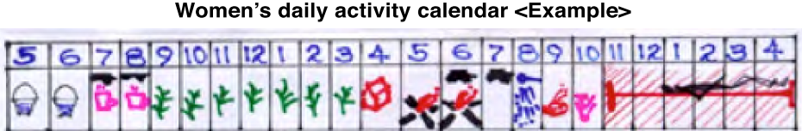
Exercise: Daily Activity Calendar
Male group and female group separately draw their “Daily Activity Calendar” of a typical weekday. The activities to be identified include farm work, cooking, cleaning, resting sleeping, etc.
They can use pictures like these. They can also write the activities if their literary rate is high.
Start with 5 o’clock in the morning.
Compare the two calendars and discuss better time use for a couple.

Slide 14
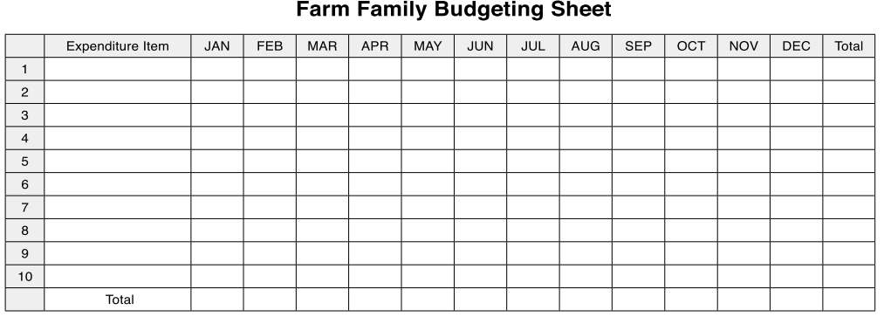
Exercise: Farm Family Budgeting
Male group and female group work separately to fill out the expenditure amount of each month on “Farm Family Budgeting Sheet ” based on their typical annual spending pattern.
[Tips!]If the famers’ literary rate is not high, try using candies, small stones, etc. to represent an amount of money.
List major expenditure items such as food, education, healthcare, farming inputs, etc.
Calculate the total amount of money

Slide 15


Exercise: Farm Family Budgeting
Male group and female group show each other’s sheet.
Discuss issues caused by lack of lack of communication between a husband and wife on…..
    household budgeting
    Inefficient utilization of financial resources
Discuss what they can do for the better management of family budget.

Slide 16
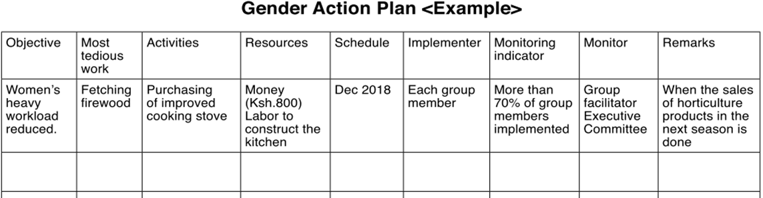
Planning: Gender Action Plan
All the farmers discuss how they can overcome gender-related issues which hinder efficient farm management. The issues include;
  Inefficient gender roles
  imbalanced decision-making power
  lack of trust and communication between a couple.
Based on this realization, the group formulates a Gender Action Plan. They will implement it and monitor its progress.

Slide 17

SUGGESTION: Organizing Discussion Sessions using Anecdotal Stories
In stead of, or on top of, organizing trainings explained so far, holding a discussion meeting for the farmers may be beneficial.
Introduce to the farmers some real-life anecdotal stories with a gender topic.
Let them discuss issues concerned with;
  Joint decision-making between a husband and wife
  gender roles which enable efficient farm and household management
  equal opportunities for both men and women.

Slide 18
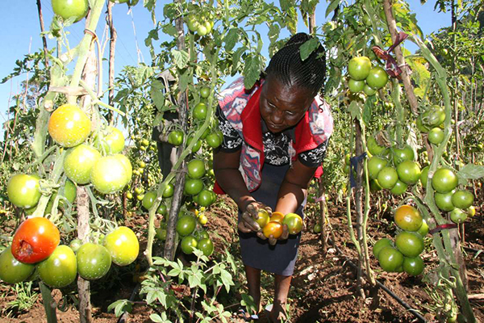
Story 1: A Story of a Husband in a Farming Household
One day I left home in the morning to go look for a market for my tomatoes which were ready for harvesting. While I was away busy looking for a market, a buyer visited my home and found my wife. He asked if she could sell the tomatoes to him but since she had no authority whatsoever to make decisions and never knew my plans, she declined.
My search for a market was unsuccessful so I headed home where my wife reported to me the events of the day. I really felt bad and my tomatoes got spoilt since I couldn’t find a place to sell them.
Is this situation familiar to you?
Why do you think this problem happened?
How do you think this kind of situation can be avoided?

Slide 19
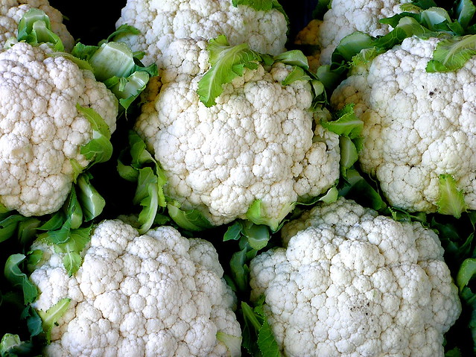
Story 2: A Story of a Wife in a Farming Household
My husband told me “I’ve heard cauliflower is profitable. Let’s plant cauliflower on all of our land”. I opposed to him by saying “Yes, but just on half of our land, not entire land” because I saw many other farmers had planted cauliflower already and heard many people saying they wanted to plant cauliflower. I knew by the time we harvest it, the price would go down. My husband did not listen to me and did what he wanted. We made a huge loss at the end of the season. After this bitter experience, however, my husband started to ask me “What crop do you think is good for this season?”
Is this situation familiar to you?
Why do you think this problem happened?
How do you think this kind of situation can be avoided?

Slide 20
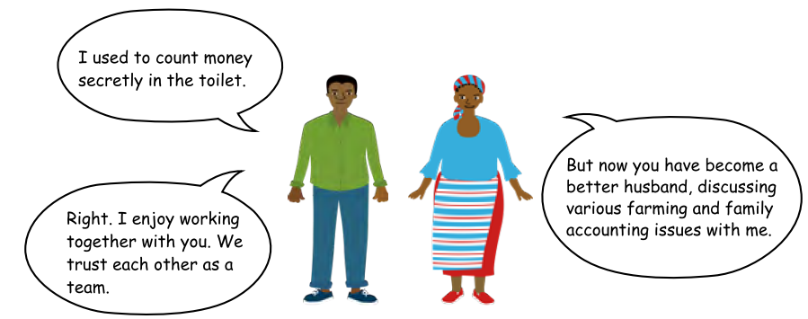
Gender Awareness Training in Action

Slide 21

TROUBLESHOOTING
Gender is a sensitive topic. What if the farmers hesitate to attend the Gender Awareness Training?→ Past experience suggests that those farmers who attended the Gender Awareness Training were very happy about attending the training. They liked the training because its focus is NOT on highlighting problems or criticizing others related to gender but on improving farming business through cooperating each other.

Slide 22
Way Forward: Implementation Schedule, Reporting, add any other necessary info. here

