Slide 1

















Introduction of SHEP Program
- Innovation for Agricultural Extension Service -

Slide 2

1. Background
Challenges of Conventional Agricultural Extension
Technology Transfer：Farmers do not adopt recommended technologies/technics demonstrated by agricultural research.
Lack of Marketing： The increase in yield does not necessarily lead to the improvement of agricultural profit.
Empowerment：Farmers ' efforts to improve farming do not persist.
SHEP as one of the agriculture extension approaches gives concrete solutions for these basic issues on agricultural extension.

Slide 3




Commitment by Govt. of Japan
1. Background
“We would like to transition away from agriculture “that enables the farmer to eat” to agriculture the farmer to earn money.” by Prime Minister Mr. Shinzo ABE@TICAD V in 2013
Commitment: Expansion to 10 countries, Capacity building of 1,000 skilled agricultural trainers, support to 50,000 farmers
※TICAD：Tokyo International Conference on African Development

Slide 4

1. Background
Outcome of SHEP Expansion so far
(As of July 2020)
30 countries implement SHEP.
  26 in Africa
  1 in Middle East
  1 in Asia
  2 in Latin America
16 more countries are planning to implement SHEP within a few years.
18,724 officials and extension staff are trained in SHEP.
186,427 farmers received SHEP trainings.
-
”
-
-

Slide 5


“What is SHEP?”
2. Introduction of SHEP Activities
Stands for “Smallholder Horticulture Empowerment and Promotion” Approach
Developed in Kenya through technical cooperation project by JICA which started from 2006 and succeeded in increasing farmers’ income
An extension approach which realize “Market-Oriented Agriculture”

Slide 6
“How to realize it in SHEP?”
2. Introduction of SHEP Activities
Essential 4 steps
Other Countries
Activities in Kenya
1. Selection of targets and sharing vision/goal
Sensitization Workshop
Selection of Target Group (Rwanda)
Sensitization Workshop
Selection of Target County
2. Farmers’ awareness of current situation and new information
Participatory Baseline Survey
Needs Assessment (Malawi)
Market Survey
Participatory Baseline Survey
FABLIST Forum
Market Survey
3. Decision making by Farmers
Crop Selection
Action Plan Making
Crop Selection
Making Crop Calendar
4. Provision of technical solutions
Training for Extension staff
Demand driven In-field trainings for farmers
In-field Training

Slide 7
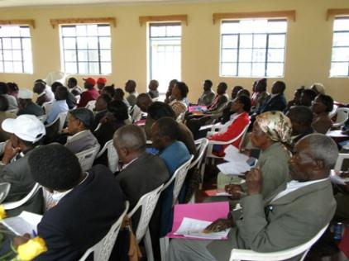
2. Introduction of SHEP Activities
Sharing the vision/goal
Sensitization Workshop
All levels of stakeholders attend the workshop
Participants understand what they are going to do
Participants identify their roles and responsibilities
All stakeholders share how to realize Market-Oriented Agriculture
Participants of the Sensitization Workshop
Notes:
5. The SHEP Approach Cont’
5.1 Sensitization Workshop
1-Day Sensitization Workshop will be carried out after the selection of Model Farmer Groups
Objective:
To sensitoze District staff (DAOs, District Desk Officers, HCDA Station Managers), Divisional staff (DAEOs), Frontline Extension Officers (FEOs), and Farmer Group Representatives (both male and female) from the Model Farmer Groups on the SHEP Approach & following field activities
After the workshop, Farmer Group Representatives (1 Male & 1 Female) and FEOs/Group Facilitators need to share all the information & knowledge gained from the workshop to the rest of members

Slide 8
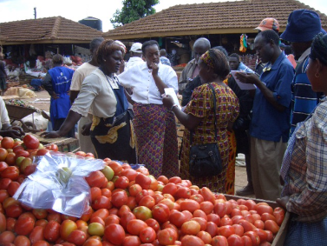
2. Introduction of SHEP Activities
2. Awareness of situation
Market Survey
Farmers visit to adjacent market and understand not only price but also required quality and quantity, selling condition, price fluctuation, etc.
Both market stakeholders and farmers can share their own information
Exercise on Market Survey
Notes:
5. The SHEP Approach Cont’
5.3 JEF2G Training: Joint Extension Staff and Farmers Dual Gender (JEF2G) Training
This is a one (1) week training for Farmer Groups Representatives (both Male & Female) and Frontline Extension Officers (FEOs)/Group Facilitators in charge of the groups
Why joint Training?:
To establish a common understanding for project activities between FEOs/Group Facilitators and farmers
To foster a working relationship between FEOs/Group Facilitators and farmers
To provide ample opportunity for sharing experiences
Objectives:
To impart skills on Action Plan Making to representatives of farmer groups and their FEOs/Group Facilitators through the practices of Market Survey and Problem & Objective Maps making
To strengthen relationship between farmers and FEOs/Group Facilitators for smooth implementation of field activities
To improve the farmers’ skills through group exercises e.g.) Market Survey, Problem & Objective Maps, Action Plan Making, preparation of “Do-nou” & Agro-processing Requisition Forms
Participants of the Training were 1 male & 1 female group representatives & FEOs/Group Facilitators
Items of the Training involved Market Survey, Crop Selection & Ranking, Problem Map, Objective Map & Group Action Plan Making
Participants are supposed to train other group members immediately (within 2 weeks) after the training

Slide 9
2. Introduction of SHEP Activities
3. Decision Making
Crop Selection
Based on the results of Market Survey, group members of farmers prioritize their target crops by themselves
Ex)
Crops | Experience | Time for planting and Duration | Expected yield / acre (kg) | Average / Expected price (Ksh) | Expected total income (Ksh) | Cost of production (Ksh) | Expected benefit (Ksh) | Market condition | Ranking
Carrot | No | April, 3 months | 4,000 | 20 | 80,000 | 25,000 | 55,000 | Middle size, cash, shape
Onion | No | March, 6month | 2,000 | 15 | 30,000 | 10,000 | 20,000 | Large size, cash
Kale | Yes | March, 3month | 8,000 | 3 | 24,000 | 5,000 | 19,000 | Fresh, cash
Tomato | Yes | May, 4month | 6,000 | 30 | 180,000 | 50,000 | 130,000 | Well matured, middle size
2
4
3
1

Slide 10
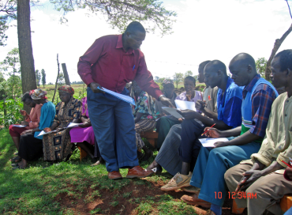
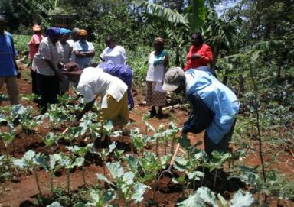
2. Introduction of SHEP Activities
4. Provision of Technical Solution
Demand Driven In-field Training
Extension Officer training Farmer Group
User friendly skills
Extension staff are trained on crops or skills according to farmers’ needs
All skills are easy for farmers to adopt
Farmers learn what they want to know, so adoption rate is high
Notes:
5. The SHEP Approach Cont’
5.6 In-field Training
In-field Training is a series of Training sessions meant to address the specific needs of the Model Farmer Groups at suitable time
All farmer group members are supposed to attend the In-field Training sessions
FEOs/Group Facilitators who are trained in FT-FaDDE conducted the training sessions on farmer groups’ demands
Training Topics for the In-field Training are the same topics which were taught during the FT-FaDDE
Lectures, exercises & demonstrations will be used for each topic during the In-field Training
FEOs/Group Facilitators are expected to carry out the series of training sessions according to the schedule

Slide 11
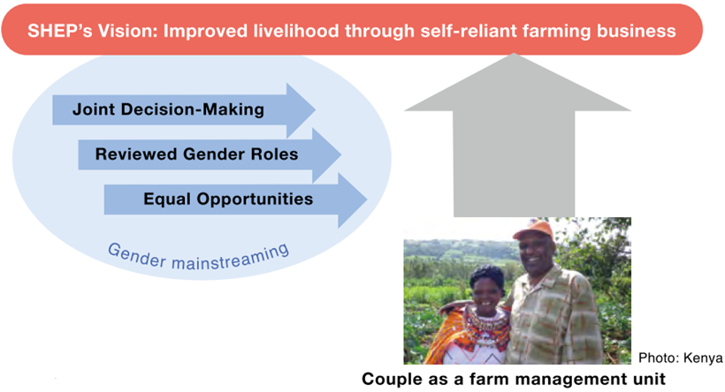
Gender in SHEP
SHEP considers gender as an integral and essential part of farm business management for smallholder horticultural farmers.
Participation of male and female farmer group members at the community level, as well as husbands and wives at the household level should be ensured in SHEP.

Slide 12
3. Inside of SHEP Approach “Motivation”
Red line: Level of motivation
Green line: Skill level
An increase in income with acquisition and utilization of the skills leads to confidence in one’s capacity.
Motivation
Skill level
High motivation facilitates learning of technical skills.
Learning with experience of research methods helps enhance motivation.
Sensitization Workshop
Exercise on Market Survey
Selection of crops to be grown
In-field training
Sales of crops
Sustainable growth
12

Slide 13

“What is the concept of SHEP?”
3. Inside of SHEP Approach “Motivation”
Feature of JICA’s technical cooperation (Capacity Development)
Various donors implement similar projects/programs
Developing and motivating people by effective activity designs and “tips”
Promoting “Farming as a Business”
Sharing information among market actors & farmers for improving efficiency of local economies (Mitigating the asymmetry of information)
Raising intrinsic (internal)motivation for continuous activities implementation
(Self-determination Theory)
-Three psychological needs to motivate people-
SHEP
Market Survey by farmers
Family budgeting
Market Info.
(variety, price, season, etc.)
Autonomy
People need to feel in control of their own behaviors and goals
Sharing market information
Stakeholder forum
Competence
People need to gain mastery of tasks and learn different skills
Producer Info.
(Farm location, production potential, etc.)
Market actors
- Retailers, middlemen
- Agricultural inputs companies (seed, fertilizers, etc.)
- Agricultural product processers
Producers
Relatedness
People need to experience a sense of belonging and attachment to other people

Slide 14
SHEP realize “Farming as Business”
3. Inside of SHEP Approach “Farming as Business”
Promoting “Farming as a Business”
Sharing information among market actors & farmers for improving efficiency of local economies
(Mitigating the asymmetry of information)
SHEP
Market Info.
(variety, price, season, etc.)
Family budgeting
Market Survey by farmers
Sharing market information
Producer Info.
(Farm location, production potential, etc.)
Stakeholder forum
Market actors
- Retailers, middlemen
- Agricultural inputs companies (seed, fertilizers, etc.)
- Agricultural product processers
Producers

Slide 15
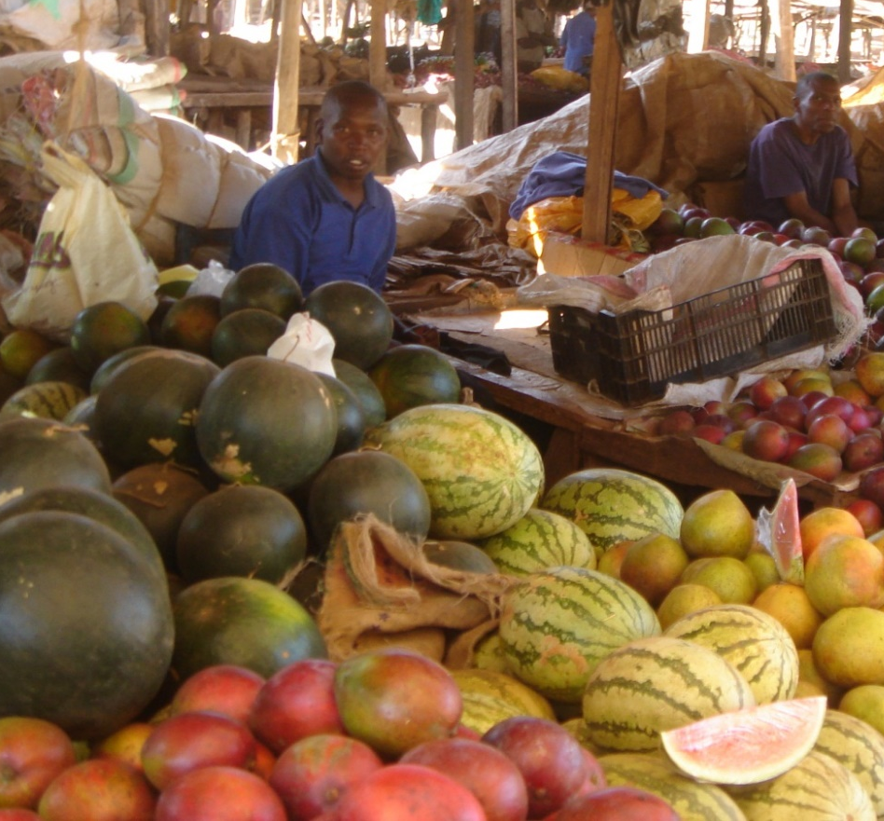
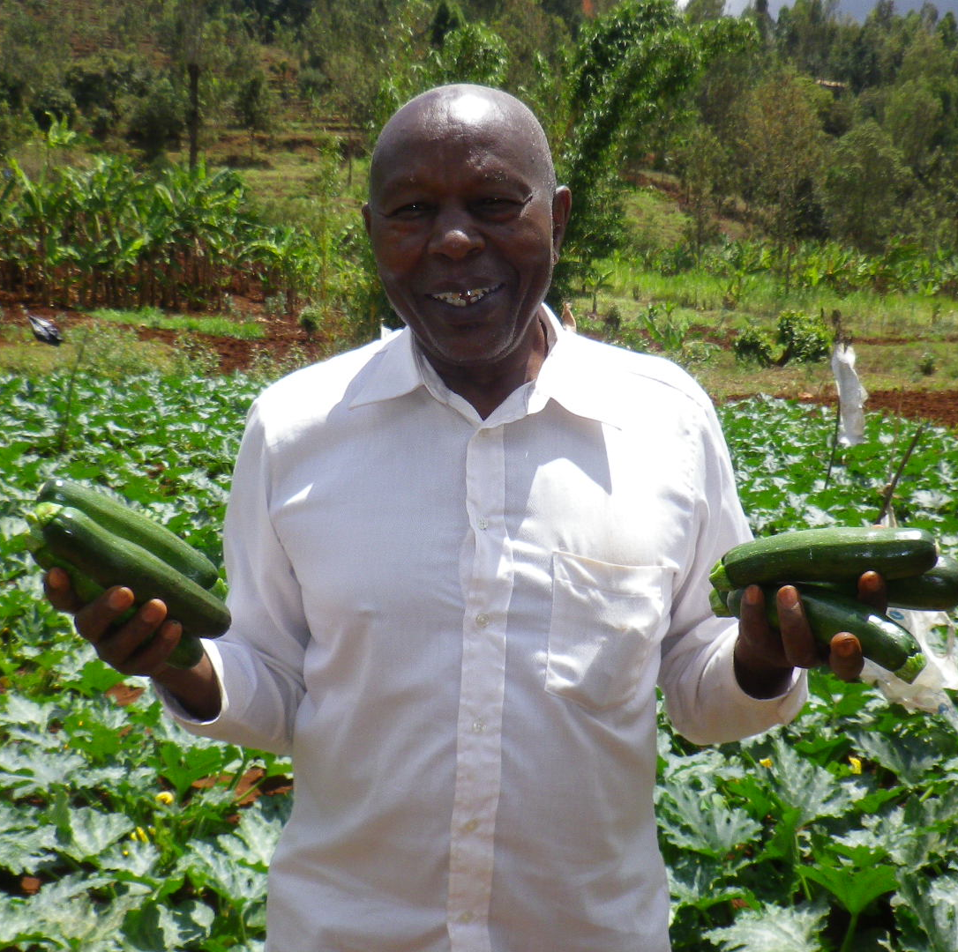
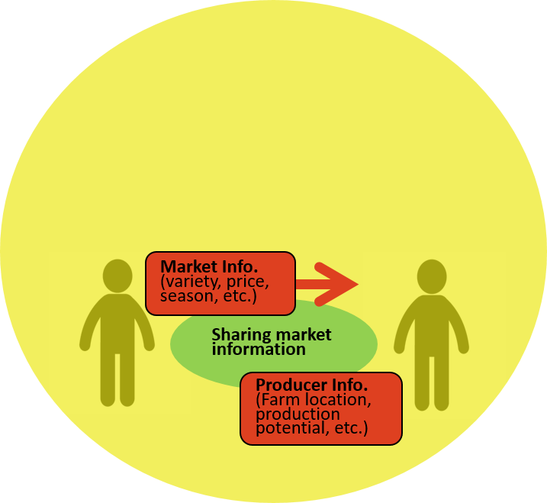
3. Inside of SHEP Approach “Farming as Business”
Market Information
（Price fluctuation, high demand crops, required quality, etc）
Promoting “Farming as Business”
Producers
Small scale farmers
Trust relationship based on “Win-Win” situation
Market Stakeholders
・Retailers, Middle agents, Supermarket
・Agro-processing companies
・Input companies
Producers’ Information
（Location, Potential, Experiences）

Slide 16
SHEP’s Emphasis on “Motivation”
3. Inside of SHEP Approach “Motivation”
Empowering and motivating people
Raising motivation for continuous activities implementation
(Self-determination Theory)
-Three psychological needs to motivate people-
SHEP
Market Survey by farmers
Family budgeting
Autonomy
People need to feel in control of their own behaviors and goals
Stakeholder forum
Competence
People need to gain mastery of tasks and learn different skills
Relatedness
People need to experience a sense of belonging and attachment to other people
Notes:
SHEPのオリジナリティの１つの柱がモチベーションであるため、今回の調査が実施された旨を説明。

Slide 17
Edward Deci’s Self-Determination Theory:
Three Psychological Needs
3. Inside of SHEP Approach “Motivation”
Autonomy
  People need to feel in control of their own behaviors and goals
Competence
  People need to gain mastery of tasks and learn different skills
Relatedness
  People need to experience a sense of belonging and attachment to other people

Slide 18
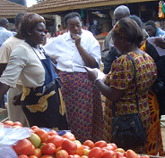
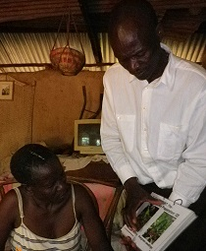
3. Inside of SHEP Approach “Motivation”
Introduction and utilization of Motivation theory
Autonomy support
  -Farmers themselves decide the crops to grow and make a crop calendar based on the results of the market survey.
Competence support
  -Skills and techniques provided to farmers are user friendly and low cost. Farmer can practice it immediately after learning
Please take a look at the samples (displayed in the back of the room).
Relatedness support
  -Face to face communication between farmers and market stakeholders benefit to build good relationship

Slide 19
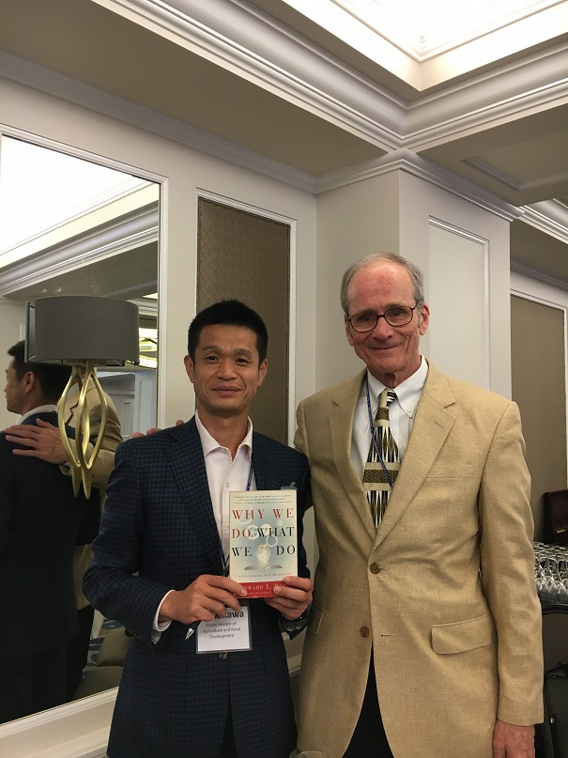
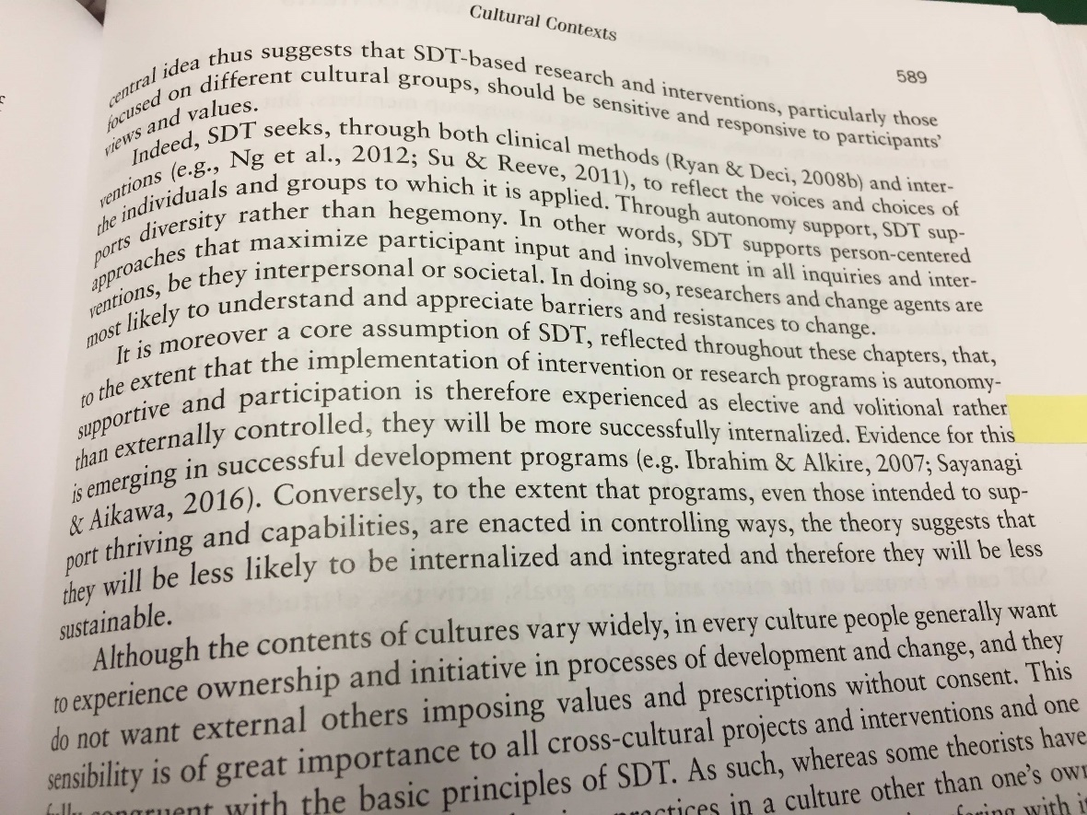
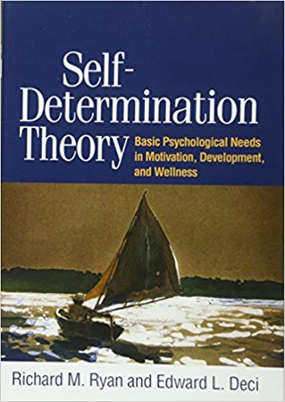
Presentation on “Utilization of SDT” at 6th International Conference of SDT
3. Inside of SHEP Approach “Motivation”
It is moreover a core assumption of SDT, reflected throughout these chapters, that, to the extent that the implementation of intervention or research programs is autonomy-supportive and participation is therefore experienced as elective and volitional rather than externally controlled, they will be more successfully internalized. Evidence for this is emerging in successful development programs (eg. Sayanagi and Aikawa, 2016

Slide 20
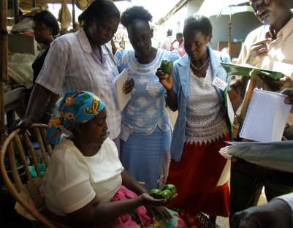
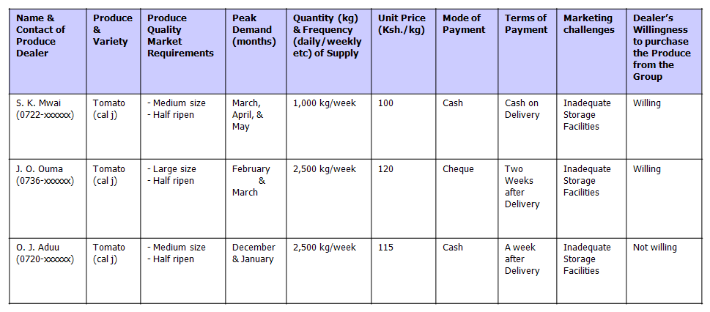
3. Inside of SHEP Approach
“What can SHEP bring about change?”
Change of farmers’ mind on marketing from “Grow and Sell” to “Grow to Sell”
Market Survey by Farmers
e.g.) Results of the Market Survey

Slide 21
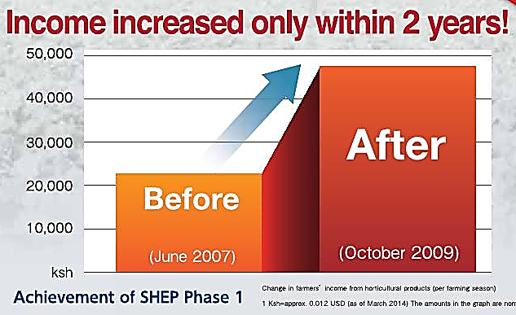
4. Results and Impacts of SHEP
“What happened at the field level?”
Income from horticulture crops increased in various countries, i.e.; Kenya, Rwanda, Lesotho, etc.

Slide 22
4. Results and Impacts of SHEP
Case of Rwanda
Average Net Income per a Member from Cooperative Farmland of Direct Support Cooperatives
Increase: 4.8 times
Increase: 2.3 times
Source: JICA SMAP Team (2016)

Slide 23
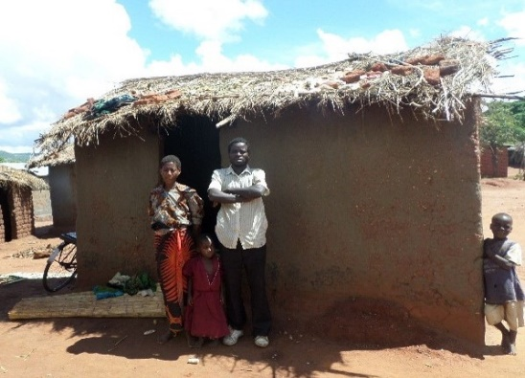
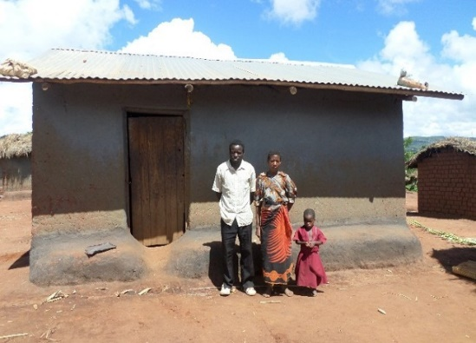
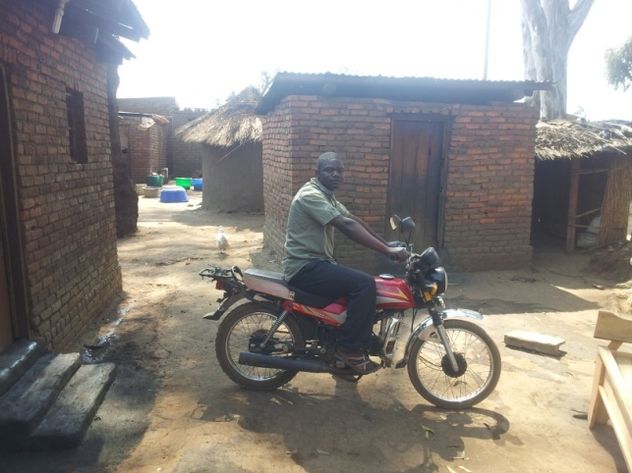
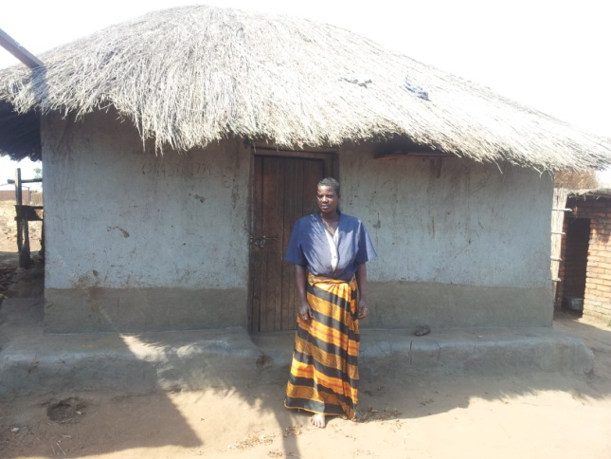
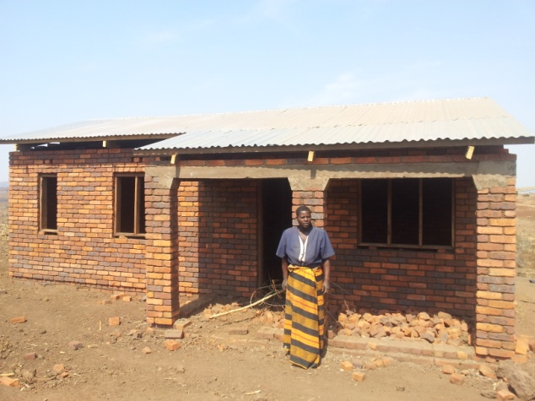
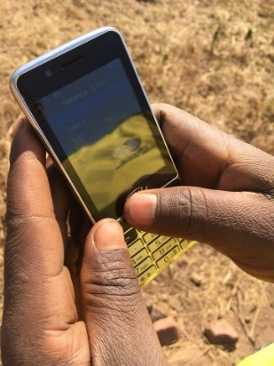
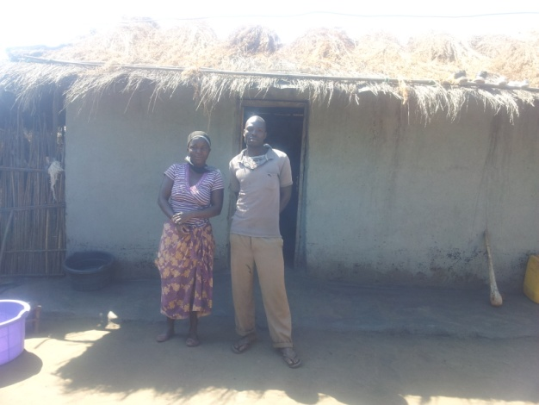
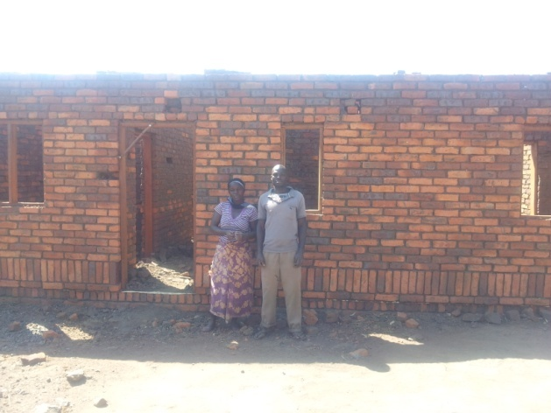
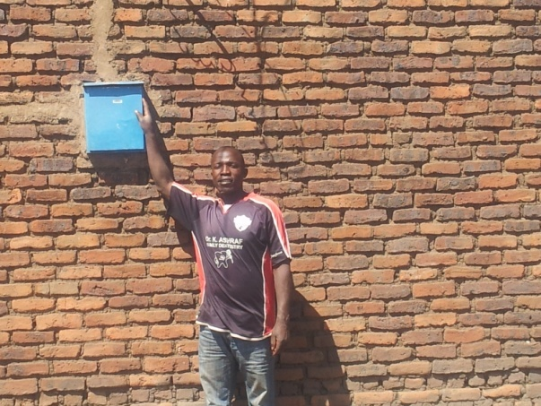
4. Results and Impacts of SHEP
Case of Malawi
Before
After
Others

Slide 24
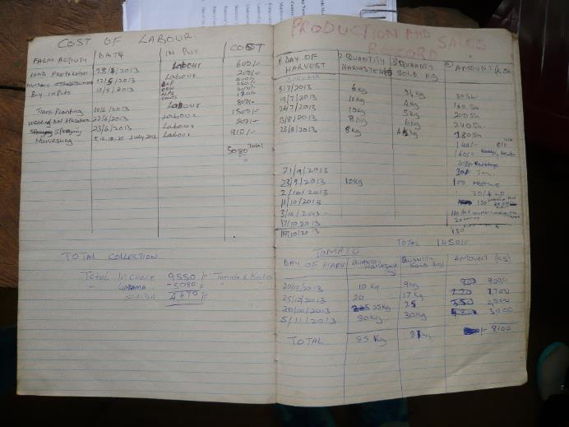
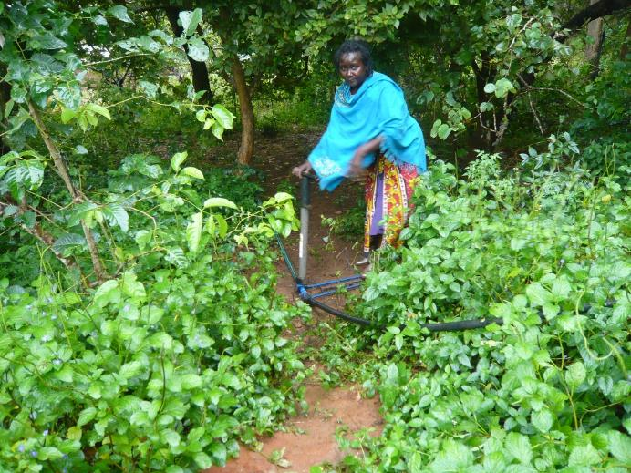
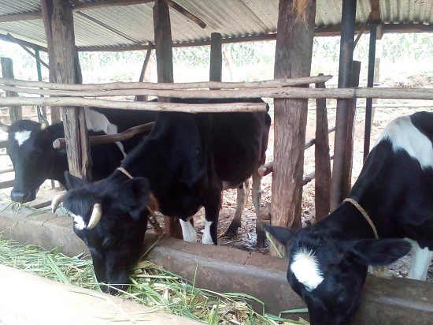
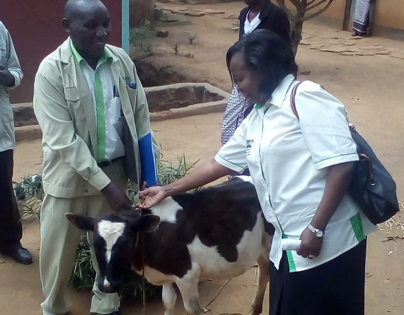
4. Results and Impacts of SHEP
Case of Kenya
Keeping a record
Reinvestment for Agriculture (Buying pump)
Investment for Livestock
Second generation

Slide 25

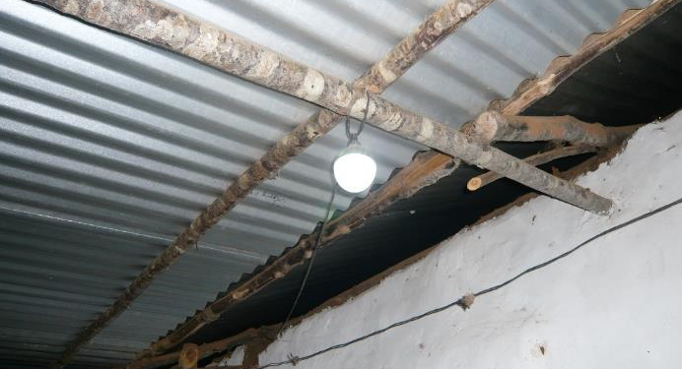
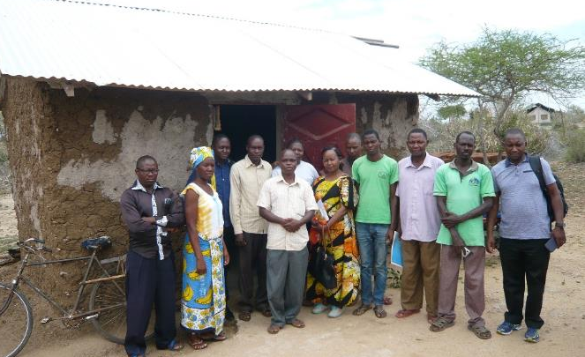
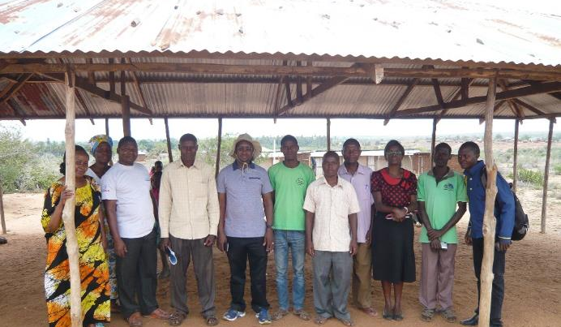
4. Results and Impacts of SHEP
Case of Kenya
Light by solar panel
Invitation by National event as a most successful young group
Building new office for group
(Current)
Building new office for group (Under Construction)

Slide 26
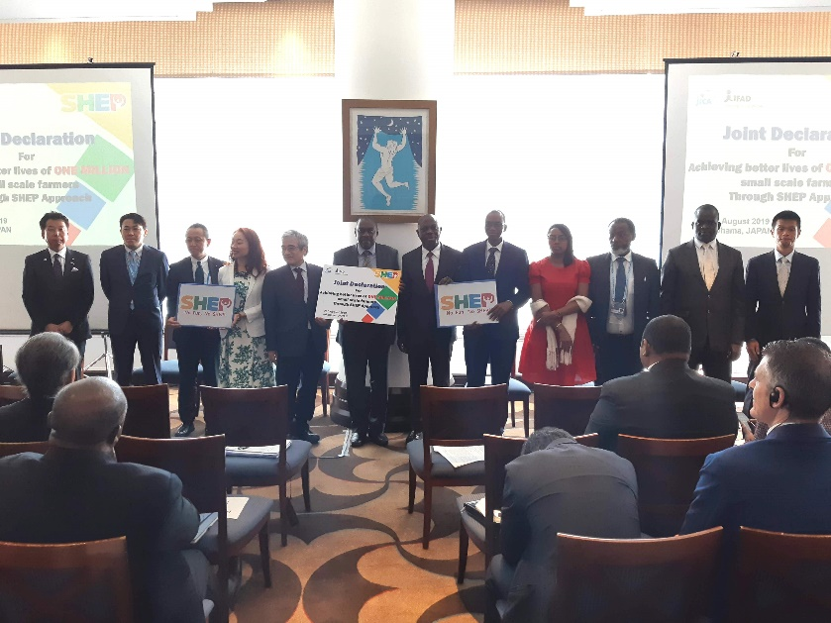

“Joint Declaration for Achieving better lives of One Million small scale farmers through SHEP Approach” by Representative of Government, Development Partners, Private Companies and Relevant Organization at TICAD VII SHEP Approach High Level Event, August, 2019
“What is our target?”
Notes:
IFAD（マラウィRLEEP、ジンバブエSIRP）、世銀（レソトSADP）

Slide 27
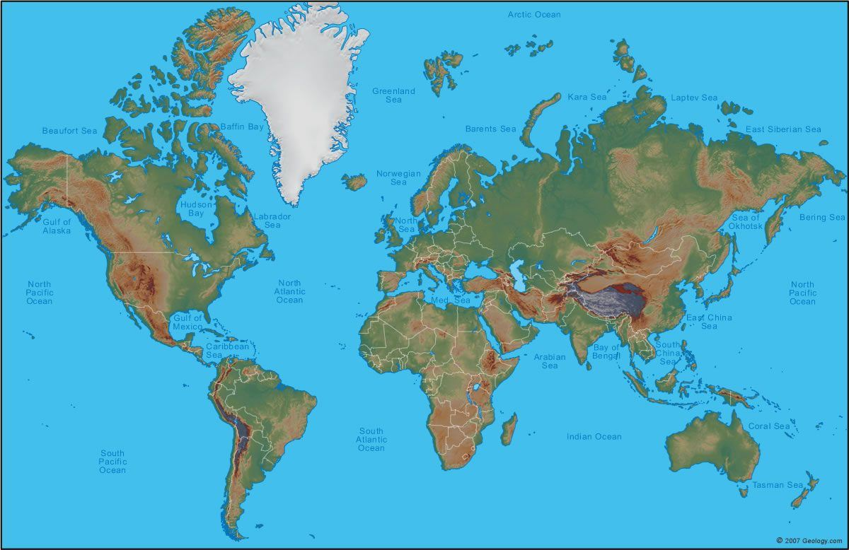
“Beyond the continents”
Tajikistan
Palestine
Bhutan
Japan
26 countries in Africa
Pakistan
Nepal
Bangladesh
El Salvador
Kenya
Sri Lanka
Latin America

Slide 28
Thank you

