Slide 1

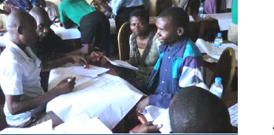

Target Crop Selection
Methods of Implementation
Type the name of your organization here.

Slide 2
WHERE ARE WE?: Target Crop Selection in SHEP’s 4 Steps
4 Steps | Activities
1. Share goal with farmers. | Sensitization Workshop
2. Farmers’ awareness is raised. | Participatory Baseline Survey (optional) Stakeholder Forum Market Survey
3 . Farmers make decisions. | Target Crop Selection Crop Calendar Making
4. Farmers acquire skills. | In-field trainings
Follow-up and monitoring (including Participatory Endline Survey)
Target Crop Selection is where the farmers make decisions.

Slide 3
PART 1: CONCEPT

Slide 4


WHY?: Objectives of Target Crop Selection
The farmer groups collectively identify the specific types of crops that are demanded by the market.
The farmers agree to produce and market the identified crops as a group.
  Note:
  During the In-field training in “Step 4”, the farmers will learn how to produce the crops they have chosen during this activity.

Slide 5
WHAT?: Outline of Target Crop Selection
The farmer groups select the target horticultural crops based on their finding during the market survey (and Stakeholder Forum, if implemented).
The groups discuss their preferred crops and build a consensus on the crops they will grow as a group.
The extension staff gives advice to the group during the crop selection process.

Slide 6
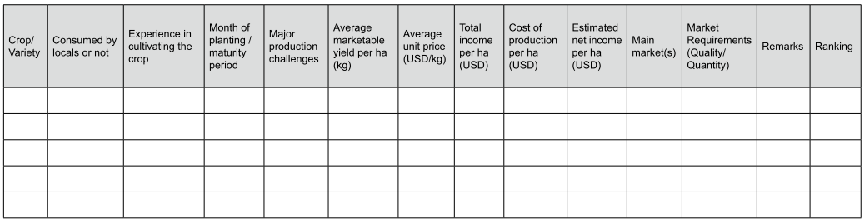
FORMAT: Target Crop Selection Sheet
Information is filled out by the farmers.
The farmers decide the ranking of each crop.

Slide 7

HOW?: Key Implementation Tips
The farmer groups discuss their future farming opportunities. They make decisions about the target crops based on their previous SHEP activities, in particular, the market survey.
Raising Motivation

Slide 8
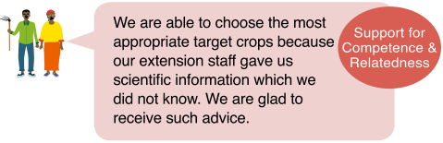
HOW?: Key Implementation Tips
The extension staff gives useful advice and suggestions, particularly in the area of agro-ecological suitability of specific crops. As a result, the farmers can make a well-rounded decision in choosing the target crops.
Raising Motivation

Slide 9
PART 2: PRACTICE

Slide 10
STEP: Implementation Procedures
Organize a meeting at the community and invite the group members as well as their spouses. [Tip!] Inviting the members’ spouses facilitate effective decision-making.
Ask the farmer group to discuss the findings of the market survey and fill out the information on the Target Crop Selection Sheet. [Tip!]Refer to the completed Baseline Survey Questionnaire and Market Survey.
Discuss advantages and disadvantages of potential target crops. Are they easy to grow, suitable to the local growing condition, affordable? [Tip!] The extension staff should give advice on production suitability and technical issues. Do not choose crops solely based on their profitability.

Slide 11
STEP: Implementation Procedures
Each group member votes for his/her preferred crops (blind voting)
    Write the name of his/her 1st & 2nd preferred crops on the voting paper.
    The majority, preferably more than 70%, of the group members should participate in this process to build a consensus among the group members.
    For the 2nd crop, repeat the process above.
    Rank the crops in accordance of the number of votes and choose two or three target crops.
    [Tip!] Make sure powerful members of the group (eg. group leaders, elderly or well-educated members) do not influence the group’s decision.

Slide 12
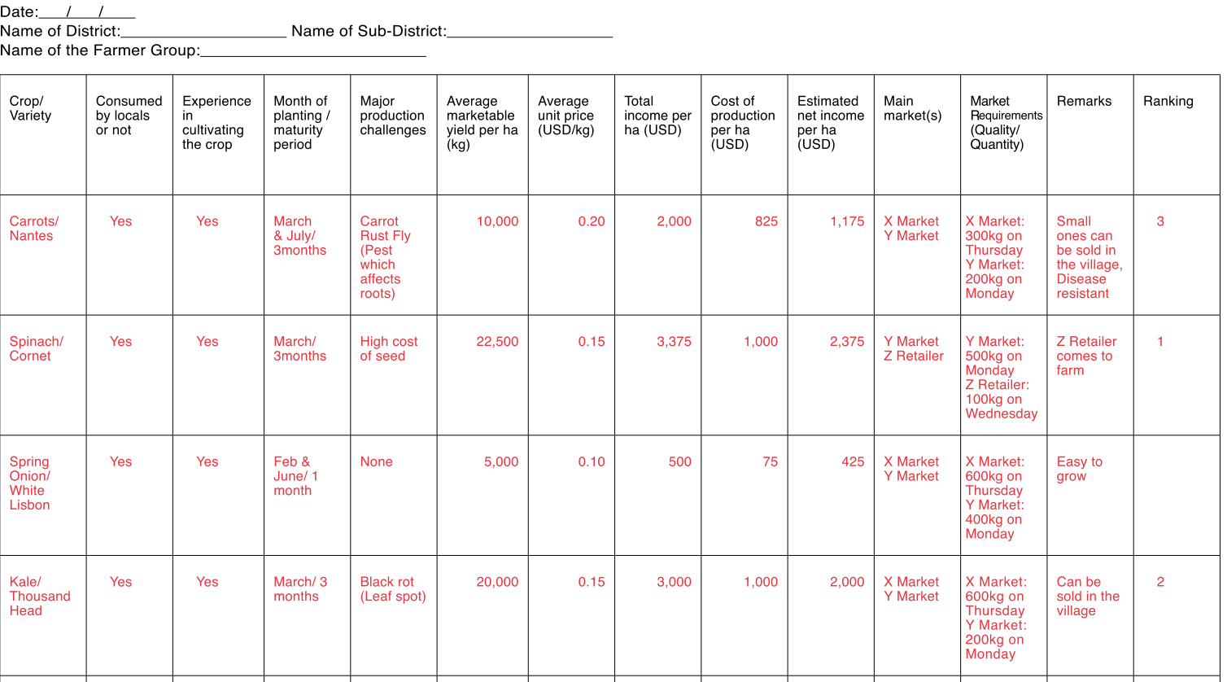
Target Crop Selection Sheet
Basic information of the farmer group
Advice from Extension Staff is critical
Info. Collected during the Market Survey
&
Info. Based on the Baseline Survey
Ranking: Result of voting

Slide 13
CHECKLIST: Points to be Confirmed after Target Crop Selection
The target farmers understand the methods of target crop selection.
Not only profitability but also agro-ecological conditions, as well as the farmers’ technical skills and financial capacity are taken into consideration in choosing target crops.
The target groups agree to undertake target crop selection on a regular basis by themselves in the future.
The male-female ratio of the participants is balanced.
The quality of participation of male and female members in decision-making is ensured.
(optional) The members’ spouses are involved.

Slide 14
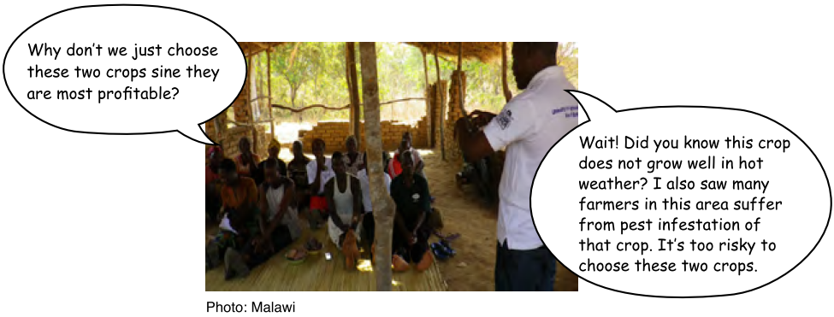
Target Crop Selection in Action

Slide 15

TROUBLESHOOTING
What if a tie vote happens?→ Ask the farmers to vote again. This time, they will vote only for the crops which got the same number of votes.
Isn’t there a risk of oversupply? → Selecting a few target crops do not necessarily saturate the local market as long as the farmers know when and what quantity they should supply to the market.
What happens to the crops that are not selected? →The benefit of selecting target crops are:
  The farmers can get intensive production trainings on those crops from the extension staff during In-field Training.
  The farmer groups can plan collective marketing for those selected crops.
  The Farmers are free to grow any other crops as they wish.

Slide 16
Way Forward: Implementation Schedule, Reporting, add any other necessary info. here

