Slide 1
JOB REPORT
JICA Knowledge Co-Creation Program
PROJECT MANAGEMENT IN INFRASTRUCTURE DEVELOPMENT
FOR CIVIL ENGINEERS
NAME

Slide 2
JOB REPORT -PROJECT MANAGEMENT IN INFRASTRUCTURE DEVELOPMENTFOR CIVIL ENGINEERS-
Introduction of my self
Name
Country
Career after graduation until present

Slide 3
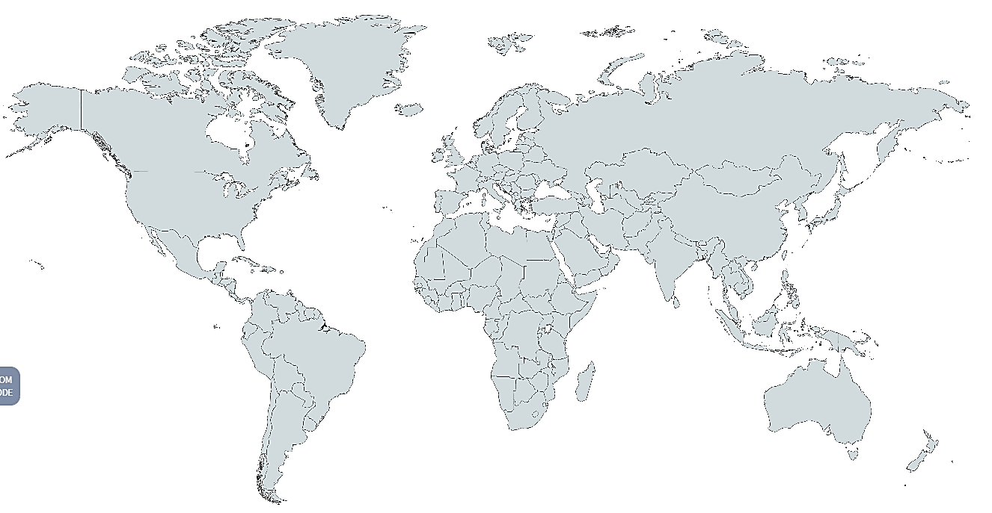
JOB REPORT -PROJECT MANAGEMENT IN INFRASTRUCTURE DEVELOPMENTFOR CIVIL ENGINEERS-
Introduction of my country
Name
Location
Capital city
Surface area
Population
Currency
Nominal GDP
Per capital GDP (in USD)

Slide 4
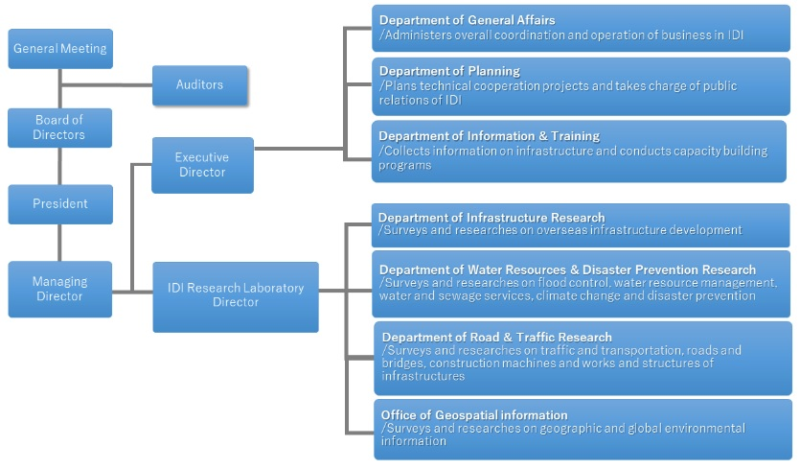
JOB REPORT -PROJECT MANAGEMENT IN INFRASTRUCTURE DEVELOPMENTFOR CIVIL ENGINEERS-
Introduction of my organization
Name
Objectives
Overview of my organization
（Please insert your organization chart）
My position in it & daily work
Sample

Slide 5
JOB REPORT -PROJECT MANAGEMENT IN INFRASTRUCTURE DEVELOPMENTFOR CIVIL ENGINEERS-
Present project management conditions in your country
Commonly used bidding and contraction systems or methods
Project evaluation systems or methods

Slide 6
JOB REPORT -PROJECT MANAGEMENT IN INFRASTRUCTURE DEVELOPMENTFOR CIVIL ENGINEERS-
Present project management conditions in your country
Most serious Problem in the field of site management
Most serious Problem about Organizational, financial, or technical issues
Others

Slide 7
JOB REPORT -PROJECT MANAGEMENT IN INFRASTRUCTURE DEVELOPMENTFOR CIVIL ENGINEERS-
Problems in project management around me

