Slide 1


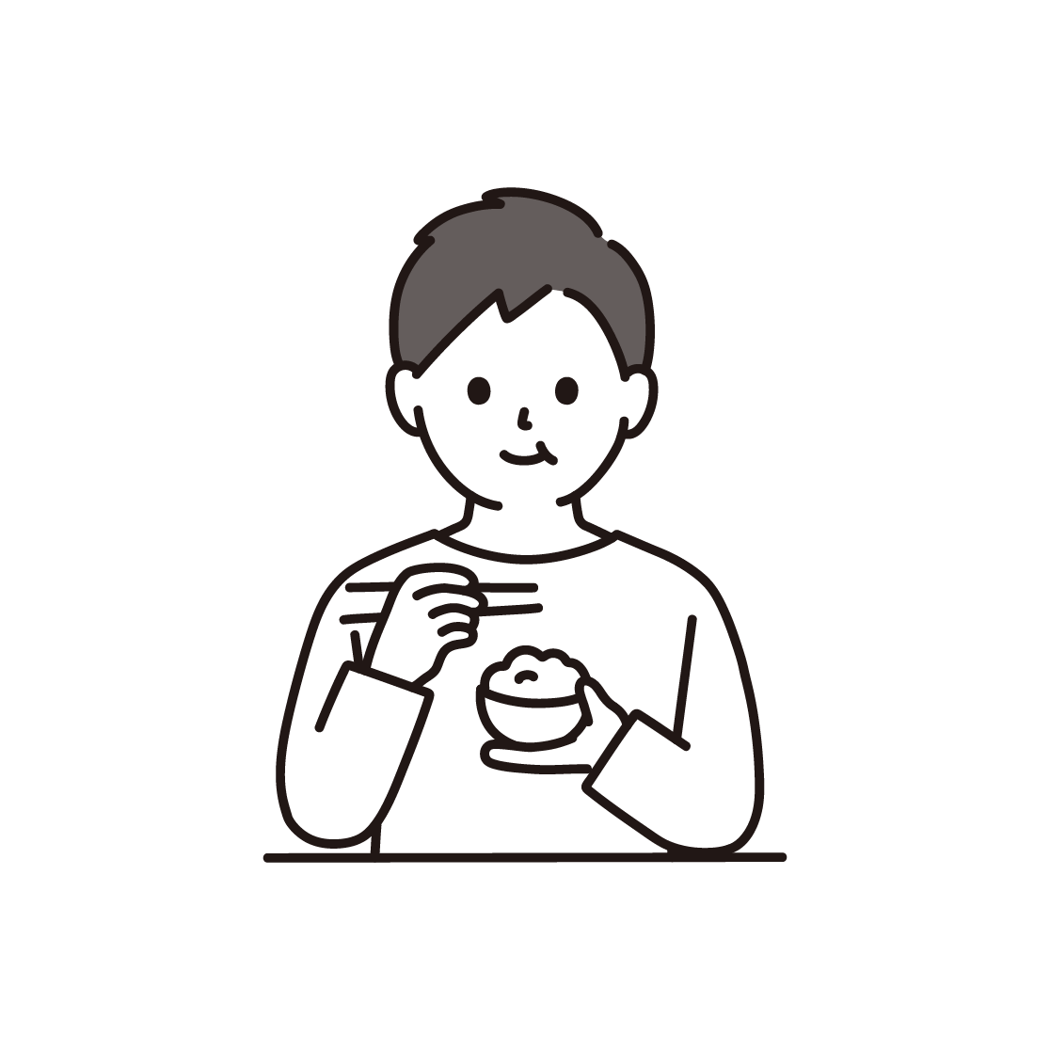
The Table of the World
（世界の食卓）

Slide 2

GOAL
Exploring and appreciating global food cultures
(世界の食文化を探求し、理解しよう）
・What is your favorite Japanese food?
・What is Daniel’s favorite British food?
・Let’s learn about world dishes
1
2
・Let’s explore world recipes!
・Let’s learn how to cook ○○
3
・Let’s cook ○○!

Slide 3
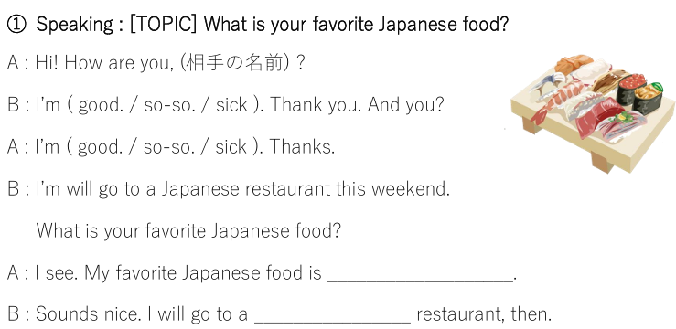

Slide 4
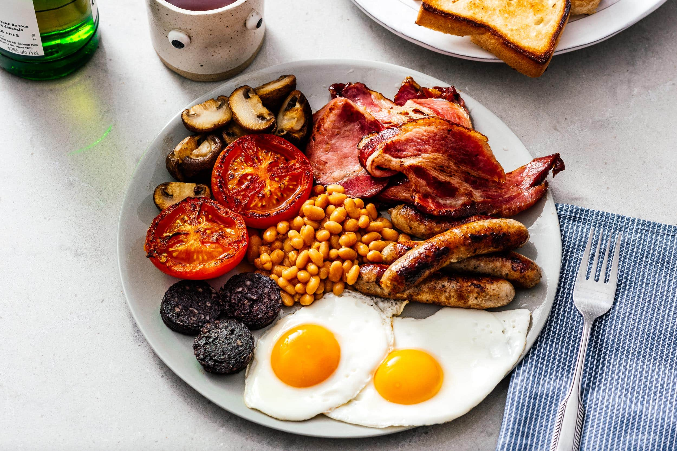
British Cuisine

Slide 5
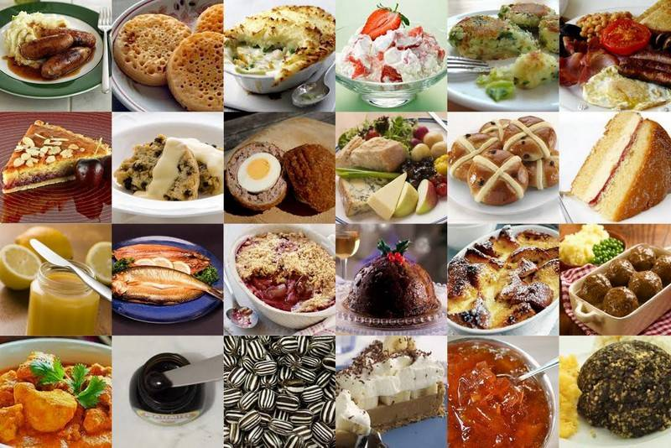
Introduction
Hello everybody! Today, I would like to talk to you about British cuisine.
British cuisine is simple, but delicious.
Let’s learn about some British food, and see what British people eat in a typical day.

Slide 6
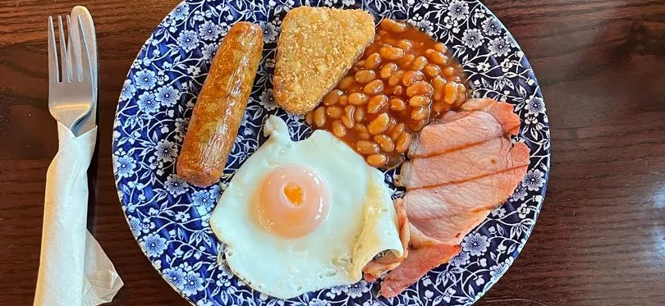
Breakfast – A full English breakfast
A full English breakfast is a delicious way to start the day. It is a plate of fried food, which may include:
Eggs (scrambled or fried)
Bacon
Sausage
Baked Beans
Toast
Mushrooms
Tomatoes
Hash browns
Black Pudding
Full English breakfasts can be huge, but they don’t always need to include everything!
A recent survey said that this is the most popular dish in the UK!

Slide 7

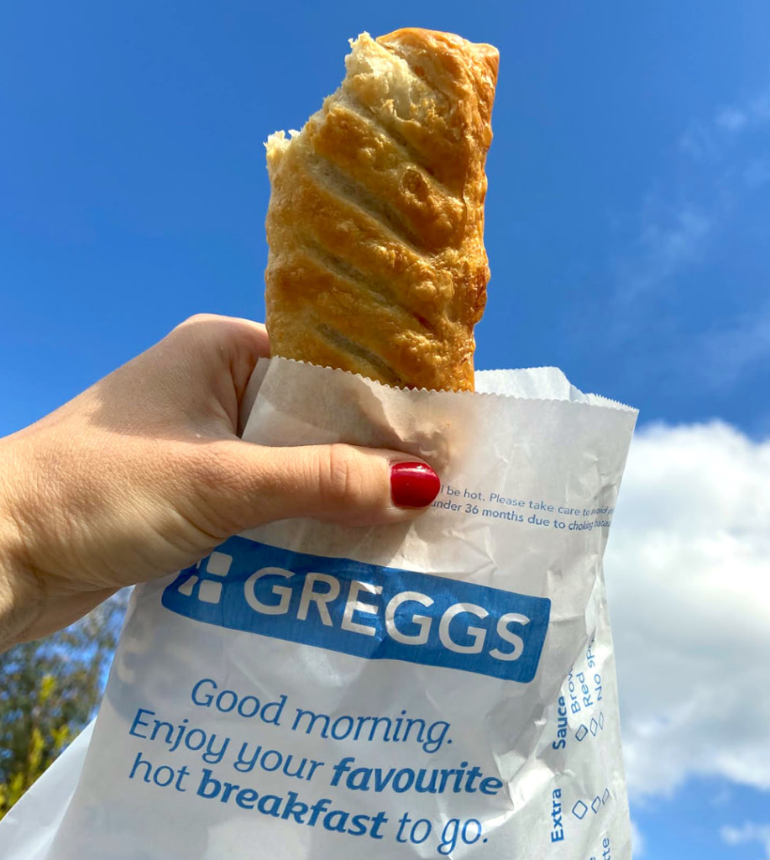
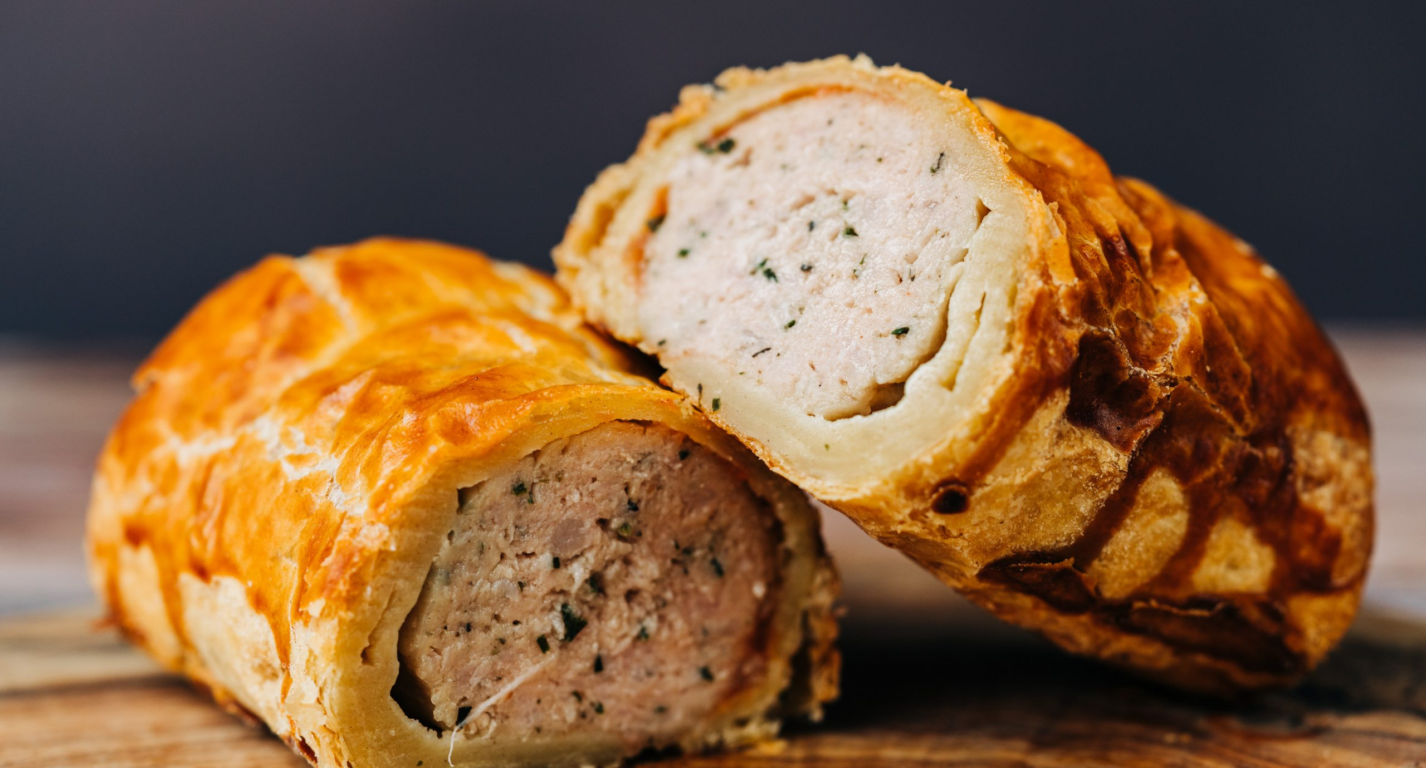
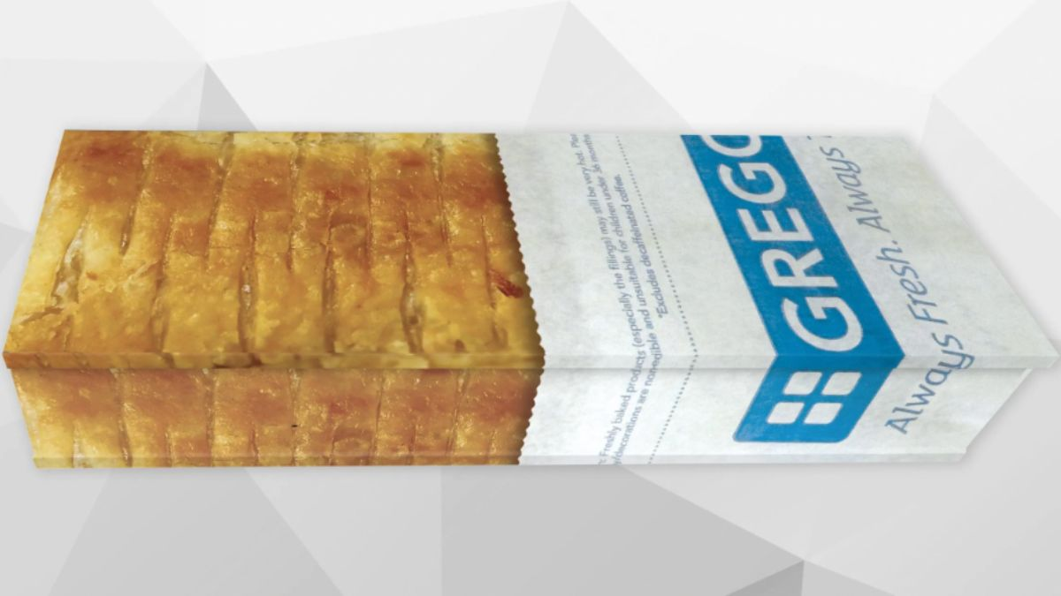
Morning snack – sausage roll
British people love pastries. There are thousands of bakeries across the country.
The most popular by far, is the chain bakery ‘Greggs’, and their most popular product is the sausage roll.
A sausage roll is made of sausage meat wrapped in puff pastry, and Greggs sells two and a half million EVERY DAY.
Sausage rolls are so important to British culture that they are featured in songs, clothing and more.
Can you guess what this is?

Slide 8


Slide 9
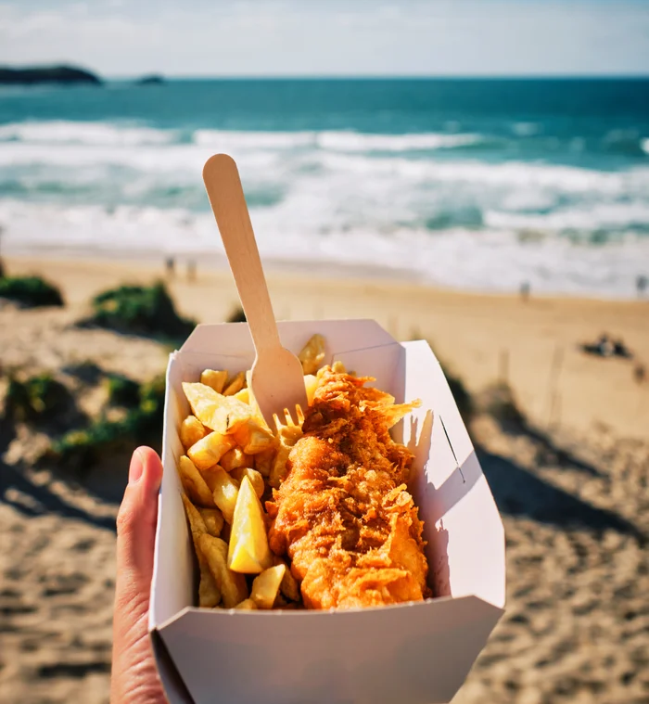
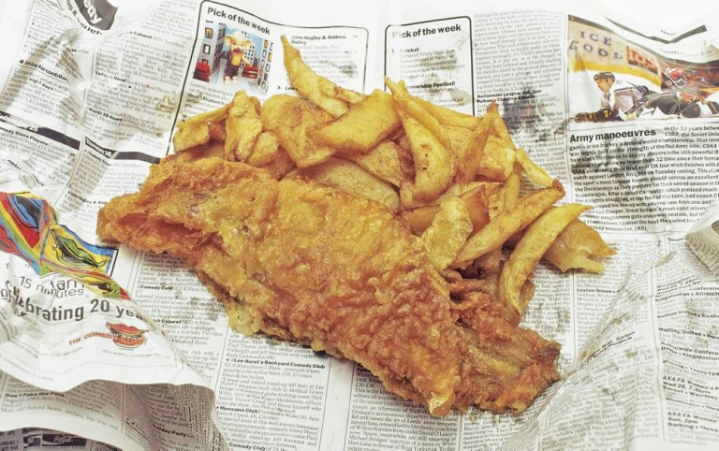
Lunch – fish and chips
Japanese people like to eat fish raw, but in the UK the most popular way to eat fish is deep fried, and served with chips.
The fish used is usually a big white fish, such as cod or haddock. The fish is deep fried and traditionally wrapped in newspaper with chips.
A fish and chip shop is called a ‘chippy’, and you can choose your favourite side sauce at most chippies.
Salt and malt vinegar is classic, but people in the north also go for gravy or curry sauce.
If you ever go to the UK, please go the the beach and have fish and chips!

Slide 10
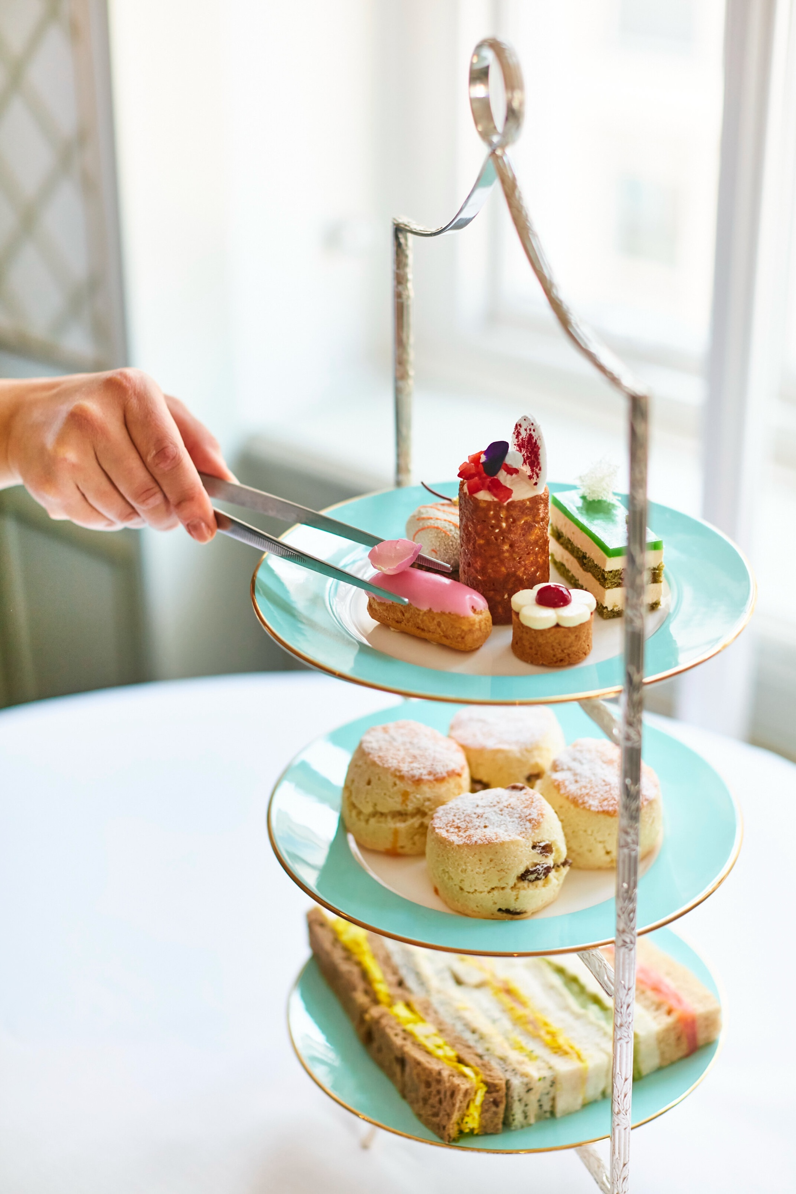
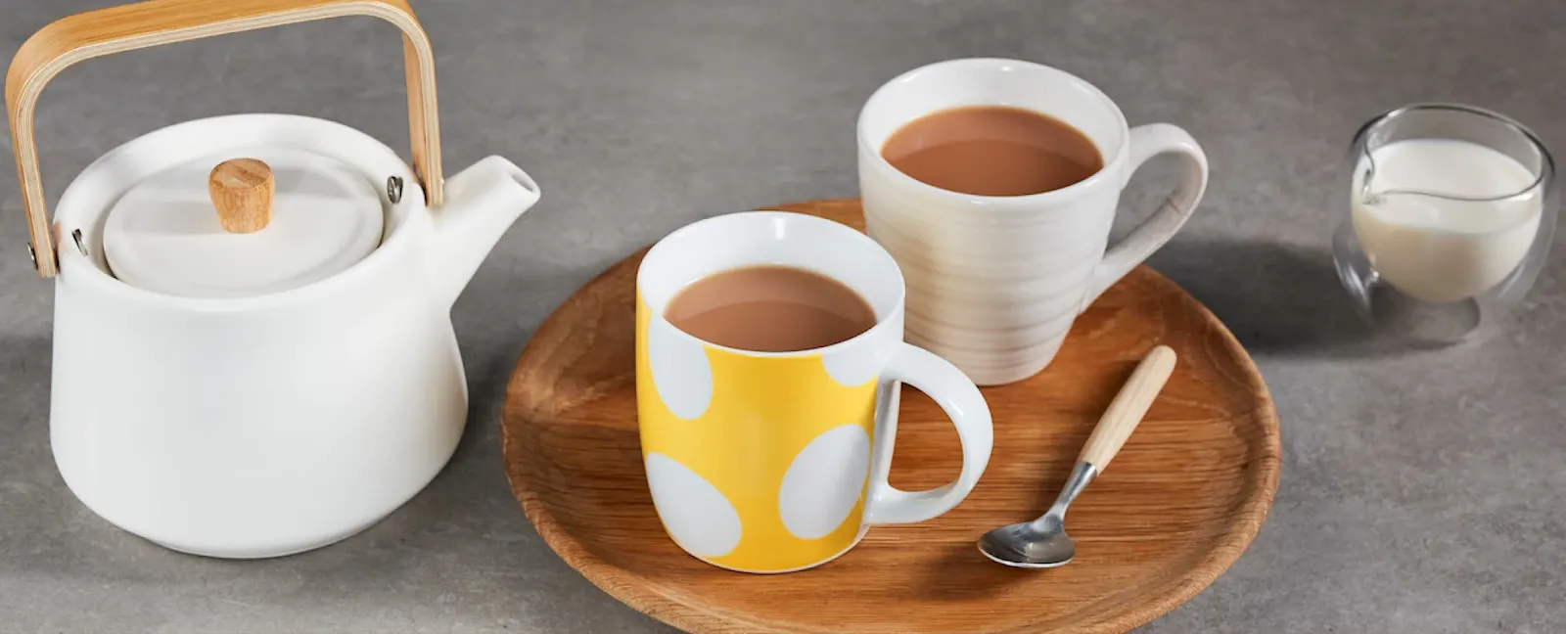
Afternoon snack – afternoon tea
Often in the afternoon, British people will have tea with biscuits or other snacks.
Tea in the UK is very different to tea in Japan: Tea in the UK is always black leaf tea, served with milk and ALWAYS served hot.
As well as biscuits, snacks can include scones, finger sandwiches and little sweets.
Of course, we also often drink tea on its own.

Slide 11
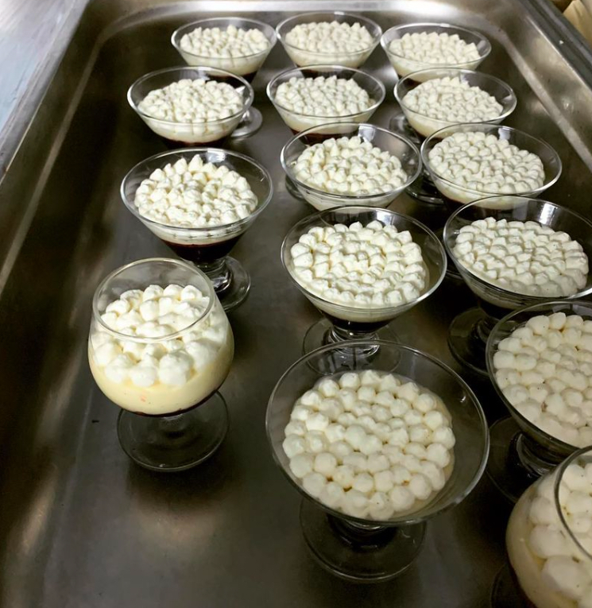
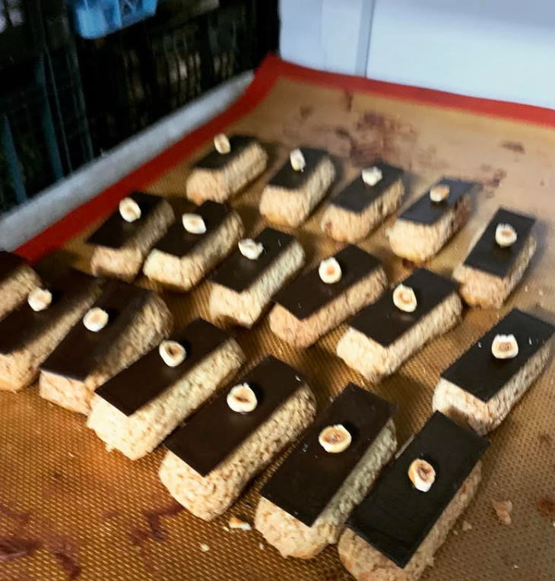

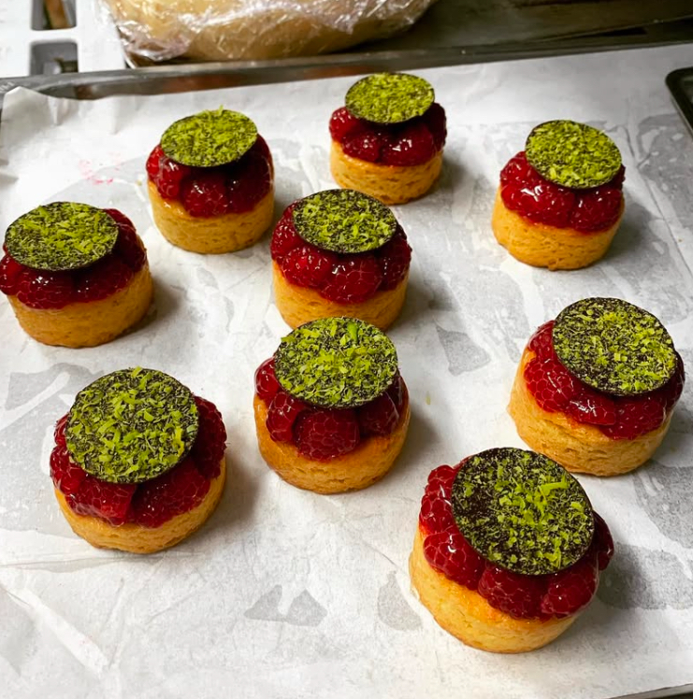

Slide 12
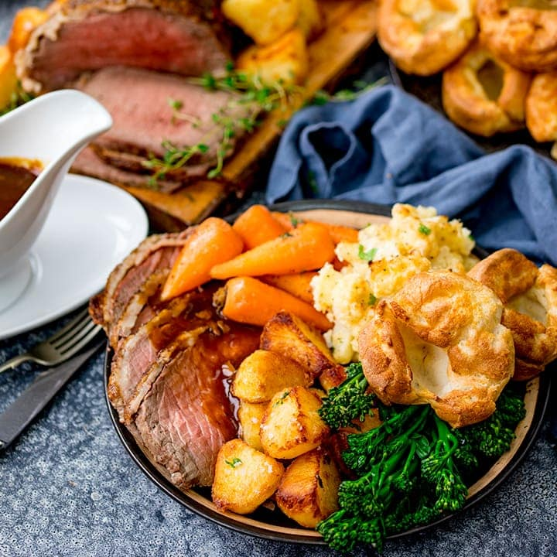
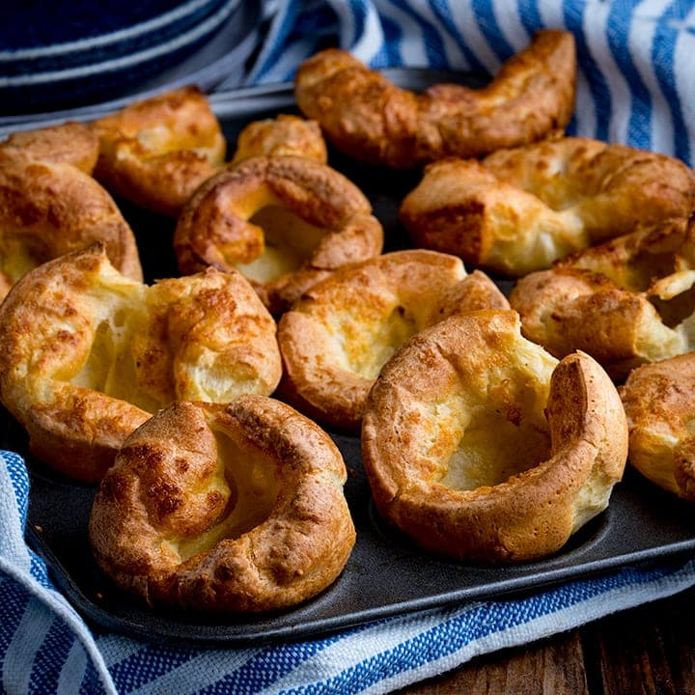
Dinner – roast dinner
‘Roast dinner’ (or ‘Sunday dinner’) is a major tradition in the UK. Every Sunday, families gather for a Sunday roast.
Sunday roast can be cooked at home, or eaten at a restaurant, and is usually had in the late afternoon.
A Sunday roast consists of:
Roasted meat (Chicken, beef, pork, or sometimes lamb)
Potatoes (Usually mashed, roasted or both)
Vegetables (For example, beans, carrots, broccoli, peas, cabbage)
Gravy
However, most peoples favourite part of a Sunday roast is a ‘Yorkshire pudding’. Yorkshire puddings are not sweet, but savoury deep fried batter that is used to mop up the gravy.

Slide 13
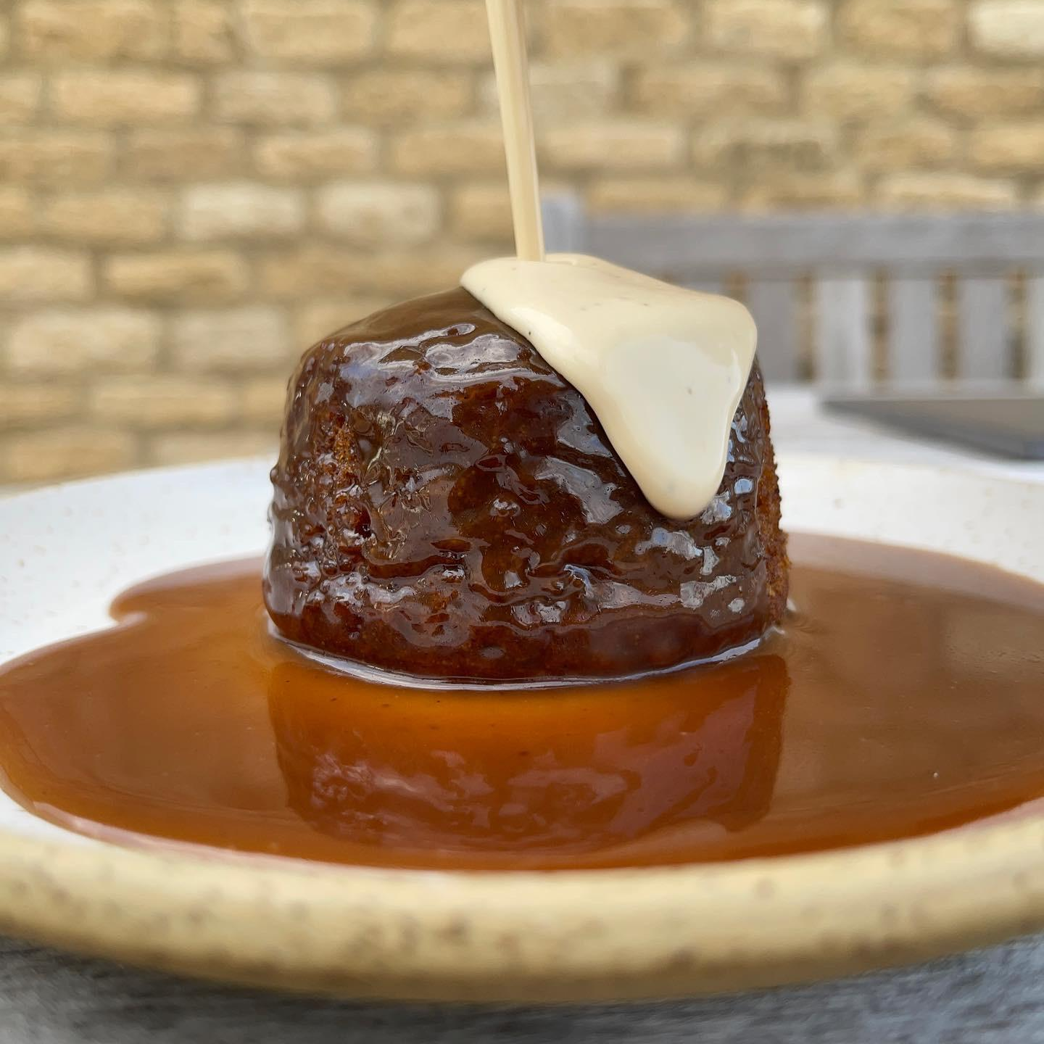
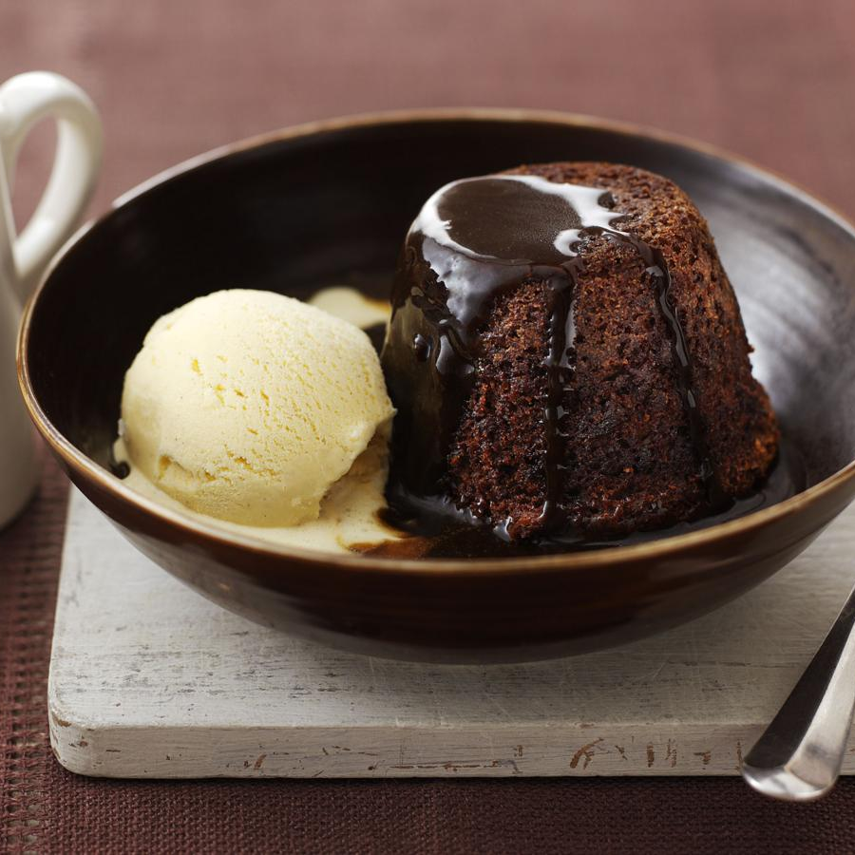
Pudding – sticky toffee pudding
In the UK, the word ‘pudding’ means any kind of dessert.
One of my favourites is sticky toffee pudding.
It is a rich, sticky sponge cake, made with dates.
You can eat it with hot custard or cold ice cream; I would recommend ice cream in the summer and custard in the winter!

Slide 14
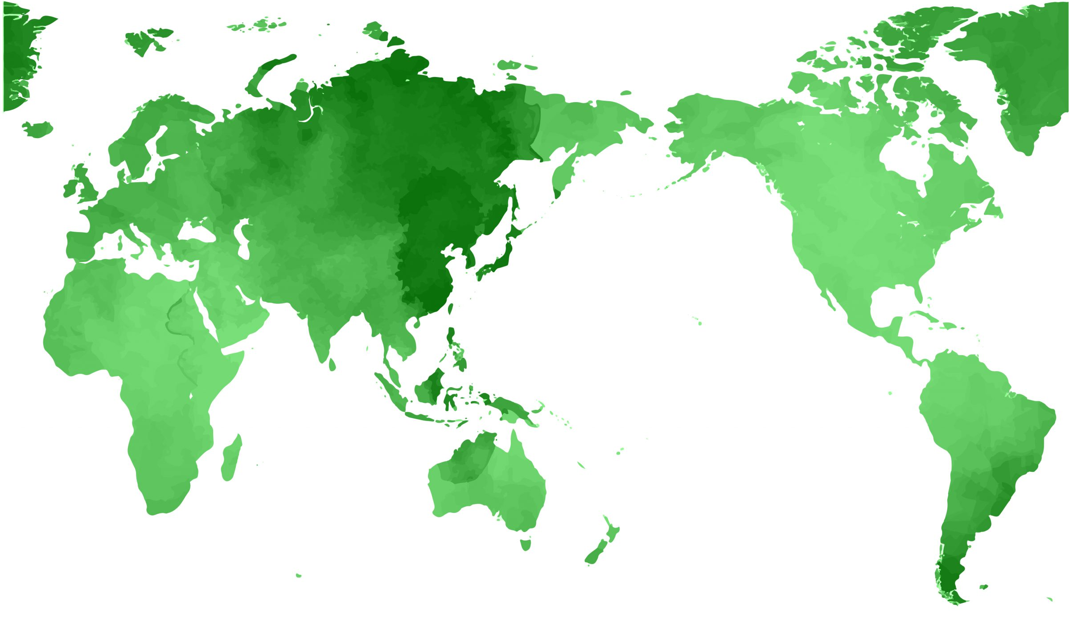

Slide 15
What Am I Cooking?
(私は何をつくっているでしょう？)

Slide 16
Question 1

Slide 17
Boil water and add salt.
(お湯をゆでて、塩を加えます。）

Slide 18
2. Put long, thin pasta in the boiling water.
(長くて細いパスタを沸騰したお湯にいれます。）

Slide 19
3. Cook the pasta until soft, then drain the water.
(パスタが柔らかくなるまでゆで、水を切ります。）

Slide 20
4. In a pan, cook bacon until crispy.
(フライパンで、ベーコンをカリカリになるまで炒めます。）

Slide 21
5. Mix eggs, cheese, and black pepper
in a bowl.
(卵、チーズ、塩コショウをボウルで混ぜます。）

Slide 22
6. Add the pasta to the bacon, turn off
the heat, and quickly mix in the egg
mixture.
(ベーコンにパスタを加え、火を止め、すぐに卵の混合物を
混ぜます。）

Slide 23
7. Stir until creamy and serve with extra
cheese on top.
(クリーミーになるまで混ぜ、仕上げにチーズをかけて完成！）

Slide 24
HINT
It’s an Italian dish with pasta, eggs, cheese, and bacon.
(イタリアの料理で、パスタ、卵、チーズ、ベーコンを使います。）

Slide 25
Question 2

Slide 26
Wash rice until the water is clear.
(米を水が透明になるまで洗います。）

Slide 27
2. Cook the rice and let it cool.
(ごはんを炊いて、冷まします。）

Slide 28
3. Mix vinegar, sugar, and salt, then stir
it into the rice.
(酢、砂糖、塩を混ぜ、ご飯に混ぜ込みます。）

Slide 29
4. Slice raw fish and other toppings.
(生の魚や、その他のトッピングを切ります。）

Slide 30
5. Put the rice in small, hand-sized
shapes.
(ご飯を小さなサイズに形作ります。）

Slide 31
6. Place the raw fish or other toppings
on the top of the rice.
(生魚やトッピングをごはんの上にのせます。）

Slide 32
7. Serve with soy sauce, wasabi, and pickled
ginger.
(醤油、わさび、がりと一緒に提供します。）

Slide 33
HINT
It’s a Japanese dish made with raw fish and vinegared rice.
(日本の料理で、生魚と酢飯を使います。）

Slide 34
Question 3

Slide 35
1. Cook ground beef with onions and garlic.
(牛ひき肉を玉ねぎとニンニクで炒めます。）

Slide 36
2. Add chili powder, cumin, and tomatoes.
(チリパウダー、クミン、トマトを加えます。）

Slide 37
3. Warm up round, flat corn or flour tortillas.
(丸くて平たいトルティーヤを温めます。）

Slide 38
4. Spoon the beef mixture onto the tortillas.
(トルティーヤに肉の混合物をのせます。）

Slide 39
5. Add toppings like lettuce, cheese, salsa,
and sour cream.
(レタス、チーズ、サルサ、サワークリームなどをトッピング
します。）

Slide 40
6. Fold the tortillas and serve.
(トルティーヤを折りたたんで完成！）

Slide 41
HINT
It’s a Mexican dish often served with various fillings wrapped in tortillas.
(様々な具材をトルティーヤで包んで食べるメキシコ料理です。）

Slide 42
Question 4

Slide 43
1. Cook basmati rice until soft and fluffy. (パスマティライスを柔らかくふわふわになるまで炊きます。）

Slide 44
2. In a pan, cook onions, garlic, ginger, and
spices like cumin, turmeric, and garam
masala.
(フライパンで玉ねぎ、ニンニク、ショウガ、クミン、
ターメリック、ガラムマサラなどのスパイスを炒めます。）

Slide 45
3.Add chicken pieces and cook until brown.
(鶏肉を加え、茶色くなるまで炒めます。）

Slide 46
4. Pour in yogurt and simmer until the
chicken is tender.
(ヨーグルトを加え、鶏肉が柔らかくなるまで煮込みます。）

Slide 47
5. Stir in fresh coriander and serve with the rice.
(新鮮なコリアンダーを混ぜ、ライスと一緒に提供します。）

Slide 48
HINT
It’s an Indian dish with lots of spices.
(たくさんのスパイスを使ったインド料理です。）

Slide 49
Question 5

Slide 50
Cook pho noodles in boiling water until
soft.
(フォー（米の麺）をお湯でゆでて柔らかくします。）

Slide 51
2. In a pot, cook ground pork with garlic and
onions.
(鍋で豚ひき肉とニンニクと玉ねぎを一緒に炒めます。）

Slide 52
3. Add tomatoes, fish sauce (namp la), and
chili paste, and stir.
(トマト、ナンプラー、チリペーストを加えて混ぜます。）

Slide 53
4. Pour in broth and simmer until flavors blend.
(出汁を加えて、味がなじむまで煮込みます。）

Slide 54
5. Serve the noodles in a bowl, pour the soup
over them, and top with fresh herbs.
(麺をボウルに入れ、スープをかけ、上に新鮮なハーブをの
せて提供します。）

Slide 55
HINT
It’s a famous Laotian and Thai noodle soup with a fish sauce broth, pork, and fresh herbs.
(ラオスやタイの有名な麺スープで、魚醤のきいたスープと豚肉、ハーブが特徴です。）

