Slide 1

Sustainable Tourism
(持続可能な観光）

Slide 2

① Understand the “sustainable tourism(持続可能な観光)”
② Consider the Tourism Challenges of Hakata Island
GOAL
1
・Where would you like to go during the winter vacation?
・Let’s think about the case of “Mt. Fuji”!
2
・The pros and cons of increasing tourism
・Let’s think about the case of “Luang Prabang”
3
・What can we do as tourists?
・What can we do to promote & protect the tourism of Hakata Island?
4
・[Writing]
The ways to protect the tourism of Hakata Island

Slide 3
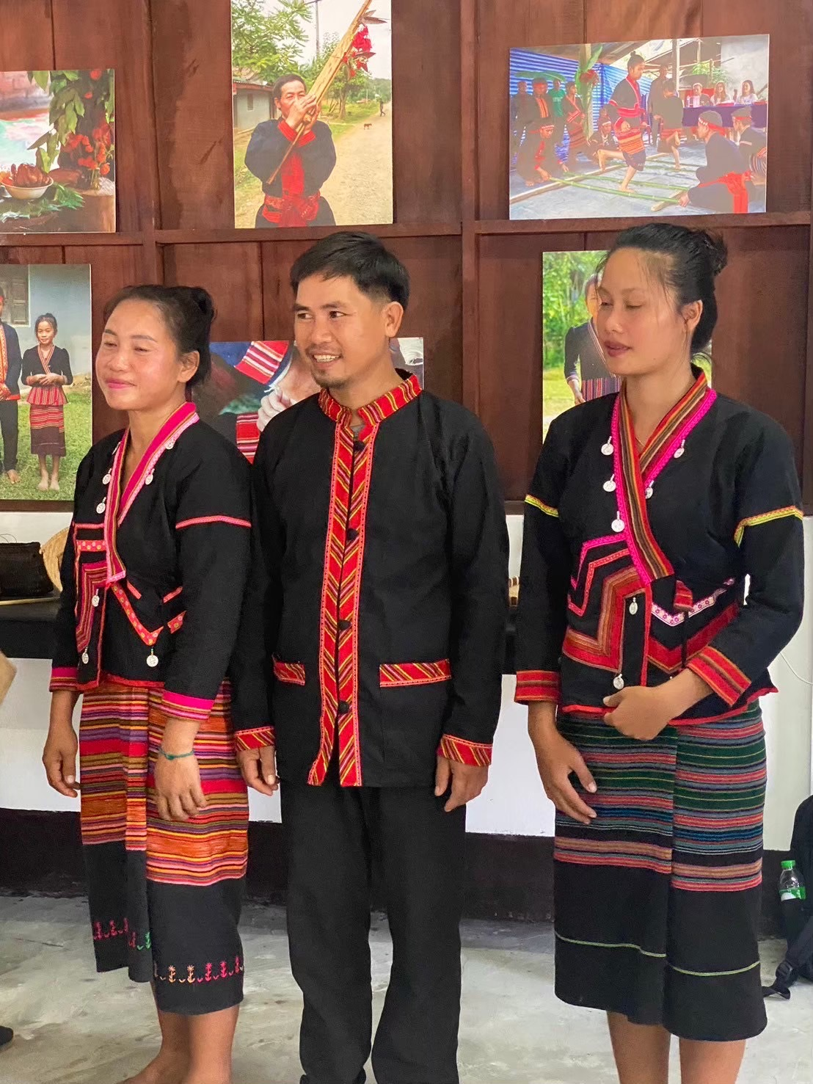
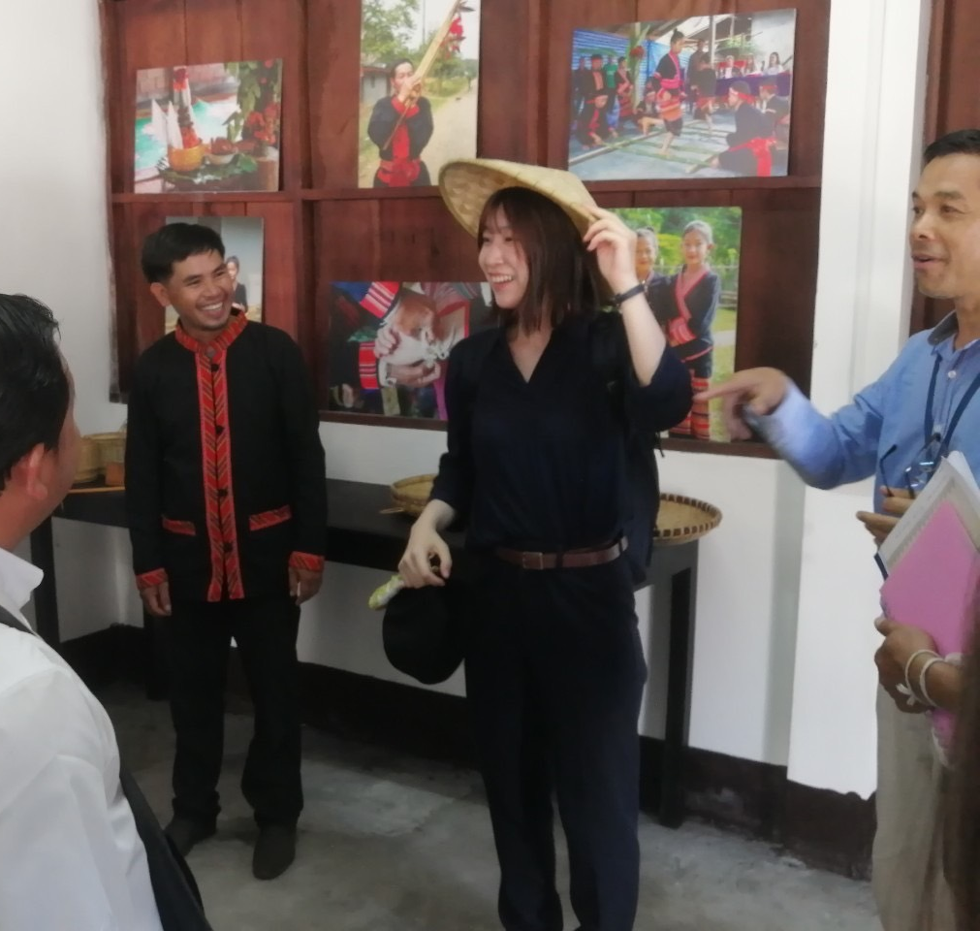

Slide 4
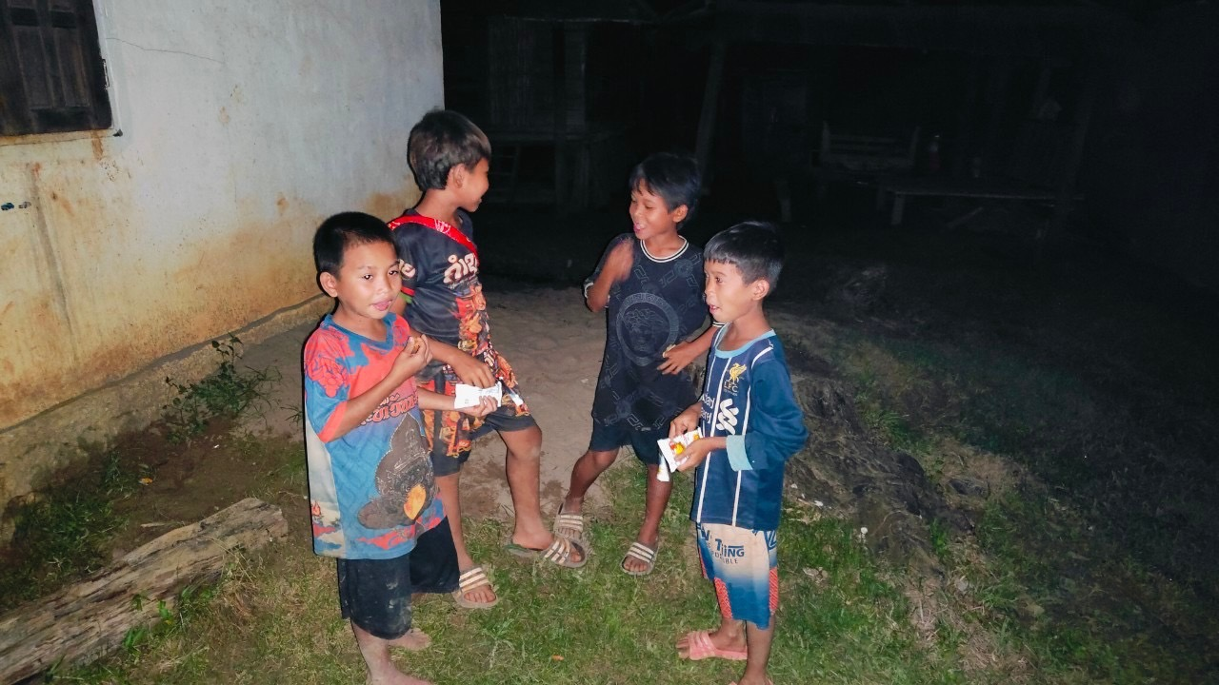

Slide 5
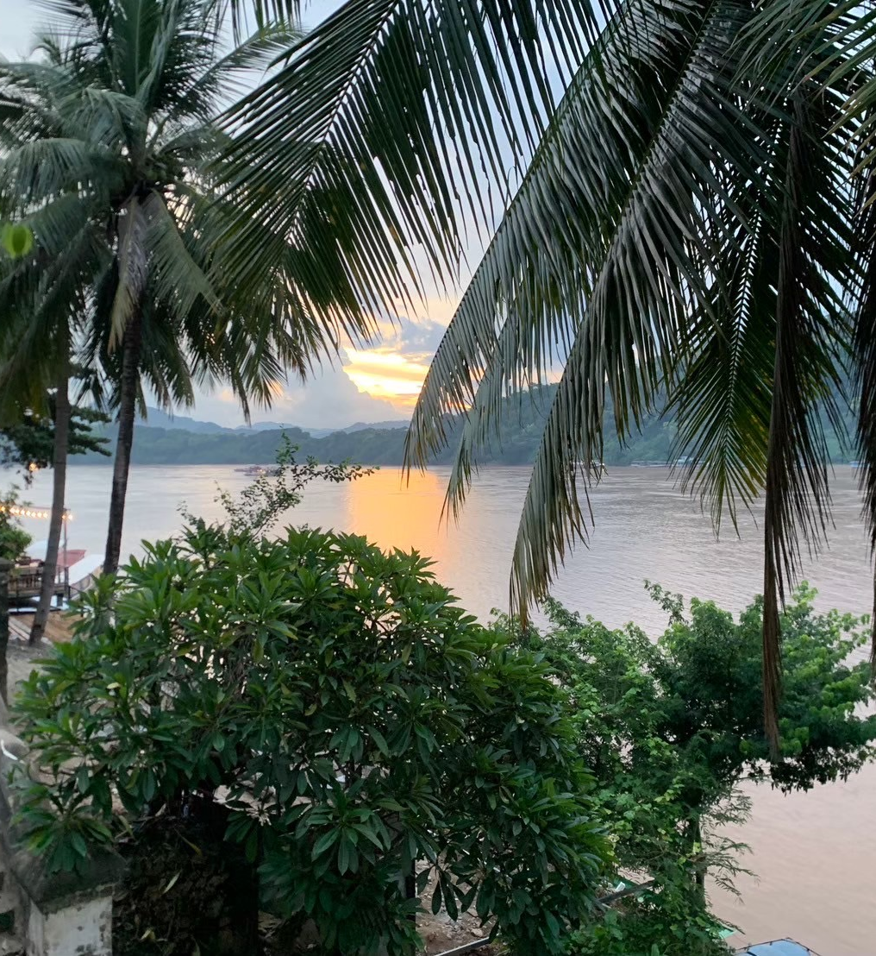
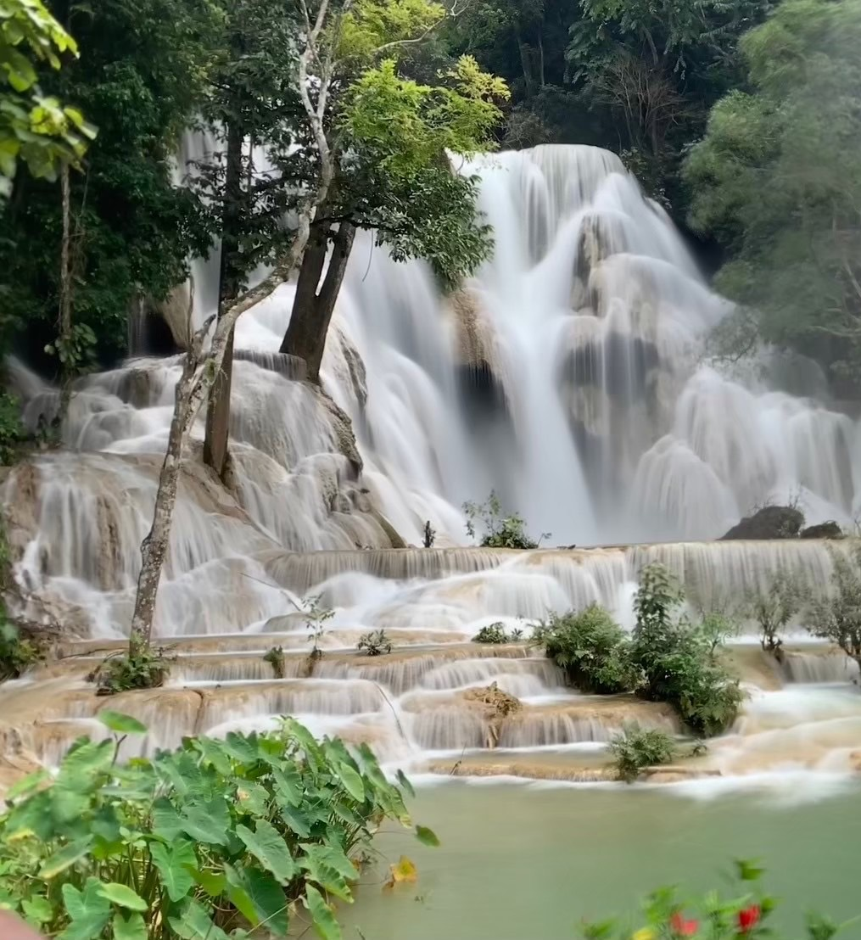

Slide 6
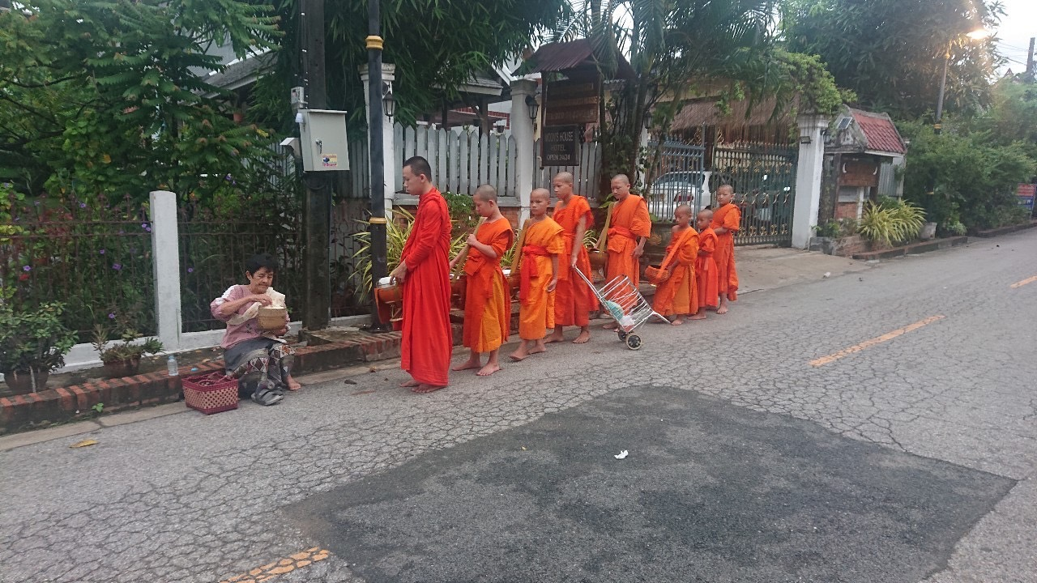

Slide 7
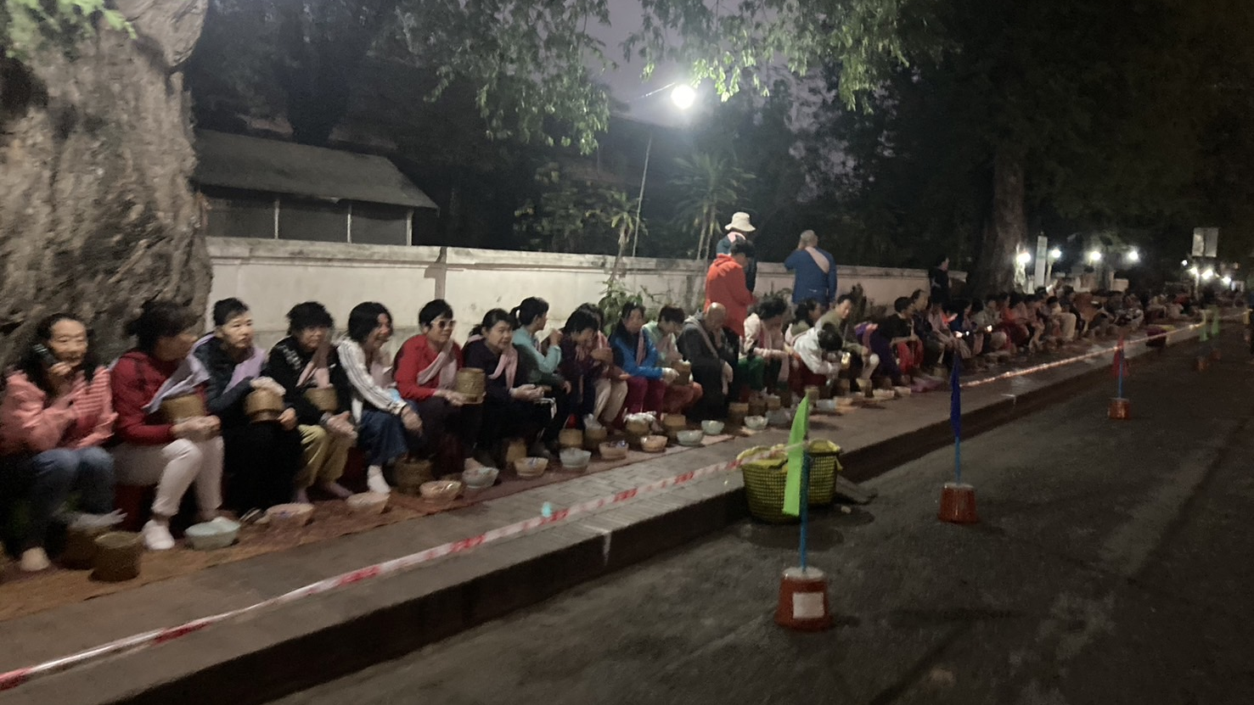

Slide 8
