Slide 1

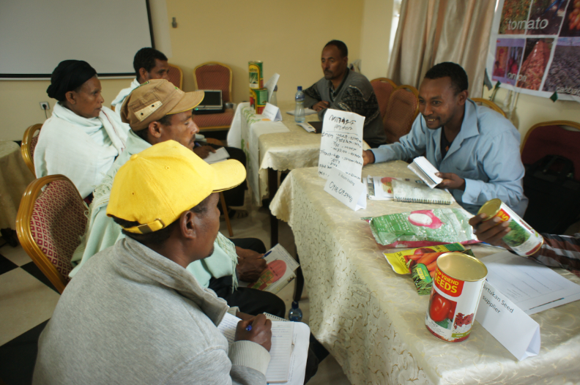

Stakeholder Forum
Methods of Implementation
Type the name of your organization here.
Please note that holding a Stakeholder Forum is not mandatory. Please implement it If your organization has enough human and financial resources.

Slide 2
WHERE ARE WE?: Stakeholder Forum in SHEP’s 4 Steps
4 Steps | Activities
1. Share goal with farmers. | Sensitization Workshop
2. Farmers’ awareness is raised. | Participatory Baseline Survey (optional) Stakeholder Forum Market Survey
3 . Farmers make decisions. | Target Crop Selection Crop Calendar Making
4. Farmers acquire skills. | In-field trainings
Follow-up and monitoring (including Participatory Endline Survey)
Stakeholder Forum as a way to raise farmers’ awareness.

Slide 3
PART 1: CONCEPT

Slide 4















WHY?: Objectives of Stakeholder Forum
Stakeholder Forum has two purposes.
  It shows farmers a business opportunity which horticultural farming can bring to them.
  It helps farmers to establish business linkages with a variety of market actors involved in horticulture business.

Slide 5

WHAT?: Outline of Stakeholder Forum
The half-day Stakeholder Forum invites both farmer representatives and market stakeholders (agricultural input suppliers, buyers, food processing companies, crop exporters, transporters, financial institutions, NGOs, etc.).
The farmer representatives visit the booths of the market stakeholders and exchange information through business talks.

Slide 6

HOW?: Key Implementation Tips
The forum should restrict the number of participants for facilitating easier communication between selected participants.
Only those market stakeholders, such as those local traders, who would become future business partners of the SHEP farmer groups should be invited.
Raising Motivation

Slide 7


HOW?: Key Implementation Tips
The extension staff should help farmers have active business talks with market stakeholders.
Profiles of the participants should be exchanged beforehand so that the participants can start business talks right away without wasting too much time at the Forum.
Raising Motivation
Raising Motivation

Slide 8
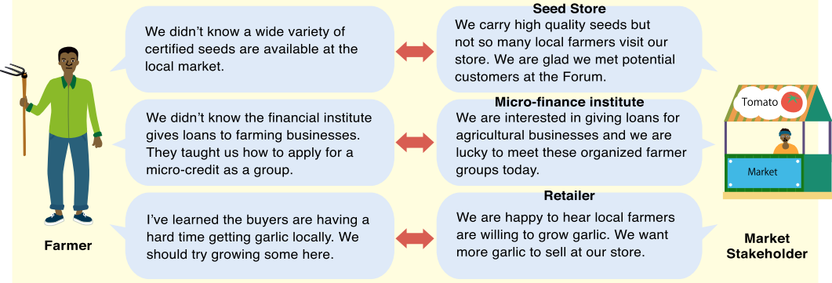
Mitigating Asymmetric Information
Stakeholder Forum tries to mitigate information gaps between farmers and market stakeholders.

Slide 9
PART 2: PRACTICE

Slide 10
STEP: Implementation Procedures
(Preparation) Reserve a conference room for holding the Stakeholder Forum. [Tip!] Use a government facility as a venue for the forum to reduce costs.
(Preparation) Identify and invite local market stakeholders to the Forum. [Tip!] Invite only those stakeholders who are interested in trading with smallholder farmers.
(Preparation)Ask farmer groups to choose four [modify the number as needed] representatives (both male and female) to attend the forum.
(Preparation) Exchange profiles of the participants before the Forum day. Ask farmer groups to bring samples of their produce to be displayed to the Forum.

Slide 11
STEP: Implementation Procedures
(Preparation) At the forum venue, prepare booths with enough tables and chairs for all the participants. [Tip!] Prepare enough seats so that the participants can focus on their discussions.
During the Forum, the farmer representatives, accompanied by the extension staff, visit booths of the market stakeholders to exchange information and have business talks.
After the Forum, the group representatives organize a feedback meeting at their group to share what they have learned during the Forum.

Slide 12
CHECKLIST: Points to be Confirmed after Stakeholder Forum
The group members are informed of the findings and results of the forum by their farmer representatives.
The target farmers understand various business opportunities of horticultural agriculture.
The target farmers widen their business networks with market stakeholders invited to the forum.
The target farmers maintain contacts with the market stakeholders invited to the forum.
The male-female ratio of market stakeholders is balanced.
The male-female ratio of the farmer representatives is balanced.
The male-female ratio of the participants in the feedback meeting is balanced.

Slide 13
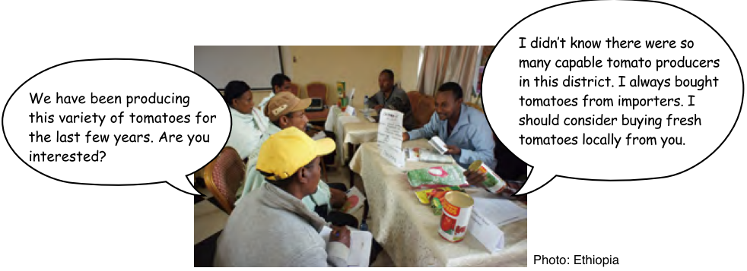
Stakeholder Forum in Action

Slide 14

TROUBLESHOOTING
What if the market stakeholders are not willing to participate in the Forum? → If the Forum is not attractive enough for the business people, they will not take part. Try to make the Forum worth attending for business people. For example, increasing the number of farmer groups attending the Forum can be a solution if the limited number of groups is the main reason for unattractiveness.
Discussions are not so active.→ Extension staff need to assist farmers proactively to facilitate active discussions.
Discussions are not constructive. The participants complain to each other. → It should be made clear right from the beginning that the participants should focus on solutions to the problems in order to create a win-win situation.

Slide 15
Way Forward: Implementation Schedule, Reporting, add any other necessary info. here

