Slide 1




Crop Calendar Making
Methods of Implementation
Type the name of your organization here.

Slide 2
WHERE ARE WE?: Crop Calendar Making in SHEP’s 4 Steps
4 Steps | Activities
1. Share goal with farmers. | Sensitization Workshop
2. Farmers’ awareness is raised. | Participatory Baseline Survey (optional) Stakeholder Forum Market Survey
3 . Farmers make decisions. | Target Crop Selection Crop Calendar Making
4. Farmers acquire skills. | In-field trainings
Follow-up and monitoring (including Participatory Endline Survey)
Crop Calendar Making is where the farmers make decisions.

Slide 3
PART 1: CONCEPT

Slide 4


WHY?: Objectives of Crop Calendar Making
Crop Calendar Making enables the farmer group to plan future action as a group in terms of;
(1) production and,
(2) Marketing
of the target crops.

Slide 5
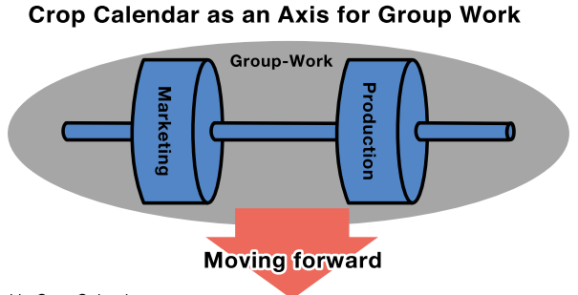
WHAT?: Outline of Crop Calendar Making
The farmer groups make an annual plan of production and marketing activities for the target crops.
The plan includes collective actions as a group for better production and marketing of the target crops.

Slide 6
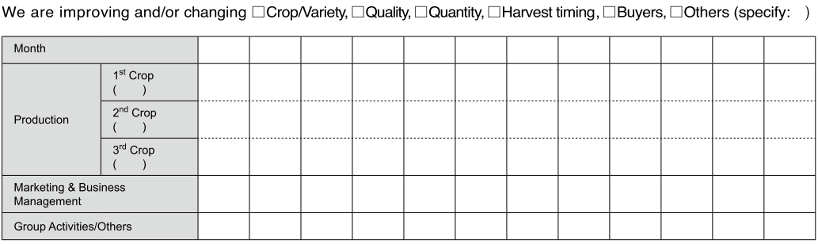
FORMAT: Crop Calendar
The farmer groups decide what they want to change (e.g. variety, quantity, quality, timing, buyers, etc.)
They identify monthly actions on production, marketing (incl. business management) and group activities.

Slide 7
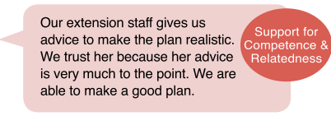

HOW?: Key Implementation Tips
The farmer groups discuss and decide the best annual production and marketing plan for generating more income from horticulture.
The extension staff ensures that the plan is realistic and sustainable taking into consideration the current capacity of the farmer group.
Raising Motivation
Raising Motivation

Slide 8
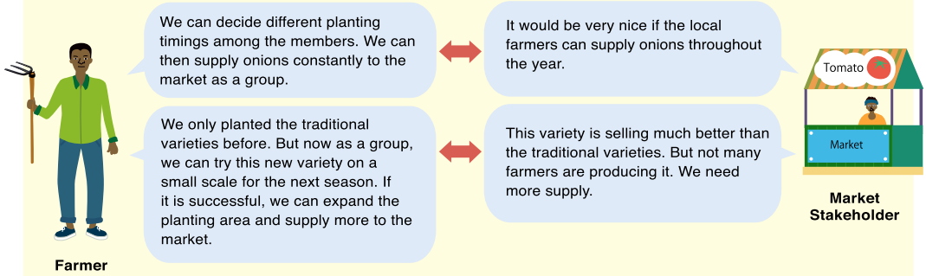
Mitigating Asymmetric Information
Planning well using the Crop Calendar mitigates information gaps between farmers and market stakeholders.

Slide 9
PART 2: PRACTICE

Slide 10
STEP: Implementation Procedures
Organize a meeting at the community and invite the group members as well as their spouses. [Tip!] Inviting the members’ spouses facilitate effective decision-making.
Ask the farmer groups to decide what changes they want to make with regard to the target crops; e.g. changes in crops/varieties, quality, quantity, harvest timing, buyers, and others such as packaging.
The farmer groups make an annual plan specifying monthly actions in terms of (1) production, (2) marketing & business management, and (3) other group activities focusing on the target crops. [Tip!] The extension staff should remind the farmers of various market information the farmers have collected so far.

Slide 11
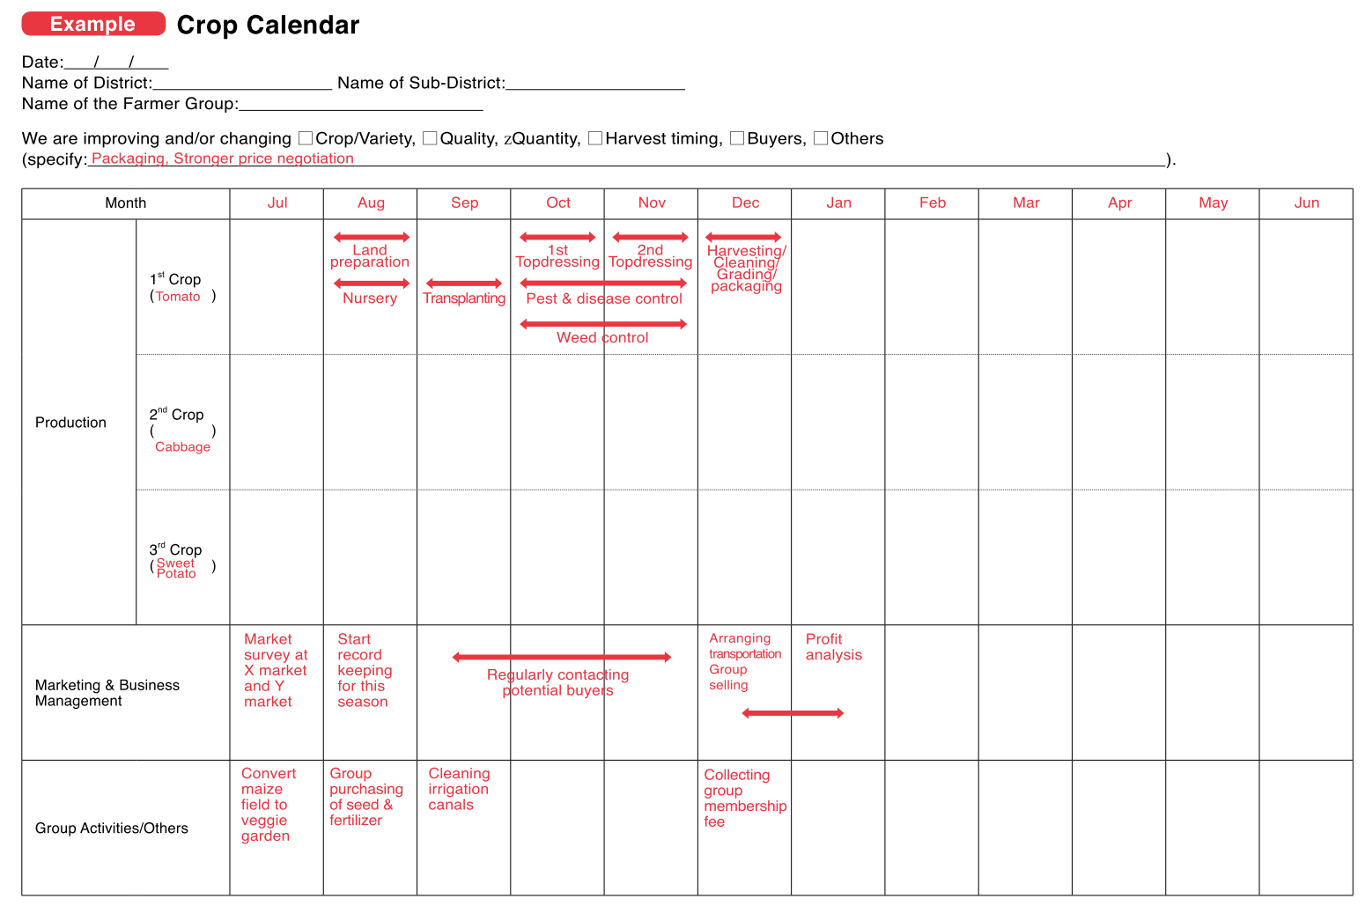
Crop Calendar
What changes and improvements do the farmer group want to make?
Production plan on the target crops
Marketing and business management plan
Other group activities

Slide 12
CHECKLIST: Points to be Confirmed after Crop Calendar Making
The target farmers understand the methods of crop calendar making.
Each one of the group members understands what specific actions and roles he or she will be taking in accordance with the group’s crop calendar.
The target groups agree to undertake crop calendar making on a regular basis by themselves in the future.
The male-female ratio of the participants is balanced.
The quality of participation of male and female members in decision-making is ensured.
(optional) The members’ spouses are involved.

Slide 13
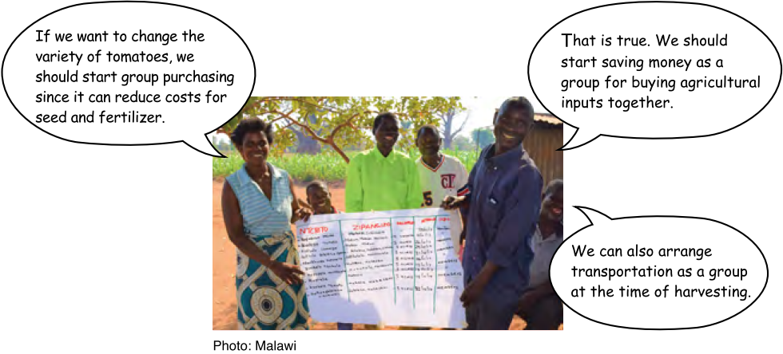
Crop Calendar Making in Action

Slide 14

TROUBLESHOOTING
Do all the farmers need to plant the same crops at the same time by making the Crop Calendar?→Not necessarily. For example, the group can agree to stagger planting timing among the members.
The farmers already planted crops when the Crop Calendar making meeting was organized. → Ideally, the Crop Calendar should be made before the planting season starts. If it is not possible to do so, encourage the farmers to produce the crops in the next season.

Slide 15
Way Forward: Implementation Schedule, Reporting, add any other necessary info. here

