Slide 1

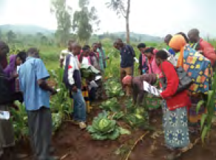

In-field Trainings
Methods of Implementation
Type the name of your organization here.

Slide 2
WHERE ARE WE?: In-field Trainings in SHEP’s 4 Steps
4 Steps | Activities
1. Share goal with farmers. | Sensitization Workshop
2. Farmers’ awareness is raised. | Participatory Baseline Survey (optional) Stakeholder Forum Market Survey
3 . Farmers make decisions. | Target Crop Selection Crop Calendar Making
4. Farmers acquire skills. | In-field trainings
Follow-up and monitoring (including Participatory Endline Survey)
In-field Trainings are where the farmers acquire new skills and knowledge.

Slide 3
PART 1: CONCEPT

Slide 4

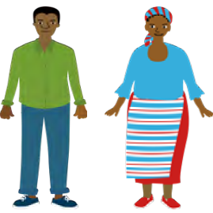
WHY?: Objectives of In-field Training
In-field Trainings are designed to teach practical skills and knowledge for producing the target crops the farmers have chosen.
It is a demand-driven training.

Slide 5
WHAT?: Outline of In-field Training
The extension staff organizes training sessions where the target farmers learn skills, techniques and knowledge necessary for the production of the target crops.
The training should be practical and conducted at the farmers’ fields or in their vicinity with ample demonstrations and exercises.

Slide 6

HOW?: Key Implementation Tips
The training should address the needs of the farmers. Spend more time where farmers need more training and spend less time if the farmers are already familiar with the topics.
Raising Motivation

Slide 7


HOW?: Key Implementation Tips
The training should be conducted using easy-to-understand training materials.
Raising Motivation
The training should be conducted truly by a demand-driven approach.
Raising Motivation

Slide 8
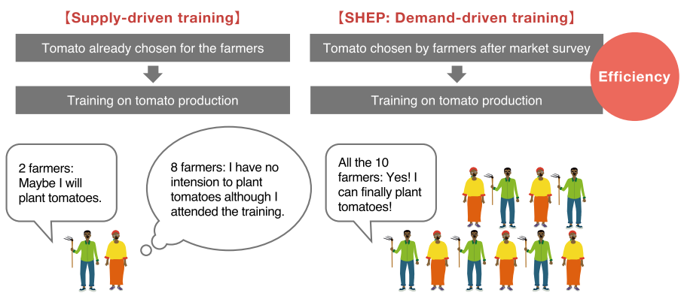
Advantage of Demand-driven Training
The farmers’ adoption rate of the new techniques would be significantly higher than supply-driven trainings.

Slide 9
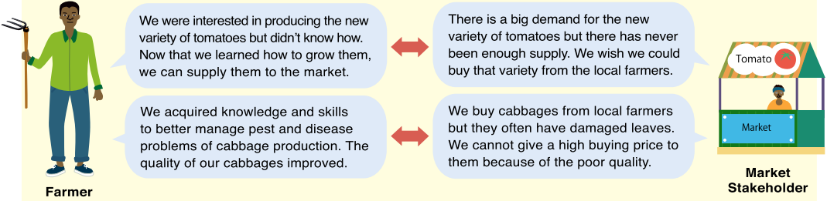
Mitigating Asymmetric Information
Providing In-field Training, which is a demand-driven training, mitigates information gaps between farmers and market stakeholders.

Slide 10
PART 2: PRACTICE

Slide 11
STEP: Implementation Procedures
(Preparation) The extension staff should learn knowledge and skills necessary for teaching farmers. If they need more training, Training of Trainers (TOT) for extension staff before training for farmers should be conducted.
The extension staff organizes training sessions composed of lectures, exercises and demonstrations for each topic using effective teaching materials. [Tip!] Invite the members’ spouses to the training if they are engaged in horticulture production.
The topics of the training should exactly match the needs of the target crop production and farmers’ capacity development needs. The training topics can be categorized into three areas:
    (1) general horticultural crops production and post-harvest handling techniques
    (2) crop-specific production techniques
    (3) managerial skills such as bookkeeping, crop budgeting, and farm record keeping.

Slide 12
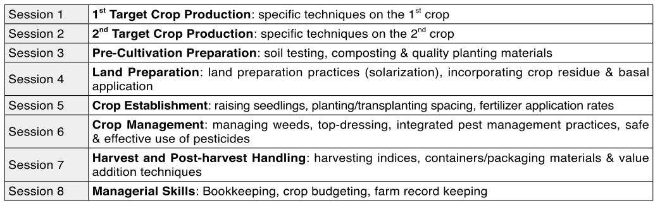
In-field Training Module (Example)
Specific to the target crops
General horticultural skills
Managerial skills

Slide 13
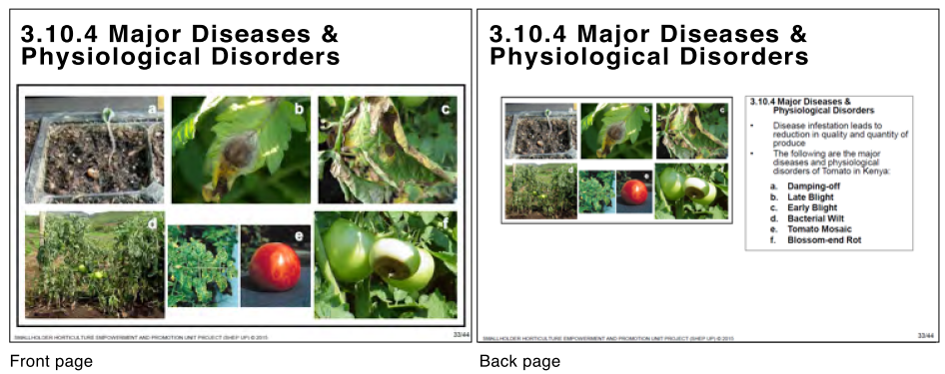
In-field Training Material (Example)
Farmers look at the front page
Extension staff read the information on the back page.

Slide 14
CHECKLIST: Points to be Confirmed after In-field Training
The target farmers understand and acquire technical knowledge and skills taught in the trainings.
The target farmers do not face any technical, financial or social difficulties applying techniques taught in the trainings. (If they do, identify the problems, consult them and give appropriate guidance to them.)
Male-female ratio of the participants is balanced.
Participation of the members’ spouses is encouraged.
Gender stereotype and gender-insensitive training methods and materials are avoided.
Sufficient consideration is given to illiterate farmers in designing training methods.
Labor-saving techniques or tools/ equipment, especially for women’s benefit, are introduced.

Slide 15
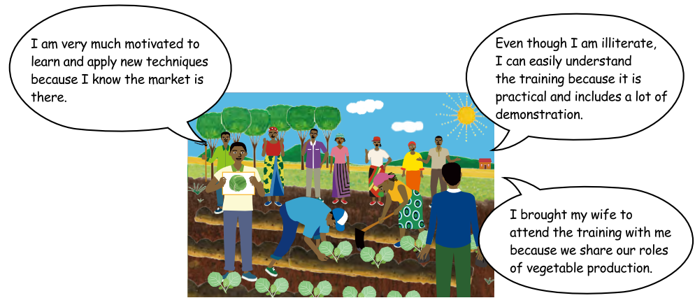
In-field Training in Action

Slide 16

TROUBLESHOOTING
What if the farmers have difficulties in understanding?→ Try to make the training as practical as possible. For example, use a language easy for them to understand, choose user-friendly training materials, show techniques by conducting plenty of demonstrations.
What if the farmers are too busy to attend the trainings? → Ideally, the In-field Trainings should be conducted before the farmers become busy planting crops. However, when such an arrangement is not possible, try organizing trainings when farmers’ availability is high.

Slide 17
Way Forward: Implementation Schedule, Reporting, add any other necessary info. here

