Slide 1

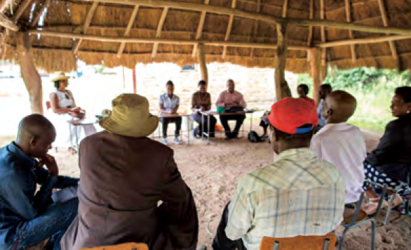

Follow-up and Monitoring
Methods of Implementation
Type the name of your organization here.

Slide 2
WHERE ARE WE?: Follow-up and Monitoring in SHEP’s 4 Steps
4 Steps | Activities
1. Share goal with farmers. | Sensitization Workshop
2. Farmers’ awareness is raised. | Participatory Baseline Survey (optional) Stakeholder Forum Market Survey
3 . Farmers make decisions. | Target Crop Selection Crop Calendar Making
4. Farmers acquire skills. | In-field trainings
Follow-up and monitoring (including Participatory Endline Survey)
Follow-up and Monitoring are when the farmers review what they have learned and achieved.

Slide 3
PART 1: CONCEPT

Slide 4

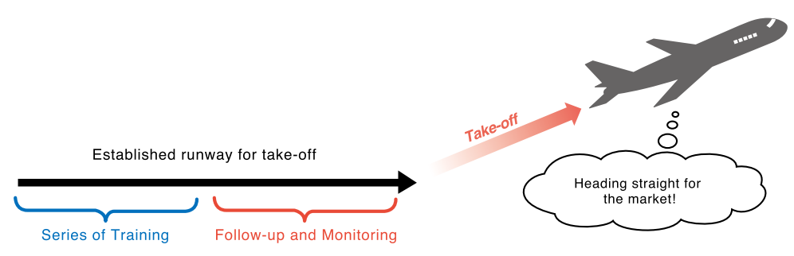
WHY?: Objectives of Monitoring and Follow-up
Aims at ensuring farmers’ actual application of taught techniques and knowledge.
Not only look at farmers’ production practices but also assess their progress of marketing and other collective work as a group.
Follow-up and Monitoring ensures that the farmers’ learning during the SHEP trainings truly sticks in their minds.

Slide 5

WHAT?: Outline of Monitoring and Follow-up
Periodically visit farmers to ensure they are applying the knowledge they have learned.
Monitor the progress of activities described in the groups’ Crop Calendars.
Participatory Endline Survey is conducted using almost the same survey formats as the Participatory Baseline Survey.
The Endline Survey data is analyzed for the purpose of comparison with the results of the Baseline Survey.

Slide 6
FORMAT: Endline Survey Questionnaire Forms
Endline Survey Part 1- Production, Income and Cost
The same form as Baseline Survey Form except for the columns where the farmers are asked to write
information on what changes they have made after SHEP

Slide 7
FORMAT: Endline Survey Questionnaire Forms
Endline Survey Part 2- Agricultural Techniques
The same form as Baseline Survey Form except for the columns where the farmers are asked to write
information on what changes they have made after SHEP

Slide 8

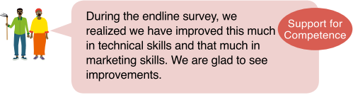
HOW?: Key Implementation Tips
Follow-up and Monitoring visits should help the farmer group “take off” to become self-reliant farmers who can practice market-orient agriculture on their own initiatives.
The Participatory Endline Survey should give the farmers opportunities to confirm how much they have improved through their experience in participating in SHEP.
Raising Motivation
Raising Motivation

Slide 9
PART 2: PRACTICE

Slide 10
STEP: Implementation Procedures
Visit the farmer groups periodically to give advice and monitor the progress of activity implementation.
Refer to the results of “Baseline Survey Part 2- Agricultural Techniques” and judge how much improvement the farmers have been making in terms of adoption of techniques. Provide support as needed.
Refer to the Crop Calendars and monitor the progress of activity implementation. Provide consultation where necessary.

Slide 11
STEP: Implementation Procedures
Collect qualitative information on gender, i.e. success stories, to see how gender equality and women’s empowerment have contributed to attaining the groups’ goal.
Undertake the Participatory Endline Survey using two types of formats.
Submit the completed forms to the designated office (Change this to an appropriate section -e.g. Project Unit, central ministry office, etc. where analysis will be made) Give feedback to the farmers when analyzed data is sent back to the extension staff.

Slide 12
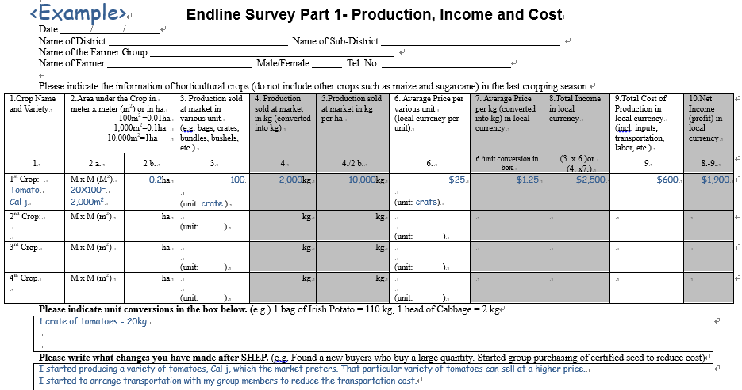
Completing Production, Income & Cost Sheet
Basic information of the farmer
Production, income & cost
Unit conversion
“Changes” after SHEP

Slide 13
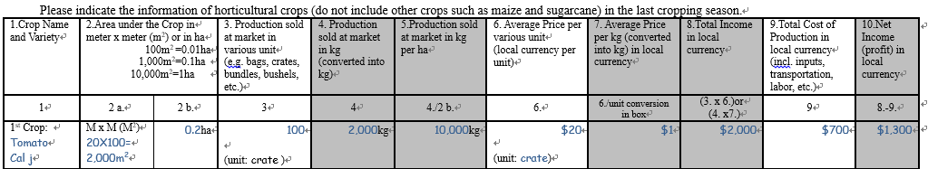
Completing Production, Income & Cost Sheet
1 Crop Name and Variety
→Indicate name of the horticultural crop and variety grown in the last cropping season.
2 (2a. & 2b.) Area under the Crop in meter X meter (m²) or ha
→Pacing can be used to estimate area under the crop

Slide 14
Completing Production, Income & Cost Sheet
3 Production sold at market in various unit (e.g. bags, crates, bundles, bushels, etc.)
→Total quantity sold at markets.
4 [Automatic calculation- no need to write in this column as long as conversion is indicated] Production sold at market in kg
→Farmers can write in kg in this column instead of writing in column 3.

Slide 15
Completing Production, Income & Cost Sheet
5 (4/2b.) [Automatic calculation- no need to write in this column] Production sold at market in kg per ha
→Analyzing productivity. Farmers do not need to write in this column.
6 Average Price per various unit (local currency per unit)
→ Marketed price per unit

Slide 16
Completing Production, Income & Cost Sheet
7 (6/unit conversion in box) [Automatic calculation- no need to write in this column] Average Price per kg in local currency
→Farmers do not need to write in this column if they do not know the price per kg.
8 (3X6) or (4X7) [Automatic calculation- no need to write in this column] Total Income in local currency
→ This is the total income from the crop.

Slide 17
Completing Production, Income & Cost Sheet
9 Total Cost of Production in local currency
→Cost of seed, planting materials, fertilizers/manures, pesticides, posts/stakes, labor costs, transportation & marketing costs,etc.
10 (8-9) [Automatic calculation- no need to write in this column] Net income (profit) in local currency
→ This is the total profit from the crop.

Slide 18
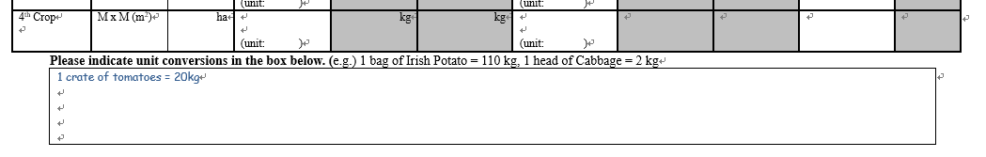
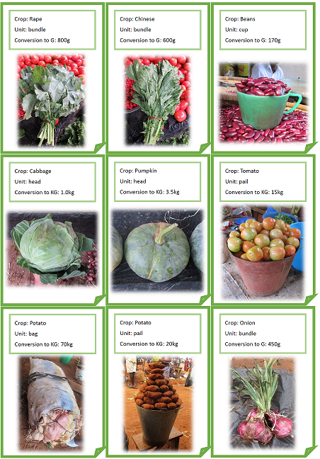
Completing Production, Income & Cost Sheet
In the box, indicate unit conversions
  <example>
  1 bag of Irish Potato 110kg
  1 head of cabbage = 2kg
  1 crate of tomatoes = 20kg
A conversion table like this will be useful.

Slide 19
Completing Production, Income & Cost Sheet
In the box, list various “changes” the farmers have made after SHEP.
  <Example>
  “I started producing a variety of tomatoes, Cal J, which the market prefers.”
  “I started to arrange transportation with my group members to reduce the transportation cost.”
Collect information on their changes in production, marketing and collective work as a group.

Slide 20
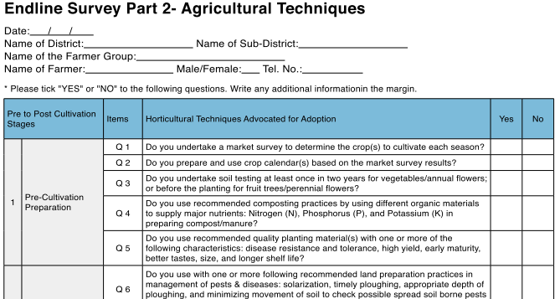
Completing Agricultural Techniques Sheet
Basic information of the farmer
Questions to assess farmer’s agricultural techniques

Slide 21
Completing Agricultural Techniques Sheet
If the answer is “Yes”, simply check (✓) the left box marked “Yes”.
If the answer is “No”, simply check (✓) the left box marked “No”.
We expect that the number of “Yes” is more than that of the Baseline Survey result.
Discuss the techniques which had many “No” answers with the farmers to see if they have any difficulties adopting such techniques.

Slide 22
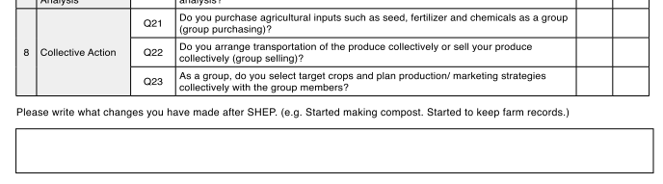
Completing Agricultural Techniques Sheet
“Changes” after SHEP
In the box, list various “changes” the farmers have made after SHEP.
  <example>
  “I started making compost.”
  “I changed from broadcasting to row planting.”
Collect information on their changes in techniques

Slide 23
CHECKLIST: Points to be Confirmed after Monitoring and Follow-up
The target farmers understand their strengths and weaknesses and are given specific guidance and advice to further improvement.
The target farmers understand when and how they can “graduate” from SHEP.
The target farmers are committed to continue adopting the production and marketing techniques in the future.
The male-female ratio of the participants is balanced.
Quality of participation of male and female members is reviewed.
Gender-disaggregated data is collected and analyzed.
Changes in gender roles between husband wife are reviewed.
Changes in decision-making between husband and wife are reviewed.

Slide 24
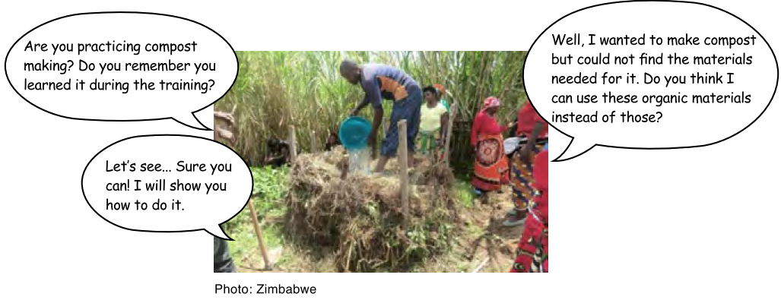
Monitoring and Follow-up in Action

Slide 25

TROUBLESHOOTING
What if the farmers become demotivated due to a crop failure? → SHEP supports farmers’ psychological needs for autonomy. Through their SHEP experience, the farmers feel they “own” the whole process of planning, decision-making, and risk-taking. Therefore, they do not easily become demotivated.
What if the farmers do not adopt production techniques sufficiently? → Process and required time for individual farmers to adopt new techniques vary. Sharing success stories and best practices with the farmers can be effective to encourage them to adopt new skills.

Slide 26
TROUBLESHOOTING
The farmer groups became disintegrated. What should we do about it?→ Try to probe what went wrong at what point. It is important for the farmers to understand that securing a volume of produce is an essential factor for small-scale farmers to increase profitability of farming business. Reconsider the group membership if it feels absolutely necessary to reorganize the group.

Slide 27
Way Forward: Implementation Schedule, Reporting, add any other necessary info. here

