Slide 1
Executive Summary

Slide 2
Contents of This Text (1/2)
This text consists of executive summary and 13 themes.
      Executive Summary
      Theme 1 Governance
      1-1 Legislation and Organization
      1-2 Water Rights
      Theme 2 Plan-based Management
      2-1 Management Plan
      2-2 Plan for Each River Basin
      Theme 3 Finance
Explanation of Water Resources Management

Slide 3
Contents of This Text (2/2)
      Theme 4 Water Pollution and Environmental Management Measures
      Theme 5 Urban Water Management
      Theme 6 River Management
      Theme 7 Groundwater Management
      Theme 8 Dam Management
      Theme 9 Environmental and Social Considerations in Large-Scale Projects
      Theme 10 Development of Human Resources and Technology
Explanation of Each Field
Capacity Development

Slide 4
Contents of Executive Summary
      Introduction
      Summary of Each Theme

Slide 5
1. Introduction (1)
Resolving water-related issues is crucial to achieving sustainable development.
Water-related issues are becoming more severe around the world.
Water-related issues
SDGs
Water resources management is closely related to Sustainable Development Goals (SDGs)

Slide 6


















1. Introduction (2)
High Relation with this Report
Medium Relation with this Report
Low Relation with this Report
Relation between the Management of Water Resources and SDGs
Source: Project Research Team

Slide 7
1. Introduction (3)
Case examples and lessons learned from Japan's experience in water resources management
Water-related issues vary by regions and basins.
There is no one-solution-fits-all model for water management.
Each country or region may develop its strategies and refer to appropriate experiences from the Japanese residents to meet their requirements.

Slide 8
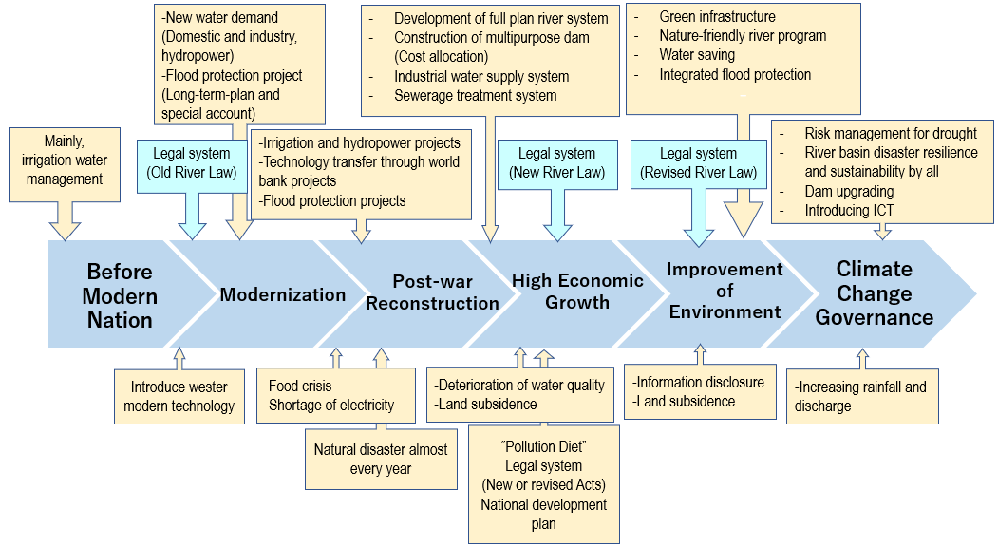
1.1 Evolving Management of Water Resources(1)
Source: Project Research Team
Efforts for Water Resources Management in Japan

Slide 9
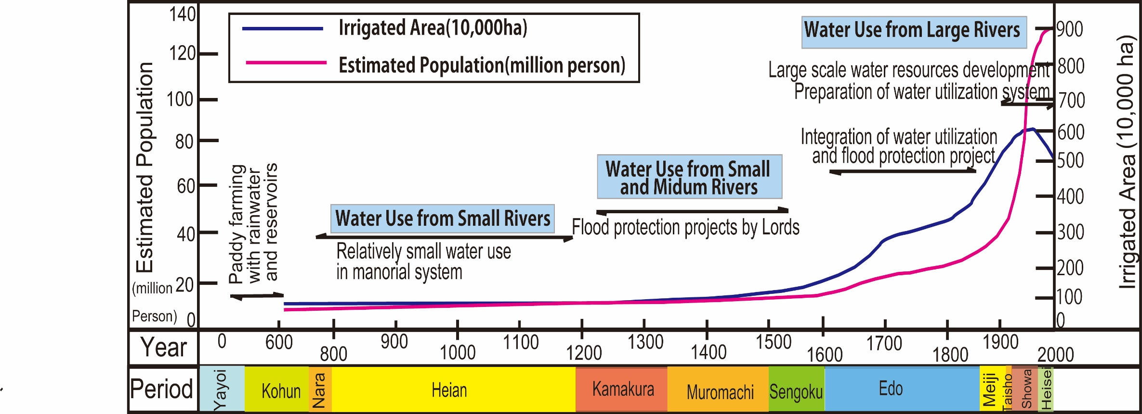
1.1 Evolving Management of Water Resources(2)
Japan fought against disasters such as floods and droughts and managed water resources over nearly 2,000 years.
Source: PRT based on Farmland and Water in Japan, Ministry of Agriculture, Forestry and Fishery
Changes in Population and Cultivated Area

Slide 10
1.1 Evolving Management of Water Resources (3)
Japan has developed the current system and practices for water resources management.
End of 19th Century
Water-related Issues
Local Communities
National Government
Traditional Water Use
Water Rights System
Water Use

Slide 11
1.1 Evolving Management of Water Resources (3)
Japan has evolved mechanisms of managing water resources to meet the emerging water-related issues along with the nation’s growth and socioeconomic changes.
End of 19th Century: Establishment of the modern nation
Navigation in Rivers
Requirement of urban public health improvement
Flood Protection Projects
Water Supply and Sewerage Projects
After 1945: Reconstruction of the devastated land
Development of irrigation water, hydropower
Flood protection and forest conservation
Food shortage, Power shortage, and sever flood damages

Slide 12
1.1 Evolving Management of Water Resources (4)
Period of High Economic Growth (Years 1955 to 1973, 19 years)
Reduced Flood Damage
Developed Water Resources
Increased Domestic, Industrial, and Irrigation Water supply
Increased Hydropower
Distortion of High Economic Growth
Pollution related disease
Urban floods
Water pollution
Land subsidence
Public Concern
Maturing Society
Diversified People’s Sense of Values
Increased interest in environmental issues
After High Economic growth
Water Environment Improvement

Slide 13
1.1 Evolving Management of Water Resources (5)
River management offices (RMOs) are responsible entities that implemented water resources management in cooperation with relevant agencies.
Responsible entities
River Administrators
Old River Law
(1986)
New River Law
(1964)
Prefectural Governors
Class A Rivers: Minister of MLIT
Class B Rivers: Prefectural Governors

Slide 14
1.1 Evolving Management of Water Resources (6)
The Water Resources Department coordinates with multiple government organizations at the national level to create policies and plans.
River Basin Committee
Drought Council
Others
Governments/Agencies
Experts
Water Right holders, Residents

Slide 15
1.1 Evolving Management of Water Resources (7)
The government-formulated water resources management plans are entirely government plans with a long-term perspective and are implemented through coordination with relevant sectors and stakeholders.
National Comprehensive Development Plan
To develop country’s
Economy
Welfare
The government formulated plans for each major river basin to manage the water resources based on relevant data, science, and engineering evidence.
To promote water resources development, flood protection
Each Sector

Slide 16
1.1 Evolving Management of Water Resources (8)
Roles and responsibilities are defined to secure finance.
National Projects
Local Government Projects
Sharing Cost by
National Government
Local Government
Sharing Cost by
Subsidies from National Government
Local Government
Other Projects
Flood Protection Projects
Sharing Cost by
Farmers for irrigation facilities
Users for water supply
Private companies for hydropower
Financing with
Due to long period of construction works
Special account for Projects (independent from general account)

Slide 17
1.1 Evolving Management of Water Resources (9)
The approach of consensus building for project implementation has continued to change.
Matsubara-Shimouke Dams
Affected People
Rebuilding Submerged Communities
Act on Special Measures for Water Source Area
Nagaragawa River Mouth Barrage
Civil Society Organization
Environmental Problems
Change in Water Governance
Information Disclosure, Transparency, Accountability
Yanba Dam
Dam Policy and Science Debate
Policy debate on Flood Protection and Environment
Re-evaluation based on Scientific Data
Three Projects Affected on Consensus Building

Slide 18
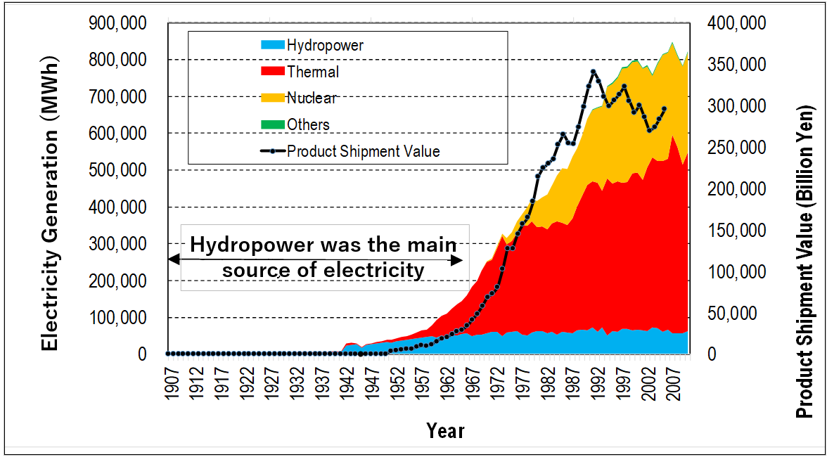
1.2 Japan’s Accomplishment in Water Resources Management (1)
Water resources management contributed to the quality improvement.
Energy Sector: Hydropower was the main source of electricity until 1965.
Hydropower generation
1950: 80%
1965: about 50%
Electricity Generation by Type and Product Shipment Value

Slide 19
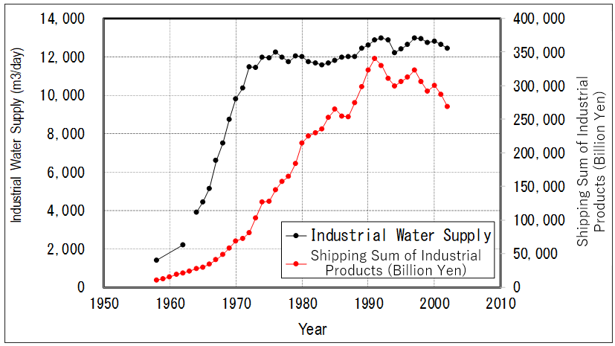
1.2 Japan’s Accomplishment in Water Resources Management (2)
Development industrial water supply system since the 1950s (Countermeasure to Land subsidence)
Increased Industrial Water Supply
Trend of Industrial Water Supply and Shipping Sum of Industrial Products

Slide 20
1.2 Japan’s Accomplishment in Water Resources Management (3)
Social Resilience
The investment in the flood protection reduced the flood damages.
1945
Reduced Flood Damage
Number of Casualties due to Floods and Flood Damages

Slide 21
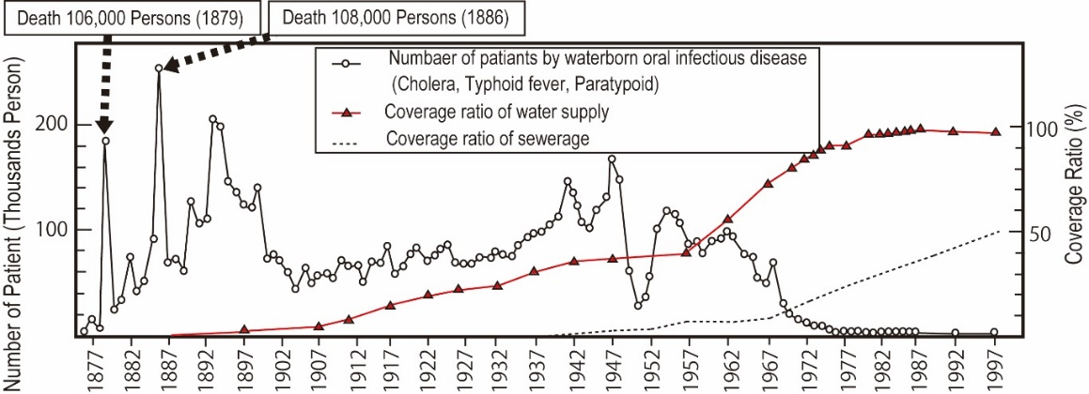
1.2 Japan’s Accomplishment in Water Resources Management (4)
Infectious diseases were reduced through developing water supply systems.
Water Supply
Patient
Source: Urban Development and Public Health, Nakatsuji Hideji, WHO in sight No.44(2010)
Number of Patients with Waterborne Oral Infections and Water Supply and Sewerage Coverage

Slide 22
1.2 Japan’s Accomplishment in Water Resources Management (5)
(2) Inclusive Services
The improved water supply and flood protection supported urban development and mitigated regional disparities.
Water Supply Volume
Income inequality was reduced
Gini Coefficient
Annual Water Supply and Gini Coefficient

Slide 23
1.2 Japan’s Accomplishment in Water Resources Management (6)
Access to safe drinking water and health was improved.
>90%(1980)
Cover Ratio of Sewerage System increased 10% in 1965 to 80% in 2019
Water Supply and Sewerage Coverage Ratio

Slide 24
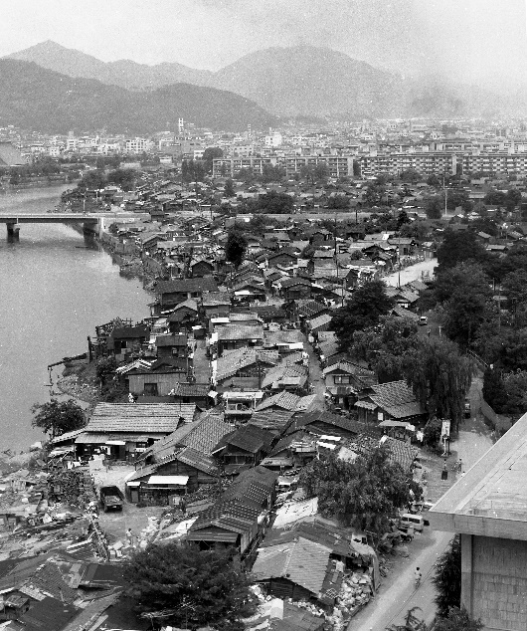
1.2 Japan’s Accomplishment in Water Resources Management (7)
In conjunction with river improvement, the government implemented projects to support the urban poor living near the river area
The government constructed public housing for low-income people and provided them with poor resettlement.
Source: The Hirosima City Archives
Atomic Bomb Slum in Hirosima

Slide 25
1.2 Japan’s Accomplishment in Water Resources Management (8)
(3) Sustainability
Japan improved the quality of river water through establishment of drainage regulations and construction of sewage systems.
Pollution disease by effluent from factories
Water quality deterioration by wastewater
Improvement of Water Quality
Effluent control
Promotion of sewerage system

Slide 26
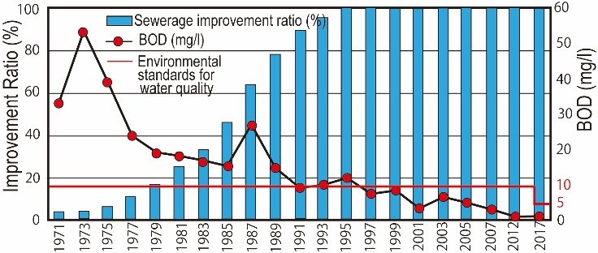
1.2 Japan’s Accomplishment in Water Resources Management (9)
Decreasing BOD
Improvement of water quality
Example: Water Quality of Yanase River
Water Quality of Yanase River and Sewerage Coverage Ratio
Source: Bureau of Sewerage, Tokyo Metropolitan Government

Slide 27
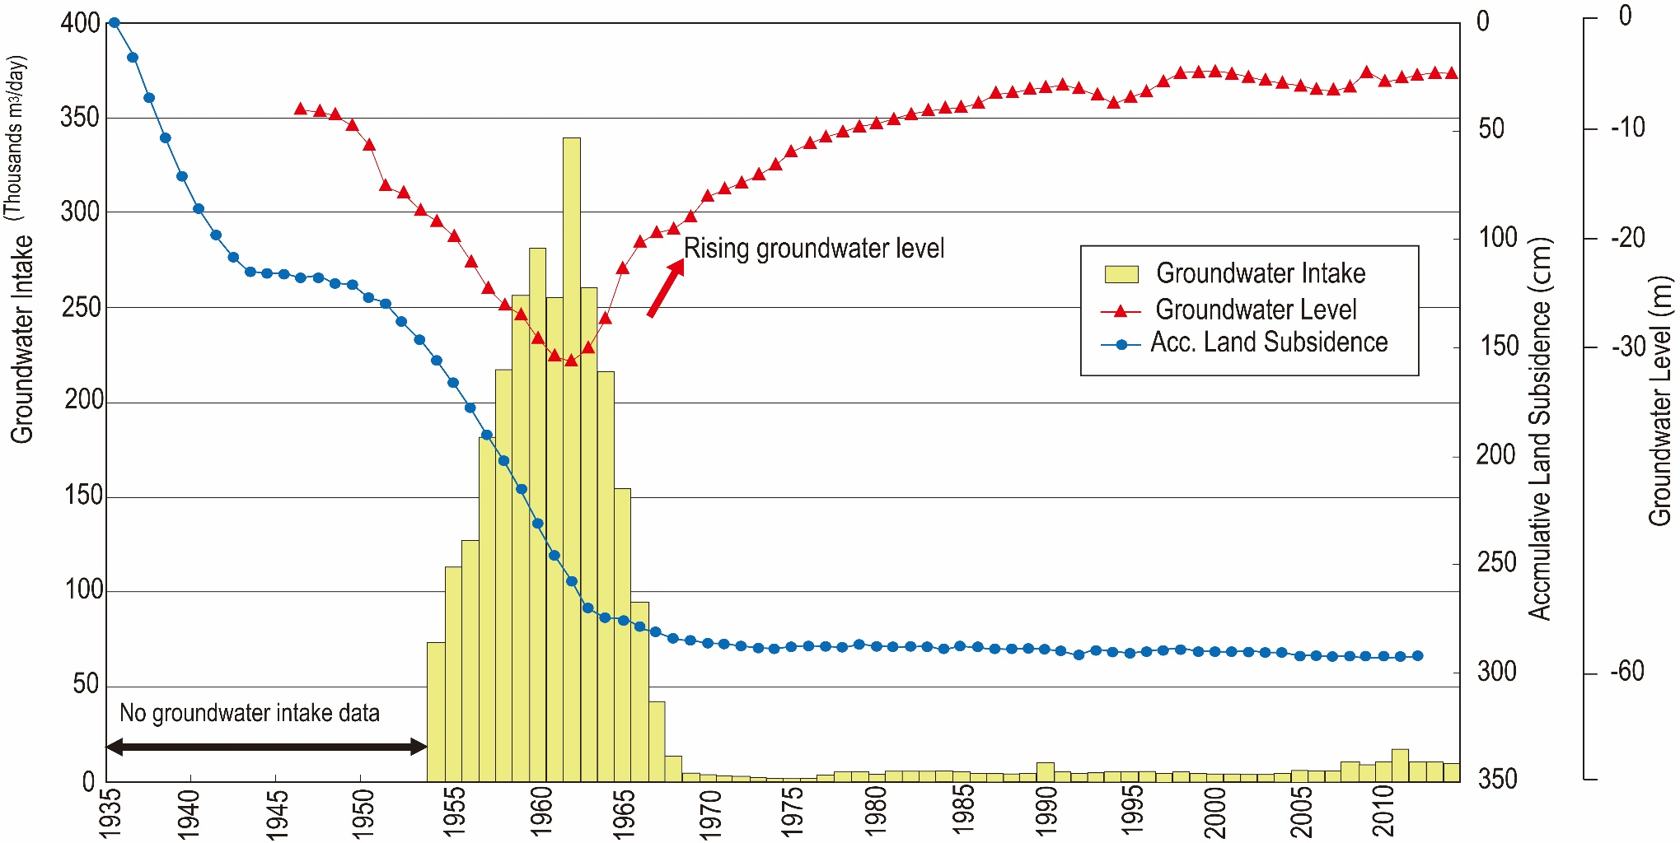
1.2 Japan’s Accomplishment in Water Resources Management (10)
Industrial water supply systems have contributed to the cessation of land subsidence.
Recover of groundwater level
Stable condition of land subsidence
Groundwater Extraction Volume, Groundwater Level, and Cumulative Land Subsidence (Osaka City)

Slide 28
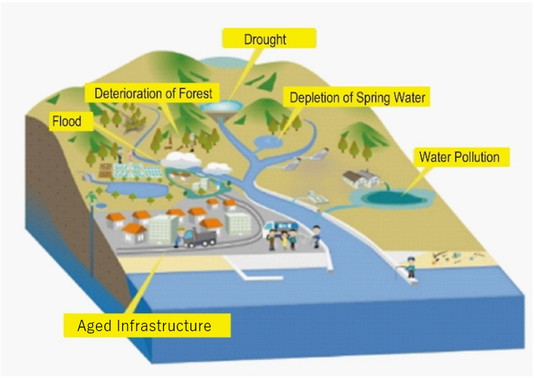
1.3 Issues for Water Resources Management in Japan(1)
Issues in Water Resources Management

Slide 29
1.3 Issues for Water Resources Management in Japan(2)
(1) Limited quick response and flexibility
Pollution diseases
Water demand projection
(2) Establishment of water governance
To respond quickly to the diversified needs of an ever-changing society.
(3) Adaptation of climate change and socioeconomic change
To enhance the resilience and sustainability of river basins by all stakeholders.
To maintain the vitality of people’s communities and improve productivity and national growth.

Slide 30
2. Outline of Each Theme
Theme |  | Flood Protection | Water Use | Environ- ment
Governance | 1-1 Legislation and Organization | O | O | O
 | 1-2 Water Rights |  | O | O
 | 1-3 Public Participation and Decision-Making Process | O | O | O
2. Plan-based Management | 2-1 Development Plan | O | O | O
 | 2-2 Plan for Each River Basin | O | O | O
3. Finance |  |  | O | O
4. Water Pollution and Environmental Management Measures |  |  |  | O
5. Urban Water Management |  | O | O | O
6. River Management |  | O | O | O
7. Groundwater Management |  |  | O | O
8. Dam Management |  | O | O | O
9. Environmental and Social Considerations for Large-Scale Projects |  |  |  | O
10. Development of Human Resources and Technology |  | O | O | O
Note: “O” indicates there is description in the Theme.

Slide 31
2.1 Legislation and Organization to Coordinate Sectors and Regions(1)
Government should establish legal systems and to coordinate interests of stakeholders.
Conflict
Stakeholders, Sectors, Regions
Role-sharing
Cost-sharing
Environment
Ecosystem
Over the past 2,000 years, Japan has restored to river management to make use of the water and to reduce flood damage.
End of 19th Century: established Modern Nation
Legal and organization system
Old River Law (1896)
New River Law (1964)
Revised River Law (1997)

Slide 32
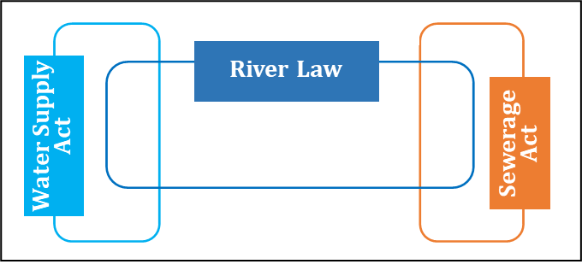
2.1 Legislation and Organization to Coordinate Sectors and Regions(2)
Japan transformed institutions to meet the changing needs of the country along with the nation’s growth, socioeconomic changes, and climate change
Modernization: End of 19th Century-Mid 20th Century
Flood Protection
1896 Old River Law
For Public Health
1890 Water Supply Act
1900 Sewerage Act
Flood Prevention and Public Health

Slide 33
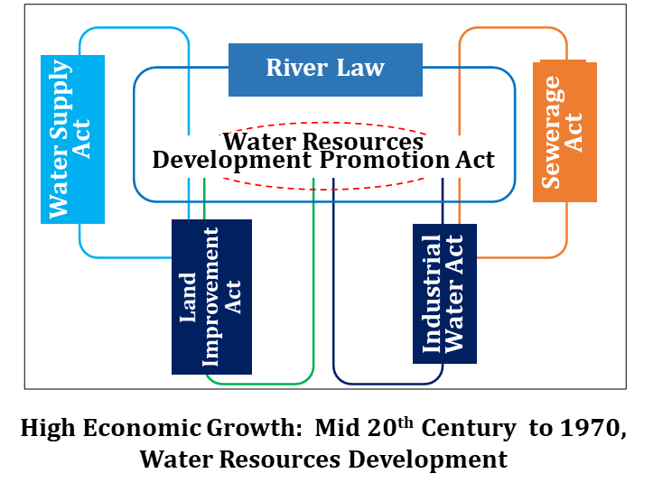
2.1 Legislation and Organization to Coordinate Sectors and Regions(3)
High Economic Growth period: Mid 20th Century to 1970
Water Resources Development
1957 Specific Multipurpose Dam Act
1958 New Sewerage Act
1963 Water Resources Development Promotion Act
River Basin Management
1964 New River Law
Irrigation and Water Supply
1949 Land Improvement Act
1956 Industrial Water Act
Water Resources Development

Slide 34
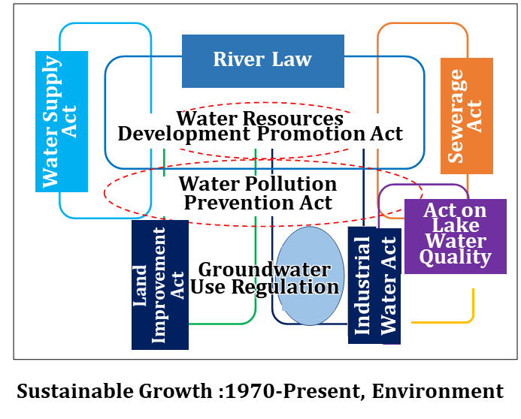
2.1 Legislation and Organization to Coordinate Sectors and Regions(4)
Sustainable Growth Period: 1970 - Present
Environment Preservation
1984 Act on Special Measures Concerning Conservation of Lake Water Quality
1997 Revised River Law
2014 Basic Act of Water Cycle

Slide 35
2.1 Legislation and Organization to Coordinate Sectors and Regions(5)
MLIT
(River Administrator)
Water and Disaster Management Bureau
River-Related Departments
(Water Policy, River Planning, Environment, and Flood Control)
Coordination between River Adminis-trators and Dam Owners
River Law
Specified Multipurpose Dam Act
Sewerage Department
Sewerage
Act
Government Agencies Related to Water and Environment
Sabo Department
Erosion Control Act
Health, Labor and Welfare Ministry (MHLW)
Water Supply Act
Sewerage Act
Water Resources Departments
Ministry of Agriculture, Forestry and Fisheries of Japan (MAFF)
Land Improvement Act
Forest Act
Coordination between Government Agencies of Water Utilization and Water Users
Water Resources Development Promotion Act
Water Resources Development Corporation Act
Act on Special Measures for Water Source Areas
Act on Promotion of Rainwater Use
Basic Act on the Water Cycle
Industrial Water Act
Electricity Business Act
Ministry of Economy, Trade and (METI)
Ministry of the Environment (MOE)
Water Pollution Prevention Act
Water Supply and Resource Act
Entities Involved in Water Resources Development and Concerned Law and Acts
Source: Project research team referring to MLIT website

Slide 36
2.2 Water Use Order with Water Rights System (1)
The government should establish the water-using order by introducing a water rights system based on past water management and the background of past development, customs and history.
Customary water right
After establishment of modern legal system
Licensed water right
The River Management Offices (RMOs) manage the water rights and issue licenses.
The RMOs stipulated by the river administrator in the river law.
Major Rivers: Minister (MLIT)
River administrator
Other Rivers: Prefectural Governors

Slide 37
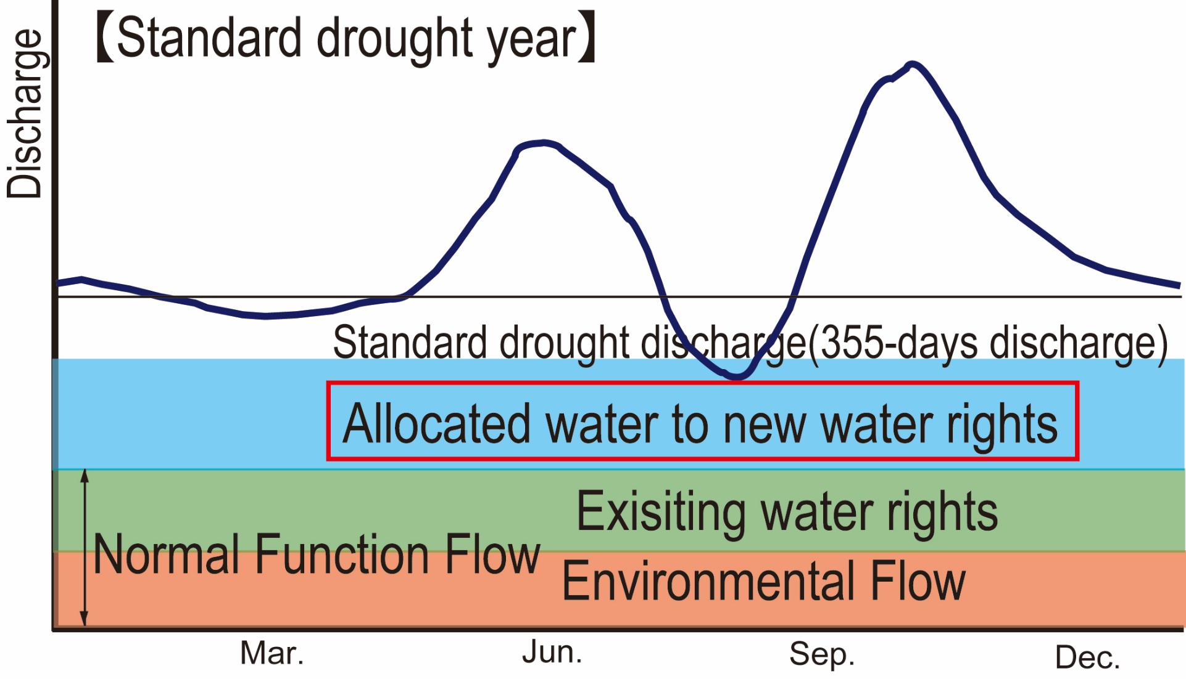
2.2 Water Use Order with Water Rights System (2)
Allocation to new applicants for water rights
Available Permit Water

Slide 38
2.2 Water Use Order with Water Rights System (3)
During drought event, water users coordinate their abstraction volumes at drought-coordinating committees in the spirit of co-assistance, which was fostered through the practices and history in each river basin.
The drought-coordinating Committee (Member: Water right holders, Observer River Administrator) establishes rule of water saving (priority, water saving ratio, etc.)
Farmers’ Associations (Agricultural Irrigation Area Improvement and Management Association) manage irrigation facilities.
Farmers’ Associations
Member: farmers in the irrigation area
Required Cost: Levy from the members
Project : subsidies from governments and some cost pay by farmers
Tax exempted due to highly public organization
To manage Irrigation facilities
To perform maintenance and renovation of facilities

Slide 39
2.2 Water Use Order with Water Rights System (3)
During drought event, water users coordinate their abstraction volumes at drought-coordinating committees in the spirit of co-assistance, which was fostered through the practices and history in each river basin.
Farmers’ Associations set rules for water allocation within irrigation area and manage irrigation facilities.
Farmers’ Associations
Member: Farmers in the irrigation area
Required Cost: Levy by the members
Project : Subsidies from governments and some cost pay by farmers
Tax exempted due to highly public organization

Slide 40
2.2 Water Use Order with Water Rights System (4)
By establishing systems for the transfer of water rights, water resources can be managed effectively
Reduced Irrigation water
Urbanization
Transfer from Irrigation water
Decreased irrigation water may be allocated to domestic and industry water.
Water Right
Actual
Water Right
Domestic and Industrial Water
Irrigation Water

Slide 41
2.3 From Government Management to Building Water Governance(1)
Water governance should be established according to the actual conditions of each river basin and local community.
Consensus building by government
Diverse needs of increased complex society
Vertically segmented administration system
Building Water Governance
Participation of residents and civil society organizations in the decision-making system
Disclosure of information
Accountability of the government

Slide 42
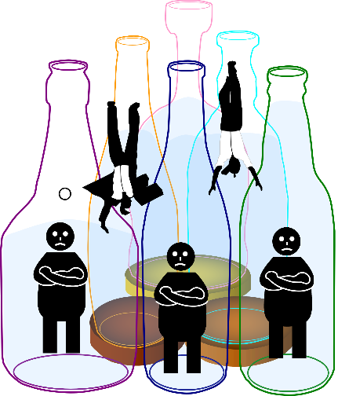
2.3 From Government Management to Building Water Governance(2)
Water governance should be established according to the actual conditions of each river basin and local community.
The bottles are governments. Citizens fall through the gap in the bottles.
Source: Japan Water Forum, Takemura Koutaro
Vertically Segmented Administrative Model

Slide 43
2.3 From Government Management to Building Water Governance (3)
The controversy over the Nagaragawa River Mouth Barrage provided an opportunity for water governance reform.
Since around the 1980s
There has been an increase in the number of cases in which the environmental impacts of public works, such as dams and barrages, became major social issues.
Nagaragawa River Mouth Barrage
MLIT: Information disclosure (all relevant data)
Roundtable meeting
Enhancement of transparency
Accountability in the decision-making process
River Basin Committee

Slide 44
2.3 From Government Management to Building Water Governance (4)
River basin committee is established in each river basin to formulate “River Improvement Plans” for flood protection, water utilization, and environment conservation.
1997: Revised River Law
Preparation of River Improvement Plan
Yodo River Basin Committee
Committee members were selected by third party(Secretariat): 2001
Wide range of issues were discussed
Conflict occurred on dam construction
Establishment of River Basin Committee
Govern-ments
Experts
Residents
Public Hearing from Residents
Committee was suspended in 2007.

Slide 45
2.3 From Government Management to Building Water Governance (5)
Information disclosure is essential to establish water governance through citizens and stakeholder participation.
2001: Information Disclosure Act
2003: Guideline for procedure of resident participation (MLIT)
There may be more than one correct answer to resolve issues by coordinating stakeholders’ opinions, and the attitude to keep looking at the most preferable answer is most required.
Quite difficult to reach a unanimous agreement in consensus
Efforts to find the most preferable solutions
Expect that the project will contribute to the region’s interest and for which all residents and stakeholders accept.

Slide 46
2.3 From Government Management to Building Water Governance (6)
A review of the projects is necessary for keeping with socioeconomic changes.
Application for a new project
Continue
Project Evaluation
Re-evaluation
Post evaluation
discontinue
It is important to strengthen the cooperation between the public and private sectors and local communities for environmental conservation and disaster prevention
Public Sector (Governments)
Institutional support
Financial supports
Private Sector (Residents)
Voluntary actions
Daily efforts in the field

Slide 47
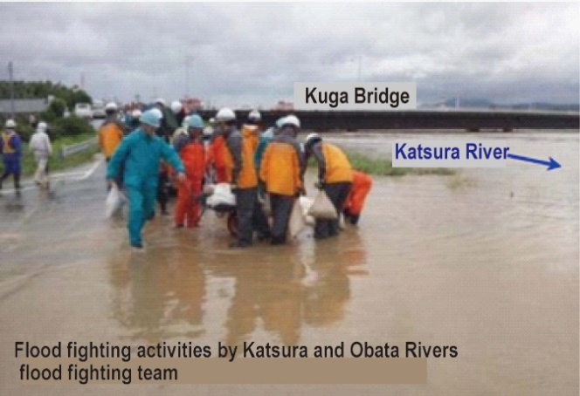
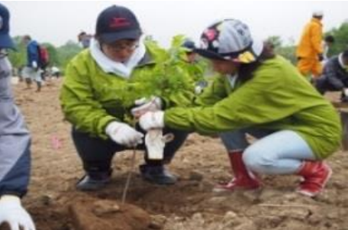
2.3 From Government Management to Building Water Governance (6)
Disaster Prevention
Environmental Conservation
Source: Outline of Typhoon No.18 in September 2013, Kinki regional development bureau, March 2014
Source: Tree Planting for Fish Breeding Campaign Regain the 100-year-ago natural beach
Flood Fighting Activities
Tree Plantation

Slide 48
2.4 Long-term Plan of Water Resources Management in a National Development Framework (1)
Water resources development plan should be a consistent framework of higher-level plans, such as the National Comprehensive Development Plan (NCDP).
Water resources Management is not done properly.
Floods, Droughts, Water quality deterioration
Water resources are not be used properly.
It affects to the growth of the country.
Achievement of resilient, sustainability, inclusive and quality growth
Proper Water Resources Development

Slide 49
2.4 Long-term Plan of Water Resources Management in a National Development Framework (2)
Water Resources Development
After 1945: Promoted as the core issue of the comprehensive regional development for the reconstruction after World War II
In 1960s : Became the important sector in the national development to resolve the issues accompanied to the high economic growth.
After 1962: Formulated the National Comprehensive Water Resources Plan (the Water Plan) to match the framework of the NCDP.
After 1945
Increased Food supply and Energy
Increased Flood Damages
1960s
Issues accompanied to the high economic growth
After 1962
Formulation of NCDP
Formulation of the Water Plan
Notes:
戦後復興時の水資源開発、
全国総合開発計画での水資源開発の位置づけ
長期の水需給計画に基づく開発等
水資源開発を位置づけ開発していった

Slide 50
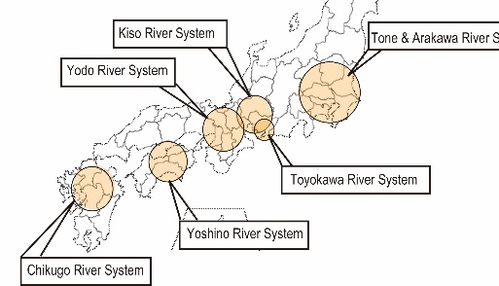
2.4 Long-term Plan of Water Resources Management in a National Development Framework (3)
The Japanese government formulated a basic plan for water resources management in the important river systems from the perspective of socioeconomic activities.
Water Resources Development Promotion Act (1961)
Water Resources Development River Systems (Full Plan)
Increase of Water Demand
Difficult Coordination among Sectors and Stakeholders
Full Plan: To provide for comprehensive development and rationalization of use of water resources
Demand projection of water use and target of water supply
Necessary facilities to achieve the supply targets
Location Map of Full Plan of River System
Source: PRT based on MLIT data

Slide 51
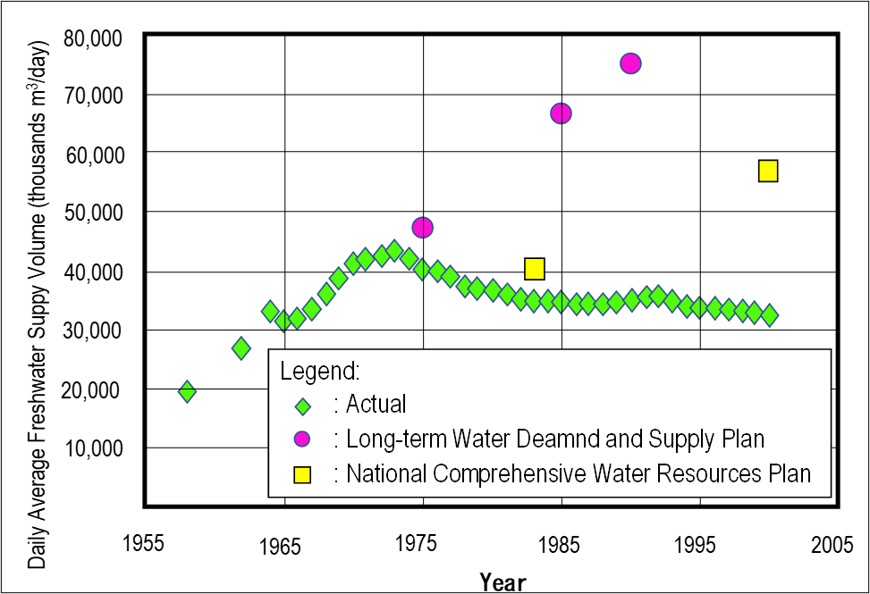
2.4 Long-term Plan of Water Resources Management in a National Development Framework (4)
All plans require a review mechanism.
Deviation between actual water demand and long-term plan water demand
Actual Demand
Projected Demand
Resources allocation tends to be almost fixed.
Planned projects were required to be changed.
Establishment of Plan Review Mechanism
Comparison of Projected and Actual Water Demand in Japan
Source: Analysis and Evaluation of Japan's Water Demand Forecasting System, Nishioka Takashi, Nasu Shingo

Slide 52
2.4 Long-term Plan of Water Resources Management in a National Development Framework (5)
Formulating a long-term plan contributes to securing a budget for long-term project implementation.
Water resources development project
Flood protection project
Special account to secure long-term budget
Long period until completion

Slide 53
2.4 Long-term Plan of Water Resources Management in a National Development Framework (6)
Under climate change, the flood management with a comprehensive and multi-layered approach by various stakeholders throughout the river basin, and the “risk management” for droughts are required.
River basin disaster resilience and sustainability through all
Flood protection: irrigation ponds, rainwater infiltration, and flood storage in urban areas
Exposure reduction: regulate urban development in hazardous areas, and
Disaster resilience: cooperation with the stakeholders for disaster response and reconstruction.

Slide 54
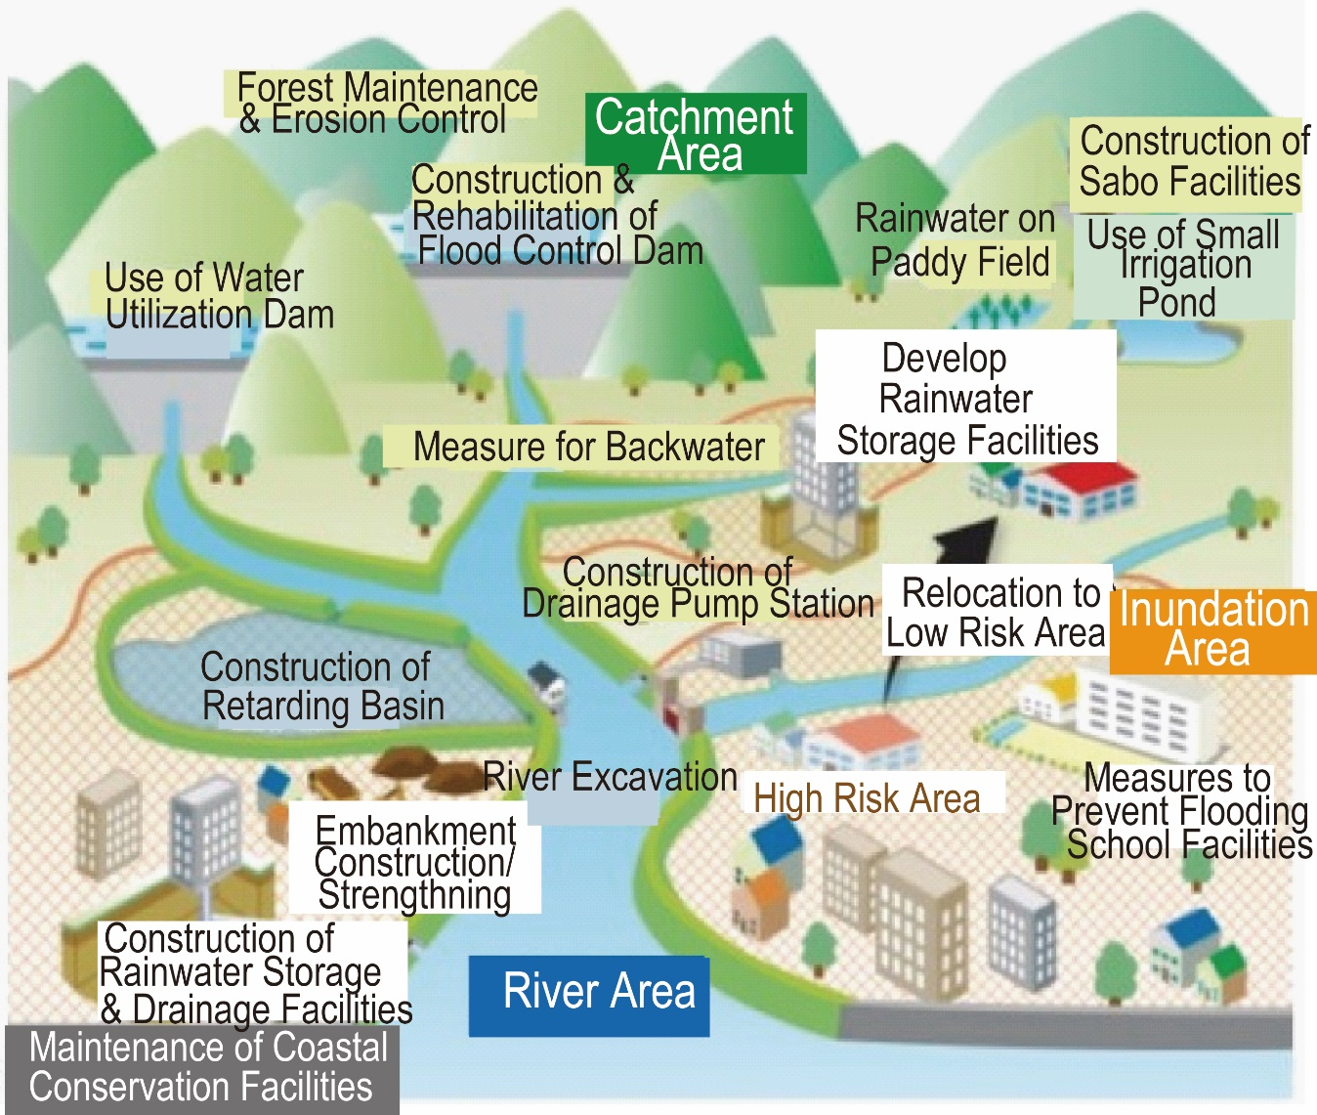
2.4 Long-term Plan of Water Resources Management in a National Development Framework (7)
River basin disaster resilience and sustainability through all

Slide 55
2.4 Long-term Plan of Water Resources Management in a National Development Framework (8)
Climate Change Impact: MLIT expected climate change impact
Rate of Change in Rainfall, Flow Rate, and Flood Frequency due to Climate Change
Climate Change Scenario | Rainfall | Flow Rate | Flood Frequency
2°C increase | Approx. 1.1 times | Approx. 1.2 times | Approx. 2 times
4°C increase | Approx. 1.3 times | Approx. 1.4 times | Approx. 4 times
Source: Proposal for Flood Control Planning in Light of Climate Change, Revised Edition, MLIT, April 2021

Slide 56
2.5 River Basin as a Unit of Water Resources Management (1)
The governments formulate water resources management plans according to basin characteristics and regional customs.
Coordination of related sectors
Setting flood protection level
Optimization of improvement of facilities and water management
The hydrological data are essential for developing management plans.
If the observation data are insufficient, satellite observation, past marks, hearsay should be recorded.

Slide 57
2.5 River Basin as a Unit of Water Resources Management (2)
The safety level of flood protection should be set according to the importance of the protected areas.
Flood Prevention Level : Probability of Occurrence
Important river: Tokyo, Osaka 1/200
Planned Flood Discharge of the Arakawa River
Source: Arakawa Upstream Basin Office, MLIT

Slide 58
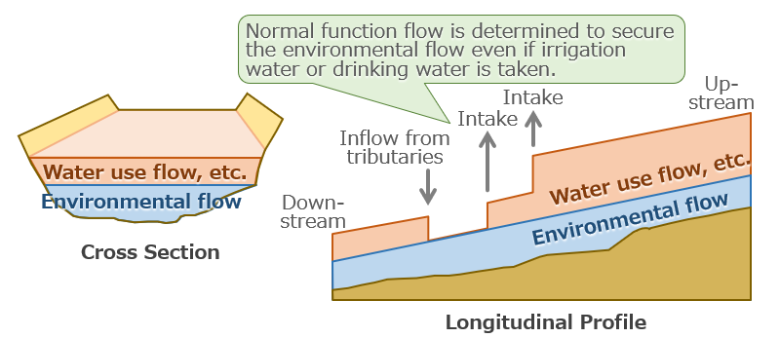
2.5 River Basin as a Unit of Water Resources Management (3)
The safety level (probable year of drought frequency) should be set as a target for the water use plan.
Safety level : 1/10
Normal Function Flow
Source: Project Research Team based on website of Hyougo Prefecture

Slide 59
2.5 River Basin as a Unit of Water Resources Management (4)
Factors for Environmental Flow
Navigation
Fishery
Tourism
Maintenance of clean water flow
Prevention of salt damage
Prevention of blockage of estuaries
Protection of river management facilities
Maintenance of the groundwater level
Landscape
Habitat of animals and plants
Securing rich contact between people and rivers

Slide 60
2.5 River Basin as a Unit of Water Resources Management (5)
A master plan and action plan should be prepared to improve the river.
Revision of River Law (1997)
Preparation of Basic Policy for River Development
River Improvement Plan
Basic Policy for River Development (Master Plan)
Flood protection
Maintenance of water use and functions
Improvement and conservation of the river environment
River Improvement Plan
(Action Plan)
Specific goals of river improvement for the period of 20 to 30 years
Specific individual project
River Basin Committee

Slide 61
2.5 River Basin as a Unit of Water Resources Management (6)
The River Management Offices (RMOs) understand the issues and needs of the field.
The RMOs are responsible for Water Resources Management.
The MLIT has a RMO for each river.
RMOs under MLIT
To understand the issues and needs of local communities in the field
To prepare measures together with the communities
To collaborate with various stakeholders
To build trust relationships with relevant persons, organizations and communities

Slide 62
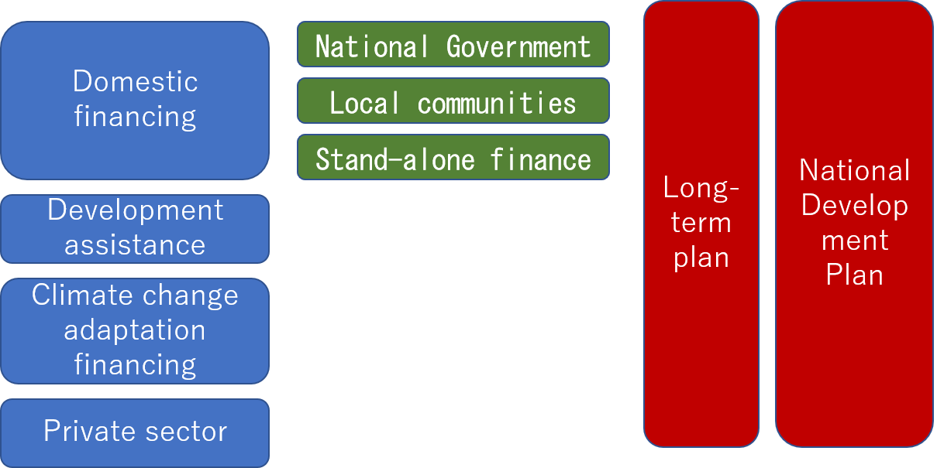
2.6 Cost Sharing according to Responsibility and Role (1)
Governments should provide financing investments and involve the private sector in water resources management.
Finance for Water Resources Development and Management
Source: Ishiwatari, M. and Akhilesh S. "Good enough today is not enough tomorrow: Challenges of increasing investments in disaster risk reduction and climate change adaptation." Progress in Disaster Science 1

Slide 63
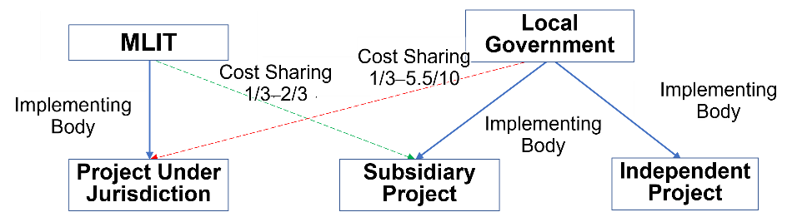
2.6 Cost Sharing according to Responsibility and Role (2)
Cost Sharing in Projects under the Jurisdiction and Subsidiary Projects
Source: Project Research Team

Slide 64
2.6 Cost Sharing according to Responsibility and Role (3)
Investments are arranged by mobilizing various sources.
Each partner shares the costs in the construction and maintenance of multipurpose facilities.
The share of the cost is determined based on the benefit obtained for each purpose.
The government should also consider public-private partnership (PPP) methods for managing facilities.
Outsourcing
Design Build
PFI (Conventional method)
PFI (Concession method)
Water supply systems
Sewerage systems

Slide 65
2.7 Effective Water Pollution Control and Environmental Conservation (1)
It is necessary to establish a legal system to prevent environmental degradation.
In High Economic Growth
Pollution diseases
Minamata disease, Itai-itai disease
Water Quality Protection Act (1958)
Industrial Wastewater Act (1958)
Water Pollution Control Act (1970)
Revised Sewerage Act (1970)
Pollution Diet (1970 )
to discuss environmental pollution issues
To conduct on-site inspections on factories
To advise remedial measures to the private companies
Local Governments
Enacted stricter Standards by Ordinances

Slide 66
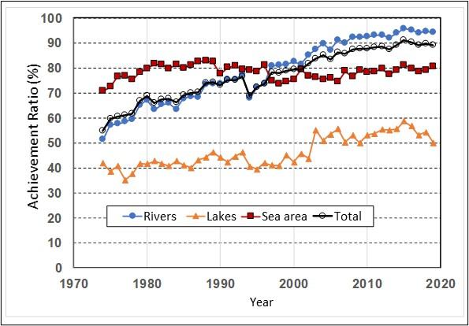
2.7 Effective Water Pollution Control and Environmental Conservation (2)
Treatment facilities are combined and developed according to population density and topographical conditions.
94.1% (2019)
River
50.0% (2019)
Lake and Marsh
Improvement of Water Quality in Rivers, Lakes, Sea and total
Source: Ministry of Environment

Slide 67
2.7 Effective Water Pollution Control and Environmental Conservation (3)
The degradation of water quality in closed water bodies requires measures against non-point source loads, where pollution discharge sources cannot be specifically identified.
Non-point source
The source areas of loads such as urban areas, farmland, and forests
The water channels and rivers
The closed water bodies where the load reaches
Sewerage systems, cleaning roads, underground infiltration facilities, and rainwater storage (Urban area)
Improvements in irrigation management, implementation of proper fertilization
Notes:
公害対策の経緯
対策としてモニタリング体制の整備

Slide 68
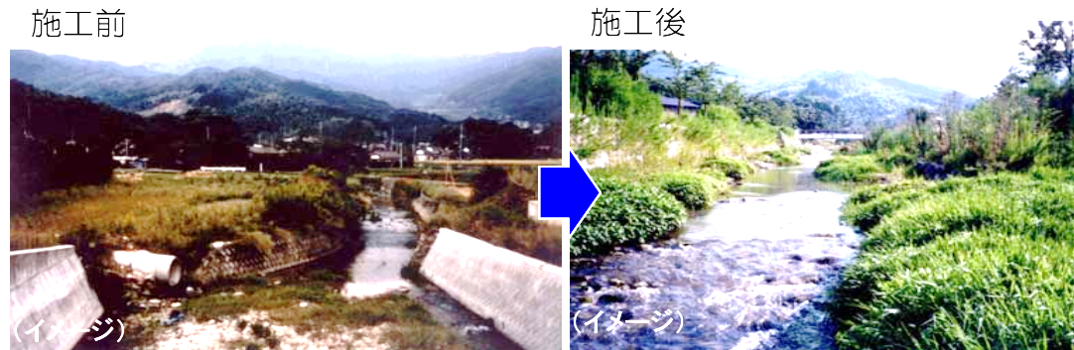
2.7 Effective Water Pollution Control and Environmental Conservation(4)
The national government has promoted "Nature-friendly river programs" since the 1990s to conserve and restore the natural environment in rivers.
Before Construction
After Construction
Artificial
Natural
Nature-Friendly River Program
Source: MLIT

Slide 69
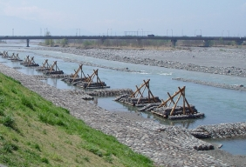
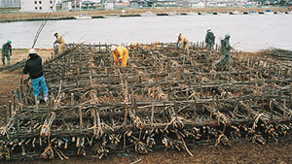
2.7 Effective Water Pollution Control and Environmental Conservation (5)
Utilize traditional technique.
Water Control Work: Sacred Cows (Groyne)
Riverbed and Riverbank Protection
(Fascine Mattress)
Source: Websites of Kouhu River and Road Office Left), and Shinanogawa Downstream Office (Right)
Traditional Construction Method

Slide 70
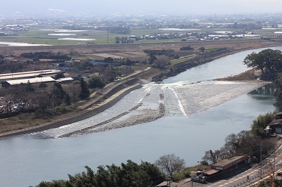
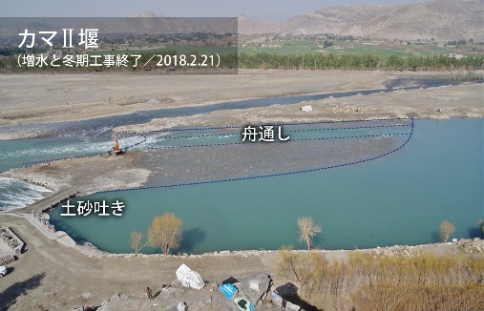
2.7 Effective Water Pollution Control and Environmental Conservation (6)
Yamada Weir (Japan, Material: Stone)
Kama II Weir (Afghanistan)
Traditional Construction Method
Source: (Left) Asakura City, (Right) Website of Peshawar-kai
Yamada Weir was operated from Edo Period (Material: Stone)

Slide 71
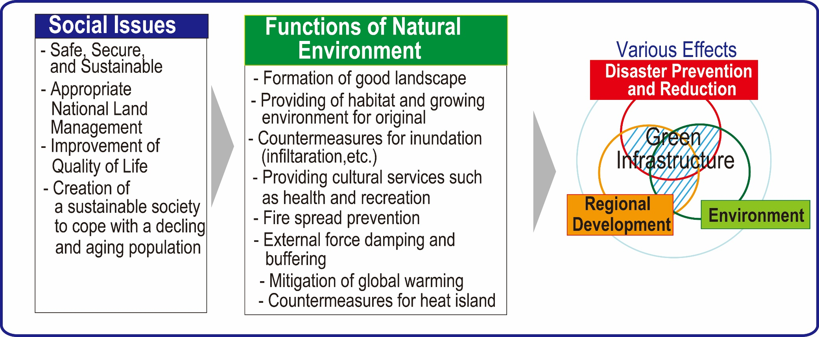
2.7 Effective Water Pollution Control and Environmental Conservation (7)
Green infrastructure has diverse effects on disaster mitigation, the environment, and regional development, leading to the achievement of the SDGs.
Scope of Green Infrastructure
Source: Green infrastructure portal site, MLIT

Slide 72
2.8 Improvement of the Urban Water Cycle (1)
The water cycle should be restored to coexistent with the environment to ensure water utilization, flood protection, and environmental conservation.
Measures | WU | FP | EN
1. Water Utilization
1.1 Water fee system | 〇
1.2 Water-saving tap | 〇
1.3 Reduction of non-revenue water rate | 〇
1.4 Rainwater harvesting (water use) | ◎ | 〇
1.5 Recycled water use | 〇
1.6 Sewerage high-treatment water use | ◎ |  | 〇
1.7 Use of recovered water for industrial use | 〇
1.8 Seawater desalination | 〇 |  | △
Note: WU: Water Utilization, FP: Flood Protection, EN: Environment Conservation
◎Extremely effective, 〇Highly effective, △Low effectiveness as a countermeasure
Measures Related to Water Utilization, Flood Protection and Environment in Urban Areas (1/2)

Slide 73
2.8 Improvement of the Urban Water Cycle (2)
Measures | WU | FP | EN
2. Flood Protection
2.1 River improvement (Construction of levee, dredging of riverbed) |  | ◎ | 〇
2.2 Retarding basin, multiple retarding basin |  | ◎ | 〇
2.3 Permeable pavement and permeable groundwater infiltration | 〇 | ◎
2.4 Underground storage |  | ◎
2.5 Underground River |  | ◎
3. Water environment
3.1 Nature-friendly River program |  | 〇 | ◎
3.2 Sewerage system maintenance |  | ◎ | ◎
4. Public awareness campaign | 〇 | 〇 | 〇
Note: WU: Water Utilization, FP: Flood Protection, EN: Environment Conservation
◎Extremely effective, 〇Highly effective, △Low effectiveness as a countermeasure
Measures Related to Water Utilization, Flood Protection and Environment in Urban Areas (2/2)

Slide 74
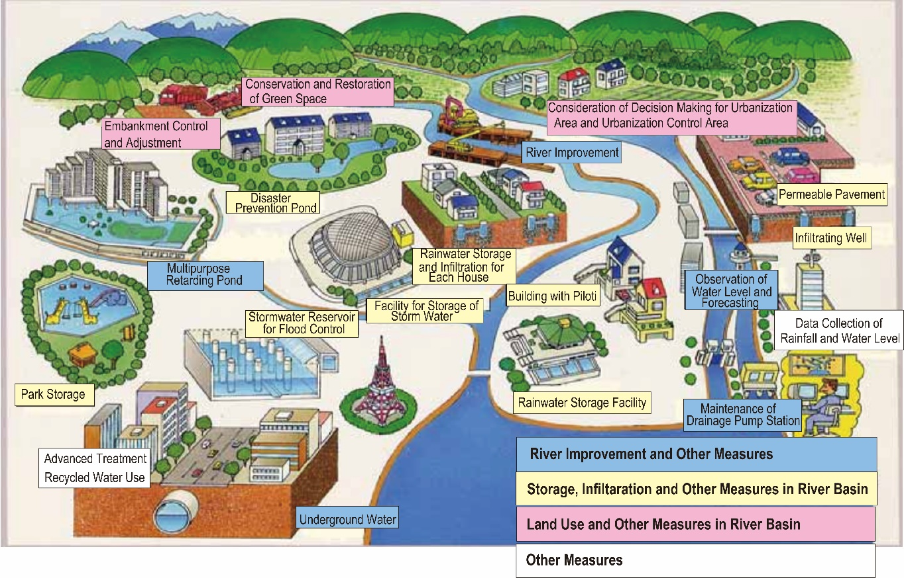
2.8 Improvement of the Urban Water Cycle (3)
Source: MLIT
Image of Measures for Urban River Basin

Slide 75
2.8 Improvement of the Urban Water Cycle (4)
Demand management can save water and benefit multiple areas.
Average leakage ratio of the water distribution system: <5%
Industrial Water Use: Recycle ratio (77.9%: 2015)
Miscellaneous Water Use: Rainwater, Recycled water, Treated sewerage water
Annual Rainwater Utilization: 11.2 million m³

Slide 76
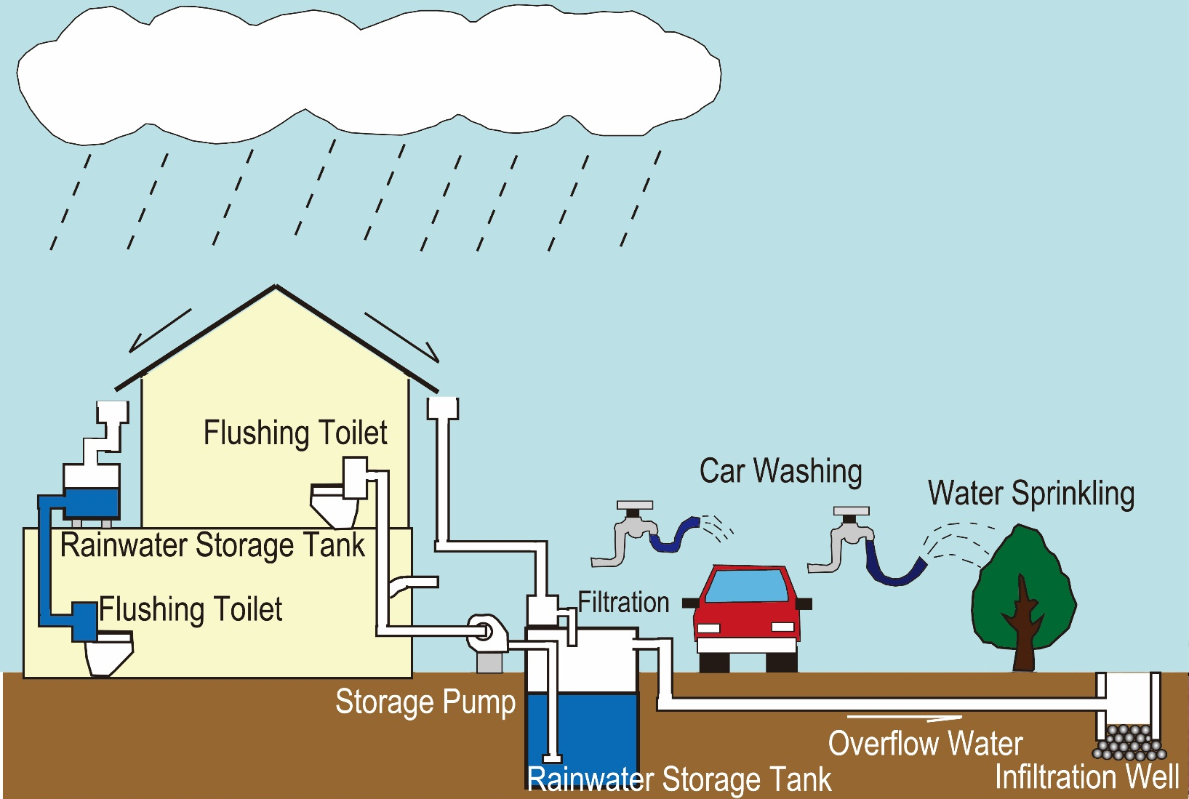
2.8 Improvement of the Urban Water Cycle (5)
Water demand management may save water and benefit multiple areas.
Rainwater Utilization
Source: Website of Sumida-ward

Slide 77
2.8 Improvement of the Urban Water Cycle (6)
Comprehensive measures are required for managing urban floods.
Normal
Green Space Preservation
Flood
Control Embankment on Agricultural Land along the River
Disaster Prevention Pond
Conservation Area
Source: Key points for river development in Tsurumi River, Tsurumi River Management Office MLIT
Measures in River Basin

Slide 78
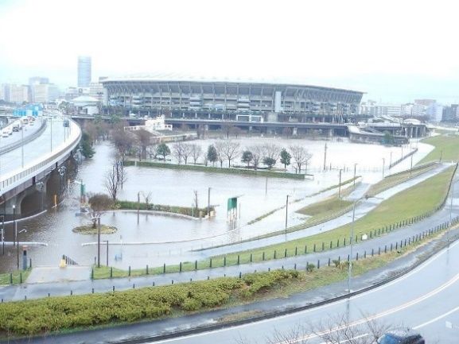
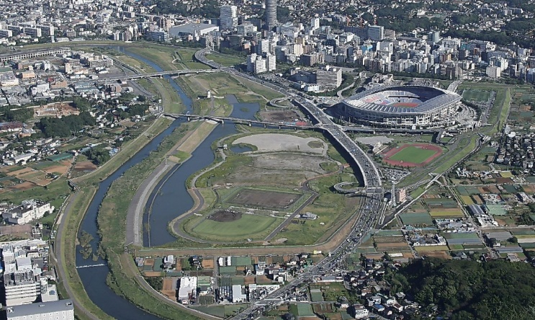
2.8 Improvement of the Urban Water Cycle (7)
Increased Flow Capacity: About 2 times
Before
Flood
After
Flood water will be stored during flood events.
Multipurpose Retarding Pond
River Improvement
Source: PRT and Tsurumi River Multipurpose Retarding Basin Pamphlet
Source: PRT and Tsurumi River Management Office MLIT
Measures in River

Slide 79
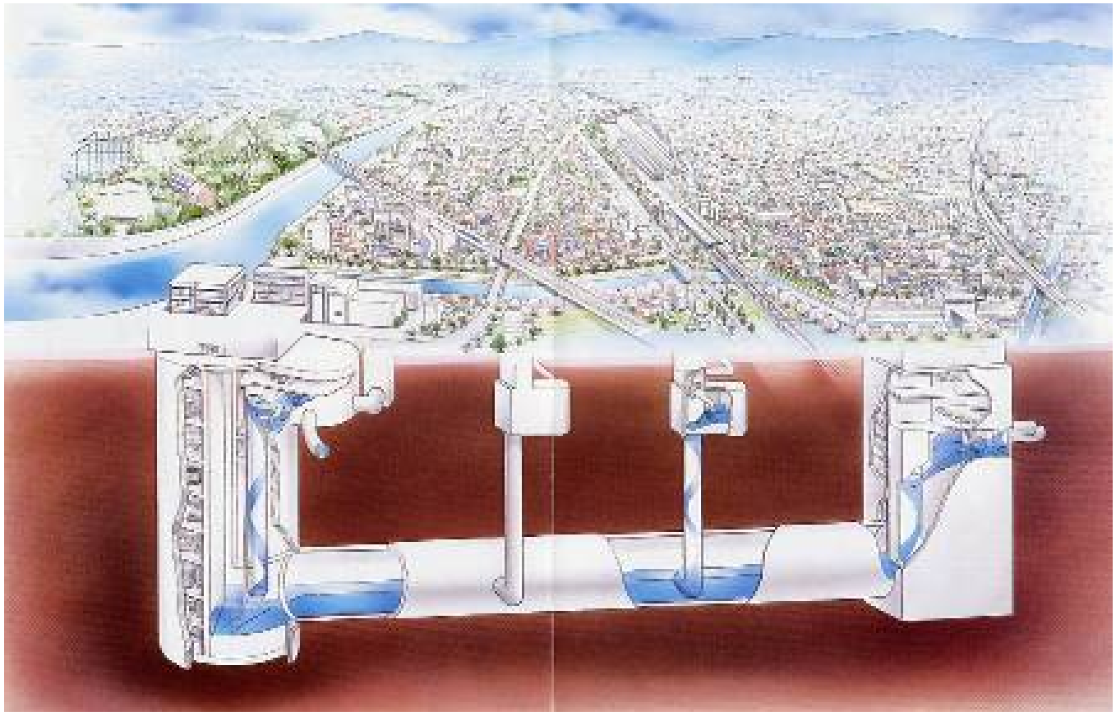
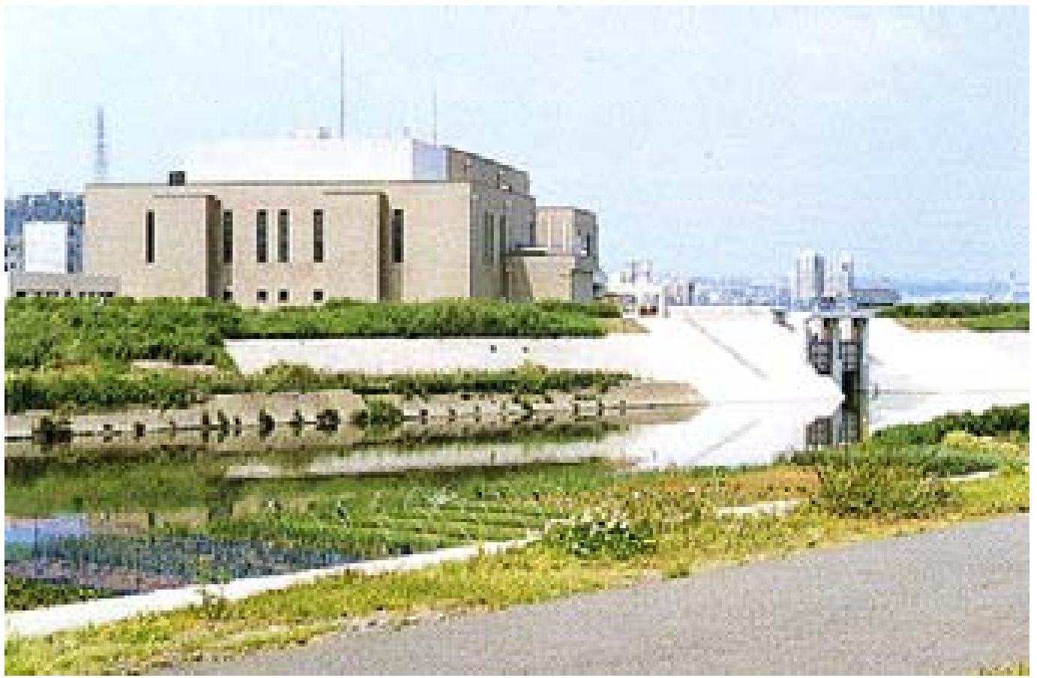
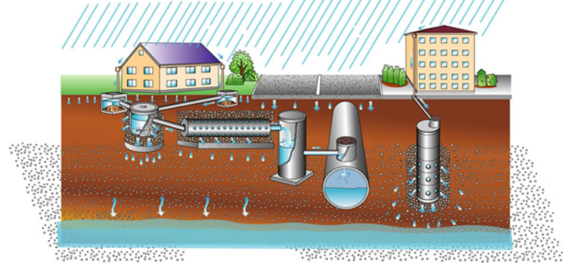
2.8 Improvement of the Urban Water Cycle (8)
Rainwater Storage Tunnel
Internal Drainage Facility
(Pumping Station)
Rainwater Infiltration Well & Trench
Measures by Sewerage System
Source: MP for Tsurumi River Basin, MLIT

Slide 80
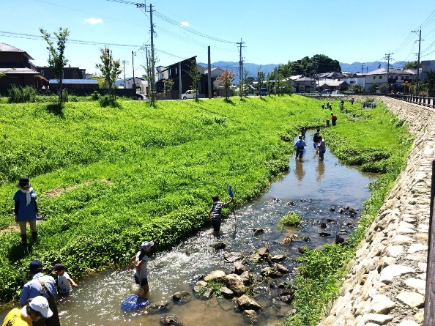
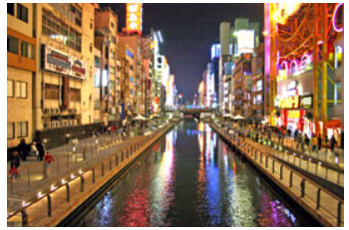
2.8 Improvement of the Urban Water Cycle (9)
Green infrastructure demonstrate a variety of functions in urban areas.
Green Infrastructure, Kamisaigo River
Urban Development Integrated with the River Space, Doutonbori River in Osaka City
Source: Fukutsu City
Source: Japan Riverfront Research Center

Slide 81
2.9 Management of River Water and Land (1)
The national government has establishes a legal system and organization to properly maintain and manage river water and land.
Permissions by River Management Offices
Occupation of flowing water
Occupation of land in river area
Collection of river products
New construction and renovation of structures
Excavation of land in river area
River flow transportation of timbers
Navigation through locks

Slide 82
2.9 Management of River Water and Land (2)
The national government has establishes a management system for rivers and river structures.
During Flood
Patrol of river facilities, and operation of dams and gates
Announcement of flood forecasts
Notice of flood information to relevant organizations
Support to flood protection activities of local community
Maintenance and Management
Patrol of river facilities
Weeding
Removal of obstacles
Visual inspection
Operation checks of gates

Slide 83
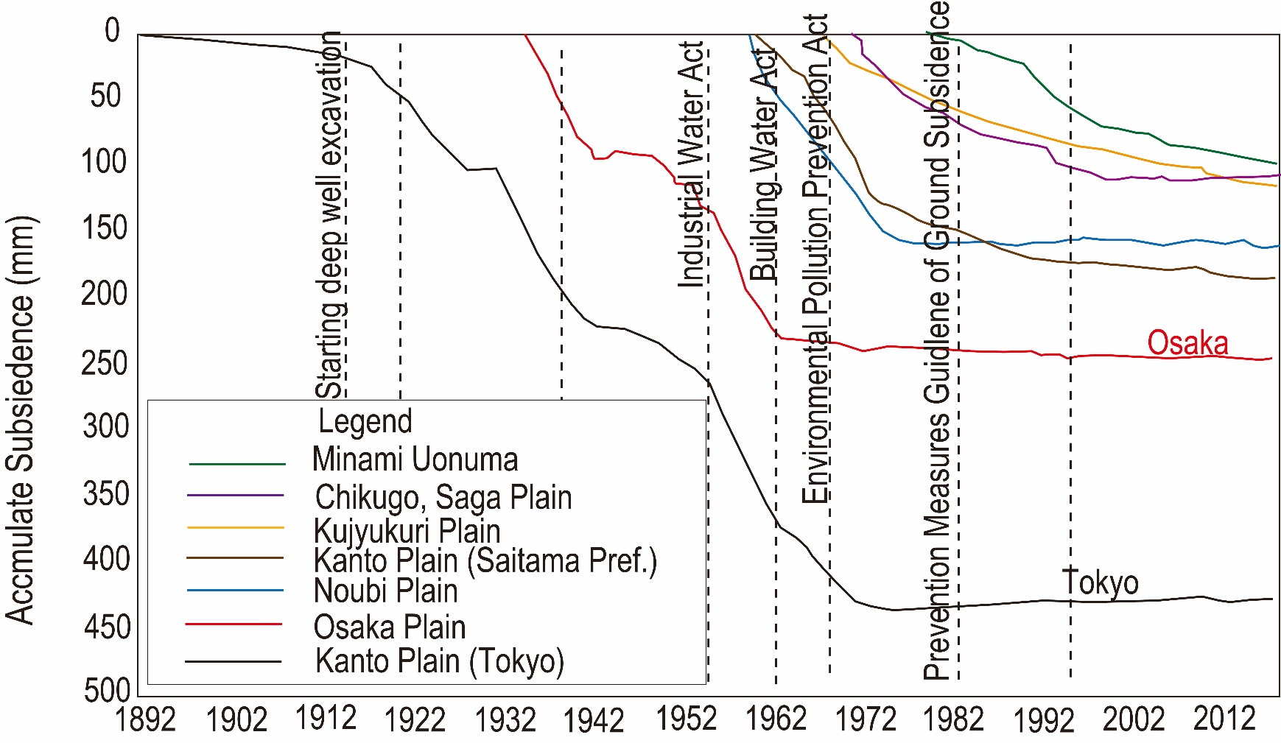
2.10 Management of Groundwater (1)
Excessive extraction of groundwater lowers the groundwater level, resulting in land subsidence, structural damage, flood damage, and saltwater contamination of the groundwater.
Changes in Land Subsidence at Representative Sites
Source: Subsidence areas in FY 2008, Ministry of the Environment

Slide 84
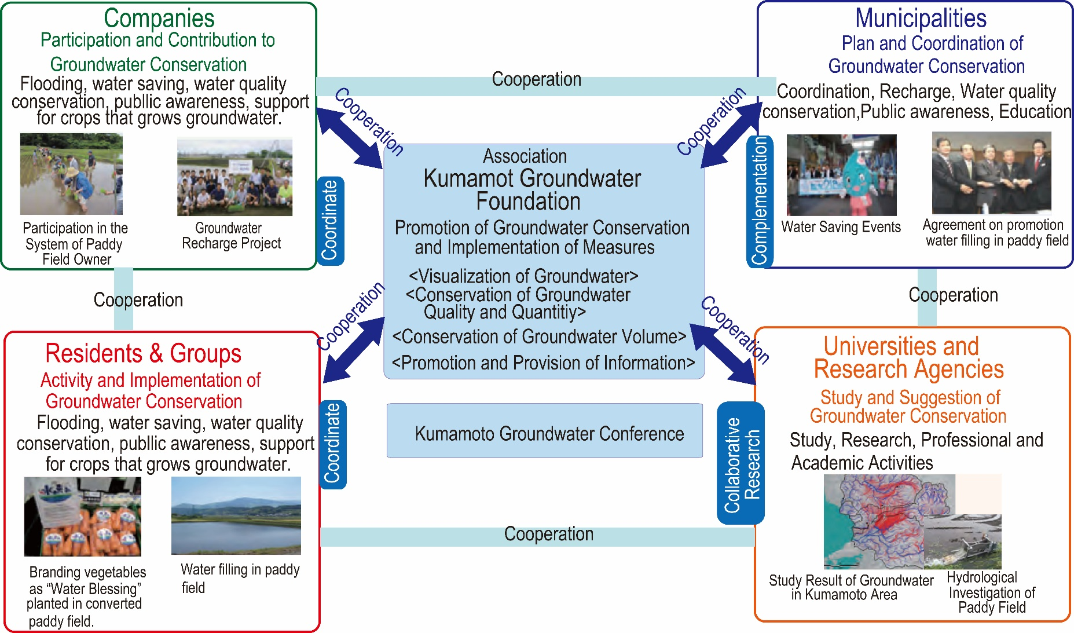
2.10 Groundwater Management (2)
The conservation and management of groundwater are realized by considering regional characteristics.
Activities of the Kumamoto Groundwater Foundation
Source: Case Studies of Watershed Management, Water Cycle Production Headquarters Cabinet Secretary

Slide 85
2.10 Groundwater Management (3)
Groundwater quality management prevents harmful substances from infiltrate into the ground.
To prevent seepage of harmful substances into the ground
Standard and guideline
Regular monitoring
Action plan against abnormal situation

Slide 86
2.11 Dam-Safety Management and Operation (1)
Because dam failure would cause damage to the downstream areas, strict dam construction and safety management processes are essential.
Dam Breaks in Japan
Name of Dam | Year of Completion | Year of Accident | Type of Dam | Damages
Iruka-ike | 1633 | 1868 | Earth fill dam for irrigation | 941 dead
Komoro Power Station | 1927 | 1928 | Buttress type concrete dam for hydropower | 5 dead
Horonai Dam | 1939 | 1941 | Gravity type concrete dam for hydropower | 60 dead
Heiwa-ike | 1949 | 1951 | Earth fill dam for irrigation | 75 dead
Yoake Dam | 1952 | 1953 | Gravity type concrete dam for hydropower | No damage
Taisyo-ike | 1949? | 1953 | Earthfill dam for irrigation | 105 dead
Wachi Dam | 1968 | 1967 | Gravity type concrete dam for hydropower | 1 dead
Fujinuma Dam | 1949 | 2011 | Earthfill dam for irrigation | 8 dead/missing
Source: PRT based on the documents of No. 21 Expert meeting on future policy and concept of flood management

Slide 87
2.11 Dam-Safety Management and Operation(2)
Dam discharge during flooding should be determined by considering the safety of downstream areas.
Dam discharges should not cause a sudden rise in the water level on the downstream reaches
D/S water level <30cm in 30minutes
The dam office should notify residents and recreational users of safety issues in the river area via speakers and patrols.

Slide 88
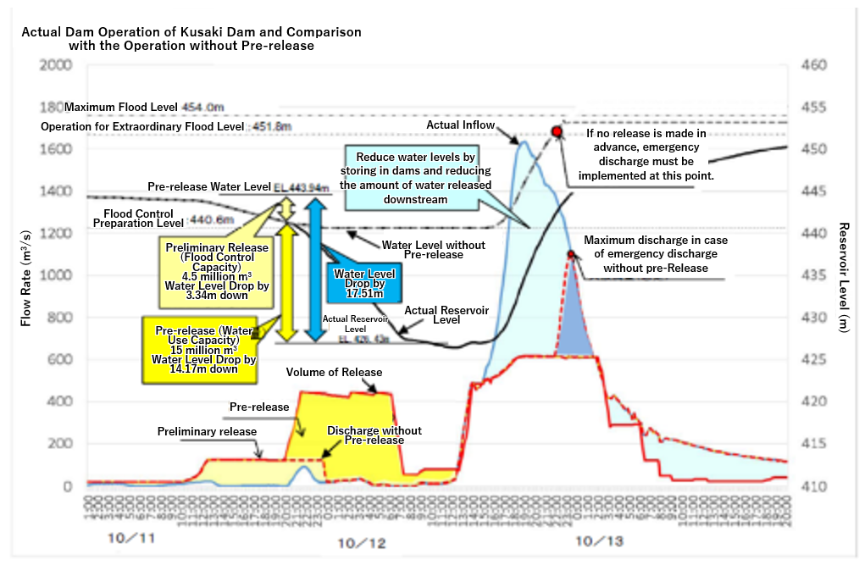
2.11 Dam-Safety Management and Operation (3)
Dams for water supply may also be used for flood protection by improving the dam operation rule.
Rainfall is predicted by using advanced technology
Pre-release
Source: MLIT
Pre-release Operation of Kusaki Dam at Typhoon No. 18 in 2019 and its Effect

Slide 89
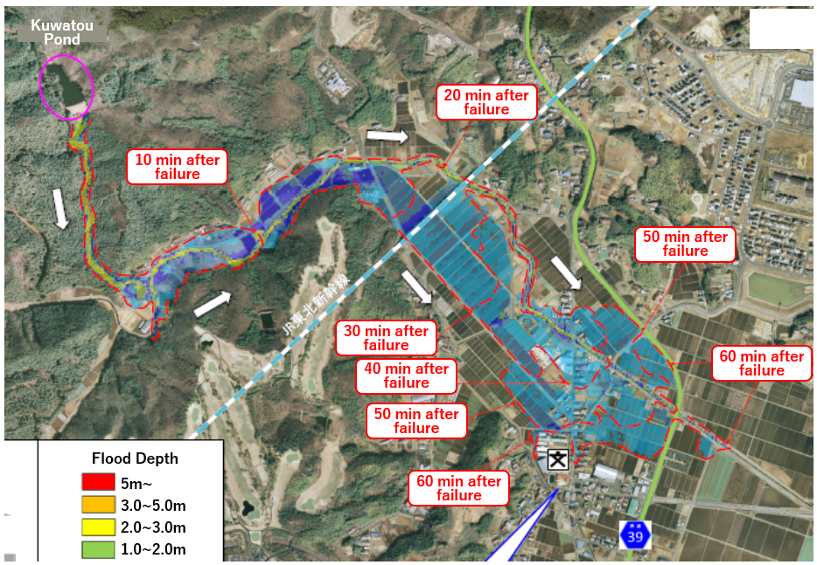
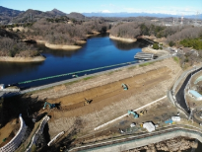
2.11 Dam-Safety Management and Operation (4)
The farmers’ association should inspect and reinforce the aged irrigation ponds
Example of Information Disseminated for the Failure of Ponds and Small Reservoirs
Seismic Resistance Reinforcing Works for Sannako Dam
Source: Natori City Office
Source: Agriculture and Rural Area Improvement Plan in Gunma Prefecture, 2020
Source: Agriculture and Rural Area Improvement Plan in Gunma Prefecture, 2020

Slide 90
2.11 Dam-Safety Management and Operation (5)
Integrated operation of multiple dams within the same river basin may achieve efficient water resources management.
Yagisawa Dam
Naramata Dam
Fujiwara Dam
Aimata Dam
Sonohara Dam
Kusaki Dam
Yanba Dam
Shimokubo Dam
Watarase Flood Control Basin
Dams Operated by the Tone River Dams Integrated Management Office
Source: Tone River Dams Integrated Management Office

Slide 91
2.11 Dam-Safety Management and Operation (6)
Advanced technologies can be effectively utilized in existing dam facilities.
Dams are enhanced by increasing the reservoir capacity with dam crest raising increasing the dam discharge capacity with additional facilities, installing hydropower equipment, and adding sediment discharge facilities.
Shin-Katsurazawa Dam for Dam Upgrading
Source: Sapporo Development and Construction Office, Hokkaido Regional Development Bureau

Slide 92
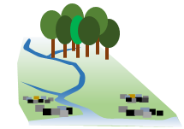
2.12 Environmental and Social Considerations of Large-Scale Projects (1)
The government should support rebuilding of local communities submerged by large-scale project to avoid fracturing or disappearing.
Act on Special Measures for Water Source Areas
Forest Environmental Tax
Support for Water Source Area in Whole River Basin
Three Acts for Power Development
Water Source Area Development Fund
Water Resources Tax
Overall Picture of Measures for Water Source Areas in Dam Construction
Source: Water Resources in Japan (FY 2014 Edition)

Slide 93
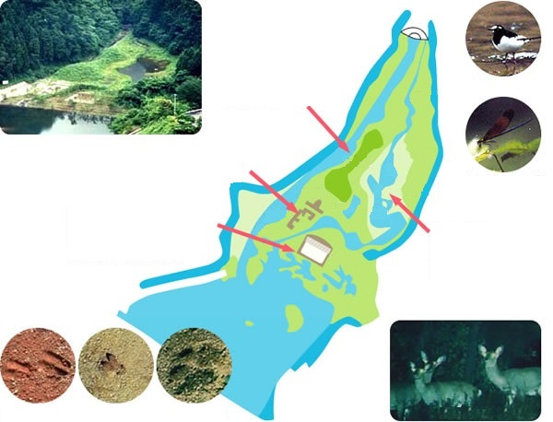
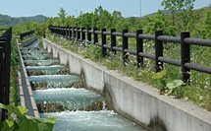


2.12 Environmental and Social Considerations of Large-Scale Projects (2)
Various environmental measures are implemented to avoid or mitigate adverse impacts. .
Environmental Measures
Twin Hills
Japanese wagtail
Stone Fence
Moat for Observation
Calopteryx cornelia
Fish Ladder of the Pirika Dam
Japanese deer footprints
Pond and Stream
Wild boar footprints
Raccoon dog footprints
Source: Website of Hakodate Development and Construction Department, Hokkaido Regional Development Bureau, MLIT
Higashizawa Biotope Created in the Miyagase Dam Area
Source: Website of the Sagami River Wide Area Dam Management Office

Slide 94
2.13 Human Resources Development and Technology Development (1)
In the Meiji era, the Japanese government promoted technological learning by inviting foreign civil engineers.
Technology Transfer
Inviting Foreign Civil Engineer
Studying Abroad
University advancement rate: 49% (Japan) at present
Human resource development
Basically, On-the-job Training (OJT)
Off-JT: training, lectures and seminars, acquisition of technical qualifications, and academic society activities

Slide 95
2.13 Human Resources Development and Technology Development (2)
The national government should develop and disseminate this technology.
Mechanisms should be established to utilize the technology developed by private companies.
Technology Development by the Government
Promotion of dissemination of technology of own research results.
National Institute for Land and Infrastructure Management (NILIM)
Public Works Research Institute (PWRI)
Technology Developed by Private Companies
Innovative River Management Project
Public Invitation to research and development in the river works

