Slide 1
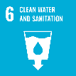
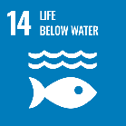


Theme1-3
Public Participation and Decision-Making Process
Meeting Diverse Needs by Building Water Governance

Slide 2
Contents
      Introduction
      Transparency in the Public Works Progress
      Reflecting the Will of the Residents in Projects
      Community and Private Sector Participation
      Lessons Learned

Slide 3
1. Introduction
What is Water Governance?
The water governance includes ;
Water management for flood protection and water utilization, and
Basic values and visions of the organizations and communities such as the idea of respecting the will and human rights of people, legality, reliability, and transparency.
Theme 1-3 describes:
Movement against dams by residents
Laws, policies, and systems related to public involvement
Necessity of project’s transparency (information disclosure, project re-evaluation)
Environmental conservation activities in cooperate with the government and the people

Slide 4
2. Transparency in the Public Works Progress
(1) Public Works Projects that affected Water Governance Reform
Three major projects became a turning point of water governance in Japan.
1953 to 1973
Matsubara and Shimouke Dams
Act on Special Measures for Water Source Area
Effected the rebuilding and restoration of residents' lives in the construction of the Kawabegawa and Yanba Dams
1968 to 1995
Nagaragawa River Mouth Barrage
Improvement of the transparency and accountability of public works projects
Effected residents’ participation, such as the River Basin Committee
1970 to 2020
Yanba Dam
Controversy on Policy, Science, and Technology
Special measures bill to promote specific areas accompanying the abolition of dam projects
Project re-evaluation involving experts
Three Major Public Works Projects Affected on Water Governance
Source: Project Research Team (PRT)

Slide 5
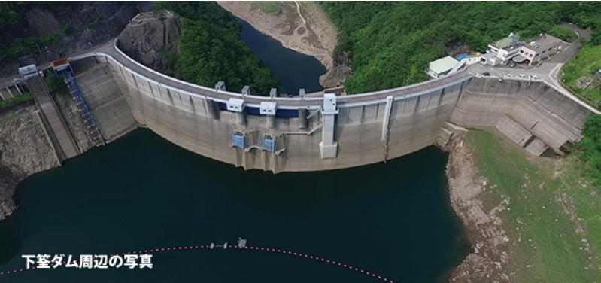
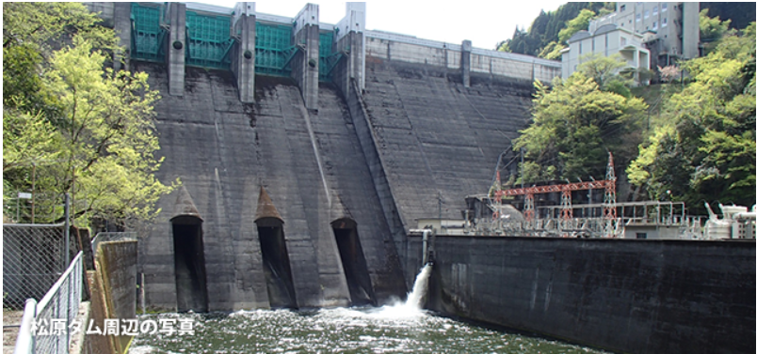
2. Transparency of Public Works Progress
(1) Public Works Projects that affected Water Governance Reform
1) Opposition Movement against Matsubara and Shimouke Dams
<1958> The explanation of compensation was insufficient. The residents came to have doubts for the construction project.
<1973> Dam was completed through the 13 years of protest movement.
Shimouke Dam
Emphasized importance of measures for water resource areas
<1973> The Act on Special Measures for Water Sources Areas
Matsubara Dam
Source: Chikugo River Dams Integrated Management Office

Slide 6
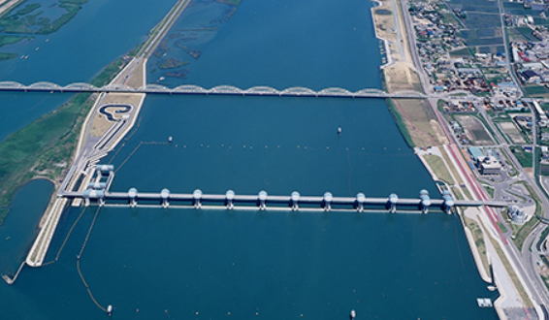
2. Transparency of Public Works Progress
(1) Public Works Projects that affected Water Governance Reform
2) Problems of Nagaragawa River Mouth Barrage
<1968> construction plan was decided.
Nationwide opposition movement by various stakeholders
Source: Japan Water Agency (JWA)
<1995> Construction completed.
Nagaragawa River Mouth Barrage
<1997> Revision of River Law
Public opinions started to be reflected in the formulation of river improvement plans.
Necessity of information disclosure and building consensus at the planning stage

Slide 7
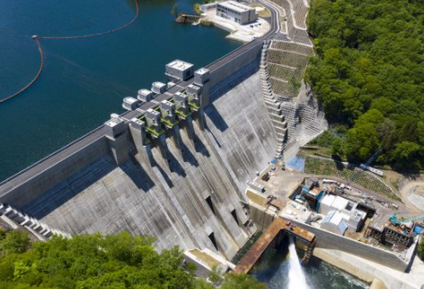
2. Transparency of Public Works Progress
(1) Public Works Projects that affected Water Governance Reform
3) Political and Scientific Argument on Yanba Dam Project
<1949> Construction plan was decided.
<1985> Residents accepted the project with Reconstruction Plan of Livelihood.
Source: Gunma prefecture
Yanba Dam
<2009> The construction of the main body was suspended due to the change of government.
The MLIT concluded the most advantageous plan is Yanba Dam in terms of science.
<2010> Re-examination of Yanba Dam started in terms of science.
<2020> Construction completed.

Slide 8
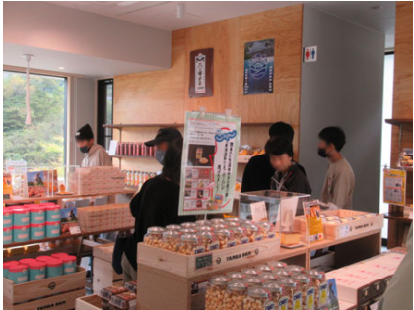
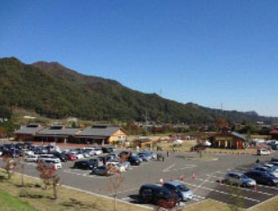
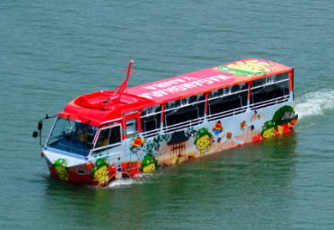
2. Transparency of Public Works Progress
(1) Public Works Projects that affected Water Governance Reform
4) Rebuilding Livelihood Measures of Yanba Dam Project
Submerged area is supported in various ways.
Relocation Lands for Submerged Residents
Regional Development Facilities
Infrastructure Tourism Initiatives
Relocation land and financial source are described in Themes 3 and 9.
Souvenir Shop
Roadside Station
Amphibious Bus
Source: Visit Gunma, Gunma prefecture

Slide 9
2. Transparency of Public Works Progress
(2) Information Disclosure
Various information are disclosed to the public in a various way.
1966
Freedom of Information Act (FOIA) in America
Example of disclosed data
1968
Plan of Nagaragawa River Mouth Barrage Project
1970~
Information disclosures began to be discussed in Japan
Survey
Result
Controversial issue about information disclosure
1982
Establishment of information disclosure ordinance in Kanayama Town, Yamagata Prefecture
Budget
Technical Report
Hydrological data
1995
Re-evaluation of public projects by review committee
Completion of Nagaragawa River Mouth Barrage
Committees
Hazardous Areas
1997
Revision of the River Law (in terms of environment and reflection of residents’ opinion
2001
Political Measures
Act on Access to Information
Source: PRT
Background of Information Disclosure
Source: PRT

Slide 10
2. Transparency of Public Works Progress
(3) Evaluation of Policies and Projects
1) System of Project Re-evaluation
The viewpoints in re-evaluating are:
project necessity
project progress forecast
possibility of cost reduction and alternative planning
Through project re-evaluation, projects with high effectiveness and efficiency are implemented.
Projects are to be re-evaluated to decide whether to “continue” or “stop”.
Planning
Implementation
Operation
Planning-phase Evaluation
Re-evaluation
Post Evaluation
Source: PRT
Every 3 or 5 years
within 5 years after completion

Slide 11
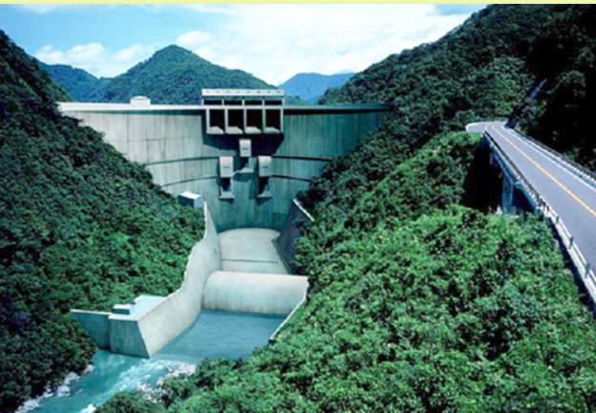
2. Transparency of Public Works Progress
(3) Evaluation of Policies and Projects
2) Reigniting the Debate on the Kawabe River Dam
Strong opposition movement by residents on compensation, necessity, flood, water utilization, environment
<2001~2017> Project Re-evaluation was conducted 5 times.
<2008> Policy change to dam-free flood protection
<2009> Construction of dam body was suspended.
<2020> The Flood in Kuma River caused serious damage.
Source: Japan Dam Foundation
Requested to construct a dam of water-flowing type.
Completion Image of Kawabe River Dam

Slide 12
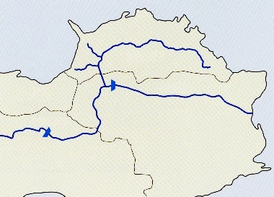
2. Transparency of Public Works Progress
(4) Turning Conflict to Cooperation: Consensus Building in Inter-basin Water Supply
1) Conflict among Prefectures over Water Diversion Project
Sanuki Mountains
Kagawa Pref. had suffered from water shortages.
Seto Inland Sea
Kagawa Pref.
Water diversion from Yoshino River running through Tokushima Pref. was required to Kagawa Pref.
Kagawa Canal
Ehime Pref.
Ikeda
Dam
Shingu Dam
Yoshino River
Tokushima Pref.
The Kagawa Water Canal Project
Sameura
Dam
Kochi Pref.
The Sameura dam required resettlement in Kochi Pref.
Conflicts between prefectures
Source: Kagawa Canal Management Office, JWA
Yoshino River Comprehensive Development Plan

Slide 13
2. Transparency of Public Works Progress
(4) Turning Conflict to Cooperation: Consensus Building in Inter-basin Water Supply
2) Issues for the Realization of Kagawa Canal Construction Project
Agreement for the construction of the Sameura Dam
Tokushima Pref. agreed with the construction of the Sameura Dam because Tokushima Pref. was designated to locate New Industrial City and required abundant water resources.
The compensation negotiation by Kochi Pref took over ten years. The agreement was finally reached by replacement of roads, construct. of resettlement land, compensation, financial supporting measures, etc.
Some farmers in Kagawa Pref. didn’t require the Project because they had ponds.
Farmers’ agreement in Kagawa Pref. to the Project
Kagawa Prefecture explained to the farmers and irrigation associations about 400 times over a period of about two years to obtain their consent.

Slide 14
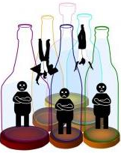
3. Reflecting the Will of the Residents in Projects
(1) Establishment of Water Governance for Each River Basin
Water governance should be built according to the local conditions for each river basin and river system.
Water governance should be built depending on the region.
No single model exists because circumstances differ from river basin to basin .
It is difficult to meet all needs for vertically divided administrative functions.
Bottles are governments.
Citizens fall through the gap in bottles.
Source: Japan Water Forum
Vertically Divided Administrative Functions

Slide 15
3. Reflecting the Will of the Residents in Projects
(1) Establishment of Water Governance for Each River Basin
Water governance should be built according to the regional condition.
The River Law was revised.
  To reflect feedback of opinions of the people concerned and others to the River Improvement Plan.
  To hear the opinions of experts and residents.
  To hold public hearings.
River Basin Committees are established.

Slide 16
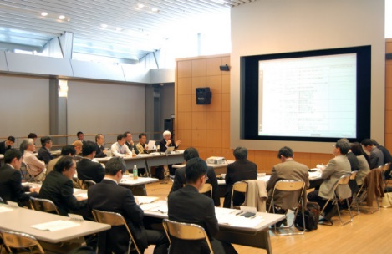
3. Reflecting the Will of the Residents in Projects
(1) Establishment of Water Governance for Each River Basin
1) Yodo River Basin Committee
Catchment area: 8,240 km²
Involved various parties concerned from the early stage of drafting river improvement plan.
Kept transparency and objectivity.
Adopted approach for the participants to recognize issues in the basin and consider and discuss potential solutions.
The opinions were in conflict especially on the dam construction.
Even six years after the start of the deliberation, the policy and plan were not formulated.
Source: Yodo River Basin Committee
The 85th Committee

Slide 17
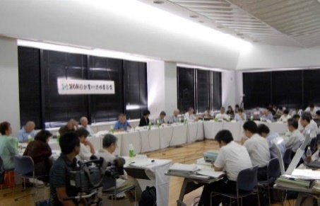
3. Reflecting the Will of the Residents in Projects
(1) Establishment of Water Governance for Each River Basin
2) Muko River Basin Committee
Catchment area: 496km²
Discussed from the beginning stage of formulating the basic policy including the Muko River dam construction.
Established with academic experts and publicly recruited residents as the members.
Held committee meetings 49 times in total.
In the end, a part of the plan were not accepted completely and alternative one was prepared.
Through the continuous discussion, a great majority of participants agreed.
Source: Muko River Basin Committee News 32
The 68th Committee

Slide 18
3. Reflecting the Will of the Residents in Projects
(2) Trial and Error to Improve Decision-making
Various consultation systems and methods should be pursued to achieve better water resources management.
(1) Points of Consensus Building
Pursue a consensus that everybody can accept.
Ask people to think about the benefit of whole region
(2) Consultation Methods
Explanatory Meeting
Public Hearing
Committee
Workshop
Task Force
Orientation
Mediation

Slide 19
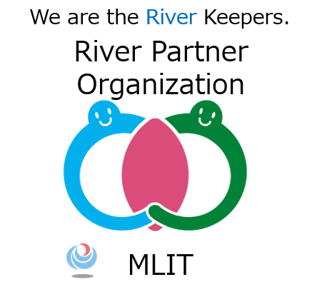
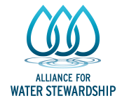
4. Community and Private Sector Participation
(1) Water Environment Conservation Activities
The public and private sectors should cooperate in water environment conservation activities.
Designation of Private organizations as River Partner Organization
Citizen Participation through Workshops such as Good-river and River-improving Workshop
CSR Activities by Private Companies such as Water Stewardship (water environment conservation activities)
Source: MLIT
Logo of River Partner Organizations
Source: Alliance for Water Stewardship
Logo of Water Stewardship

Slide 20

4. Community and Private Sector Participation
(2) Recent Notable Activities for Water-Environment Conservation
Forest-Village-River-Sea Project contributes to local society and economy by promoting the conservation and restoration of the natural environment.
secure the connection between forests, villages, rivers, the sea
What is the blessings of the nature?
MOE
Source: The Ministry of the Environment
Forest-Village-River-Sea Project

Slide 21
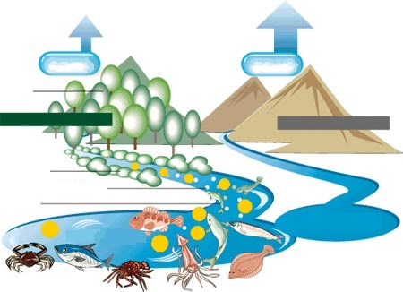
4. Community and Private Sector Participation
(2) Recent Notable Activities for Water-Environment Conservation
Forest for Fish Breeding is one of the protection forests designated in accordance with the Forest Act.
Forests of about 60,000 ha have been designated as Forest for Fish Breeding in Japan.
Evaporation
15%
Evaporation
40%
Forest
Mountain w/ Forest
Mountain w/o Forest
Riparian Forest
Plankton
Nourishment
Fish
Innutritious Poor Sea
Nutritious Rich Sea
Source: UMI & NAGISA Foundation, OPRI, Ocean Newsletter No.23 (July 2001)
Fish Breeding Functions of Forest

Slide 22
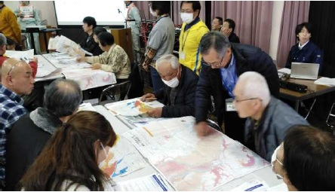
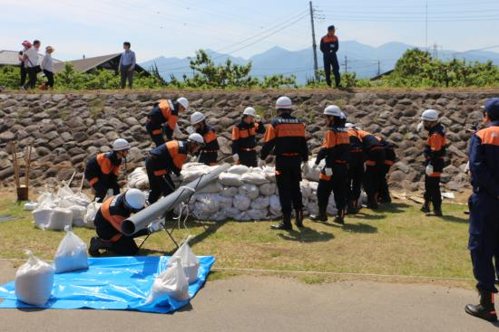
4. Community and Private Sector Participation
(3) Roles of Individuals and Companies in Disaster Measures
It is important to promote efforts so that every single citizen can regard the disaster as “my own event” and make action voluntarily.
Rebuilding Flood-Conscious Societies through making My Timeline
Disaster Prevention Activity by Flood Fighting Teams
The individual disaster prevention plan
Source: MLIT
Source: MLIT
My Timeline Preparation Course
Flood Protection Activities and Drill

Slide 23
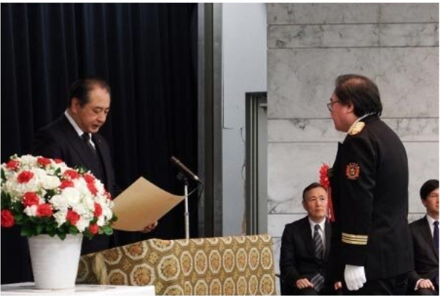
4. Community and Private Sector Participation
(4) Establishment of an Award System
It is expected to increase the motivation by giving commendations to the activities of private organizations and individuals.
Flood-fighting-related Awards
River Contributor Awards
Japan Water Prize and Japan Stockholm Junior Water Prize
Source: MLIT
The Vice Minister Presenting the Award

Slide 24
5. Lessons Learned (1)
  (1) Water resources could be managed by establishing water governance that involves local communities and stakeholders from the planning stage.
  Japanese experience shows that a top-down approach driven by government organizations cannot respond to various needs of local communities. A legal framework also needs to be established to arrange governance. The River Act was revised to promote public participation in the decision-making processes of policies and plans for river basin improvement in Japan. Access to information through a variety of means is a prerequisite for the consensus building process.

Slide 25
5. Lessons Learned (2)
  (2) Governance should be established in each river basin according to local conditions.
  To reflect a wide range of opinions from academic experts and residents, a committee or forum should be formulated. It may take a long time to reach a consensus among a wide range of stakeholders. There is no single right answer for how to reach a consensus. The Yodo River Basin Committee and other river committees took innovative approaches. A comprehensive understanding of the situation and issues is needed.

Slide 26
5. Lessons Learned (3)
  (3) Mechanism of reviewing projects may improve transparency and accountability.
  Changes in socioeconomic conditions may reduce the necessity of projects. Governments need to review and revise project activities according to changes.
  (4) It is important to strengthen cooperation among the public and private sectors and local communities for environmental conservation and disaster management.
  Local communities and residents need to prepare for disasters in accordance with local conditions. The private sector may provide solutions to various issues by utilizing its resources. The government may support these activities through financial support, training, and awards.

