Slide 1




Theme 2-2
River Basin Planning
Optimizing Management Using River Basin as a Planning Unit

Slide 2
Contents
      Introduction
      Planning for the Improvement and Management of Rivers
      Plans for Water Cycle Recovery
      Lessons Learned

Slide 3
1. Introduction
Consequences of Development Without River Basin Plan:
Uncontrolled deforestation and agricultural development
Degradation of basin’s water-retaining function
Increase of surface soil erosion
Uncontrolled water intake
Degradation of ecosystem, water quality and quantity
In return, the above would affect the water abstraction and flood damages
Theme 2-2 describes:
Methods used for the development and management of water resources needed to ensure a healthy water cycle in Japan.

Slide 4
2. Planning for the River Improvement and Management of Rivers
(1) Management of Meteorological and Hydrological Observation Data and Inclusion in Planning
It is necessary to gather and manage the basic meteorological and hydrological observation data.
Japan Meteorological Agency (JMA) has 1,300 rainfall stations.
MLIT has regulations on observation:
  Rules for Hydrological Observation Services
  Detailed Rules for Hydrological Observation Services
  Guidelines for Quality Verification of Hydrological Observation Data
MLIT has the database of observed data registering more than 6,000 stations for rainfall, water level and discharge, etc.

Slide 5
2. Planning for the River Improvement and Management of Rivers
(2) Basic Policy for River Improvement Plans
In Japan, a long-term "Basic Policy for River Development" is established.
Based on this Policy, “River Improvement Plan (RIP)" is formulated for each river system,
RIP sets goals for the immediate future (20-30 years) on details of RIP and maintenance.

Slide 6
2. Planning for the River Improvement and Management of Rivers
(2) Basic Policy for River Improvement Plans
Item | Basic Policy of River Development | River Improvement Plan
Composer | River Administrator | River Administrator
Procedure | Hearings of opinions of the Social Infrastructure Development Council (prefectural river councils for Class B river systems) To be published after Policy formulation | Hearings of opinions of relevant local governments Hearings of opinions of academic experts and concerned residents To be published after Plan formulation
Contents | Basic Policy of river improvement from a long-term perspective Concept of river improvement without specifying details such as individual projects | Goals of river improvement in 20~30 years Specific details of river improvement including individual projects planned
Note: Small rivers managed by municipalities (locally designated rivers and ordinary rivers) are excluded from the table.
Source: MLIT, Technical Criteria for River Works, Practical Guide for Planning (March 2008)

Slide 7
2. Planning for the River Improvement and Management of Rivers
(3) Flood Protection
1) Safety Level of Flood Protection
Importance of Rivers and Safety Level of Flood Protection Plan
River Importance | Design Flood Scale (Return Period) | River Administrator | Planning Conditions (e.g., Land Use)
A | More than 200 years | National government | Major cities, nature restoration projects, major dam projects, rivers crossing prefecture boundary
B | 100 – 200 years | Ditto | ditto
C | 50 – 100 years | Prefecture government | Cities
D | 10 – 50 years | ditto | Others
E | Equal to or less than 10 years | ditto | Others

Slide 8
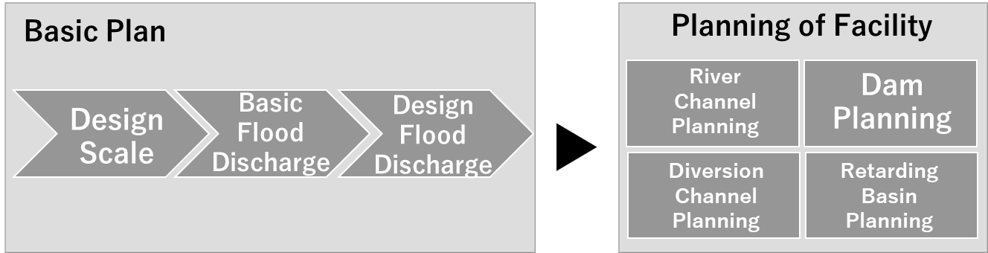
2. Planning for the River Improvement and Management of Rivers
(3) Flood Protection
2) Basic Flood Protection Plan
Source: Project Research Team (PRT)
Workflow from Flood Protection Plan to Facility Planning
Source: MLIT website
Example of Design Flood Discharge Distribution

Slide 9
2. Planning for the River Improvement and Management of Rivers
(3) Flood Protection
3) River Channel Planning
Quantitative safety (discharge capacity)
Qualitative safety (safety of river management facilities)
Minimizing the total cost (including maintenance costs)
Development and conservation of river environment (conservation and restoration of the environment and harmonization with river use)
Land use along river
History and culture of river and region

Slide 10
2. Planning for the River Improvement and Management of Rivers
(3) Flood Protection
4) Flood Protection of Arakawa River
The Arakawa River is an important river in the Tokyo Metropolitan Area.
Catchment area is 2,940 km².
The population within the river basin is 9.3 million.
The assets in the potential inundation area is estimated at about JPY 78 trillion.
The safety level or design discharge for flood protection is set at once in 200 years (1/200).

Slide 11
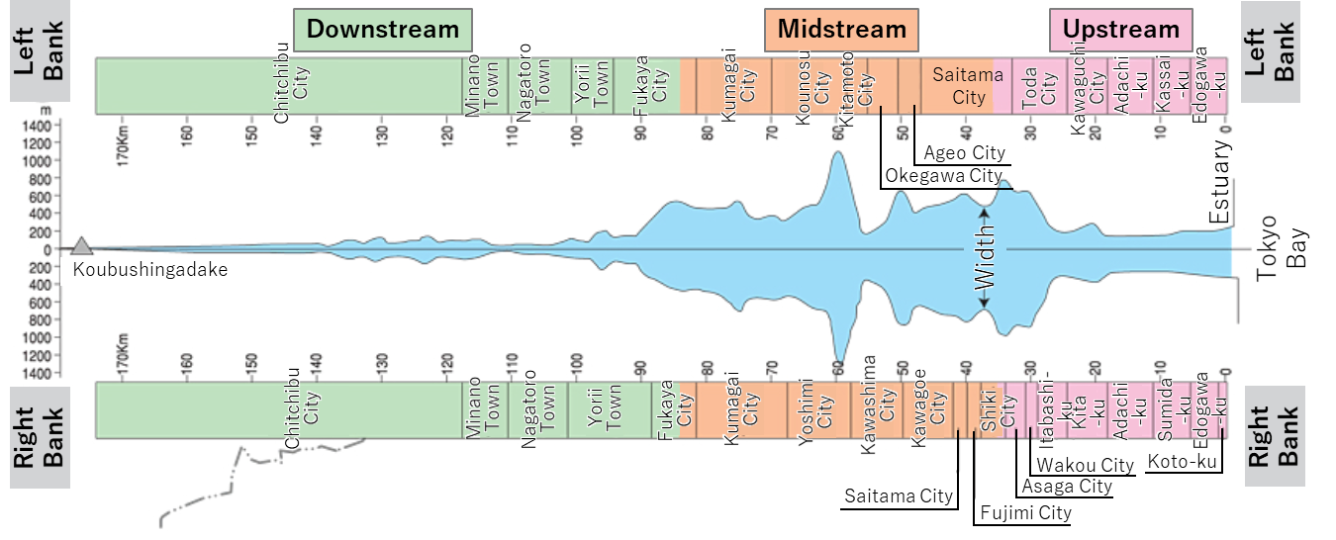
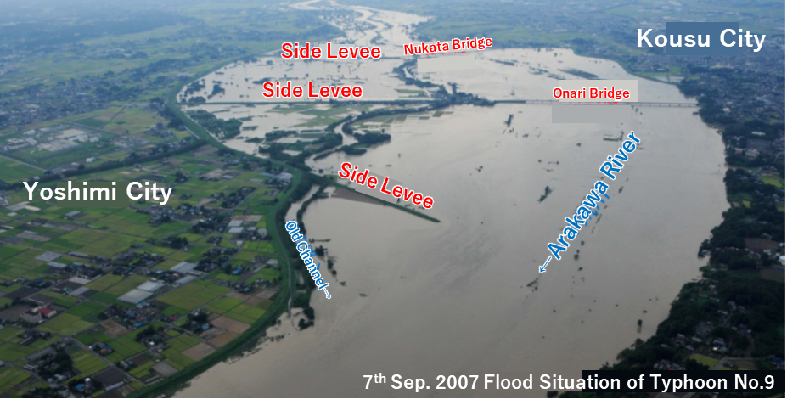
2. Planning for the River Improvement and Management of Rivers
Narrow manmade bypass for quick water-discharging from retarding area
(3) Flood Protection
4) Flood Protection of Arakawa River
Source: MLIT
Wide middle reaches for retarding flood to protect downstream cities
Source: MLIT website
Source: MLIT

Slide 12
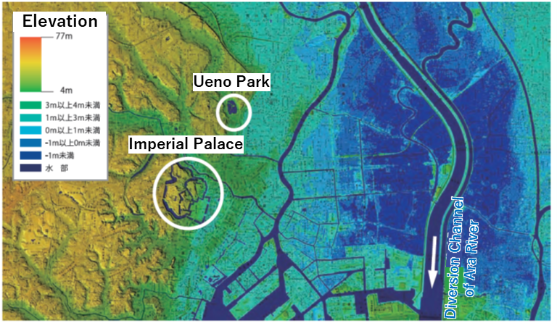
2. Planning for the River Improvement and Management of Rivers
(3) Flood Protection
4) Flood Protection of Arakawa River
High Standard Levee to avoid catastrophic damage in case of floods exceeding design scale
Source: MLIT
Concept of High Standard Levee
Ground subsided by 4 m and levee height raised
Source: MLIT
Ground Level around the Bypass of Arakawa River

Slide 13
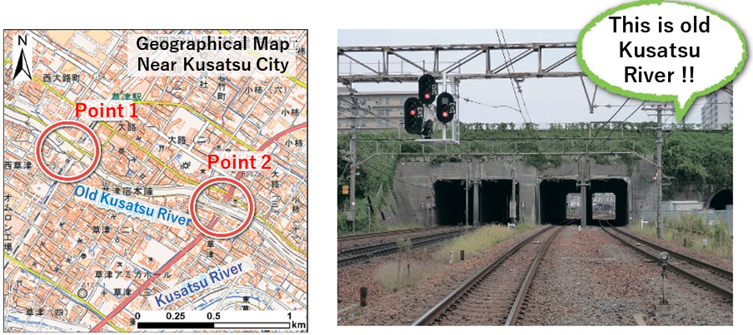
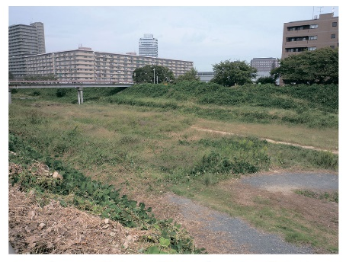
2. Planning for the River Improvement and Management of Rivers
(3) Flood Protection
5) “Ceiling River” in Japan
Sediment depth deposited on riverbed, viewed at Point 1
Railroad runs underneath the river at Point 1
Source: Geographical Survey Institute
Source: Geographical Survey Institute
Example of Ceiling River

Slide 14
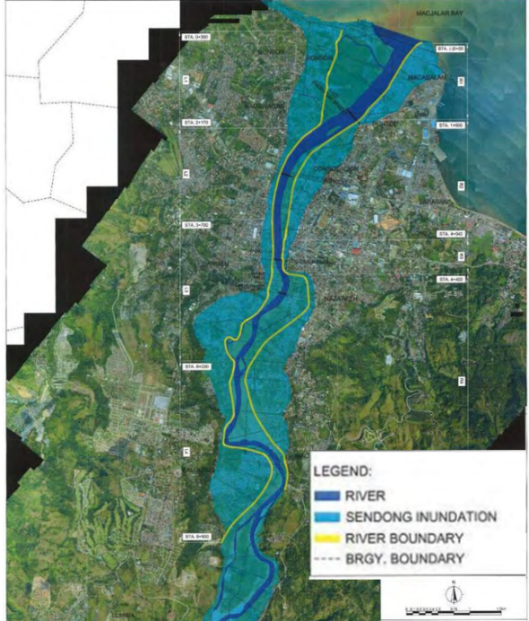
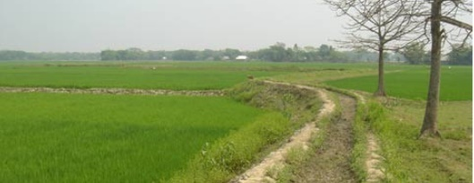
2. Planning for the River Improvement and Management of Rivers
(3) Flood Protection
6) Application of the Japanese Flood Protection Technology in Foreign Countries
Levees are in the middle of the floodplain.
Levees protects paddy from flooding until the harvest completed
Source: JICA
Source: JICA
Floodplain and Riverine Areas (Cagayan de Oro River in Philippines)
A submerged Levee Protects Paddy from Flooding (Hoar District, Bangladesh)

Slide 15
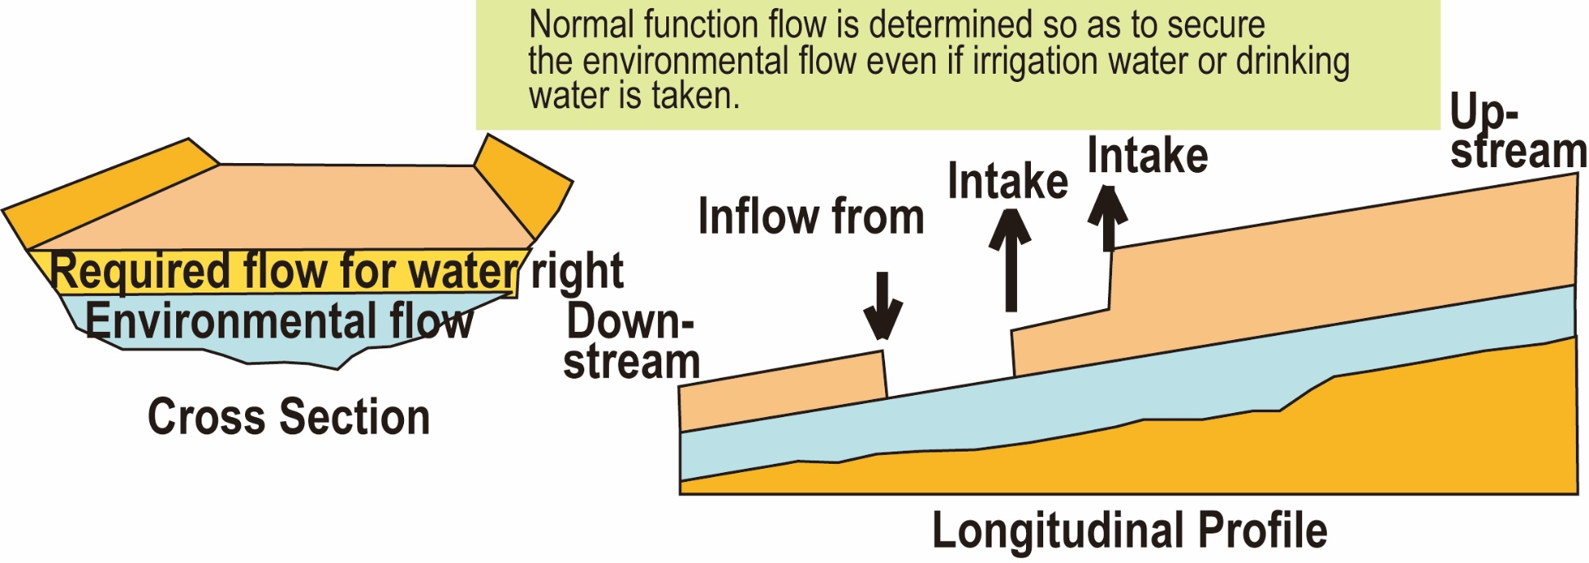
2. Planning for the River Improvement and Management of Rivers
(4) Water Use and Drought Management
1) Normal Function Flow
Source: Prepared by Project Research Team based on Hyogo Prefecture website
Image of Defining Normal Function Flow

Slide 16
2. Planning for the River Improvement and Management of Rivers
(4) Water Use and Drought Management
2) Safety Level
Target frequency of Drought is once in ten years (1/10) in Japan.
USA (California, San Francisco, New York): The severest drought in history.
Australia (Southeast Queensland): Once in 100 years.
United Kingdom (UK: London): Once in 50 years.

Slide 17
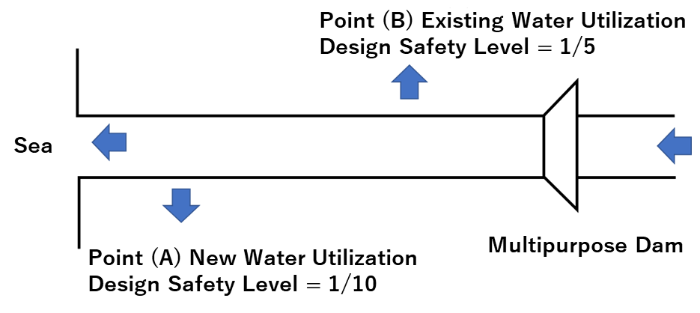
2. Planning for the River Improvement and Management of Rivers
(4) Water Use and Drought Management
3) Coverage of Costs by the Government for Supplying Water to Existing Irrigation Users
A multipurpose dam may be constructed to supply water to a new water user at Point A with a planned safety level (1/10).
An existing water right holder for irrigation at Point B. Water may be abstracted with a safety level (1/5).
Source: PRT
Diagram of the Water Use Point

Slide 18
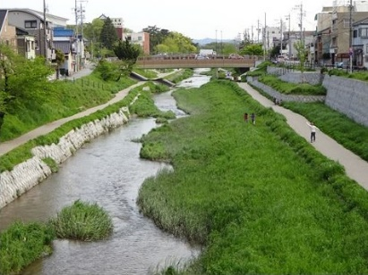
2. Planning for the River Improvement and Management of Rivers
(5) Conservation of the Water Environment
“Nature-friendly river works" as the basis for all river development
It aims at preserving and restoring a good river environment while ensuring the necessary flood-protection safety and minimizing the impacts on the good habitat and growth environment of living things.
Source: MLIT website
Nature-­friendly River Works on Iga River

Slide 19
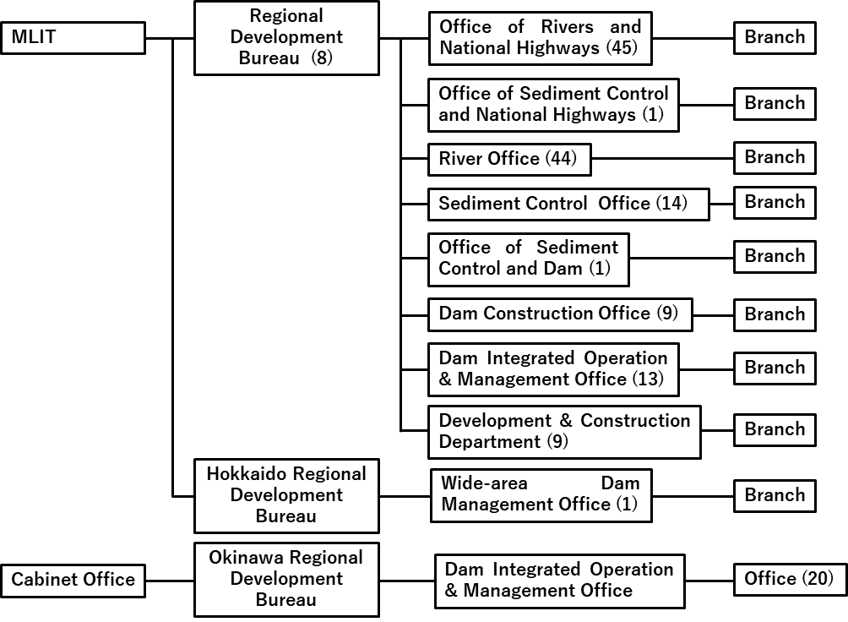
2. Planning for the River Improvement and Management of Rivers
(6) Institutional Arrangement
MLIT has a river office for each river basin, and a branch office thereunder. There are about 140 offices related to rivers, dams, and Sabo works.
Source: Project Research Team based on Cabinet Secretariat Documents
National River-related Offices

Slide 20
3. Plans for Water Cycle Recovery
(1) Promotion of Basin Management
The River Basin Water Cycle Plan includes
Current and future issues
Principles and future goals
Goals for maintaining or restoring the sound water cycle
Measures to achieve the goals
Indicators to show current status of the water cycle and progress of the Plan

Slide 21
3. Plans for Water Cycle Recovery
(2) River Basin Water Cycle Plan
An example of Healthy Water Cycle Plan of Lake Inba Basin
Projects for water quality improvement and conservation
Regulations for water quality conservation
Cleanup of rivers flowing to the Lake
Cleanup of the Lake
Runoff management in the basin
Source: Lake Inba Basin Healthy Water Cycle Conference
Location of Lake Inba

Slide 22
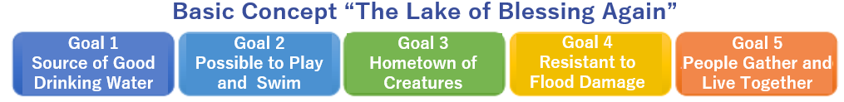
3. Plans for Water Cycle Recovery
(3) Example of the River Basin Water Cycle Plan
“Healthy Water Cycle Plan of the Lake Inba Basin” in Chiba Prefecture is introduced. It is located to the east of Tokyo.
Lake Inba is an aquatic habitat characterized by rich and pure water, supporting agriculture and fishery.
Urbanization gave rise to an increase in the pollution load from domestic wastewater.
In 2016, “Plan for Healthy Water Cycle in the Lake Inba Basin” was formulated with a target of 2030.
The plan has five goals as shown below:
Source: Healthy Water Cycle Conference of Lake Inba Basin, March 2017

Slide 23
3. Plans for Water Cycle Recovery
(3) Example of the River Basin Water Cycle Plan
The following countermeasures are being implemented:
1) Improving sewerage systems (install combined treatment septic tanks) and agricultural drainage facilities (livestock waste treatment facilities).
2) Tightened effluent standards, pollution load control, effluent control, and guidance for small businesses.
3) Purification of inflowing river water by nature-friendly river works, river cleaning, and channel dredging.
4) Purification of lakes using aquatic plants, maintenance of vegetation zones, and lake cleaning.
5) Installation of infiltration and storage facilities for urban effluent (permeable pavement), and control of fertilizer in the drainage from farmland.

Slide 24
4. Lessons Learned (1)
  (1) Water resources should be managed using a river basin as the planning unit.
  A water resource management plan should be developed according to the individual characteristics and customary practices in the basin. The plan should also ensure consistency among sectors throughout the basin, set management goals, and optimize facility development and environmental management throughout the river basin. An extensive database of hydrological data is needed to develop this plan.
  (2) Master and action plans are crucial for effectively managing a river.
  In Japan, the River Law stipulates that river management offices should formulate the Basic Policy for River Improvement as a master plan for the comprehensive conservation and use of water resources, and the River Improvement Plan as an action plan with a timeline of for 20‒30 years, specifying actions including individual projects.

Slide 25
4. Lessons Learned (2)
  (3) To manage drought and flood disasters, targets of safety levels should be set for their development.
  In Japan, the drought safety level has been generally set at 1/10, and the flood protection safety level is determined based on the importance of the target river basin. Storage facilities and levees are planned to satisfy these requirements.
  (4) Local offices are needed to respond to local needs in the field.
  The RMOs should be established to help understand key local issues and the needs of water resources management. In addition, given the need to collaborate with various related organizations and local communities, it is important to build trusting relationships with these organizations.

Slide 26
8. Lessons Learned (4)
  (5) Collaboration among various stakeholders is needed to recover from water cycle deterioration.
  Urbanization has resulted in increased basin damage in the water cycle of river flow and groundwater in a river basin. Additionally, an increased water demand has increased groundwater exploitation and subsequent surface water rise, causing environmental function to decline, depleting spring water, and exacerbating water pollution. Japan began formulating river basin plans and management systems by engaging multiple stakeholders to establish a healthy water cycle.

