Slide 1

Theme3
Finance
Sharing Responsibilities and Costs among Stakeholders

Slide 2
Contents
      Introduction
      Financial Framework of Water Resources
      Cost Allocation in Water Resources Development
      Lessons Learned

Slide 3
1. Introduction
Why is funding essential for water resource project?
Water resources projects require a huge cost and a long period of time.
Financial support well-balanced development of national land and water resources.

Slide 4
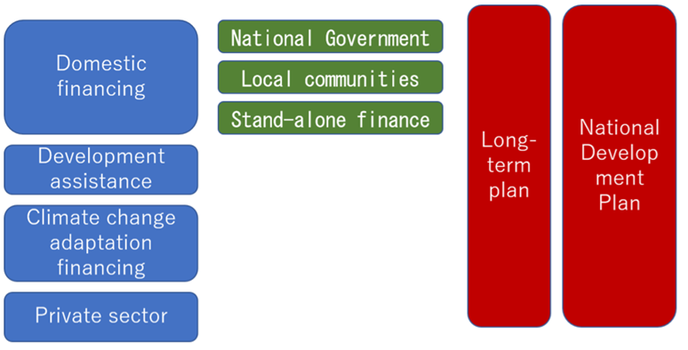
2. Financial Framework of Water Resources
(1) Legal Systems
1) Financial Arrangement
Source: Ishiwatari, M. and Akhilesh S. "Good enough today is not enough tomorrow: Challenges of increasing investments in disaster risk reduction and climate change adaptation." Progress in Disaster Science 1
Financial for Water Resources Development and Management

Slide 5
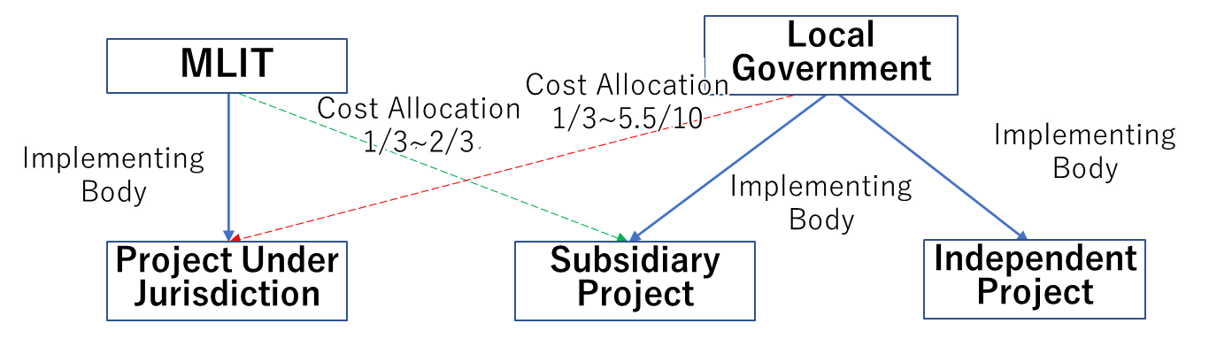
2. Financial Framework of Water Resources
(1) Legal Systems
2) Legal System of Cost Sharing for Water Resources Projects in Japan
Source: Project Research Team
Cost Sharing in Projects under the Jurisdiction and Subsidiary Projects

Slide 6
2. Financial Framework of Water Resources
(1) Legal Systems
2) Legal System of Cost Sharing for Water Resources Projects in Japan
Sharing of Project Costs
Purpose | River Type | Cost Sharing
River Administrator (Flood Protection) | Class-A River | MLIT 2/3, Prefecture 1/3
 | Class-B River | MLIT 1/2, Prefecture 1/2
Irrigation |  | Beneficiaries 1/10, of the rest, National Government (MAFF) 3/4, Prefecture ¼
Water Supply |  | 1/2 – 1/3 of government subsidy (MHLW)
Sewerage |  | Public Sewerage : Main Culverts 1/2, Final treatment plant 1/2 or 5.5/10 Basin Sewerage : Main Culverts 1/2, Final treatment plant 1/2 or 2/3)
Industrial Water Supply |  | Government subsidy within 40% (METI)
Power Generation |  | In principle the cost is to be borne by the power company (charges from the electricity consumers)

Slide 7
2. Financial Framework of Water Resources
(1) Legal Systems
3) History of Financial Systems
History of Act and Subsidy
Year | Act or Subsidy
1896 | The River Law
1899 | Act for Agricultural Land Improvement
1908 | Subsidies for individual land improvement works
1911 | Special Account Act for Flood Protection, Electricity Business Act
1940 | Subsidy for river-water control projects related to Dam and reservoir
1957 | Multi-Purpose Dams Act
1961 | Water Resources Development Promotion Act Water Resources Development Corporation Act
1962 | Act on Emergency Measures for Erosion and Flood Protection A special account for flood protection
1966 | The government bonds for construction

Slide 8
2. Financial Framework of Water Resources
(2) Framework of Diverse Funding
1) Special Accounts
1) Framework of Special Account for Flood Protection
Source: "Problems of Flood Protection Projects and Flood Protection Policy" (Toshiyuki Kamimura, Toyo University)
Revenue Sources of the Special Account for Flood Protection

Slide 9
2. Financial Framework of Water Resources
(2) Framework of Diverse Funding
2) Removal of Special Accounts
The Special Account had an issues;
Blocked clarity of public finance
Implementation of Projects with low need and low urgency
Waning the significance of the special account
Unused or carried-over funds
Unclear benefits and costs in transfers and borrowing from the general national account
Difficult monitoring
The special account for social infrastructure promotion projects was abolished and included in the general national account.

Slide 10
2. Financial Framework of Water Resources
(2) Framework of Diverse Funding
2) Government Bonds for Construction
Public works are financed by issuing government bonds or by borrowing.
As future generations will also benefit from public facilities, they should also bear the costs as well.
Government bonds for construction are issued within the amounts decided by the National Diet.

Slide 11
2. Financial Framework of Water Resources
(2) Framework of Diverse Funding
3) Fiscal Investment and Loan Program (FILP)
Source: Prepared by simplifying " Structure of Fiscal Investment and Loan Program" by the Ministry of Finance.
The FILP Framework

Slide 12
2. Financial Framework of Water Resources
(2) Framework of Diverse Funding
4) Charges for Use of River Water (Water Rights Fees)
Prefectural governments collect charges for river water use.
These charges are exempted for use in domestic water supply, public power generation, and irrigation.
Most of these charges are collected from private companies operating in power generation and industrial water supply.

Slide 13
2. Financial Framework of Water Resources
(2) Framework of Diverse Funding
5) Subsidies for Urgent Disaster Rehabilitation Works
1) It covers various public facilities of rivers, coasts, landslide protection, roads, ports, fishery ports, sewerage, and parks.
2) It assesses project costs immediately after disasters and promptly secures supplementary budgets.
3) It helps starting work promptly, often on the day of the disaster, before cost estimation by providing subsidies retroactively.
4) It aims at functional rehabilitation, and not necessarily reviving the original forms.
5) It provides a package budget to each prefecture covering all rehabilitation works so that prefectural governments have flexibility in project implementation.

Slide 14
2. Financial Framework of Water Resources
(2) Framework of Diverse Funding
6) Farmers are Responsible for Irrigation Facilities
Example of Subsidy-Responsibility Ratio for Land Improvement
Projects | Nation | Prefecture | Municipality | Local
National Projects for Irrigation and Drainage | 75 | 25 | 5 | 0
Prefectural Project for Irrigation and Drainage | 50 | 25 | 10 | 15
Prefectural Projects for Farmland-Disaster Prevention | 55 | 37 | 8 | 0

Slide 15
2. Financial Framework of Water Resources
(2) Framework of Diverse Funding
7) Public Private Partnership for Supply and Sewerage Services
Types and Number of PPP for Water Supply and Sewerage Services
Type | Details of Privatization
Business Outsourcing | Outsource the entire operation and management of the water purification plant Private companies undertake overall operation and maintenance.
DB (design, build)or DBO (design, build, operation) method | Performance-based contract Private sector utilize its knowhow and complement the human resources for more efficient operations compared with normal outsourcing.
PFI (conventional method) | In addition to the DBO method, outsource to the private sector including financing.
PFI (Concession method) | Private contractors can participate in the operation of the water supply business as well as to set charge rates flexibly within certain range.

Slide 16
2. Financial Framework of Water Resources
(2) Framework of Diverse Funding
8) Cost Bearing by the Private Sector
“River Basin Disaster Resilience and Sustainability by all”
in which all parties involved in the basin, that is, the national government, local governments, private sector, and residents jointly implement countermeasures.
Rainwater-storing and infiltration facilities are necessary
The public sector provides subsidies for facility construction and exempts taxes to reduce the maintenance and management costs.

Slide 17
3. Cost Allocation in Water Resources Development
(1) Cost Allocation by Specific Multi-Purpose Dams Act
River administrators, the Minister of MLIT or prefectural governments, have unified responsibility for construction and management of multipurpose dams.
Co-ownership is not provided to the water users regardless of their allocation in the construction cost. Instead, the right to use the dam is provided.
The calculation method to allocate the construction and management costs is established for the water users.

Slide 18
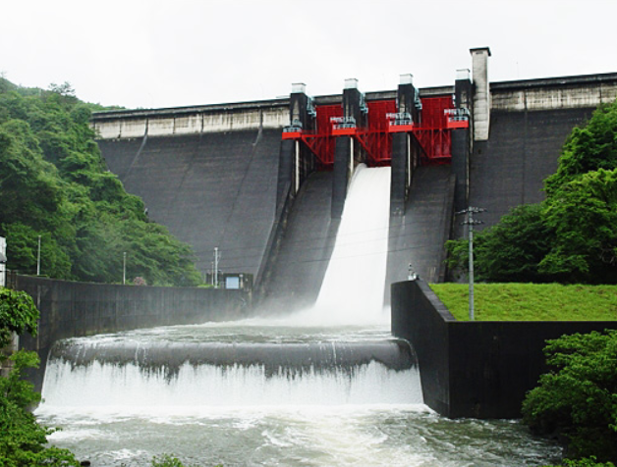
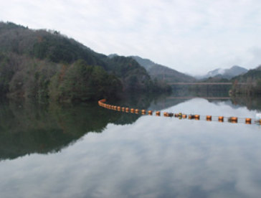
3. Cost Allocation in Water Resources Development
(2) Public Finance and Advanced Investment
Upon completion of multipurpose dams, Water Resources Development Corporation (WRDC) can recover the funds on instalment basis from the local governments and beneficiaries.
In the case of Muroo Dam,
Storage capacity is 14.3 million m³
6.45 million m³ was for new irrigation water use.
301/1,000 of the construction cost was allocated to water use.
Muroo Dam
Muroo Reservoir

Slide 19
3. Cost Allocation in Water Resources Development
(3) Allocation of Maintenance Cost
Source: JWA, Task Overview 2020
Cost Allocation for Management of Multi-purpose Dams Managed by the Japan Water Agency

Slide 20
3. Cost Allocation in Water Resources Development
(4) Support to Communities Affected by Large-scale Projects
Source: Japan Water Resources 2014 Ver.
Overview of Water-Source-Area Promotion Fund

Slide 21
4. Lessons Learned (1)
  (1) To secure sustainable budgeting over a long construction period, a legal framework should be established.
  Water resources management often involves large-scale construction projects that require considerable budgets and long construction periods. Thus, it is necessary to secure stable budgeting regardless of the nation's short-term economic and financial situation. In Japan, the development plan was established through legislation, and the budget was secured via measures such as the special account for flood protection.

Slide 22
4. Lessons Learned (2)
  (2) Diverse mechanisms should be established to increase financial resources.
  Water resources development involves various stakeholders, including the national and local governments as well as the private sector. Fiscal frameworks such as special accounts, construction bonds, subsidies, and loan programs contributed to the development of water resources to meet the rapidly growing water demand driven by high economic growth in Japan. To provide loans to local governments and organizations that have difficulty managing construction costs in a lump sum, Japan introduced a system of loans program (i.e., FILP) and water resources development bonds. These local governments repay the loans after the completion of projects.

Slide 23
4. Lessons Learned (3)
  (3) To implement water resources development involving multiple water users, a cost-allocation system should be established.
  It is difficult to determine the cost allocation for each project through negotiating among stakeholders, including water users. In Japan, an act clarifies the method of cost allocation and the division of roles among water users.
  (4) PPPs can improve water management.
  Since Japan is facing difficulties in managing water facilities because of its aging and decreasing population, the government introduced PPPs to improve financial and technical situations using the technical know-how of the private sector.

Slide 24
4. Lessons Learned (4)
  (4) Beneficiary farmers should pay levies and provide compulsory worker services to develop and manage irrigation facilities.
  Farmers’ associations historically play a significant role in developing and maintaining water sources and water utilization facilities in Japan. These associations require their member farmers to pay a levy or engage in compulsory labor services.

