Slide 1
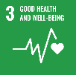
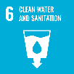
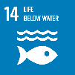
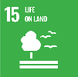
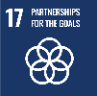
Theme 4
Water Pollution and Environmental Management
Preventing damage to human health and lives and creating Sustainable Environment

Slide 2
Contents
      Introduction
      Water Pollution
      Securing Clean Surface Water
      Financial Resources for Measures against Water Pollution
      River Environmental Management
      Lessons Learned

Slide 3
1. Introduction
Why is water pollution control important?
Prioritize Economy over Environment and Water Pollution
Destruction of Environment and Severe Pollution
Need to Establish Legal System to Regulate and Improve Quality of Wastewater Discharge

Slide 4
2. Water Pollution
(1) Water Pollution Diseases and Legal System in Japan
“Polluting Industry”
After the World War II, to achieve heavy industrialization was promoted.
The Government prioritized infrastructure development for industry over living facilities.
Large-scale industrial complexes were built in the coastal areas and pollution intensified and spread spatially.
Four major pollution-related diseases emerged because of wastewater from factories and air pollution
Minamata
Itai-Itai
2nd Minamata
Yokkaichi Asthma

Slide 5
2. Water Pollution
(1) Water Pollution Diseases and Legal System in Japan
Local Governments faced the brunt of criticism regarding environmental issues, and had to solve the problems on their own before the national government could act.
From early 1950s, movement to establish pollution-related regulations began, however, it was difficult due to opposition from the industry sector, especially from the mining industry.
From 1953 to 1957, MHW held 20 conferences with the relevant ministry. In 1970, “Pollution Diet” enacted 14 pollution-related laws.
MHW: Ministry of Health and Welfare

Slide 6
2. Water Pollution
(1) Water Pollution Diseases and Legal System in Japan
1) Legal Systems for Dealing with Water Pollution
Water Pollution Prevention Act (1970)
Basic Environment Act (1993)
2) Organization Development
Central Environment Council dealt with environmental policy in general.
Environmental Agency integrally control pollution regulations under the jurisdiction of 13 ministries.
Local governments given the responsibility to formulate and implement measures

Slide 7
2. Water Pollution
(2) Wastewater Regulation
2) Factory Effluents
Source: Environmental Strategy of Water, Nakanishi Junko, Iwanami Publications
BOD Loading

Slide 8
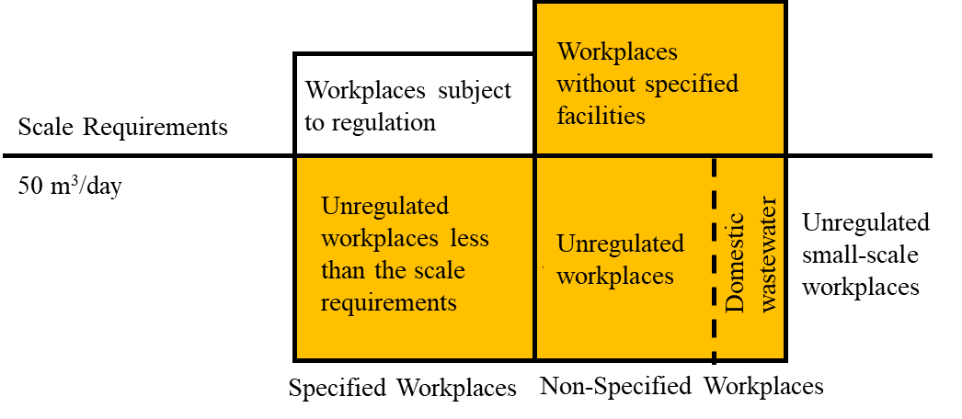
2. Water Pollution
(2) Wastewater Regulation
2)Factory Effluents
Regulated by effluent standards and total pollutant load control.
Obligation to measure and on-site inspection.
Factories have own treatment facilities before discharging wastewater into public waters, or they are connected to sewerage systems.
Source: Project Research Team (PRT)
Specified Factory Subject to Water Pollution Prevention Act

Slide 9
2. Water Pollution
(2) Wastewater Regulation
3) Agricultural Wastewater
Domestic water treatment:
  Johkasou (On-site wastewater treatment)
  Rural Sewerege Systems
Regulation for Pesticides:
  Manufacture, import sell, use only registered pesticides by MAFF.
  Standard for applicable type of crops, time of use, amount of use.

Slide 10
2. Water Pollution
(3) Water Quality Monitoring to Ensure Clean Water
Source: Japan’s water environment Administration, September 2012, Ministry of the Environment
Regular Monitoring System

Slide 11
2. Water Pollution
(3) Water Quality Monitoring to Ensure Clean Water
Measurement Site in Japan
Source: Japan’s water environment Administration, September 2012, Ministry of the Environment
Information Disclosure

Slide 12
3. Securing Clean Surface Water
(1) Improving Water Quality Discharged into Public Water Bodies
1) Pollution Sources
Source: Prepared based on Guidelines and Commentary on the Comprehensive Basin-wide Planning of Sewerage Systems, MLIT, 2015
Sources of Pollution and Discharge

Slide 13
3. Securing Clean Surface Water
(1) Improving Water Quality Discharged into Public Water Bodies
2) Domestic Wastewater Treatment in Japan
  Wastewater treatment connection rate was 90.9% in 2017.
Pollution Diet
Source: Promotion of Sewerage Development, MLIT, with additions and corrections
Wastewater Treatment Connection Ratio

Slide 14
3. Securing Clean Surface Water
(1) Improving Water Quality Discharged into Public Water Bodies
2) Domestic Wastewater Treatment in Japan
Source: MLIT Website
Treatment Facility Development

Slide 15
3. Securing Clean Surface Water
(1) Improving Water Quality Discharged into Public Water Bodies
2) Sewerage Treatment
  Sewerage Treatment Coverage Ratio is 79.7% as of 2019. It has increased by 70% in 50 years since 1965.
Source: MLIT Website
Changes in Water Supply and Sewerage Treatment Coverage Ratio

Slide 16
3. Securing Clean Surface Water
(1) Improving Water Quality Discharged into Public Water Bodies
3) Category of Sewerage System
Public Sewerage System
Treats sewage in urban areas
River Basin-wide Sewerage System
Receives & treats sewage from sewerage systems managed by multiple local governments
Urban Sewerage System
Drain sewage mainly from rainwater in urban areas

Slide 17
3. Securing Clean Surface Water
(1) Improving Water Quality Discharged into Public Water Bodies
4) Domestic Water Treatment in Rural Area
Source: Website of Cleanup Federation in Wakayama Prefecture
Domestic Water Treatment by Johkasou

Slide 18
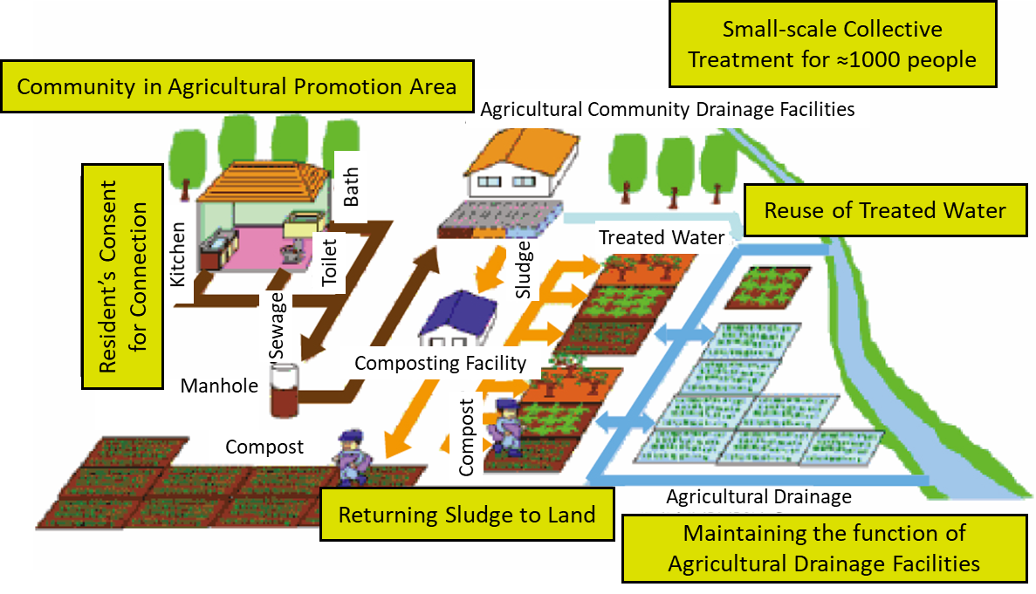
3. Securing Clean Surface Water
(1) Improving Water Quality Discharged into Public Water Bodies
5) Rural Sewerage System and Drainage
Source: Ministry of Agriculture, Forestry and Fisheries website
Rural Sewerage System and Drainage

Slide 19
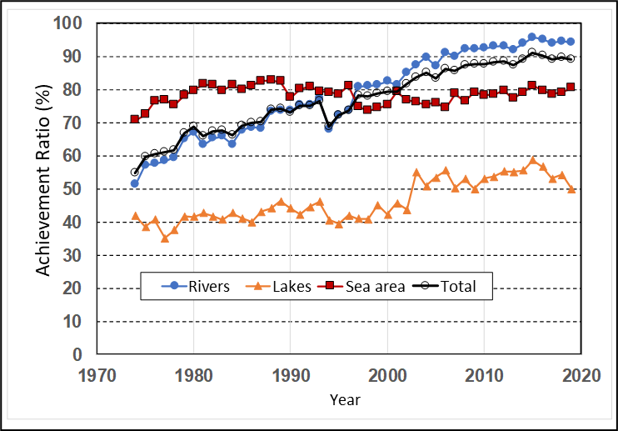
3. Securing Clean Surface Water
(2) Improving Water Quality in Closed Water Bodies Prone to Water Quality Degradation
1) Achievement of Environmental Standard
Source: 2019 Water Quality Measurements of Public Waters, Ministry of the Environment
Ratio of Environmental Standards Achievement (BOD or COD)

Slide 20
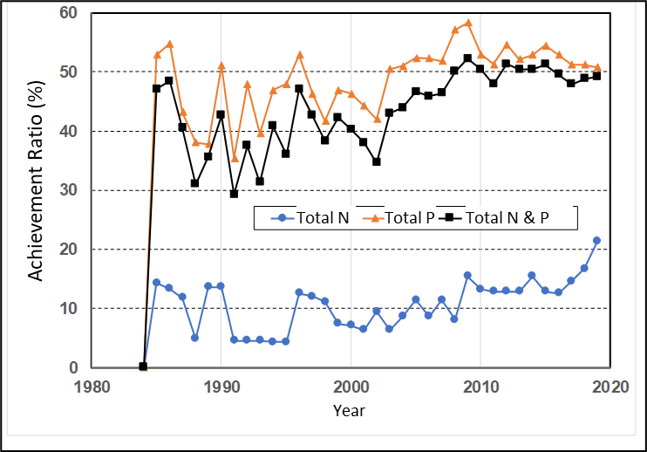
3. Securing Clean Surface Water
(2) Improving Water Quality in Closed Water Bodies Prone to Water Quality Degradation
1) Achievement of Environmental Standard
Source: 2019 Water Quality Measurements of Public Waters, Ministry of the Environment
Ratio of Environmental Standards Achievement for T-N and T-P in Lakes

Slide 21
3. Securing Clean Surface Water
(2) Improving Water Quality in Closed Water Bodies Prone to Water Quality Degradation
2) Runoff Water Improvement Promotion Plan
Point Source Loads
Increase coverage area of sewerage system, Johkasou (on-site wastewater treatment).
Non-point Source Loads
Measures for Load Source: Preventing load generation by human activities, removing load substances accumulated in source area.
Measures for Discharged Load: Controlling rainwater runoff and purifying discharged water.
Measures at Water Area to be Conserved: Prevent pollution runoff flowing into rivers by purification.

Slide 22
4. Financial Resources for Measure Against Water Pollution
(1) Cost Sharing
  Sewerage Facilities: publicly owned company financially independent
  Construction cost: borrowing through local government bond
  Beneficiaries pay principle
Type | Construction Costs
Public Sewerage | Government Funds (Grant Rate: ½ of major pipes, ½ or 5.5/10 of treatment plants)
 | Local Funds | Local government bonds (Appropriation rate 100%) Contribution from users Prefectural subsidies
River-basin Sewerage | Government Funds (Grant Rate: ½ of major pipes, ½ or 2/3 of treatment plants)
 | Local Funds | Local government bonds (Subsidies: Appropriation rate 60%, Local government finance: Appropriate rate 90%) Local government cost: Local Government bonds (Subsidies: Appropriation rate 60%, Local government finance: Appropriation rate 90%） Transfer to General Account (cities, towns, villages) Transfer to General Account (Prefectures)

Slide 23
4. Financial Resources for Measure Against Water Pollution
(2) Financial Resources for Facility Development
  Key issues for sewerage facility development:
  Principle of public fund for rainwater treatment and users fee for sewerage.
  Improving financial management of publicly owned companies for sewerage system.
  Financial support for developing sewerage system in rural areas (subsidies, grants, other incentives).
  Collect sewerage usage fees at same time as water usage bills.

Slide 24
4. Financial Resources for Measure Against Water Pollution
(3) Polluter-Pays Principle
  The Polluter-Pays Principle
  Countries where the government bears cost of pollution control is unfair in international competition.
  “Guiding Principles concerning International Economic Aspects of Environmental Policies” OECD, 1972.
  Private businesses were required to invest in water pollution control measures.
  Government provided loans for these facilities.
Basic Environment Law
Water Pollution Prevention Act

Slide 25
5. River Environmental Management
(1) Trends in River Environment Improvement
1958- River water quality survey for addressing water pollution
1975 River Council report on River Environment Management
1983 Start formulating Basic Plan of River Environment Management
1990 Initiative of “Nature-friendly River Work”
1990 National Survey on Natural Environment in River and Water Shore
1997 Revision of the River Law (include river environment)
2002 Formulating and promoting Nature Restoration Projects
2013 Formulating and promoting Nature Restoration Projects
2013 River Cooperation Organization System (people’s participant)

Slide 26
5. River Environmental Management
(2) Revision of the River Law
Source: New developments in river environment administration, MLIT
History of River Law Revision

Slide 27
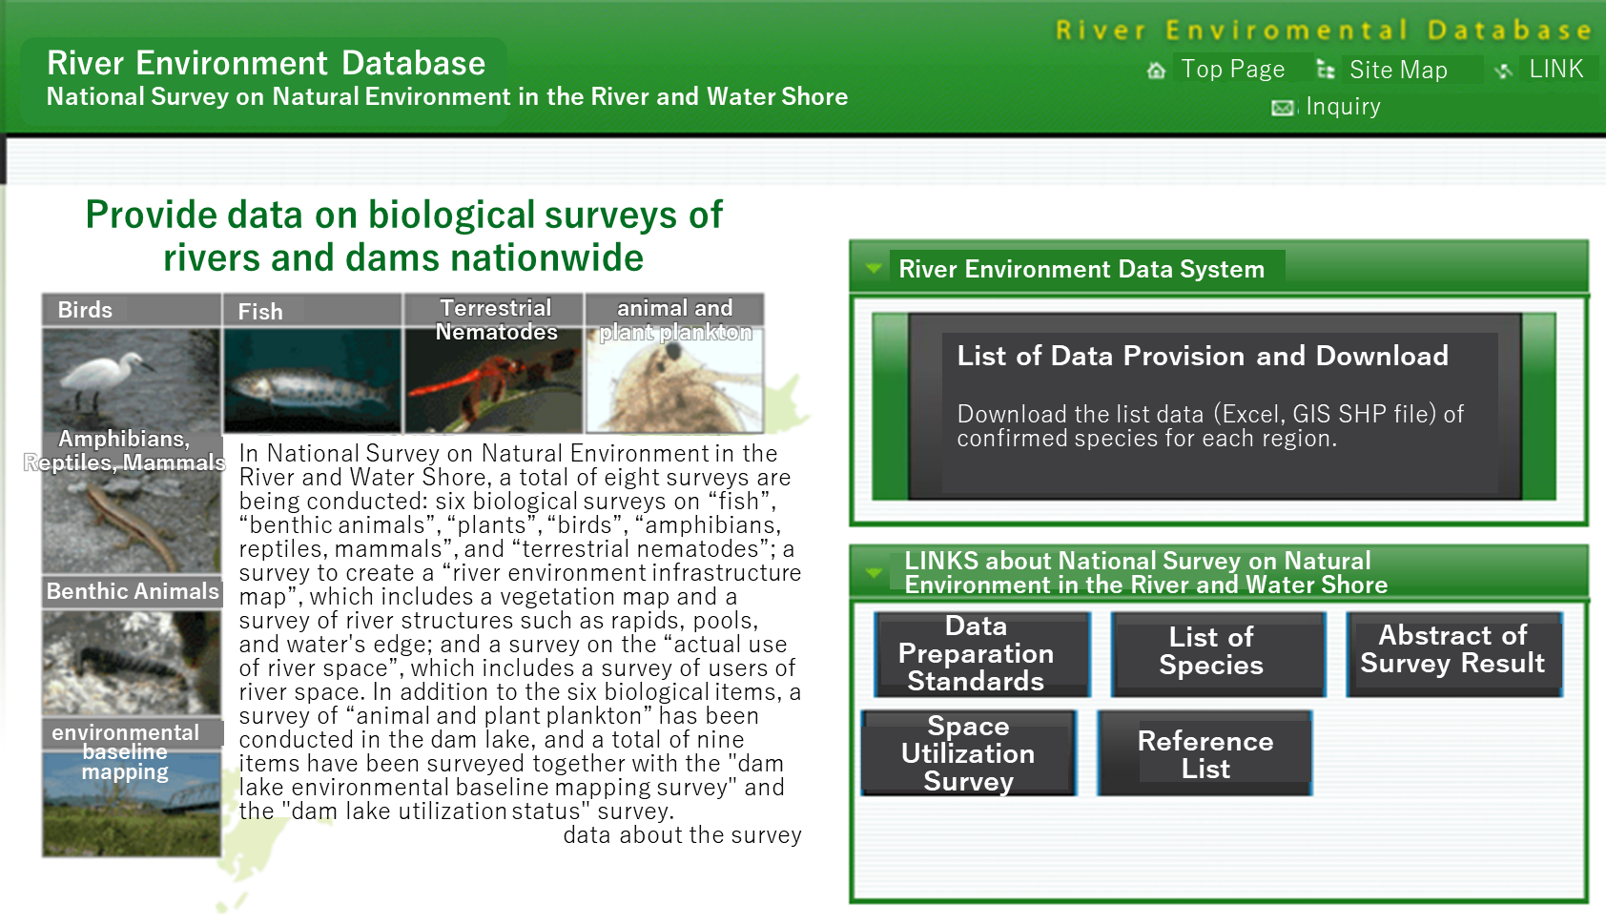
5. River Environmental Management
(3) River Environment Survey
National Survey on Natural Environment in the River and Water Shore
Eight Surveys
  Results made public as a database
  Used for river development and maintenance plan study
Biological Survey
Amphibian, reptile & mammal
Terrestrial Insect
Fish & Shellfish
Bird
Plant
Benthic Animal
River Space Utilization Survey
River Environment Base Map Survey
Source: MLIT National Institute for Land and Infrastructure Management website

Slide 28
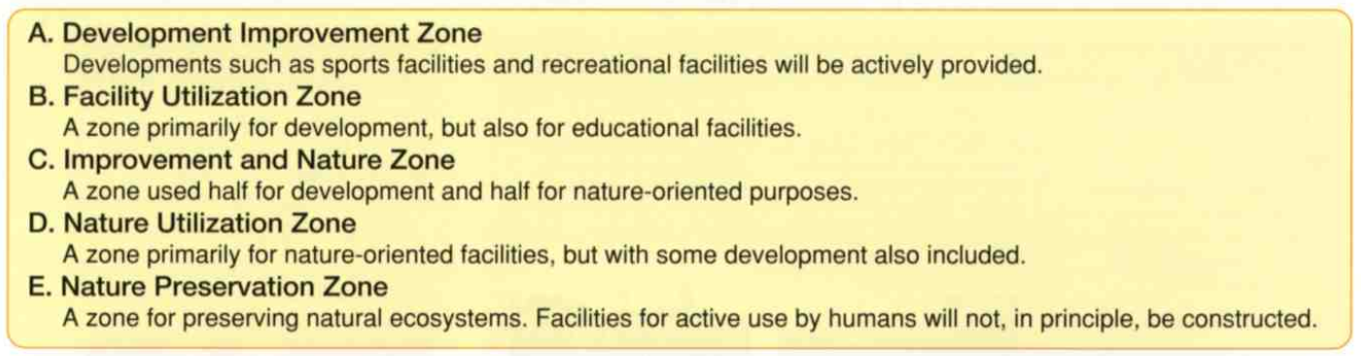
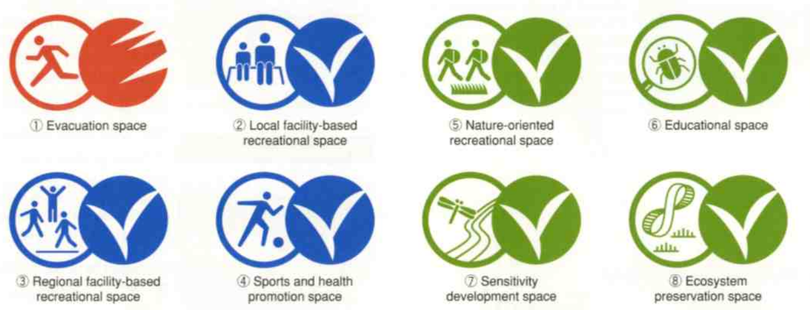
5. River Environmental Management
(4) Plan to Manage the River Environment
Tama River Environmental Management Plan – Space Management
Source: Guidebook to the Plan to Manage the Natural Environment of the Tama River, MLIT, March 2002

Slide 29
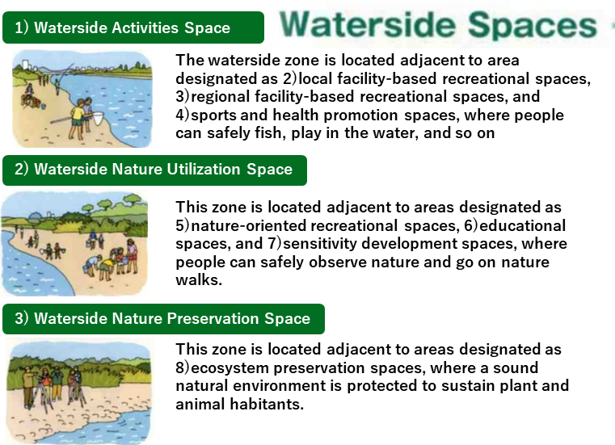
5. River Environmental Management
(4) Plan to Manage the River Environment
Tama River Environmental Management Plan –Water Surface Management
Source: Guidebook to the Plan to Manage the Natural Environment of the Tama River, MLIT, March 2002

Slide 30
5. River Environmental Management
(5) Management of River Water Quality
  River Law (1964)
  Maintaining and improving water quality by diluting or purifying wastewater and preventing saltwater intrusion,
  Maintaining river channels and prevention of blockage of river mouth,
  Maintaining water level for water intake and navigation, and
  Growth and breeding of aquatic animals and plants.
River Water Purification Methods
  Purification using gravel
  Purification using rapids and pools
  Thin laminar flow purification method
  Vegetation purification method

Slide 31
5. River Environmental Management
(5) Management of River Water Quality
Sumida River Water Quality Improvement
  In 1940, chemical plants and dyeing factories increased. BOD increased to 5-10 mg/l.
  By 1952, the river became so polluted that fish could no longer thrive.
  Toxic gases and malodors caused mild coughing, red eyes, loss of appetite and headaches in peoples living nearby.
Efforts to improve water quality through legislation
  Sewerage system development
  Pipeline from the Tone River via the Arakawa River to secure the water supply, and as diluted water to purify the Sumida River.
  Dredging since 1958 which continues to this day.

Slide 32
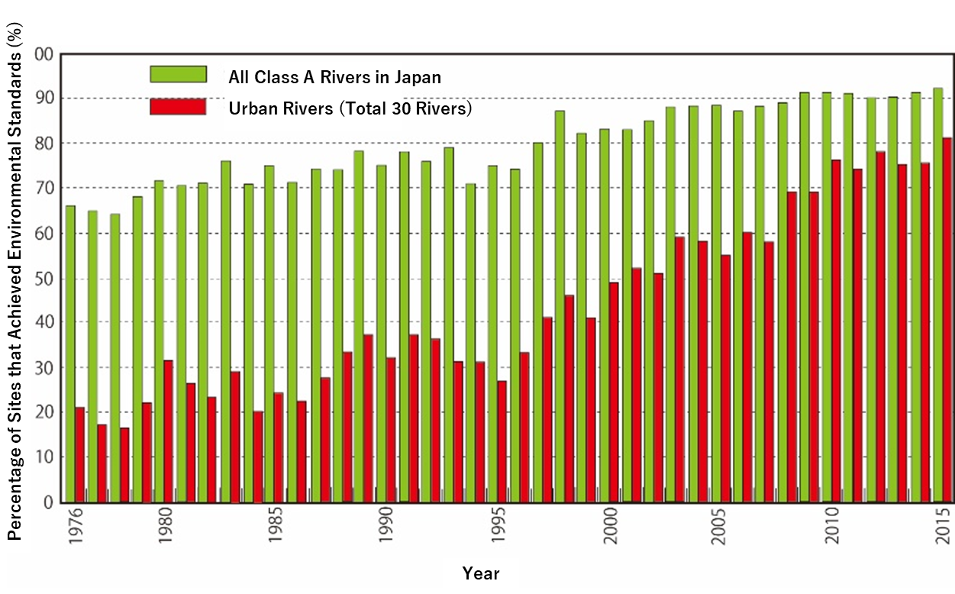
5. River Environmental Management
(6) Efforts to Improve Water Quality in Urban Rivers
Source: MLIT website
Achievement Percentage of Environmental Standards in Class A Rivers and Urban Rivers

Slide 33
5. River Environmental Management
(6) Efforts to Improve Water Quality in Urban Rivers
Clean Stream Renaissance 21 (1993) and the stage 2 (2001)
  Water quality improvement goals by local governments, river management offices (RMOs), sewerage offices, and related organizations.
  Water quality improvement targets according to condition of each river.

Slide 34
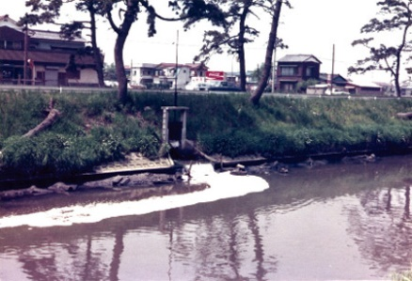
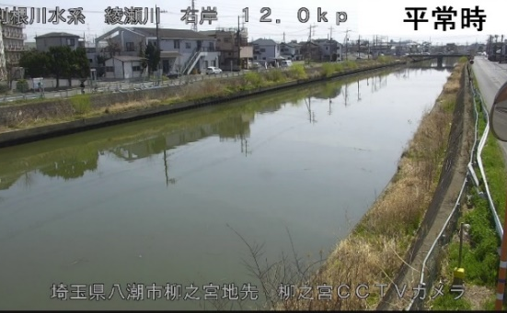
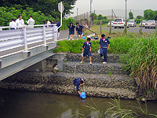
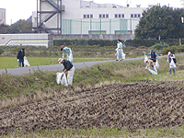
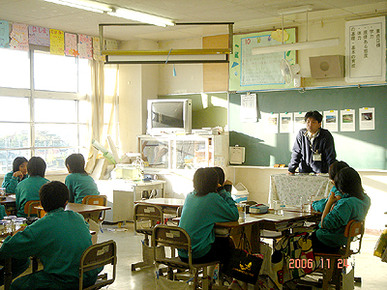
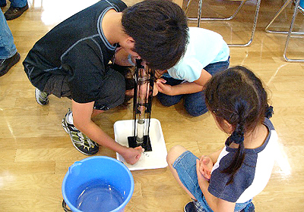
5. River Environmental Management
(7) Water Quality Improvement in Ayase River
  The dirtiest river in Japan since 1980s for 15 years.
  Collaboration with local communities, no longer the worst in 2000.
  1973
  2021
Source: MLIT Edogawa River Office Website
Source: Edogawa River Office Website
Collaboration & Education with Local Residents

Slide 35
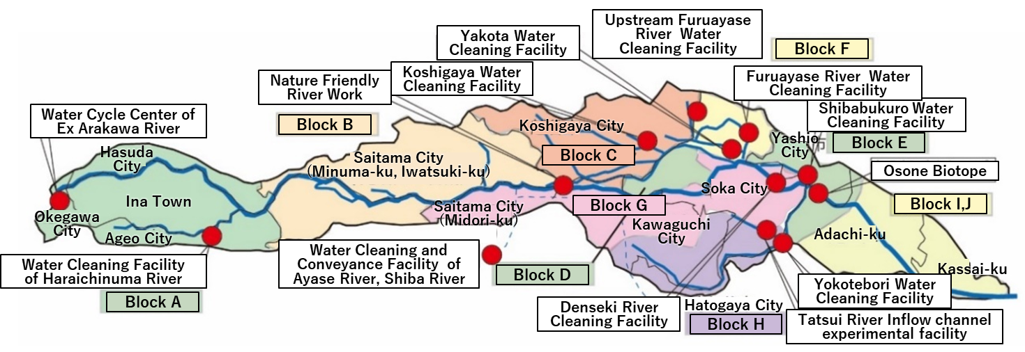
5. River Environmental Management
(7) Water Quality Improvement in Ayase River
  Divide the river basin into 10 blocks to plan and implement measures respectively for improving water quality according to the standard.
Source: Based on MLIT Edogawa River Office Website; and Ayase River Seiryu Renaissance II Annual Report 2011, Ayase River Seiryu Renaissance II Regional Council, November 2011
Countermeasures by Blocks in the Ayase River Basin

Slide 36
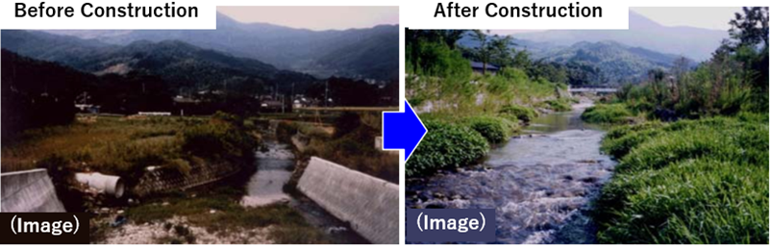
5. River Environmental Management
(8) Nature-Friendly River Work
  Public needs for restoring natural environment in early 1990s
  “Nature-Friendly River Works” Initiative by MLIT
    “Nature-friendly River Works” initiative (MLIT, 1990)
    “Basic Guidelines for Creating Nature-friendly Rivers” (2006)
    “Technical Standards for River Channel Planning for Small and Medium Rivers” (2008)
Source: MLIT
Nature-Friendly River Works (Before and After Construction)

Slide 37
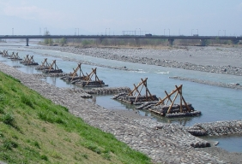
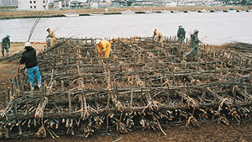
5. River Environmental Management
(9) Use of Traditional Construction Methods
  Nature-friendly materials that blend in with surroundings
  Highly adaptable to waterfront topography
Seigyu (water control)
Fascine Mattress (erosion control)
Source: Kofu Rivers and National Highways Office website
Source: Shinano River Downstream Office website
Notes:
Traditional construction methods are nature-friendly because the materials used are local wood, bamboo, stone, etc., which blend in with the surrounding natural conditions and are highly adaptable to waterfront topography.
Traditional Japanese construction methods include:
Water control works such as Seigyu to change the flow of water,
Submerged fascine mattress to protect river banks,
Riparian forests to mitigate the effects of floods, and
Weirs used for agricultural water intake

Slide 38
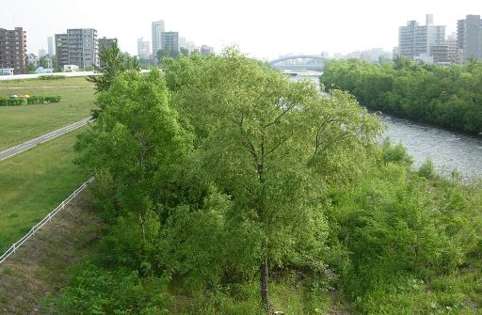
5. River Environmental Management
(9) Use of Traditional Construction Methods
Source: Hokkaido Development Bureau website
Riparian Forest (flow control)
Notes:
Traditional construction methods are nature-friendly because the materials used are local wood, bamboo, stone, etc., which blend in with the surrounding natural conditions and are highly adaptable to waterfront topography.
Traditional Japanese construction methods include:
Water control works such as Seigyu to change the flow of water,
Submerged fascine mattress to protect river banks,
Riparian forests to mitigate the effects of floods, and
Weirs used for agricultural water intake

Slide 39
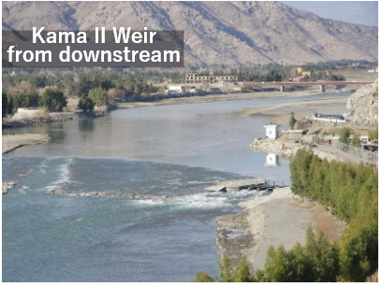
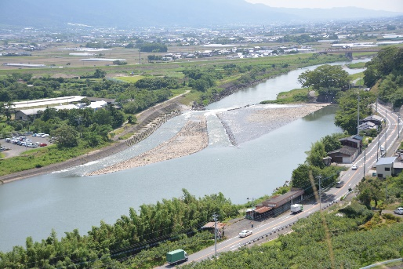
5. River Environmental Management
(9) Use of Traditional Construction Methods
  Weir using traditional construction method and apply to overseas.
Kama II Weir (Afghanistan)
Yamada Weir (Japan)
Source: Peshawar Association website, Provided by Asakura City
Notes:
Traditional construction methods are nature-friendly because the materials used are local wood, bamboo, stone, etc., which blend in with the surrounding natural conditions and are highly adaptable to waterfront topography.
Traditional Japanese construction methods include:
Water control works such as Seigyu to change the flow of water,
Submerged fascine mattress to protect river banks,
Riparian forests to mitigate the effects of floods, and
Weirs used for agricultural water intake

Slide 40
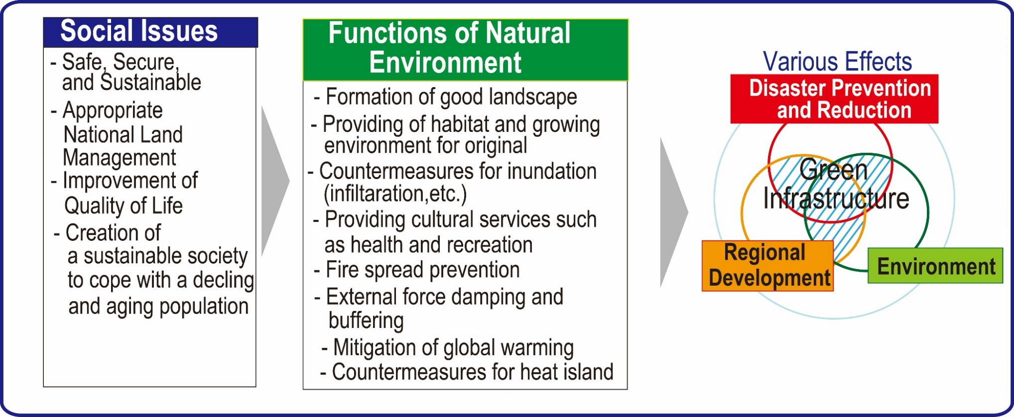
5. River Environmental Management
(10) Green Infrastructure Initiatives
  Disaster management
  Environmental improvement
  Regions’ attractiveness
  Carbon-neutral society
Source: Green Infrastructure Portal Site, MLIT
Green Infrastructure

Slide 41
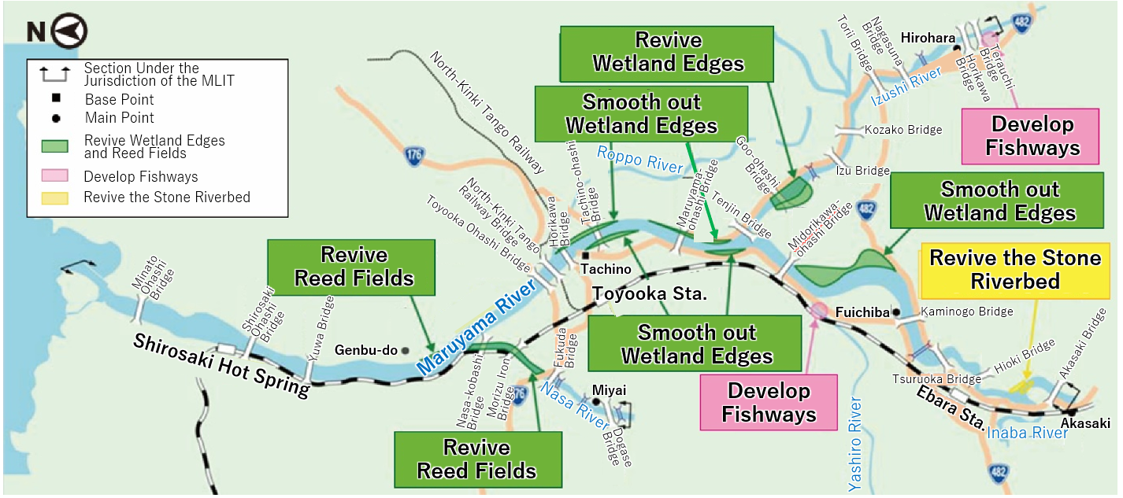
5. River Environmental Management
(11) Efforts in Maruyama River
  Ecological network based on the river formed in cooperation with local community.
Source: MLIT Kinki Regional Development Bureau Toyooka River National Highway Office Website
Efforts in Maruyama River

Slide 42
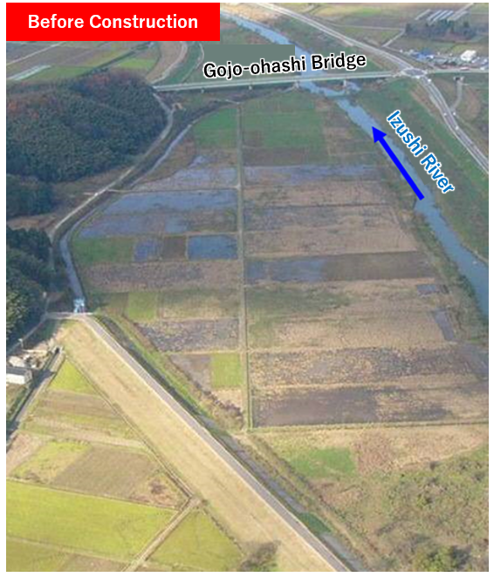
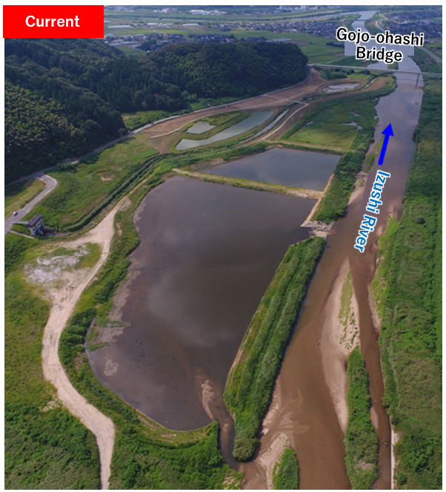
5. River Environmental Management
(11) Efforts in Maruyama River
Source: MLIT Kinki Regional Development Bureau Toyooka River National Highway Office Website
Wetlands revived in Kayo area

Slide 43
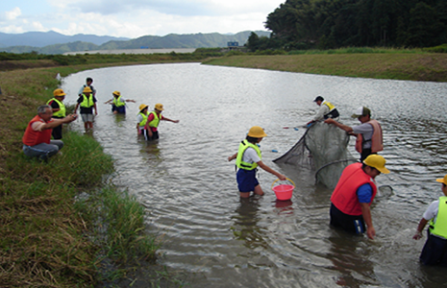
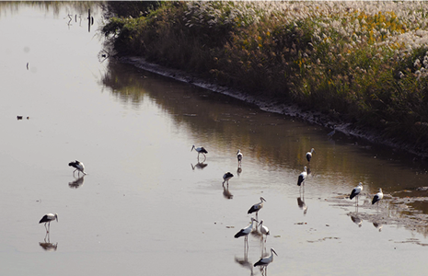
5. River Environmental Management
(11) Efforts in Maruyama River
Source: MLIT Kinki Regional Development Bureau Toyooka River National Highway Office Website
Ecological survey with children
Stocks feeding in the wetlands

Slide 44
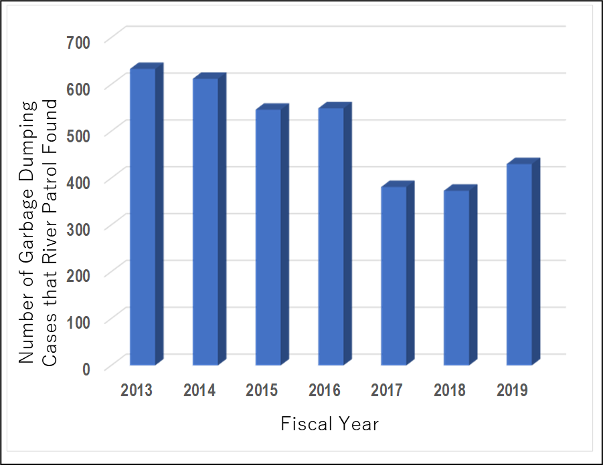
5. River Environmental Management
(12) Measures against Illegal Dumping of Waste
  River administrators work with NPOs & local governments for “trash pickup” activities, daily river patrols, reporting illegal dumping to police & public relations.
Source: Created based on the Arakawa-Karyu River Office website
Number of Garbage Dumping Cases in Lower Reaches of Arakawa River

Slide 45
6. Lessons Learned (1)
  (1) Establishing a legal system and enforcement mechanisms can regulate adverse environmental effects.
  Water pollution affects human health and lives and may destroy ecosystems and the environment. In Japan, government policies prioritizing economic growth resulted in the emergence and spread of disastrous pollution-related diseases. During the high economic growth, water pollution caused by effluents from factories led to the outbreak of pollution-related diseases, such as Minamata and Itai-itai, affecting tens of thousands of people. The legal systems and local government ordinances cover water quality standards, monitoring, and penalties. Local governments can conduct on-site inspections of factories and impose on penalty for illegal actions.
  (2) Pesticide use should be regulated as they deteriorate the quality of river water and groundwater.
  In Japan, various standards have been established to regulate pesticide use. The permissible pesticides should also be registered, and crops for which the pesticides can be used, the time when they can be used, and the permissible amount for use are specified.

Slide 46
6. Lessons Learned (2)
  (3) Domestic wastewater should be treated to achieve quality that meets the standard values.
  In Japan, local governments have formulated basic plans to develop basin-wide sewage systems. Treatment methods can be optimized by the conventional sewerage system and Johksou, on-site treatment facility at the household level, taking into account the population density, topographic conditions, and economic efficiency.
  (4) For closed water bodies such as lakes and marshes, more stringent measures are essential for preserving water quality.
  In lakes, marshes, inland bays, land-locked seas, and other closed water areas, improving water quality is difficult once deteriorated. There are two types of pollution loads: point and non-point sources. For the latter, improvement measures are required over large areas because the discharge points of pollutants are difficult to be identified. The act was enacted, followed by the setting of long-term targets, formulation of short-term plans, and implementation of water quality improvement for lakes and marshes in Japan.

Slide 47
6. Lessons Learned (3)
  (5) Green infrastructure can contribute to the creation of a carbon-neutral society and resolution of various social issues.
  Green Infrastructure or nature-based solutions, which utilize the diverse environmental functions, highlight the region’s attractiveness based on the river’s characteristics, local nature, and culture as well as mitigating disaster damage. In Japan, the River Law was revised to make the environment an internal objective for river improvement projects.

