Slide 1
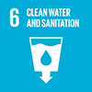
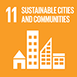


Theme 5
Urban Water Management
Integrated Response to Complex Problems

Slide 2
Contents
      Introduction
      Water Cycle in Urban Area
      Water Utilization Efforts
      Flood Protection Efforts
      Improving Water Environment
      Lessons Learned

Slide 3
1. Introduction
What is urban water management?
Solving water-related problems such as flood damage, tight water supply, and deterioration of environment, which are becoming more serious due to urbanization, via strengthening governance with various related organizations and stakeholders, and implementing structural and non-structural measures based on scientific grounds.

Slide 4
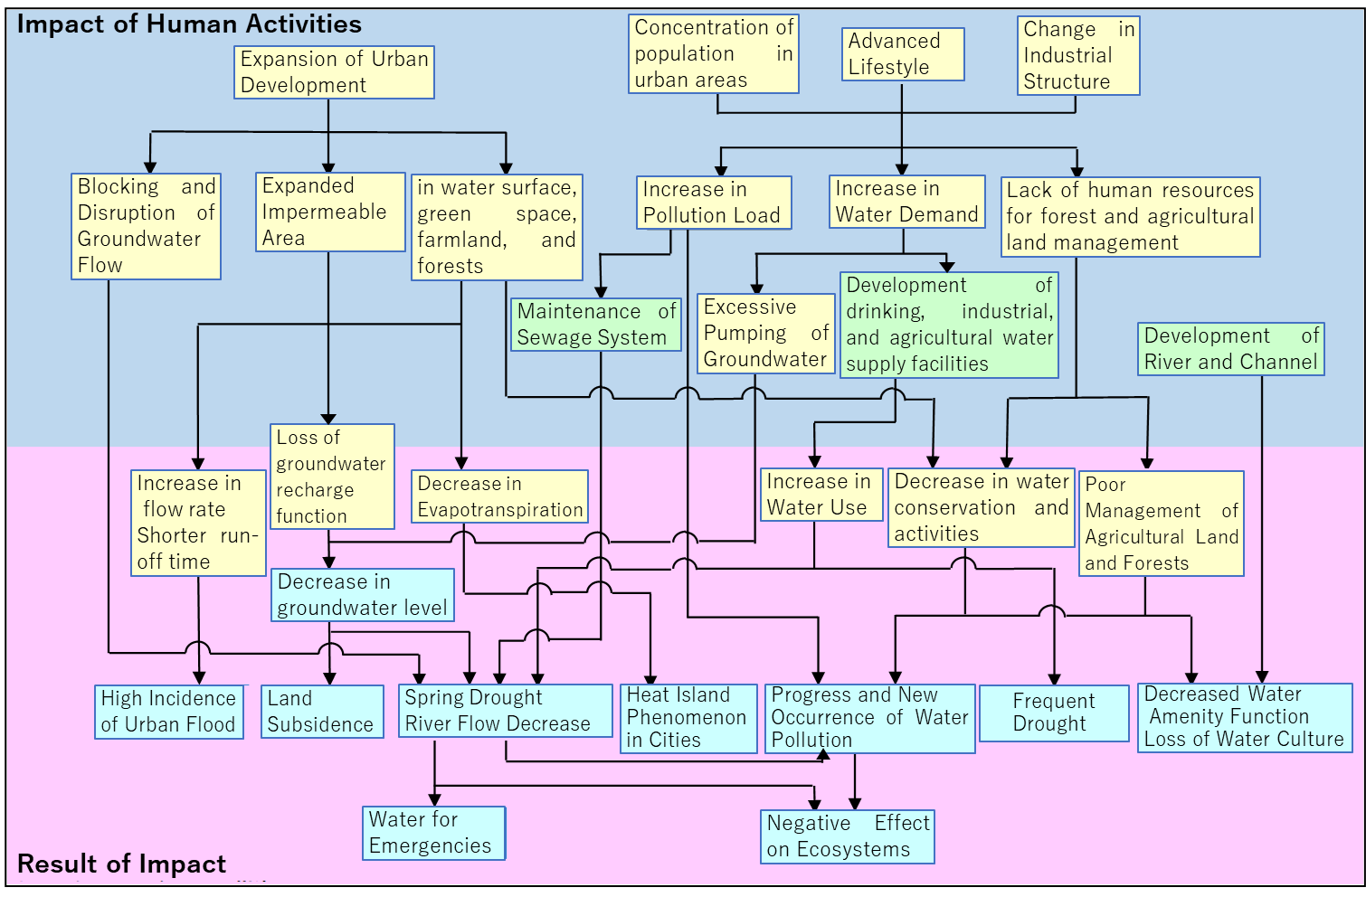
2. Water Cycle in Urban Area
Impacts of Human Activities on the Water Cycle
Source: “Toward the Creation of a Sound Water Cycle System”, Liaison meeting of related ministries and agencies regarding the development of a healthy water environment, October 2003
Impacts of Human Activities on the Water Cycle

Slide 5
2. Water Cycle in Urban Area
Measures to address Problems related to Water Sources
Water Use
Flood Protection
Environment
Water supply fee system
Water saving faucet spindle
River improvement
Nature-oriented river
Multi-purpose detention basin
Reuse grey water
Sewerage Maintenance
Reduce leakage ratio
Treated wastewater
Underground River
Awareness raising activities
Reuse industrial water
Rainwater storage
Underground Water Storage
Nature-oriented River Works
Permeable pavement
Desalination

Slide 6
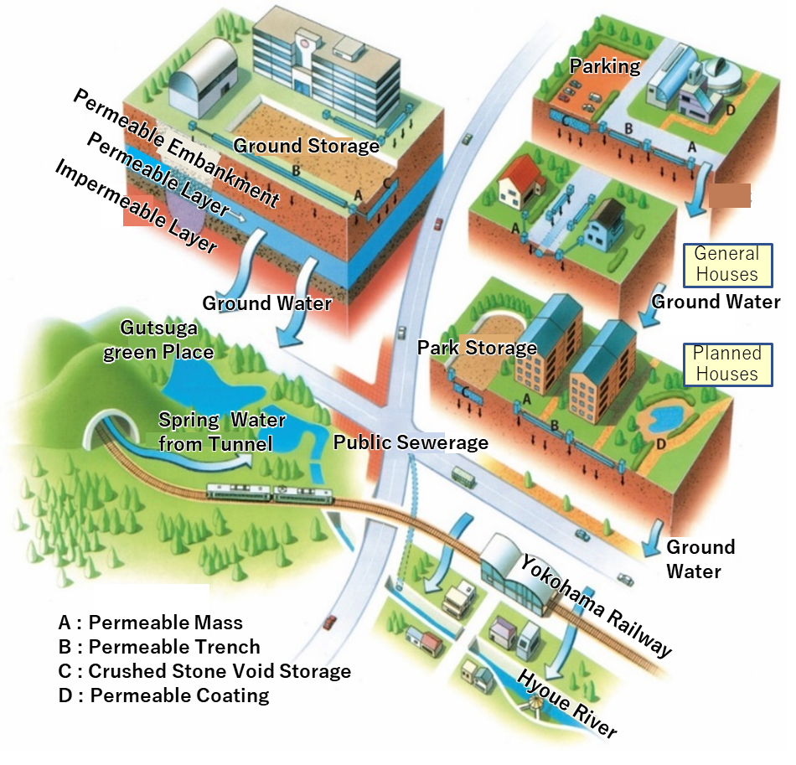
2. Water Cycle in Urban Area
Development of Hachioji Minamino City
Flood peak discharge reduced by 20~40%
Drought discharge increased by 1.5 ~ 2 times
Source: UR x Green Infrastructure Case Studies UR Agency
Hachioji Minamino City Water Cycle Regeneration System

Slide 7
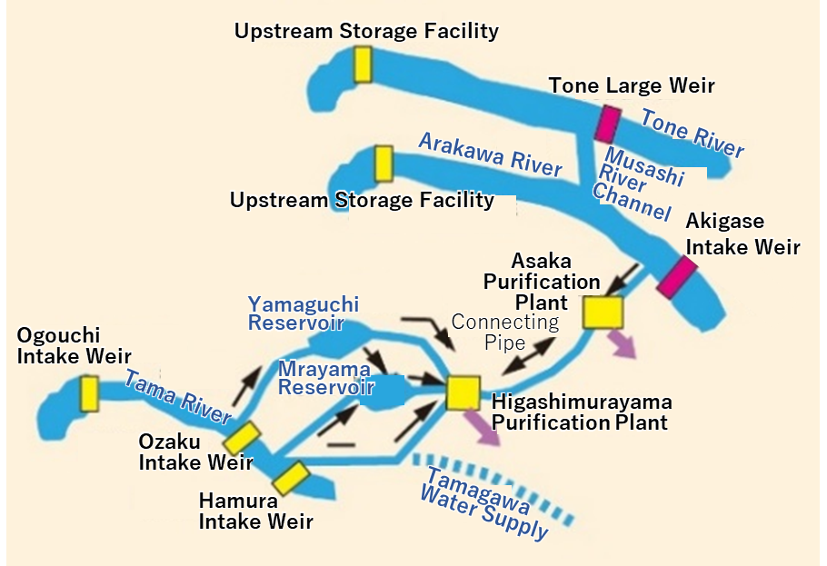
3. Water Utilization Efforts
(1) Controlling Water Use
Source: Tokyo Metropolitan Government Bureau of Waterworks website
Wide-area Water Resources Utilization

Slide 8
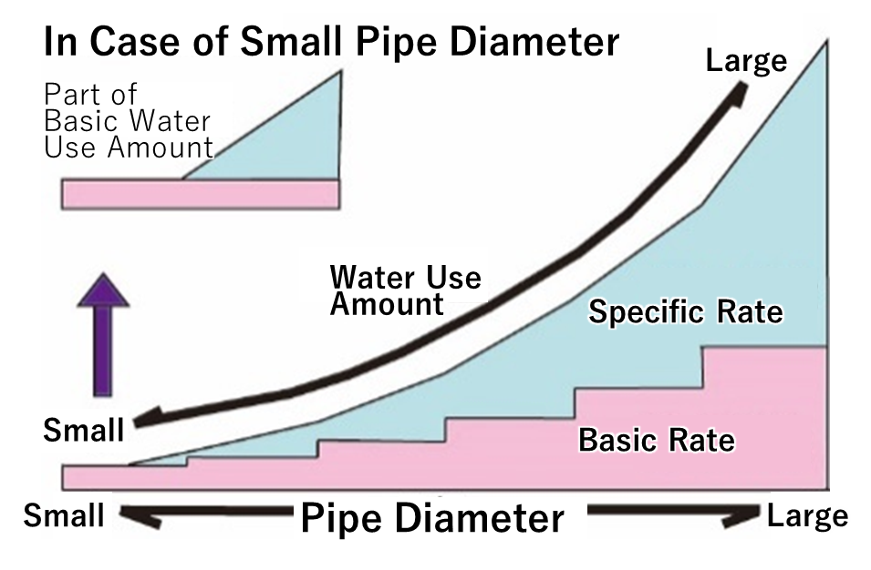
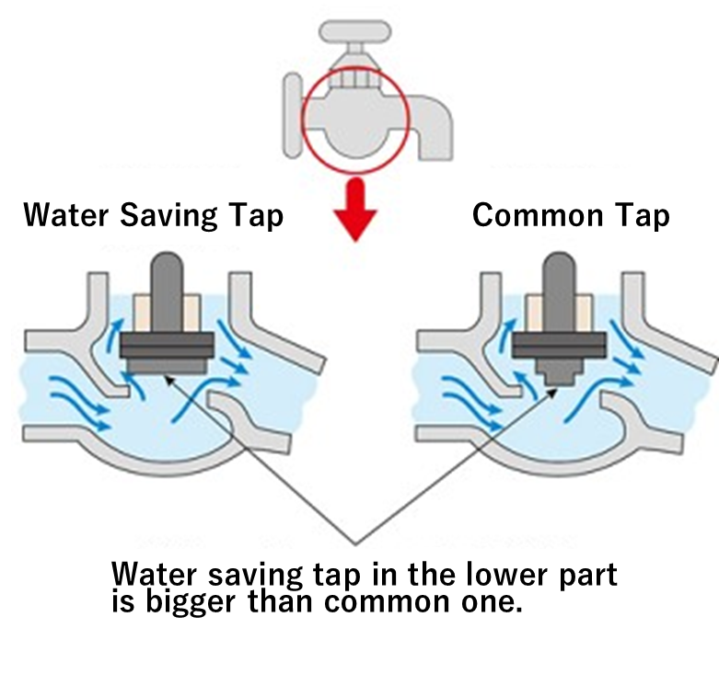
3. Water Utilization Efforts
(1) Controlling Water Use
Source: PRT
Source: Tokyo Metropolitan Government, Bureau of Waterworks
Two-part Tariff System
Water Saving Tap

Slide 9
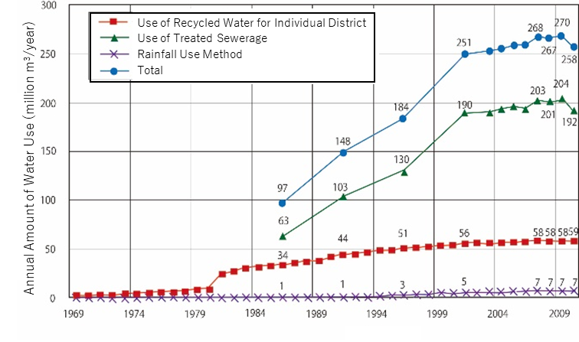

3. Water Utilization Efforts
(1) Controlling Water Use
Awareness-raising activities
Mizu-iku
Public Relations Activities
Mascot character
Water Day
Source: Kumamoto City Website
Eco-Mark System
Water Saving Campaigns
Source: Japan’s Water Resources (2013), MLIT
Trends in Rainwater and Recycled Water Use

Slide 10
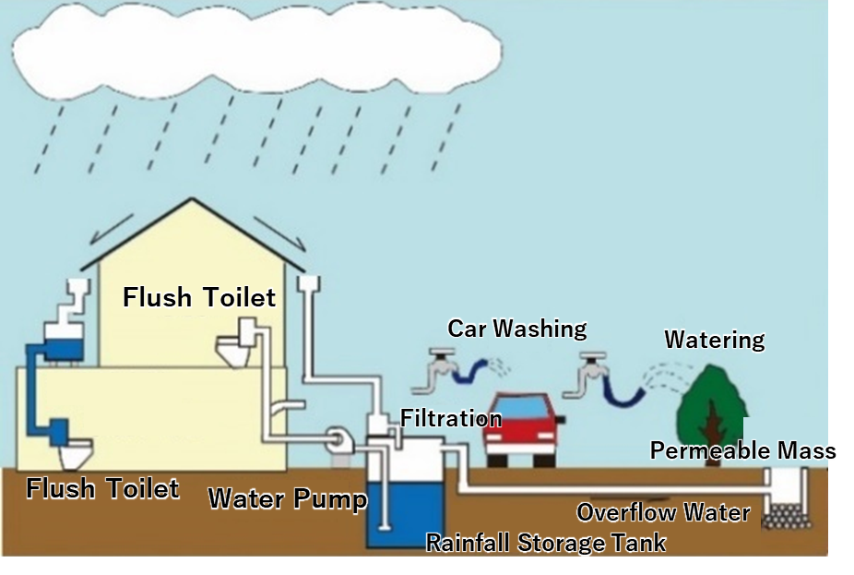
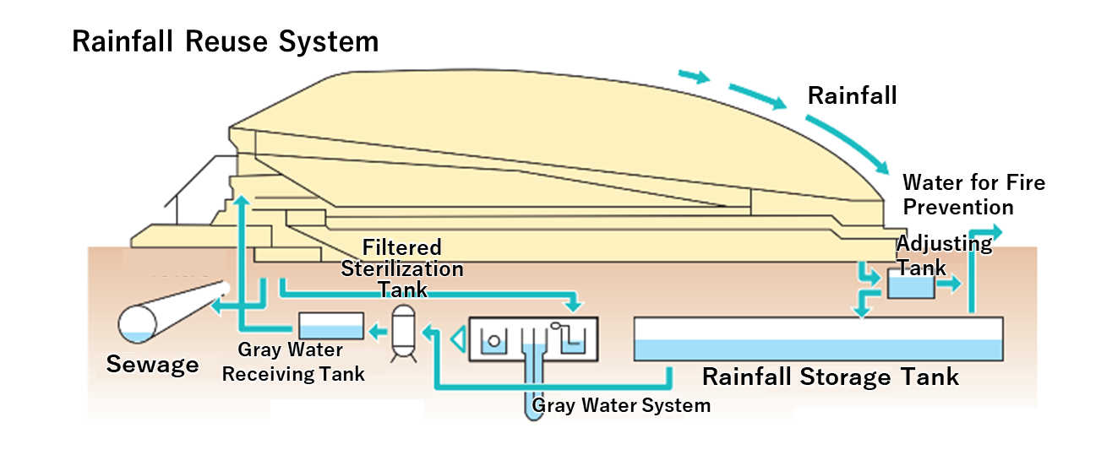
3. Water Utilization Efforts
(1) Controlling Water Use
Using Miscellaneous Water
Source: Rainwater Use Case Studies, MLIT
Rainwater Use at Tokyo Dome
Source: Sumida Ward Website
Underground storage tank (3,000 m³)
Toilet flushing, firefighting
30% rainwater utilization rate
Rainwater Reuse

Slide 11
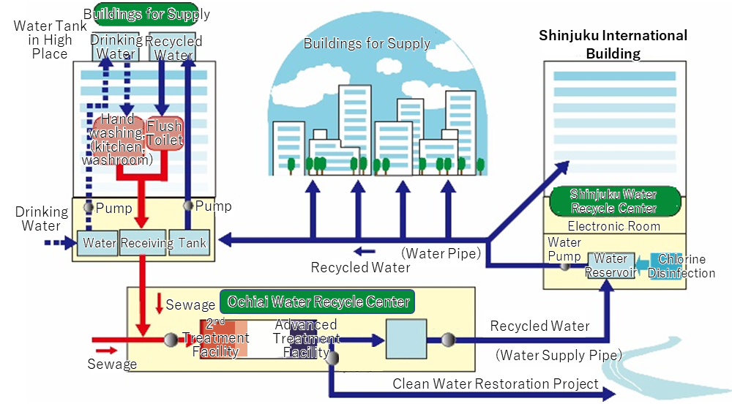
3. Water Utilization Efforts
(1) Controlling Water Use
Using Miscellaneous Water
Source: Tokyo Metropolitan Government Bureau of Sewerage
Recycled Water Supply System (Nishi-Shinjuku and Nakano-Sakaue Area)

Slide 12
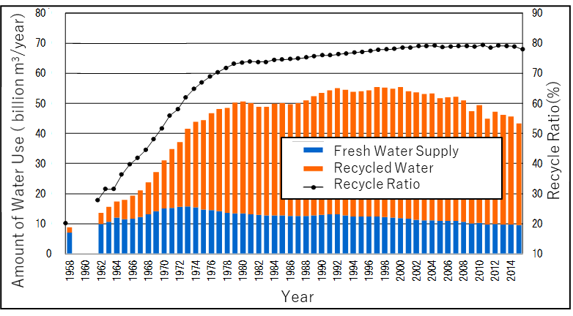
3. Water Utilization Efforts
(1) Controlling Water Use
Source: Statistics from the Ministry of Economy, Trade and Industry
Changes in Industrial Water Usage

Slide 13
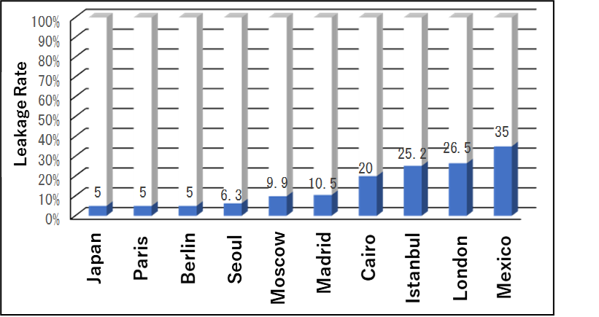
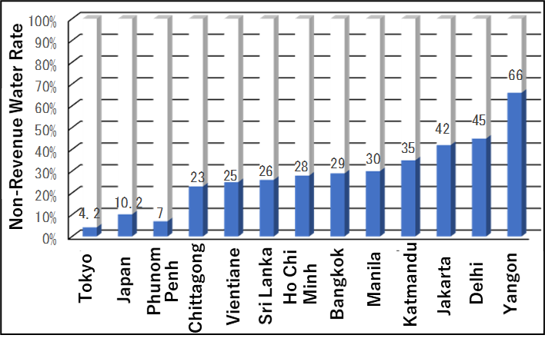
3. Water Utilization Efforts
(2) Improvement in Leakage in Water Supply
Source: Japan’s Approach to Global Water Problems (2012),, House of Representatives Research Office, Legislation and Survey No. 332
Source: Tokyo: Japan Water Research Center (Public Interest Incorporated Foundation), Water Services Hot News No. 543, December 16, 2016
Comparison of Non-Revenue Water Ratio in Cities in Japan and Developing Counties
Leakage Ratio in World’s Major Cities

Slide 14
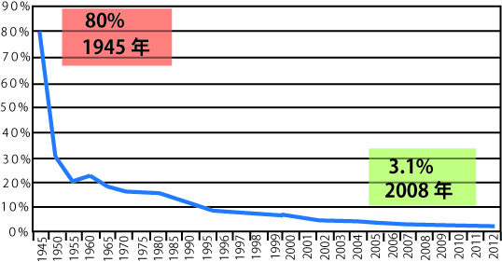
3. Water Utilization Efforts
(2) Improvement in Leakage in Water Supply
Prevent leakage by:
Setting specific goals to reduce the leakage rate
Formulate a comprehensive plan that is feasible & effective in medium to long term
Source: Experience of Japanese Water Supply Projects Created based on JICA
Leakage Ratio in Tokyo

Slide 15
3. Water Utilization Efforts
(3) Utilization of Non-conventional Water Resources
Countries & regions with scare water resources -> desalination is viable option
Cost
For 10,000 m³/day capacity or more:
Construction cost: 100-200 1000 yen per 1m³/day
Production cost: 100~150 yen /m³
Japan:
682 desalination plants
60% industrial use, and rest 219 for consumer use mainly on small islands

Slide 16
4. Flood Protection Efforts
(1) Implementation of Comprehensive Flood Protection
During period of high economic growth, urban planning was done without considering flood risks
Increased surface runoff
Degradation of water retention capacity & natural spring
Increase in flood damages
Inundation damage account for 71% of total damage
Flooding: runoff volume exceeding sewerage system capacity
17.6 billion yen flooding damage in 10 years in Tokyo
42.9 billion yen inundation damage
Comprehensive Flood Protection Measure
Act on Countermeasures against Flood Damage of Specified Rivers running across Cities

Slide 17
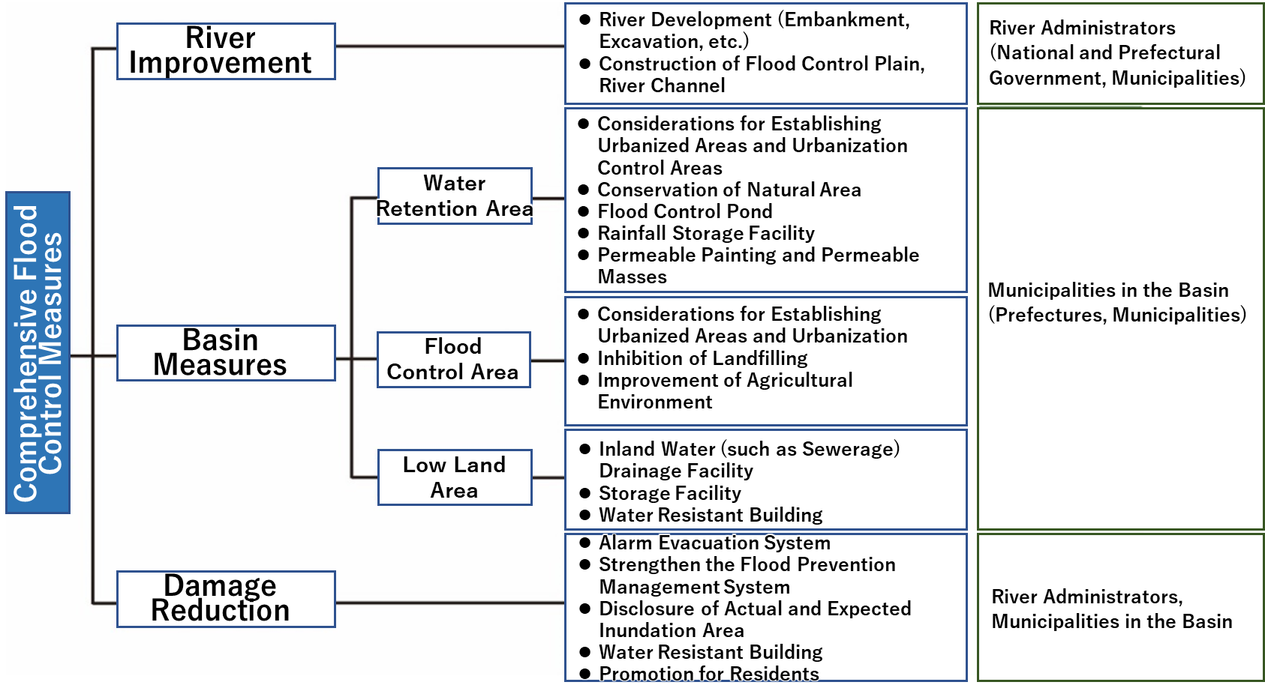
4. Flood Protection Efforts
(1) Implementation of Comprehensive Flood Protection
“Promotion of Comprehensive Flood Protection Measure” in 17 rivers (1980)
Source: Toward the creation of a plan of a sound water cycle system, Liaison meeting of related ministries and agencies regarding development of a healthy water environment, October 2003

Slide 18
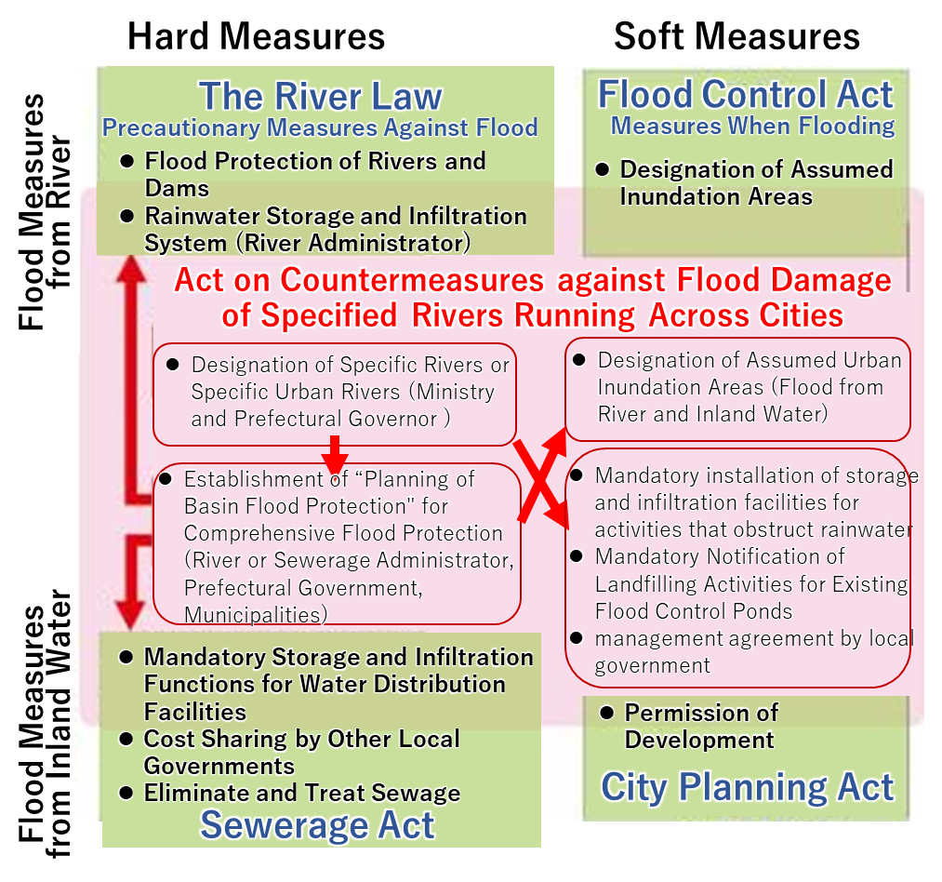
4. Flood Protection Efforts
(1) Implementation of Comprehensive Flood Protection
Source: FY2009 Policy Review Results (Evaluation Report): Comprehensive Flood Countermeasures – Verification of the Implementation Status of the Act on Countermeasures against Flood Damage of Specified Rivers Running across Cities, MLIT (March 2010)

Slide 19
4. Flood Protection Efforts
(1) Implementation of Comprehensive Flood Protection
Wastewater measures through Sewerage
2007 Report
Construction of rainwater drainage pipes
Pumping stations
Rainwater storage pipes
Development of inundation damage maps
Law on the Promotion of Rain Water Usage (2014)
Control concentrated outflow into sewer & rivers by temporarily storing rainwater
“Flood Damage Control Area” system (2015)
PPP and private sector redevelopment
Government provide financial support
Local government manage facilities
2018: only 59% of Tokyo’s sewerage system can handle 5-year rainfalls

Slide 20
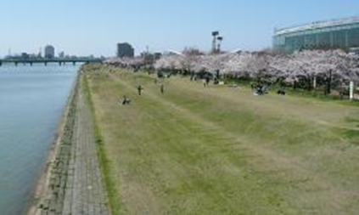
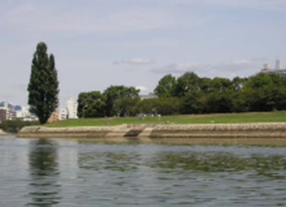
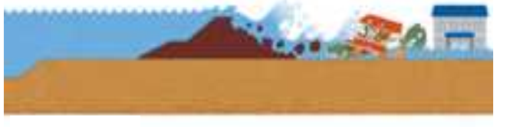
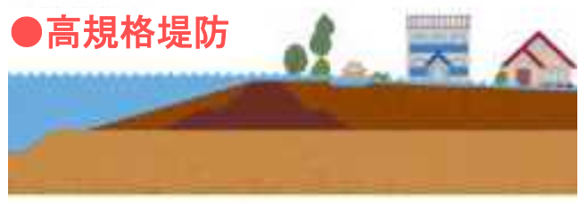

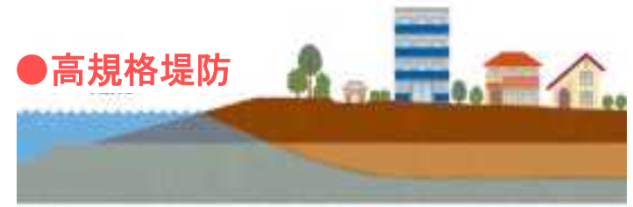
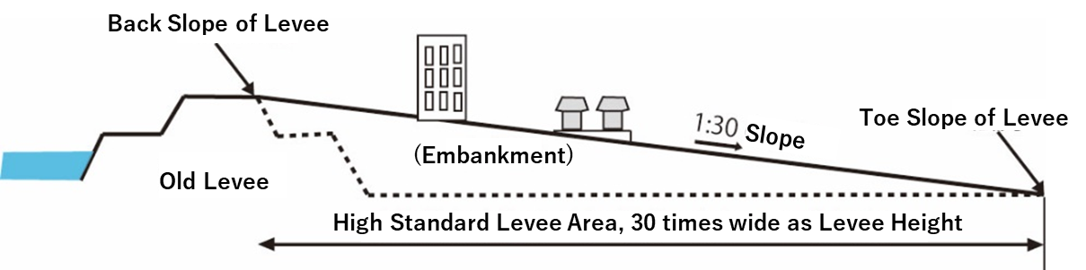
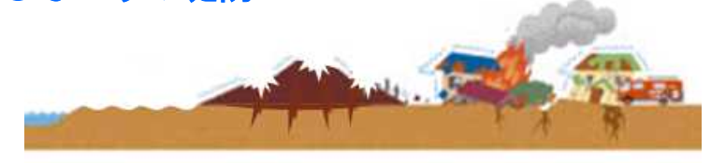
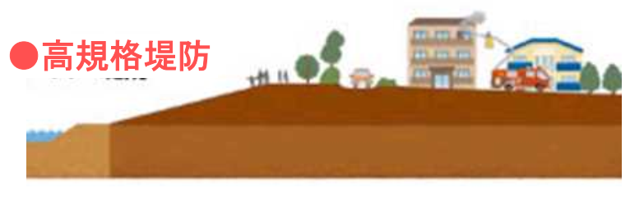
4. Flood Protection Efforts
(2) River Improvement in Urban Areas
Overtop
Infiltration
Source: MLIT Shinano River Downstream Office Website
Source: MLIT Website
Hydrophilic Revetment
Earthquake
Source: Current Status and Issues of Development of High Standard Levees, Nobuhiro Yamashita, Research and Legislative Reference Bureau, National Diet Library, Reference No.831 (April )
High Standard Levee Concept Diagram
Source: MLIT Website

Slide 21
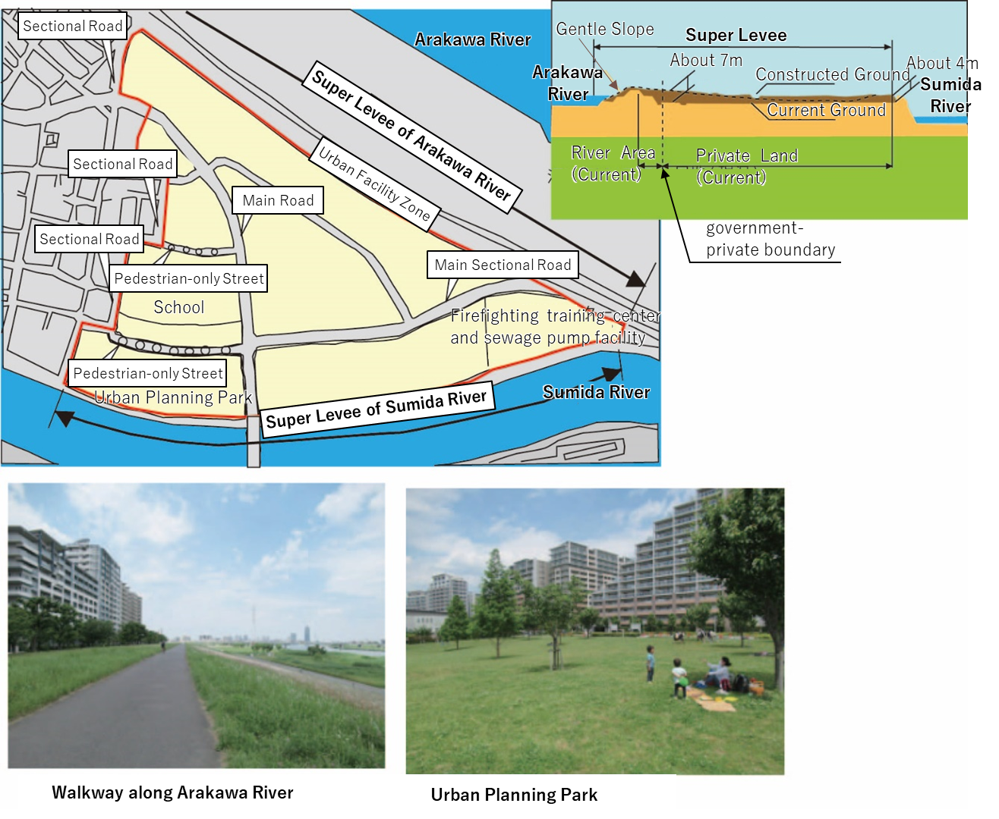
4. Flood Protection Efforts
(2) River Improvement in Urban Areas
Source: UR x Green Infrastructure Case Studies with addition by the Project Research Team
Heart Island SHINDEN

Slide 22
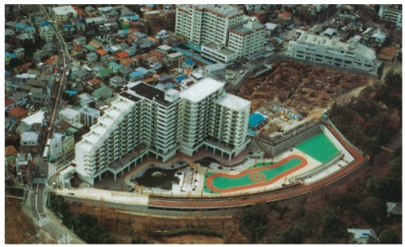
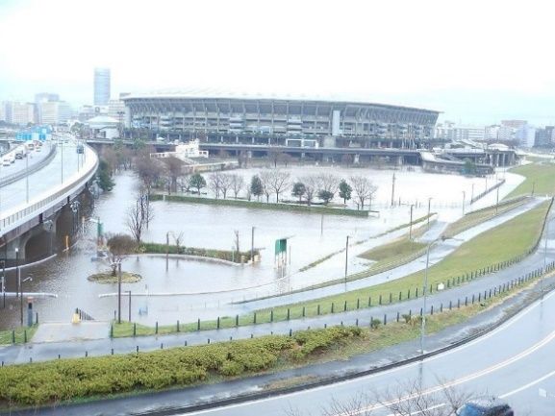
4. Flood Protection Efforts
(3) Retarding Basin, Regulation Ponds and Underground Diversion Tunnel
Effective for temporarily storing flood water
Integrated joint project to utilize space & reduce costs
50% land ownership UR, 50% Shinjuku/Nakano wards
Tokyo Gov. uses entire area as regulating pond, covers related implementation and O&M costs
Source: Myoshoji River No. 1 Regulating Pond pamphlet, Tokyo Metropolitan Government
Myoshoji River No.1 Adjustment Pond
Source: Tsurumi River Multipurpose Retarding Basin Pamphlet (edited)
Source: MLIT Keihin River Office Facebook
Tsurumi River Multipurpose Retarding Basin
During flood event

Slide 23
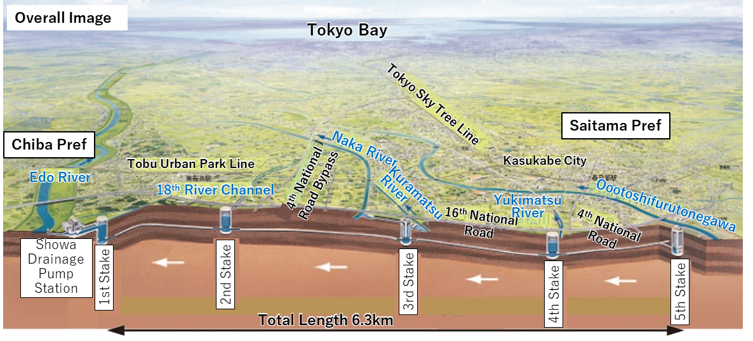
4. Flood Protection Efforts
(3) Retarding Basin, Regulation Ponds and Underground Diversion Tunnel
Source: MLIT Edogawa River Office Website
Overall Image of the Metropolitan Ara Outer Discharge Tunnel

Slide 24
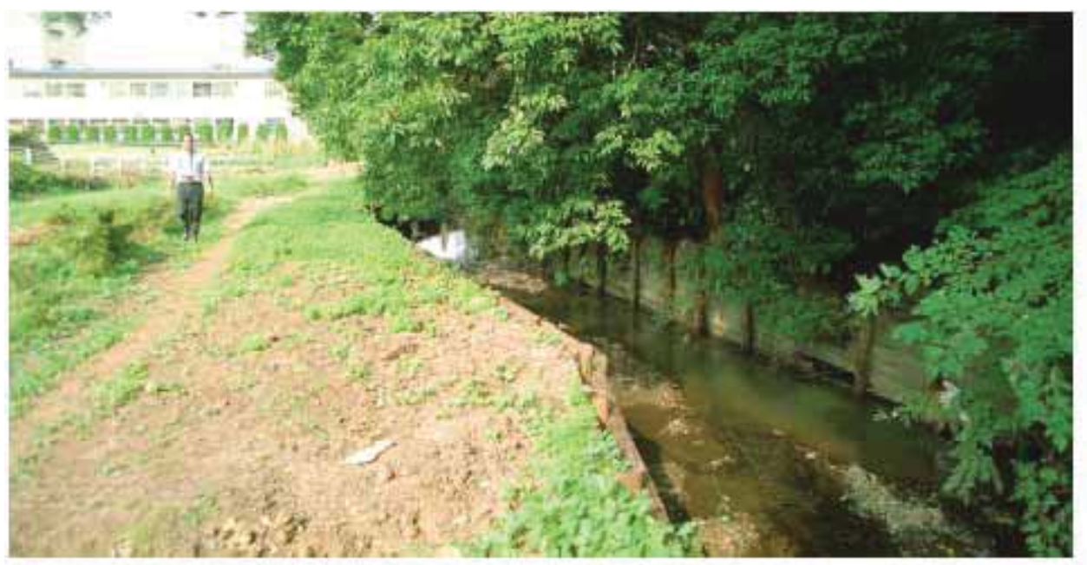
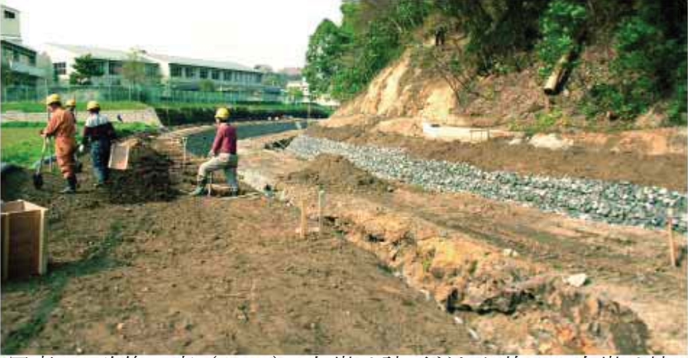
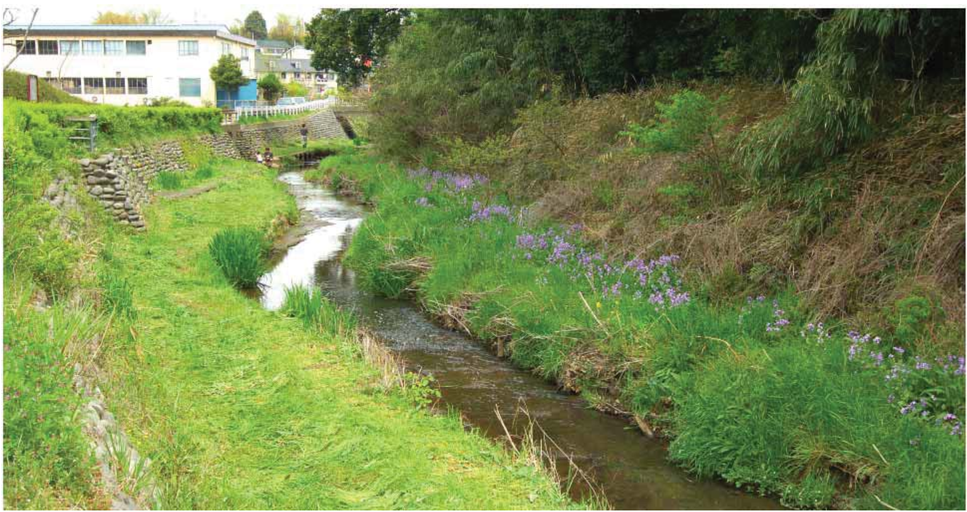
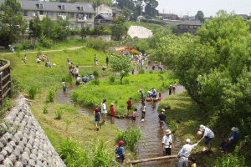
5. Improving Water Environment
(1) Sewerage Improvement & (2) Development of Green Infrastructure
Before construction: plank hurdle revetment
Renovation: Gabion revetment
13 years: Natural connection between slope & river
Source: Nature-oriented River Management Reference Book, Riverfront Research Center
Source: Yokohama City Website
Umeda River

Slide 25
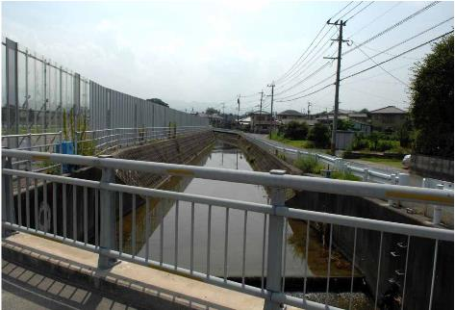
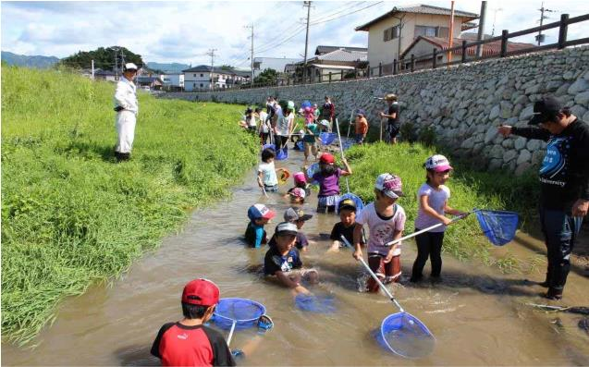
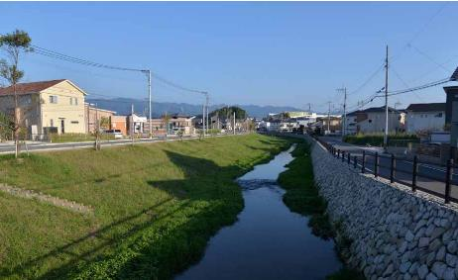
5. Improving the Water Environment
(1) Sewerage Improvement & (2) Development of Green Infrastructure
before
after
Frequently used for environmental studies by children
Source: River Law Amendment 20 Years Nature-friendly River Management Promotion Committee, 1st Pamphlet: Specific Examples of Nature-friendly River Management (No. 1), MLIT
Kamisaigo River

Slide 26
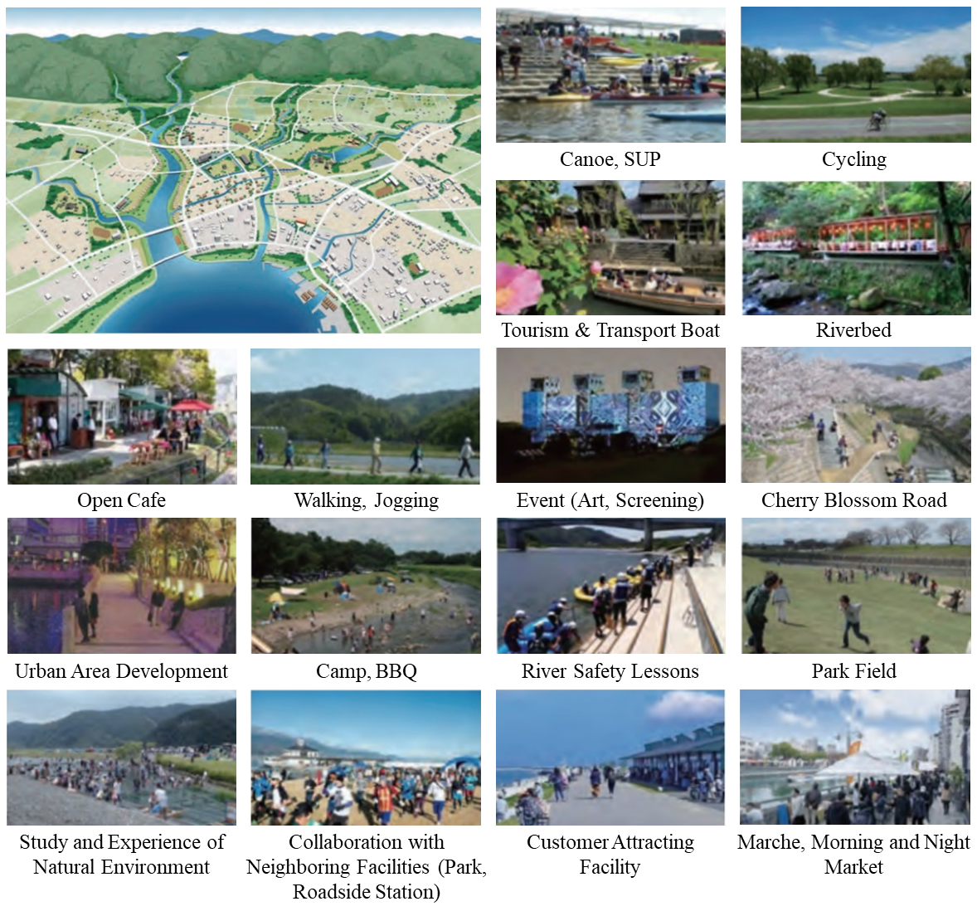
5. Improving Water Environment
(3) Use of Waterfront for Tourism
Source: Guide for Formulating a River-Town Development Plan, 1st Edition, MLIT, March 2020

Slide 27
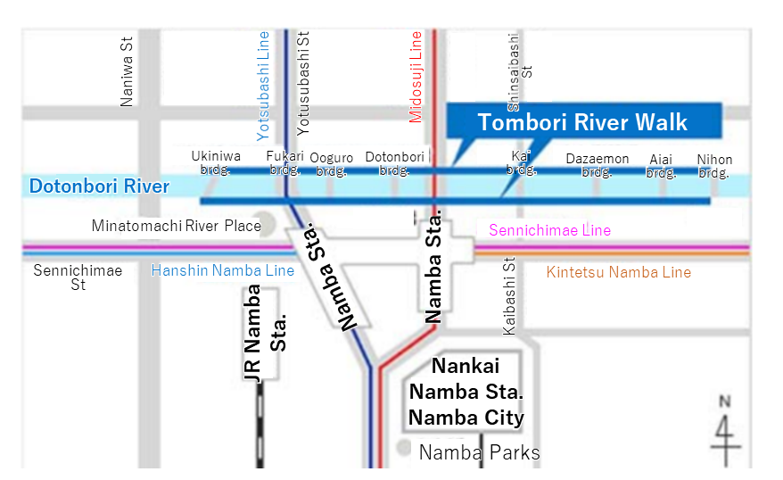
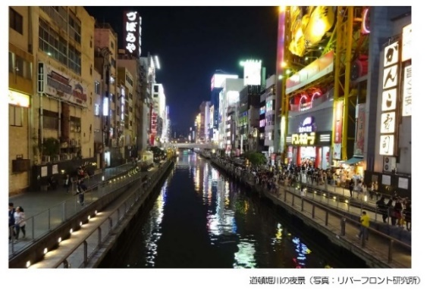
5. Improving Water Environment
(3) Use of Waterfront for Tourism
Source: MLIT Material
Dotonbori River
River-Town Planning
“Kawamachi Zukuri”
New values and characteristics unique to the region are created
Help revitalize the community
Improve local brand
Opportunities for local interaction
Tourism promotion

Slide 28
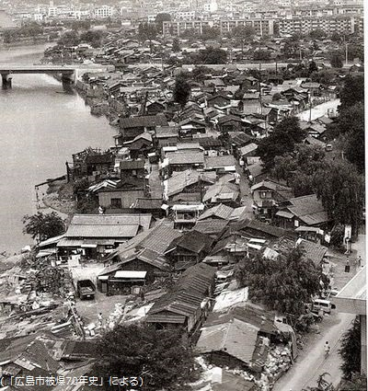
5. Improving Water Environment
(4) Response to the Urban Poor in the River Area
Post-World War II
“Atomic Bomb Slums”
Many people (victims & repatriates) living in barracks build on riverside
Coping with Housing Shortage
4500 high-rise housing constructed
Parks & riverside spaces secured
Source: 70th Anniversary of Hiroshima Atomic Bombing
Atomic Bomb Slum in Hiroshima

Slide 29
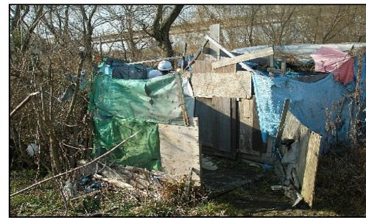
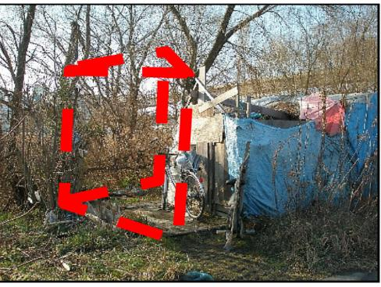
5. Improving Water Environment
(4) Response to the Urban Poor in the River Area
Current Residents Living in High Water Channel Area
before
Cases where the homeless have built temporary huts & settled down on flood water channel area of rivers
In Arakawa, patrols are conducted to provide guidance to the people
after
Source: Efforts to respond to homelessness in the lower Arakawa River, Arakawa River Office, Onagi River Sub-branch, Ooyama Takeshi, MLIT Material
Approach to the Homeless in the Arakawa River

Slide 30
6. Lessons Learned (1)
  (1) To ensure coexistence with the environment and resolve various urban related issues, the water cycle should be restored.
  The concentration of urban population, expansion of urban areas, and increase in socioeconomic activities have caused deterioration of the water cycle in urban areas. These affect various areas in terms of the quality and quantity of water, the riparian environment, and groundwater. Organizations were concerned about the need to collaborate to restore the water cycle.
  (2) To cope with water demand due to the influx of the population into urban areas, water demand management and water recycling should be promoted.
  Water demand could be managed by tariff systems and other software measures. The reduction of water leakage and use of rainwater and recycled water should be promoted. A review of the production process and recycling water is also required for industrial water supply.

Slide 31
8. Lessons Learned (2)
  (3) To mitigate the flood damage in urban areas, comprehensive measures should be taken.
  Urbanization caused a decline in water retention capacity and an increase in peak flood discharge. Flood risk is increased by climate change. Thus, integrated approaches to improve river facilities, river basins, and flood damage mitigation should be undertaken. Cooperation among related organizations should also be consolidated.
  (4) To conduct efficient development, the private sector’s expertise should be utilized.
  For example, parks and piloti-type housing complexes were developed above regulation ponds to store floodwaters in Tokyo. The government organizations provided incentives to the private sector. This has enabled the effective use of expensive land in urban areas.

Slide 32
8. Lessons Learned (3)
  (5) To improve the water environment, multiple approaches should be taken in terms of water quality, discharge, ecosystems, and recreation.
  A decline in water quality during high economic growth in Japan has resulted in ecosystem deterioration, and residents have avoided access to rivers. Various efforts to improve the water environment have been implemented to integrate “river space” and “town space,” improve the waterfront environment, and conserve the ecosystem. Flood protection facilities have also contributed to urban development by providing recreational functions. Involving the local community and private organizations in implementing these initiatives was necessary. This collaboration led to the creation of a good space uniting the “river” and “town,” which promoted tourism and rejuvenated the area.

Slide 33
8. Lessons Learned (4)
  (6) Developing green infrastructure can achieve multiple benefits.
  Flood protection works contribute to achieving various objectives using natural functions. These objectives include disaster management, improvement of the living environment and waterfront, conservation of ecosystems, promotion of regional development, and mitigation of climate change.
  (7) To improve issues of the urban poor in rivers public housing should be provided with river improvement works.
  There were many slum areas along rivers in urban areas in Japan during post-WWII periods. Japan resolved these problems by providing affordable public housing for the urban poor with implementing flood protection works.

