Slide 1



Theme 7
Groundwater Management
Secure Alternative Water Sources along with Regulations

Slide 2
Contents
      Introduction
      Groundwater Use
      Water Quality Management
      Comprehensive Groundwater Conservation
      Lessons Learned

Slide 3
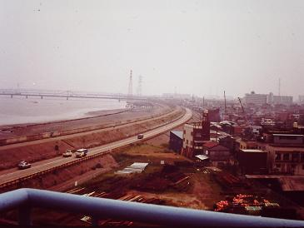
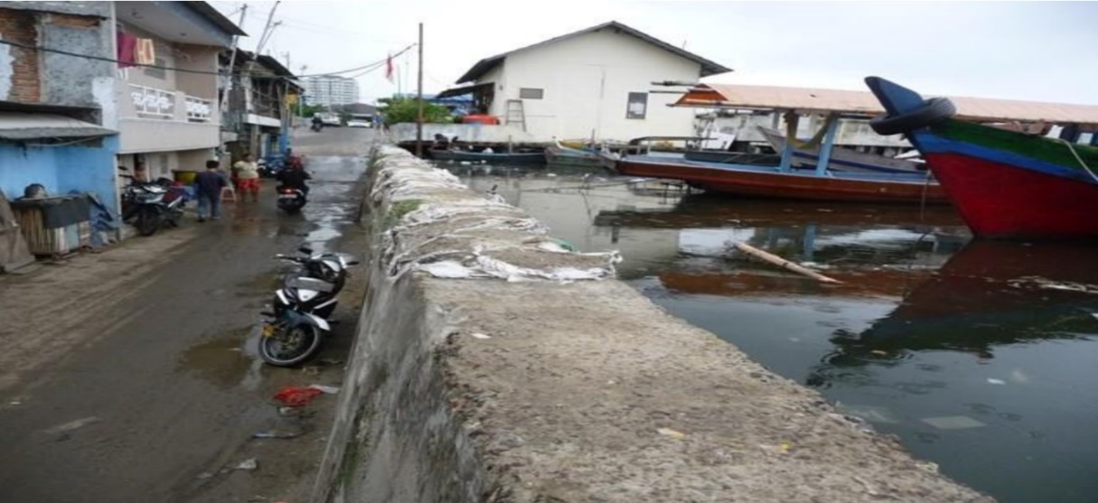
1. Introduction
Source: Tokyo Metropolitan Government, Bureau of Environmental Website
Source: JICA
Zero Meter Area alongside Arakawa River
Zero Meter Area in Jakarta, Indonesia
Land Subsidence

Slide 4
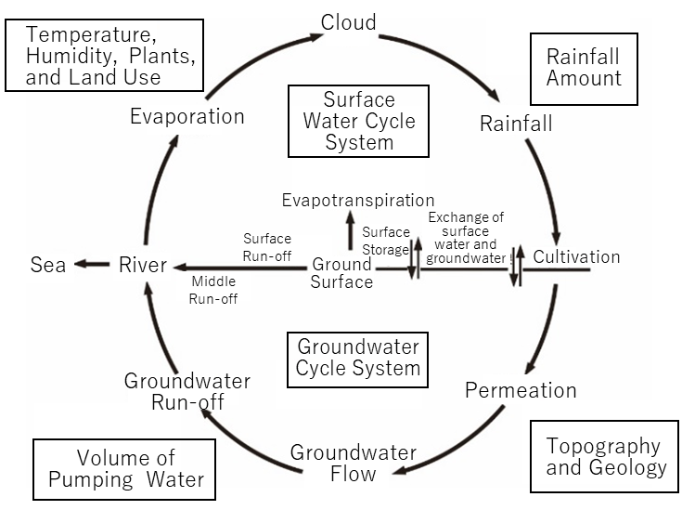
2. Groundwater Use
(1) Current Status of Groundwater Use in Japan
1) Groundwater in the Water Cycle
Source: Toward the Conservation and Sound Use of Groundwater, Advisory Group on Future Groundwater Use, March 2007, MLIT
Conceptual Diagram of the Water Cycle

Slide 5
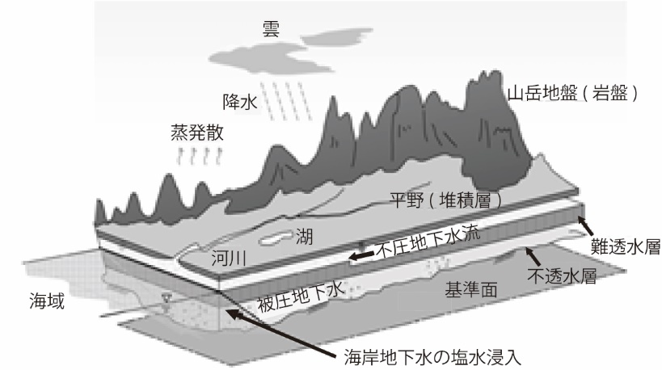
2. Groundwater Use
(1) Current Status of Groundwater Use in Japan
1) Groundwater in the Water Cycle
Cloud
Mountain ground (rock)
Rainfall
Evapotranspiration
Plain
(Sedimentary Layer)
Unpressured Groundwater
Lake
River
Pressured Groundwater
Sea
Saltwater intrusion in coastal groundwater
Source: Toward the Conservation and Sound Use of Groundwater, Advisory Group on Future Groundwater Use, March 2007, MLIT
Conceptual Diagram of the Water Cycle

Slide 6
2. Groundwater Use
(1) Current Status of Groundwater Use in Japan
2) Groundwater in Japan
Source: Japan’s Water Resources, data from MLIT
Annual Water Use by Source in Japan

Slide 7
2. Groundwater Use
(2) Regulation and Measures of Groundwater Use by Legislation
1) Land Subsidence Problem
The Edo Period (1603-1868)
Groundwater was used as common property of communities.
The Meiji Period (1968-1912)
Groundwater use for urban water supply increased.
Groundwater use was accelerated since deeper and larger diameter wells became possible with mechanical drilling.
No public regulation.

Slide 8
2. Groundwater Use
(2) Regulation and Measures of Groundwater Use by Legislation
1) Land Subsidence Problem
From around 1930
Land subsidence of locally 15 to 17 cm per year was observed.
From the post-WWII reconstruction period until the high economic growth (1955 -1973)
Groundwater use increased rapidly.
Depletion of groundwater and damages of land subsidence and saltwater intrusion became serious especially in Tokyo and Osaka.

Slide 9
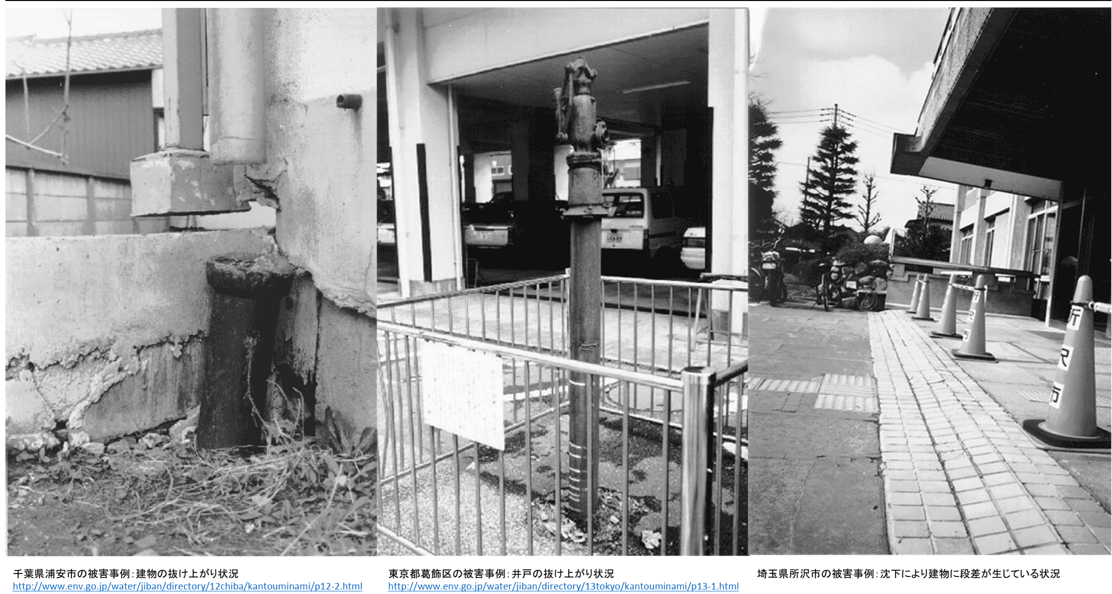
2. Groundwater Use
(2) Regulation and Measures of Groundwater Use by Legislation
1) Land Subsidence Problem
Slopes between building side and garden side, Saitama pref.
Column footing rose above ground level.
Hand-pump for groundwater floated up above ground level, Tokyo
The rainwater pipe rose above ground level, Chiba pref.
Source: National Ground Environment Information Directory, Ministry of the Environment
Damage by Land Subsidence in Tokyo Urban Area

Slide 10
2. Groundwater Use
(2) Regulation and Measures of Groundwater Use by Legislation
2) Salinization
Salinization of groundwater is caused by seawater intrusion into an aquifer when the groundwater level is lowered below sea level owing to excessive water extraction.
Since 1960, salinization issues occurred in many coastal areas.
The groundwater level must be maintained above the sea level to prevent salinization through:
1) restricting the amount of groundwater extraction,
facilitating artificial recharge of groundwater,
limiting the groundwater restriction zone to a coastal area and allowing saltwater intrusion in a limited zone, or
building impermeable walls to prevent saltwater intrusion.

Slide 11
2. Groundwater Use
(2) Regulation and Measures of Groundwater Use by Legislation
3) Legal Regulations against Land Subsidence
The ordinances of local governments were more effective in restricting groundwater extraction than national laws.
In the 1970s, local governments established ordinances to regulate pollution as well as groundwater extraction in areas that National Acts could not cover.
The ordinances covered groundwater extraction without limiting the purpose of water use.
The ordinances also did not require the alternative development of water sources besides groundwater.

Slide 12
2. Groundwater Use
(2) Regulation and Measures of Groundwater Use by Legislation
4) Changing Water Sources for Industrial Water
The groundwater extraction for industrial water use was regulated by the Industrial Water Act by restricting the use of existing wells.
This promoted converting water sources from groundwater to surface water.
When local governments developed industrial water supply systems, industrial entities were instructed to abolish their own wells.
The cost of groundwater extraction by industrial entities was JPY 1–3/m³. The tariff of industrial water use provided by local governments was set at JPY 3.5/m³. Subsidies were provided by the national government to avoid cost increases by changing water sources.
In 2001, this tariff increased to 24.4 yen/m³. However, it was still one-eighth of the unit cost of water supply by local governments. ➔ Environmental costs to the industry and local government.

Slide 13
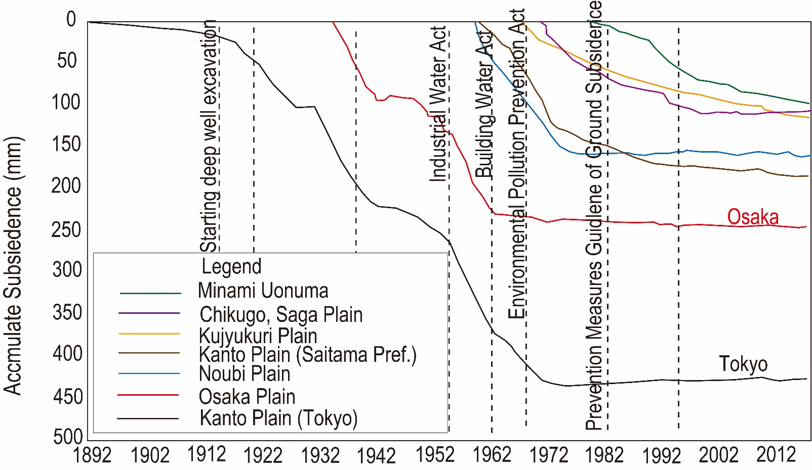
2. Groundwater Use
(2) Regulation and Measures of Groundwater Use by Legislation
5) Land Subsidence
Groundwater extraction is restricted by Acts and Ordinances, followed by the recovery of groundwater level. The land subsidence substantially stopped.
Source: Overview of Land Subsidence in Japan in 2019, Ministry of the Environment, Water and Air Environment Bureau (2019 March)
Land Subsidence experienced countrywide

Slide 14
2. Groundwater Use
(2) Regulation and Measures of Groundwater Use by Legislation
6) Regulation by Tokyo Metropolitan Government
Stage 1 (1900~1916)
Demand for daily water use depended on groundwater by more than 60%, but the land subsidence was not significant.
Stage 2 (1916~1960)
The land subsidence became significant and finally serious. No effective measure was taken.
Stage 3 (1961~1974)
Enacting the regulations of groundwater extraction based on the Industrial Water Act and the Building Water Act recovered the groundwater level gradually.
Stage 4 (1975~)
The groundwater level continued recovering, and land subsidence ceased.

Slide 15
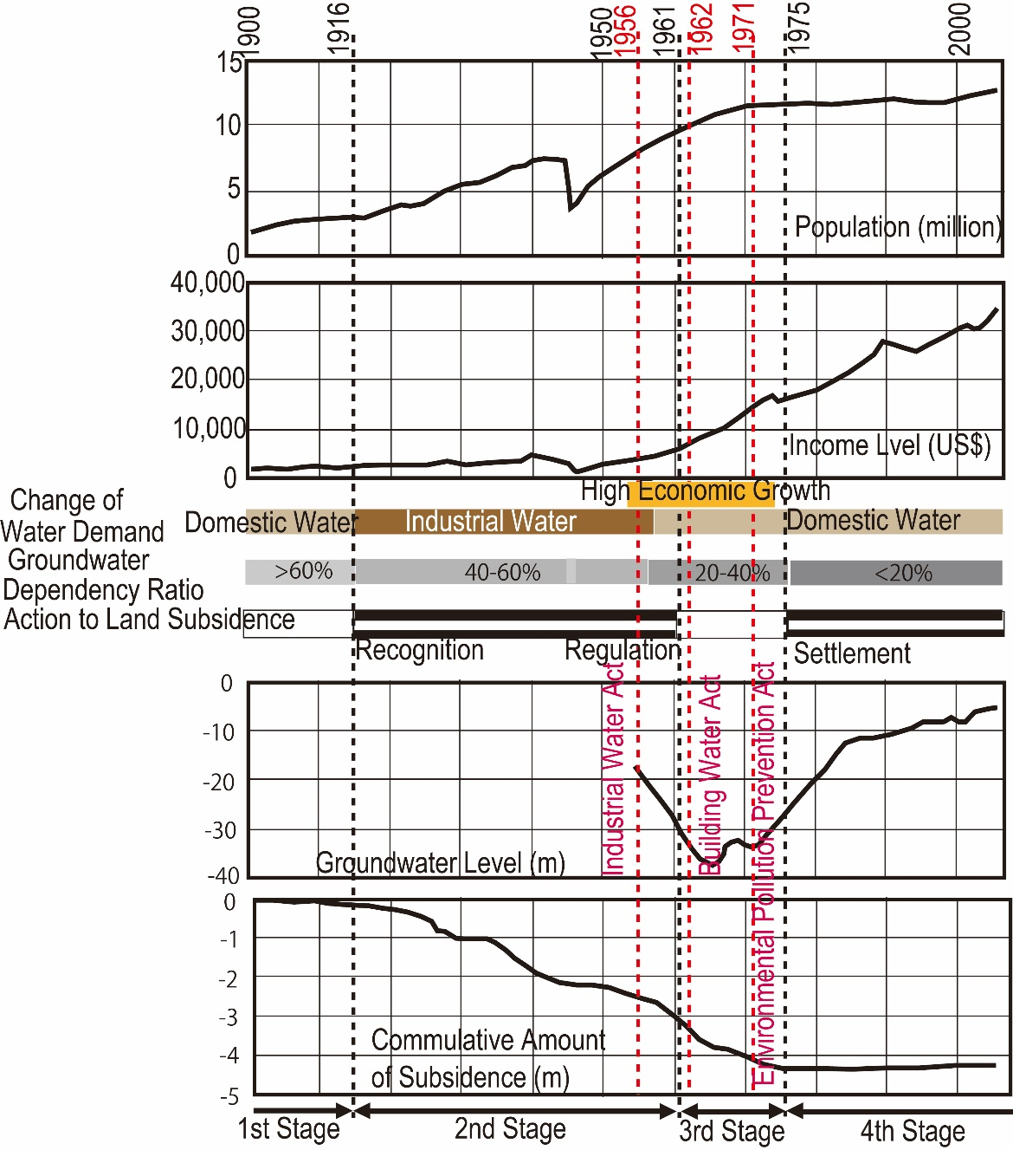
(2) Regulation and Measures of Groundwater Use by Legislation
6) Regulation by Tokyo Metropolitan Government
1900-1916: Land subsidence was not significant.
1916-1960: Land subsidence became substantial and serious.
1961-1974: Enacted regulations on groundwater extraction. The groundwater level gradually recovered.
1975– : The land subsidence ceased.
Source: Urbanization and Land Subsidence in the Case of Tokyo: A Stage-by-Stage Approach Using Long-term Indicators, Tomoyo Toyoda & Shinji Kaneko, National Institutes for the Humanities, Institute for Global Environmental Studies
History of Land Subsidence in Tokyo

Slide 16
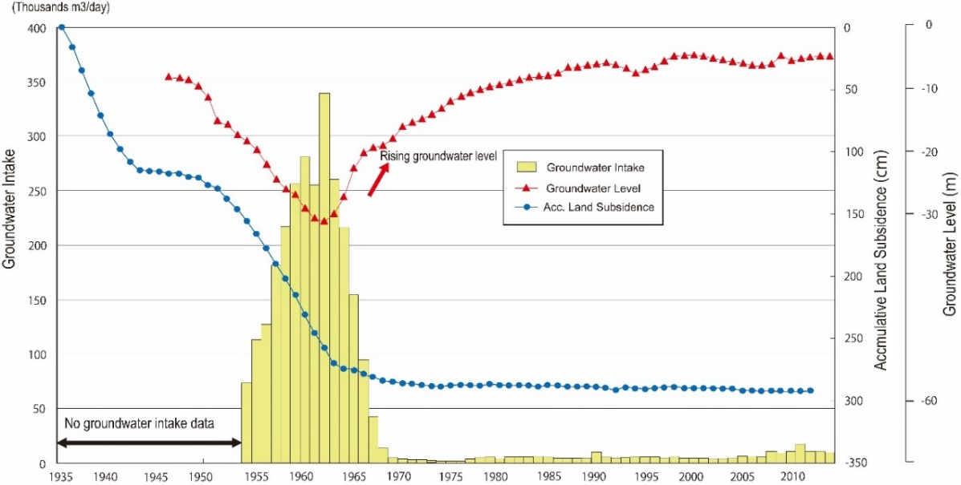
2. Groundwater Use
(2) Regulation and Measures of Groundwater Use by Legislation
7) Regulation in Osaka City
Osaka City regulated groundwater extraction rates. It allowed extractions only from deep layers, below -500 ~ -600 m. It made groundwater use difficult.
Source: "Report on the effective use of groundwater in consideration of the ground environment in the Osaka City area", Study Council on the Effective Use of Groundwater in Consideration of the Ground Environment in Osaka City Area (1991 February)
Groundwater Use and Land Subsidence in Osaka City

Slide 17
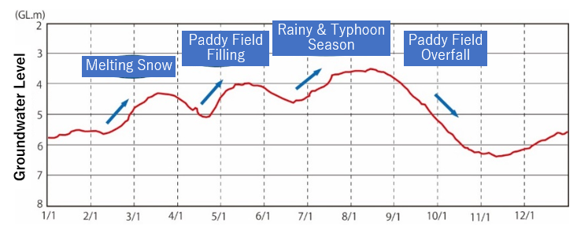
2. Groundwater Use
(2) Regulation and Measures of Groundwater Use by Legislation
8) Measures to counteract Drying of Wells in Snowfall Areas
Drying of Wells in Snowfall Areas
In snowfall areas, groundwater is used to melt & remove snow on roads during snow season, which may cause drying of wells.
Source: Groundwater and Spring Water in “Echizen Ono, the Hometown of Yui” ~Revitalization of Spring Water Culture~ Ono City, Fukui Prefecture
Seasonal Changes in Groundwater Level (Kasuga Park Observation Well)

Slide 18
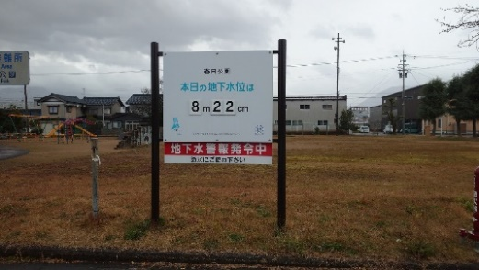
2. Groundwater Use
(2) Regulation and Measures of Groundwater Use by Legislation
8) Measures to counteract Drying of Wells in Snowfall Areas
Measures in Ono City (Kasuga Park) in Fukui Prefecture
Groundwater is monitored. A warning is issued when a low groundwater level is observed.
Source: Ono City
Kasuga Park Observation Well and Warning Board

Slide 19
2. Groundwater Use
(3) Groundwater Monitoring
1) Reporting Water Extraction
The ordinances by local governments require groundwater users to record their extraction volume and report it to the governors.
2) Monitoring Land Subsidence
Monitoring Items:
Ground Level
Groundwater Level
Land Subsidence
Survey Items:
Geology
Amount of water extraction

Slide 20
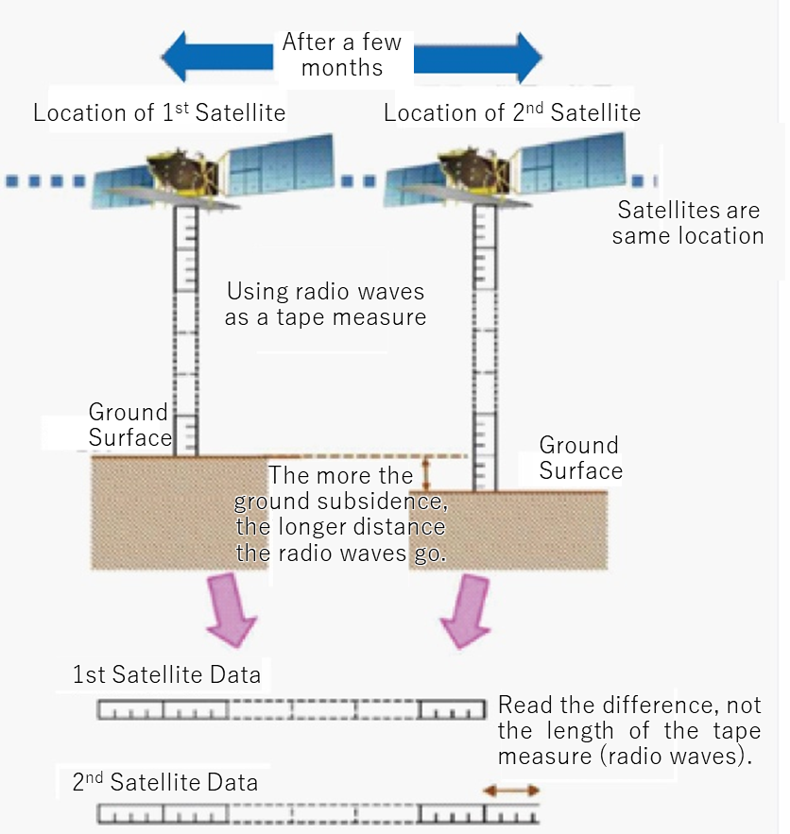
2. Groundwater Use
(3) Groundwater Monitoring
3) Monitoring by Satellite Data
MOE published "Manual for Utilization of Satellites in Land Subsidence Observation" (2017).
It uses Advanced Land Observing Satellite-2 "Daichi-2" (ALOS-2).
Source: Manual for the Use of Satellite Observation for Land Subsidence, Ministry of the Environment
Land Subsidence Monitoring by
SAR Satellite

Slide 21
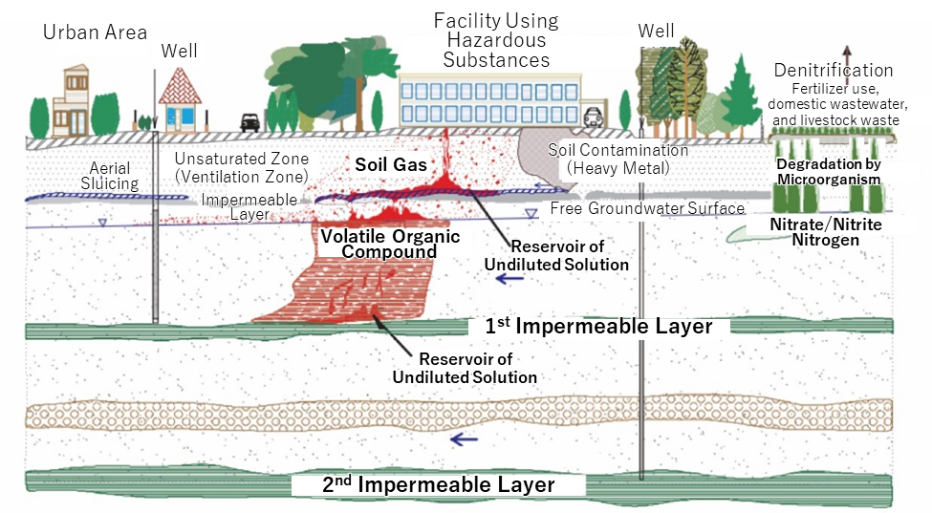
3. Water Quality Management
(1) Groundwater Contamination Mechanism
Main Substance of Contamination
volatile organic compounds (VOCs)
Heavy metals
Nitrate-nitrogen and nitrite-nitrogen
Source: To clean up Groundwater, Ministry of the Environment (2004)
Depiction of Groundwater Contamination

Slide 22
3. Water Quality Management
(2) Monitoring of Groundwater Quality
Established Standards
1. Groundwater Environmental Standards (Basic Environment Act)
2. Groundwater Purification Standard (Water Pollution Prevention Act)
3. Underground Infiltration Standard (Water Pollution Prevention Act)
The Groundwater Quality Survey
1. General survey
2. Survey of areas around contaminated wells
3. Continuous monitoring survey

Slide 23
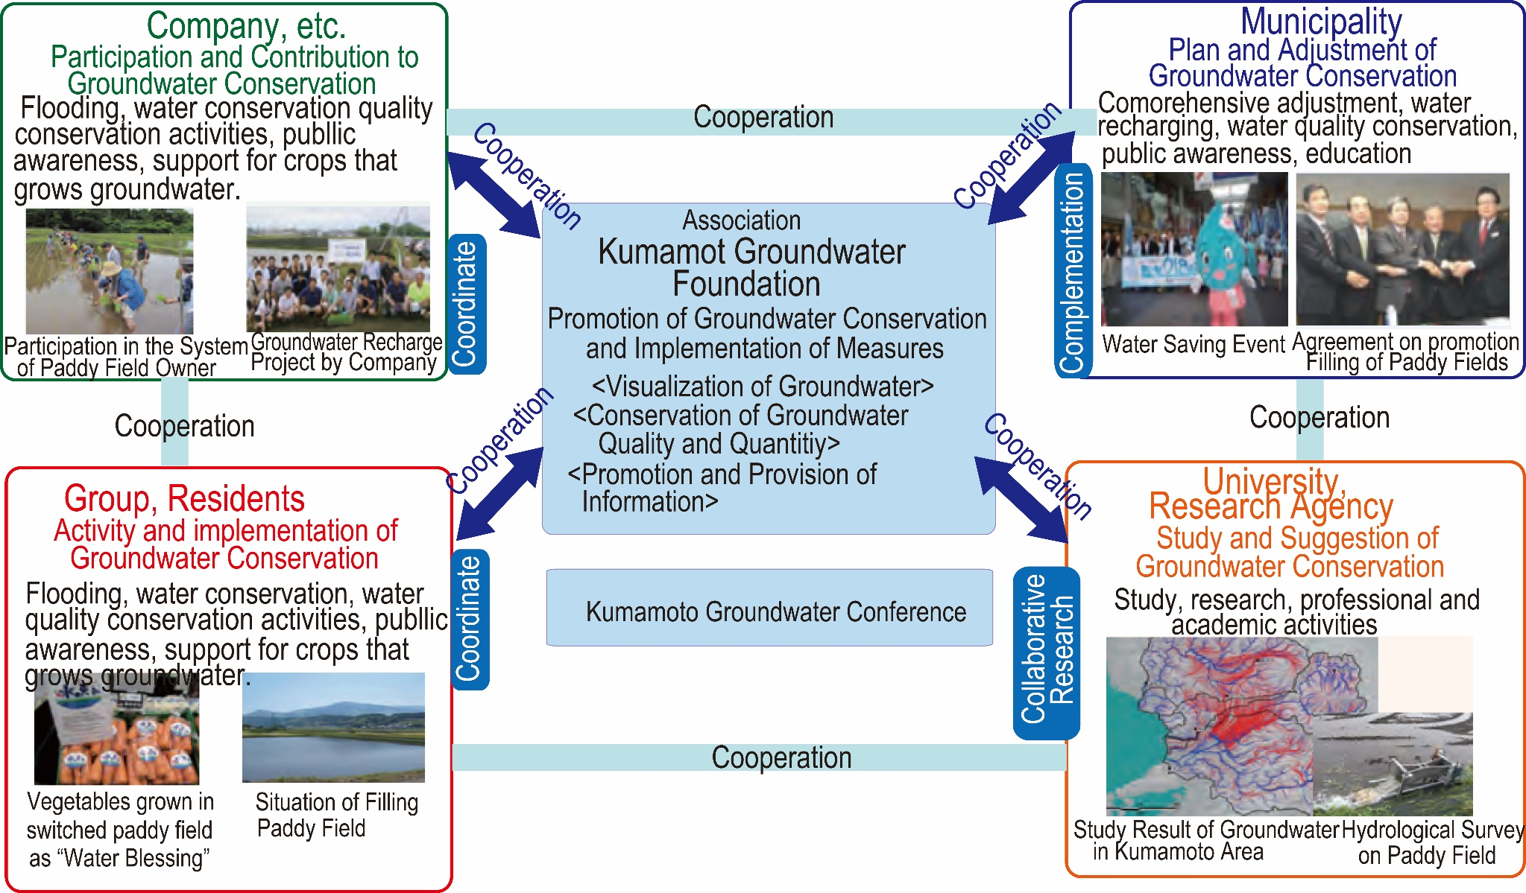
4. Comprehensive Groundwater Conservation
Source: Case Studies of Watershed Management, Water Cycle Production Headquarters Cabinet Secretary
Activities of the Kumamoto Groundwater Foundation

Slide 24
8. Lessons Learned (1)
  (1) Excessive extraction of groundwater lowers the groundwater level, which may induce land damage, structural damage, aggravated flood damage, and saltwater intrusion.
  Groundwater is a key component of a healthy water cycle. Land subsidence is an irreversible phenomenon resulting from the consolidation of underground clay layers owing to the drainage of water contained in the clay layers.. Excessive extraction of groundwater has caused land subsidence in major cities, including Osaka and Tokyo, at rates of over 20 cm per year and a total subsidence of more than 5 m. Coastal areas have experienced salinization in groundwater, which has precluded its usage for drinking and industrial purposes, and has caused salt damage to crops.

Slide 25
8. Lessons Learned (2)
  (2) Regulation of groundwater extraction and the development of alternative water sources are necessary for groundwater conservation.
  In Japan, acts and ordinances have been established by the national and local governments to regulate groundwater use. Governments developed industrial water supply systems that use surface water as an alternative source. Their acts and ordinances stipulate the criteria for groundwater use permits. Groundwater users have been registered and are required to record and report the amount of groundwater extracted. Local governments continuously monitor the groundwater situation and land subsidence.

Slide 26
8. Lessons Learned (3)
  (3) Proper groundwater quality management is required to prevent the infiltration of hazardous substances into groundwater.
  Once groundwater is contaminated and the contamination spreads, restoration of groundwater quality is difficult. Therefore, early monitoring and measures are necessary. Management systems require environmental standards for groundwater quality, annual monitoring plans, and a system that enables prompt responses to emergency situations.
  (4) To ensure sustainable conservation and usage of groundwater, a council of stakeholders should be established according to regional conditions.
  Kumamoto City formulated mechanisms of groundwater management in collaboration with local governments, the private sector, residents, universities, and research institutions. Their management is supported by scientific evidence developed with universities and institutions in Kumamoto.

