Slide 1


Theme 8
Dam Management
Managing & Operating Dams Safely, and Enhancing their Functions

Slide 2
Contents
      Introduction
      Safety Management of Dams
      Dam Operation during Flood
      Dam Operation for Water Supply
      Measures for Rehabilitation and Improvement of Dam Function
      Lessons Learned

Slide 3
1. Introduction
Passed more than 50 years
Source: Edited data from Year Book od Dams (Japan Dam Foundation)
History of Dam Construction in Japan
Many dams were constructed in the 1960s to 1970s, and more than 50 years have already passed.
It is necessary to manage aging dams efficiently and to maintain or improve their functions as necessary.

Slide 4
2. Dam Safety Management
(1) Standards and Systems for Safety of Dams
Name of Dam | Comple-tion | Acci dent | Type of Dam | Purpose | Damages
Iruka-ike | 1633 | 1868 | Earthfill dam | Irrigation | 941 dead
No.1 Regulating Pond, Komoro Hydropower Station | 1927 | 1928 | Buttress type concrete dam | Hydro-power | 5 dead
Horonai Dam | 1939 | 1941 | Gravity type concrete dam | Hydro-power | 60 dead
Heiwa-ike | 1949 | 1951 | Earthfill dam | Irrigation | 75 dead
Yoake Dam | 1952 | 1953 | Gravity type concrete dam | Hydro-power | -
Taisyo-ike | 1949 | 1953 | Earthfill dam | Irrigation | 105 dead
Wachi Dam | 1968 | 1967 | Gravity type concrete dam | Hydro-power | 1 dead
Fujinuma Dam | 1949 | 2011 | Earthfill dam | Irrigation | 8 dead/ missing
Source: Edited data from the documents of No.21 Expert meeting on future policy and concept of flood management

Slide 5
2. Dam Safety Management
(1) Standards and Systems for Safety of Dams
Plan
River Administrator permit based on River Law.
(Occupation of Water, Land, Permission of New Construction)
Design
Review and Approved by Dam Basic Design Meeting
(Public Works Research Institute, NILIM, etc.)
Construction
Review and Approved by Experts of Public Works Research Institute, NILIM, etc.
Review and Approved of Initial Impounding Test by Dam Basic Design Meeting
Completion
Final Inspection and Approval by River Administrator
(Multipurpose Dam) MILT establishes the right to use Dam
Source: Prepared based on "Construction of Multipurpose for Dams" published by Japan Dams
Notes:
図はRiver ActこれをRiver Lawに修正

Slide 6
2. Dam Safety Management
Review of Technical Standards Based on Experience of Great Disasters
1. Great Hanshin-Awaji Earthquake (1995)
Static Rigid Body Stability Analysis Method
Design seismic coefficient
Probable Maximum Earthquakes
Level 2 earthquakes
2. Damages due to Excessive Flood
Review and Improvement of:
Information dissemination
Public awareness
Forecasting technology

Slide 7
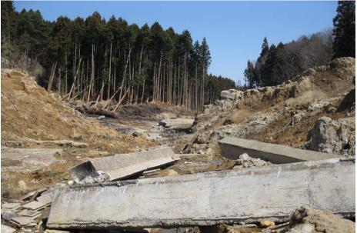
2. Dam Safety Management
Safety Management of Ponds & Small Reservoirs for Irrigation
8 dead, 124 house damaged
Dam was constructed with insufficient compaction & embankment with rich sand
Magnitude of earthquake beyond past experiences
Source: Brief session by Tohoku University one month after Earthquake dated on 13 April 2011
July 2018 collapse of 32 ponds
Fujinuma Dam Failure
(2011 Earthquake)
The Law of Management and Conservation of Ponds and Small Reservoirs for Irrigation (2019)
The Law of Management and Conservation of Ponds and Small Reservoirs for Irrigation (2019)
Notes:
Causes of the Break and Plan of Restoring for Fujinuma Dam, Water, Land and Environmental Engineering, Oct. 2015

Slide 8
2. Dam Safety Management
(1) Standards and Systems for Safety of Dams
Source: Data of Miyagi Prefecture
Example of Information Disseminated for the Failure of Ponds and Small Reservoirs and Evacuation by Using Hazard Map

Slide 9
2. Safety Management of Dams
(1) Standards and Systems for Safety of Dams
Examples of Maintenance and Management of Old Ponds and Small Reservoirs
Source: Agriculture and Rural Area Improvement Plan in Gunma Prefecture, 2020
Sannako Dam Reinforcing against eqrthquake
(Irrigation Water Supply Dam)

Slide 10
2. Safety Management of Dams
(2) Inspection for Dam Safety
Patrol & daily inspection
Occasional Inspection
Earthquakes, floods
Once in 3 years
Inspection of implementation status of maintenance
Inspection of dam structure and its reservoir
Periodic Inspection
Once in 30 years
Detect deteriorations & damages from long-term viewpoint
Comprehensive Dam Inspection

Slide 11
2. Safety Management of Dams
(2) Inspection for Dam Safety
Deputy Manager (Administration)
Deputy Manager (Technical) (2persons)
General Management of Conservation Measures
Officer of Conservation Measures (2persons)
Construction Expert
Senior Expert Staff
Special Investigator
Office Director
Community Relations Division
Fujiwara Dam Management Branch Office
Sonohara Dam Management Branch Office
Information of Disaster Prevention Division
Yanba Dam Management Branch Office
Aimata Dam Management Branch Office
Research and Development Division
Regional Water Management Division
Management Division
Research Division
Administration Division
Source: Website of Tone River Dams Integrated Management office
Tone River Integrated Dam Group Operation Office of MLIT

Slide 12
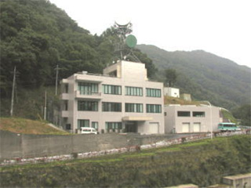
2. Safety Management of Dams
(2) Inspection for Dam Safety
3 Regular Staffs
Part-time Staffs
3~4 Outsourced Staff
Source: Website of Tone River Dams Integrated Management Office
Branch office of Fujiwara Dam
Notes:
Source: Website of Tone River Dams Integrated Management Office

Slide 13
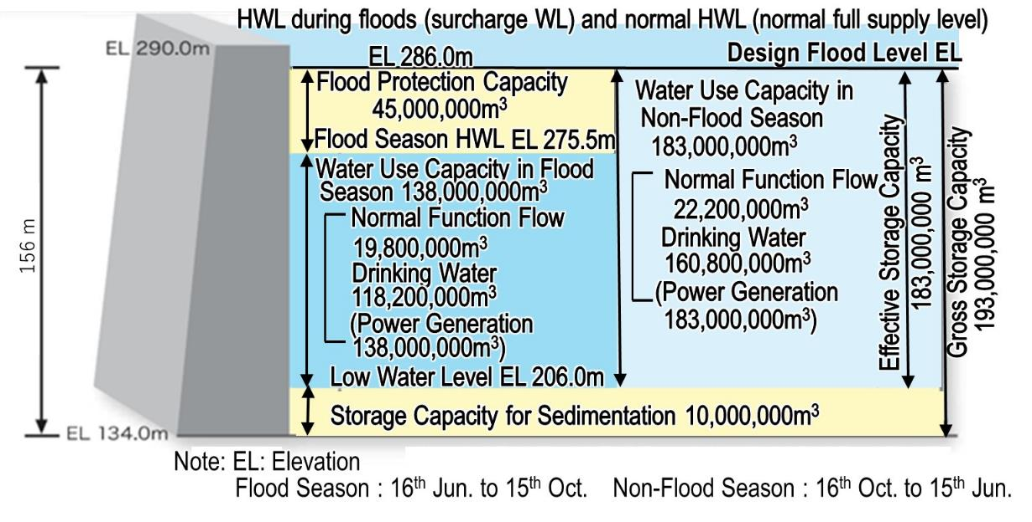
3. Dam Operation During Flood
(1) Storage Capacity Allocation and Flood Protection of Multipurpose Dam
Source: Pamphlet of Miyagase Dam, Sagami River System Dam Management Office, Kanto Regional Development Bureau, MLIT
Non-flood season: 183 million m³ for water supply
Flood season: flood control space of 45 million m³ , rest for water supply
Storage Capacity Allocation of Miyagase Dam
Notes:
Source: Pamphlet of Miyagase Dam, Sagami River System Dam Management Office, Kanto Regional Development Bureau, MLIT

Slide 14
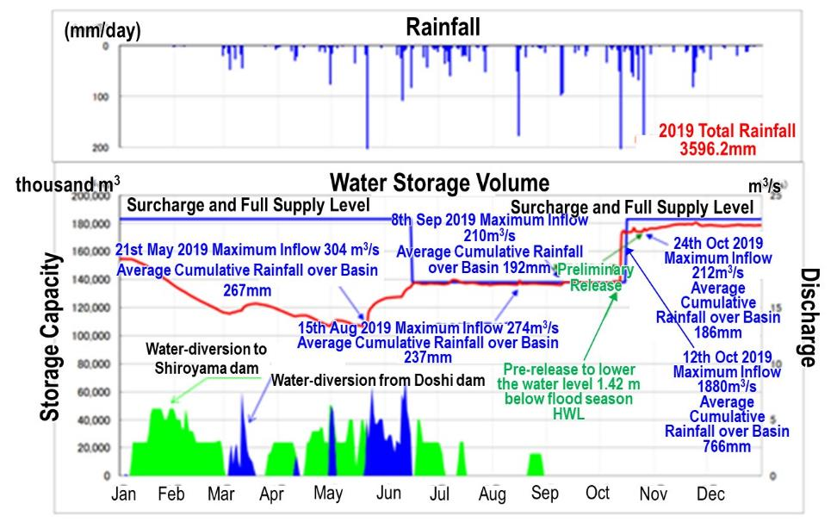
3. Dam Operation During Flood
(1) Storage Capacity Allocation and Flood Protection of Multipurpose Dam
Note: Doshi dam will divert its water, when it is expected to start spilling therefrom, to Miayagase dam for storage therein while Miyagase dam will divert its water to Shiroyama dan which is in shortage of stored water to meet the water supply to Tokyo.
Source: Website of Sagami River System Dam Management Office
Annual Reservoir Operation Record of Miyagase Dam
Notes:
Source: Website of Sagami River System Dam Management Office
Note: Doshi dam will divert its water, when it is expected to start spilling therefrom, to Miayagase dam for storage therein while Miyagase dam will divert its water to Shiroyama dan which is in shortage of stored water to meet the water supply to Tokyo.

Slide 15
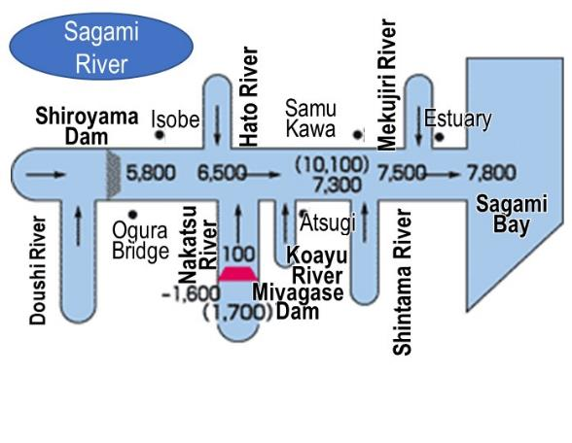
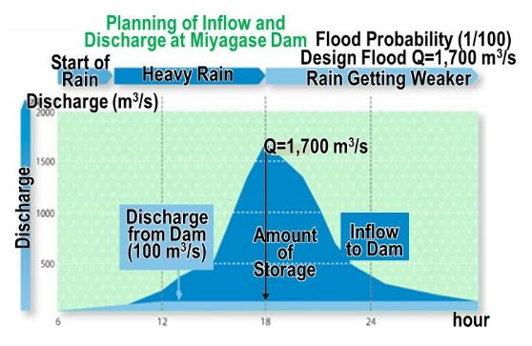
3. Dam Operation During Flood
(1) Storage Capacity Allocation and Flood Protection of Multipurpose Dam
Example of flood protection – Miyagase Dam
Peak flood inflow: 1,700 m³/s
Constant release operation: 1600 m³/s
Downstream release amount: 100 m³/s
Source: Website of Sagami River System Dam Management Office
Flood Protection Plan of Sagami River and Flood Protection by the Miyagase Dam
Notes:
Source: Website of Sagami River System Dam Management Office

Slide 16
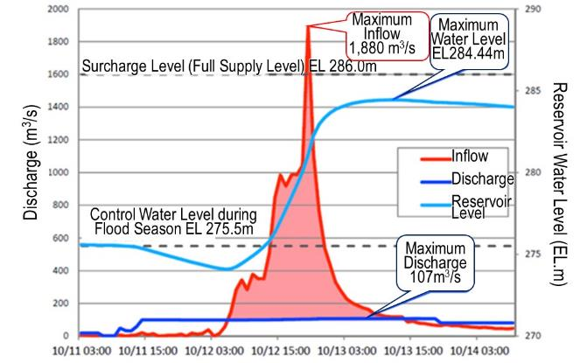
3. Dam Operation During Flood
(1) Storage Capacity Allocation and Flood Protection of Multipurpose Dam
Example of flood protection – Miyagase Dam
Source: States of Dams at Typhon No.19 in 2019, MLIT
Flood Protection (Miyagase Dam for Typhoon No.19, 2019)

Slide 17
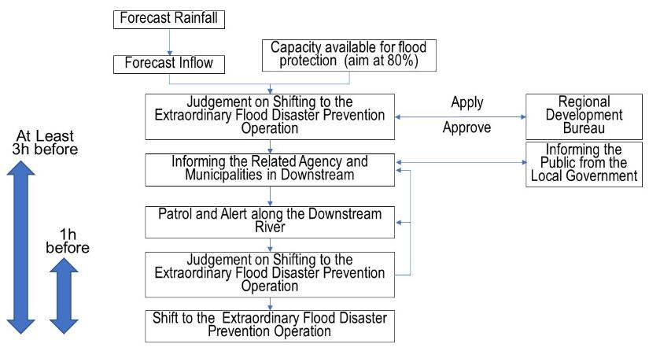
3. Dam Operation During Flood
(2) Dam Operation during Extraordinary Flood Exceeding the Design Discharge
Source: Hearing from Tone River Dams Integrated Management Office and Notes on Procedure for Operation of Nomura Dam

Slide 18
3. Dam Operation During Flood
(2) Dam Operation during Extraordinary Flood Exceeding the Design Discharge
July 2018 major flood damage along Hijikawa River (100 year flood)
People in flooded area may not have received dissemination information from Nomura Dam & Kanogawa Dam
Proposed Measures to reduce flood damages caused by dam operation
Source: MLIT
Hijikawa River Inundation

Slide 19
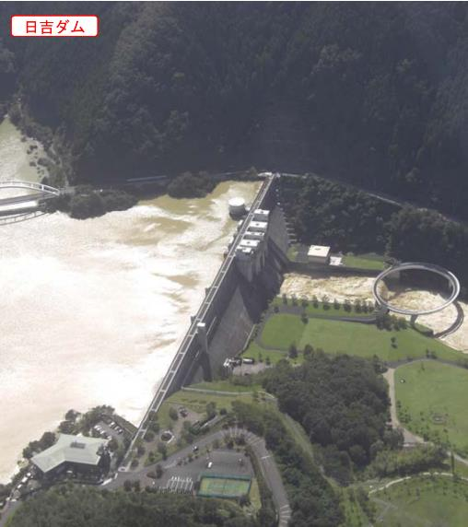
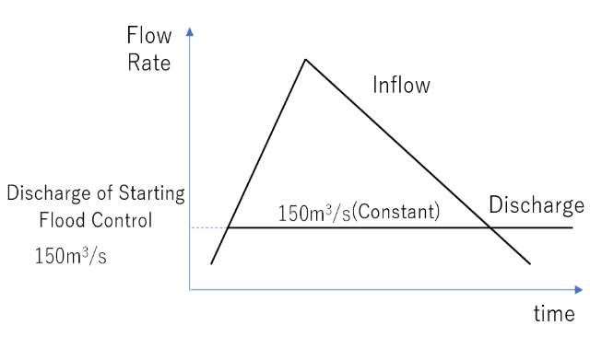
3. Dam Operation During Flood
(2) Dam Operation during Extraordinary Flood Exceeding the Design Discharge
Advanced Dam Operation during Heavy Flood (Typhoon No.18)
Hiyoshi dam
Q_{max}=1,360 m³/s
Q_{out}=150 m³/s
Flood Protection Plan
Typhoon No.18:
Q_{max}= 1,690 m³/s > Q_{max} (Plan) =1,360 m³/s
Source: Kinki Regional Development Bureau (MLIT)
Hiyoshi Dam

Slide 20
3. Dam Operation During Flood
(3) Operation and Role of Water Supply Dam during Flood
Classification of Water Supply Dam and Necessary Actions to Release Flood Water
Type 1
Type 2
Flood discharge increase significantly
Increase in flood flow velocity
Reservoir needs to store part of flood inflow
Rising water levels upstream
Riverbed upstream has risen due to sedimentation, or
Dam area not large enough
Preliminary discharge
Type 3
Type 4
Sudden rise in water level during flood
Flood discharge > reservoir capacity, or
Operation of flood discharge gates complicated
Pre-releasing water to lower water level
Flood water release cause no adverse effect on flood management downstream
None
Article 52 of River Law: River administrator has authority to instruct temporary storage of flood water to the owner of the water supply dam

Slide 21
3. Dam Operation During Flood
(3) Operation and Role of Water Supply Dam during Flood
Recent efforts to use reservoir water in water supply dams for flood protection
Source: MLIT
Advance Release Operation of Kusaki Dam at Typhoon No. 18 in 2019 and its Effect

Slide 22
3. Dam Operation During Flood
(4) Securing Safety for Residents and River Users in Downstream Area
Source: Summary of Discussions for Verification of Information Sharing on the Operation of Nomura Dam and Kanogawa Dam, November 2018
Example of Notification and Information Sharing
(Nomura Dam and Kanogawa Dam)

Slide 23
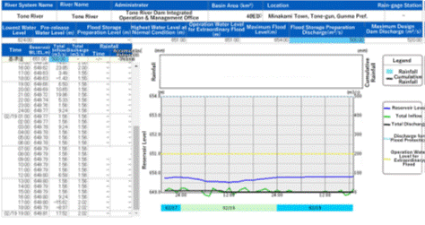
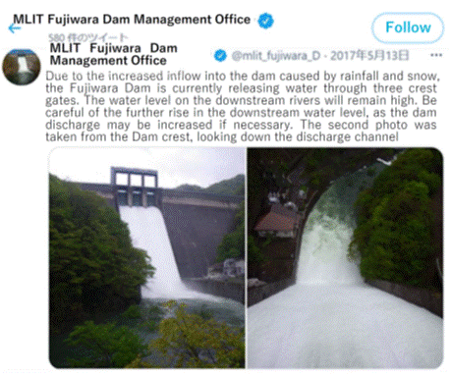
3. Dam Operation During Flood
(4) Securing Safety for Residents and River Users in Downstream Area
Source: MLIT
Real-time dam data of MLIT
Source: Fujiwara Dam
Warning of discharge release (Twitter)

Slide 24
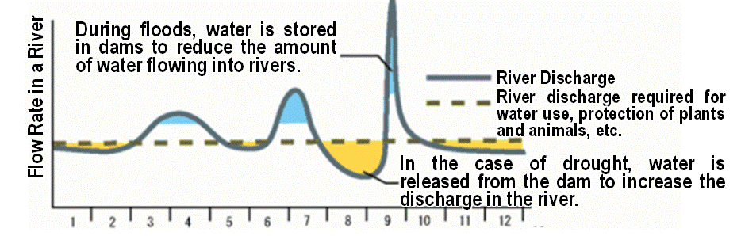
4. Dam Operation For Water Supply
(1) Water Supply by Dam
Source: MLIT
Illustration of Water Supply Enhanced by Dam

Slide 25
4. Dam Operation For Water Supply
(2) Integrated Operation of Dams
Integrated Operation of Multiple Dam
Integrated operation by considering the dam’s location, reservoir volumes, and characteristics of the river basin
Example: nine dams managed by national government & Japan Water Agency Tone River basin
Yagisawa Dam
Naramata Dam
Naramata Dam
Yagisawa Dam
Fujiwara Dam
Fujiwara Dam
Aimata Dam
Sonohara Dam
Aimata Dam
Kusaki Dam
Yanba Dam
Yanba Dam
Kusaki Dam
Shimokubo Dam
Watarase Flood Control Basin
Shimokubo Dam
Watarase Retarding Basin
Source: Tone River Dams Integrated Management Office
Dams Operated by the Tone River Dams Integrated Management Office

Slide 26
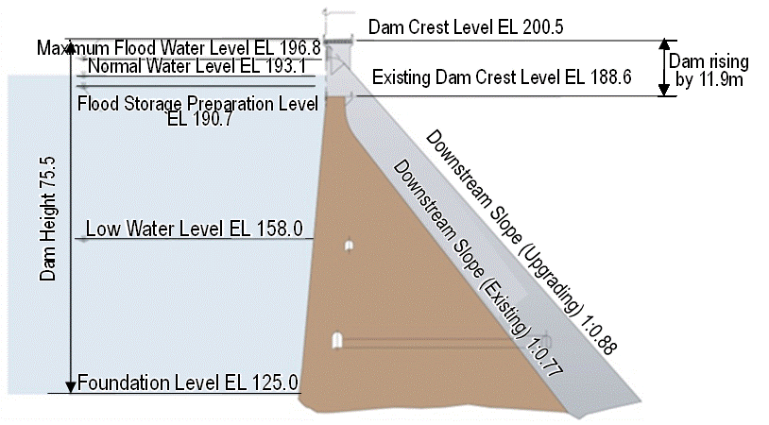
5. Measures for Rehabilitation and Improvement of Dam Function
(2) Dam Rehabilitation Technologies in Japan
Source: Sapporo Development and Construction Office, Hokkaido Regional Development Bureau
Cross Section of Dam Body

Slide 27
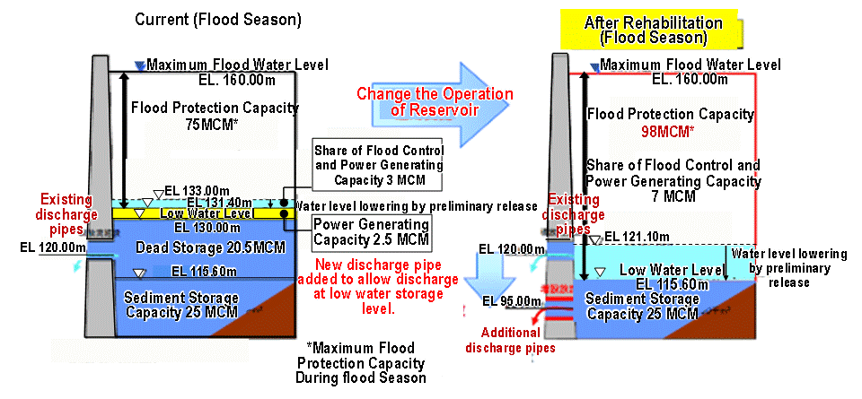
5. Measures for Rehabilitation and Improvement of Dam Function
(2) Dam Rehabilitation Technologies in Japan
Installation of Additional River Outlet Facility by Drilling (Tsuruda Dam)
Source: Sendai-gawa River Office, MLIT
Reformulation of Reservoir Operation for Tsuruda Dam

Slide 28
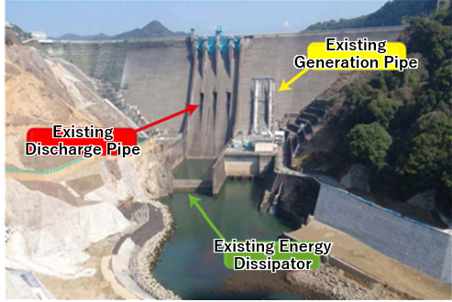
5. Measures for Rehabilitation and Improvement of Dam Function
(2) Dam Rehabilitation Technologies in Japan
Installation of Additional River Outlet Facility by Drilling (Tsuruda Dam)
Existing Power Pipes
Expanded Discharge Pipe
Existing Energy Dissipator
Source: Sendai-gawa River Office, MLIT
Source: Sendai-gawa River Office, MLIT
Drilling of Dam Body
Rehabilitation Works

Slide 29
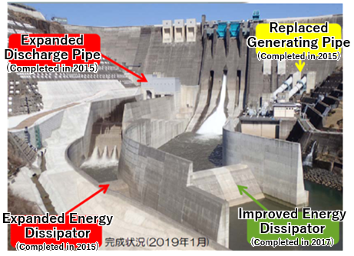
5. Measures for Rehabilitation and Improvement of Dam Function
(2) Dam Rehabilitation Technologies in Japan
Installation of Additional River Outlet Facility by Drilling (Tsuruda Dam)
Replacement of Power Pipe
(Completed in 2015)
Expanded Discharge Pipe
(Completed in 2015)
Expanded Energy Dissipator
(Completed in 2015)
Improved Energy Dissipator
(Completed in 2017)
Source: Sendai-gawa River Office, MLIT
Restoration Works

Slide 30
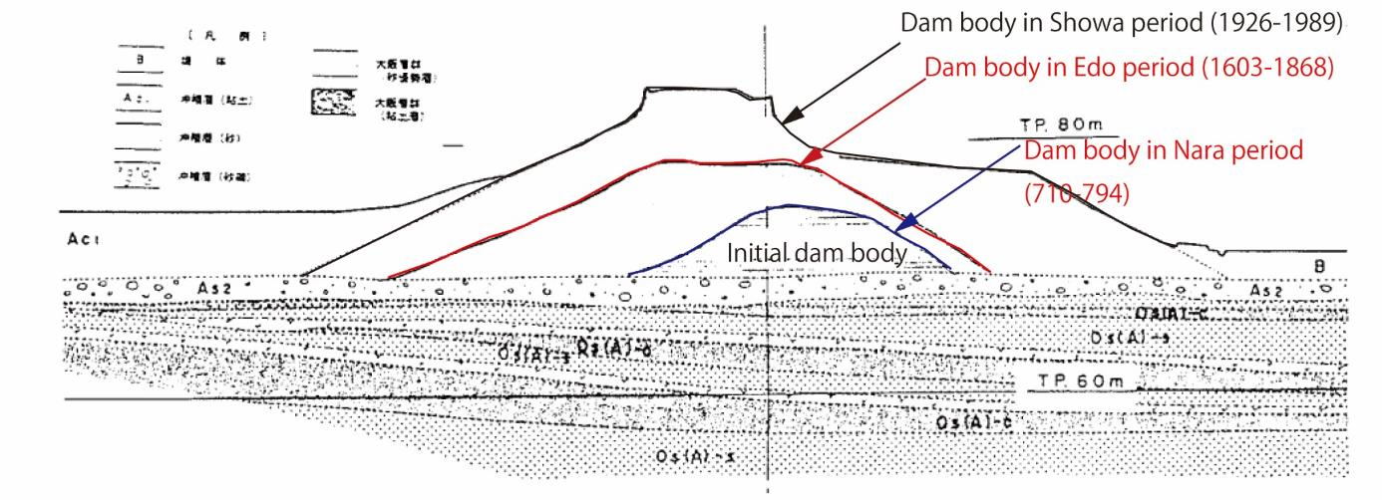
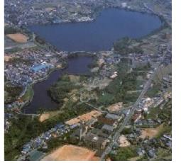
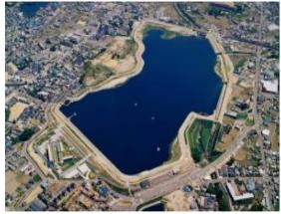
5. Measures for Rehabilitation of Dam & Improvement of its Function
(2) Dam Rehabilitation Technologies in Japan
Restoration of Japan’s Oldest Dam (Improvement of Sayama-ike)
Source: Sayama-ike Dam Talks about History of Civil Engineering, Historical Studies of Civil Engineering No.15
History of Restoration Works
Source: Website of Osaka Prefecture
Before and after Restoration

Slide 31
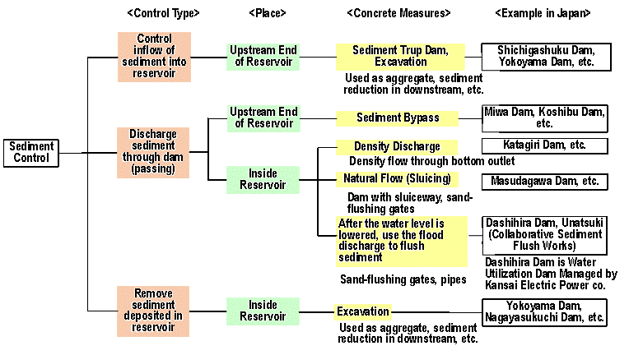
5. Measures for Rehabilitation and Improvement of Dam Function
(3) Technologies for Dam Sediment Control
In Japan, the sediment capacity of reservoirs is determined by estimating the sedimentation volume that will be deposited over 100 years.
Sediment Gates
Sediment discharge
bypass facility
Source: MLIT (left) , Guide for Dam Sediment Control (Draft), Tenryu River Dams Integrated Management Office, Hokuriku Regional Development Bureau, MLIT(right)

Slide 32
5. Measures for Rehabilitation and Improvement of Dam Function
(3) Technologies for Dam Sediment Control
2009
2017
Source: Nakagawa River Office
"To Restoring Sediment Downstream” (Nagayasuguchi Dam)

Slide 33
6. Lessons Learned (1)
  (1) To secure dam safety, legislation, technical guidelines, and examination system should be established.
  The mechanisms of dam safety should involve thorough examination at each stage, i.e., planning, design, construction, and maintenance. It is important to conduct daily inspections and patrols, as well as periodic inspections, and not to overlook any small changes or signs of risk. The periodic and comprehensive inspections and establishment of extension plans for the service life can improve the management and reduce the lifecycle costs. Because many ponds built in the old days have structural problems, accidents should be prevented through legislation and financial support for the inspection and reinforcement of dam structures.

Slide 34
6. Lessons Learned (2)
  (2) To secure a dam and its downstream areas during flooding, operation rules should be followed.
  The operation rules prescribe gate operations and procedures for the patrol and warning methods for downstream areas. They also cover the gate operations for extraordinary floods that exceed the design flood. This is intended to prevent artificial flooding in downstream areas, even under extraordinary floods. The flood inflow should be discharged in the same amount as entering the reservoir. The inflow volume can be obtained from the flood-inflow forecast based on rain radar data. Flood forecasting is effective for introducing and deciding whether to pre-release reservoir water for increasing the flood-protection capacity before floods.
  (3) Integrated operation of multiple dams can ensure an adequate water supply.
  The integrated operation of multiple reservoirs in the basin and reallocation of the reservoir capacity may enhance the reliability of the water supply and improve the river environment.

Slide 35
6. Lessons Learned (3)
  (4) Rehabilitation works can extend lifetime and functions of dams.
  Existing dams can be rehabilitated at a relatively low cost, in a short time, and with minimal burdens on nature and society. Additionally, it is possible to improve the dam functions by using the latest software and hardware technologies, e.g., flood forecasting and countermeasures for reservoir sedimentation, dam raising, and the construction of dam-discharging facilities. Some rehabilitation works can be implemented without interfering with the dam operation.

