Slide 1

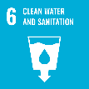

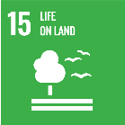

Theme9
Environmental and Social Consideration in Large-scale Projects
Supporting the Reconstruction of Submerged Communities

Slide 2
Contents
      Introduction
      Promotion to Develop Water Source Areas and Support for Relocated Residents
      Environmental and Ecosystem Consideration in Water Source Areas
      Lessons Learned

Slide 3
1. Introduction
Why is environmental consideration required?
Large-scale structures may change a way-of-life of residents and communities.
Construction projects often alternate the natural topography and lose beautiful landscape.
Such physical changes may threaten the habitat and behavioral range of plants and animals in the project area
Theme 9 describes,
Supporting the people in reconstructing their lives
The various environmental measures and environmental protection in water resources
Environmental Impact Assessment

Slide 4
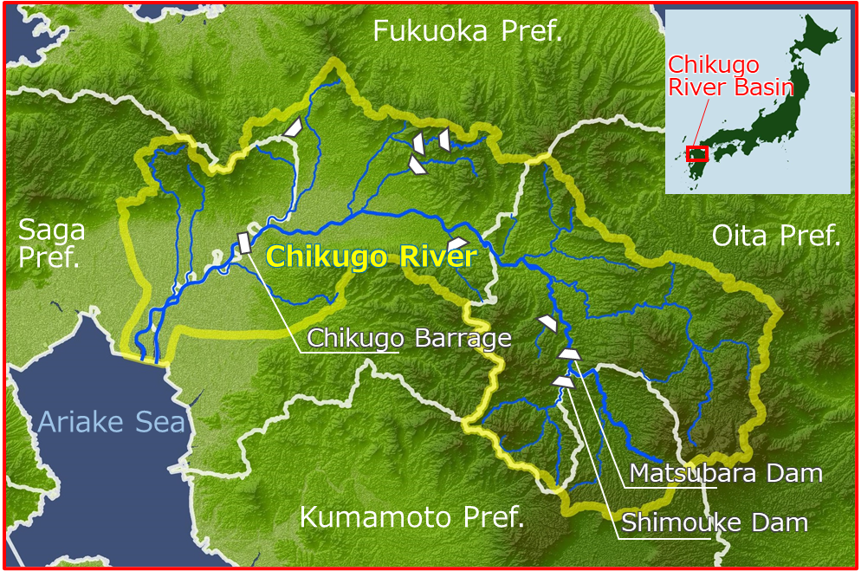
2. Promotion and Support for Reservoir Areas
(1) Measures for Local Communities and Residents to be
Submerged due to Dam Construction
1) Opposition Movement against Shimouke Dams (13 years)
Consider consistency between public works projects and basic human rights
Protect the property rights of residents in submerged area
Source: Created based on the Japan Water Agency’s website
The Chikugo River Basin and Shimouke Dam

Slide 5
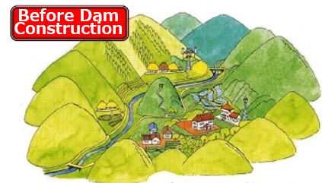
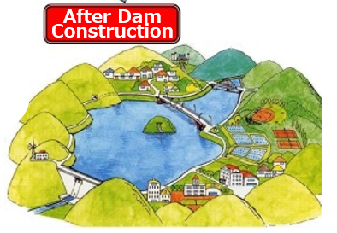
2. Promotion and Support for Reservoir Areas
(1) Measures for Local Communities and Residents to be
Submerged due to Dam Construction
2) Support System for Residents of Submerged Areas
Compensation by Dam Developer
Act on Special Measures for Water Resources Areas
Water Source Area Development Fund
Soft Measures for Regional Revitalization
Source: Water Resources in Japan (FY 2014 Edition)
Overall Picture of Measures for Water Source Areas in Dam Construction

Slide 6
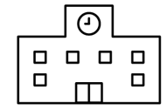
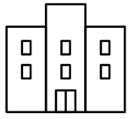
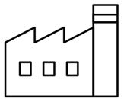

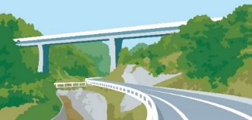
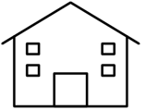

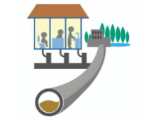
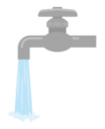
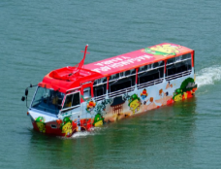
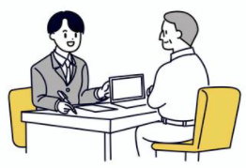
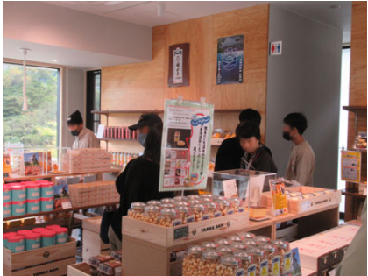
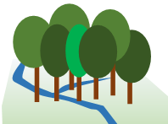
2. Promotion and Support for Water Source Areas
(2) Establishing Legal System and Securing Financial Resources
General Compensation
Act on Special Measures for Water Sources Areas
Relocation site
Relocation of public facilities
Land improvement, roads, simple water supply, sewerage, public facilities
Tourism and recreation facilities
Reservoir Area Development Fund
Reginal Revitalization
Special product
Support network
Counseling
Forest maintenance

Slide 7
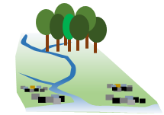
2. Promotion and Support for Water Source Areas
(2) Establishing Legal System and Securing Financial Resources
Act on Special Measures for Water Source Areas
Forest Environmental Tax
Support for Water Source Area in Whole River Basin
Three Acts for Power Development
Water Source Area Development Fund
Water Resources Tax
Source: Project Research Team (PRT)
Support for Water Source Areas in Whole River Basin

Slide 8
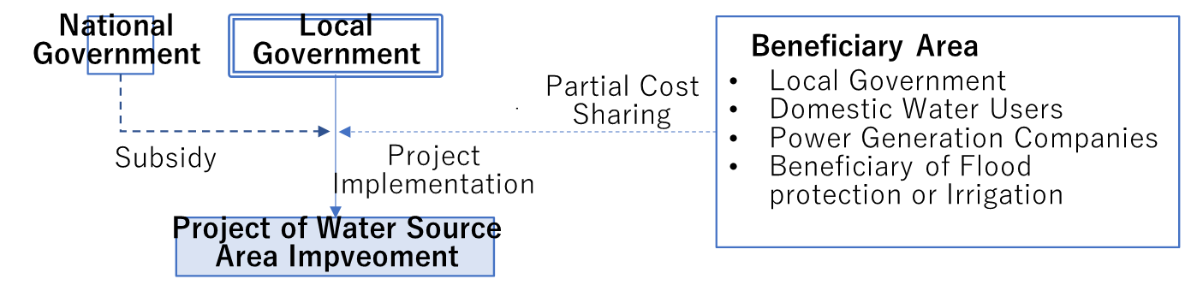
2. Promotion and Support for Water Source Areas
(3) Fair and Satisfactory Compensation Process
1) Act on Special Measures for Water Resource Areas
National government, local municipalities, and beneficiary area share the cost.
Source: PRT
Cost Burden for Projects Related to the Water Source Area Improvement Plan

Slide 9
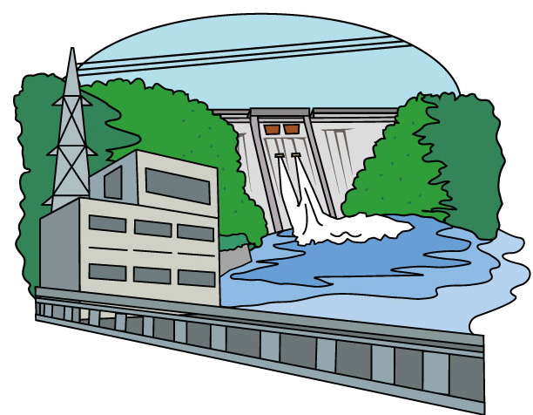


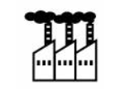
2. Promotion and Support for Water Source Areas
(3) Fair and Satisfactory Compensation Process
2) Three Acts for Power-Resources
These laws aim to promote power supply development and facilitate operations by helping subsidize areas where power supply development is to take place.

Slide 10
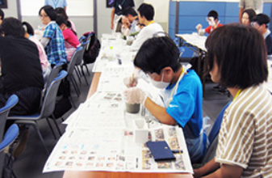
2. Promotion and Support for Water Source Areas
(3) Fair and Satisfactory Compensation Process
3) Reservoir Area Development Fund
The Fund is used for meticulous projects for reconstruction of residents’ livelihood and community development
It is collected from beneficiaries located downstream area.
In the Tone River system, the community is revitalized through mutual exchange between people in upstream and downstream area.
Source: Tokyo and Gunma Prefecture Website
Upstream and Downstream Exchange Project in Tone River

Slide 11
2. Promotion and Support for Water Source Areas
(3) Fair and Satisfactory Compensation Process
4) Financial Resources for Water Source Area Conservation
Act on Forest Environment Tax and Forest Environment Transfer
Tax for Reservoir Area
Tokyo
Sagami Dam
Yamanashi
Shiroyama Dam
Water source forest development in Kanagawa Pref
Miyagase Dam
Water Conservation
Forest
●Kawasaki City
Miho Dam
●Yokohama City
Sagami River
Shizuoka
Sakawa River
Sagami Bay
Source: Kanagawa Prefecture website
Forest in Water Source Area

Slide 12
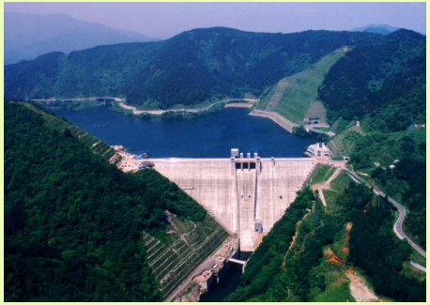
2. Promotion and Support for Water Source Areas
(4) Relocation Site Development
By preparing relocation sites, the local community and industry can reconstruct the livelihood for relocated residents.
In Miyagase Dam, total number of 281 persons relocated. 68% of persons were relocated to the alternative site.
Source: Dam Handbook
Miyagase Dam

Slide 13
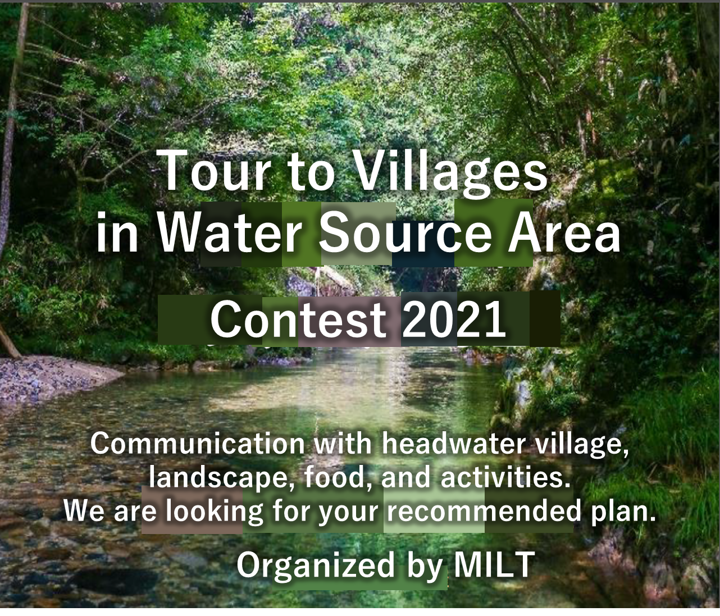
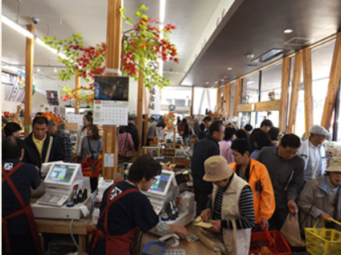
2. Promotion and Support for Water Source Areas
(5) Involvement of People outside the Water Source
1) Support for Livelihood
The MLIT is implementing the “headwater villages support project” to revitalize the region
Source: Headwater Villages Support Project, MLIT
Source: Road Station of Yanba Dam Website
Contest for the Design of a Trip to Headwater Villages
Specialty Products

Slide 14
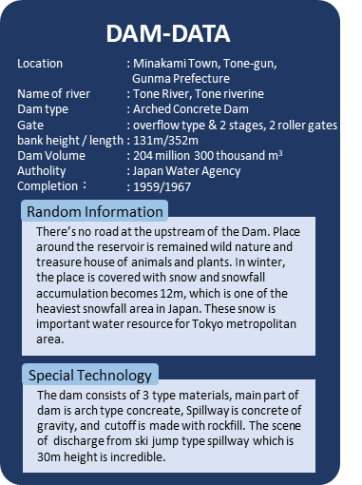
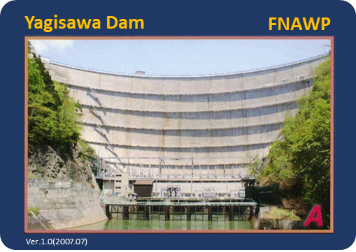
2. Promotion and Support for Water Source Areas
(5) Involvement of People outside the Water Source
1) Act on Special Measures for Water Resource Areas
Dam Card Distribution
“Dam card" is distributed to people who visited the dam.
Source: MLIT website
Example of Dam Card

Slide 15
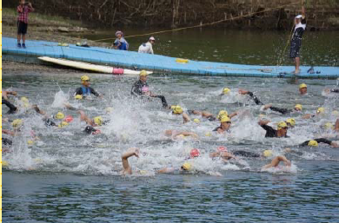
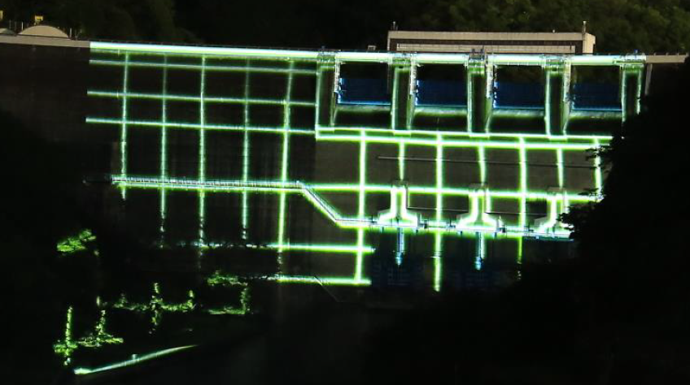
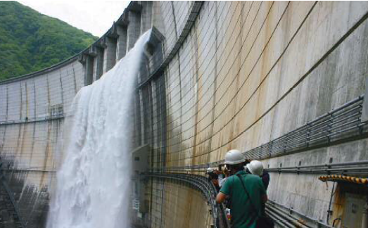
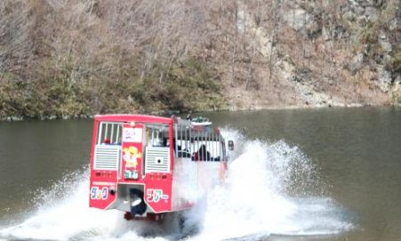
2. Promotion and Support for Water Source Areas
(5) Involvement of People outside the Water Source
Economic Revitalization Using Reservoirs
Projection Mapping
Triathlon tournament utilizing the dam environment
Backstage tour by private entities
Source: Izumo River Office website
Source: Yodo River Dams Integrated Management Office website
Source: Nikkou City Website
Regional Revitalization Using Reservoirs

Slide 16
3. Environmental and Ecosystem
(1) Environmental Impact Assessment and Countermeasures
1) Environmental Impact Assessment (EIA)
1. Primary Environmental Impact Consideration
2. Scoping Document
3. Draft Environmental Impact Statement (EIS)
4. Environmental Impact Statement (EIS)
5. Impact Mitigation Report

Slide 17
3. Environmental and Ecosystem
(1) Environmental Impact Assessment and Countermeasures
2) JICA’s System on Environmental and Social Considerations
1. Categorization (4 categories)
2.Documents on environmental and social considerations
3. Environmental review results
4. Monitoring results

Slide 18
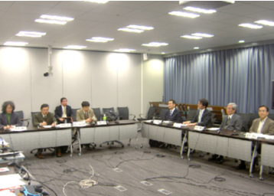
3. Environmental and Ecosystem
(1) Environmental Impact Assessment and Countermeasures
3) JICA’S Environmental and Social Consideration
Advisory Committee for Environmental and Social Considerations
Residents Relocation Plan
Source: JICA
Advice of Advisory Committee for Environmental and Social Considerations

Slide 19
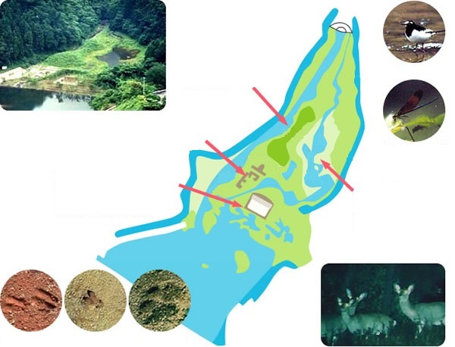



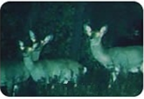
3. Environmental and Ecosystem
(2) Environmental Conservation Measures
1) Conservation of Ecosystems by Biotopes and Fishways
Twin Hills
Stone Fence
Moat for Observation
Calopteryx cornelia
Japanese wagtail
Pond and Stream
Japanese deer footprints
Wild boar footprints
Raccoon dog footprints
Source: Website of the Sagami River Wide Area Dam Management Office, Kanto Regional Development Bureau, MLIT
Higashizawa Biotope Created in Miyagase Dam Area

Slide 20
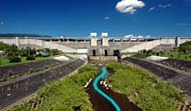
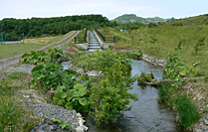
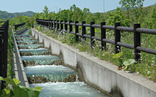
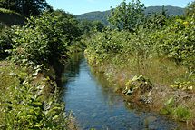
3. Environmental and Ecosystem
(2) Environmental Conservation Measures
1) Conservation of Ecosystems by Biotopes and Fishways
Lower channel in low flow channel
Refuge Pool
Pirika Dam Fishway
Fish Ladder
Nature-oriented Fishway
Source: Website of Hakodate Development and Construction Department, Hokkaido Regional Development Bureau, MLIT

Slide 21
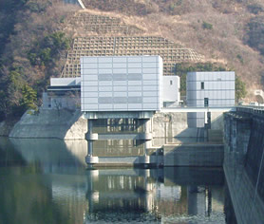
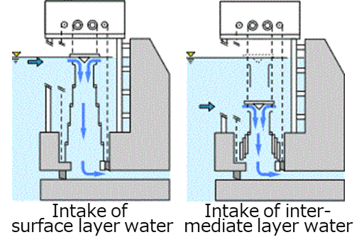
3. Environmental and Ecosystem
(2) Environmental Conservation Measures
2) Measures for Water Quality Deterioration Caused by Dam Discharge
Exterior view of facility
Mechanism of selective intake
Source: Website of the Sagami River Wide Area Dam Management Office, Kanto Regional Development Bureau, MLIT
Selective Intake Facility of the Miyagase Dam

Slide 22
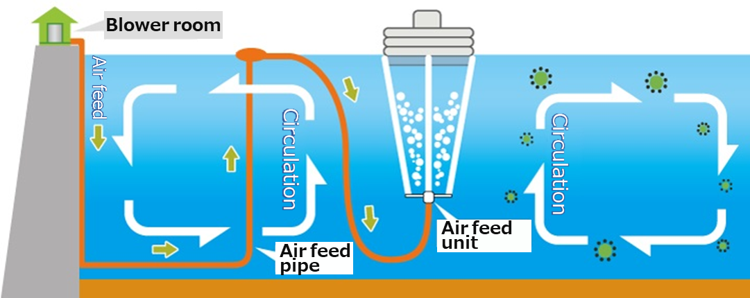
3. Environmental and Ecosystem
(2) Environmental Conservation Measures
2) Measures for Water Quality Deterioration Caused by Dam Discharge
Source: Website of the Hijikawa River Dam Integrated Management Office, Shikoku Regional Development Bureau, MLIT
Mechanism of the Aeration System

Slide 23
4. Lessons Learned (1)
  (1) Large-scale projects should be planned for the benefits of affected local communities also.
  Large-scale projects, such as dam construction, could adversely impact local communities and ecosystems if appropriate measures are not taken. The entire community could be submerged and collapsed. Projects should support local communities and industries in rehabilitating their lives and activities. The project should include relocation site development as a part of the project. Support for livelihood reconstruction is required for the affected residents. Affected people must be involved in the process of consensus building and planning for reconstruction and resettlement programs.

Slide 24
4. Lessons Learned (2)
  (2) Measures for water source areas, including financial resources, need to be institutionalized.
  It is necessary to implement various effective measures for water source areas. Legal systems should be provided to implement measures and secure the financial resources necessary for implementation, such as river basin funds.
  (3) Partnerships with various stakeholders should be established to support the water source areas.
  Cooperative relationships with downstream areas, private companies, and civil society organizations are crucial for mobilizing resources and developing activities. People outside the water source areas, such as those from downstream or urban areas, should be involved in efforts to revitalize the water source area. Interactions between people and those in the water source area deepen their understanding about each other and develop cooperative activities.

Slide 25
4. Lessons Learned (3)
  (4) Assessing the environmental impact and considering conservation are prerequisites for large-scale projects.
  Large-scale water management projects may affect the natural environment. To improve the project plan, there is a need to properly assess the environmental impacts, and carefully consider environmental conservation measures. It is also necessary to establish a procedure for environmental impact assessments, prepare the necessary documents at each stage, and incorporate residents’ opinions into the assessment. Various environmental conservation measures should be implemented when constructing and managing facilities to avoid or reduce the adverse impacts.

