Slide 1
Theme10 Development of Human Resources and Technology Establishing Systems to Meet Changing Needs

Slide 2
Contents
Introduction
Securing and Developing Human Resources
Technology Development
Lessons Learned

Slide 3
1. Introduction
It is necessary to secure and develop diverse human resources in water resources management and develop necessary technologies to respond to changing social conditions and needs.
Why is Human Resources Development required?
The works of water resources management cover wide-range of fields.
Involvement of people with different specialties is required.
A certain number of human resources should be secured and trained to enhance individual expertise.

Slide 4
2. Securing and Developing Human Resources
(1) Securing Human Resources
<1870~> The government invited foreign engineers to modernize engineering and promote technology learning
<1880~> Engineers who studied abroad at national expense led public works, taking over the position of foreign engineers. They taught science and engineering and trained their successors.
<20th Century~> Japan continued developing human resources by acquiring, inheriting and developing advanced technologies transferred from the Western countries.

Slide 5
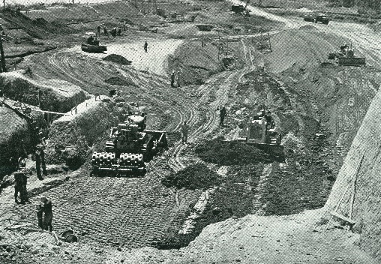
2. Securing and Developing Human Resources
(1) Securing Human Resources
The Aichi Irrigation Project is one of the projects that 500 engineers and local government officials received technical guidance by USA consultants.
Source: Aichi Irrigation Project
Construction using Large Machinery

Slide 6
2. Securing and Developing Human Resources
(2) Developing Human Resources
Training
In Japan, the capacity development is practically conducted by self-development through OJT as the core.
Off-JT was conducted to promote ability development.
Lectures and Seminars
National Institute for Land and Infrastructure Management (NILIM), MLIT
Public Works Research Institute (PWRI) , MLIT
Acquisition of Technical Qualifications, Japan
professional engineers (PEs)
first-class construction management engineers
first-class architects

Slide 7
2. Securing and Developing Human Resources
(3) Japan’s Support in Developing Human Resources
JICA is working to support in developing the human resources for the sustainable development, by dispatching experts and providing study programs.
Dispatching JICA Experts
Technical Cooperation Projects
Task-specific Training
Japanese Yen Loan (supporting the development of human resources in the developing countries)

Slide 8
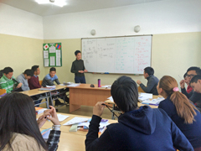
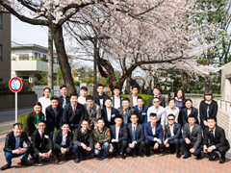
2. Securing and Developing Human Resources
(3) Japan’s Support in Developing Human Resources
2) Other Activities
Scholarship Program for Human Resources Development
Science and Technology Research Partnership for Sustainable Development (SATREPS)
Source: JICA
Higher Education Support Program for Engineering in Mongolia

Slide 9
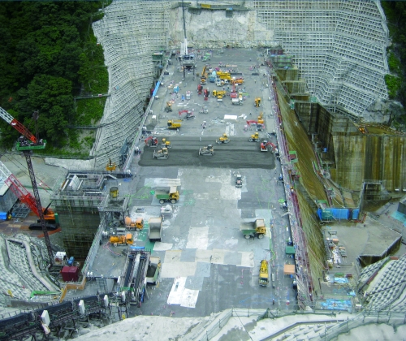
3. Technology Development
(1) Roles of Government Agency
To disseminate the technology to local governments and companies through horizontal deployment of research results;
To lead the technology development on themes that meet the social needs.
Example: The Roller Compacted-Dam Concrete (RCD) method, a dam construction method developed in Japan is a typical example.
This method enabled the effective use of large machinery in concrete dams, and reduction of construction costs.
Source: Japan Dam Engineering Center
RCD Method (Yunishigawa Dam)

Slide 10
3. Technology Development
(2) Utilization of Technologies of Companies
1) i-Construction
Problem: shortage of workers
i-Construction
1) Fully utilizing ICT
2) Standardizing Specifications
3) Distributing the timing and load
Abb.: ICT: information and communications technology. UAV: unmanned aerial vehicle
Source: MLIT
Improvement of Productivity by i-Construction

Slide 11
3. Technology Development
(2) Utilization of Private Sector Technologies
2) Public Invitation for Research and Development in River Works Technology
This system was established to research and develop river works technology;
Themes of technology are selected by inviting proposals from universities, public corporations, and companies.
An evaluation committee examines and suggests entrusting R&D to certain organizations.
Public invitation theme of FY2021 is “Development of evaluation technologies that contribute to the study of strengthening structures of river levees against overflow.”

Slide 12
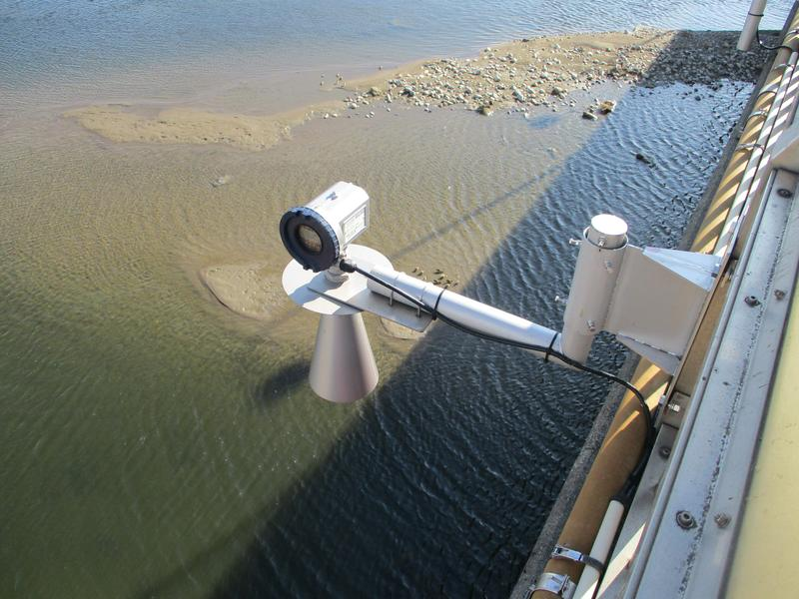
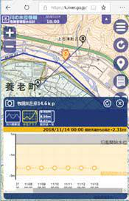
3. Technology Development
(2) Utilization of Private Sector Technologies
3) Innovative River Management Project
Innovative River Management Projects under the MLIT
Risk management type water level gauge
Simple river monitoring camera
All-weather drones
Land and underwater laser drones
Unmanned and labor-saving flow-observing equipment
Source: Foundation of River and Basin Integrated Communications
Risk Management Type Water Level Gauge

Slide 13
3. Technology Development
(2) Utilization of Private Sector Technologies
4) Issuing verification certificates for new construction technology
Public service corporations issue verification certificates for new construction technologies developed in the private sector.
The public-service corporations also support the dissemination of such new technologies.
A web system is operated to provide reference information for new technologies.
5) Bidding system
The comprehensive bid evaluation method requires bidders to submit technical proposals. It has become the standard for the government to procure construction works and services.
Each company conducts its own research and development.

Slide 14
4. Lessons Learned (1)
(1) To continuously secure human resources to manage water resources, the education system should be expanded in line with the development of society.
Various human resources with different specialties are required to manage water resources. The number of personnel need to increase with progress in infrastructure development. To meet these requirements, it is necessary to develop and successfully implement technologies transferred from developed countries and steadily expand the skills of human resources. It is also necessary to establish an education system to support technology and human networks.
(2) To develop skills by broadening the knowledge of human resources, off-JT and OJT should be positioned as the core for capacity development in water resource management.
It is effective in providing various opportunities and encouraging off-JT. The utilization of training programs would also be helpful.

Slide 15
8. Lessons Learned (2)
(3) To transfer technology to domestic administrators and engineers, financing from development agencies may provide good opportunities.
After World War II, Japan utilized loans from the World Bank for large-scale development projects. Western consultants were engaged as per the loan conditions of the World Bank. Japan utilized the opportunity to acquire knowledge and the latest technology to organize and manage large-scale projects.
(4) To meet social needs, the national government should lead technology development on the themes needed.
The national government takes the initiative to promote large-scale technology development that meets social needs and requires cooperation among the government, industry, and academia.

Slide 16
8. Lessons Learned (3)
(5) The national government should strive for the dissemination of research results.
It is important to establish unified technical standards that meet national requirements and share these standards among the parties concerned to ensure the quality of water resource management.
(6) The government can encourage the private sector to invest in research and development.
The Japanese government uses advanced technologies, including those from different fields, to rationalize water resource management through inviting research programs and technical proposal for bidding.

