Slide 1



Slide 2

Who We Are
The Japan International Cooperation Agency (JICA) is an organization responsible for implementing Japan’s ODA in a unified manner and engages in international cooperation for developing countries.
Mission
JICA, in accordance with the Development Cooperation Charter, will work on human security* and quality growth.
Vision
Leading the world with trust
JICA, with its partners, will take the lead in forging bonds of trust across the world, aspiring for a free, peaceful and prosperous world where people can hope for a better future and explore their diverse potentials.
* A concept that focuses on each and every individual through protection of individuals from serious and wide-ranging
threats to their survival, daily lives, and dignity and empowerment of people for sustainable self-reliance and community
building, so that all people can reach their full potential.
01

Slide 3




01
Organization
97
overseas offices
15
domestic offices
1,979
full-time staff
145
countries and regions
JICA cooperated with
02

Slide 4


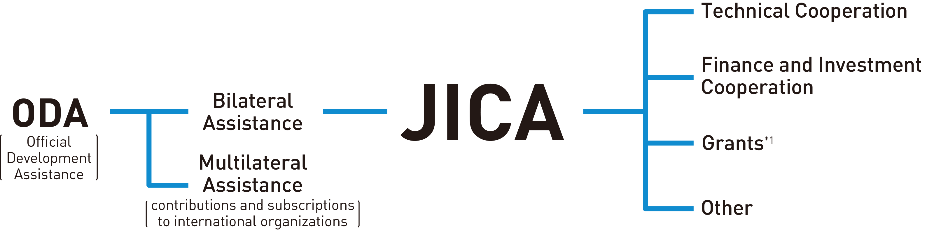
02
ODA and JICA
The Significance of Japan’s International Cooperation
The number of people living in fragile
and conflict-affected areas
(2023 World Bank estimate)
The percentage of people in ASEAN states
who rated Japan as a reliable friend of their countries
(Ministry of Foreign Affairs, “Opinion Poll on Japan in ASEAN in FY2023,” FY 2023)
Approx. 1 billion
91 ％
JICA, Playing a Core Role in Japan’s ODA
*1 Excluding Grants that the Ministry
of Foreign Affairs provides due to
diplomatic necessity.
*2 As of July 1, 2024.
03

Slide 5
03
Types of JICA’s Cooperation
Technical Cooperation
People-to-people cooperation
Finance and Investment
Cooperation
Lending or investing of funds under concessional terms to developing countries for their development
Grants
Core infrastructure development and
equipment provision
Citizen Participation
A broader base of international cooperation
Emergency Disaster Relief
Response to natural and other disasters
Research
Co-creating practical knowledge for peace and development
Public-Private Partnerships
Supporting social and economic development through private sector business activities
04

Slide 6
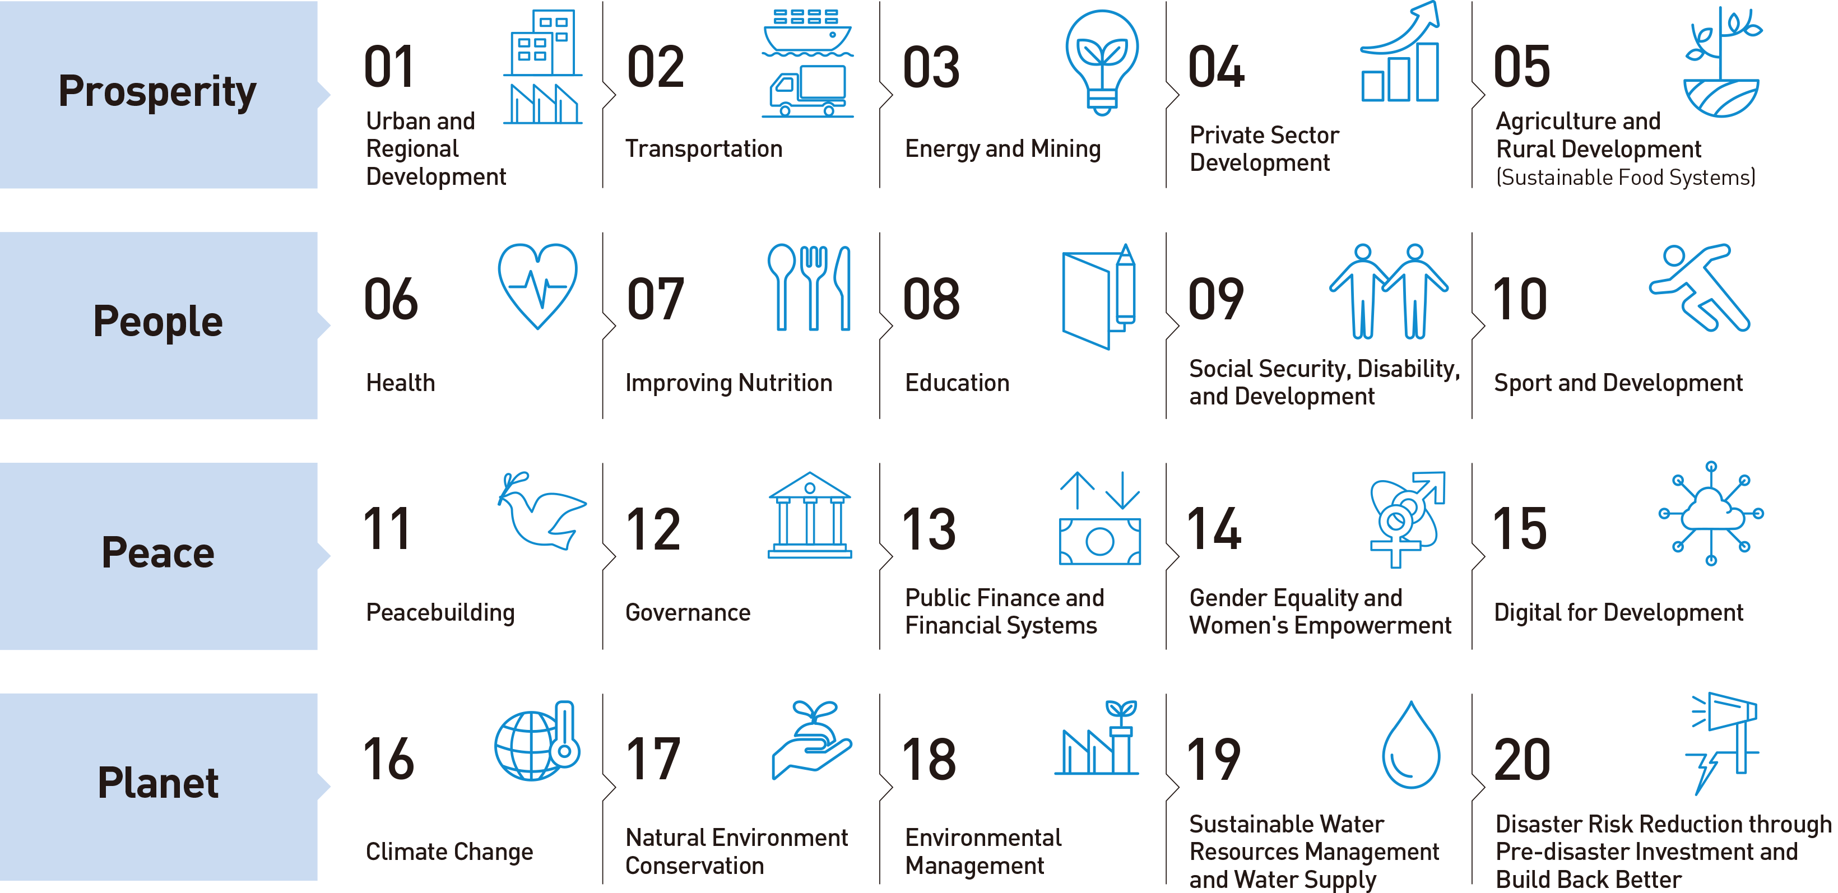
04
JICA Global Agenda
The JICA Global Agenda is a set of cooperation strategies for global issues that identifies the development goals and actions undertaken from a global perspective in terms of contributing toward the SDGs.
05

Slide 7




04
JICA Global Agenda Impact from JICA’s Cooperation
Total installed capacity of operational geothermal power-
generation facilities that have been built with ODA Loans.
（FY 1978-/as of November 2023）
Clean Energy
［03 Energy and Mining］
1,592 MW
Development of Industrial
Human Resources
［04 Private Sector Development］
The total number of industrial human resources in Asia
（as of July 2023）
Over 18,000 people
The amount of rice production in Sub-Saharan Africa
（From 14 million tons in the baseline year to 32.30 million tons in 2021）
Expanded Food Production
［05 Agriculture and Rural Development］
2.3 times
The total number of copies distributed annually in countries where support related to the MCH Handbook was provided.
（FY2019）
Maternal and Child Health
(MCH) Handbook
［06 Health］
34 countries 9 million copies
06

Slide 8



04
JICA Global Agenda Impact from JICA’s Cooperation
Improvement of
Children’s Learning
［08 Education］
The number of children provided with a quality educational environment（FY2015–FY2017）
Over 15 million children
The number of countries and people who benefited from the “JICA Clean City Initiative.”（FY2021-/ as of November 2023）
Realization of Clean City
［18 Environmental Management］
42 countries 170 million people
Access to Safe Water
［19 Sustainable Water Resources Management and Water Supply］
The number of people who gained access to safe water for water supply facilities（Cumulative total for FY1999–FY2022）
84 million people
07

Slide 9
05
JICA Sustainability Policy
● Climate-Related Information Disclosure in Accordance
with TCFD Recommendations
● Environmental Management
● Biodiversity Initiatives
Environment
● Human Rights
● Gender Equality
● JICA’s Sustainability Bonds
● Sustainable Procurement
Social
● Sustainability Management Structure
● Environmental and Social Considerations
● Engagement inside and outside the organization
Governance
08

Slide 10

06
Scale of Operations by Region （Fiscal 2023）
●Southeast Asia and Pacific
Cooperation with 23 countries
Total value of JICA programs ¥ 515.4 billion
●Latin America and the Caribbean
Cooperation with 31 countries
Total value of JICA programs ¥ 74.8 billion
●East Asia, Central Asia, and the Caucasus
Cooperation with 9 countries
Total value of JICA programs ¥ 57.8 billion
●Africa
Cooperation with 48 countries
Total value of JICA programs ¥ 108.9 billion
●South Asia
Cooperation with 8 countries
Total value of JICA programs ¥ 1,200.2 billion
●Middle East and Europe
Cooperation with 24 countries and regions
Total value of JICA programs ¥ 486.6 billion
09

Slide 11
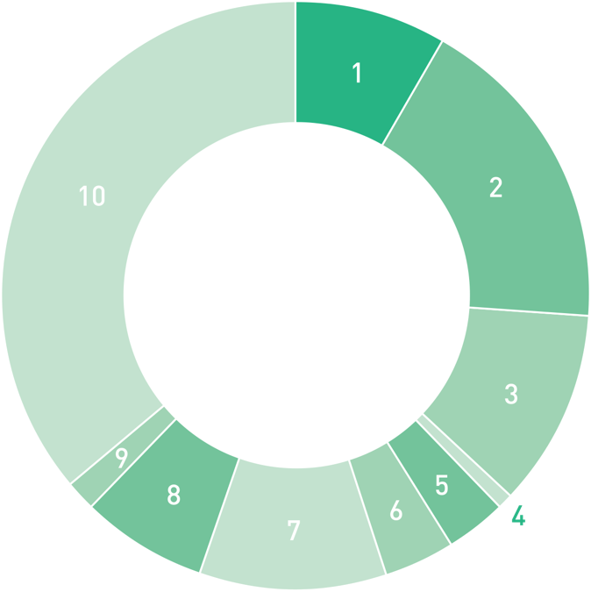

07
Cooperation by Sector
Technical Cooperation
（Fiscal 2023）
189.1 billion
1
Planning and administration
8.4％
¥16.0
2
Public works and utilities
17.9％
¥33.9
3
Agriculture, forestry
and fisheries
10.7％
¥20.2
Technical
Cooperation
4
Mining and
manufacturing
0.8％
¥1.6
5
Energy
3.4％
¥6.4
6
Business and tourism
3.8％
¥7.2
7
Human resources
10.4％
¥19.7
8
Health and medical care
6.8％
¥12.9
9
Social welfare
1.7％
¥3.2
10
Other
36.0％
¥68.0
(Unit : billion)
10

Slide 12
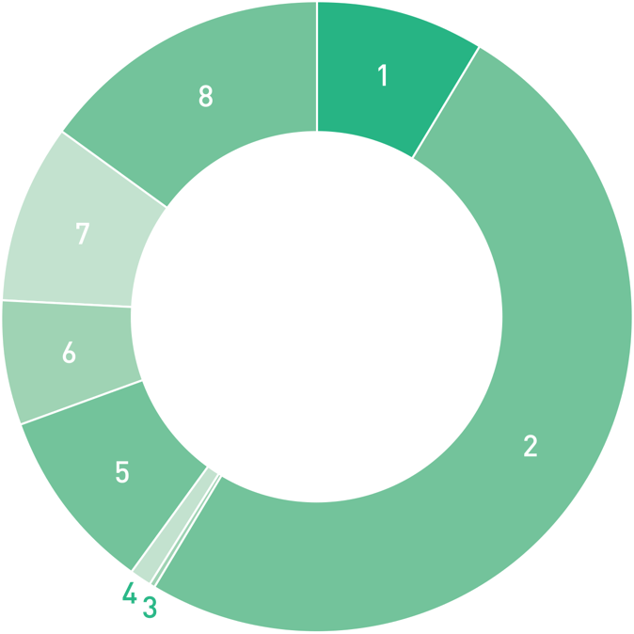

07
Cooperation by Sector
Finance and Investment
Cooperation（Fiscal 2023）
2,464.3 billion
1
Electric power
and gas
8.8％
¥217.6
2
Transportation
50.0％
¥1,232.6
Finance and
Investment
Cooperation
3
Irrigation and
flood control
0.1％
¥2.5
4
Agriculture, forestry
and fisheries
1.3％
¥31.0
5
Mining and
manufacturing
9.4％
¥230.5
6
Social services
6.4％
¥157.5
7
Program loans
9.1％
¥224.7
8
Other
14.9％
¥368.0
(Unit : billion)
11

Slide 13
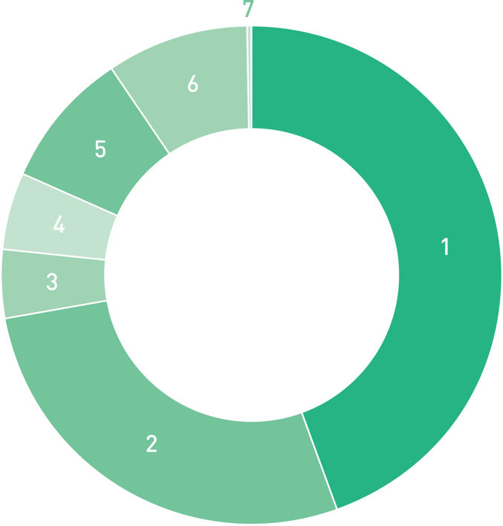

07
Cooperation by Sector
Grants（Fiscal 2023）
155.3 billion
1
Planning and
administration
44.6％
¥69.3
2
Public works and utilities
27.6％
¥42.9
3
4.3％
¥6.6
Grants
Agriculture, forestry
and fisheries
4
Energy
5.2％
¥8.0
5
Human resources
8.9％
¥13.8
6
Health and medical care
9.0％
¥13.9
7
Social welfare
0.5％
¥0.7
(Unit : billion)
12

Slide 14
08
Scale of Technical Cooperation by type（Fiscal 2023）
Newly
dispatched
Cumulative
total
Acceptance of training participants
12,195
699,211
（FYs 1954–2023）
Dispatch of experts
7,702
215,340
（FYs 1955-2023）
Dispatch of study team members
3,548
312,861
（FYs 1957-2023）
Dispatch of Japan Overseas Cooperation Volunteers
909
47,944
（FYs 1965-2022）
Dispatch of other volunteers
120
8,206
（FYs 1999-2022）
13

Slide 15

09
Overview by Region Southeast Asia
FY 2023 Total value of JICA programs 505.727 billion yen
Technical Cooperation
26.775 billion yen
462.063 billion yen
16.889 billion yen
Finance and Investment Cooperation
Grants
JICA cooperates in the development of Mass Rapid Transit (MRT) systems in various countries, including Indonesia, the Philippines, and Vietnam.
To support measures against climate change, we have started support in formulating long-term plans targeting decarbonization in Cambodia, Laos, and Indonesia.
JICA emphasizes collaborations with the ASEAN Community, and has begun cooperating in the development of the food value chain and cybersecurity countermeasures.
Philippine Coast Guard and multi-role response vessel conducting offshore training
14

Slide 16
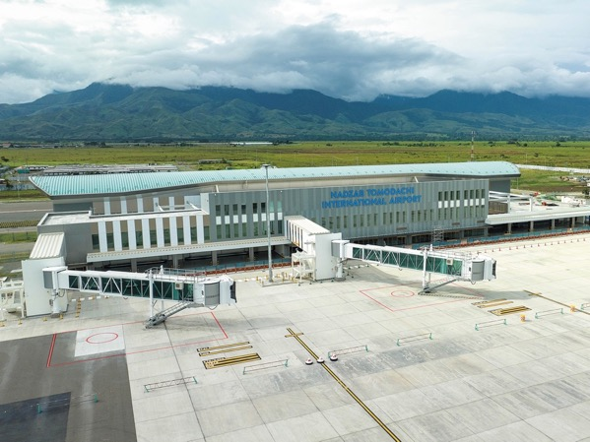
09
Overview by Region The Pacific
FY 2023 Total value of JICA programs 9.719 billion yen
Technical Cooperation
4.928 billion yen
―
4.792 billion yen
Finance and Investment Cooperation
Grants
Based on the Ninth Pacific Islands Leaders Meeting (PALM 9) held in 2021, JICA’s cooperation in the region revolves around five priority areas, including climate change / disaster resilience and strengthening the foundation for sustainable and resilient economic development.
JICA began cooperating to increase resilience in the face of climate change, for example by transmitting weather information to the Pacific Climate Change Centre (PCCC) in Samoa, and by providing training to administrative officers in the region.
In keeping with directions newly put forward at PALM10, held in July 2024, we will cooperate in contributing to strengthening the bonds that developed between Japan and PICs.
The Nadzab Tomodachi International Airport in Papua New Guinea, constructed with JICA’s cooperation, opened in October 2023.
15

Slide 17

09
Overview by Region
East Asia, Central Asia,
and the Caucasus
FY 2023 Total value of JICA programs 57.836 billion yen
Technical Cooperation
5.984 billion yen
49.599 billion yen
2.253 billion yen
Finance and Investment Cooperation
Grants
JICA provided Uzbekistan with financial cooperation loans to contribute to growth in the private sector and support vulnerable parties susceptible to the effects of economic conditions.
JICA conducted surveys aimed at strengthening logistics functions in the Caspian Sea Route (Middle Corridor), which does not pass through Russia, a country currently subject to economic sanctions.
JICA will cooperate in the training of engineers in Mongolia, putting in place an environment to support that training.
In Uzbekistan, ODA loan projects have been undertaken in a wide range of fields, including power plants. (Photo: Shibuya Atsushi)
16

Slide 18
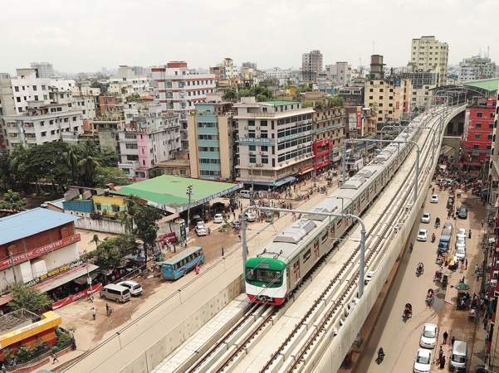
09
Overview by Region South Asia
FY 2023 Total value of JICA programs 1,200.24 billion yen
Technical Cooperation
17.717 billion yen
1,166.002 billion yen
16.521 billion yen
Finance and Investment Cooperation
Grants
In India and Bangladesh, JICA contributes to the reduction of greenhouse gas emissions through improvement of transportation and a modal shift to public transportation by supporting the construction of urban railways and intercity railways.
In Pakistan, JICA has initiated collaboration between Japanese companies and local ICT talent with the aim of improving industrial competitiveness.
In Afghanistan, after the Taliban took control of Kabul in 2021, JICA continued its support and considered other possibilities for cooperation to meet a wide range of humanitarian needs through collaboration with international organizations and in line with Japanese government policies.
Dhaka Mass Rapid Transit (MRT) Line-6 in Bangladesh. The red and green cars color the city.
17

Slide 19
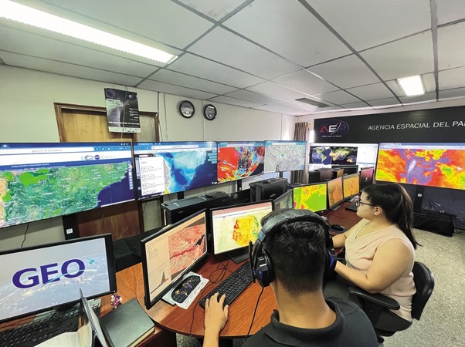
09
Overview by Region
Latin America and
the Caribbean
FY 2023 Total value of JICA programs 74.776 billion yen
Technical Cooperation
11.373 billion yen
59.839 billion yen
3.564 billion yen
Finance and Investment Cooperation
Grants
JICA approved Private-Sector Investment Finance (PSIF) for Brazil and Peru to achieve climate change measures and Universal Health Coverage (UHC).
Collaborations with Paraguay in the aerospace field were also initiated. There are plans to use satellite data in the agricultural and disaster prevention fields with the cooperation of the Kyushu Institute of Technology and the Japan Aerospace Exploration Agency (JAXA).
In Guatemala, international seminars are held to improve public safety in the region, sharing expertise from the Japanese police.
Staff analyzing satellite data at the Agencia Espacial del Paraguay (AEP), the Government of Paraguay’s Space Agency, with the cooperation of JICA and JAXA [Photo: AEP]
18

Slide 20
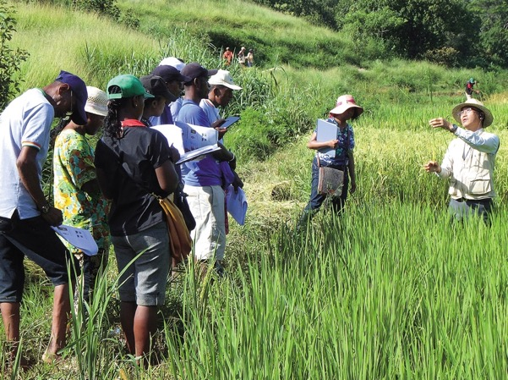
09
Overview by Region Africa
FY 2023 Total value of JICA programs 108.86 billion yen
Technical Cooperation
36.208 billion yen
37.661 billion yen
34.990 billion yen
Finance and Investment Cooperation
Grants
JICA contributes to achieving this by steadily implementing the initiatives that Japan announced at TICAD8.
JICA invited 135 participants in the African Business Education Initiative for Youth (ABE Initiative) to Japan.
JICA has delivered ODA loans of 10 billion yen to the Tanzania Agricultural Inputs Support Project (TAISP), while also promoting the Coalition for African Rice Development (CARD) initiative to increase rice production in Africa.
Experts of the Project of Rice Productivity Improvement in Central Highland (PAPRIZ) providing guidance regarding rice production in Madagascar
19

Slide 21
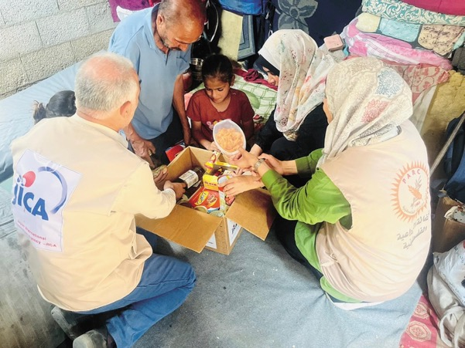
09
Overview by Region Middle East and Europe
FY 2023 Total value of JICA programs 486.614 billion yen
Technical Cooperation
13.486 billion yen
396.858 billion yen
76.270 billion yen
Finance and Investment Cooperation
Grants
In the Middle East, in response to the armed conflict in the Gaza Strip, JICA provided variety of materials to Gaza, including tents, blankets, medical consumables, and food kits.
In addition to the continued support for the oil refinery project in Iraq, JICA is cooperating in the water sector in Tunisia, and the extension of Cairo Metro in Egypt as key infrastructure to support the day-to-day lives of the citizens.
In Europe, JICA has been involved in clearing landmines and unexploded ordnance in Ukraine, and has cooperated in emergency recovery and economic reconstruction, for example by promoting private sector investments.
JICA put related parties in the Tohoku region in contact with Ukraine and Türkiye, and provided opportunities to learn from experiences in recovery from the East Japan earthquake.
A family living in the Gaza Strip receives distribution of a food kit
20

Slide 22
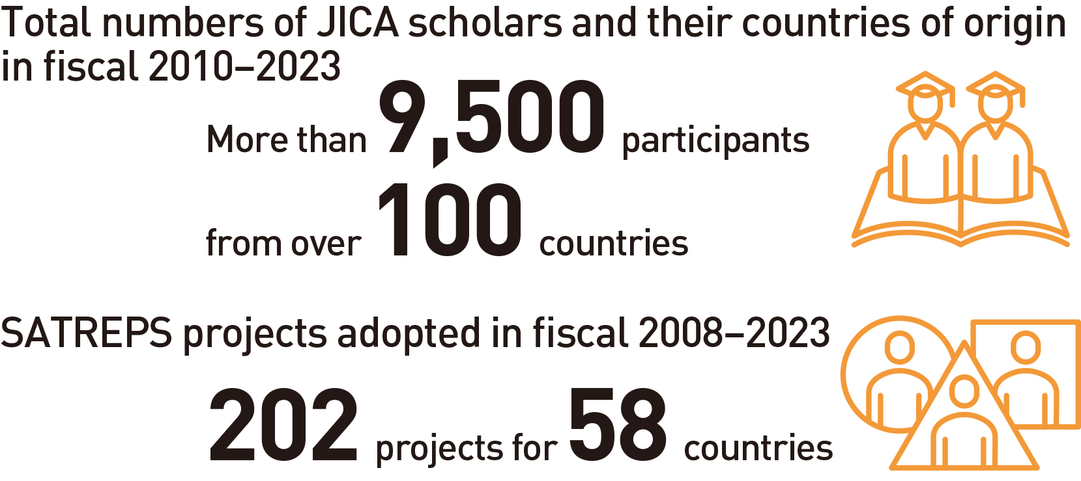
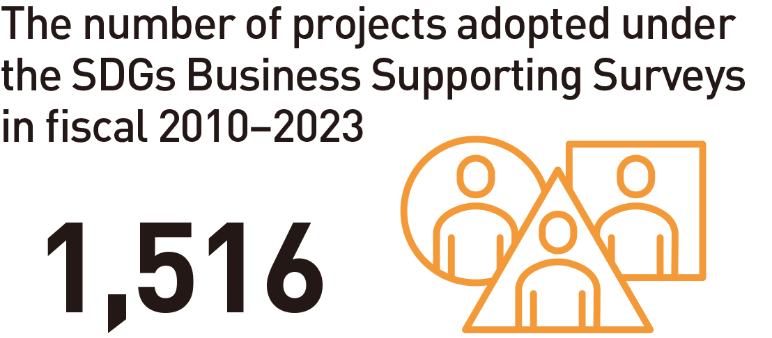
10
Partnerships
Universities and Research Institutions /
Private Sector
Partnerships with Universities and Research Institutions
Cooperation with the Private Sector
JICA Development Studies Program (JICA-DSP)
Sharing Japan’s modernization experiences and lessons learned from its development cooperation
JICA Program for Japanese Studies (JICA Chair)
Expanding JICA-DSP abroad
Science and Technology Research Partnership for Sustainable Development (SATREPS)
Contributions to the SDGs with innovations in science and technology
Private-Sector Investment Finance
Support for economic and social development by private enterprises
Preparatory Survey for Private-Sector Investment Finance
Supporting the formation of promising PSIF projects
SDGs Business Supporting Surveys
Expanded roles for business
Partnerships and co-creation with private enterprises
21

Slide 23
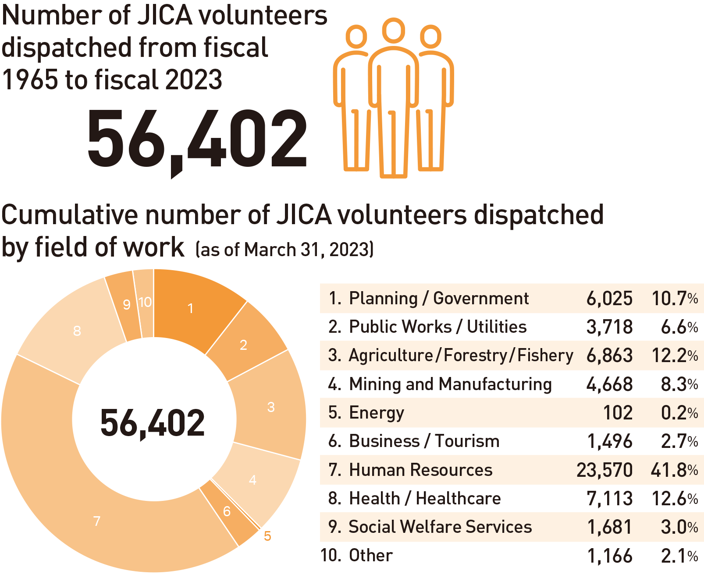
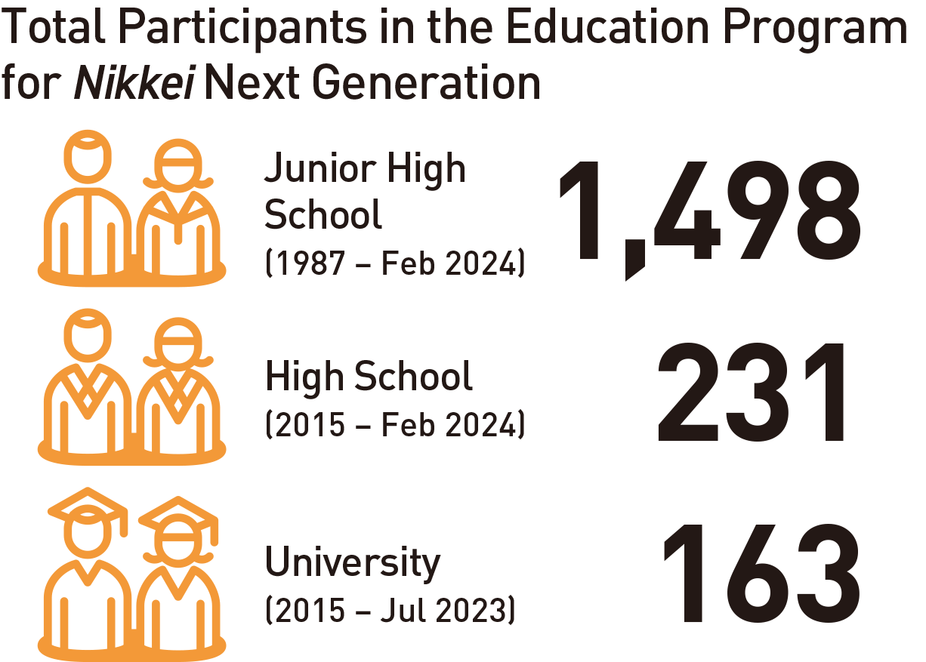
10
Partnerships
Volunteer /
Nikkei Communities
Volunteer Programs
Partnership with Nikkei Communities
Citizen-led international cooperation
Contributions to diversifying development issues
Toward the building of a sustainable co-creation society
Promoting Nikkei community businesses with Japanese companies
Creating settings for Nikkei schoolmates to learn from each other
Training in Japan for Nikkei students resumes after 4-year hiatus
22

Slide 24
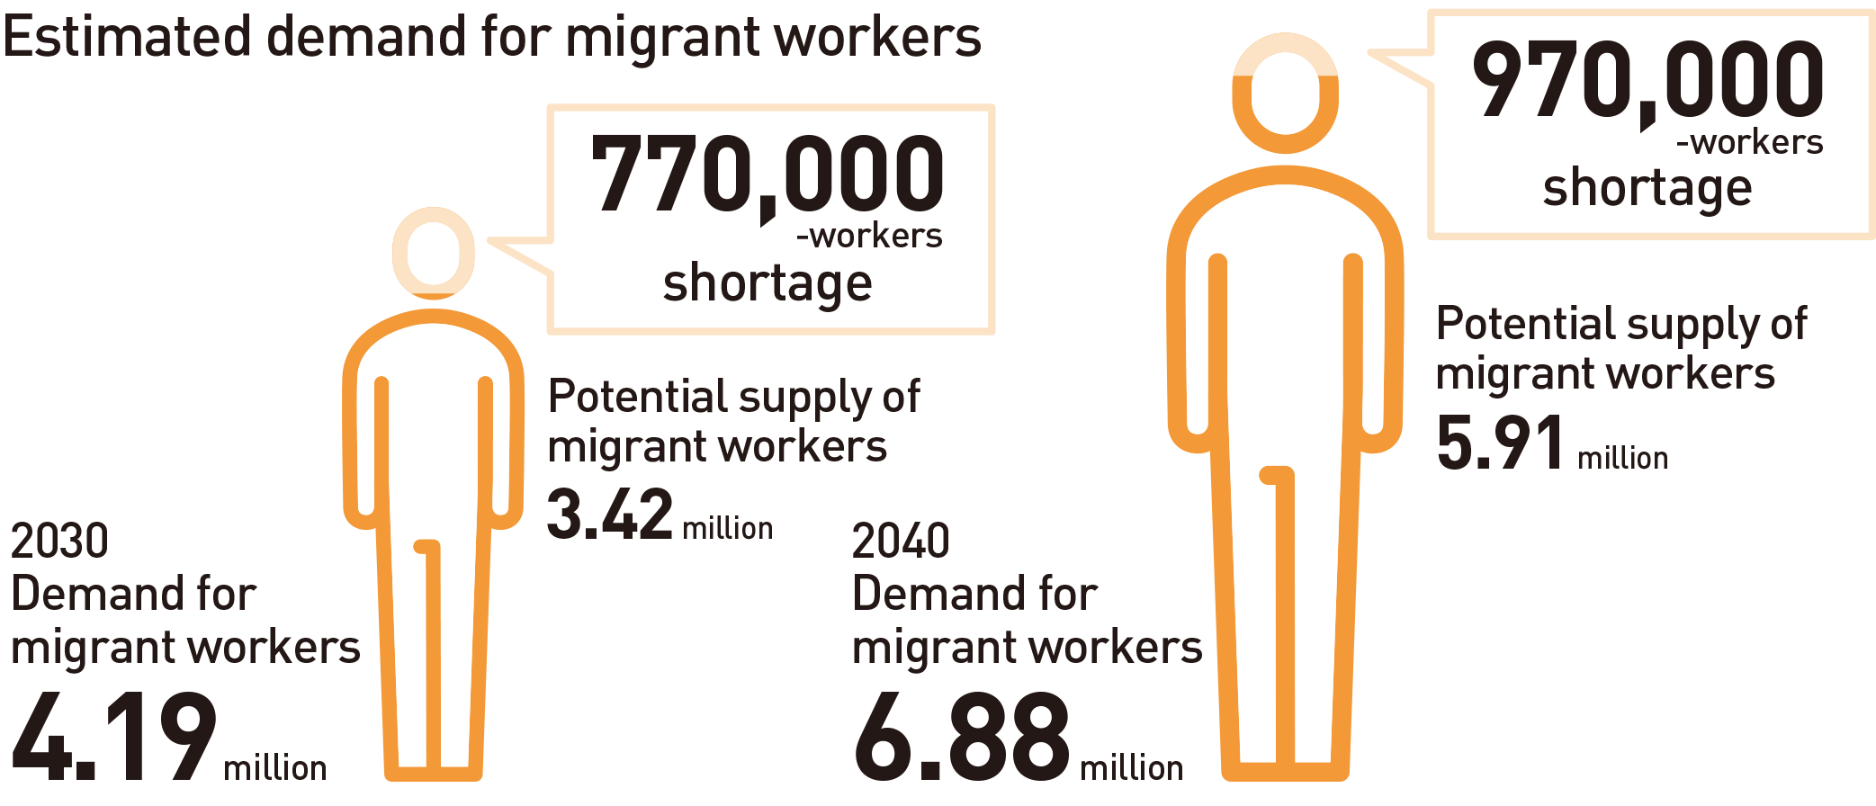
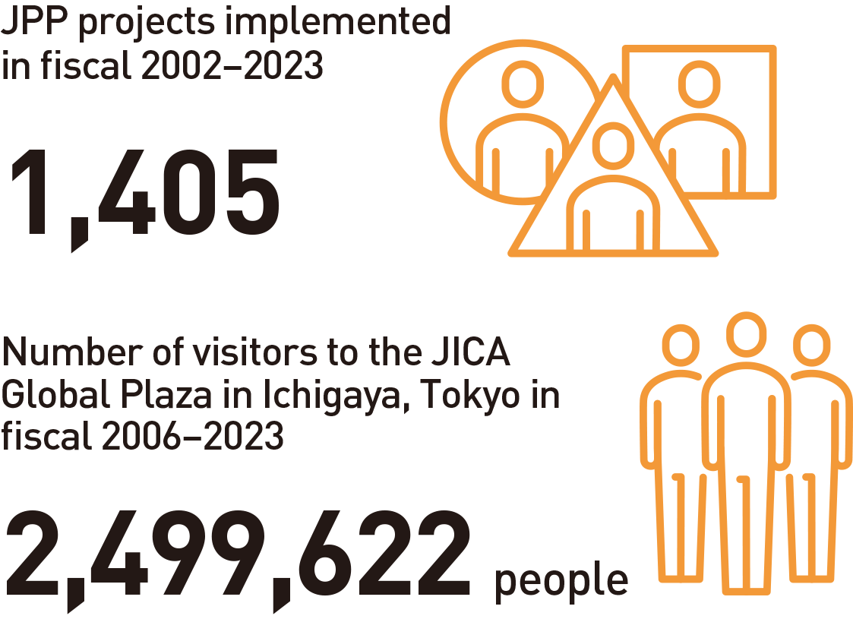
10
Partnerships
Foreign Human Resources /
Citizen Participation
Support for the Acceptance of Foreign Human Resources / Multicultural and Inclusive Society
Promoting Citizen Participation in International Cooperation
Citizen Participatory Cooperation
Contributions to developing countries and Japan
Collaboration projects
An expanded range of donation options
Development Education
JICA Global Plaza
Promotion of development education at schools
Realizing a Japan and world that leaves no one behind
The three pillars of JICA’s initiatives
1.Respect for human rights of migrant workers
2.Capacity development to enhance migration’s contribution to economic development
3.Creation of an inclusive society with foreign human resources
23

Slide 25
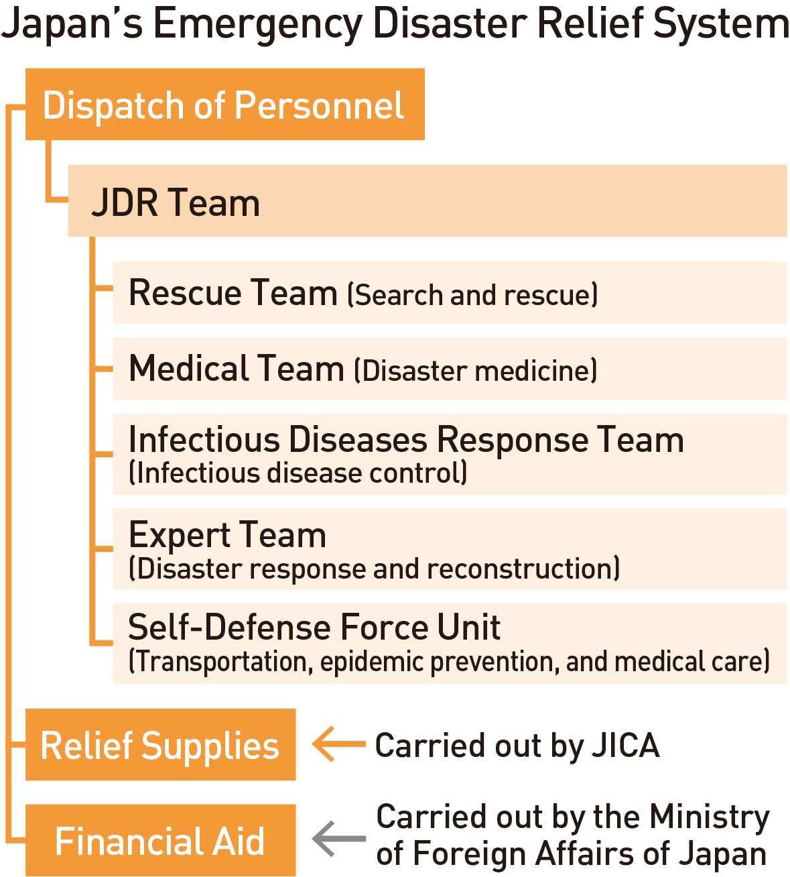
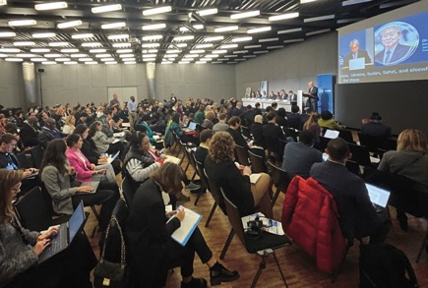
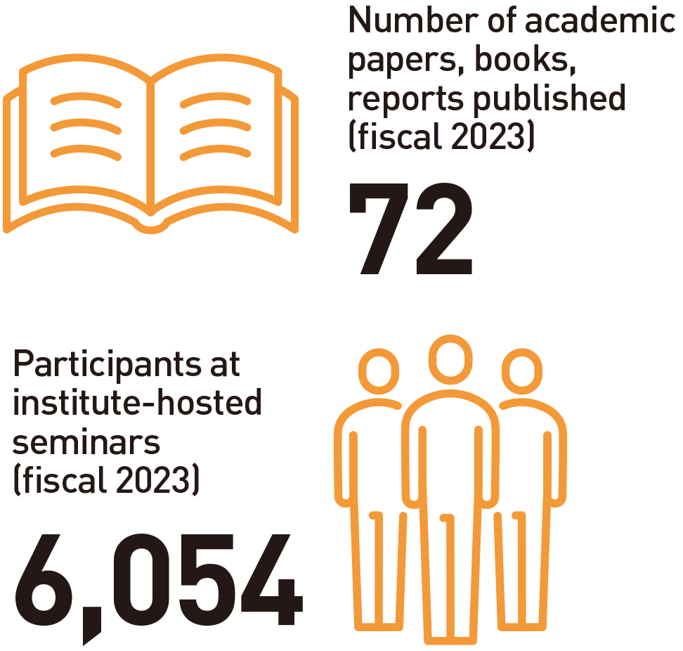
10
Partnerships
Emergency Disaster Relief / International Organizations / Research
Emergency Disaster Relief
Partnerships with International Organizations and Other Development Partners
Research
Co-creating Practical Knowledge for Peace and Development
Contributions to the Realization of Human Security
Publicity of Research Findings and Knowledge
Support for overseas disasters
Dispatch of JDR teams
Provision of emergency relief goods
Maximizing Development Impact through International Cooperation
Contributions to International Trends in Development Cooperation
At the 2nd Global Refugee Forum in Geneva, Switzerland in December 2023, JICA’ s president emphasized the importance of promoting the HDP Nexus.
24

Slide 26
