Slide 1


JAPAN INTERNATIONAL COOPERATION AGENCY

Slide 2

Who We Are
The Japan International Cooperation Agency (JICA) is an organization
responsible for implementing Japan’s ODA in a unified manner and
engages in international cooperation for developing countries.
Mission
JICA, in accordance with the Development Cooperation Charter,
will work on human security* and quality growth.
Vision
Leading the world with trust
JICA, with its partners, will take the lead in forging bonds of trust across the
world, aspiring for a free, peaceful and prosperous world where people can
hope for a better future and explore their diverse potentials.
* A concept that focuses on each and every individual through protection of individuals from serious and wide-ranging
threats to their survival, daily lives, and dignity and empowerment of people for sustainable self-reliance and community
building, so that all people can reach their full potential.
01

Slide 3




01
Organization（as of November 1, 2025）
96
overseas offices
15
domestic offices
2,000
full-time staff
145
countries and regions
JICA cooperated with
02

Slide 4
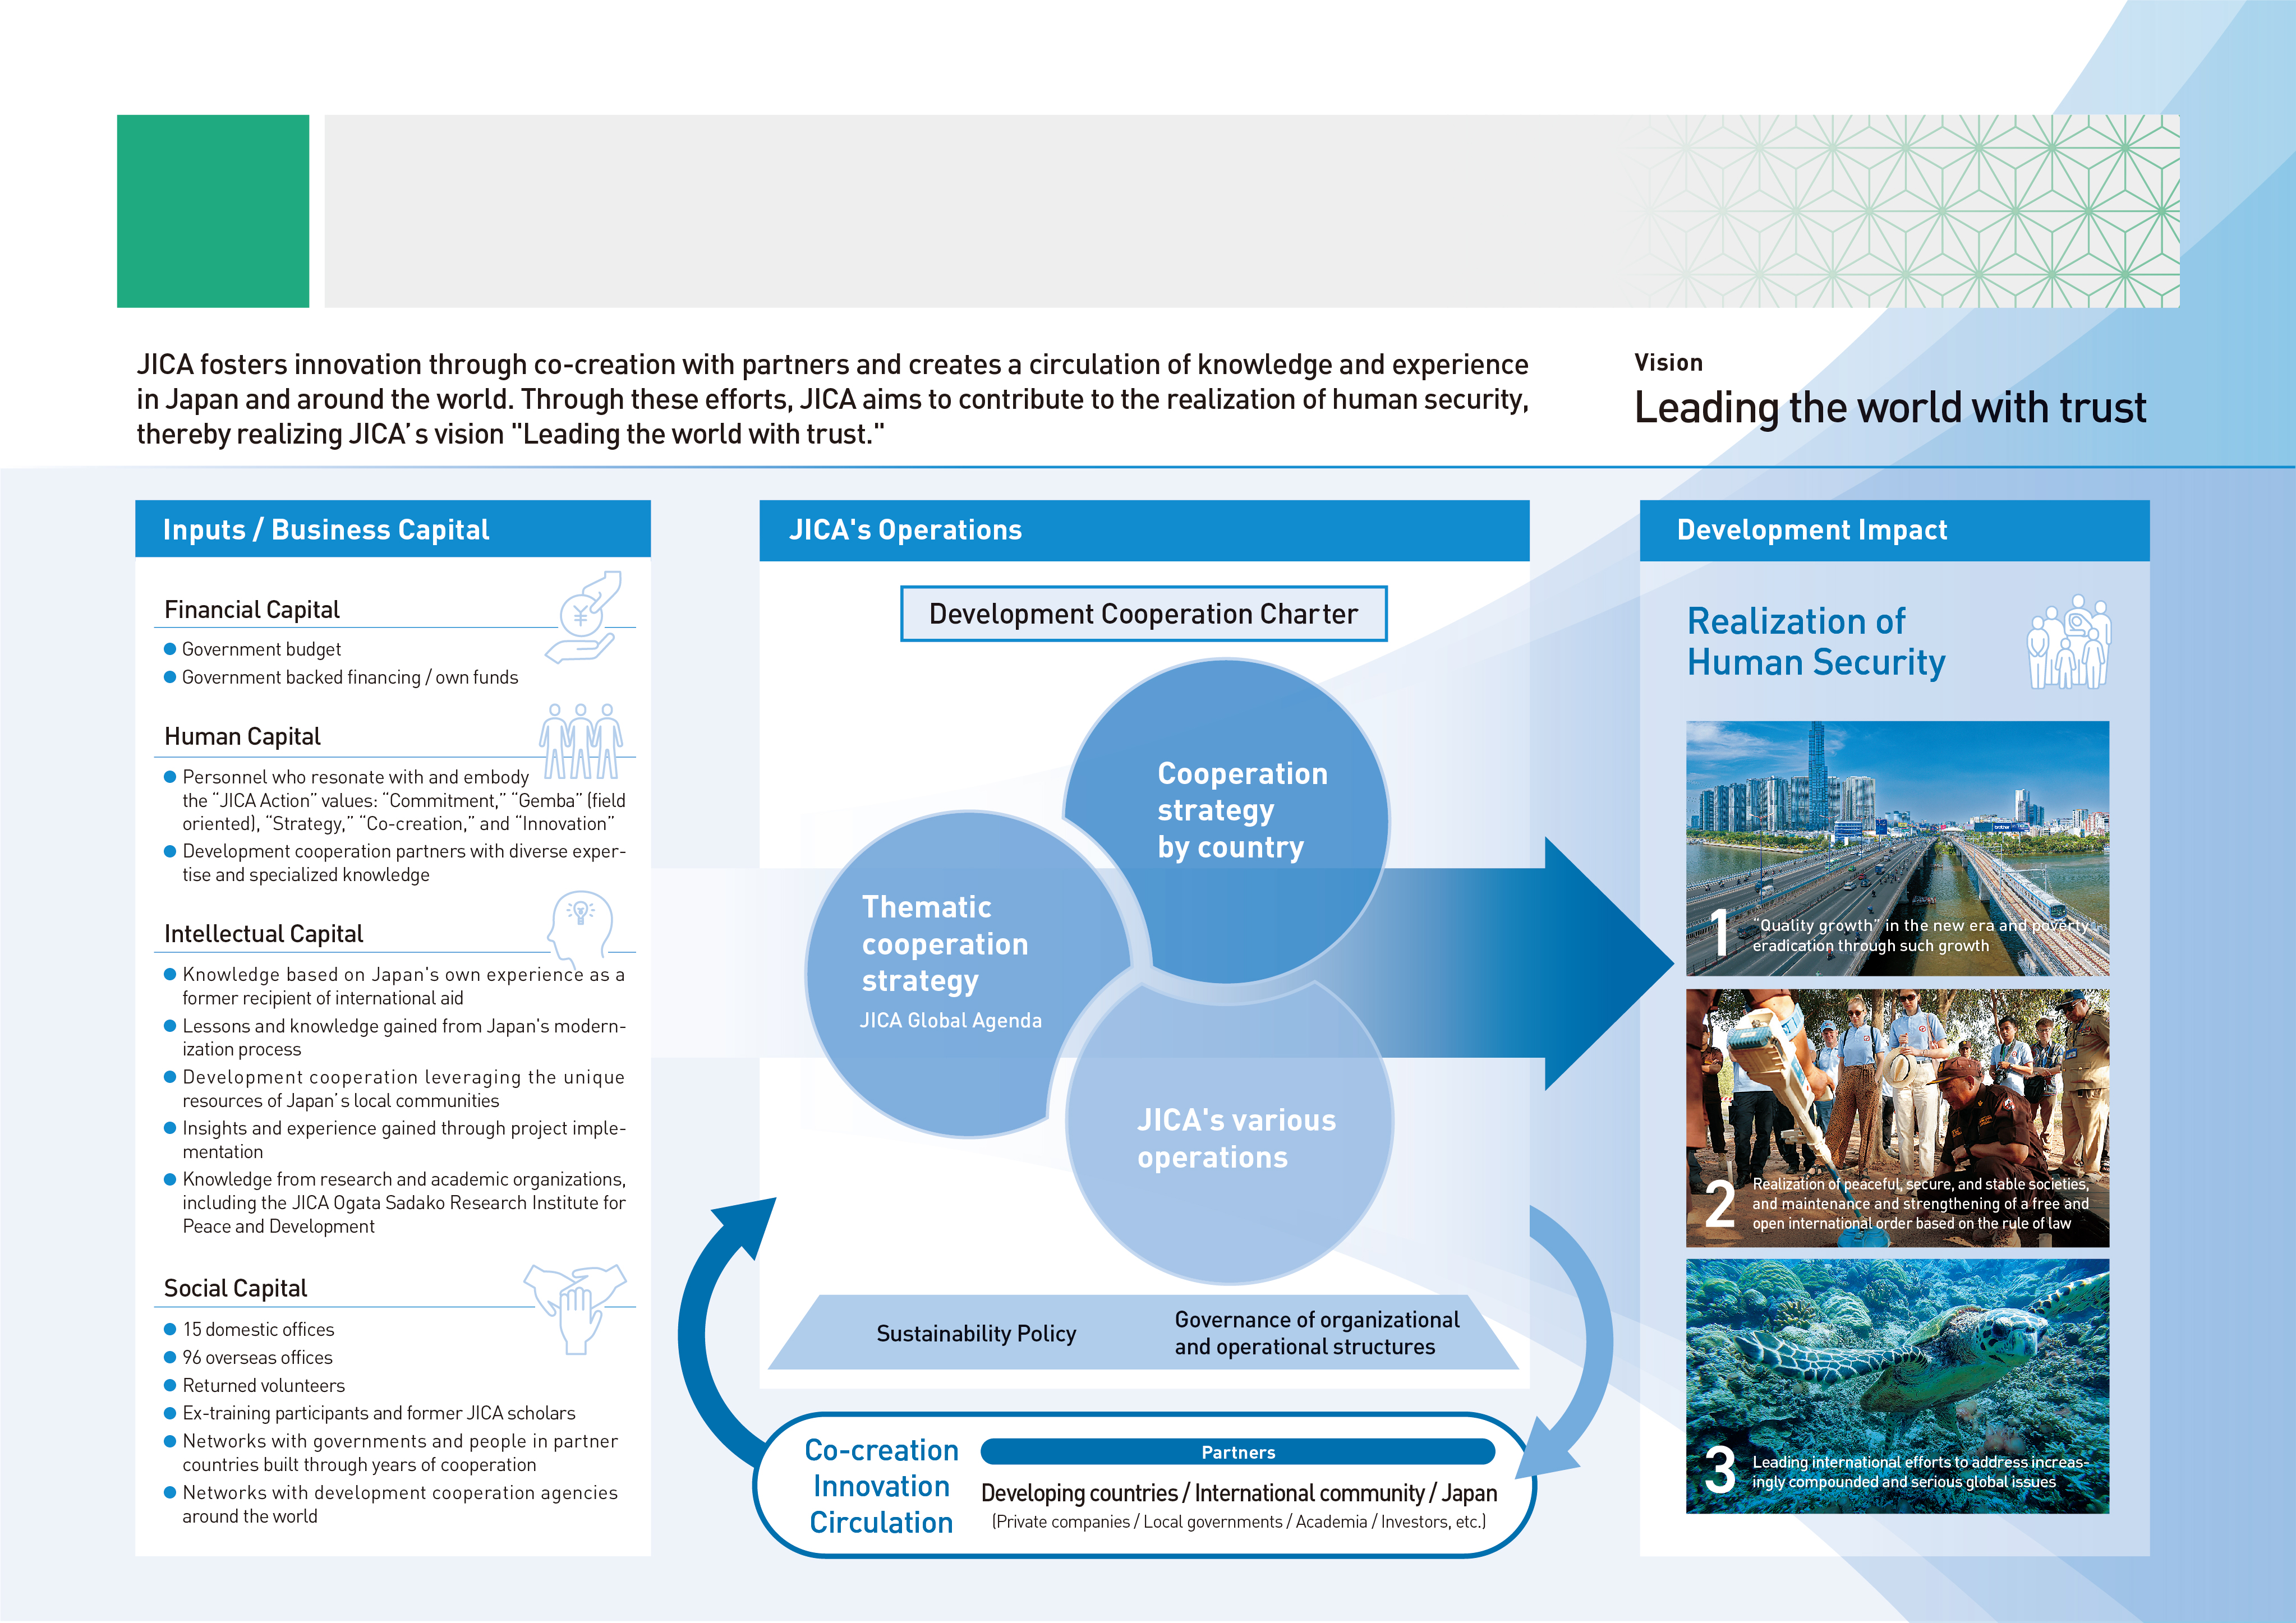
Creating Development Impact through
JICA and Its Operations
02
03

Slide 5
03
Types of JICA’s Cooperation
Technical Cooperation
People-to-people cooperation
Finance and Investment Cooperation
Lending or investing of funds under concessional terms to developing countries for their development
Grants
Core infrastructure development and equipment provision
Citizen Participation
A broader base of international cooperation
Emergency Disaster Relief
Response to natural and other disasters
Research
Co-creating practical knowledge for peace and development
Public-Private Partnerships
Supporting social and economic development through private sector business activities
04

Slide 6
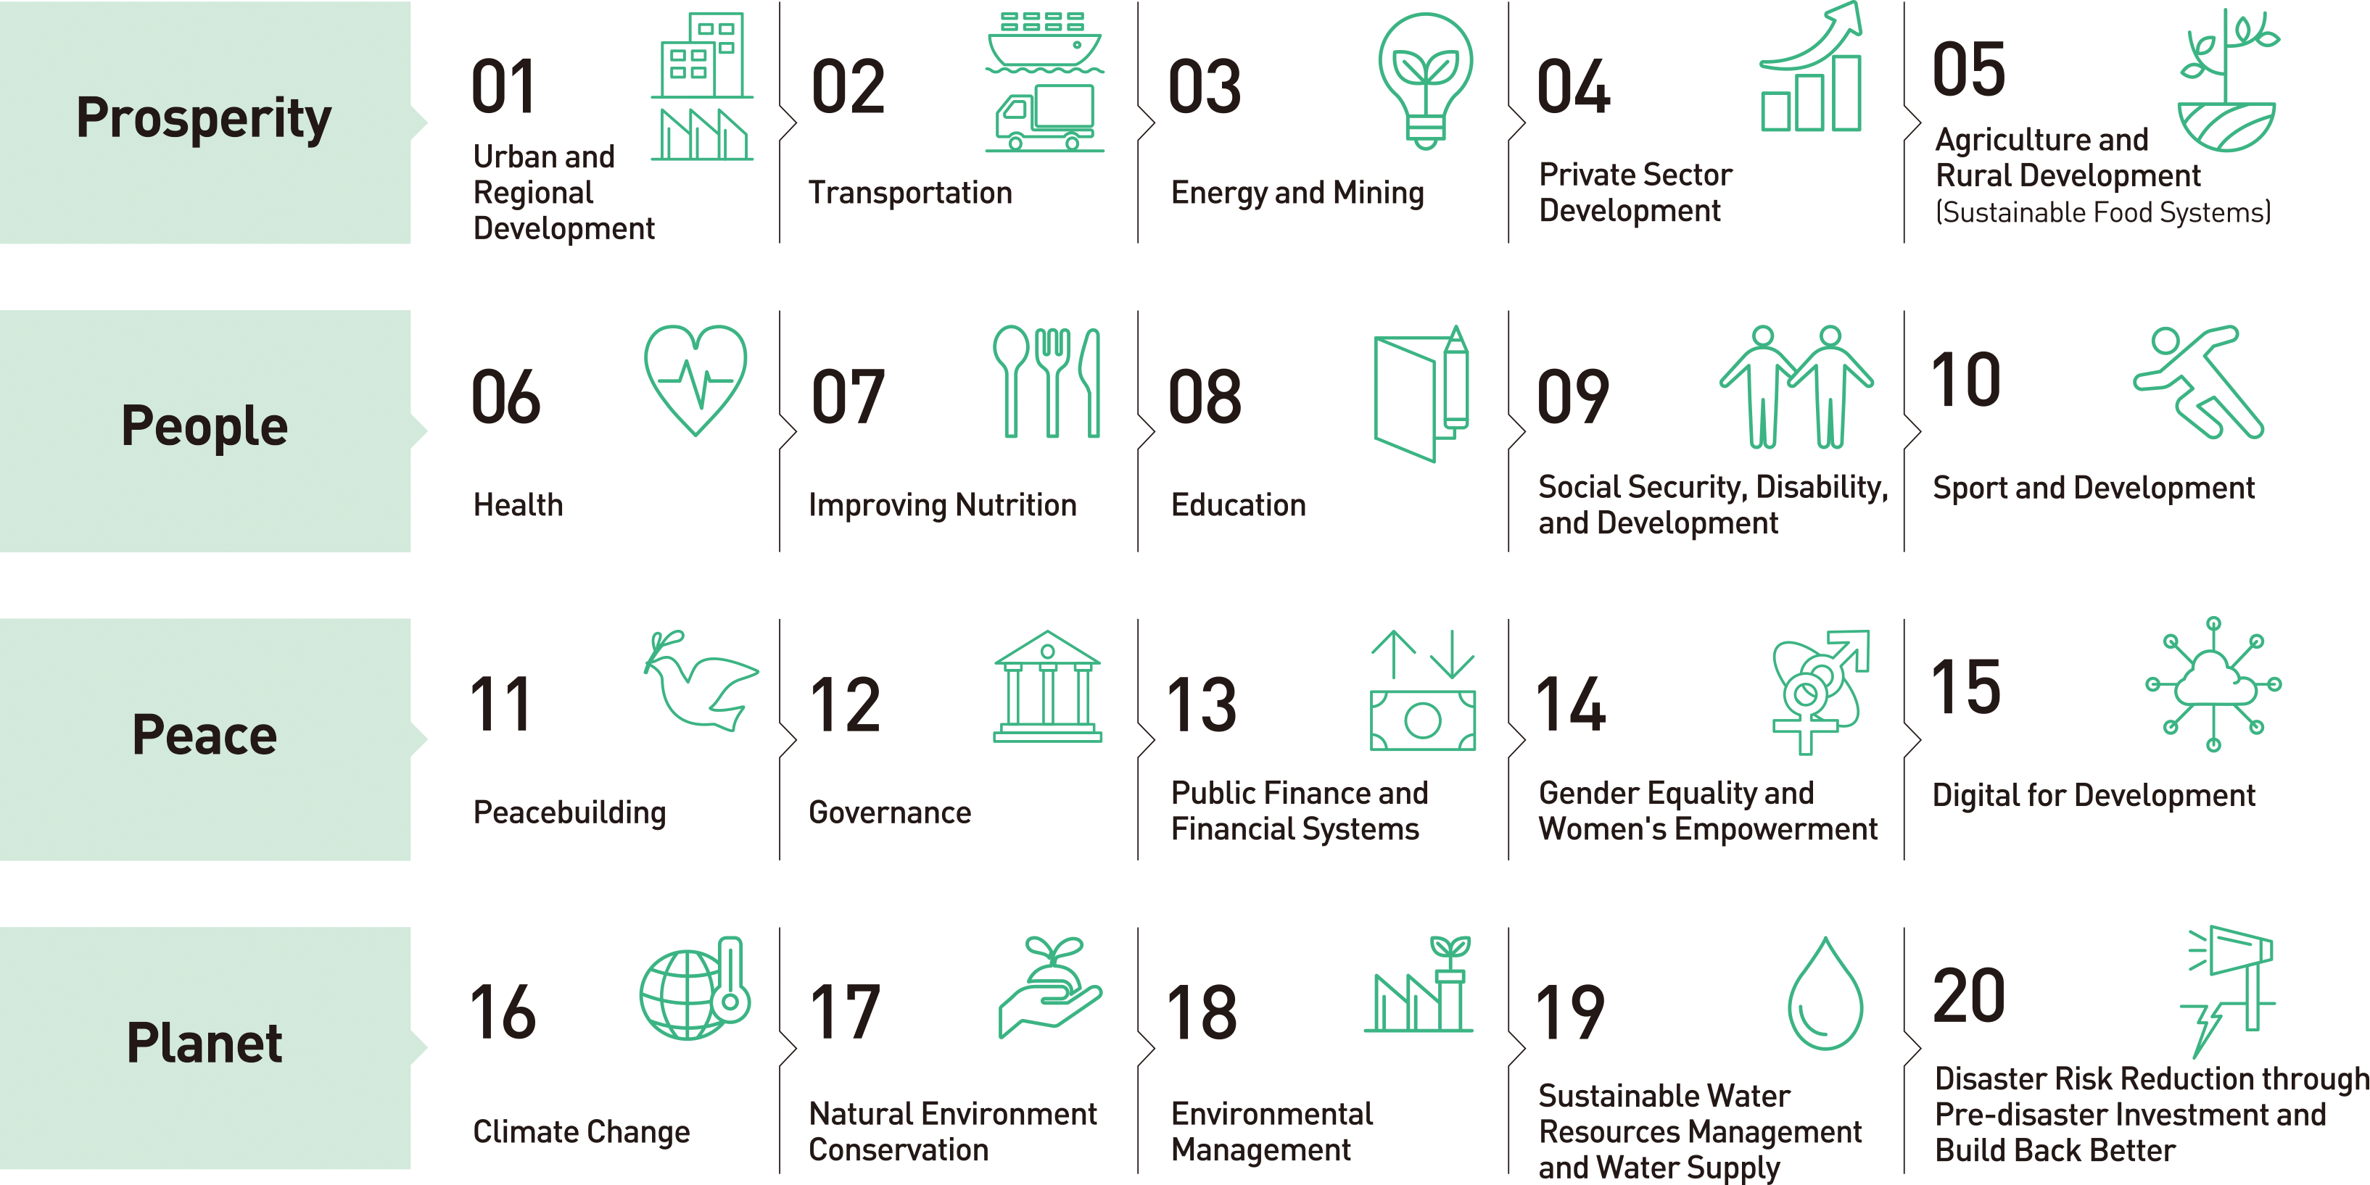
04
JICA Global Agenda
The JICA Global Agenda is a set of cooperation strategies for global issues that identifies the development goals and actions undertaken from a global perspective in terms of contributing toward the SDGs.
05

Slide 7
05
JICA Sustainability Policy
● Climate-Related Information Disclosure in ​
Accordance with International Standards​
● Initiatives for Mainstreaming Biodiversity​
Environment
● Human Rights and Diversity, Equity and Inclusion
● Gender Equality
Social
● Internal and External Engagement
● JICA’s Sustainability Bonds
● Environmental and Social Considerations
● Procurement
Governance
06

Slide 8

06
Scale of Operations by Region （Fiscal 2024）
●Southeast Asia and Pacific
Cooperation with 23 countries
Total value of JICA programs ¥ 614.9 billion
●Latin America and the Caribbean
Cooperation with 32 countries
Total value of JICA programs ¥ 222.6 billion
●East Asia, Central Asia, and the Caucasus
Cooperation with 9 countries
Total value of JICA programs ¥ 88.2 billion
●Africa
Cooperation with 49 countries
Total value of JICA programs ¥ 133.3 billion
●South Asia
Cooperation with 8 countries
Total value of JICA programs ¥ 482.8 billion
●Middle East and Europe
Cooperation with 24 countries and regions
Total value of JICA programs ¥ 238.5 billion
07

Slide 9
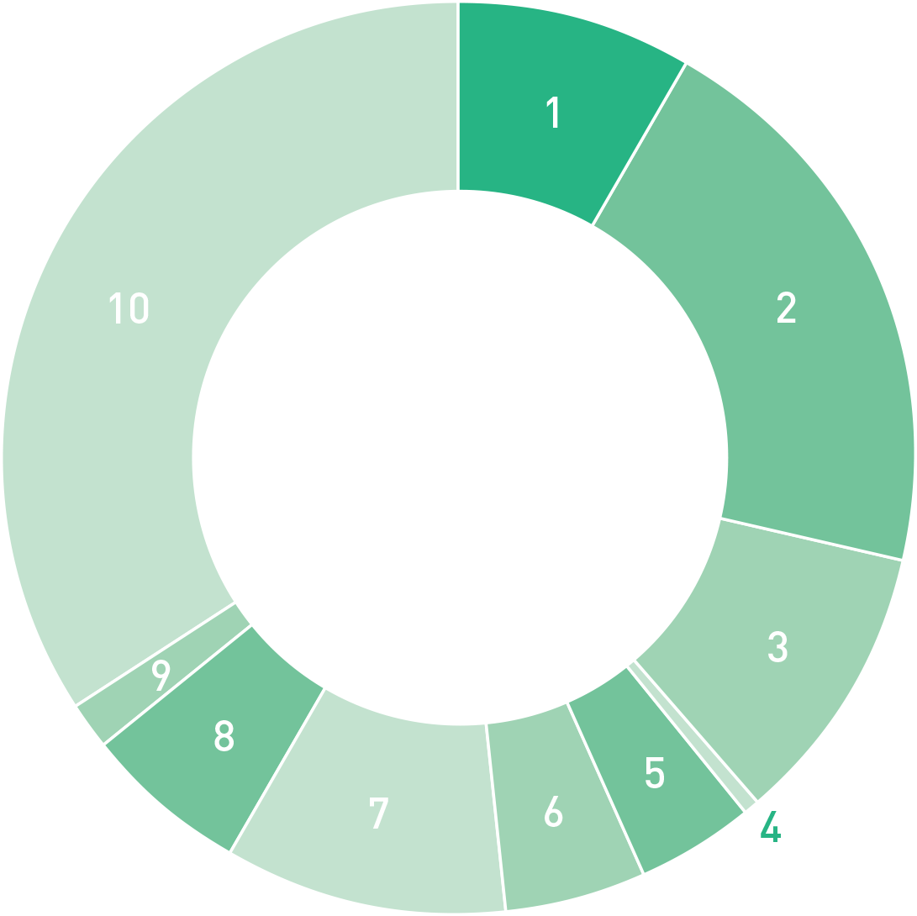

07
Cooperation by Sector
Technical Cooperation
（Fiscal 2024）
¥ 204.1 billion
1
Planning and administration
8.4％
¥17.2
2
Public works and utilities
20.4％
¥41.6
3
Agriculture, forestry
and fisheries
10.0％
¥20.4
Technical
Cooperation*
4
Mining and
manufacturing
0.4％
¥0.9
5
Energy
4.1％
¥8.4
6
Business and tourism
5.0％
¥10.1
7
Human resources
10.0％
¥20.4
8
Health and medical care
6.1％
¥12.4
9
Social welfare
1.6％
¥3.2
10
Other
34.0％
¥69.4
* Technical Cooperation expenses include Technical Cooperation expenses managed under the Finance and Investment Account budget, but exclude administration costs.
(Unit : billion)
08

Slide 10
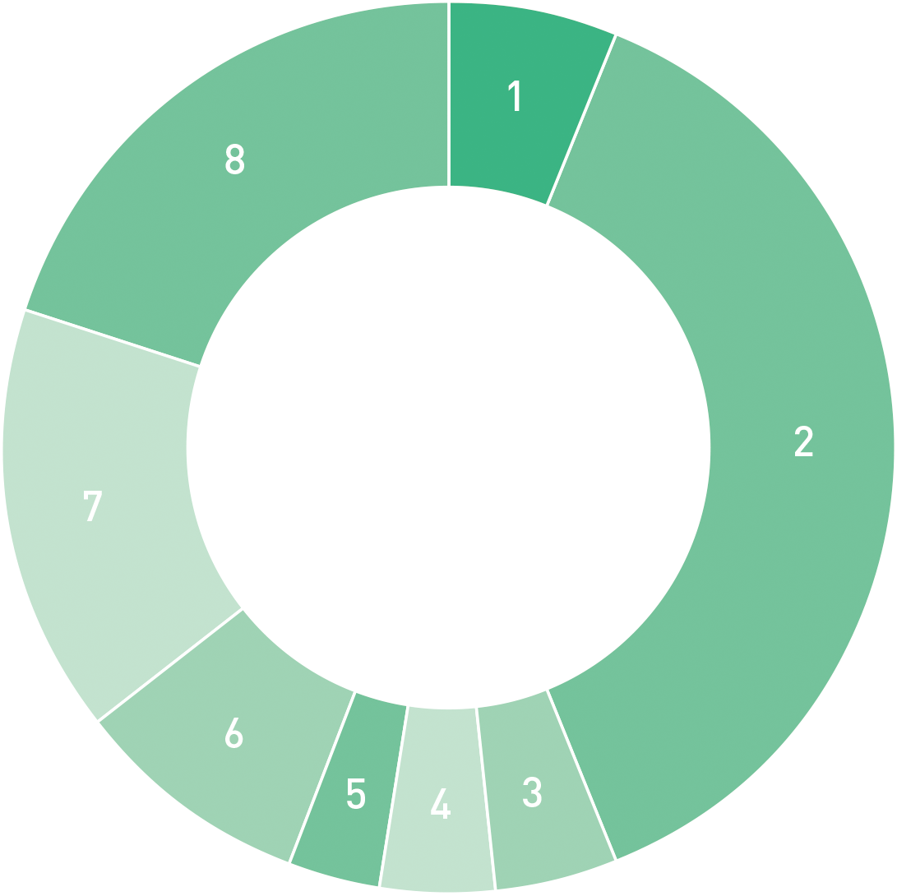

07
Cooperation by Sector
Finance and Investment
Cooperation（Fiscal 2024）
¥ 1,873.3 billion
1
Electric power
and gas
6.3％
¥118.2
2
Transportation
37.7％
¥707.0
Finance and Investment
Cooperation*
3
Irrigation and
flood control
4.5％
¥83.4
4
Agriculture, forestry
and fisheries
4.2％
¥78.1
5
Mining and
manufacturing
3.2％
¥60.0
6
Social services
8.7％
¥163.6
7
Program loans
15.5％
¥290.5
8
Other
19.9％
¥372.4
(Unit : billion)
* Total commitment amount of ODA Loans and Private-Sector Investment Finance.
09

Slide 11
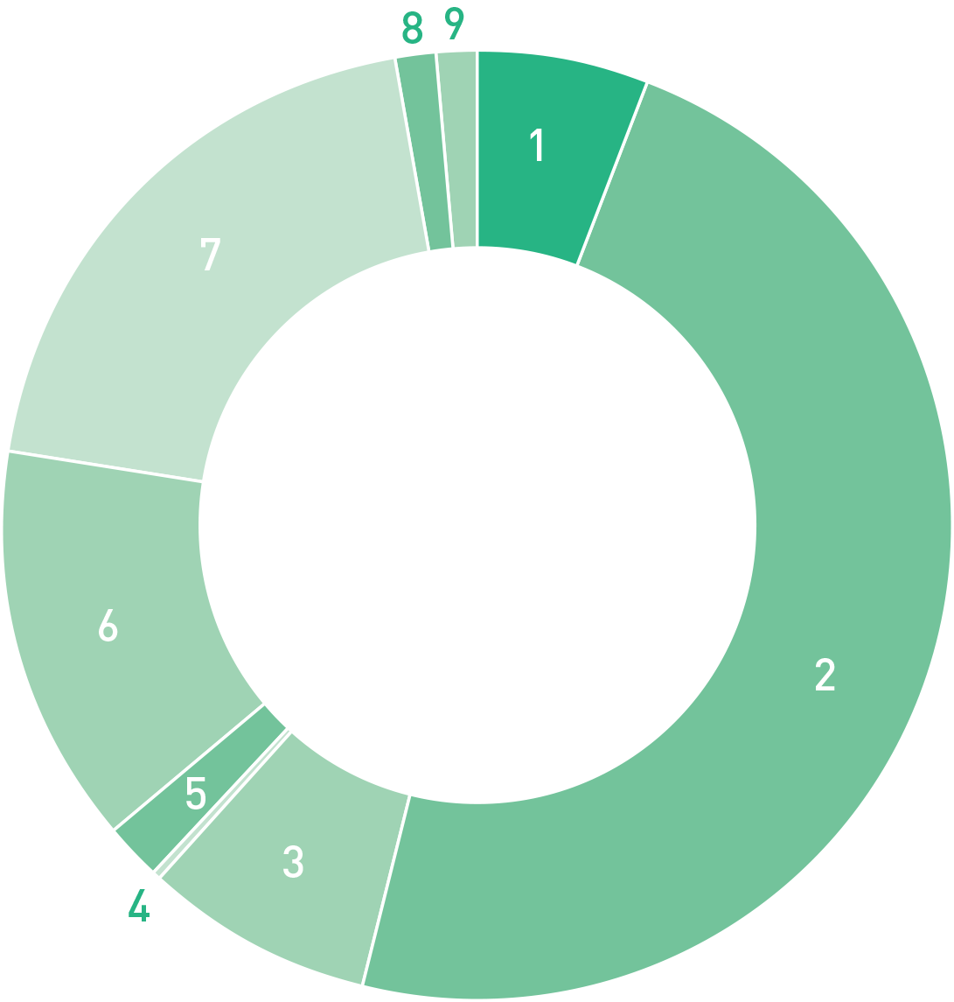

07
Cooperation by Sector
Grants（Fiscal 2024）
¥ 104.6 billion
1
Planning and
administration
6.1％
¥6.3
2
Public works and utilities
47.9％
¥50.1
3
Agriculture, forestry
and fisheries
8.0％
¥8.3
Grants*
4
Mining and manufacturing
0.2％
¥0.2
5
Energy
1.9％
¥2.0
6
Human resources
13.5％
¥14.2
7
Health and medical care
19.9％
¥20.8
8
Social welfare
1.4％
¥1.5
9
Other
1.1％
¥1.2
(Unit : billion)
* Aggregated amount of Grants committed through concluding of respective Grant Agreements.
10

Slide 12
08
Scale of Technical Cooperation by type（Fiscal 2024）
New
Cumulative total
Acceptance of training participants
12,108
711,319
（FYs 1954–2024）
Dispatch of experts/
study team members
10,055
538,256
（FYs 1955-2024）
Dispatch of Japan Overseas Cooperation Volunteers
956
48,900
（FYs 1965-2024）
Dispatch of other volunteers
91
8,297
（FYs 1999-2024）
11

Slide 13
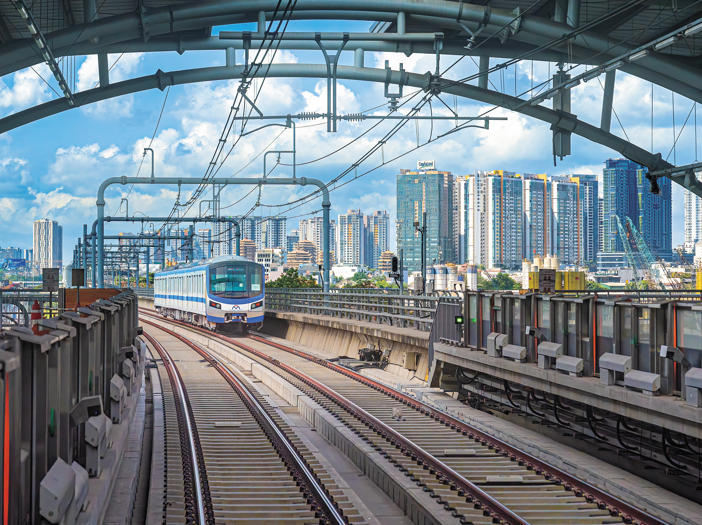
09
Overview by Region Southeast Asia
FY 2024 Total value of JICA operations 591.4 billion yen
27.5 billion yen^{*1}
548.9 billion yen^{*2}
14.9 billion yen^{*3}
*1 Technical Cooperation expenses include Technical Cooperation expenses managed under the Finance and Investment Account budget, but exclude administration costs.
*2 Total commitment amount of ODA Loans and Private-Sector Investment Finance.
*3 Aggregated amount of Grants committed through concluding of respective Grant Agreements.
(*1–*3 also apply to pages 12–18)
Technical Cooperation
Finance and Investment Cooperation
Grants
In December 2024, Ho Chi Minh City Urban Metro Line No. 1, constructed with an ODA loan and featuring Vietnam’s first underground section, commenced operation.
In the Philippines, where natural disasters have been occurring more frequently as a result of climate change, JICA works to address vulnerabilities to a wide range of disasters by providing cooperation in river channel improvement projects and financial support.
JICA supports the creation of foundations that ensure regional cohesion and sustain the region into the future, including assistance toward Timor-Leste’s formal accession to ASEAN.
Ho Chi Minh City Urban Metro Line No.1 commenced operation, including the first underground section in Vietnam
12

Slide 14
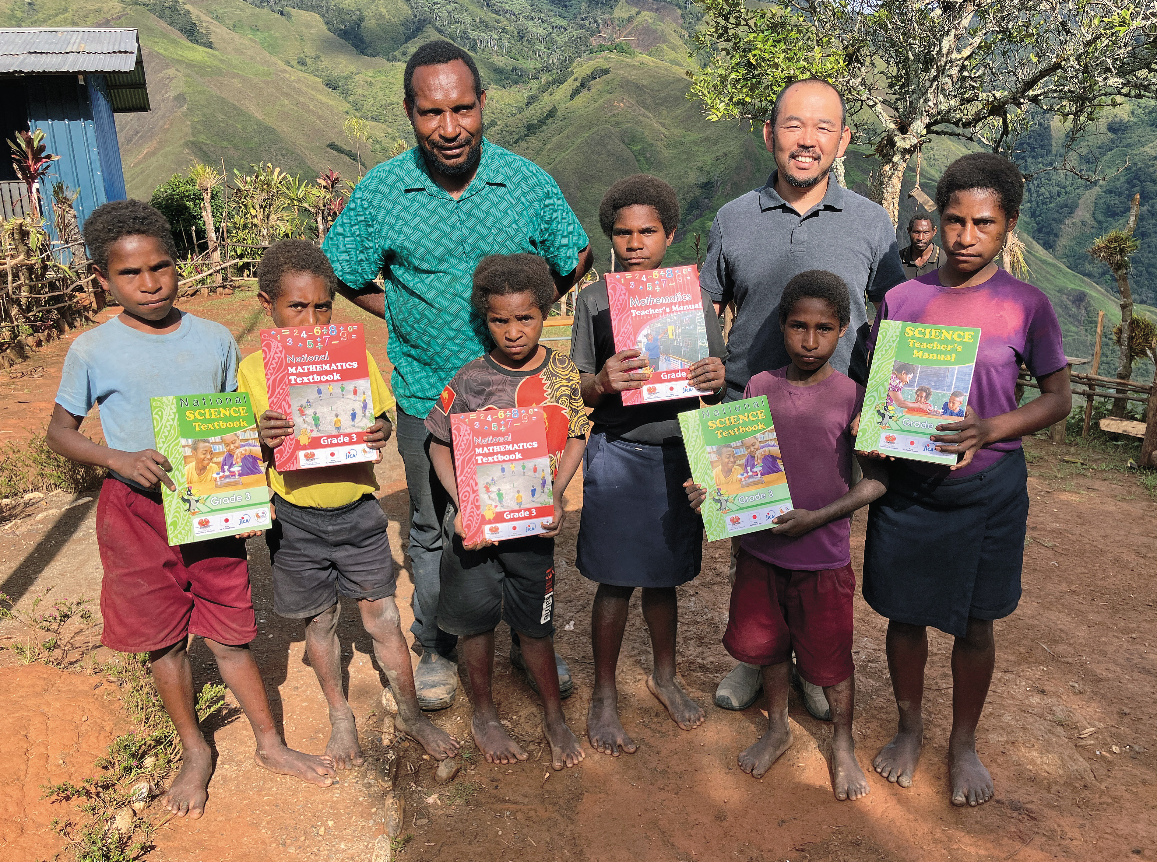
09
Overview by Region The Pacific
FY 2024 Total value of JICA operations 23.5 billion yen
Technical Cooperation
5.6 billion yen
5.0 billion yen
12.9 billion yen
Finance and Investment Cooperation
Grants
When an earthquake struck Vanuatu in December 2024, JICA provided emergency relief and supported recovery efforts to advance a resilient and sustainable reconstruction in line with the Build Back Better approach.
In the Federated States of Micronesia, JICA began the Pohnpei Port Expansion Project, which is funded by grants, to improve marine logistics and increase safety at the country’s largest port.
In Papua New Guinea, it has played a central role in the development of teaching materials and the creation of action plans to enable children to receive a good education.
Children in Papua New Guinea, receiving textbooks that incorporate Japan's mathematics teaching approach
13

Slide 15

09
Overview by Region
East Asia, Central Asia,
and the Caucasus
FY 2024 Total value of JICA operations 88.2 billion yen
Technical Cooperation
6.9 billion yen
73.7 billion yen
7.6 billion yen
Finance and Investment Cooperation
Grants
JICA provided Uzbekistan with a development program loan for building an inclusive and resilient society, and an ODA Loan to support improvements to medical care.
In the Kyrgyz Republic, it has completed the Sakura Bridge on an arterial road and the Kyrgyz Republic-Japan Friendship Tunnel, which is equipped with snow fences.
In Mongolia, it promoted industrial cooperation and joint research with Japan through human resource development in higher engineering education, and also conducted surveys aimed at expanding international airport facilities that support strengthened air connectivity.
JICA cooperates in activities for improving childhood nutrition through schools in Mongolia [Photo: Suzuki Kaku]
14

Slide 16
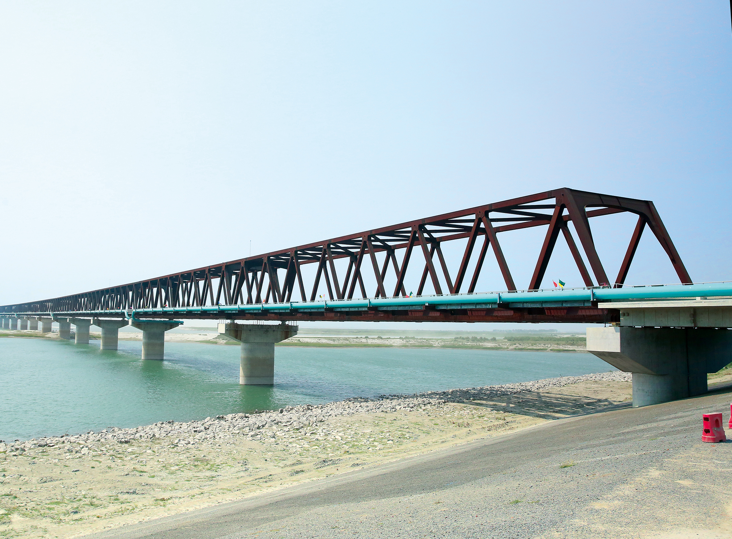
09
Overview by Region South Asia
FY 2024 Total value of JICA operations 482.8 billion yen
Technical Cooperation
20.7 billion yen
445.2 billion yen
16.9 billion yen
Finance and Investment Cooperation
Grants
In Nepal, the country’s first mountain road tunnel, which is currently being supported through an ODA loan, achieved a breakthrough in April.
JICA began cooperation in Bhutan on a project to develop hydroelectric power plants and transmission lines to ensure a stable supply of electricity, advance decarbonization, and strengthen power connectivity.
In India and Bangladesh, where an interim government was established in August 2024, JICA continued to support the construction of urban and intercity railways.
In Afghanistan, JICA continued its support for cooperation to meet a wide range of humanitarian needs through collaboration with international organizations in line with the Government of Japan’s policies.
Jamuna Railway Bridge, the longest in Bangladesh, commenced operation in March 2025
15

Slide 17
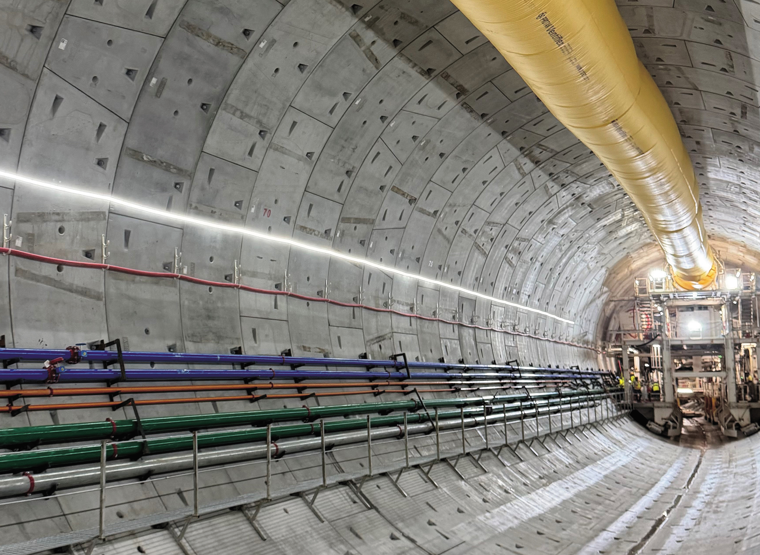
09
Overview by Region
Latin America and
the Caribbean
FY 2024 Total value of JICA operations 222.6 billion yen
Technical Cooperation
13.5 billion yen
207.7 billion yen
1.4 billion yen
Finance and Investment Cooperation
Grants
The Japan-Brazil Green Partnership Initiative (GPI) was launched, and related projects have started to address strategies in the area of the environment, global warming, and sustainable development.
In Panama, construction of a subway system utilizing Japan's monorail technology is progressing smoothly toward its 2028 opening.
The TSUBASA (Transformational Startups' Business Acceleration for the SDGs Agenda) program has launched a new training program for companies seeking to propose business models to government and other public organizations.
Site in Panama where subway shield tunnel drilling is underway
16

Slide 18
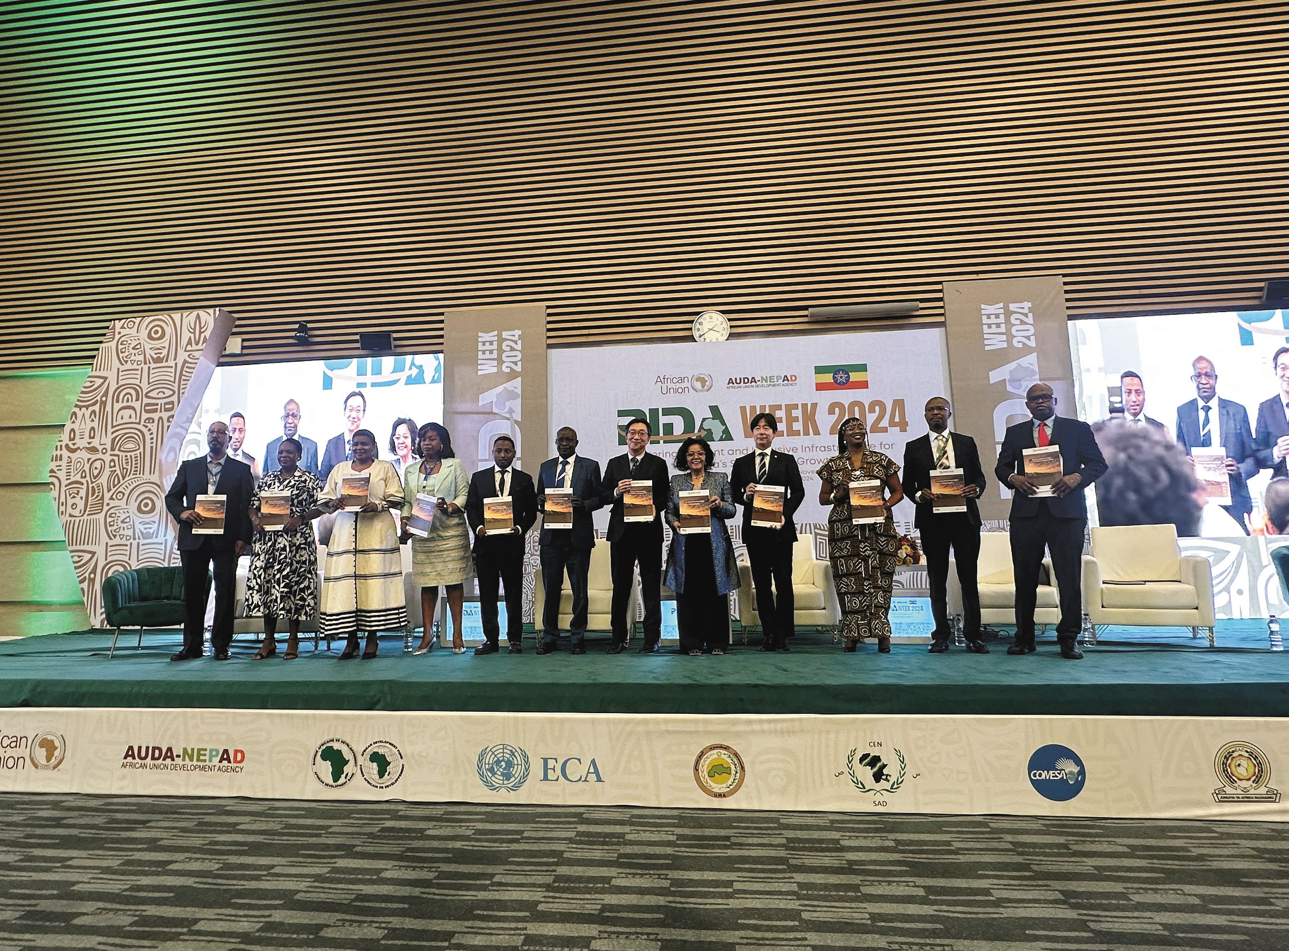
09
Overview by Region Africa
FY 2024 Total value of JICA operations 133.3 billion yen
Technical Cooperation
37.3 billion yen
52.2 billion yen
43.7 billion yen
Finance and Investment Cooperation
Grants
In January 2025, JICA held a seminar in Zambia in collaboration with AfCFTA and the African Union Development Agency (AUDA-NEPAD) in order to share experiences and training regarding the One Stop Border Post (OSBP), which aims to streamline and speed up immigration and customs-related procedures. Regional Economic Communities (RECs) in Africa also participated in this seminar, wherein they discussed problems and solutions with respect to trade facilitation and the promotion of regional integration.
At TICAD9, held in August 2025 in Yokohama, then former Japanese Prime Minister Ishiba announced the establishment of a public-private-academia joint study group on strengthening the Japan-Africa economic partnership, which was being launched to promote the implementation of the African Continental Free Trade Area (AfCFTA).
At PIDA Week, held in November 2024, JICA jointly launched the OSBP Status Report together with AUDA-NEPAD ［Photo: Homma Toru]
17

Slide 19
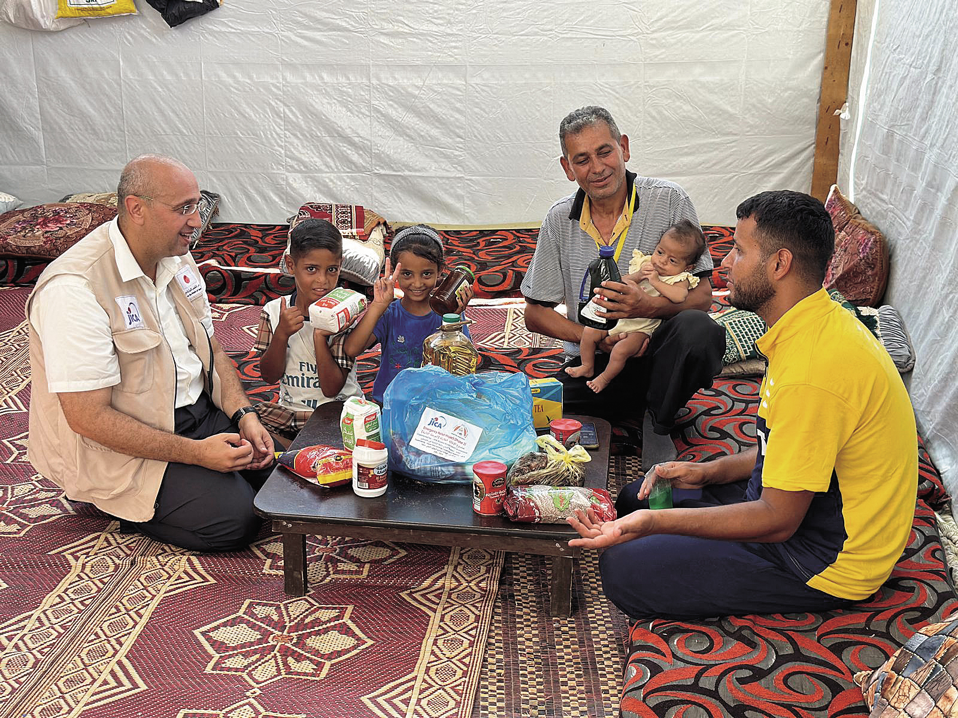
09
Overview by Region Middle East and Europe
FY 2024 Total value of JICA operations 238.5 billion yen
Technical Cooperation
18.1 billion yen
213.2 billion yen
7.2 billion yen
Finance and Investment Cooperation
Grants
JICA provided a variety of materials including food kits to the Gaza Strip, Palestine. It also continued its oil refinery plant project in Iraq to increase production of high-quality petroleum products that comply with environmental regulations.
In Europe, JICA has been involved in clearing landmines and unexploded ordnance in Ukraine and has cooperated in emergency recovery and economic reconstruction by supporting business development through collaboration between Japanese and local companies.
In Türkiye, JICA has cooperated in creating earthquake recovery plans, rebuilding infrastructure, and providing support to SMEs. In the Western Balkans, JICA cooperated in putting in place an environment for entrepreneurs to achieve high-quality growth.
JICA distributed food kits, tents, medical consumables, and other items seven times in the Gaza Strip, Palestine
18

Slide 20
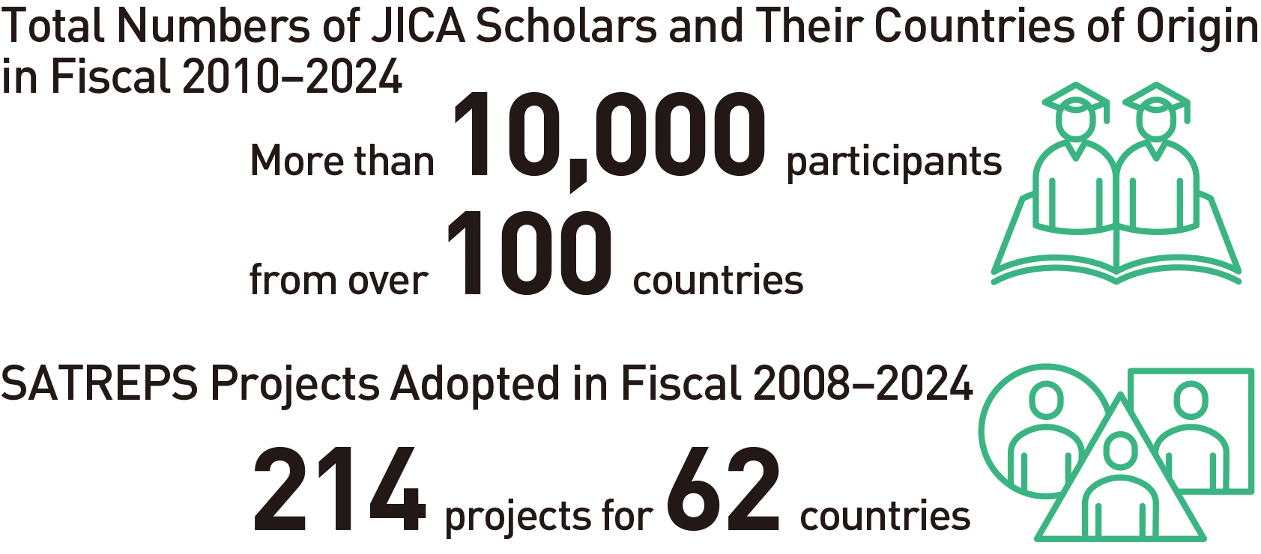
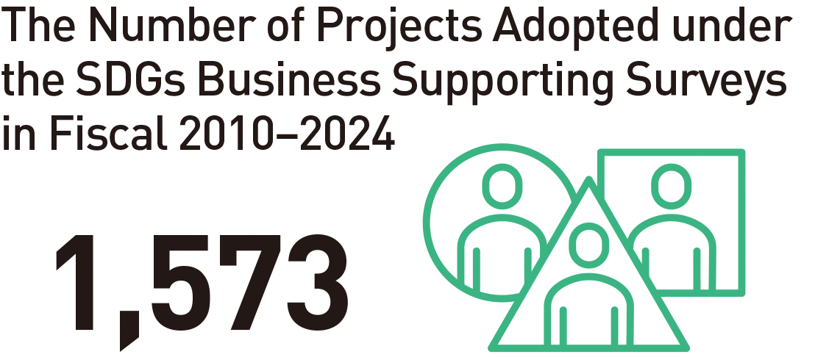
10
Partnerships
Universities and Research Institutions / Private Sector
Partnerships with Universities and Research Institutions
Cooperation with the Private Sector
JICA Development Studies Program (JICA-DSP)
Sharing Japan’s modernization experiences and lessons learned from its development cooperation
JICA Program for Japanese Studies (JICA Chair)
Expanding JICA-DSP abroad
Science and Technology Research Partnership for Sustainable Development (SATREPS)
Contributing to the SDGs through science, technology and innovation
Private-Sector Investment Finance
Support for economic and social development by private enterprises
Preparatory Survey for Private-Sector Investment Finance
Supporting the formation of promising PSIF projects
SDGs Business Supporting Surveys (JICA Biz)
Expanded roles for business
Partnerships and co-creation with private enterprises
19

Slide 21
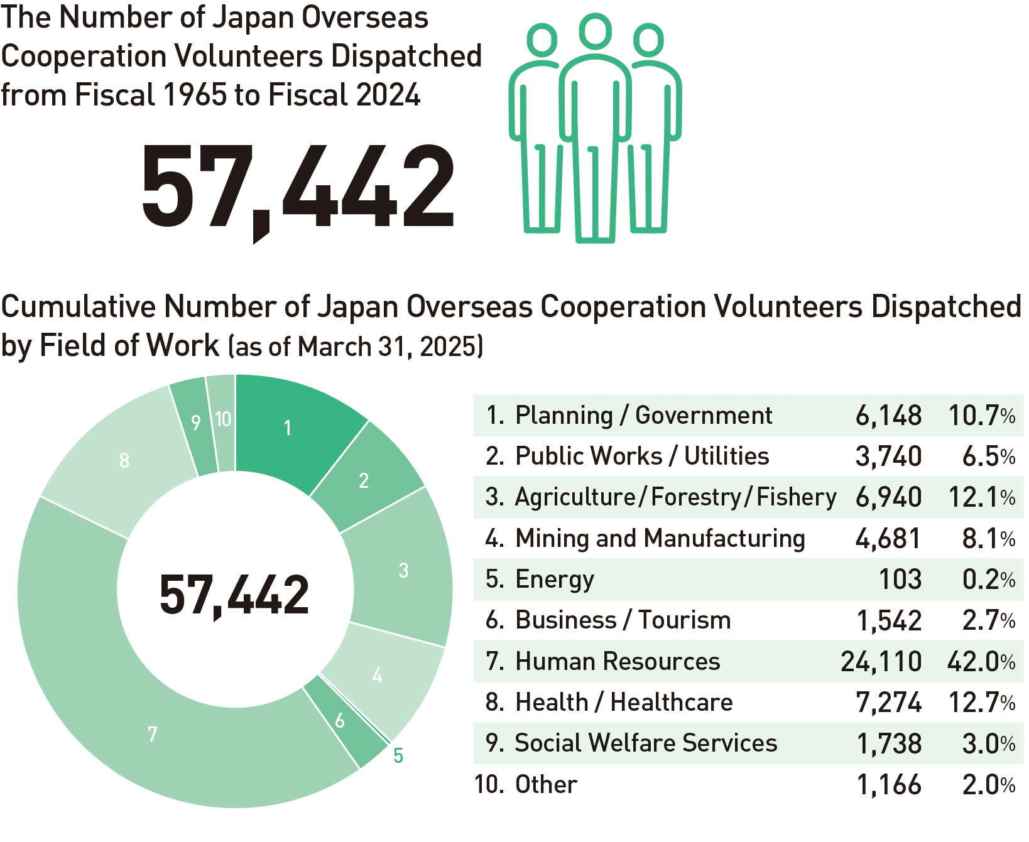
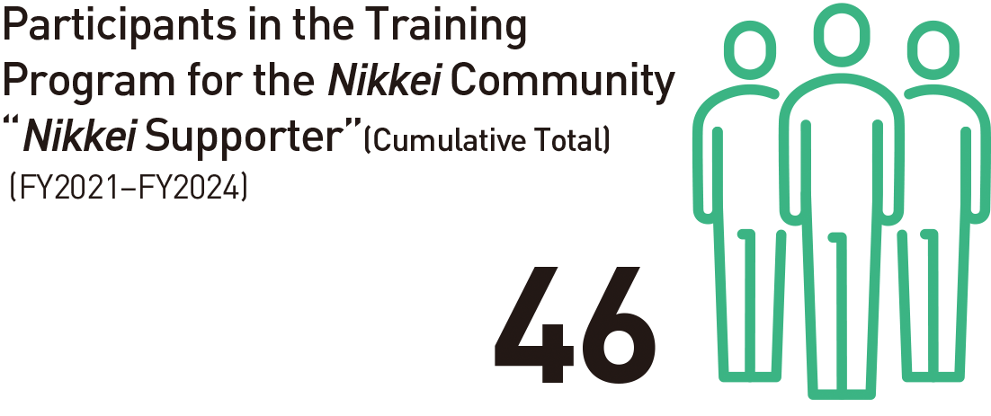
10
Partnerships
Volunteer /
Nikkei (Japanese descendants) Communities
JICA Volunteer Program
Partnership with
Nikkei Communities
Citizen-led international cooperation
Contributions toward diversifying development challenges
Mutual understanding deepened through interactions
Business partnerships with Nikkei communities
Future-oriented partnership programs for Nikkei communities
20

Slide 22
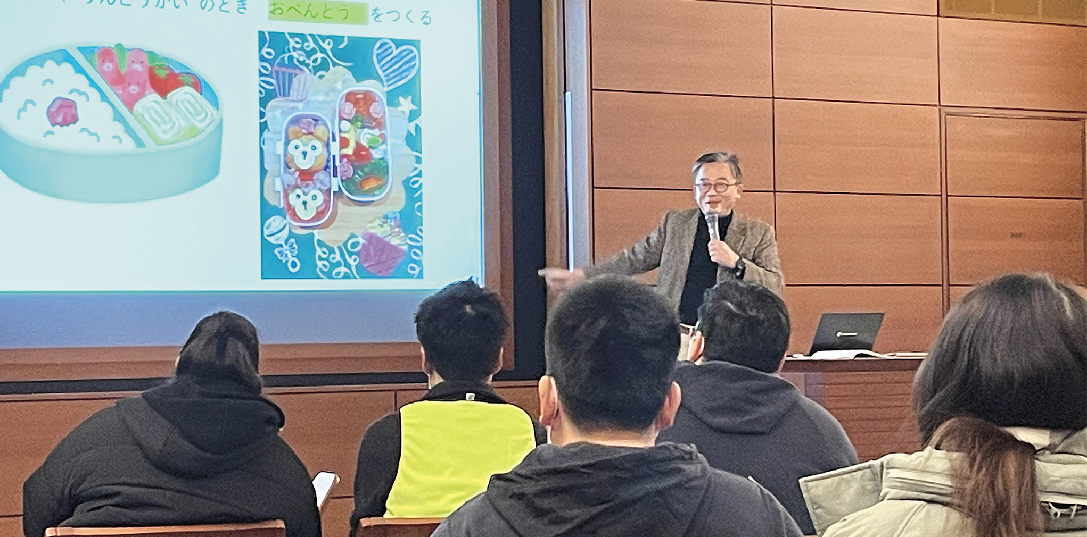
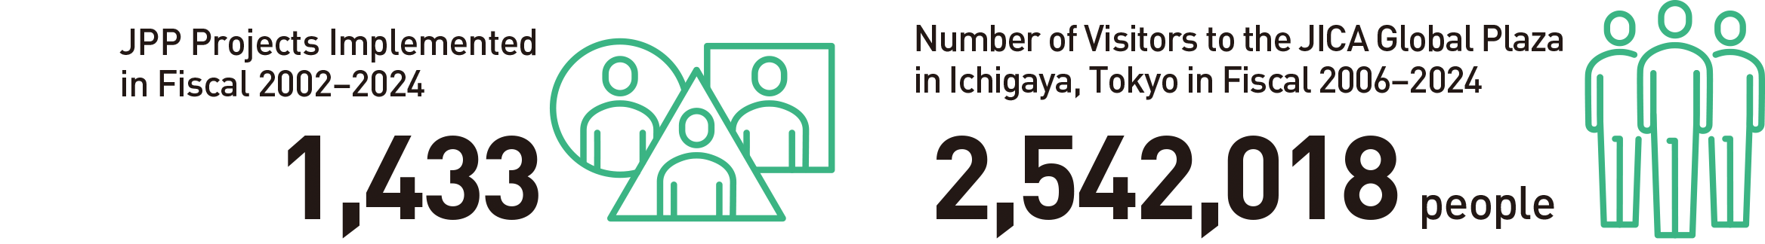
10
Partnerships
Foreign Nationals / Citizen Participation
Support for the Acceptance of Foreign Nationals / Multicultural and Inclusive Society
Promoting Citizen Participation in International Cooperation
Citizen Participatory Cooperation
JICA promotes Citizen Participation in International Cooperation by working primarily with domestic NGOs, local governments, universities, and private companies as key partners
To promote citizens’ participation in international cooperation, JICA implements programs such as the JICA Partnership Program (JPP)
Development Education
To contribute to the development of creators of a sustainable society
To hold interactive exhibitions based on the concept of “seeing, listening, and touching”
Guest lecture service on international cooperation
To implement “JICA Overseas Training for Teachers,” wherein teachers visit developing countries
To support materials for development education
Response based on the government’s “Comprehensive Measures for Acceptance and Coexistence of Foreign Nationals”
An information session on school life in Japan targeting children with roots in other countries, conducted by JICA in cooperation with NPOs
21

Slide 23
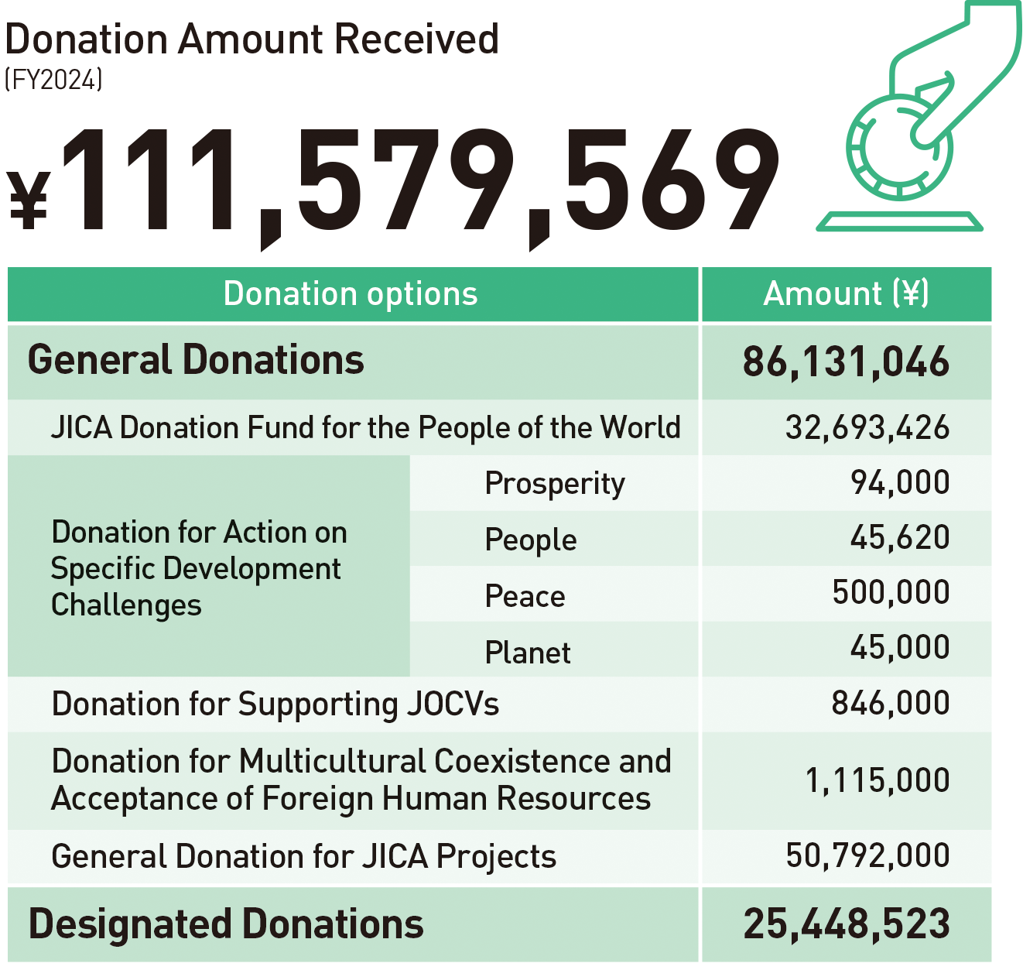
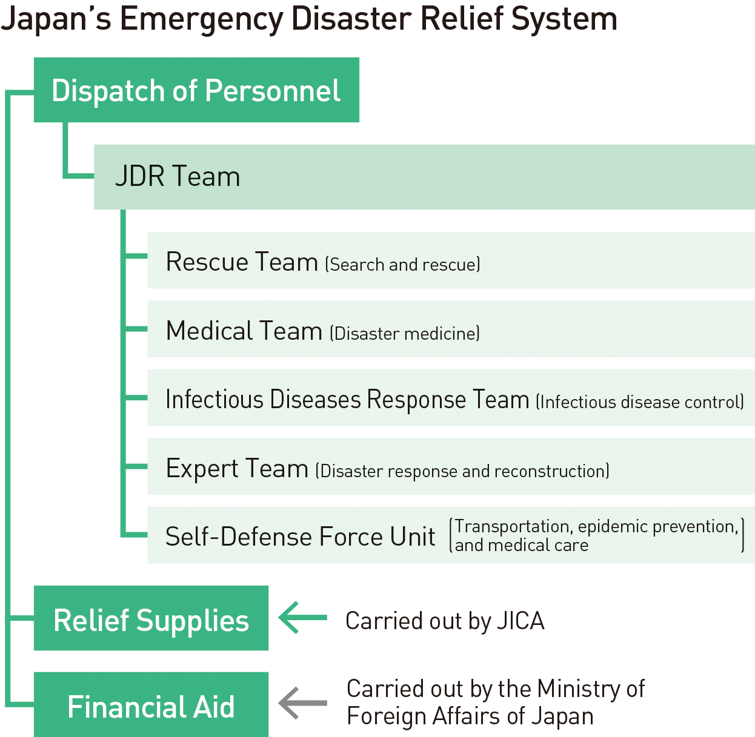
10
Partnerships
Donations / Emergency Disaster Relief
Donations
Emergency Disaster Relief
Promoting participation in development cooperation through donations
JICA implements various operations that address domestic and international social issues through the use of donations
Emergency response to overseas disasters
Dispatch of JDR teams
Provision of emergency relief goods
22

Slide 24
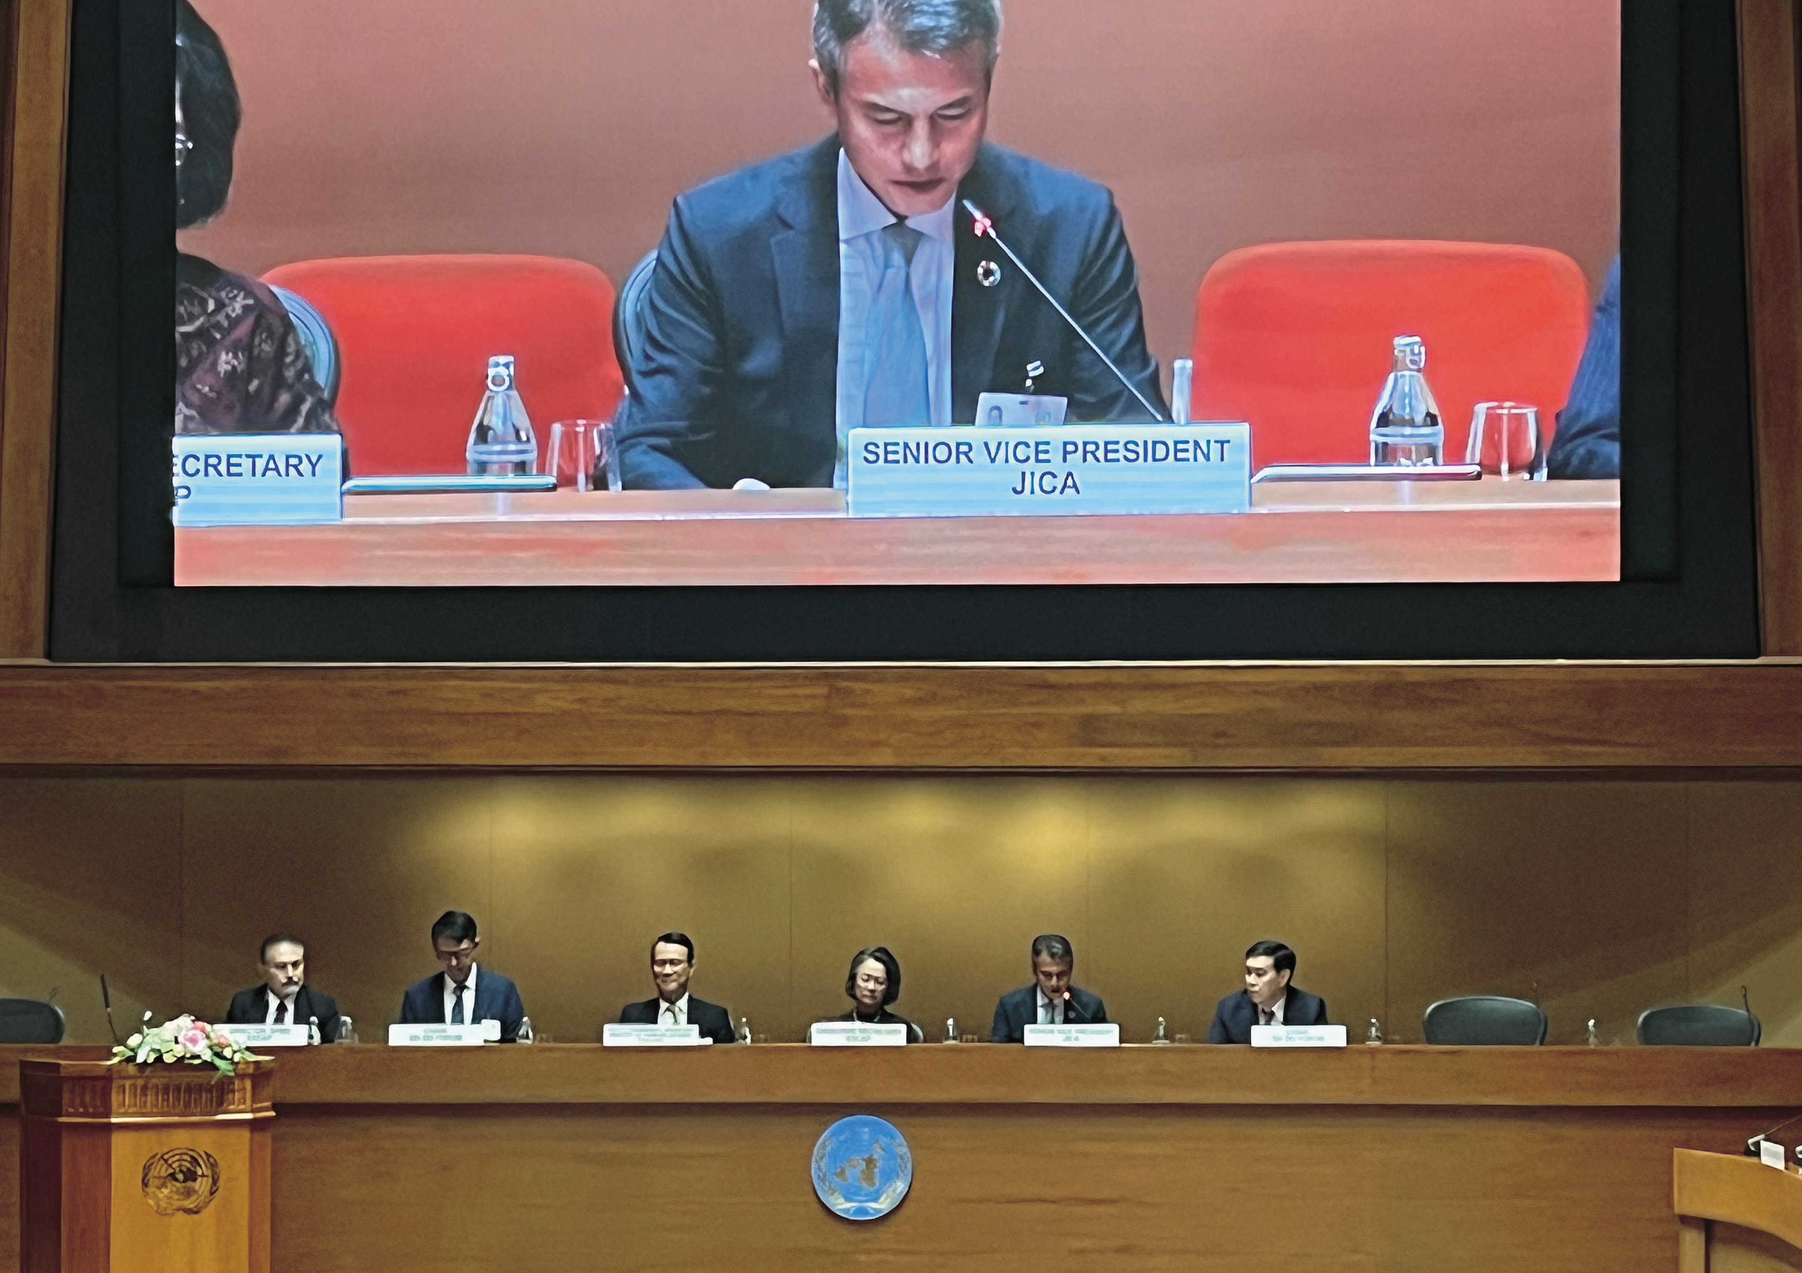
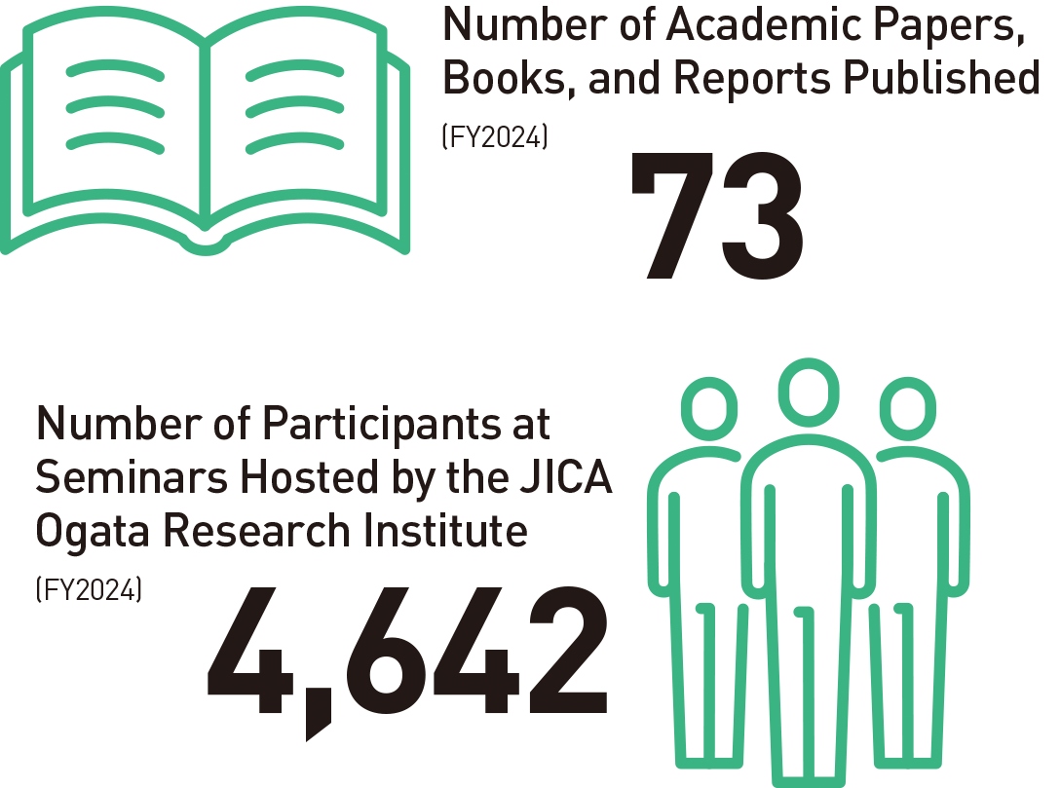
10
Partnerships
International Organizations / Research
Partnerships with International Organizations and Other Development Partners
Research
Co-creating Practical Knowledge for Peace and Development
Contributions to the realization of human security
Publicity of research findings and knowledge
Demonstrating development impact and feeding back into operations
Tackling increasingly complex challenges through international cooperation
Contributions to international trends in development cooperation
Strengthening partnerships with diverse actors
JICA presented its initiatives at the South-South and Triangular Cooperation Forum hosted by the United Nations Economic and Social Commission for Asia and the Pacific (UNESCAP) in November 2024
23

Slide 25
