Slide 1
What is 5S principle?
5S Training of Trainers for Training Institutions
Training material No. 13

Slide 2







Aren’t you frustrated in your workplace?
Oh, this position makes me tired !
I cannot remember what/how to next…
Where is that document ?
I cannot find it !
Why I am making mistakes again and again
Oh time is not enough to complete this work!
Why we cannot communicate
properly?

Slide 3

Are you positive thinker or negative thinker?

Slide 4
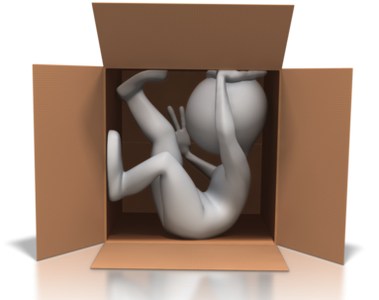

Thinking negatively in inside box and give-up?

Slide 5


Work together and do something with big positive attitude?

Slide 6

Even you are positive thinker, you still need something to make your ideas realistic
You need tools !

Slide 7


There are useful tools
5S
approaches

Slide 8
What is 5S ?
5S is a philosophy and a way of organizing and managing the workspace and work flow with the intent to improve efficiency by eliminating waste, improving flow and reducing process unreasonableness.
It is for improvement of
working environment

Slide 9
What is 5S ?
5S activities are to create good working environment through reduction of “Muri”, “Mura”, and “Muda”
It help to have a basis of strong management of workplace
What is “Muri”, “Mura”, and “Muda”?
  Muri : overburden, unreasonableness or absurdity
  Mura : unevenness or inconsistency, primarily with physical matter and the human spiritual condition
  Muda : activity which is wasteful or doesn’t add value
Source: http://blog.5stoday.com/category/muri-mura-muda/

Slide 10
5S in Japanese/English/Swahili
5S is literally five abbreviations of Japanese terms with 5 initials of S.
 | Japanese | English | Ki-Swahili
S-1 | Seiri | Sort | Sasambua
S-2 | Seiton | Set | Seti
S-3 | Seiso | Shine | Safisha
S-4 | Seiketsu | Standardize | Sanifisha
S-5 | Sitsuke | Sustain | Shikilia
Notes:
5-S is literally five abbreviations of Japanese terms with 5 initials of S.
Convenient translation to English and Swahili similarly provides five initials of S.

Slide 11
Background on 5S activities
The word “5S(five S)” was generalized in 1980’s in manufacturing sector in Japan, as Toyota Production System (TPS) became famous in the sector and “5S activities” were set as one of the bases of TPS
Service industry started to used “5S” in 1990’s

Slide 12
Background:
- National Demonstration Project -
NDP was designed to test TQM approach for health care quality and safety improvement
NDP was conducted in US (1989-1990) and Japan (2000-2004)
Many private hospitals in Asia, Europe, and US are practicing KAIZEN-TQM approaches for health care quality, hospitals management and safety improvement

Slide 13
What 5S can do?

Slide 14

Team work improvement through everyone’s participation

Slide 15


Identify Abnormalities

Slide 16


Identify wastes and reduce the wastes

Slide 17






The 7 wastes
Overproduction
Over processing
Inventory
Rework
Waiting
Transportation
Motion
Mr. Taiichi Ohno, Former President of Toyota Motors

Slide 18

Improve productivities

Slide 19

Improve safety

Slide 20





If no 5S activities….
Hesitate what to do
Looking for necessary
items
Remember what /
how to do
Making mistake

Slide 21
Details of 5S approach

Slide 22
5S: Sort-Set-Shine-Standardize-Sustain
S1:
Sort
S2:
Set
S3:
Shine
S4:
Standardize
S5:
Sustain

Slide 23
S1: Sort
Focuses on eliminating unnecessary items from the workplace
Categorize equipment, furniture, tool in your working place into the following 3 categories
  Necessary
  Unnecessary
  May not necessary
This step will also help with the “just in case” attitude
S1:
Sort
S2:
Set
S3:
Shine
S4:
Standardize
S5:
Sustain
Back to main

Slide 24




S1: Sorting activities
Equipment, material, tools files, furniture etc. can be categorized based on the frequency of use!
Equipment, materials
tools etc. in your work place
May need it
Items only used occasionally
are in this category
Not need it
Need it
Items not used in current work
process are in this category
Items often use are in this category

Slide 25
Examples of “Sorting”
Place “Red tag” for categorization of items to identify unnecessary items
Move unnecessary items( broken tools, obsolete jigs and fixtures, scrap and excess raw material etc.) to central stored area
Free up valuable floor space (Space utilization)
Finding abnormality of equipment and tools (Out of order, missing parts etc.)

Slide 26
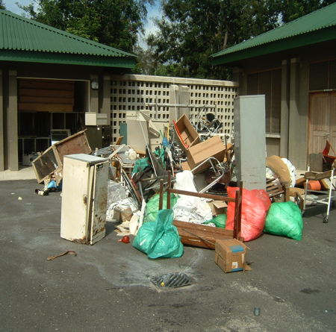
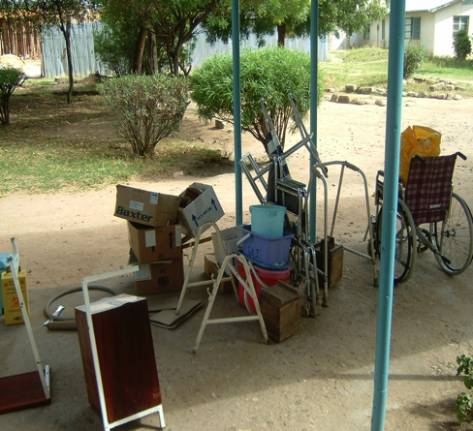
Notes:
What do you see?

Slide 27
S2: Set
“Set” is based on finding efficient and effective storage of necessary items
Apply “Can see, Can take out, and Can return” philosophy
This will save time and energy to look for something
S1:
Sort
S2:Set
S3:
Shine
S4:
Standardize
S5:
Sustain
Back to main

Slide 28



S2: Setting activities
Think not only “beatification.
Need to consider workflow and
arrange items
Needed items
Items often use
(with current
work process)
Have consensus among
co-workers on where and
how to organize necessary
items
Use 5S tools for proper
Organization of items
such as
Labeling
Color coding
Numbering
Zoning etc.
Arrange them properly based on
“Can see, Can take-out, Can
return” Philosophy

Slide 29
Example of “Setting” activities
Labeling , numbering, zoning for clear identification of storage areas to keep necessary items
Set necessary items matching with workflow to minimize unnecessary movement and transportation time

Slide 30
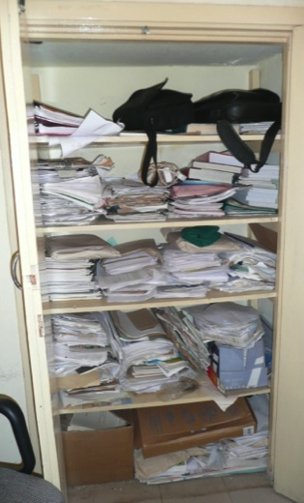
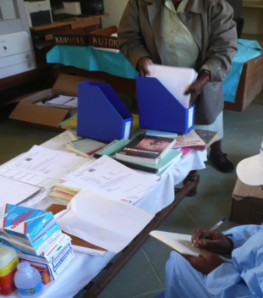
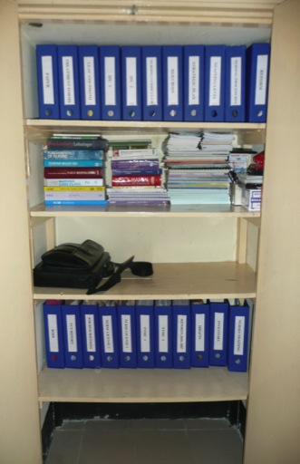
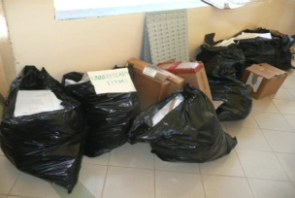
BASELINE PHOTOGRAPHS
AUGUST
2008
ADMINISTRATION
SEPTEMBER
2008
PROCESS
Before 5S
MID. YEAR
After
5S

Slide 31
S3: Shine
Cleaning up one’s workplace daily so that there is no dust on floors, machines or equipment.
It will create ownership and build pride in the workers
S1:
Sort
S2:
Set
S3:
Shine
S4:
Standardize
S5:
Sustain
Back to main

Slide 32



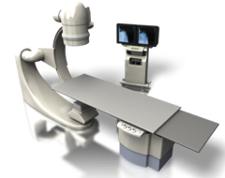

S3: Shining activities
Clean floor, windows and walls.
Clean and Maintain office automation machines, medical equipment and tools, office furniture
Develop and follow regular cleaning and Maintenance schedule

Slide 33
Example of “Shining” activities
Daily sweeping and mopping of floor, bathroom, corridor etc.
Regular cleaning and maintenance of equipment and tools
Periodical check for changes in equipment and the service area such as: leaks, vibration, misalignment, breakage etc.
IPC activities such as hand hygiene, waste segregation are also part of shine

Slide 34
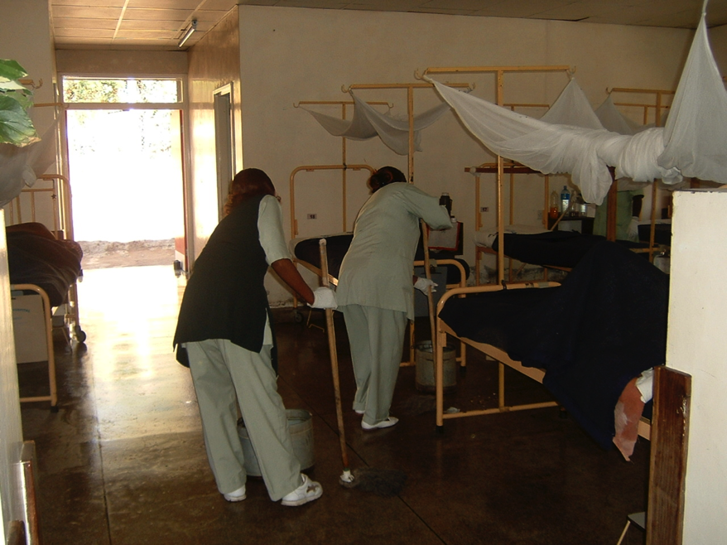

Slide 35
S4: Standardize
Maintain an environment where S1 to S3 are implemented in the same manner throughout the organization
Give opportunities to employees to take active part in the development of these standards.
S1:
Sort
S2:
Set
S3:
Shine
S4:
Standardize
S5:
Sustain
Back to main

Slide 36


S4: Standardizing activities
S1
S2
S3
Develop mechanism to standardize
S1-S3 implementation for continuation
Standardization will leads equalization of activities
= “Production leveling and smoothing”
Standardization is useful for;
Easy implementation of S1 to S3 activities
Equalization process output
Everyone’s participation

Slide 37
Example of “Standardize” activities
Work instructions, Standard Operating Procedures (SOPs)
Checklist development and regular usage for SOPs
Mechanism and format development for ordering supplies, reporting etc
Color coding for waste segregation
Standardized common symbols

Slide 38
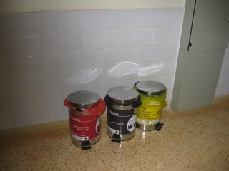
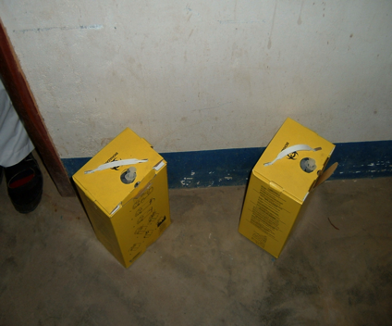
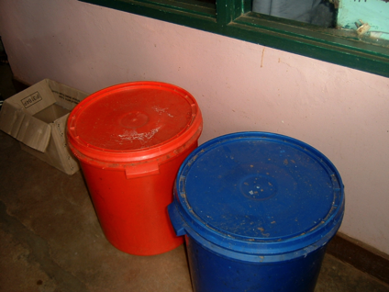

Slide 39
S5 : Sustain
Maintain S1-S4 through discipline, commitment and empowerment
It focuses on defining a new mindset and a standard in workplace
S1:
Sort
S2:
Set
S3:
Shine
S4:
Standardize
S5:
Sustain
Back to main

Slide 40





S5: Sustainability activities
People get bored if no changes.
Need to develop a mechanism to
make staff exited and motivated
Further Improvement
Prevent fallback
Improvement
Measure improvement with proper
periodical monitoring

Slide 41
Example of “Sustain” activities
Regular progress reporting
Refresher training
Periodical evaluation of 5S activities with proper advices for continuation and further improvements
Appreciation, recognition and awarding on good 5S activities
Reminder using 5S corner, new letters, good practice sheet etc.

Slide 42
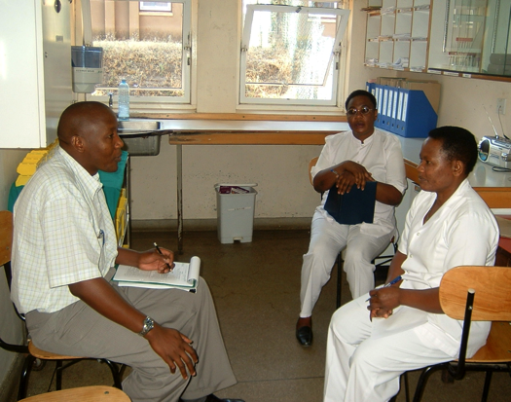
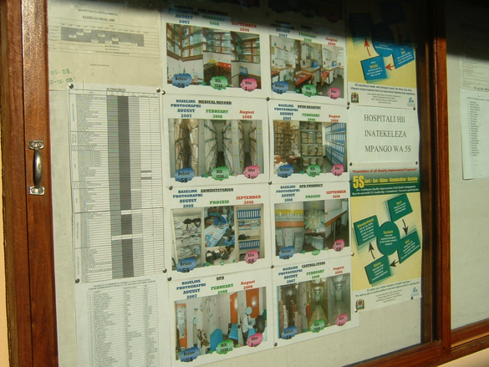

Slide 43
5S Conceptual Framework
SORT
SUSTAIN
STANDARDIZE
SET
SHINE

Slide 44
5S is becoming popular for seven solid reasons
Visible results enhance the generation of more and new ideas
The workplace gets cleaned up and better organized
Hospital and office operations become easier and safer
Results are visible to everyone - insiders and outsiders
People are naturally disciplined
People take pride in their clean and organized workplace
As a result the company’s good image generates more better

Slide 45
5S-KAIZEN-TQM Phases
Preparatory phase
3 month
Introductory
Phase
6 month
Implementation phase
2 years
Maintenance phase
On going
Situation analysis
Training of managers
Training of staff
Sorting
Setting
Shining
Standardizing
Sustaining
Expansion areas to practice 5S activities
Continue 5S cycle

Slide 46
Target of 5S
Targets of Five-S include:
Zero changeovers leading to product/ service diversification
Zero defects leading to higher quality
Zero waste leading to lower cost
Zero delays leading to on time delivery
Zero injuries promoting safety
Zero breakdowns bringing better maintenance
Notes:
This is the actual purpose of implementation of 5S activities. 5S is not a cleaning campaign, and possible to solve the issues mentioned here.

Slide 47
Remember (1/2)
5S implementation can improve both working environment and the service content.
  Benefits on WEI will be better realized as you go along the training.
Go systematically to implement S1-S5:
  Sort necessary & unnecessary items;
  Arrange items according to work flow;
  Make workplace and tools shining (daily cleaning);
  Standardize “sort-set-shine” process; and
  Workers acquire positive attitude to sustain & improve quality of health services.

Slide 48
Remember (2/2)
Effectiveness of 5S in improving health care services content:
  Complement to patient safety efforts, e.g.,
    Minimizes chances of providing wrong medicine, and treating wrong patients through proper sorting (files, records) and appropriate labeling (medicines, op-sites), as well as, use of checklist to avoid leaving items (such as gauze and scissors) by use of safe surgery checklist.
  Contribute to better continuum of care, e.g.,
    Use of patient discharge checklists ensure correct linkages to needed services.

Slide 49
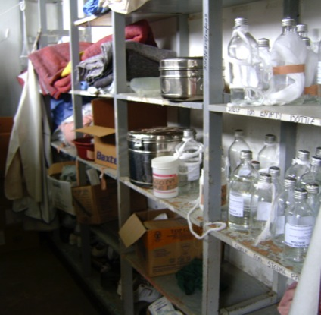
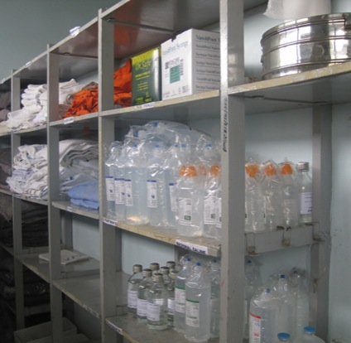
Example of 5S activities
Before 5S (2009)
Disorganized items in the store. Took long time to searching items needed
After 5S (2010)
Use labeling and organize items lead to minimize time for searching items, easy to control stocks

Slide 50
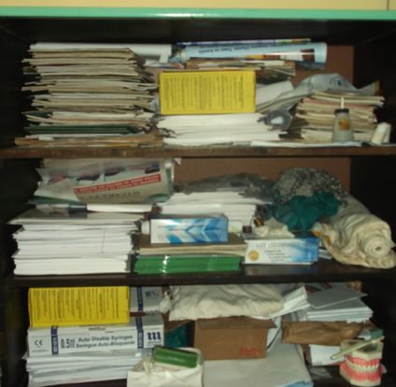
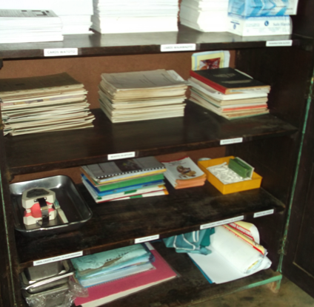
Example of 5S activities
Before 5S
Disorganized cabinet in a ward at Usangi DH
After 5S

Slide 51
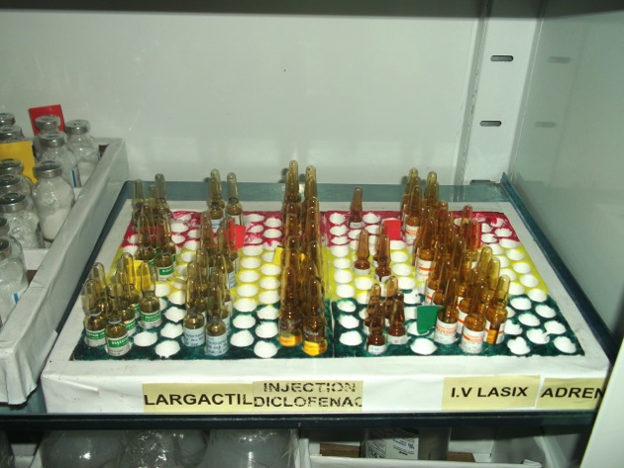
Using color coding for Visual control of ampules in a ward at MNH
Green means
“enough stock”
Yellow means giving warning on
“stock is getting less”
Red means giving warning on
“close to stock out and refill ”

Slide 52
Wrap-up
Positive attitude is very important for implementation of 5S activities
It is not “Cleaning Campaign”
5S activities are to create good working environment through reduction of “Muri”(overburden), “Mura”(unevenness), and “Muda”(waste)
5S can identify and reduce “abnormalities” and “waste”, improve “team work”, “cleanness”, “safety” and “productivity”
It is a basis of organization management

Slide 53

Thank you for listening !

