Slide 1
5S Tools
5S Training of Trainers for Training Institutions
Training material No. 14

Slide 2
What are 5S tools?
“5S tools” are developed to help practice of 5S activities
Many 5S tools using management techniques called “Visualization” for easy recognition and communication for actions
5S tools can be combined to enhance effectiveness of 5S activities
All tools require an agreed set of rules
All staff working in the health facility must know those rules and everyone should follow the rules

Slide 3
Types of 5s tools
Red tag
Alignment
Labeling, Tapes
Numbering, Alphabetical cording
Safety signs
Signboard
Zone
X-Y axis
Symbols
Color cording
5S Corner

Slide 4
Quality of services and management
Leadership and team work
Leadership and
commitment of
Management
Total Quality Management
KAIZEN
X-Y axis
Sign board
Working environment
Positive attitude
Color coding
5-S
Numbering
Symbols
Labeling
5S tools are like a fertilizer to grow the root !

Slide 5
Red Tag
Useful for S1
Use it when can not decide an items are “necessary” or “not necessary”
Record necessary information on the Red Tag, stick or hang it on the item that cannot make decision.
If the items is not used for 1 month = Unnecessary item
If the item is used within 1 month = Necessary item

Slide 6
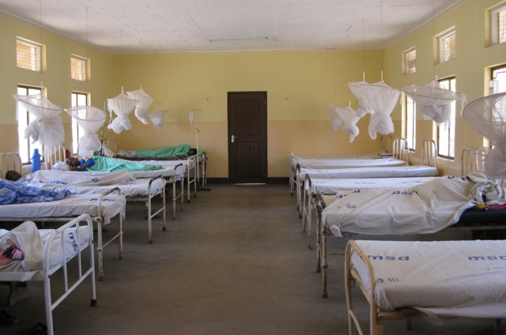
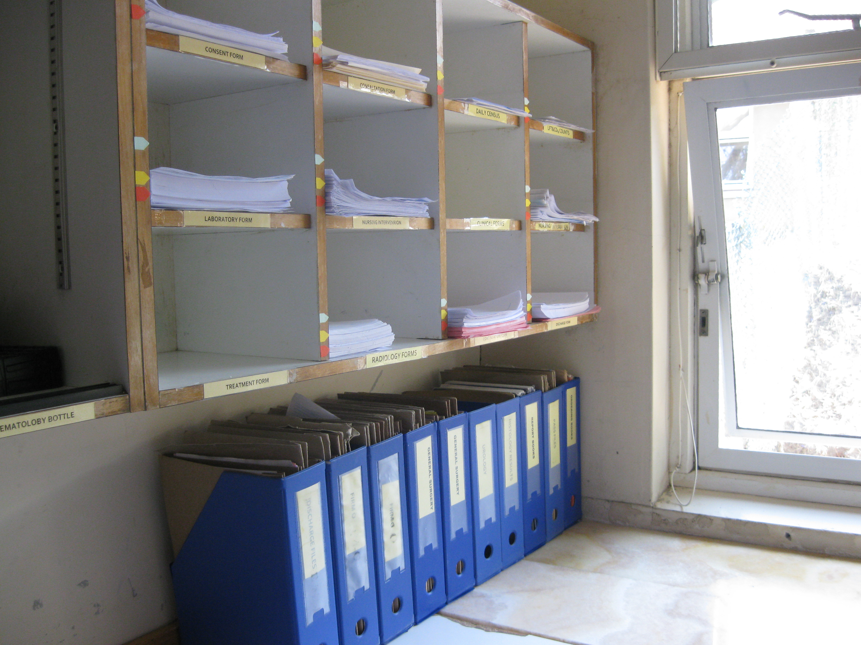
Alignment
Useful for S2
It is useful to improve orderliness and beautification when you organize files, equipment, materials and other items.

Slide 7
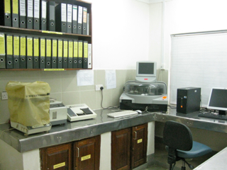
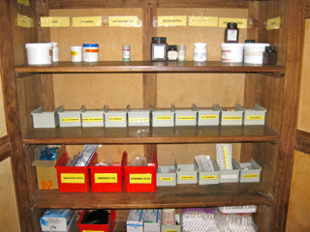
Labeling
Useful for S2 and S4
Labels are used when you identify each item and organize them properly.
It is useful especially for storing files and items in cabinets/shelves.

Slide 8
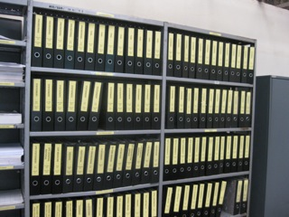
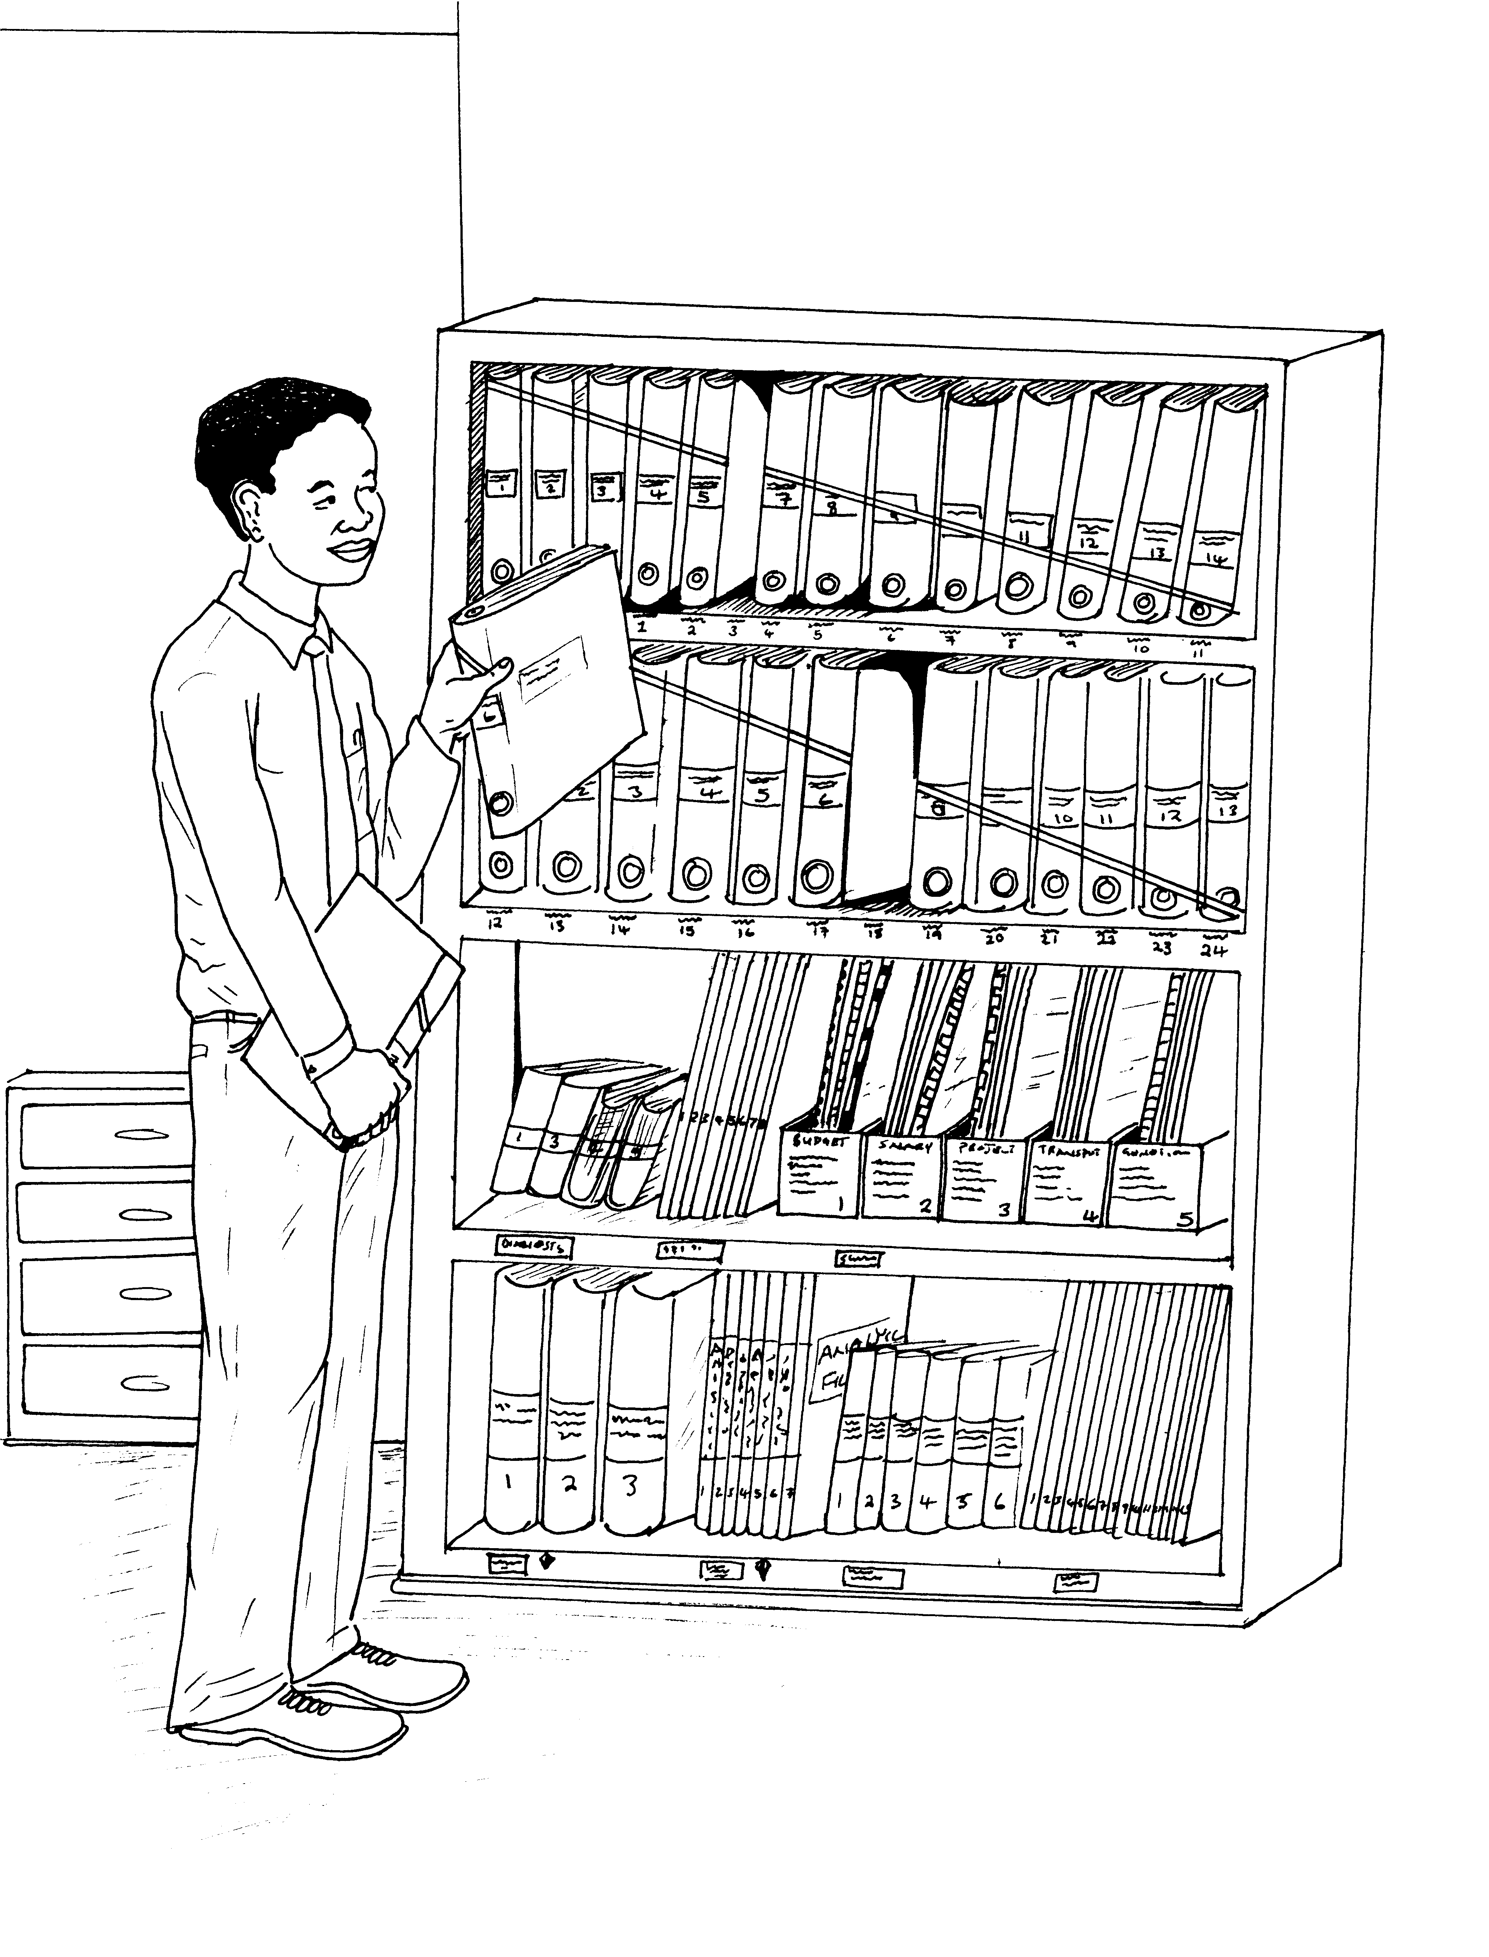
Taping
Useful for S2 and S4
Draw a connected diagonal line on spine of books/files
The line tells users where to return and helps to arrange items in order

Slide 9
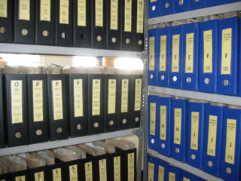
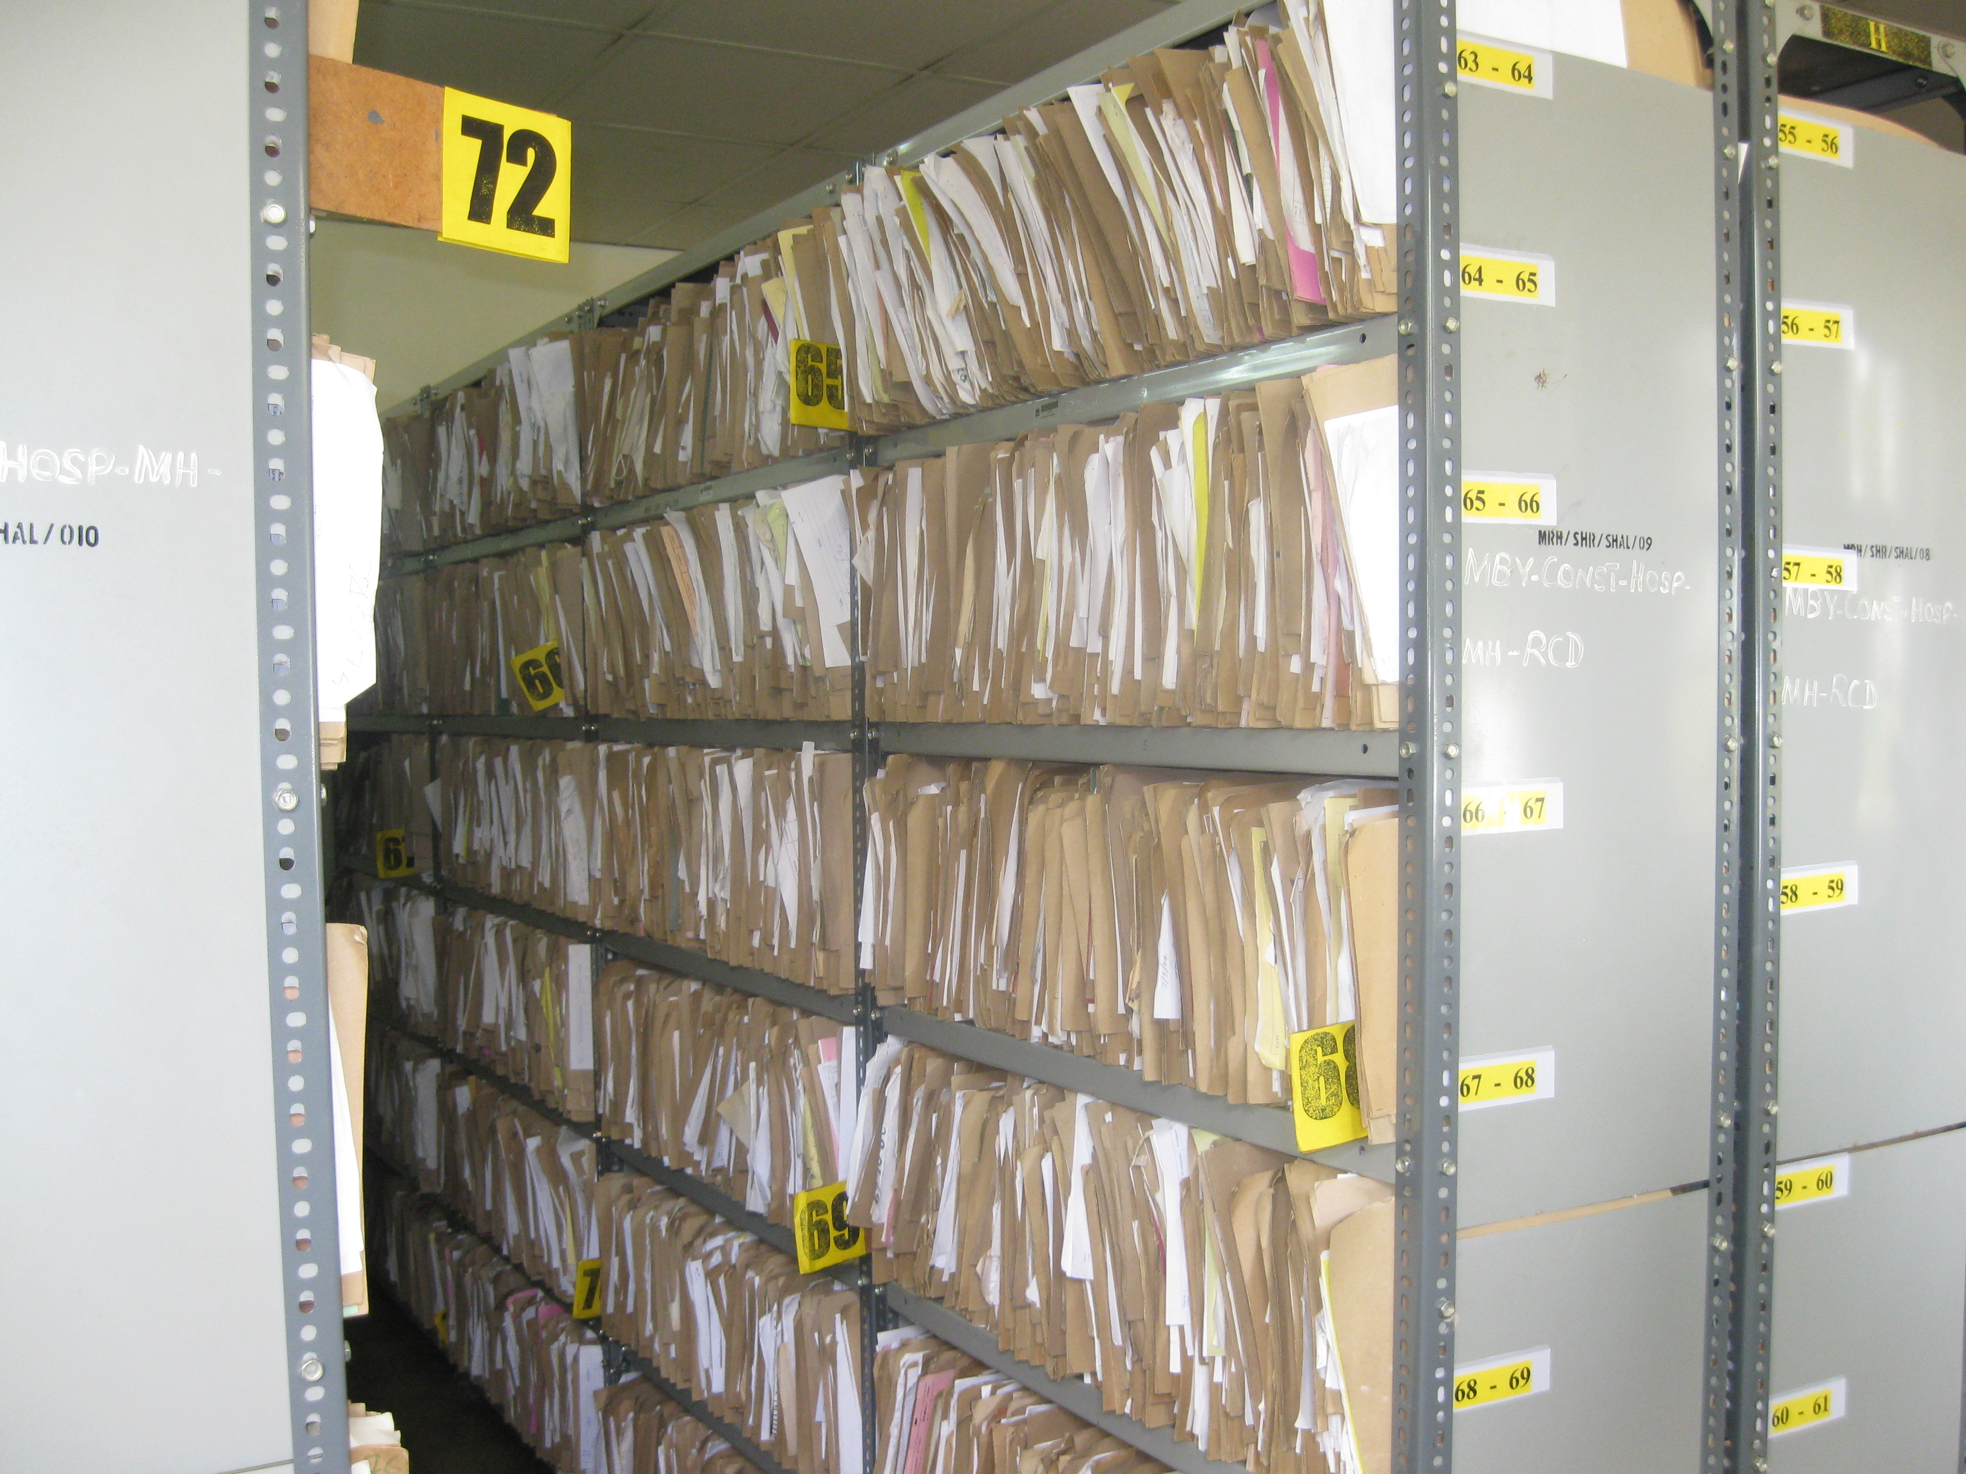
Numbering / Alphabetical cording
Useful for S2
Used to organize files and other items by numbers/ alphabets
It helps users to find necessary items or information quickly and easily.
It is very useful for practicing “Can See - Can Take Out – Can Return” principle.

Slide 10
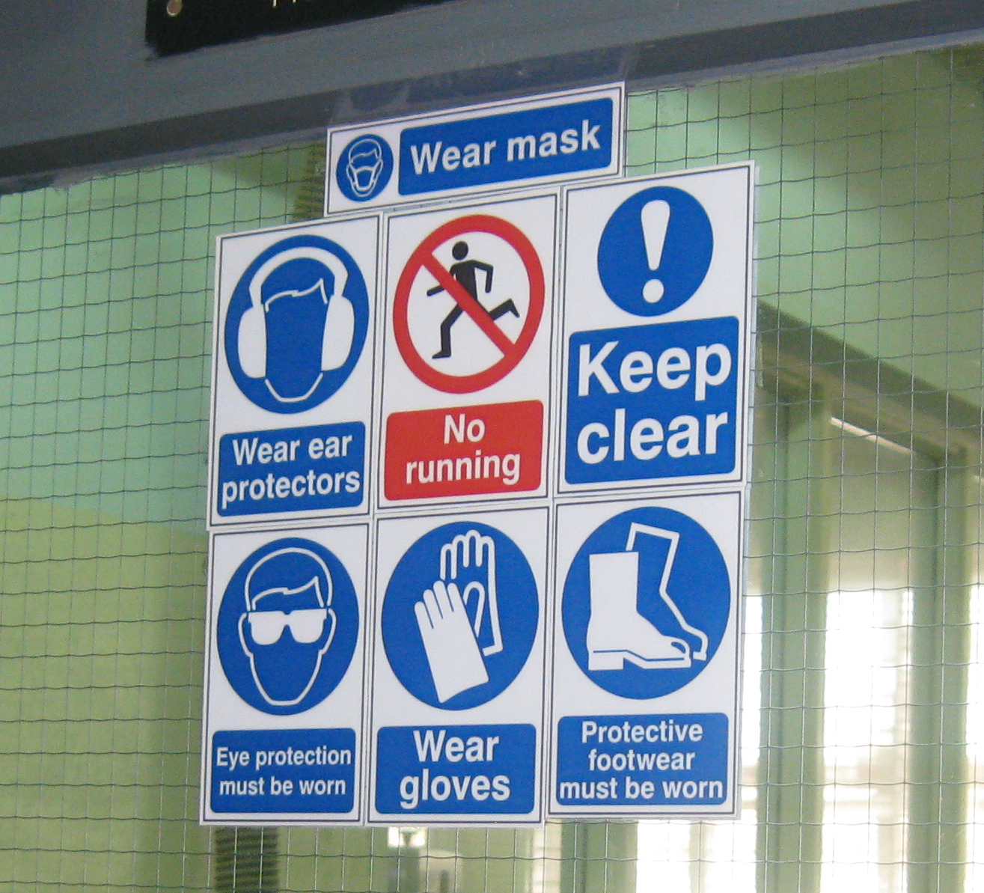
Safety signs
Useful for S2 and S4
Used to warn visitors and workers to pay attention on hazardous items.
Majority of hazardous items, which are commonly used in health facility, has international/national standardized safety signs.
It is recommended to use common safety signs

Slide 11
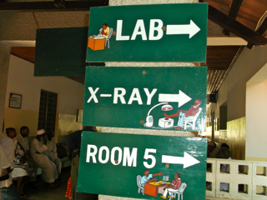
Signboard
Useful for S4
Signboards are used for identifying locations of places and guiding facility users to the place where they want to visit.
Recommended to use common languages that are understood by all; in Tanzania Kiswahili and English are acceptable.

Slide 12
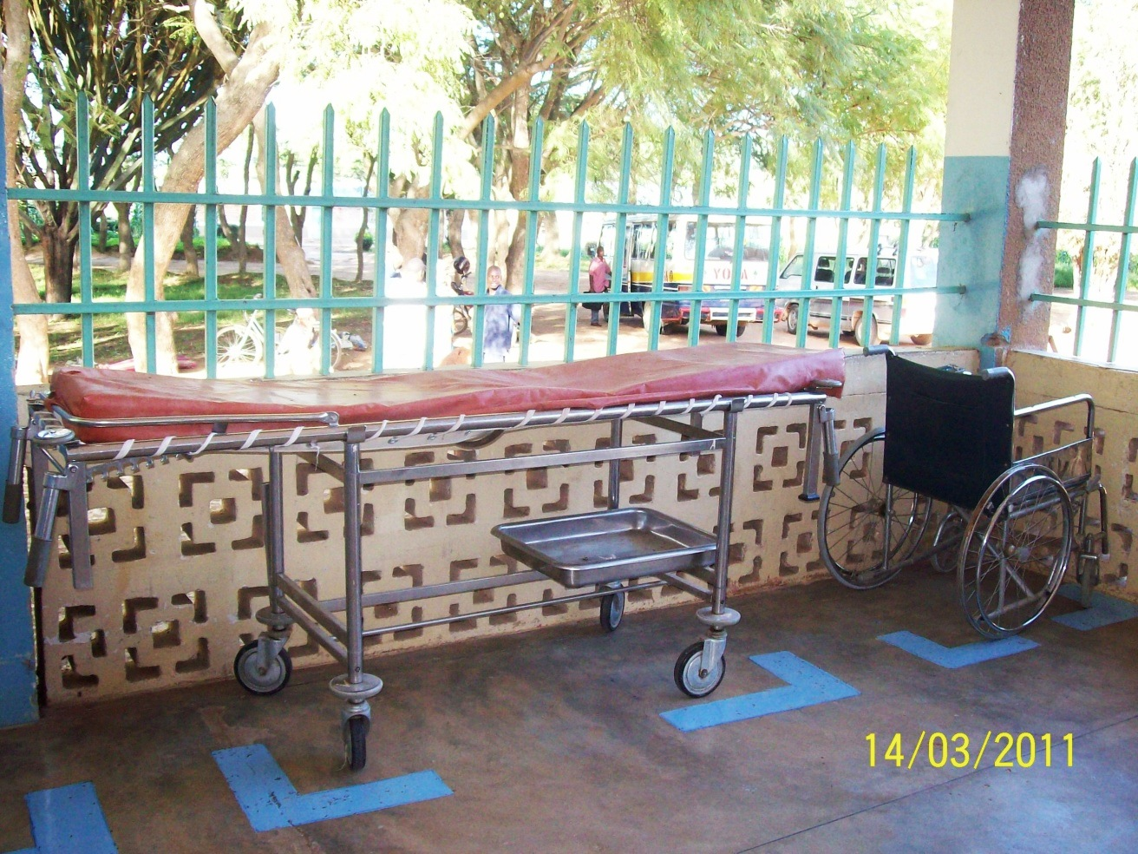
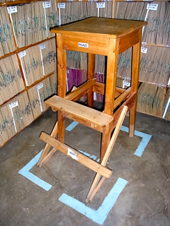
Zone
Useful for S2 and S4.
Zoning is used to identify or recognize proper location/ storage of items.
It helps people to understand “where it is supposed to be”

Slide 13
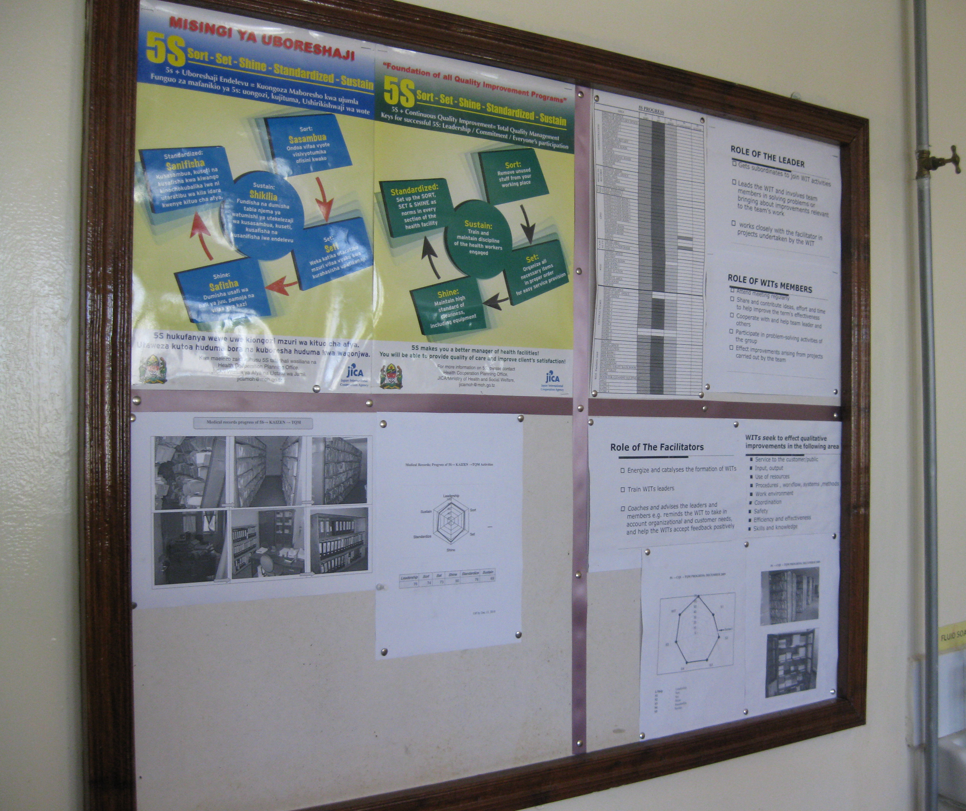
X-Y Axis
Useful for S2 and S4 especially when displaying information/ posters
This is used for improvement of orderliness and beautification
Limited space can be utilized and easy to fine necessary information
It is important to remove old/outdated posters from notice boards regularly to keep it tidy.
X
Y

Slide 14
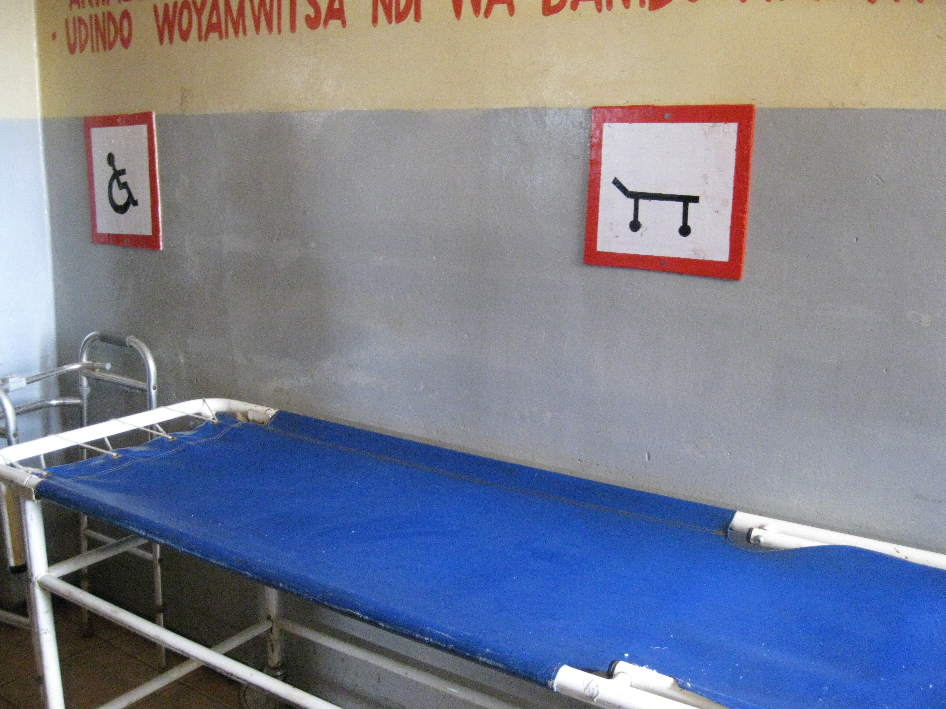
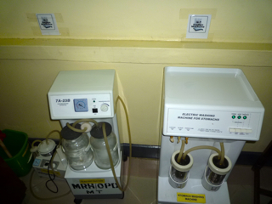
Symbols
Useful for S2 and S4
Everyone can understand the meaning of “something” by marks/symbols/pictogram without or minimum explanation.

Slide 15
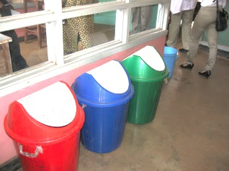
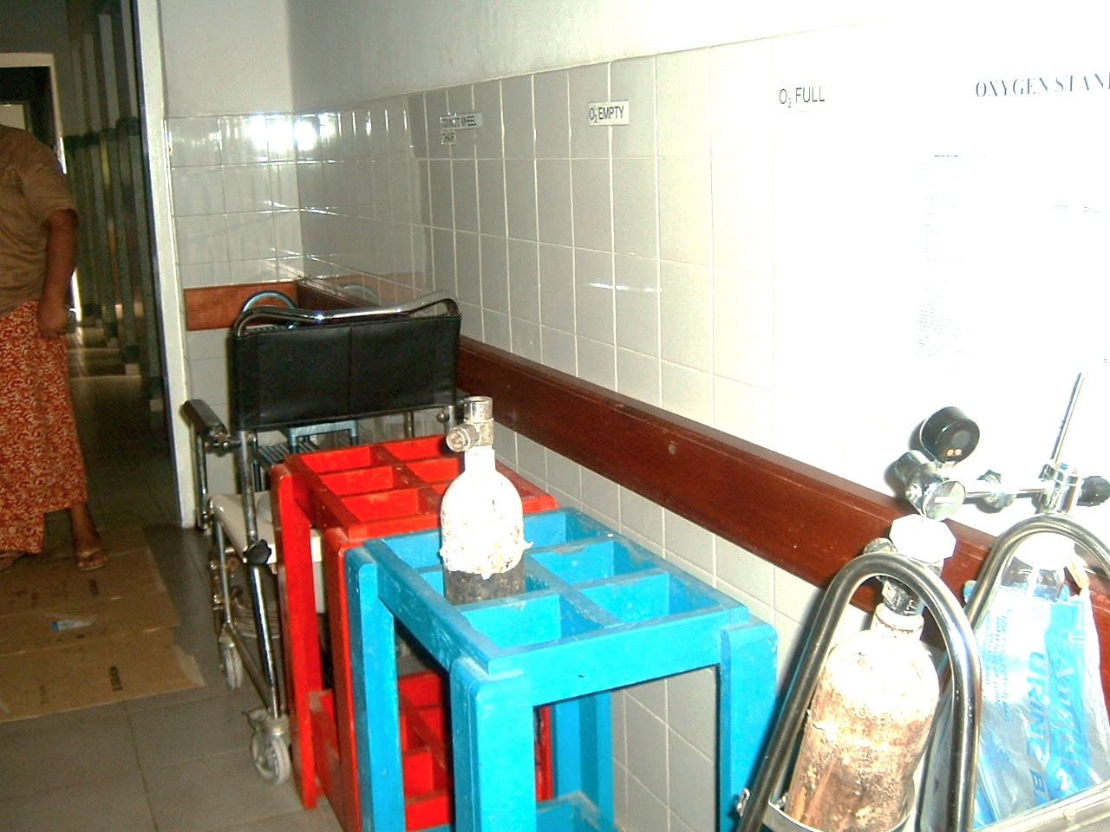
Color coding
Useful for S4
Color coding makes facility users understand the meaning of “something” by different colors.
It is often used for waste segregation, categorization of areas/zones for particular items
National IPC Guidelines and Health Care Waste Management standards/ policy/ guidelines should be referred to follow national color coding for different types of wastes.

Slide 16
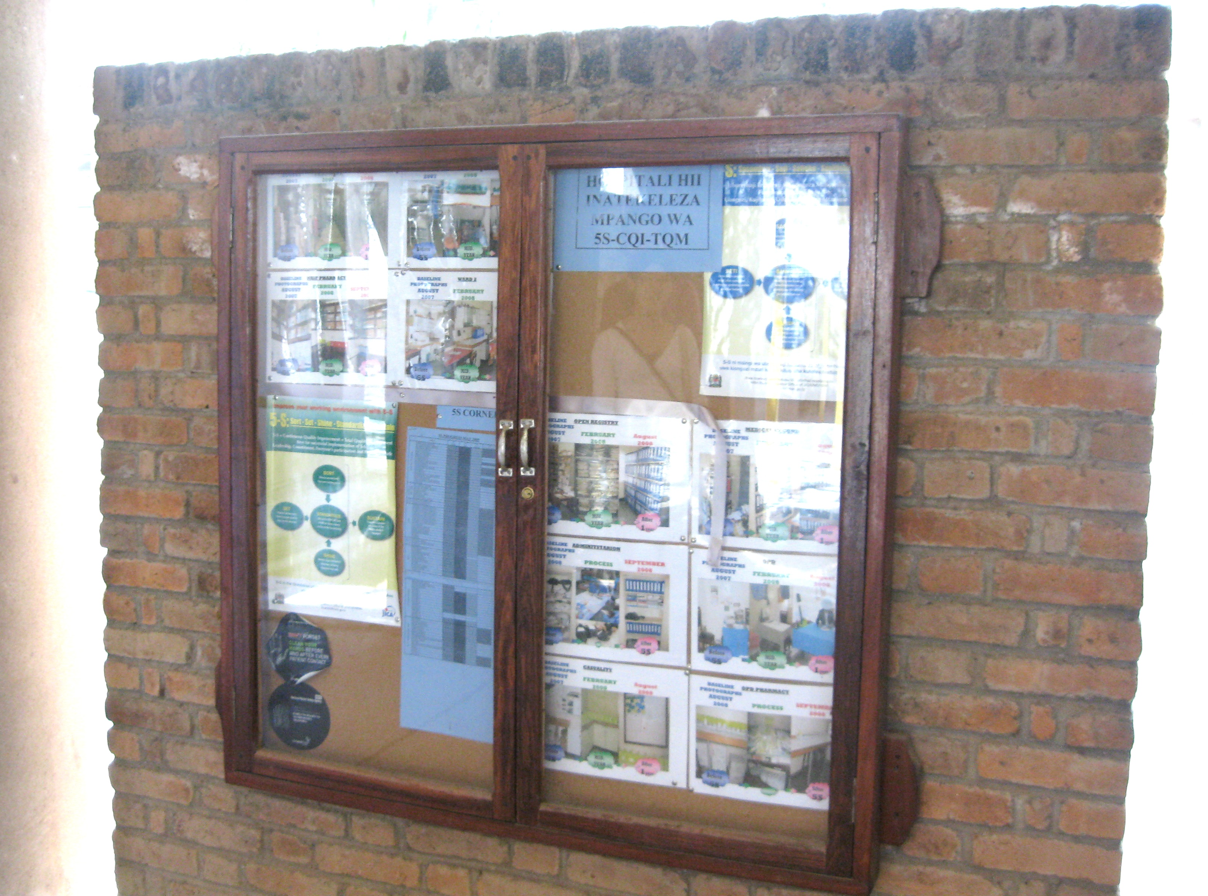
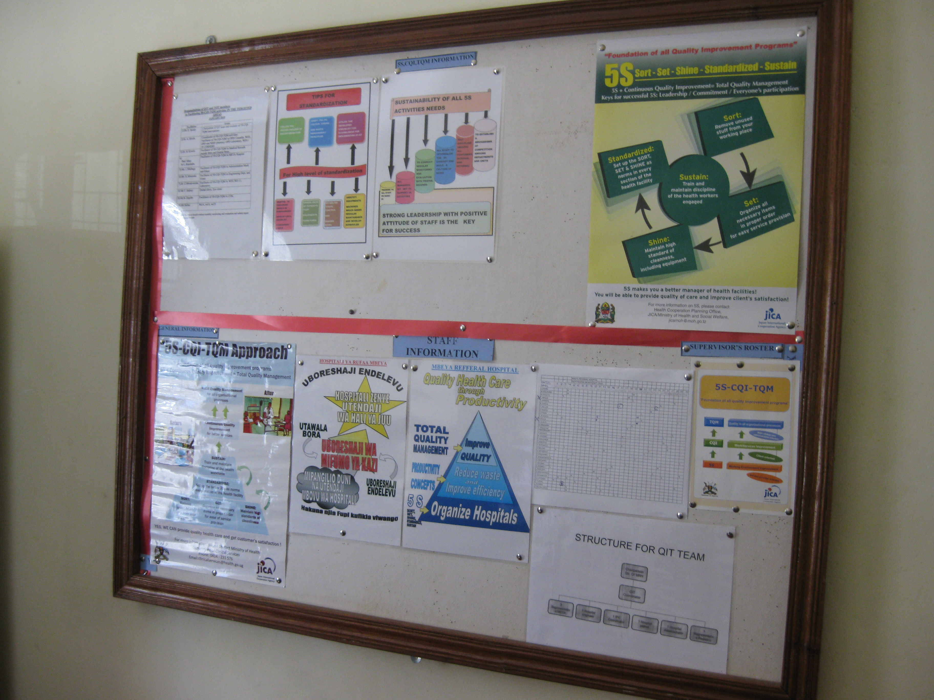
5S corner
Effective for S5
Use existing notice board or establish new one
Can be displayed:
5-S posters
Pictorial progress report
Implementation progress chart/table
M&E information
Training information
QIT/WIT Meeting information
Mission statement on QI
Waste bin color coding and type of waste
Rules of 5S tools

Slide 17
Key points for 5S tools utilization
Everyone in the health facility should know the meanings and rules of 5S tools
Think of people working in the next process
Need to have monitoring mechanism to check proper usage of 5S tools and effectiveness

Slide 18
5S tools utilized by 5S stages
 | 5S tools | S1 | S2 | S3 | S4 | S5
1 | Red tag
2 | Numbering, Alphabetical cording
3 | Labeling, Tapes
4 | Safety signs
5 | Sign board
6 | Zone
7 | X-Y axis
8 | Alignment
9 | Symbols
10 | Color coding
11 | 5S Corner

Slide 19
What is “Visual Control”?

Slide 20
Definitions
Visual – See, eye , optical
Control – manage,direct
Definition- Visual control is a technique employed in many places where information is communicated by using visual signals instead of texts or other written instructions.
Visual control are the signals or symbol seen by eye to manage the place or working environment

Slide 21
What is “Visual control”?
“Visual signals are used instead of texts or other written instructions.
“The design is deliberate in allowing quick recognition of the information being communicated, in order to increase efficiency and clarity. “
Information source: http://en.wikipedia.org/wiki/Visual control

Slide 22
What is “Visual Control”? (cont’d)
Visual control is the principle of increasing efficiency and effectiveness simply by deliberately making things visible.
When things are visible, they are kept in conscious mind.
It also serves to ensure that everyone has a common viewpoint of what is being displayed.

Slide 23
Visual control
Visualization
Recognition
Judgment
Action
Communication
Check
Problem solving

Slide 24
Examples of visual control
Stock control by color
Plan vs Actual sheet

Slide 25
Examples of visual control
Machine Control panel
Standard work flow

Slide 26
Examples of visual control
Screw is tight
“Normal condition”
Screw is lose or too tighten up
“Abnormal condition”

Slide 27
Examples of visual control with 5S tools

Slide 28
What’s wrong?

Slide 29
Examples of visual control with 5S tools

Slide 30
Examples of visual control with 5S tools

Slide 31
Examples of visual control with 5S tools

Slide 32
Examples of visual control
Infectious
Non-infectious

Slide 33
Visual control requires two simple conditions;
Need to have an agreed set of rules
Everyone must know the agreed set of rules

Slide 34
Where are the areas for effectively usage of Visual control?
Schedule and Delivery Controls
Quality Controls
Work Controls
Facility Controls
Equipment & Tooling Controls
Performance Improvement Controls
Material Flow Controls

Slide 35
Combination of 5S tools
Numbering
Labeling
Color coding
X-Y axis

Slide 36
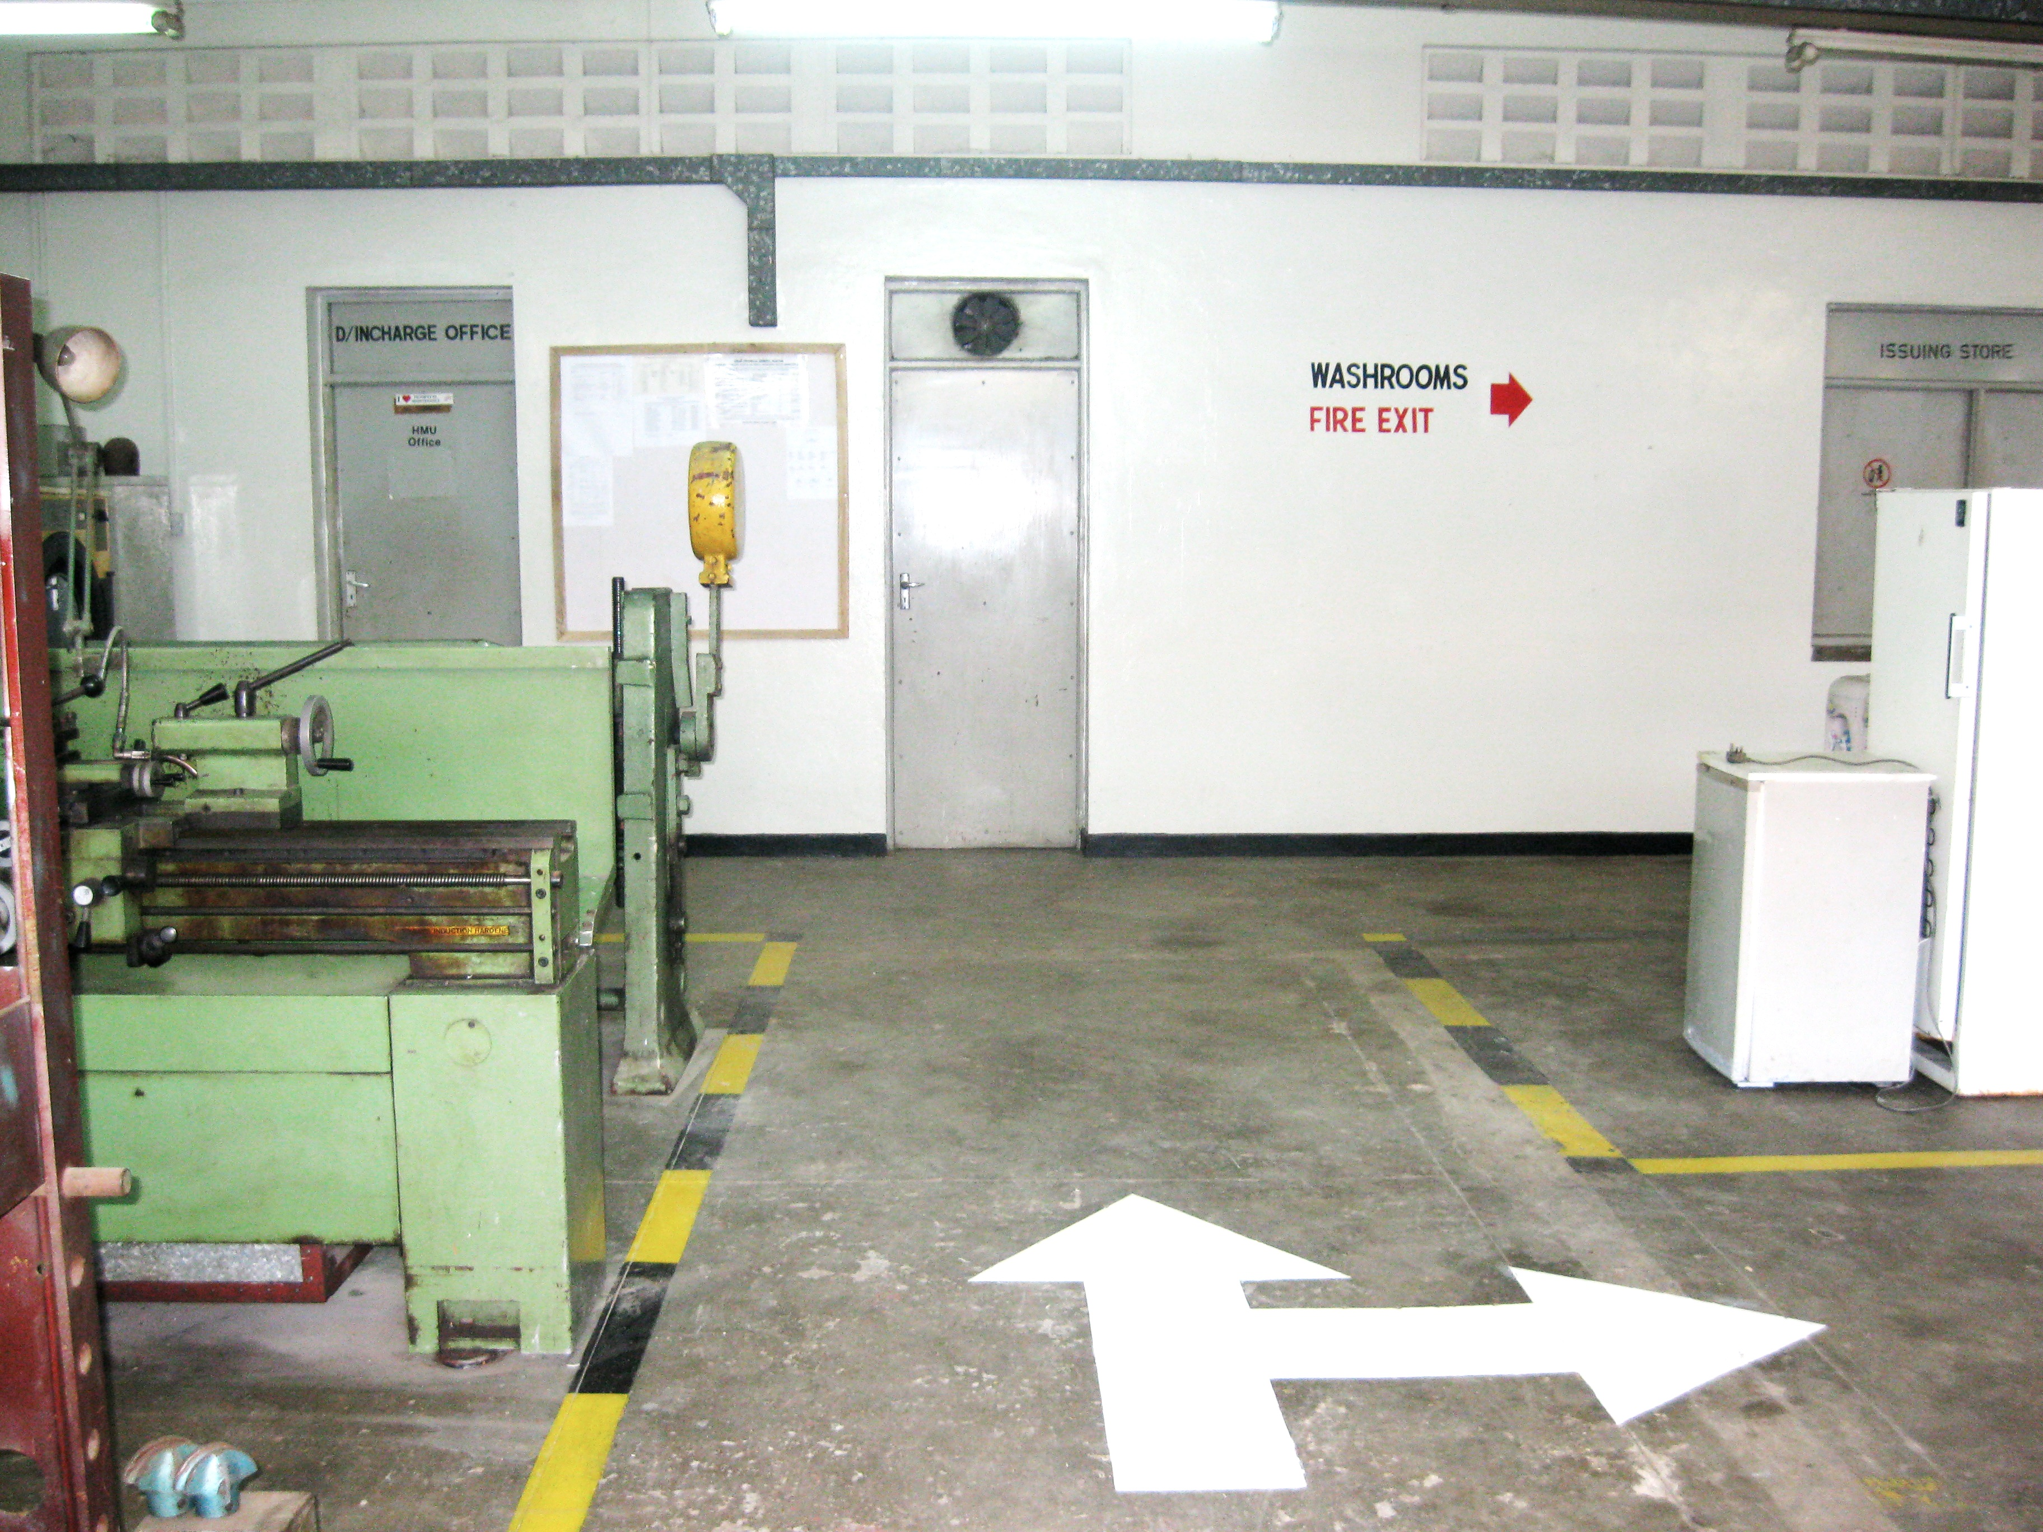
Combination of 5S tools
Directions sign
Directions sign
Safety signs

Slide 37
What do you think…?

Slide 38
Colour coded for segregation of wastes, properly labelled on waste bins, instructions are given to staff……Why it happens????

Slide 39
Possible causes
Weak knowledge on waste management among staff
Weak commitment to waste segregation among staff
Negligence of rules and regulations

Slide 40
What could be done for improvement
Proper training/ instruction of staff
Medical staff
Non-medical staff
Positive mind set and commitment
Color coding of segregation areas
Share information on color coding of waste segregation to all staff
Establish monitoring mechanism

Slide 41
Benefit of using Visual Control in your workplace
Make problem visible to everyone = Corrective action can be taken immediately
Display the operating or progress status in an easy to see format
Save time for searching something/somewhere
Manage items/ materials/ stocks easily = reduce taking inventory
Obtain common understand of rules and regulation
Notes:
Visual control are means, devices, or mechanisms that are designed to manage or control the operations/ processes so as to meet the following purposes:
make the problems, abnormalities, or deviation from standards visible to everyone and thus corrective action can be taken immediately,
display the operating or progress status in an easy to see format.
provide instruction.
convey information.
provide immediate feedback to people

Slide 42
Thank you for your attention.
Any questions?

