Slide 1
Lean Management
KAIZEN Training of Trainers
KAIZEN Facilitators’ Guide
Page __ to __ .

Slide 2
Objectives of the session
At the end of the session, trainees are able to:
Understand the philosophy on lean management
Describe the relation between 5S-KAIZEN and Lean management
Describe what is lean tools
Describe the importance of thinking and acting in lean management for health care improvement in Tanzania

Slide 3
Environment surrounding health services in TZ
Although Tanzanian health sector has made significant progress over the last several years, there are many significant challenges that still need to be addressed, including:
Health resources (HRH, financial, commodities…) shortage
Low quality of health services
Low reliability of the public health facility
However, we cannot stop providing
health services to the community

Slide 4
What should we do for improvement of the situation?

Slide 5
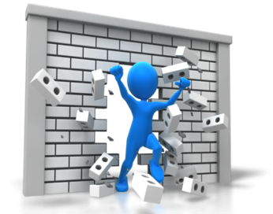
Think “out of box” and break through
Notes:
Environment surrounding health services in TZ is very difficult. Need to think out of box and try to break through the current situation

Slide 6
Answer is … “Lean Management”
Notes:
How we can Break through. The answer is “Lean Management”

Slide 7
What is the difference between Kaizen and Lean?
 | KAIZEN | Lean Management | Six Sigma
Origin | Japanese TQC and Toyota Production system | management philosophy developed from Toyota Production System (TPS) | set of techniques and tools for process improvement. Developed by Motorola in 1986.
Definition | A problem solving process. focuses on eliminating waste, improving productivity, and achieving sustained continual improvement in targeted activities and processes of an organization. | focused on improving process speed and quality through reduction of process wastes. | a disciplined, data-driven approach and methodology for eliminating defects
Program/activities driven by | Bottom to top (Bottom up approach) | Top to bottom (Top down approach) | Top to bottom (Top down approach)
Implementation structure | Small group activities (QC circle / QIT / WIT) | Lean Teams Problem-Solving and Self Directed Work Teams are the most common types | Black, Green, Yellow belts
Tools used for the approach | Use QC 7 tools and New QC 7 tools | Lean Tools (5S, Kanban, Andon, JIT, TPM, etc.) | DMAIC, Statistical approach
Developed/Conceptualized by | Masaaki Imai and Toyota Motors | Womack, Jones and Roos, MIT | Bill Smith at Motorola

Slide 8
Two ways communication and improve organization
KAIZEN approach
From bottom to top
Lean Management
From top to bottom
Workers should have positive mindset, and trying to make workplace and services better (“KAIZEN mind”)
Managers need to know
“Lean management” to guide workers for Improvement of work flow and productivity

Slide 9
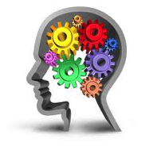
What is “Lean thinking”? Basic concept for Lean management
A business methodology which aims to provide a new way to think about how to organize human activities to deliver more benefits to society and value to individuals while eliminating waste.
Simple definition is:
“Becoming ‘lean’ is a process of eliminating waste with the goal of creating value.”

Slide 10
How can we eliminate “wastes”? Different types of waste in your organization

Slide 11
7 types of wastes in work place
Over production
Creating more material or information or tests or treatment than needed
Over processing
Processing beyond the standard
Inventory
More material or information than needed
Rework
Repetition or correction of a process
Waiting
People or items that wait for a work cycle to be completed
Transportation
Unnecessary movement between processes
Motion
Unnecessary movement with a process

Slide 12
“Muri”, “Mura”, “Muda”
Muri Unreasonable burden | Any activity asking unreasonable stress or effort from personnel, material or equipment. In short: OVERBURDEN For people, Muri means: a too heavy mental- or physical burden. For machinery Muri means: expecting a machine to do more than it is capable of- or has been designed to do.
Mura Un-level workloads | Any variation leading to unbalanced situations. In short: UNEVENNESS, inconsistent, irregular. Mura exists when workflow is out of balance and workload is inconsistent and not incompliance with the standard.
Muda Any forms of Waste in the process | any activity in your process that does not add value. MUDA is not creating value for the customer. In short: WASTE Type I muda: Non-value-added tasks which seam to be essential. Business conditions need to be changed to eliminate this type of waste. Type II muda: Non-value-added tasks which can be eliminated immediately.

Slide 13
What should be used for elimination of wastes?

Slide 14
Lean Principles
5. Pursuit
Perfection
Strive for perfection by continually
removing successive layers of waste
4. Establish
Pull system
Only make what is pulled
by the customer just-in-time
1. Define
Value
Specify what creates value
from the customers perspective
Lean
Principles
3. Create
Flow
Make those actions
that create value flow
2. Map Value
Stream
Identify all steps across
the whole value stream

Slide 15
Lean Principles Mental Model for lean thinking
Lean Principles |  | What should be done
1) | Define Value | Define value from a patient’s perspective. Try to understand their health and non-health expectations. How patients’ experience could be improved.
2) | Map Value Stream | Evaluate how all the steps of a process or procedure to provide services in the health facility. Then, eliminate any steps that do not contribute to performance, productivity or safety of the health facility.
3) | Create Flow | Eliminate waste between steps of a process and create smooth workflow for high efficiency
4) | Establish Pull system | Allow the patient to receive or request services if and when need.
5) | Pursuit Perfection | Continuously adapt to an ever-changing environment and patients’ needs in order to deliver high quality of health services.

Slide 16
An example of Define Value
Long waiting time
for consultancy?
Good communication and explanation of treatment?

Slide 17
An example of map value stream
Registration of patients
Handover the file to the patient
Asking the patient to go and wait at OPD
Entering
Information into HMS
Looking for patient file from shelf
Measure vital sign of the patient
“Process of seen patients at OPD”
Are all the steps necessary ?
Are there any steps can be eliminated or change for better?

Slide 18
An example of create “flow”
Registration of patients
Handover the file to the patient
Asking the patient to go and wait at OPD
Entering
Information into HMS
Looking for patient file from shelf
Measure vital sign of the patient
Process of seen patients at OPD
Registration can be divided into 2 lanes:
Registration of new patients, and
Registration of returning patients for smooth registration

Slide 19
How can we apply Lean Principles?

Slide 20
Use “Lean Tools”
Lean tools are essential for accelerating the practice of lean management.
There are over 50 lean tools that organization can adopt for lean management
Lean tools can be selected based on the characteristic of organization and services provided
It is important to know how to use each lean tool
Possible to obtain lots of lean tools from:
http://www.systems2win.com/solutions/lean.htm

Slide 21
Continuous improvement
Patient focused
Eliminate waste
Simplify
everything
Create flow
Pull system
(Kanban)
Quick –set up
Just In Time
Mistake-Proofing
(Poka-yoke)
Point of use storage
Batch size reduction
Standardized work
Takt Time
Problem solving process
(KAIZEN process)
Total Productive Maintenance
Visual control
Stopping the line
5S approach
Value Stream Mapping
Workplace layout
Lean tools
Note that tools in the blue box are taught in 5S training

Slide 22
Wrap up: Lean process
Identify the problems, needs and expectations of patients
Review the current situation and process of the services provided
Try to eliminate wastes and unnecessary procedure with lean tools
Establish mechanism of “Pull system”
(demand driven)
Try to improve the situation continuously and maintain high quality of services

Slide 23
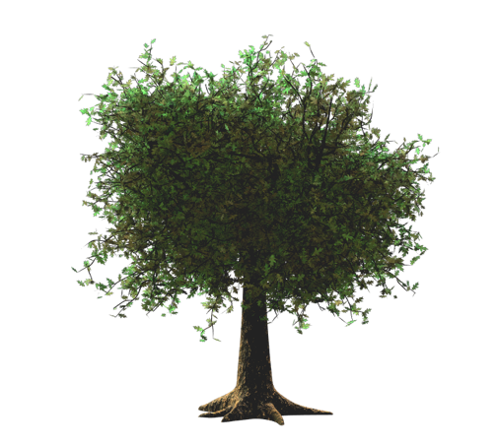
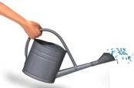
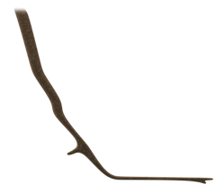
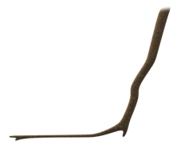
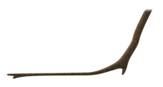
Lean management and 5S-KAIZEN-TQM Approach
Highly Reliable Organization (HRO)
Leadership and team work
Quality of services and management
Total Quality Management
Lean Management
Wastes
Leadership and
commitment of
hospital management
Positive mindset for improvement of quality among frontline workers
KAIZEN
Working environment
Positive attitude
5-S
Notes:
5S is the foundation of KAIZEN

Slide 24
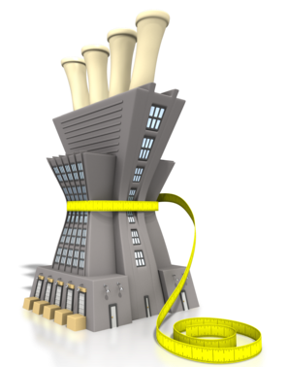
Achieve “Lean” with “KAIZEN”
Continues Quality Improvement and open quality spiral concepts achieve “Lean management”

Slide 25
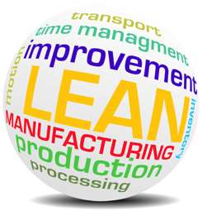
Thank you for listening ! any question?

