Slide 1
Basic Concepts of 5S-KAIZEN-TQM Approach
KAIZEN Training of Trainers
2015
KAIZEN Facilitators’ Guide
Page __ to __ .

Slide 2
Objectives of the session
At the end of the session, trainees are able to:
Understand basic concepts of 5S-KAIZEN-TQM Approach
Understand what is high quality of health care services
Understand targets of 5S and KAIZEN activities
Understand benefits of 5S and KAIZEN activities

Slide 3
Introduction: “Lots of problems”
Financial problems
Technical problems
Human Resource problems
Infrastructure
problems
Time limitation
in health care provision
Notes:
This slide indicates or explains how managers at health facilities are facing different kinds of problems.
Ask the participants if they do agree with the above situation.

Slide 4
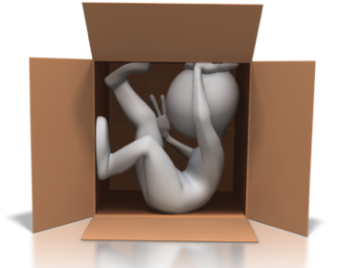
If you are facing problems, …
Think inside the box and give up?
Work together and do something?
OR
Waiting “resources” from somewhere.
Work with “ ”
for improvement.
?

Slide 5
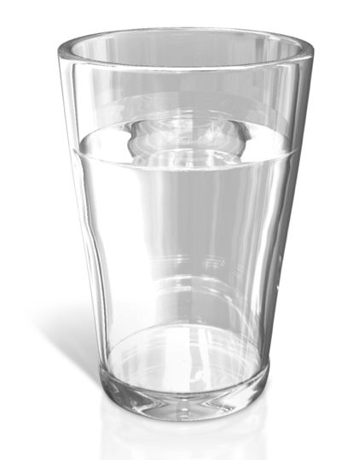
Are you positive thinker or negative thinker?
Notes:
Do you feel the glass is half full or half empty

Slide 6
Even if we are a positive thinker, we still need “tools” to make our ideas realistic
The tool is 5S-KAIZEN-TQM Approach

Slide 7
5S-KAIZEN-TQM Approach
Stepwise approach for better management & quality of health care
Highly Reliable Organization
TQM
KAIZEN
Maximum use of the capacity of the entire organization
5S
Participatory problem solving process
Working environment improvement

Slide 8
Conceptual framework “5S-KAIZEN-TQM Tree”
Highly Reliable Organization (HRO)
Quality of services and management
Total Quality Management
Lean Management
Leadership and
commitment of
hospital management
Wastes
Positive mindset for improvement of quality among frontline workers
KAIZEN
Leadership
Positive attitude
Working environment
5-S
Notes:
5S is the foundation of KAIZEN

Slide 9
What is 5S ?
5S is a philosophy and a way of organizing and managing the workspace and work flow with the intent to improve efficiency by eliminating waste, improving flow and reducing process unreasonableness
Working Environment Improvement (WEI)

Slide 10
What 5S can do? (Benefit of 5S)

Slide 11
Identify Abnormalities

Slide 12
Identify wastes,
and reduce the wastes

Slide 13
7 types of wastes in work place
Over production
Creating more material or information or tests or treatment than needed
Over processing
Processing beyond the standard
Inventory
More material or information than needed
Rework
Repetition or correction of a process
Waiting
People or items that wait for a work cycle to be completed
Transportation
Unnecessary movement between processes
Motion
Unnecessary movement with a process

Slide 14
Promote everyone’s participation

Slide 15
Improve safety

Slide 16
Improve productivities

Slide 17
Target of 5S
Targets of 5S include:
Zero changeovers leading to product/ service diversification
Zero defects leading to higher quality
Zero waste leading to lower cost
Zero delays leading to on time delivery
Zero injuries promoting safety
Zero breakdowns bringing better maintenance
ZERO
Notes:
This is the actual purpose of implementation of 5S activities. 5S is not a cleaning campaign, and possible to solve the issues mentioned here.

Slide 18
What is KAIZEN ?
KAIZEN is a problem solving process with existing resources
KAIZEN can help a hospital to create “continuous quality improvement culture” to meet in/external clients’ satisfaction and expectation
Make things better step by step; KAIZEN Steps
Target is “your work”

Slide 19
What KAIZEN can do?

Slide 20
Find root causes of problems and solutions

Slide 21
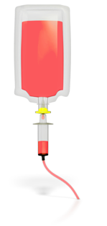
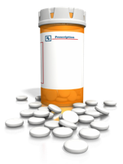
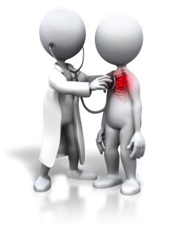
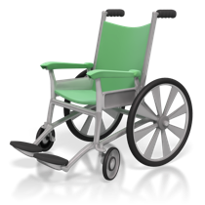
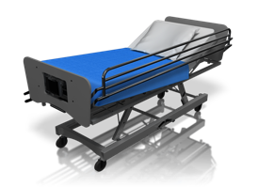
Improve all kinds of hospital management

Slide 22
Improve quality of services

Slide 23
Strengthen Team work

Slide 24
What is TQM ?
Total Quality Management (TQM) is a multi-disciplinary and participatory processes with continuity by all categories of staff for realizing high quality services
TQM process, (consisting of 5S and KAIZEN), should be a part of institutional managerial framework for seeking high productivity and quality of services

Slide 25
What TQM can do?

Slide 26
Improves quality of the final products or services

Slide 27
Increase customer satisfaction
External customer
Internal customer

Slide 28
Visible growth of organization

Slide 29
Making right decision for quality improvement

Slide 30
Reduction of costs
Save money
Utilize available resources

Slide 31
“Managing whole facility with certain level of quality”

Slide 32
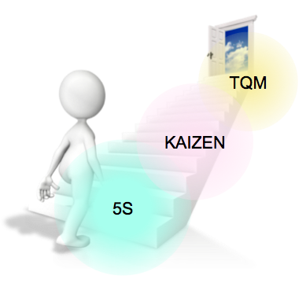
Conclusion
5S-KAIZEN-TQM Approach is one of the tools for quality improvement in health care
The one of important purposes of 5S-KAIZEN is to eliminate waste in work place
Maximum utilization of existing resources
Anyone can do it with:
Little knowledge
Little dedication
Little hard work and
A very big positive attitude
Our wisdom has no limitation

Slide 33
KAIZEN Mind will help you to solve problems
Thank you for listening

