Slide 1
KAIZEN implementation Small KAIZEN and Large KAIZEN
KAIZEN Training of Trainers
2015
KAIZEN Facilitators’ Guide
Page __ to __ .

Slide 2
Objectives of the session
At the end of the session, trainees are able to:
Understand what is KAIZEN
Understand what is “problem” and levels of problem
Understand “Small KAIZEN” and Large KAIZEN
Understand how to practice Small KAIZEN and Large KAIZEN
Understand outline of Small KAIZEN

Slide 3
What is “Problem”?
Desired/Ideal status
Gap(s)
e.g. This house was supposed
to built in 6 months
Problem(s)
Actual situation
Difference/Gap between “Desired status” and “Actual /current situation” is “problem(s)”
e.g. 6 months passed but
not yet completed

Slide 4
What is “Problem”?
“Filling the gap (solving problem)”
KAIZEN
Desired/Ideal status
best practices, professional standards or expected goal in hospital service provision
Actual situation
Clarifying ideal situation can help you to identify problems in your working place

Slide 5
Level of problems/issues – level of KAIZEN
Very few
Large issues
Management level
of KAIZEN needed
10%
Few medium
issues
Large KAIZEN needed
30%
Many small
issues
Small KAIZEN needed
60%

Slide 6
What is “KAIZEN”?
“KAIZEN” is a problem solving process for achieving a Total Quality Managed hospital
It is repetitive (continuous) possible changes on your way of working
改 善
KAI ZEN
“Change” & “Improvement”
II
Change for the better
Notes:
Continuous practice of KAIZEN cases at all sections in the health facility will make the facility as “Total Quality Managed Hospital through “Lean Management”

Slide 7
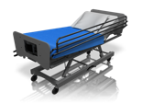
Where KAIZEN is practiced?
Outpatient service department
Physiotherapy
Kitchen
Operating Theater
Engineering department
Laundry
Wards
Sterilization Department
Medical record department
Mortuary
Administration offices
X-ray
Pharmacy
Schools
Laboratory
Answer is …
Store
Everywhere in a hospital
“Hospital-wide activity”

Slide 8
Who practices KAIZEN activities?
Hospital services are providing in all hospital areas
Only nurses are practicing KAIZEN?
Only laboratory staff are practicing KAIZEN?
NO!!
Answer is …
Everybody in a hopsital practice
KAIZEN activities

Slide 9
When KAIZEN is practiced?
Recommended period to finish one-KAIZEN cycle is 6 months
However, KAIZEN activities are practiced in this 6 month only?
Answer is …
Everytime to provide hospital services to internal and external clients

Slide 10
Target of KAIZEN
The target of “KAIZEN” is your work, not others’
Dissatisfaction, complains to the current situation, complains about people are not fit to be the KAIZEN theme because it is based on “negative attitude”
KAIZEN theme must be based on positive wishes of workers such as “we would like to be/do……”
Notes:
This contribute to creating ownership of the process

Slide 11
Differences between large and small problems
Large problem
Small problem
Contributing factor 2
Contributing factor 3
Contributing factor 1
Contributing factor 4
“Large problem” is composed of several “contributing factors”
Small problem is simple composition. Not complicated
KAIZEN Process (QC story)
Small KAIZEN

Slide 12
Different level of “KAIZEN”
 | Large KAIZEN (KAIZEN Process - QC story) | Small KAIZEN
Target | Large problem, Medium problem | Small problem
Period of implementation | Need certain time (one KAIZEN cycle is maximum 6 months) | Short time (Few minutes – less than one month)
Process of implementation | Identify problems Collect baseline data Identify causes Come up with possible measures Implement measures… etc. | Identify problems Come up with the solutions Implement
Persons in charge | All section staff | All section staff
Type of record | Records according to QC story | Good practice sheet, Small KAIZEN sheet
Key question is…
“can you come up with the solutions immediately?”

Slide 13
Small KAIZEN

Slide 14
Small KAIZEN
Quick and easy KAIZEN
Small KAIZEN helps to
eliminate or reduces waste
promotes personal growth of employees and the organization
serves as a barometer of leadership
Implementing health workers’ ideas as small changes can be done by the worker him/herself with very little investment of time

Slide 15
Process of Small KAIZEN
The idea is very easily implemented without any agreement.
Immediately solved issues
Quickly improved!!
Implement the ideas/solutions
Small KAIZEN sheet
KAIZEN suggestion board
WIT file etc.
!!
Record activities and share with other staff and QIT
Find problems, wastes or opportunities for improvement
Come up with ideas for improvement
Agreement
Realization etc.
Discuss the ideas with supervisor and WIT

Slide 16
KAIZEN Suggestion Board
KAIZEN suggestions
To Do
Doing
Done

Slide 17
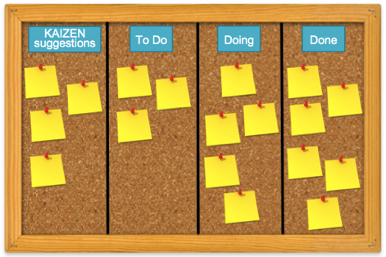
How to use KAIZEN suggestion board
Small KAIZEN
Write your idea on small paper and stick it when you come up with ideas for improvement
Move the paper to “TO DO” when supervisor or WIT are discussing
Move the paper to “Doing” when you are practicing the ideas after agreement from the supervisor or WIT
Move the paper to “Done” when you complete the ideas

Slide 18
Examples of KAIZEN Suggestion Board
Mbeya Zonal Referral Hospital
Singida Regional Referral Hospital

Slide 19
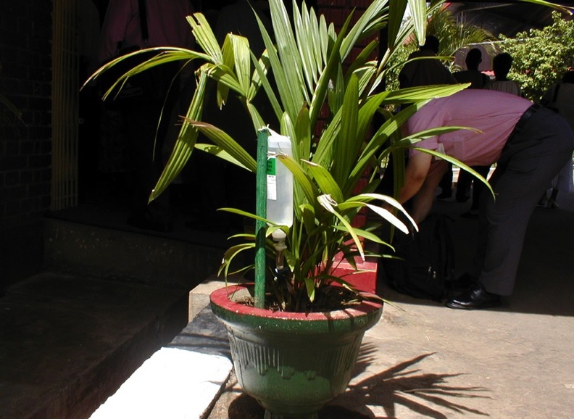
Example of Small KAIZEN
Small KAIZEN was done by gardeners in the hospital by recycling discarded clean infusion set for water supply for plants.

Slide 20
Example of keeping Small KAIZEN

Slide 21
Small KAIZEN is overlaps with 5S activities
Examples:
Waste bin color coding to prevent mix-up of medical wastes
Labeling on switches to save energy
Visual control to prevent stock out or improve inventory
Proper numbering to shorten retrieve patient files

Slide 22
Large KAIZEN

Slide 23
KAIZEN Process (QC story)
Basic procedure for solving problems scientifically, rationally, efficiently and effectively
remove barriers
reduce wastes
One cycle of KAIZEN activities takes maximum 6 months
Composed by seven (7) steps

Slide 24
KAIZEN Process
Solving problems at working place,
and improve situation and condition
Step 7: Standardization of effective countermeasures
Step 6: Check effectiveness of the countermeasures
Step 5: Implementation of the identified countermeasures
Step 4: Identification of countermeasure
Step 3 Root cause analysis
Step 2: Situation analysis
Details of each steps will be explained later, followed by lectures and practice sessions
Step 1: Selection of KAIZEN Theme

Slide 25
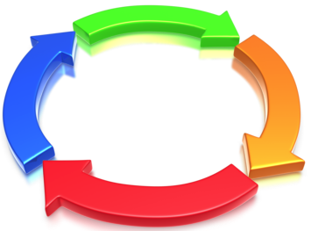
PDCA cycle and “KAIZEN”
Important is “continuous improvement“
Do not stop here after ACT.
Step 7:
Standardization
Step 1:
KAIZEN theme selection
Act
Step 2:
Situation analysis
Check
Plan
Step 6:
Check effectiveness
Step 3:
Root cause analysis
Do
Step 4:
Identification of countermeasures
Step 5:
Implement countermeasures

Slide 26
Innovation
Maintenance
New standard
After the innovation (Actual)
Maintenance
New standard
After the innovation (Actual)
Innovation
Dramatic but
intermittent progress
Innovation

Slide 27
KAIZEN
Plus
Innovation
New standard
Maintenance
Innovation
New standard
KAIZEN
Improvement with maximum utilization of available resources
Maintenance
Innovation
Desirable progress by combination of two opposing approaches

Slide 28
Tips for KAIZEN
Share of ideas and good/best practices within the hospital, and adopt the practices everywhere in the hospital
Integrate everyone's image
Don’t blame other’s opinions (No blaming culture)
Do what you can do with maximum utilization of existing resources
Notes:
The concept of KAIZEN is process change and improvement by accumulation of small changes

Slide 29
Thank you for listening!

