Slide 1
KAIZEN activities for improving health care and hospital management
2015
KAIZEN Training of Trainers

Slide 2
Objectives of the session
After the session, the trainees will be able to:
  Understand KAIZEN can be adopted to improvement quality of care in both of developing countries and developed countries
  Understand KAIZEN can improve hospital management; financial management, stock management, information management etc.
  Understand KAIZEN can improve health care service provision

Slide 3
Word of “KAIZEN” in the world
“KAIZEN” is now known worldwide as continuous problem solving process to improve working environment, process and conditions
KAIZEN are adopted not only to clinical setting but also several hospital management settings in health care facilities
Let’s go and see “actual improvements in hospital management and health care services by KAIZEN

Slide 4
Virginia Mason Medical Center
(U.S.A.)
In 2002, the hospital adopted Toyota Production System philosophies and practices to health care; Virginia Mason Production System (VMPS):
  Customer first
  Highest quality
  Obsession with safety
  Highest staff satisfaction
  A successful economic enterprise
The hospital staff have been improving the quality of patient care with VMPS
VMPS, Virginia Mason Medical Center: https://www.virginiamason.org/vmps
Notes:
VMPS:
Customer first
Highest quality
Obsession with safety
Highest staff satisfaction
A successful economic enterprise

Slide 5


Actual improvement in
Virginia Mason Medical Center
“Eliminating wasted nurses’ steps and increasing time to care patients”
Nurses were able to improve the flow of how they went about their day – eliminating wasted steps to get necessary medical equipment and supplies, and increasing time spent with patients
  Steps walked per day fell from 10,000 from roughly 1,200
  Time in direct patient care was increased to 90% of their time from 35%
Care
VMPS, Virginia Mason Medical Cetnter: https://www.virginiamason.org/vmps

Slide 6


Actual improvement in
Virginia Mason Medical Center
“Faster revenue cycle”
The finance department improved “Days Revenue Outstanding”
Cash deposits improved from $471 million in 2003 to $794 million in 2009
Increased the revenue $323 million
2009
2003
678,300,000,000 Tanzania Shilings
VMPS, Virginia Mason Medical Cetnter: https://www.virginiamason.org/vmps
Notes:
outstanding: 未納の、未払いの

Slide 7
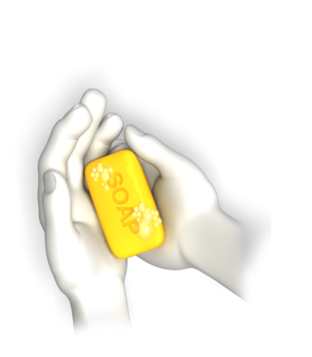
Actual improvement in the hospitals in Pittsburgh (U.S.A)
Eliminate MRSA in the hospital
TPS and KAIZEN done by the management level and service provision level cooperatively to reduce error in patient care, including the incidents of HAI
Dropped in MRSA infection rate by approximately 70% after TPS, KAIZEN in many areas
A Quest to Eliminate MRSA at the Veterans Health Administration’s Hospitals in Pittsburgh:
http://www.lean.org/FuseTalk/Forum/Attachments/Positive%20Deviance%20Pittsburgh%20VA%20MRSA%200709041.pdf
Notes:
MRSA infections continue their steep rise in U.S.
HAI: Hospital Acquired Infections
TPS: Toyota Production System
MRSA: Methicillin Resistant Staphylococcus Aureus

Slide 8

Mitchell’s Community Health Center (Cape Town)
“Implementing a structured triage system at a community health center”
More than 100 un-booked patient presenting daily at the health center, most of them were requesting reissuing of his/her prescription
By KAIZEN,
  all patients are assessed properly according to the standardized protocol
  a number of patients requiring reissuing of the prescription was decreased by 50%
Reference:
Implementing a structured triage system at a community health centre using Kaizen

Slide 9
Mbeya Zonal Referral Hospital (Tanzania)
In 2007, 5S-KAIZEN-TQM Approach was introduced to the hospital
The hospital has been orienting hospital staff including students and new employees on 5S-KAIZEN continuously
Almost all areas in the hospital are practicing 5S
High performing areas in 5S are practicing KAIZEN
The hospital is improving own hospital/health care services by 5S and KAIZEN

Slide 10


Actual improvement by KAIZEN in MZRH (1)
“Reducing patient waiting time for the consultation at OPD”
The frequency of the several problems was reduced from 42 to 24 (42.9% reduction)
The patients’ waiting time for the consultation was improved from 45 minutes to 15 minutes
Problems before KAIZEN
Problems after KAIZEN
The KAIZEN was done by hospital staff at OPD in MZRH.

Slide 11
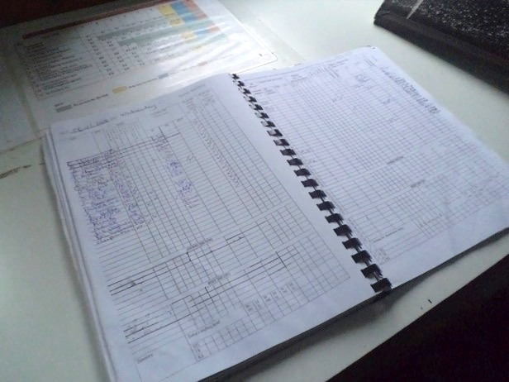
Cont.
Standardized instruction for daily staff allocation and monitoring book; Easy to allocate the staff

Slide 12

Actual improvement by KAIZEN in MZRH (2)
“Improving waste management in the hospital”
The frequency of the improper waste management was reduced from 155 to 22. (85.8% reduction)
The cost for procuring waste bin liners were also reduced (next slides)
Problems before KAIZEN
Problems after KAIZEN
The KAIZEN was done by IPC team in MZRH.

Slide 13
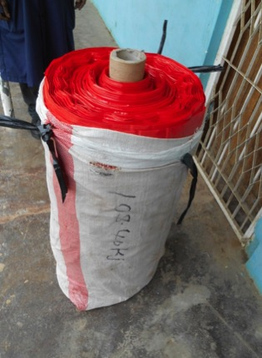
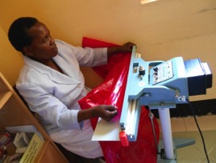
Transition of costs for procuring waste bin liners in MZRH
KAIZEN Implementation

Slide 14
Conclusion of the session
KAIZEN can improve and enhance several aspects of hospital management and health care services:
  Hospital administrative management
  Clinical administrative management
  Quality of care
  Infection Prevention Control
  Patient and staff safety etc.

Slide 15

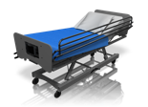








Cont.
Physiotherapy
Outpatient service departments
Operating Theater
Kitchen
Wards
Engineering department
Laundry
Medical record department
Sterilization Department
Administration offices
Mortuary
Training institutions for health
X-ray
General Store
Pharmacy
Laboratory
Therefore, KAIZEN must be adopted to every work procedure in everywhere in RRHs

Slide 16


Conclusion (2)
Possible to reduce costs/expenditure by KAIZEN; eliminating “waste” in working environment and working process
Cost
Quality Improvement

Slide 17
Thank you very much for listening

