Slide 1
KAIZEN Step 2: “Situation Analysis”
KAIZEN Training of Trainers
KAIZEN Facilitators’ Guide
Page __ to __ .

Slide 2
Objectives of the session
At the end of the session, trainees are able to:
Define what is situation analysis in KAIZEN process
Describe process of situation analysis
Describe how to develop and utilize Pareto chart properly
Demonstrate the process of situation analysis

Slide 3
KAIZEN Process
STEP
7
Standardization
STEP
6
Check effectiveness of countermeasure
STEP
5
Implementation of countermeasure
STEP
4
Identification of countermeasure
STEP
3
Root Cause Analysis
STEP
2
Situation Analysis
STEP
1
Selection of KAIZEN theme

Slide 4
Steps of situation analysis in KAIZEN process
Identify contributing factors
Identify measurable data and information
Define methodologies for data collection
Conduct data collection
Develop a calculation table
Develop Pareto chart
Set target
[1]
[2]
[3]
[6]
[5]
[4]
[7]

Slide 5
Steps of situation analysis in KAIZEN process
Identify contributing factors
Identify measurable data and information
Define methodologies for data collection
Conduct data collection
Develop a calculation table
Develop Pareto chart
Set target
1
2
3
4
5
6
7

Slide 6
Steps of situation analysis (1)
Brainstorm to identify contributing factors of the problem (KAIZEN theme)
Contributing
factor 1
Contributing
factor 2
Contributing
factor 4
Contributing
factor 3
“Large problem” is composed of several contributing factors.
Large Problem

Slide 7
Steps for Situation analysis (2)
Identify measurable data and information of each identified contributing factor
Identify methodologies of the data collection;
Period of data collection (maximum 1 months)
Kinds and number of data source: retrospective data or prospective data
Collection method

Slide 8
Steps for Situation analysis (3)
Conduct data or information collection according to the methodologies
Develop a calculation table of frequency and its accumulation ratio to compile the data

Slide 9
Example of calculation table
KAIZEN Theme is “Giving wrong medication is reduced”
SQ# | Contributing factors | Before KAIZEN
 |  | Frequency | Cumulative frequency | Accumulation ratio
1 | Number of giving wrong injectable medicines | 25 | 25 | 46%
2 | Number of giving wrong inhale medicines | 16 | 41 | 76%
3 | Giving wrong oral medicines | 6 | 47 | 87%
4 | Giving wrong volume of insulin | 5 | 52 | 96%
5 | Number of giving wrong ointment | 2 | 54 | 100%
 | Total | 54 | - | -
Descending order
Calculation formulas will be explained on the next slide

Slide 10
Points of development of calculation table
Contributing factors will be put in descending order of its frequency
Cumulative frequency = (its frequency) + (the previous cumulative frequency)
Accumulation ratio = (each cumulative frequency) ÷ (Grand total of frequency) × 100
Please see next slide!!

Slide 11
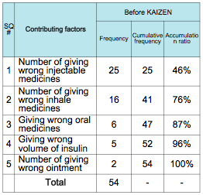
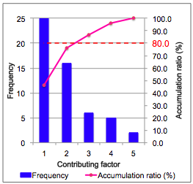
Steps for Situation analysis (4)
Develop “Pareto chart” based on the data table, to identify prior contributing factor(s) to be solved
“Calculation table”
“Pareto chart”

Slide 12
What is Pareto chart?
Cut off line is 80%
It is a type of chart that contains both bars and a line graph, where individual values are represented in descending order by bars, and the cumulative total is represented by the line
One of the seven basic tools of quality control
80.0
http://en.wikipedia.org/wiki/Pareto_chart
Example of Pareto chart

Slide 13
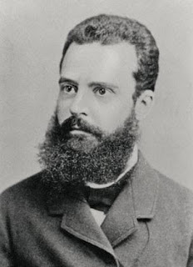
Pareto principle
It is also called as “80:20 rule”
It is a technique helps to identify the top 20% that needs to be addressed to resolve the 80% of the problems
Vilfredo Federico Damaso Pareto, Italian economist, developed this concept

Slide 14
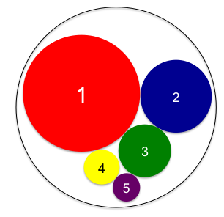
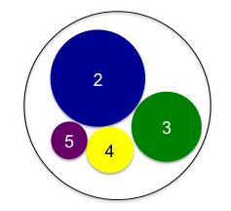
Necessity of Pareto chart in KAIZEN Process
To identify “large contributing factors”
If the large contributing factor(s) is solved, the situation with the problems will be improved effectively and easily
Reduced by eliminated the contributing factor “1”
Problem
Contributing factors
Situation with problems before KAIZEN (100% of the problem)
Situation with problems after KAIZEN (reduced problem)

Slide 15
(Example) Data table and Pareto Chart
Maximum number of the axis shall match with the frequency of the first faactor
SQ# | Contributing factors | Before KAIZEN
 |  | Frequency | Cumulative frequency | Accumulation ratio
1 | Number of giving wrong injectable medicines | 25 | 25 | 46%
2 | Number of giving wrong inhale medicines | 16 | 41 | 76%
3 | Giving wrong oral medicines | 6 | 47 | 87%
4 | Giving wrong volume of insulin | 5 | 52 | 96%
5 | Number of giving wrong ointment | 2 | 54 | 100%
 | Total | 54 | - | -
Cut off line is 80%
80.0
Period of data collection: 31st January 2014 to 30th February 2014 (30 days)
Data source: medication and treatment chart
Number of investigated patient (chart): 50
Methodologies of data collection need to be described clearly.

Slide 16
Target setting
The last step of KAIZEN Step 2 is “target setting”
“Desire” and “target” is different
We want to reduce 70% of the problem! This is our “target of KAIZEN”
What is the reason of 70% reduction of the problem??
……… We just want…
Is it just your desire?
It is important to explain the reasons of your target setting.

Slide 17
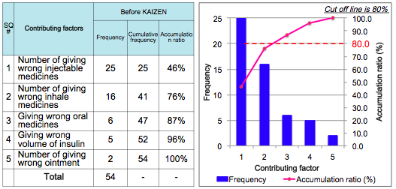
Pareto rule can be useful for target setting
Ideally, 80% of the problem (vital few) is the target of the KAIZEN based on Pareto rule.
But it is difficult!!
In the example above, if your target is
“46% reduction” it means to solve all of the 1st contributing factor
“87% reduction” it means to solve all of the 1st, 2nd and 3rd contributing factors)

Slide 18
Cont.
Our target is to reduce 46% of number of giving wrong injectable medicines.
Target setting
By when? | By September
What? | Number of giving wrong injectable medicines
How? | 46% reduction
* Do not forget: Need to consider “the problem is still remained even if you achieve your target

Slide 19
Thank you for listening

