Slide 1
KAIZEN Step 3: “Root Cause Analysis”
KAIZEN Training of Trainers
2015
KAIZEN Facilitators’ Guide
Page __ to __ .

Slide 2
Objectives of the session
At the end of the session, trainees are able to:
Describe importance of identifying root causes of the contributing factor(s)
Describe how to practice root cause analysis by developing and utilizing Fishbone diagram
Demonstrate the process of root cause analysis at their working place

Slide 3
KAIZEN Process
STEP
7
Standardization
STEP
6
Check effectiveness of countermeasure
STEP
5
Implementation of countermeasure
STEP
4
Identification of countermeasure
STEP
3
Root Cause Analysis
STEP
2
Situation Analysis
STEP
1
Selection of KAIZEN theme

Slide 4
KAIZEN Step 2 and Step 3
1
1
2
3
2
4
5
Identify the contributing factors
Prioritize the contributing factor(s) to be solved
Find root causes of the contributing factor(s)
KAIZEN Step 2
KAIZEN Step 3

Slide 5
Cause-Effect diagram (Fish bone diagram)
Cause
Cause
Effect
Cause
Cause
It is developed by Prof. Kaoru Ishikawa
It connects “effect” and “cause(s)” systematically with line
Clarification of relations between effect and cause(s)

Slide 6
Two types of Fishbone diagram
Fishbone diagram for Management
It is aimed for prevention of possible problem not yet occurred.
It is also aimed to identify factor to be control. It does not need to ask why-because question
Fishbone diagram for Problem Solving
It is aimed to find root causes of problem already occurred
It is developed based on data and information obtained from Step 2
Find root causes that are affecting the major contributing factor(s)

Slide 7
Steps of root cause analysis (1)
Put effect (= the major contributing factor) in the step 2 as ”head of fish”; “Why (the contributing factor) happened?”
Draw heavy line from left to the effect on the center; ”Backbone of fish”
Why (the contributing factor) happened?

Slide 8
Steps of root cause analysis (2)
Determine large category of cause according to your working environment
MSHEL group; Management, Software, Hardware, Environment
4M group; Man, Machine, Material, Method
Environment
Human
Why (the contributing factor) happened?
Hard (machine/equipment)
Soft (System and methodology)

Slide 9
Example of grouping of causes
Human: knowledge, skills health conditions, physical conditions etc.
Soft: system, methodologies, mechanism etc.
Hard: material, equipment, furniture, tools etc.
Environment: facility environment (water supply, electricity, smell, humidity etc.), working environment (work space, accessibility of materials, arrangement etc.)

Slide 10
Steps of root cause analysis (3)
Seek possible causes for the effect (the primary cause)
Categorize the primary cause into category
Avoid to mention to things in terms of “recourse shortage”
Environment
Human
Why (the contributing factor) happened?
Hard (machine/equipment)
Soft (System and methodology)

Slide 11
Steps of root cause analysis (4)
Narrow down cause(s) of each primary cause (the secondary cause)
Avoid to mention to things in terms of “resource shortage”
Environment
Human
Why (the contributing factor) happened?
Hard (machine/equipment)
Soft (System and methodology)

Slide 12
Steps of root cause analysis (5)
Find out “root causes” by asking “Why it is happening?” in enough time (recommended 5 times) for each possible causes listed on primary branch, and branch them into secondary, tertiary.
Human
One
Two
Make circle on it!
Three
This is Root cause
Why (the contributing factor) happened?
Four
Five times!!

Slide 13
Example of Fishbone diagram
Environment
Human
Why (the contributing factor) happened?
Hard (machine/equipment)
Soft (System and methodology)

Slide 14
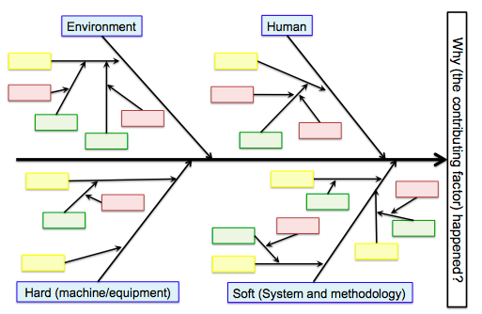
Continue asking “Why-Because” in 5 times
One cause might have more than 2 causes
The most major contributing factor on the right side
“Why (_____) happens?”
The categories can be determined according to your situation

Slide 15
Remarks on development of Fishbone diagram
Effect = Major Contributing factor, which was identified in Step 2, and Effect is not equals to “KAIZEN Theme”, identified in Step 1
If two contributing factors account for 80% (Pareto rule) in the step 2, it is necessary to develop two fishbone diagrams

Slide 16
Cont.
When repeat “Why~? – Because~” in 5 times, situation of own workplace need to be thought before searching a cause of others
While analyzing root causes, it is necessary to avoid blaming other sections; KAIZEN is for own

Slide 17
Cont.
Avoiding mentioning “shortage of resources”; “No money”, “No human resource”, “No material” etc.
Finding root causes should not be done with your instincts and senses. Your experiences, knowledge, and information should be used

Slide 18
If root cause(s) are not identified properly, any countermeasures could not be come up with…
The problem will never be solved!!

Slide 19
Let us try to develop Fishbone diagram

