Slide 1
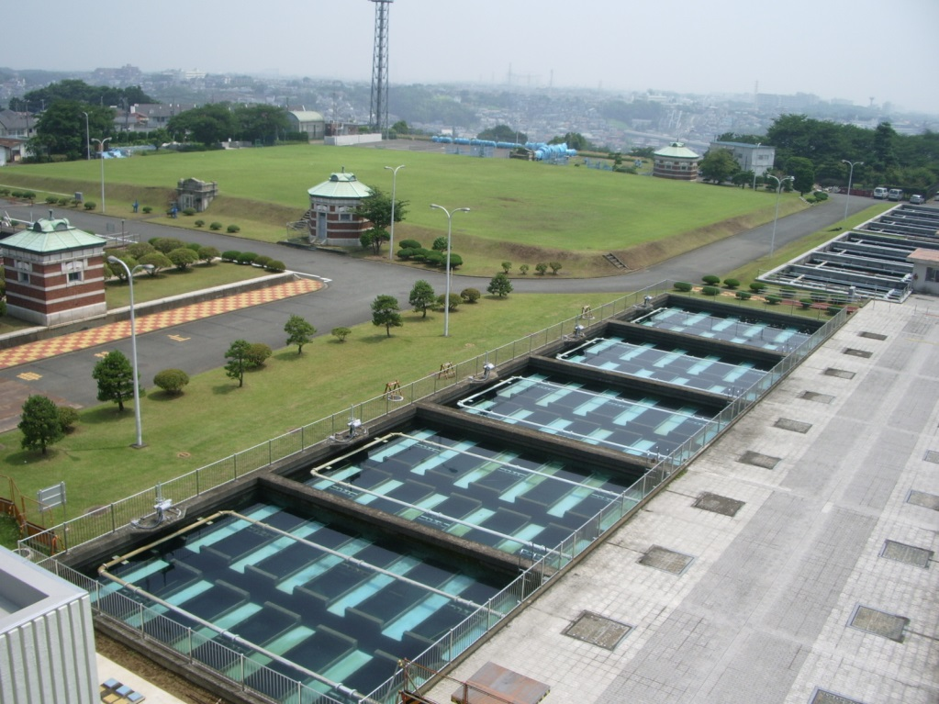
Japan's Experiences on Water Supply Development: Overview
No. I1 Ver. 1
Nishiya Water Treatment Plant in Yokohama

Slide 2
Contents
Introduction
Goal 6 of SDGs and Japan's Experiences
Universal and Equitable Access
Safe Drinking Water
Sustainable Water Resources Management
Ensuring Availability
Efficient Water-Use
Sustainable Management
Affordable Drinking Water
Engaging Local Communities
Lessons Learned

Slide 3
Q1. How has Japan achieved almost 100% water supply coverage? Q2. How can Japanese waterworks provide around the clock supply of safe affordable drinking?
1. Introduction
Frequently asked questions from participants of the water supply training courses
?

Slide 4

2. Goal 6 of SDGs and Japan's Experiences
Goal 6: Ensure availability and sustainable management of water and sanitation for all.
Water Supply Targets
Universal and equitable access
Affordable
Safe
Efficient water-use
Integrated resource management
Public engagement
Japanese Achievements
Almost 100% water supply coverage
Water tariff system structured with consideration for low income groups as well as ensures full cost recovery
High-quality tap water to all customers
Low leakage rate (4.69% in 2013)
Securing water resources in collaboration and coordination with all stakeholders
Always moving forward with full support of local communities

Slide 5
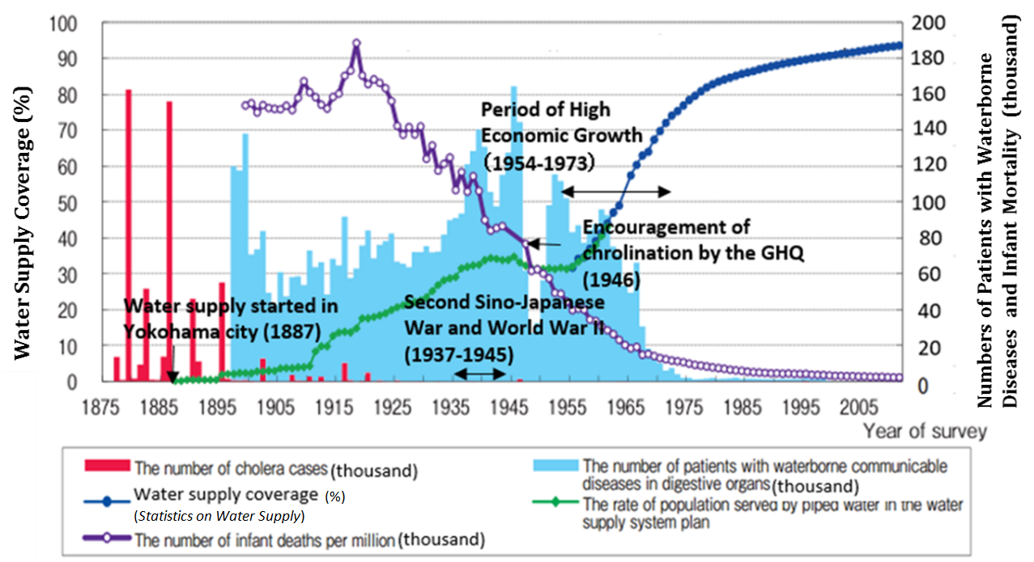
3. Universal and Equitable Access
Water Supply Coverage (%)
Numbers of Patients with Waterborne
Diseases and Infant Mortality (thousand)
Source: Added to the figure from Water Resources Department, Water and Disaster Management Bureau, Ministry of Land, Infrastructure, Transport and Tourism, "Water in Japan," http://www.mlit.go.jp/common/001044443.pdf

Slide 6
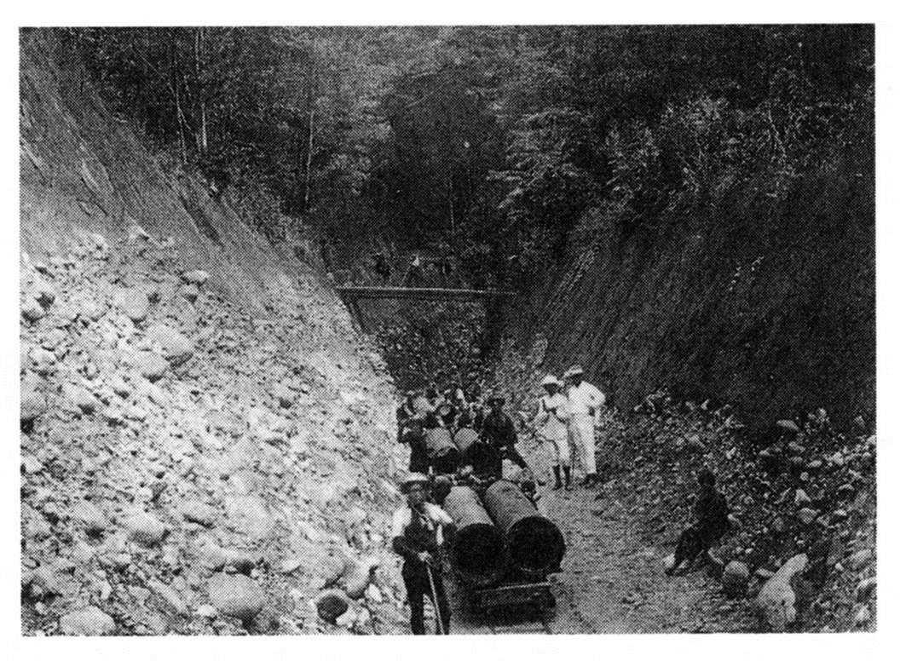
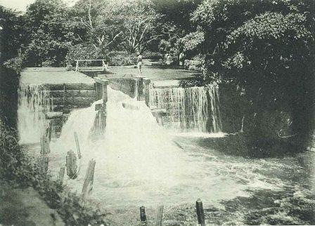
3. Universal and Equitable Access
(1) Reducing Incidence of Waterborne Diseases
Water supply system was developed as a measure to improve public health and to prevent the spread of waterborne diseases.
Water supply distributes filtered and disinfected water through pressured iron pipes.
Cholera outbreaks were eliminated in Yokohama in 1887 .
The Waterworks Ordinance was enacted in 1890 .
Establishment of Yokohama water in 1887
Sekiguchi weir of Kanda Josui (Waterworks) in 1919
Tokyo Waterworks Historical Museum http://www.suidorekishi.jp/minitenji2015.html

Slide 7

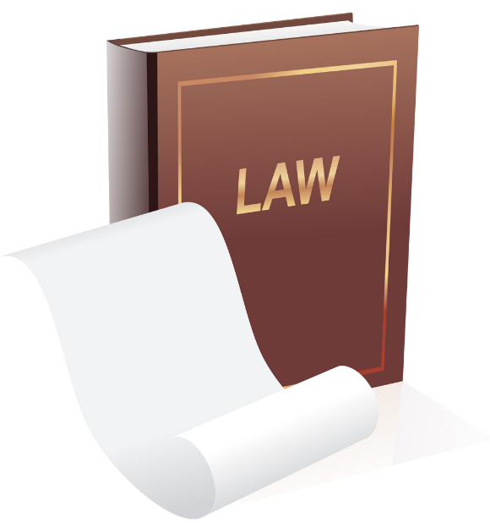

3. Universal and Equitable Access
(2) Development of Nationwide Water Supply System
The following measures were implemented:
Funding for urban water supply: from municipal bonds purchased by public funds (public financial institutions, pension funds, etc.)
Funding for rural water supply: subsidies for small-scale utilities (1952)
Enactment of the Water Supply Act (1957)
Approval (License) system requiring master plans
Human resources development
Enactment of “Guidelines for Water Supply Facilities Standards” (1966)

Slide 8
4. Safe Drinking Water
(1) Water Quality Standards and Facilities Standards under the Water Supply Act
Standards are revised periodically as new knowledge emerges on toxic substances and the public concerns, and the technical level of water quality testing.
Water Supply Act
Facility to secure safe water
Article 4 Drinking Water Quality Standards
Article 5 Water Supply Facility Standards
Quality assurance in Construction → Article 12,13,16, etc.
Appropriate Operation → Article 19-23, etc.
The Ministry of Health, Labour and Welfare
Health center
Check and Support
Water utilities

Slide 9
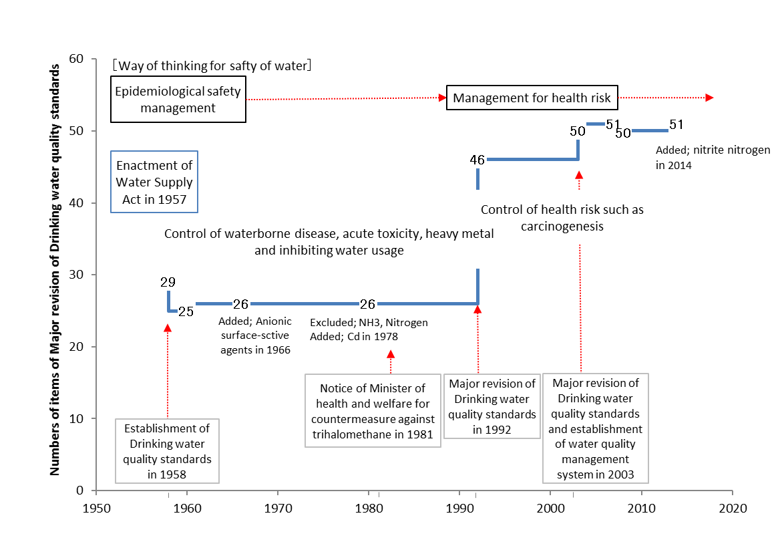
4. Safe Drinking Water
Water quality standards have been reviewed periodically.
Regular Meetings for Revision
Control of health risk such as cancer
Epidemiological safety
51
46
Number of Water Quality Parameters
29
Major revision in 1992
Establishment in 1958

Slide 10
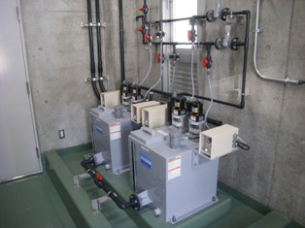
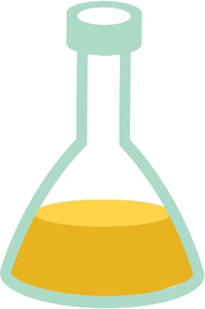
4. Safe Drinking Water
Advantages
(2) Chlorination
Chlorination after WWII contributed considerably to safe water supply.
Prevented waterborne diseases
Reliable process
Easy and simple
Low cost
Disadvantages
Toxicity
Generation of disinfection by-products
Corrosion of equipment
Chlorination system
Source: Kyoto City
http://www.city.kyoto.lg.jp/suido/page/0000092339.html

Slide 11
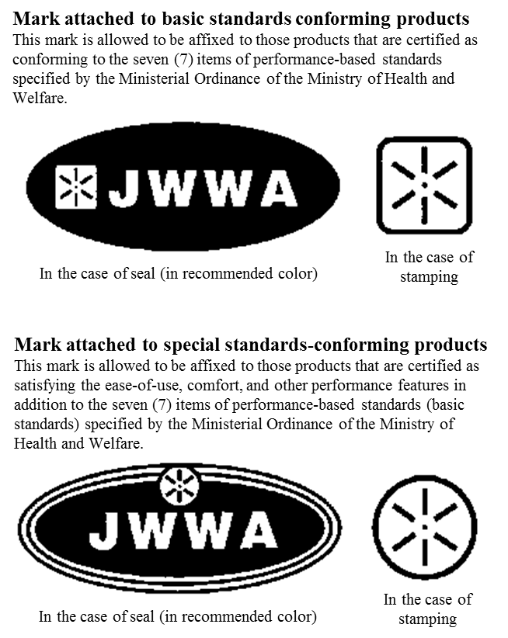
4. Safe Drinking Water
Sticker attached to standards conforming products
(3) Quality Management of Materials and Equipment
Sticker
Standards and certification system that ensure materials and equipment quality:
Japanese Industrial Standards (JIS)
JWWA (Japan Water Works Association) standards
Examinations and certification by JWWA
Sticker

Slide 12
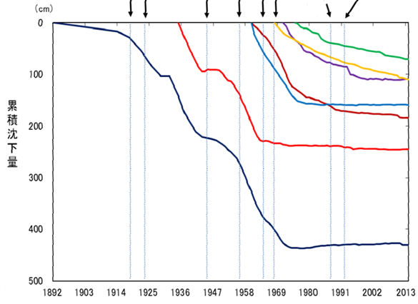
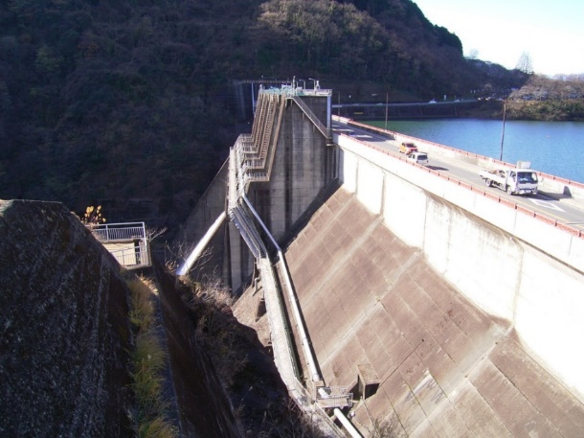
5. Sustainable Water Resources Management
(1) Securing Water Resources
To meet increasing demand - must conserve water quality and work with other users.
Development of multipurpose dams for efficient investment, and for bulk water supply system
Control pollution of water resources
Control depletion of groundwater sources and prevention of land subsidence caused by over pumping
Other Cities
Total Subsidence (cm)
Osaka
Tokyo
Multi purpose dam
Land subsidence controlled since 1970s.

Slide 13
5. Sustainable Water Resources Management
Water source
Surface water
Rivers
25.5% (3.91 billon m³/year)
Dam reservoirs
47.3% (7.25 billon m³/year)
Lakes
1.4% (0.22 billon m³/year)
Riverbank infiltration
3.6% (0.54 billon m³/year)
Ground water
Shallow wells
6.6% (1.01 billon m³/year)
Deep wells
12.7% ( 1.95billon m³/year)
Others
2.9% (0.45 billon m³/year)
Total 100.0% (15.33 billon m³/year)
Source: JWWA, Water Sources in Japan (2014), http://www.jwwa.or.jp/shiryou/water/water02.html

Slide 14
6. Ensuring Availability
(1) Operation and Maintenance of Facilities
The national government and water utilities worked closely to enhance management of facilities through investigation and by sharing lessons. Preventive maintenance through Time Based Maintenance (TBM) and Condition Based Maintenance (CBM) is essential, and is implemented by keeping record and sharing information.
Increased oversight
Sharing knowledge
Keeping records of operations and construction
Development of guidelines and minimum level of expertise
Outsourcing to private sector
Securing sustainability through asset management
Construction and expansion
Accidents
Tightened regulations
Cut in workforce
Safe and stable water supply through long-term viable maintenance

Slide 15
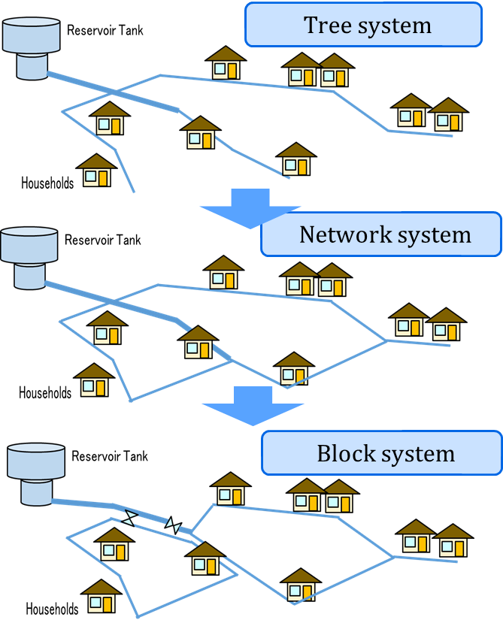
6. Ensuring Availability
(2) Water Supply Operation by Efficient Water Distribution Systems
Equalizing water pressure and shortening downtime by using block distribution system.
1st stage: Tree (dendritic) system for simple distribution
2nd stage: Network system to minimize the negative impact of accidents and ensure operational flexibility
3rd stage: Block system for
(1) optimizing water pressure,
(2) understanding distribution condition and optimizing operation
(3) identifying and minimize accidental damage and providing of backup water supply
Monitoring and control point to find leakage

Slide 16
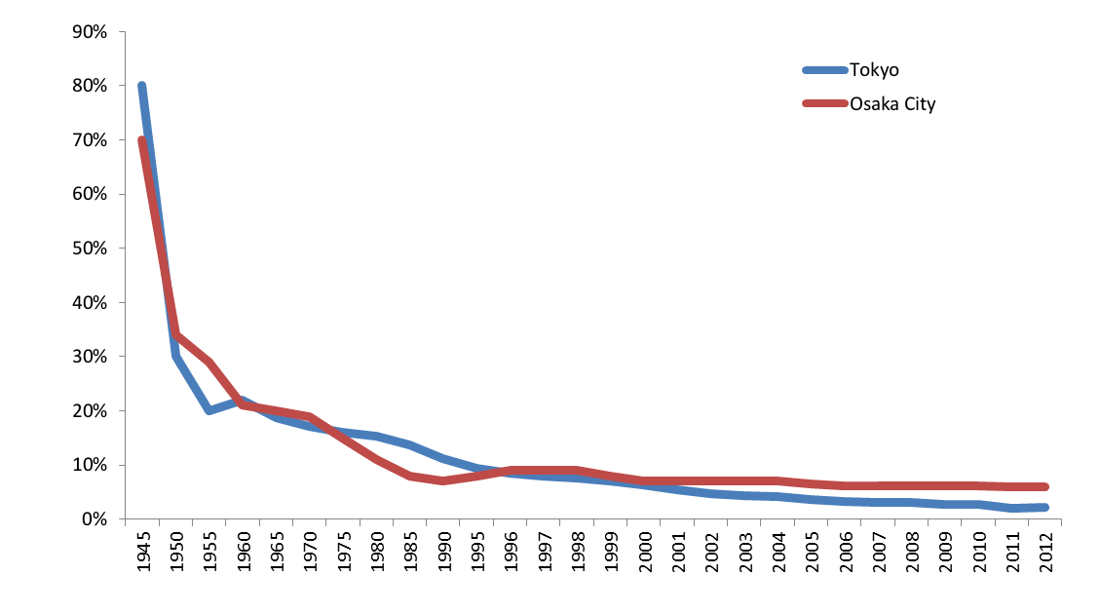
7. Efficient Water-Use
(1) Water Leakage Prevention
Average leakage rate dropped to 4.7% (2013) from 70-80% in 1945. Efforts prompted by serious droughts and accidents involving the suspension of service.
Improved quality of pipe materials and active leakage control.
Ensuring meter accuracy and scheduled replacement as required by the Measurement Act.
Reduction of measurment errors, rare unauthorized/ illegal connections.
80％ (1945,Tokyo)
3.1％ (2008,Tokyo)
Drop in leakage rate in large cities

Slide 17
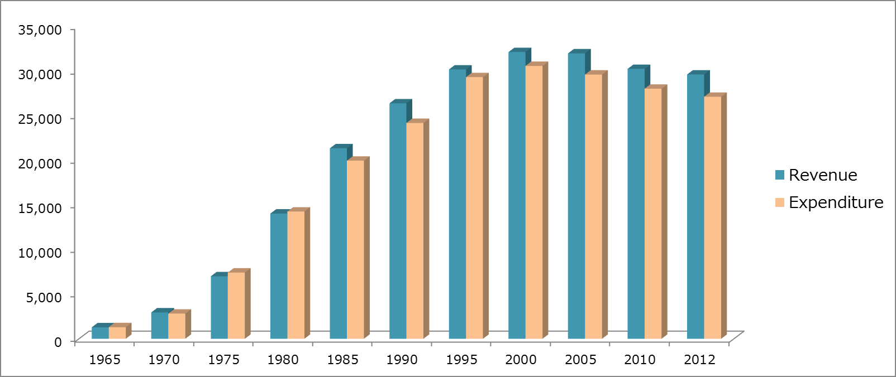
8. Sustainable Management
(1) Self-Supporting Accounting System and Cost Recovery
Total Revenue
（water tariff, etc.)
＞
Total Expenditure
(repayment of the long-term loans, interest payments, operation and maintenance costs, administrative expenses, etc.)
=
100 million JPY
Source: Based on information from JWWA, "The Outline of Water Supply,” 1st ed. 1986 and 6th ed. 2015.
Change in Total Revenue and Expenditure of Water Utilities in Japan

Slide 18
8. Sustainable Management
(1) Self-Supporting Accounting System and Cost Recovery
Setting tariff systems based on:
Fairness (beneficiaries pay principle)
Affordability
Clarity in the pricing of water tariff
Transparency & accountability
Understanding of customers
Efficient management
Source: Kawanishi Water and Sewerage Authority
http://www.kawanishi-water.jp/ikkrwebBrowse/ material/files/group/2/h27-12-1.pdf

Slide 19
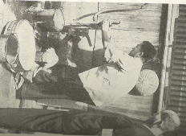
8. Sustainable Management
(2) Customer Relations
Starts with understanding the fundamental importance of water tariffs.
Staff repairing a tap
The Water Supply Act stipulates that :
A water utility shall specify " Water Supply Rule" including water tariff calculation, cost of service connection, and condition of water supply.
A water utility has the obligation to supply safe drinking water.
A water utility shall notify customers of the results of water quality testing, and other information about water supply services.
Source: Osaka Municipal Waterworks Bureau, “One Hundred Year History of Water Supply in Osaka City,” Osaka Municipal Waterworks Bureau, 1996.

Slide 20
8. Sustainable Management
(3) Master Plan, Business Plan and PDCA Cycle
Master plans and business plans are essential. They are guideposts for sound day to day management, while visualizing the path toward future directions.
Plan
In the preparation of plans, all staff members are engaged and share objectives. It is a good opportunity for team building
PDCA ensures the continuous improvement of sustainable business operations.
Sustainable Management
Act
Do
Check

Slide 21

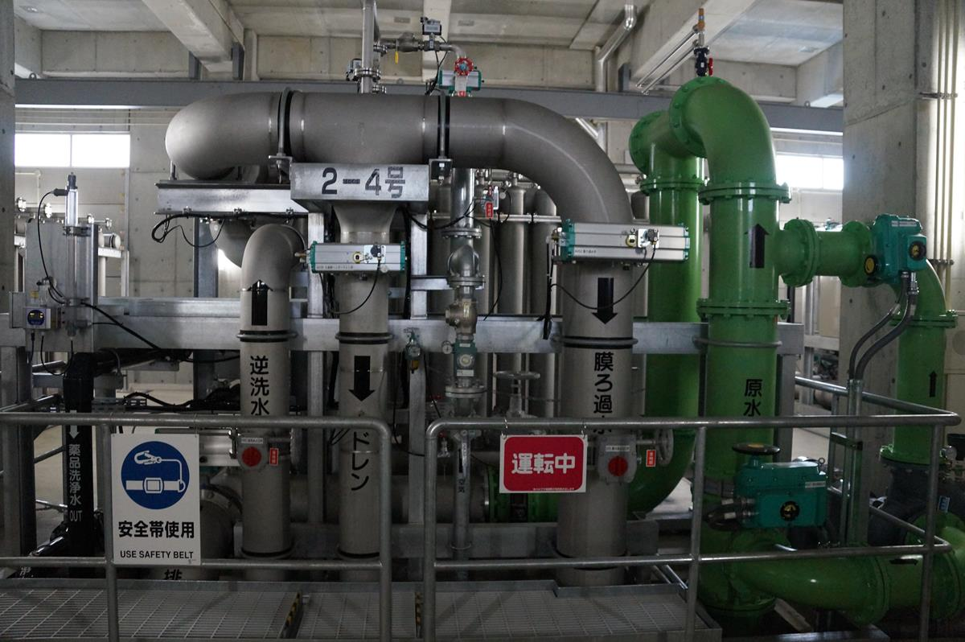
8. Sustainable Management
(4) Public-Private Partnerships (PPP)
Involvement of private companies in the water supply business is increasing.
Public utilities
Private companies
Private companies must be qualified and are inspected to ensure that their performance meet national standards.
PPPs are promoted under legal frameworks with clearly defined allocation of the risks among the parties.
Inside of water purification plant “CERAROKKA”; built by PFI scheme in Yokohama

Slide 22
9. Affordable Drinking Water
(1) Consideration for the Low-Income Group
Affordability
Electricity
“Minimum volume” with minimum rate, a cross-subsidy.
Reduction and exemption as a welfare policy of the local government.
Installment plan and funds for subsidizing connection charge in the past.
Gas
Water
Percentages of water, gas and electricity tariffs in average monthly living expenses

Slide 23
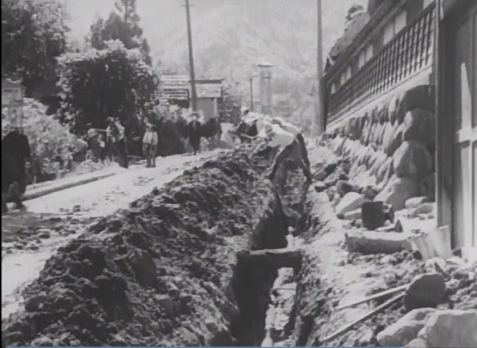
10. Engaging Local Communities
(1) Participation of Residents
Local residents contributed funds and labor, in developing rural water supply systems.
Public consultations, customer satisfaction surveys, supporters system (monitoring system by customers), etc.
Villagers working in rural water supply development.
Source: Susumu Hani, the film “Water in Our Life,” 1952

Slide 24
10. Involving Local Communities
Old days, simple issue
Nowadays, diversified
Need to collaborate with citizens
Source: Ministry of Health, Labour and Welfare, http://www.mhlw.go.jp/stf/shingi/2r98520000027cq9.html

Slide 25
11. Lessons Learned (1)
(Legal Framework for Universal Access) The national government established the legal frameworks to support utilities in securing funds and in standardizing technical requirements in developing water supply system. Utilities could issue public enterprise bonds for long-term financing. Small utilities in rural areas could not recover the cost with their operation and utilized national subsidies for facility construction.
(Water Resources Development) The national government established an organization responsible for multi-purpose dam constructions and coordination of dam users. By sharing both the costs and benefits of dam construction, the financial burden for each water utility was reduced. Measures and new laws to improve and protect raw water quality, have helped to restore water quality.

Slide 26
11. Lessons Learned (1)
(Safe water supply) To operate a stable supply of good quality water for 24 hours a day, the national government established water quality standards. Water utilities are responsible for implementing water quality analysis, and made efforts to secure quality pipe materials and equipment. The JIS and other standards, and JWWA inspection played key roles to guarantee the quality of pipe materials and equipment.
(Maintenance for Stable Water Supply) Preventive maintenance is very important for a stable water supply. Accidents can be prevented by analyzing data and information of daily inspections, operation, and repairs. Information and knowledge sharing by manual and OJT, regulations and guidance by the national government played an important role for the prevention of accidents and problems.

Slide 27
11. Lessons Learned (2)
(Leakage Control) The average leakage rate in Japan is 4.7%. The dramatic drop from 70-80% after the war was the result of corrective and preventive measures implemented after experiencing severe droughts and water scarcity. These include detection and repair of leaking pipes, replacement of aging pipes and installation of new pipes with better materials and improvement of pipe connections and construction methods. Pipe networks organized in distribution blocks facilitates the leakage reduction activities.
(Sustainable Management) Self-supporting accounting system and cost recovery have been essential for sustainable management. Utilities are required to prepare a financial plan, clearly describe future conditions demonstrate efforts for cost reduction. Master plans, business plans and PDCA cycle are important tools for sustainable management.
(Affordable Tariff) Minimum rates including minimum water are set relatively low making it affordable for low-income group. The progressive rates allocate more financial liabilities to high-volume users (a cross subsidy). Low-income group can apply for tariff reductions or exemptions.

Slide 28
11. Lessons Learned (3)
(Training of Utilities’ Staffs) The National Institute of Public Health developed the human resources required to establish the nationwide water supply system. Utility workers were trained through OJT and attended training programs conducted internally. JWWA organizes seminars and committees for knowledge sharing and professional development.
(Public Relations) Public relations activities and mechanisms for public participation are important to building mutually supportive relationship between the utility and its customers. Staff of each utility understand that customers’ willingness to pay is directly related to their level of satisfaction with the quality of service. Maintaining trusting relationships with customers is a very important component of the water supply service.

