Slide 1
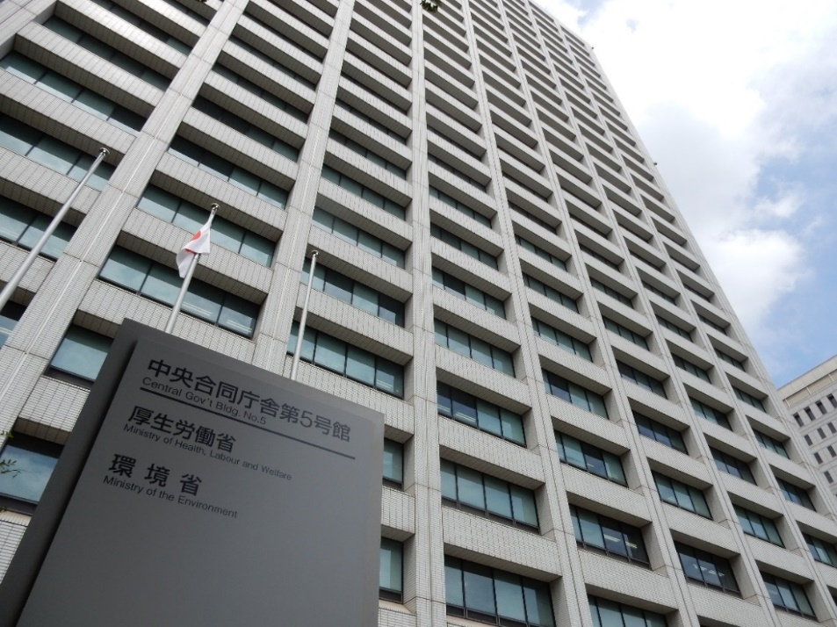
Sector Governance and
Regulation for Nationwide Full Coverage of Water Supply Service
No. T1 Ver. 1
The Ministry of Health, Labour and Welfare; regulatory agency of water supply (August 12, 2016)

Slide 2
Contents
      Introduction
      Purpose of Water Supply: Public Health
      Historical Path towards Nationwide Coverage
      Regulatory Framework and Administration
      Challenges in Maintaining Universal Coverage
      Lessons Learned

Slide 3
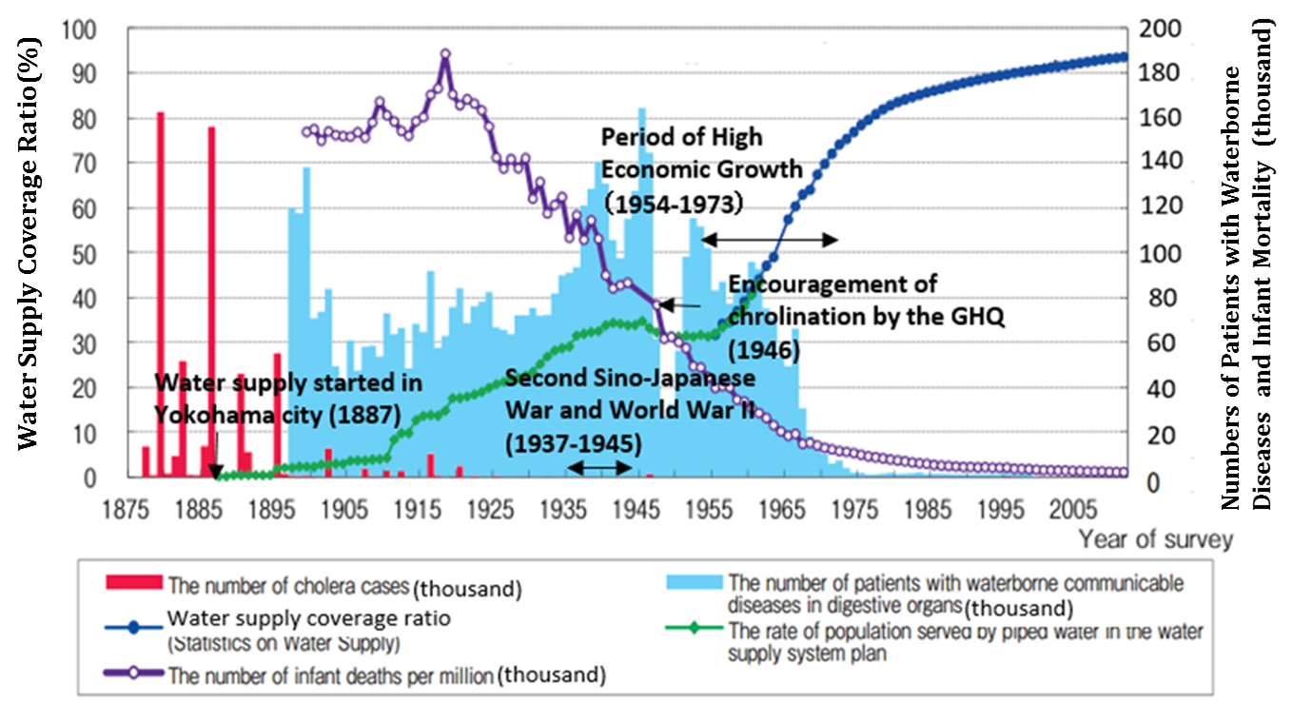
1. Introduction
Water Resources Department, Water and Disaster Management Bureau, Ministry of Land, Infrastructure, Transport and Tourism, "Water in Japan," http://www.mlit.go.jp/common/001044443.pdf

Slide 4
1. Introduction
Frequently asked questions from the participants of water supply training courses
Q1. Why have Japan’s water utilities been providing safe drinking water to the customer’s tap on a continuous 24 hours a day basis?
Q2. What laws and regulations did Japan implement to achieve nationwide full coverage of water supply service?
Q3. How did Japan develop laws, regulations and standards for water supply? What kinds of factors helped water utilities to comply with them?
Q4. How do small and medium scale water utilities in Japan comply with the laws, regulations and standards? How do they supply safe water for 24 hours a day?

Slide 5
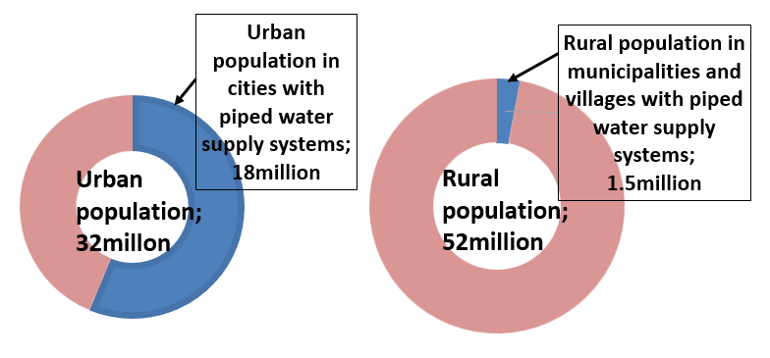
2. Purpose of Water Supply: Public Health
  (1) Public Health Objective
  Water supply in rural areas was the problem.
Population served by piped water supply systems in 1952
Source: Susumu Hani, the film “Water in Our Life,” 1952

Slide 6
2. Purpose of Water Supply: Public Health
  (1) Public Health Objective
Improving public health
Preventing
water borne diseases
Providing a hygienic environment
Article 1
Purpose of the Act
Improving public health and
the living environment
Article 2
Responsibilities of the National Government and local governments
Waterworks are indispensable for the protection of human health

Slide 7
2. Purpose of Water Supply: Public Health
  (2) Water Quality and Facility Standards to Secure Public Health
Safeguarding public health
Drinking water quality standards
Facility standards
Article 4
Absence of contaminants
Pathogens, Toxic substances
Free of excessive metal substances
Copper, Iron, etc.
Drinking water quality standards
Article 5
Facility
standards
Location and arrangement for economical and easy practical operation and maintenance
Structures and materials withstanding water pressure, earth pressure, seismic forces, etc.
Free of water contamination and less leakage

Slide 8

2. Purpose of Water Supply: Public Health
(3) Modern Water Utilities and Their Contribution to Public Health
In Japan, public health has improved, as indicated by a reduction of waterborne diseases and infant mortality. This is direct result of increasing the coverage of modern water supply systems (continuous water supply by pressured pipes) and disinfection with chlorine.

Slide 9
2. Purpose of Water Supply: Public Health
Column: Contamination of Drinking Water
If the pressure is maintained in the water pipe,
a slight crack in the pipe may lead to leakage but pressure would not allow contaminants to enter.
Water outage would generally
reduce pressure or create negative pressure
in the pipe.
Contaminants may seep through the cracks.
This poses a risk to the safety of tap water and to public health.

Slide 10
3. Historical Path towards Nationwide Coverage
(1) Public Ownership
  1890 Waterworks Ordinance
  → Water supply service by public ownership and responsibility
  1946 The Constitution of Japan
  → Article 25 right to life clause → water supply for all
  1957 Water Supply Act
  → Water supply for all including rural population
  → Large investment for Small Scale Public Water Supply in all municipalities
Article 25 of
the Constitution of Japan
Goal 6 of SDGs;
Sustainable Development Goals
All people shall have the right to maintain the minimum standards of wholesome and cultured living. In all spheres of life, the State shall use its endeavors for the promotion and extension of social welfare and security, and of public health.
Ensure availability and sustainable management of water and sanitation for all.

Slide 11
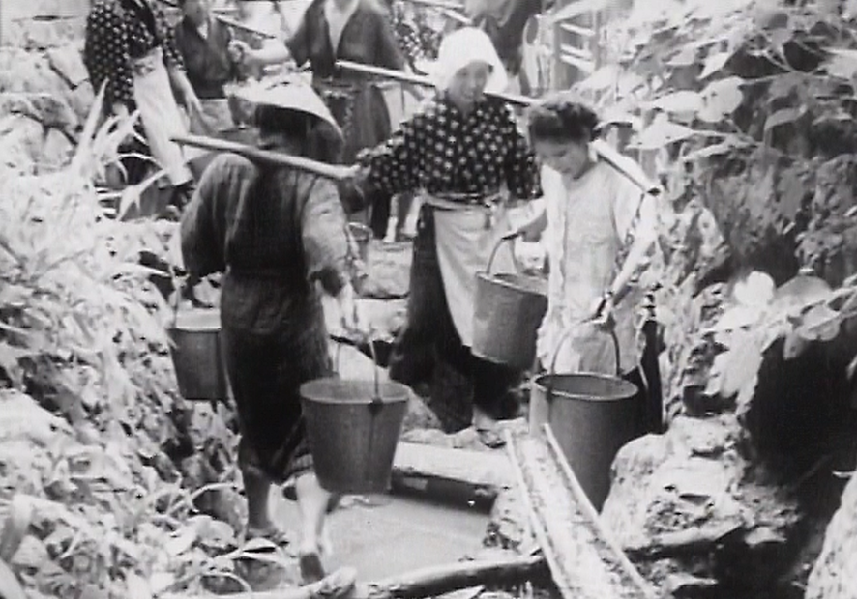
3. Historical Path towards Nationwide Coverage
Carrying water before promotion of water supply systems, Source: Susumu Hani, the film “Water in Our Life,” 1952

Slide 12
3. Historical Path towards Nationwide Coverage
(2) Water Supply Development in Urban Areas
Period | Characteristics of waterworks
Early stage of construction (1887 – 1945) | Mainly funded by bond floatation and own funds, financed by tariffs Small portion of subsidy by the national government
After World War II (1945 – 1954) | Technical support from GHQ (widespread introduction of chlorination) Subsidy for reconstruction following the war until 1954
Early period of high economic growth (1954 – 1967) | Rapid population growth and water demand Massive water resources development and expansion of water supply service areas by bond floatation No subsidy from the state government
Late period of high economic growth to the present (1967 – ) | Targeted subsidy for water resources development, advanced water treatment, replacement of aging pipes, disaster risk reduction, etc. Debt repayment Asset management for rehabilitation

Slide 13
3. Historical Path towards Nationwide Coverage
(3) Development of Small Waterworks in Rural Areas
Small scale water supply
by residents
in communities
Small Scale Public Water Supply (population served 101-5000) by municipal governments
Type | planned service population | Accounting system | Funding source | Location
Municipal Water Supply | ≧5001 | Public enterprise accounting system | (mainly) Bond floatation | Urban area
Small Scale Public Water Supply | 101-5000 | General account | National subsidy and Bond floatation | Rural area
Facility for Drinking Water Supply | ≦100 | Self-financing by local residents | Joint investment by users and communities | Rural area

Slide 14
3. Historical Path towards Nationwide Coverage
(3) Development of Small Waterworks in Rural Areas
Enforcement of the Water Supply Act
  Nationwide full coverage of water supply service
  National subsidy for small scale public water supply systems
Human resource development
  Education for staff of prefectural governments
  They support planning and design of small scale public water supply
Leadership by mayors
  Promotion of water supply for improvement of living conditions in their villages
  Effective utilization of national subsidy

Slide 15
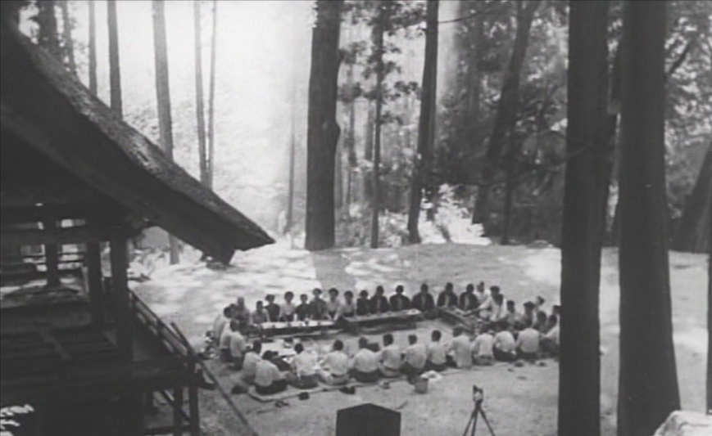
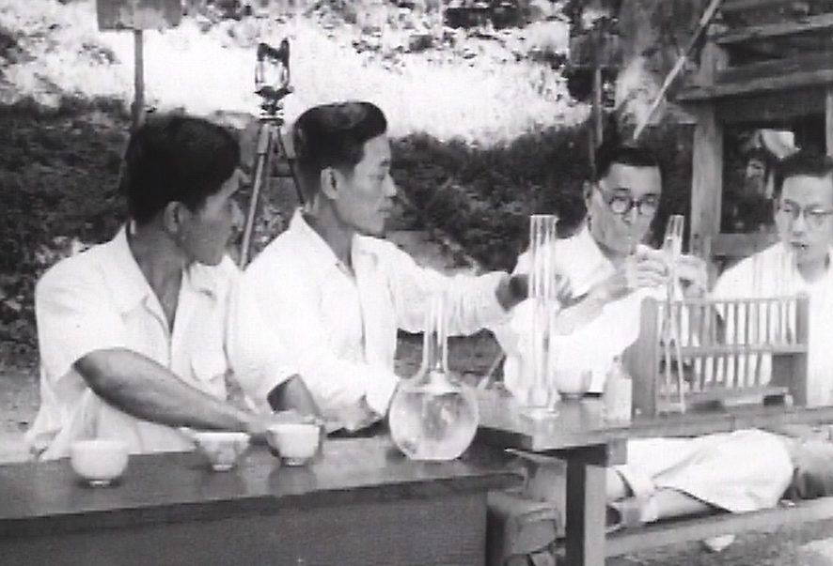
3. Historical Path towards Nationwide Coverage
Consultation with engineers of prefectural government and health center, Source: Susumu Hani, the film “Water in Our Life,” 1952

Slide 16
4. Regulatory Framework and Administration
(1) Legal System
The examples concerning the Water Supply Act
Constitution
The supreme law of the nation
Water Supply Act
Law
Codified law enacted by the Diet
Order for Enforcement of Water Supply Act
Order for enforcement of law
Collective rules necessary for enforcing certain laws
Ordinance for Enforcement of the Water Supply Act
Administrative rules for conducting the order for enforcement of law
Ordinance
Ministerial Ordinance on Drinking Water Quality Standards
Ministerial order
Order of ministry enacted by its minister
Public notice; Method as Specified by the Ministerial Ordinance on Water Quality Standards
Public notice
Notice to provide legally binding information for the public
Notice concerning partial revisions of the water quality standards
Notice to provide certain information between government organizations
Notice

Slide 17
4. Regulatory Framework and Administration
(2) Approval (License) System of the Waterworks
1890 Waterworks Ordinance
Public ownership principle
Approval(License)
Safe water supply
1957 Water Supply Act
Public ownership principle
Approval(License)
Safe water supply
Water quality standards
Water supply facility standards
Technical administrator of waterworks
Approval(License) for waterworks
Special license for waterworks issued by the national government (or the prefectural governor). Licensing aims to make sure operators are able to deliver a continuous, stable, safe and clean supply of water.
Application for Approval (License) requires the following;
  Water volume and water quality of source
  Maps and drawings of water supply facilities
  Total amount of construction expenses and their planned funding source ,
  Construction period
  Water tariff and management plan

Slide 18
4. Regulatory Framework and Administration
Information provided in the application for Approval(License) is basis for a master plan
(Project plan)
Service area, population and water supply volume
Outline of planned water supply facilities
Planned date for start of water supply
Construction expenses and finance
Balance of income and expense
Water tariff
(Construction design plan)
Volumes of daily water supply
Type of water sources and water intake points
Capacity and quality of water resource
Location of water supply facilities
Water purification process
Pressure of water distribution pipes
Scheduled dates of commencement and completion for construction works
Attached documents;
Evidence to explain reliability of raw water intake
Location of water supply facilities
Water source
Layout plan, elevation, section and structural drawing for main water supply facilities
Layout plan and longitudinal section for transmission and distribution pipelines

Slide 19
4. Regulatory Framework and Administration
Criteria for license
Article 8 of the Water Supply Act
Licensing of water supply services can be rejected, unless the application meets the following requirements:
The commencement of water supply services is in accordance with the general demand of the community.
The plan for the water supply services is certain and reasonable.
Designs for construction of water supply facilities meet the Water Supply Facility Standard.
The water supply service area does not overlap the service area of any other water suppliers.
Water supply conditions meet requirements of articles of the Water Supply Act.
In the case of water supply services applied by entities other than local public entities, there exists a certain financial foundation capable of performing the water supply services.
The commencement of water supply services is required from a viewpoint of public interest.

Slide 20
4. Regulatory Framework and Administration
Waterworks Ordinance (1890)
The first modern water supply system in Japan began supplying water in Yokohama city in 1887 and shortly thereafter in several other cities. Among these, some systems were installed privately and fell short of the facility standard or were poorly managed. Under these circumstances, the Waterworks Ordinance was promulgated in 1890.
“Public ownership principle” and “Approval(License)” had been already defined in the Waterworks Ordinance and these concepts were further elaborated by the Water Supply Act.
Article 2: Municipalities may not install a water supply facility without public funds.
Article 3: Municipalities must provide a prospectus containing the following details through a prefectural governor to the Home Minister for Approval (License) to install a waterworks system.
Article 10: Anyone who has access to water supply services may request the mayor to test water quality and to check the volume.

Slide 21
4. Regulatory Framework and Administration
(3) Other Relevant Laws
In addition to the Water Supply Act, some related acts supporting waterworks play an important role in operating waterworks and constructing facilities.
Essential rule for continuous management of water utility
Water Supply Act
Local Public Enterprise Act
・ Principle of Cost Recovery
Measurement Act
・ Approval of meter types and inspection to ensure accuracy
・ Replacement in 8 years
River Act
・ License for use of river water
・ Authorization for intake facilities

Slide 22
4. Regulatory Framework and Administration
(4) Administrative Framework
Detailed rules of the Water Supply Act
→ Order for Enforcement of Water Supply Act,
Ordinance for Enforcement of the Water Supply Act
Administrative guidance for rational execution of law is conducted as necessary based upon ministerial order, public notice and public notice of the Ministry of Health, Labour and Welfare, etc.
Ministry of Health, Labour and Welfare
Prefectural government
Direct Approval (License)
Guidance and supervision
On-site inspection
Guidance and supervision
Technical assistance
Approval (License)
Guidance and Supervision
Technical assistance
Health center
Water utilities
population served ＞50,000
Water utilities
population served ≦50,000

Slide 23
4. Regulatory Framework and Administration
Japanese Administrative System for Water Supply
National Government:
the Water Supply Division of the Ministry of Health, Labour & Welfare
Ministerial order：Ministerial ordinance on Drinking Water Quality Standards (Order of the Ministry of Health, Labour and Welfare No. 101 of May 30, 2003)
Public notice：Concerning partial amendment of the ministerial order which specifies technical standards for water supply facilities (April 8, 2008)
Prefectural government,
City establishing health center
Health center
Health center
Health center
Planned service population ≦50,000
Planned service population ＞50,000
Health center: An organization established based upon the Community Health Act
Ensures comprehensive promotion of regional public health measures

Slide 24
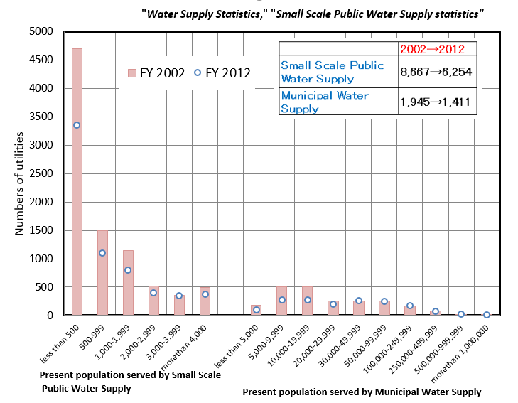
5.Challenges in Maintaining Universal Coverage
Number of the Small Scale Public Water Supply, whose served population is less than 5,000, is decreasing by consolidation, but still many.
Numbers of water utilities according to population served (FY2002→FY2012)

Slide 25
5.Challenges in Maintaining Universal Coverage
Challenges Specific to Smaller Utilities
Water Supply Development with slogan “Nationwide full coverage of water supply service” in Japan.
Small and medium scale public water supply utilities contributed to progress of water supply coverage.
Small and medium scale public water supply utilities have problems concerning renewal, maintenance and management, etc.
Measures for solving problems
Planning of Water Supply Vision
Planning of Water Safety Plan
Asset management
Promotion of consolidation of water utilities
  Making of a master plan
  Ensuring continuity of safe water supply
  Correct recognition of current situation
  Consolidation with water supply utilities in adjacent areas

Slide 26
      6. Lessons Learned (1)
  (Continuous Pressurized Water Supply) Japan introduced the modern water supply systems to reduce the incidence of waterborne diseases including cholera. Water supply facilities were built to treat and deliver a continuous supply of safe drinking water through pressurized distribution networks to customers around the clock. The modern water supply is one of the important determinants of public health and healthy living environment in Japan.
  (The Water Supply Act) Japanese government established the Waterworks Ordinance in 1890, and the Water Supply Act in 1957 to promote the establishment of water supply systems. These laws emphasize the technical aspects of the operations and focus on improving public health and the running of the water supply business for public good. The Water Supply Act defines water quality standards and facilities standards.
  (Approval (License) of Water Utilities) The Waterworks Ordinance instructed municipalities to construct water supply systems using public financing and requires waterworks to be approved by the national government (or the prefectural governor). The Approval(License) system ensures that all utilities have a certain level of technical competence.

Slide 27
      6. Lessons Learned (2)
  (Universal Access) Based on Article 25 of the Japanese Constitution, all citizens shall have the right to maintain the minimum standards of wholesome and cultured living. The national government has provided universal access to water, including in rural areas.
  (Financing of Urban Utilities) Urban waterworks cover their expenses for facility construction with income generated from tariffs and with funds from bond issues and equity capital. Some national subsidies were also used.
  (Government Assistance for Rural Areas) Utilities in rural areas required extra government assistance in terms of training and financial support. The active role played by local politicians made it possible to set up the Small Scale Public Water Supply in these areas as a high priority.
  (Enforcement of the Act) Japanese legal system has many detailed stipulations spelled out in government ordinances and public notices to show how to abide by the relevant Acts including the Water Supply Act. The Act defines the administrative process for the development of water supply with different levels of government working together.

Slide 28
      6. Lessons Learned (3)
  (Acts Relevant to the Water Supply Act) The Measurement Act, which stipulates accurate metering and billing. The Local Public Enterprise Act, which requires utilites to use specific business accounting systems, contributes to their sustainable financial operations.
  (Challenges of Rural Water Supply) Waterworks in rural areas were developed using national subsidies. They maintain their technical capabilities with the help of the Water Supply Facilities Maintenance Manual, and obtain staff training conducted by local governments. Other issues such as the cost bearing for facility renewal, succession of techniques, and maintaining staff capability in a shrinking work force, are serious challenges for their long term sustainable operation.

