Slide 1
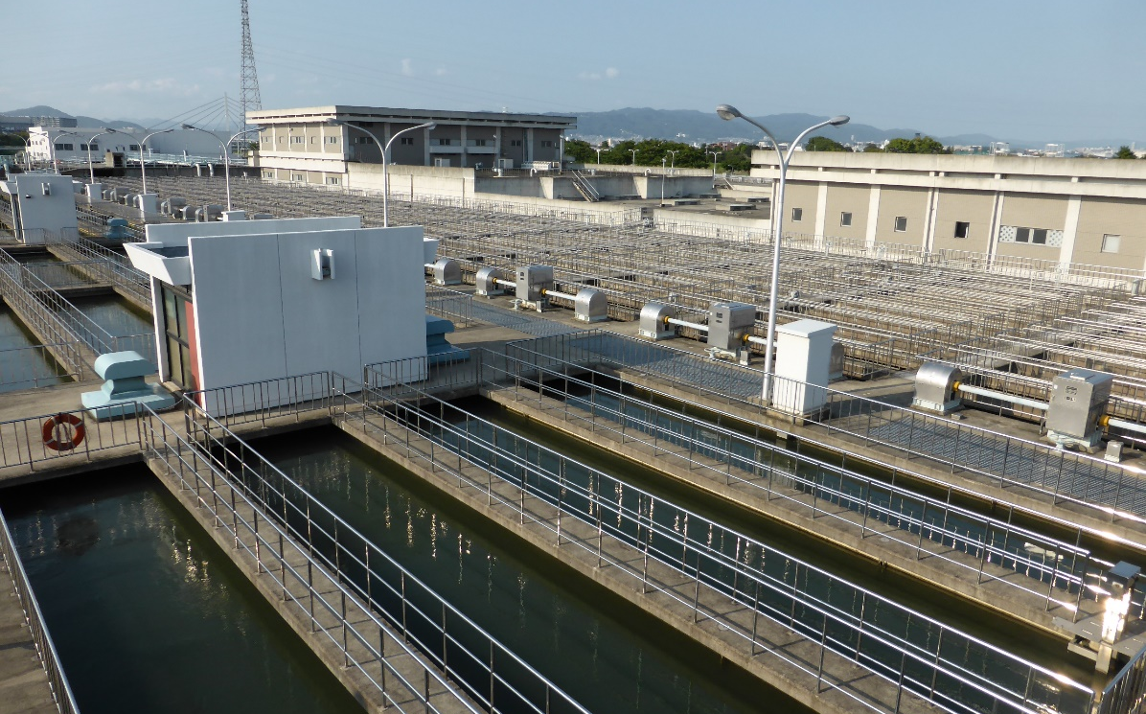
Water Supply System: from Water Sources to Distribution
No. T2 Ver. 1
Amagasaki Water Treatment Plant,
Hanshin Water Supply Authority

Slide 2
Contents
      Introduction
      Water Sources and Treatment Systems
      Development of Surface Water
      Treatment Processes and Water Quality Control
      Groundwater Use and Prevention of Land Subsidence
      Distribution Systems
      Engineering Design and Master Plans
      Lessons Learned

Slide 3
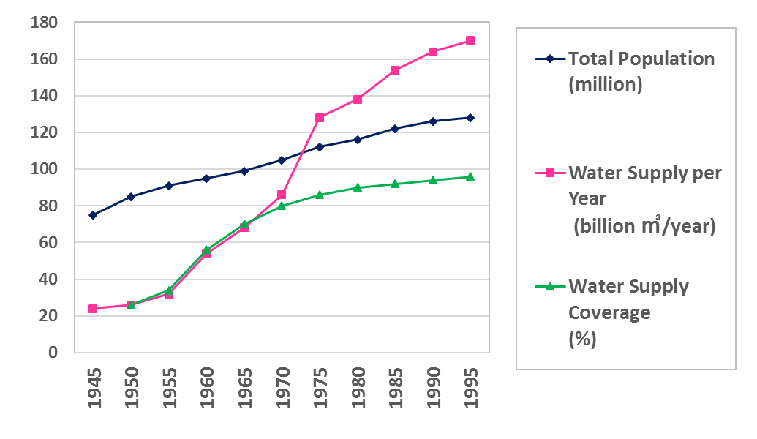
1. Introduction
What is the water supply system?
Securement of water sources
Water treatment facilities suitable for different water sources
Water transmission and distribution system
Engineering Design
Development of water supply systems raised the amount of drinking water supply in Japan sharply since the 1950s.
Annual water supply volume in Japan
JWWA, Water Supply Services Overview, 6th edition (2015) p.21

Slide 4
1. Introduction
Frequently asked questions from participants of the water supply training courses
Q1. How did Japanese water utilities choose water sources and maintain facilities for stable and economical safe water supply?
Q2. How did they develop water sources to meet increasing demand? How did they manage the conflicts with other water use? How do they share the cost with other stakeholders in water resource development?
Q3. How water source developed for water supply in wide areas? How the Bulk Water Supply is managed?
Q4. How did Japan control pollution of water sources?
Q5. How did Japan overcome land subsidence?
Q6. How did Japanese utilities develop water distribution pipelines? What are characteristics of them?
Q7. Why does Japan emphasize planed facility constructions? How do Japanese water utilities steadily develop water supply facilities in required level? How master plans are made and utilized?

Slide 5
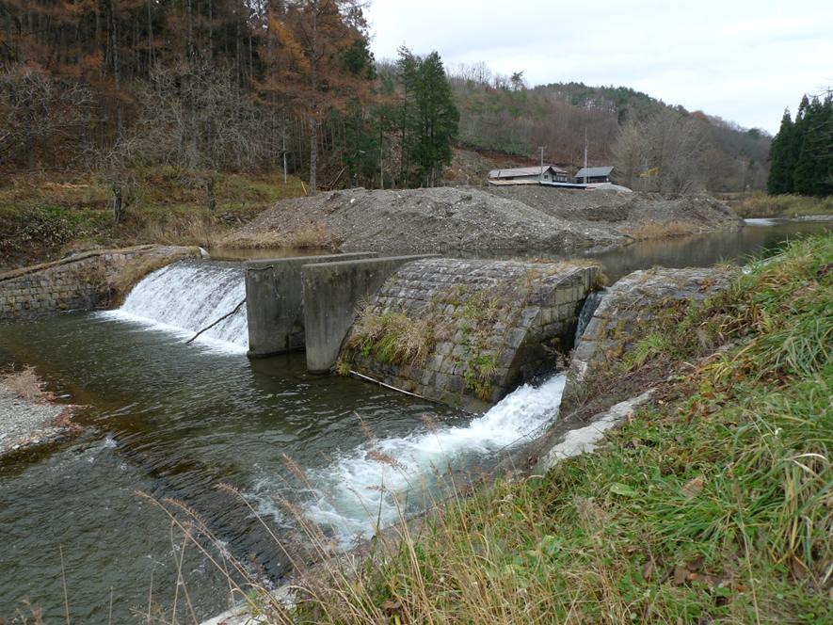
2. Water Sources and Treatment System
It is better to select clean and safe water sources without microbial contamination.
Meteorological water
(rain water)
Spring water, stream water, groundwater
Water source from mountain stream
Quantity
Need to prevent microbial contamination.
Surface water from dam reservoirs and rivers
Plentiful but contaminated
River water has been used in response to increased water demand.

Slide 6
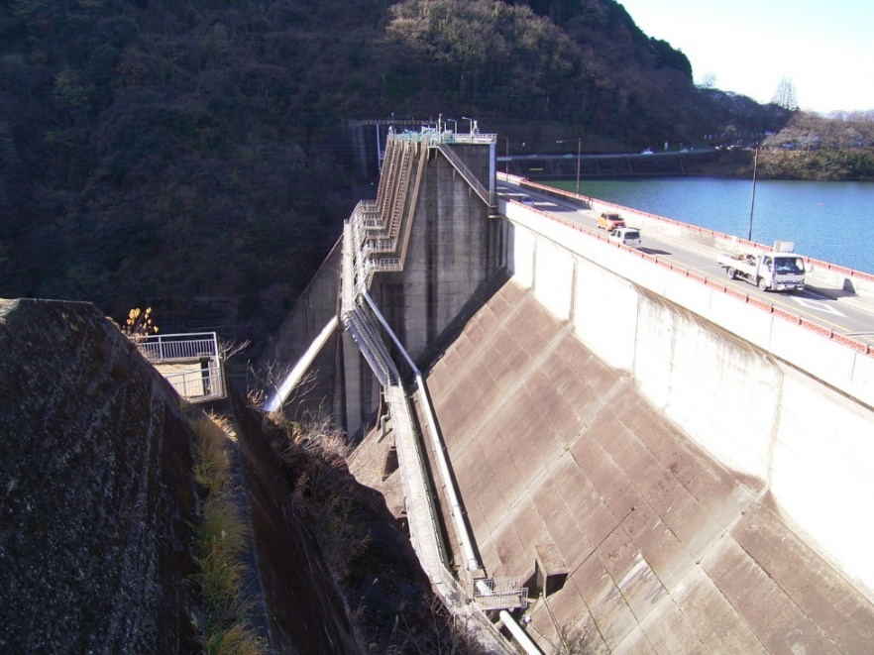
3. Development of Surface Water
  (1) Water Rights
In Japan, water rights has been established pursuant to state law for the orderly allocation of water and to manage conflicts among stakeholders, with due considerations to customary water rights.
1896 Former River Act included the concept of water rights system.
1961 Current water rights system was established.
Multi-purpose dam for cost efficiency
Coordination of the interests of stakeholders
Watershed conservation
The Shiroyama Dam and Lake Tsukui

Slide 7
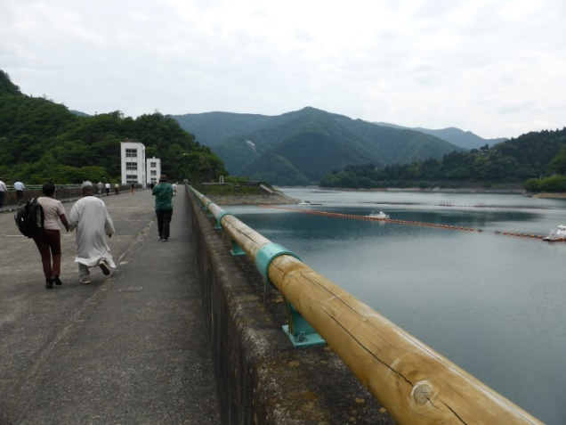
3. Development of Surface Water
  (2) Comprehensive River Development
In Japan, in order to meet increasing water demand, water sources were developed mainly by multipurpose dams planned under the Comprehensive River Development Projects, which covered and coordinated water use, flood control and environmental conservation.
1951 Comprehensive River Development Project started.
1961 Act on Advancement of Water Resources Development enacted.
For financial efficiency, multipurpose dams are constructed by sharing the burden with other water users and river administrators.
Water saving and leakage reduction were proactively promoted in order to reduce the cost of water resources development.
Ogouchi Dam

Slide 8
3. Development of Surface Water
  Example: Coordination of Water Use through Comprehensive Development: Kagawa Canal in Shikoku Region
New user: Kagawa Pref.
Conflict management
National government steps in by:
Bringing together key stakeholders in planning how to develop the entire Shikoku Region
Making a special act for the plan
Transparent and fair sharing of hydrological data set by the initiative of the national government
Discussing comprehensive river basin management, covering not only water use by Kagawa Pref., but also flood control needs of Tokushima Pref.
Providing compensation for negatively-affected Kochi Pref., where dam site is located, from the beneficiary, Kagawa Pref., such as subsidy for forestry
Flood: Tokushima Pref.
Historic user:
Tokushima Pref., Ehime Pref.
Dam site: Kochi Pref.
Kagawa
Tokushima
Ehime
Kochi
Kagawa Canal
Yoshino River
Sameura Dam site
Shikoku Region

Slide 9
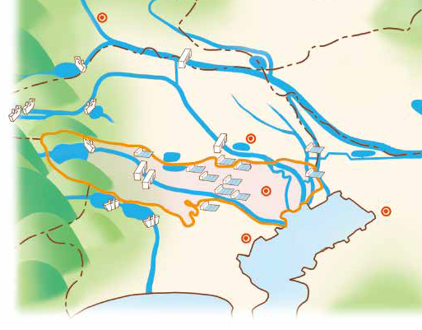
3. Development of Surface Water
  Example: Water source development by the Tokyo Metropolitan Government Bureau of Waterworks
1957 Commissioning of the Ogouchi Dam in Tokyo
1964 Serious drought during Tokyo Olympics
1965 Commissioning of the raw water transmission pipe connecting the Tone River (outside of Tokyo) and the Tama River (in Tokyo)
1965 Commissioning of the Musashi Channel to bring more water from other prefectures to Tokyo
Water resource and Tokyo area
Musashi Channel
Transmission pipe
Arakawa River
Tone River
Tokyo
Ogouchi Dam
Tama River
Source: Bureau of Waterworks Tokyo Metropolitan Government
https://www.waterworks.metro.tokyo.jp/kids/study/images/study_13-14-15-16.pdf

Slide 10
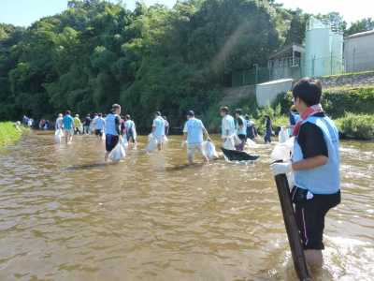
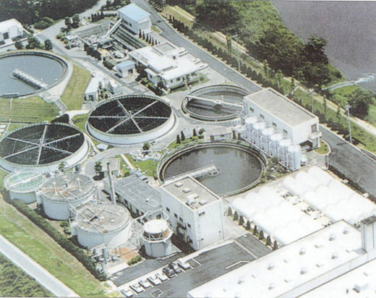
3. Development of Surface Water
  (3) Watershed Conservation
In Japan, steady and long-term efforts were made not only for the purpose of water supply, but also for the improvement of water quality in the entire watersheds.
River cleaning campaign
Effluent regulation
Wastewater treatment plants
Conservation of forests in water source areas
Wastewater Treatment Plant

Slide 11
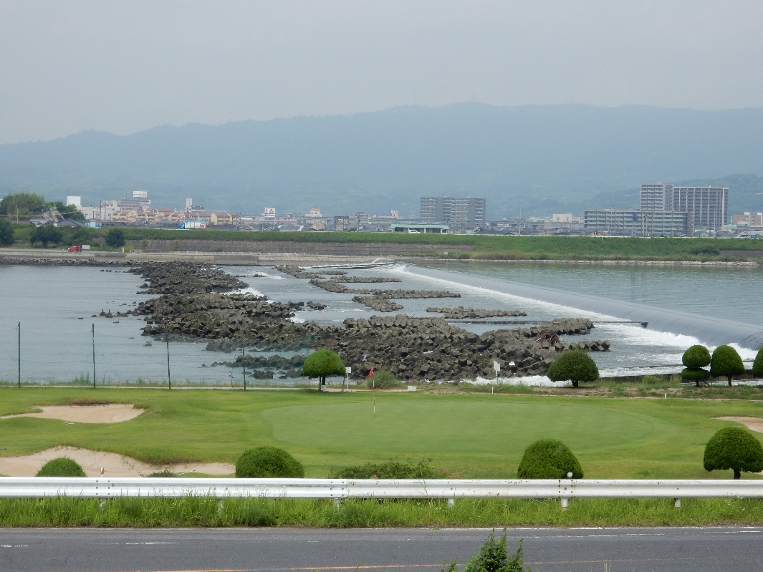
3. Development of Surface Water
  (4) Salt Water Intrusion
Intake of water in the downstream of rivers can aggravate salt water intrusion. Japan dealt with this issue by installing estuary barrages.
River water
Sea water
River flow
Simple estuary barrage in Okayama city

Slide 12

3. Development of Surface Water
  (5) Bulk Water Supply
Bulk Water Supply
Large-scale water sources for the project in a wide region
Securing of water sources
Reduction of investment costs
Note: Bulk Water Supply in Japan are operated by public institutions, and different from the private bulk water supplies often seen in developing countries.

Slide 13
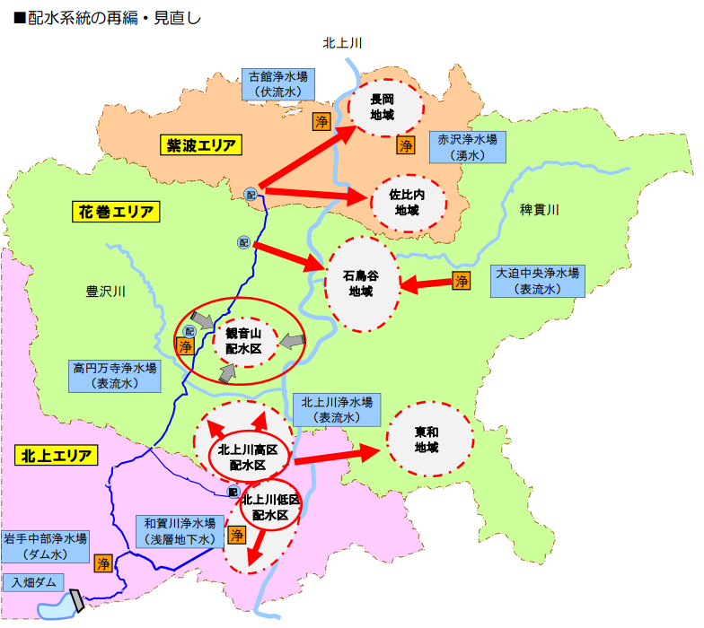
3. Development of Surface Water
  (5) Bulk Water Supply
Small WTP
Main water treatment plant is connected to other small water treatment plant
Shiwa Town
P
P
Small WTP
R
Hanamaki City
R
P
Small WTP
P
R
R
P
Stable water supply.
Main WTP
P
P
Small WTP
Kitakami City
R
Small WTP
P
Main WTP
Iwate Tyubu Water Treatment Plant
P
An example of water supply integration
(Iwate Chubu Water Supply Authority)

Slide 14
4. Treatment Process
  (1)Chlorination
Advantages
Very effective against waterborne diseases
Reliable disinfection
Easy to operate
Simple injection device
Low cost
Chlorination is the most effective disinfection method for the drinking water supply.
The effectiveness of chlorination was recognized as countermeasure against deteriorated public health in Japan after World War II .
Disadvantages
Toxicity
Generation of disinfection by-products
Corrosion of equipment
Over-reliance on chlorination may lead to neglect of water purification technology
Chlorination has prevented waterborne diseases, which were caused by contamination of water sources.

Slide 15
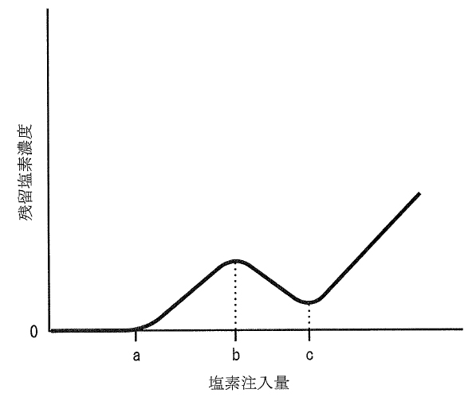
4. Treatment Process
  Water Treatment Using Chlorine
Ammonia Removal
（Break point chlorination）
Pre-chlorination to remove algae and ammonia(a)
Generation of chloramines (a)
Destruction of chloramines (b)
Destruction of chloramines
Pre-chlorination
Break point chlorination
High injection rate to
reduce the chloramine
generate free chlorine (c)
Generation of free chlorine
Generation of chloramines
(ｂ)
Concentration of
residual chlorine
(ｃ)
Break point
(a)
Manganese Removal
Oxidation of manganese by chlorine
Chlorine dosing rate
Rapid and certain removal by filtration of manganese sand, which has manganese dioxide coating.
Source: Ministry of the Environment,
Government of Japan,
http://www.env.go.jp/hourei/05/000188.html

Slide 16
4. Treatment Process
  The Standards of Chloride Concentration
After the World War II, GHQ prescribed the chlorine dosing rate based on their experiences in a developing country.
Residual chlorine at tap; 2.0 mg/l
It was too high in Japan, where hygiene conditions were rather well-maintained.
Bringing in the precedents without considering local situation
After independence, the Japanese government reduced the chlorine dosing rate.
Free residual chlorine at tap; 0.1 mg/l
Combined residual chlorine ; 0.4 mg/l

Slide 17
4. Treatment Process
  (2) Selection of Treatment Process
Water treatment facilities play a central role in water supply systems and its performance has a direct impact on the quality of the water supplied.
Good water quality
Spring water, stream water, pure shallow groundwater
Disinfection
Surface water with less turbidity
Slow sand filtration
Disinfection
Surface water with much turbidity
Rapid sand filtration
Disinfection
Abundant water volume

Slide 18
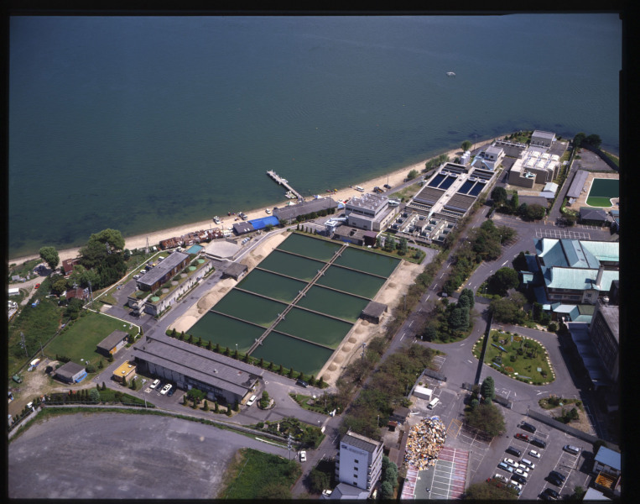

4. Treatment Process
  (3) Slow Sand Filtration
Slow sand filtration is suitable for relatively clean raw water.
It provides biological treatment when water passes through a gelatinous layer (or biofilm) which consists of algae and bacteria, etc.
Gravity settling in sedimentation tank
sand filtration with filtration velocity 4 – 5 m/day
(Japanese standards)
chlorination
Advantages
Simple facilities
Less chemicals and electricity
Removal of odor
Yanagasaki water treatment plant, Otsu City Public Enterprise Bureau
Source: Otsu city Public Enterprise Bureau, Main water supply facilities
http://www.city.otsu.lg.jp/kigyo/about/water/1454032216393.html

Slide 19
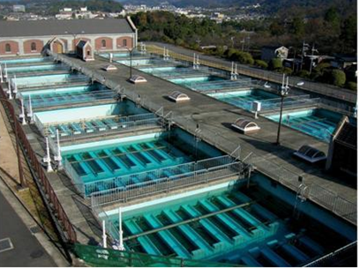
4. Treatment Process
  (4) Rapid Sand Filtration
In the early days of construction of water supply systems in Japan, slow sand filtration was selected for treatment of small volumes of relatively clean raw water. In response to the increasing demand, coagulation, sedimentation, and rapid sand filtration became the mainstream treatment technology.
Economic growth caused a huge water demand
Intake points were moved downstream to get larger water volumes
High in contaminants and high turbidity
Advantages of RS filtration
Adjusts to changes in turbidity
Less space for facility
Removal of highly concentrated ammonia
The first plant using rapid sand
filtration in Japan(Keage WTP, Kyoto City)

Slide 20
4. Treatment Process
  The Background of Widespread Application of Rapid Filtration
Smaller footprint than slow sand filters, making it possible to built in a small plots.
Disruption of river bed caused by digging for construction materials.
Why rapid filtration was selected in Japan?
Increased levels of ammonia in source waters due to contamination beyond the ability of slow sand filtration.
?
It may be only a trend; it was the most advanced technology at that time.

Slide 21
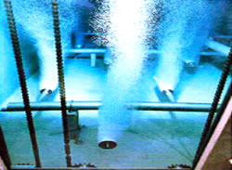
4. Treatment Process
  (5) Advanced Water Treatment
Exacerbating pollution of source waters has reached to the levels that made it difficult to treat source waters by conventional water treatment processes designed for the removal of turbidity and disinfection. Japan has carried out a series of studies for the combination of various water treatment technologies to develop advanced water treatment technologies.
Ozonation
=Oxidize organic matter
Activated carbon adsorption
=Biological reactor
Removal of odor and organic substances improves drinking water quality.
Ozone contact basin
Tokyo Metropolitan Government Bureau of Waterworks：https://www.waterworks.metro.tokyo.jp/suigen/topic/13.html

Slide 22
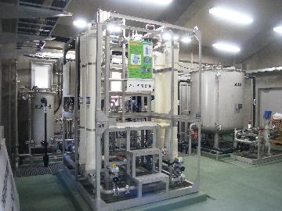
4. Treatment Process
  (6) Membrane Filtration
Advantages of membrane filtration technology requires less land areas, low maintenance and minimal manpower because it is easy to control automatically.
The use of membrane filtration is expected to increase around the world in the future.
1994-1996 MAC 21 research project; Industry-government-academia collaboration
Membrane filtration technology continues to be developed.
Membrane filtration facilities, Water supply system for Kuroda area in Kyoto city, Waterworks Bureau, City of Kyoto
http://www.city.kyoto.lg.jp/suido/page/0000160981.html

Slide 23
4. Treatment Process
  (7) Water Reuse
Water reuse can be an option even in developing countries, when water resources become too scarce or degraded to be handled with ordinary water supply systems.
In Japan, reused water is not used directly for potable use. It is used mainly for industrial process water and toilet flushing in regions where the use of groundwater is strictly regulated (ex. Tokyo) or in regions where water resources frequently run short.
Indirect water reuse
Grey water
Sewage treatment plant
Intake and water treatment plant
Drinking water
Discharge to the river

Slide 24
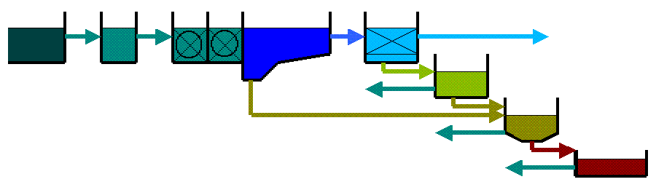
4. Treatment Process
  (8) Wastes from Treatment Plants
The sludge from the sedimentation system is sent to gravity thickener
and condensed by gravity thickener.
The filter backwash water is sent to filter backwash clarifier then it is sent to gravity thickener.
The dewatered sludge is often disposed but it is sometimes utilized for materials for cements, playgrounds and agricultural compost etc.
Receiving well
Flash mixing chamber
Sedimentation basin
Rapid sand
filters
Drinking water
Filter backwash clarifier
Flocculation basin
Gravity thickener
Dewatering process

Slide 25
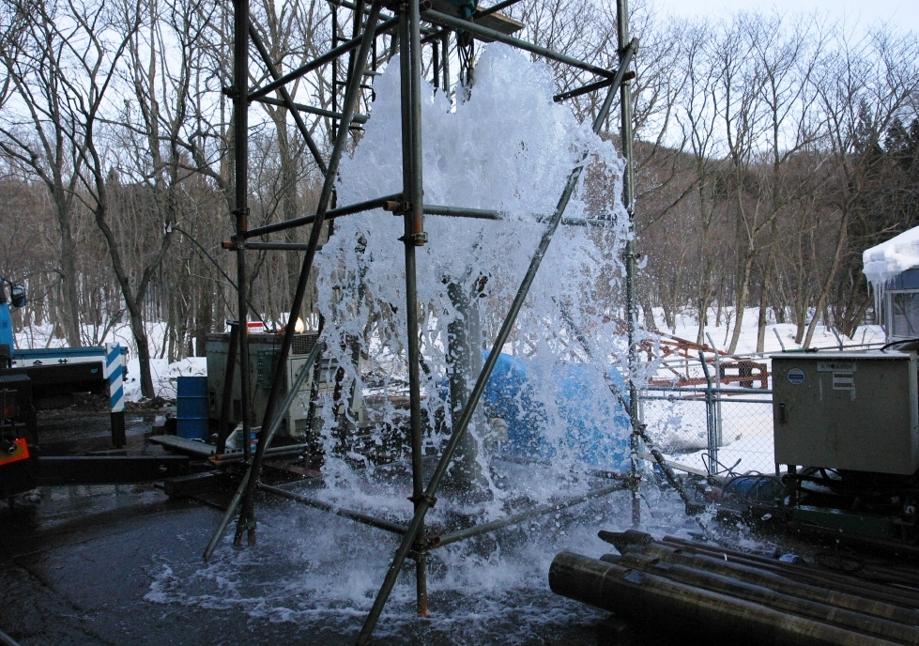
5. Groundwater Use and Prevention of Land Subsidence
  (1) Groundwater Withdrawal
In general, groundwater is clear and suitable as a drinking water source. But in some cases, it requires treatment to meet water quality guidelines.
Check water quality carefully because some groundwater is not good for drinking water.
Contaminated by
Fe, Mg, As…or E. Coli.
Maintain and monitor the well regularly.
Groundwater source
（Takizawa Village, Iwate Prefecture）

Slide 26
5. Groundwater Use and Prevention of Land Subsidence
  (2) Land Subsidence
Japan experienced serious land subsidence in some regions, but has brought it under control by introducing strict regulations for use by industries and large buildings, and supplying alternative sources such as surface water and reclaimed wastewater.
Monitoring of the levels of ground and groundwater tables
Introduce regulations for pumping groundwater to restrict water withdrawal
Provide other water sources instead of groundwater
Preventing overuse of groundwater to avoid negative effect of land subsidence
Monitor groundwater levels, land subsidence and groundwater withdrawal regularly

Slide 27
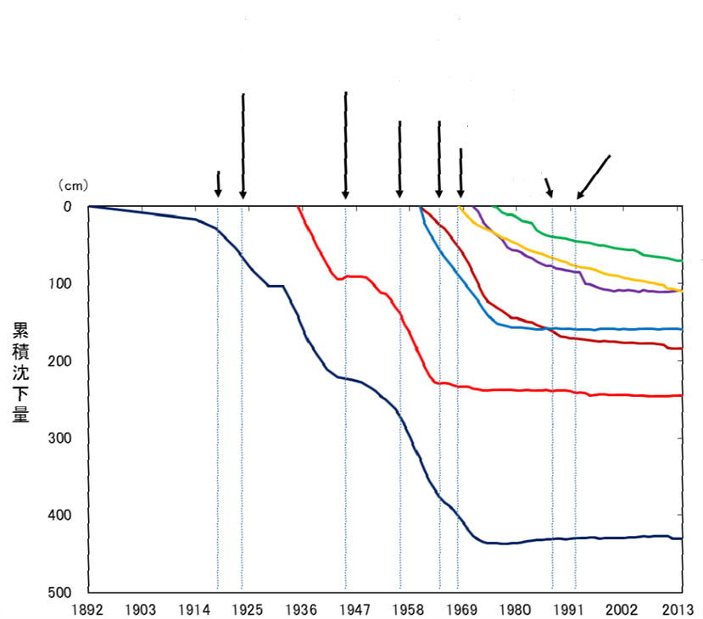
5. Groundwater Use and Prevention of Land Subsidence
  The Background of Land Subsidence in Japan
1930s-40s The cause of land subsidence was found to be excessive groundwater pumping.
No countermeasures, economic recovery was priority
Lifting phenomena at pumping facility
1950s Land subsidence became recognized as a serious social problem causing flooding and lifting of buildings.
Other Cities
Total Subsidence (cm)
Various countermeasures
Osaka
Today Japan has almost stopped land subsidence.
Tokyo

Slide 28
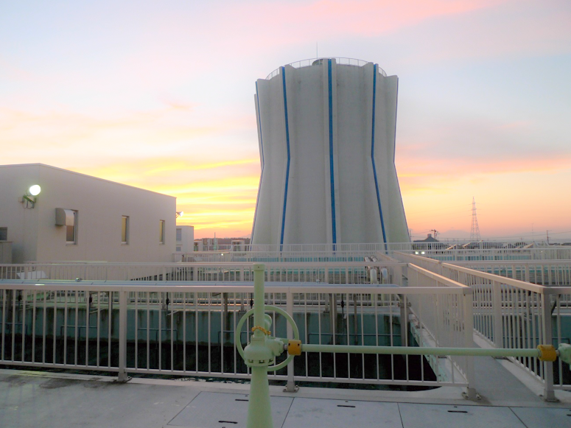
6. Distribution Systems
  (1) Distribution Systems
The investment in distribution infrastructure such as service reservoirs, pump stations and pipelines is very costly and it accounts for 2/3 of the total capital cost of all the water supply facilities. Therefore, good planning of the distribution system based on the long-term perspective is very important.
For good planning,
Construct service reservoirs in high places
Use elevated tanks when there is no suitable high place
Plan the capacity of service reservoirs and distribution network based on the long-term water demand projection
Understand pump technology and water hammer pressure to prevent critical damages to the system
Elevated tank,
Hachinohe Region Water Supply Authority

Slide 29
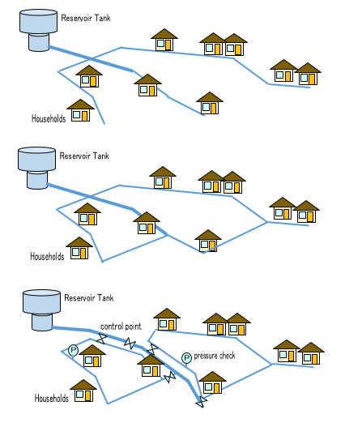
6. Distribution Systems
  (2) Pipeline Configuration
Tree system
The planning policy for distribution pipelines has been changing gradually in Japan, from simple distribution to more sophisticated control of water distribution.
1st stage: Tree (dendritic) system for simple distribution
2nd stage: Network system to minimize the negative impact of accidents and ensure operational flexibility
3rd stage: Block system for
(1) optimizing water pressure
(2) clear picture of water supply operation
(3) identification of accidental damage and provision of backup water supply
Network system
Block system
Monitoring and control point to find leakage

Slide 30
7. Engineering Design and Master Plans
  (1) Importance of Facility Standards
The most important concept for water supply is to secure the safe supply of water through well-designed water facilities. The design standards to define the function and capacity of water facilities are specified in the Water Supply Act.
Need to acquire design methods and accumulate technical knowledge
Coordinated by
Japan Water Works Association
Share know-how among senior engineers of major water utilities
Build up the Design Criteria for Water Supply Facilities
It has been complementing the design standards of the Water Supply Act.
Update the Design Criteria on a regular basis

Slide 31
7. Engineering Design and Master Plans
  (2)Updating the Design Concepts
The design concepts for water supply facilities need to be improved, reflecting the situations of each country. For example, since Japan is an earthquake prone country, the design of water supply facilities has been improved gradually based on lessons learned from the damage of past earthquakes.
The Great Hanshin/Awaji Earthquake 1995
The Great East Japan Earthquake 2011
Damage was reduced.
Improvement in preparedness
Manuals for Emergency Response in Earthquakes
Seismic Design and Construction Guidelines for Water Supply Facilities
Anti-seismic pipeline for distribution main
Efforts to secure emergency water supply

Slide 32
7. Engineering Design and Master Plans
  (3) Step by Step Expansion
Water supply systems require large amounts of funding for construction, and therefore, must be expanded step by step, based on medium to long-term master plans including business plans with sound financial policy.
Updated master plan
Primary master plan
Adjust master plan step by step according to actual income and finance
City A
Pipe network
Pipe network
Water resource
Water facilities
Water resource
Water facilities
Finance
Organization
Finance
Land acquisition
Construction first year
Organization
Construction 5 years
Land acquisition
Construction 10 years
10 -year plan

Slide 33
7. Engineering Design and Master Plans
  (4) System to Validate Proper Operation and Management
Approval (License), stipulated in the Water Supply Act, requires a master plan. It was effective in the early stage of expansion when water utilities were not yet technically sophisticated.
A master plan
Prepared with technical assistance by prefectural governments and health centers.
As Japan has shifted from the expansion stage to the maintenance stage, Approval(License) is now supplemented by the following plans and systems:
Application for License
・Demand prediction
・Facility plan
・Financial plan
（Tariff setting）
Waterworks Vision
Annual business plan and budget to be approved by local councils
Water Safety Plan
Used for screening to obtain subsidy
Asset Management

Slide 34
8. Lessons Learned (1)
  (Selection of Water Source) It is ideal if pristine water sources can be used for drinking water supply. This is especially important for small- and medium-scale utilities that are in short of human resources and technical capabilities.
  (Surface Water Development) The water rights system and Comprehensive River Development were effective for developing water resources. It requires cooperation of stakeholders, negotiations and sometimes conflict management. Dam construction is expensive, so that municipalities needed to get together and work with other users and river authorities on multipurpose dam construction. They also organized to secure Bulk Water Supply.
  (Chlorination) Chlorination contributed a lot to the supply of safe tap water. However, it has some disadvantages including; production of disinfection by-products, formation and corrosion of equipment.
  (Rapid Sand Filtration) The coagulation, flocculation, sedimentation and rapid sand filtration process is often used to treat highly polluted raw water. The choice depends on quality of the raw water and water demand. Many utilities use this method to treat large volume of polluted water especially in urban area, which usually located at downstream.

Slide 35
8. Lessons Learned (2)
  (Dealing with Source Water Deterioration) Japan developed technologies and new approaches to deal with challenges of water source pollution and drought. These include advanced water treatment, membrane filtration and wastewater reuse. Although new technology development requires larger investment, it can produce high quality waters to win the public support for the water supply.
  (Prevention of Land Subsidence) Japan faced serious land subsidence due to over-pumping of groundwater in some regions. This problem is under control by strictly regulating groundwater abstraction, providing alternative water sources and monitoring ground levels and groundwater levels.
  (Transmission and Distribution Systems) The investment for transmission and distribution systems accounts for two thirds of the total investment cost of the water supply system, so that it is important to plan and construct distribution reservoir, pumps and pipelines efficiently based on the long-term plans. Japan has taken advantage of its hilly terrain to build gravity flow systems to save money and energy for easy control of water distribution.

Slide 36
8. Lessons Learned (3)
  (Block Distribution Systems) Distribution pipelines have evolved from dendritic systems, to network and block distribution systems as cities expand. The advanced designs provide better control of water distribution and minimize supply disruptions.
  (Master Plan) Japan expanded its water supply systems by well-planned and stepwise expansion to keep pace with population growth and water demand. This approach is effective for sound financial management of the utilities. Formulation of a master plan, which includes long-term projection of demographic and social changes is effective in developing water supply system and expanding water supply coverage.
  (Approval(License) System) The Water Supply Act stipulates the requirements for Approval(License), facility standards and qualification of technical administrators. These set the high standard for water supply quality and sound business management. The national government is encouraging the preparation of Water Vision and Water Safety Plan to ensure technical stability of utilities. Preparation of annual business plan, which includes budget plan based on the Local Public Enterprise Act, and the approval by the local assembly ensures sound business management.

