Slide 1
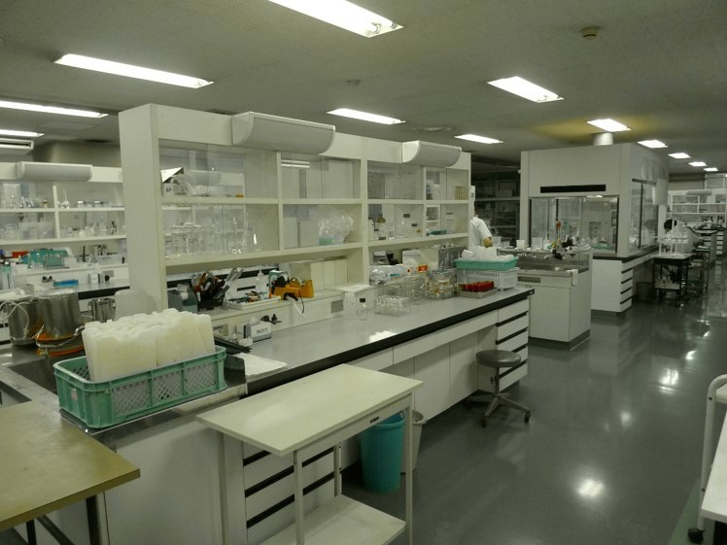
Water Quality Management
No. T3 Ver. 1
Water quality laboratory at Kitachiba Water Supply Authority (September 21, 2011)

Slide 2
Contents
      Introduction
      Importance of Water Quality Management
      Drinking Water Quality Standards and its Compliance
      Drinking Water Quality Testing
      Standards for Water Supply Materials and Equipment
      Preventing Deterioration of Source Water Quality
      Lessons Learned

Slide 3
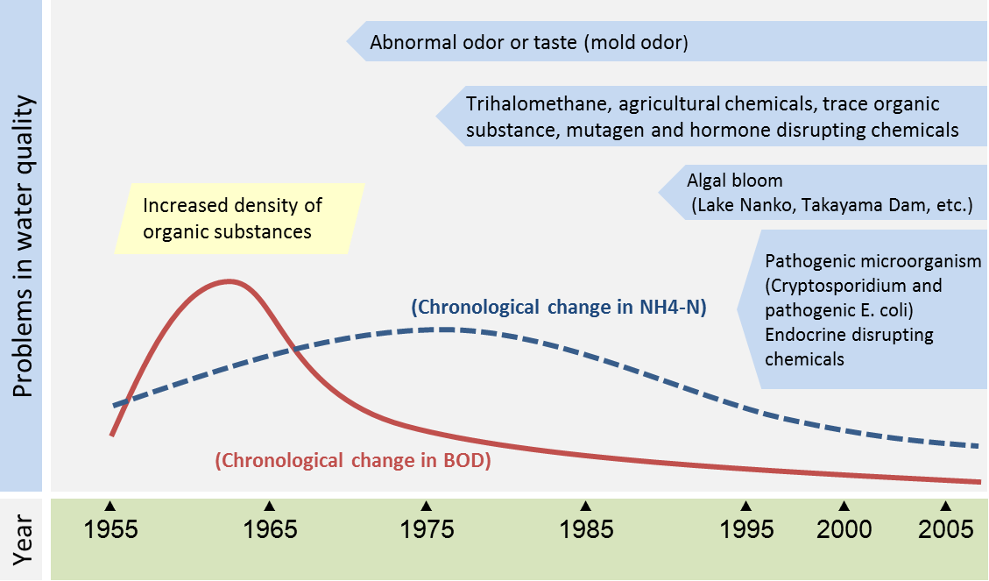
1. Introduction
Historical change in Yodo River water quality; water source for Osaka
Yodogawa river office, Ministry of Land, Infrastructure, Transport and Tourism, "Historical transition of water quality problem," [Online] Available: https://www.yodogawa.kkr.mlit.go.jp/know/data/problem/02/a.html [Accessed 8 July 2016]

Slide 4
1. Introduction
Frequently asked questions from participants of the water supply training courses
Q1. What measures were implemented to reduce the incidence of waterborne diseases such as cholera, which affected Japanese society in the past?
Q2. Why Japan could implement long-lasting water quality management?
Q3. What are the requirements for compliance with water quality standards for water utilities in Japan?
Q4. How has the good quality equipment required for water quality management been procured in Japan?
Q5. How has Japan dealt with the serious problems caused by deterioration of source water quality?

Slide 5
2. Importance of Water Quality Management
(1) History and Background of Water Quality Management
No significant risk to health from lifetime exposure
Safe drinking water
Requirements for safe drinking water
Water quality conservation at water sources
Maintenance of water quality in pipelines
Proper water treatment
Maintenance of water quality in water service devices
Drinking Water Quality Standards
Defined by the Water Supply Act
Appropriate facilities
Appropriate management

Slide 6
2. Importance of Water Quality Management
Column: Article 18 of the Water Supply Act
Customers of water supply
Water utilities
eligible for requesting water quality testing at tap
Emphasis on epidemiological safety of water supply
Water Supply Act
Drinking Water Quality Standards
Customer‘s right to request water quality testing
Awareness of responsibility by water utilities to provide safe water.
Integrated water quality management by water utilities

Slide 7
2. Importance of Water Quality Management
(2) Water Quality Management System
Water Utilities
Utilize data for future water quality control
Ministry of Health, Labour and Welfare (MHLW) utilizes data for
・Revising water quality standards
・Accuracy check (evaluation and ranking) of testing organizations
Water source
Automatic measurement of
turbidity, electrical conductivity, etc.
Detailed testing at least once a year
Water Treatment Plant
Automatic measurement of each process for appropriate treatment.
Distribution Reservoir
Automatic measurement of
turbidity, color and residual chlorine.
Testing organizations
・Water utilities
・Prefectural government
・Water quality testing organizations registered by MHLW
Taps
Daily testing for Turbidity, color and residual chlorine
Detailed testing once a month
or once in three months

Slide 8
2. Importance of Water Quality Management
(3) Cost of Water Quality Management
Water quality management requires …
Skilled staff to conduct water quality management activities
Water treatment chemicals
Energy for water treatment plant
Management and operation of appropriate organization
Water quality management costs
Estimation of cost in drafting business plan

Slide 9
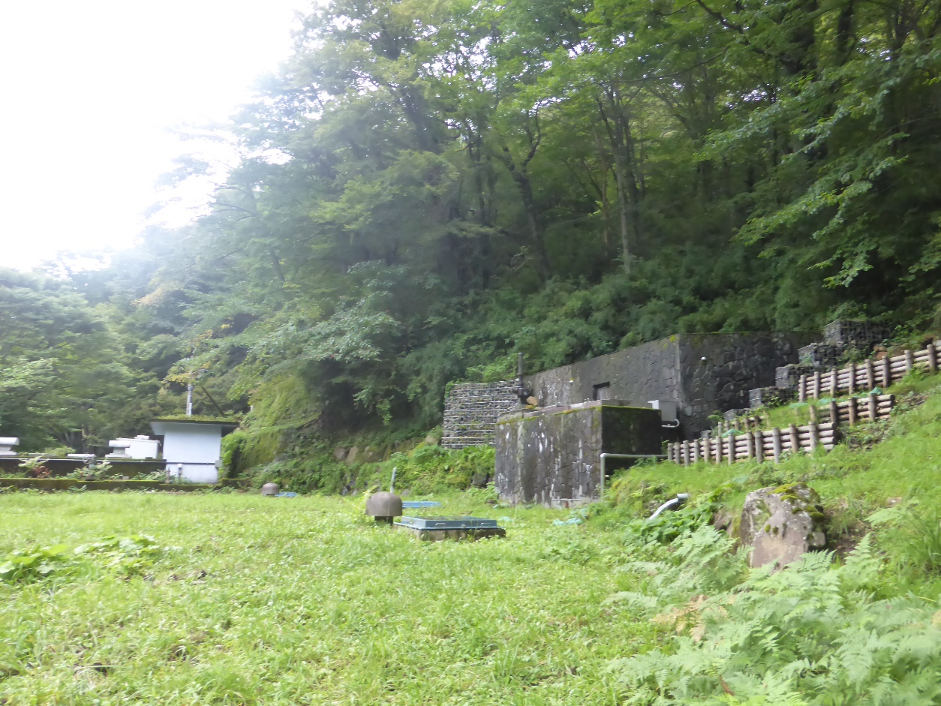
2. Importance of Water Quality Management
Small Scale Public Water Supply Using Good Quality Water Sources
By using pristine spring water sources from the foot of the mountain, raw water is stored in an intake tank and only chlorinated before distribution.
Small Scale Public Water Supply
Limited financial capacity
Understaffing
Pristine water source
Reduction of water treatment cost
Easy water quality management

Slide 10
2. Importance of Water Quality Management
(4) Clear Responsibility for Water Quality Management
Appoint responsible person for water quality
management
Water Supply Services Technical Administrator (Article 19)
Responsibilities
Inspection of water supply facilities to meet technical standards
Water quality examination
Sanitary measures such as disinfection
Water supply suspension
Establish administrative checking system
On-site inspection, guidance and supervision by a supervising authority (Article 36, Article 39 of the Water Supply Act)
On-site inspection, instruction for improvement and water supply suspension order by the national government or prefectural government
Assist small and medium scale water utilities whose capacity is limited
Support by health center
Assessment of result of water quality examination
Providing technical information

Slide 11
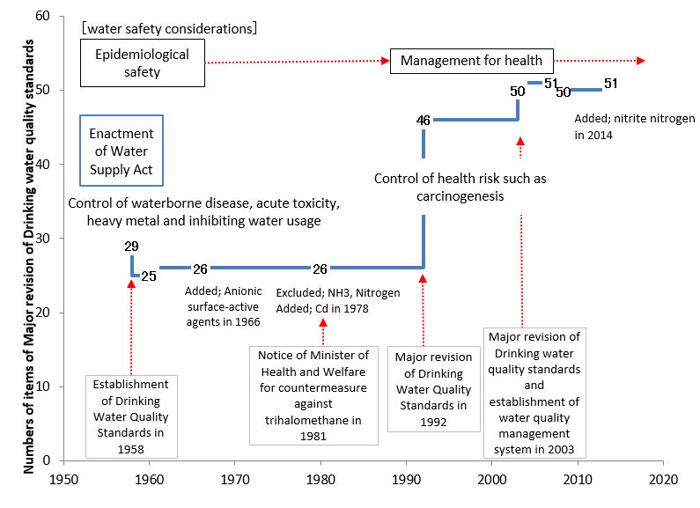
3. Drinking Water Quality Standards
(1) Formulation of Drinking Water Quality Standards
Drinking Water Quality Standards in Japan have been developed and modified based on the new knowledge on toxic substances and the technical level of water quality testing.

Slide 12
3. Drinking Water Quality Standards
(2) Notifications about Drinking Water Quality
National Government
(Water Supply Division of the Ministry of Health, Labour and Welfare)
Article 39 of the Water Supply Act; Collection of reports and on-site inspection
Article 36 of the Water Supply Act; Instruction for improvement, etc.
Article 14 of the Order for Enforcement of Water Supply Act; Delegation of authority to the prefectural
governors
Prefectural government,
City with health centers
Health center
Health center
Health center
Health center
Water utilities
Planned service population ≦50,000
Water utilities
Planned service population ＞50,000
Health center; Organization established based upon Community Health Act
Ensures comprehensive promotion of regional public health measures

Slide 13
4. Drinking Water Quality Testing
(1) Water Quality Parameters and Testing Methods
Evolution of Drinking Water Quality Standards
Measurement technology
1958
Control of waterborne disease and acute toxicity
Bacterial culture, gravimetric method, titration and calorimetric method
＋
1978
Control of heavy metal and soil contamination
Absorption spectrophotometer
Atomic absorption spectrophotometer
＋
1992
Control of health concerns related to carcinogens and disinfection by-products
Flameless atomic absorption
spectrophotometer
Ion chromatography
ICP/MS
GC/MS
LC/MS
Revision of threshold value based on improved measurement technology
2015

Slide 14
4. Drinking Water Quality Testing
(2) Responsibility for Water Quality Testing
How can
Small-Scale Utilities
manage
water quality testing?
Water utilities must make their own arrangements for water quality testing
1. Establish a shared testing facility
2. Utilize external service such as health centers, etc.
Water quality testing by health centers became difficult as parameters stipulated in Drinking Water Quality Standards increased.
Increasing outsourcing to private testing facility registered by the Minister of Health, Labour and Welfare
Water utilities prepare a water quality monitoring plan, conduct daily tests (residual chlorine, color and turbidity) by themselves, judge the safety of water and guarantee water quality.

Slide 15
4. Drinking Water Quality Testing
(3) Administrative Framework for Water Quality Testing
Contents of water quality monitoring plan
Specific water quality issues that require attention in the water quality monitoring plan
Items, sampling points and frequency for regular water quality testing
Items omitted from regular testing and the reasons
Items for extraordinary water quality testing and the reasons
Tests that will be outsourced, when water utilities send samples to health centers or private laboratories
Other issues to be considered, such as evaluation of the results, revision of the water quality monitoring plan, quality control, and reliability assessment
The national government or the prefectural government checks the water quality monitoring plan and recommends improvements where necessary.

Slide 16
4. Drinking Water Quality Testing
People engaged in Water Quality Management
Manufacturers
of material and equipment for water supply
Maintenance in usual operations
Measures in an emergency
Water utilities
Technical administrator
Sanitary engineers, mechanics, electricians, etc.
Technicians of the laboratory
Staff who monitor water quality at tap
Administrative staff in government
Providing new information about water quality
Check for compliance of water quality management

Slide 17
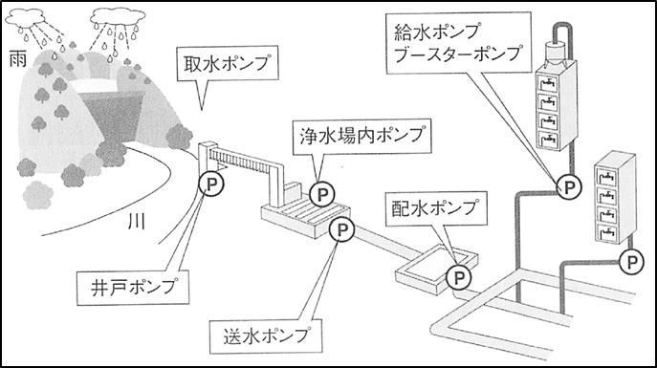
5. Standards for Materials and Equipment for Water Supply
Water quality management
from water source to each tap
Need to ensure quality of material and equipment for water supply
Water service pump,
Booster pump
Water source
Water intake pump
Pump at water treatment plant
Distribution pump
Well pump
Conveying pump
Water supply pipelines

Slide 18
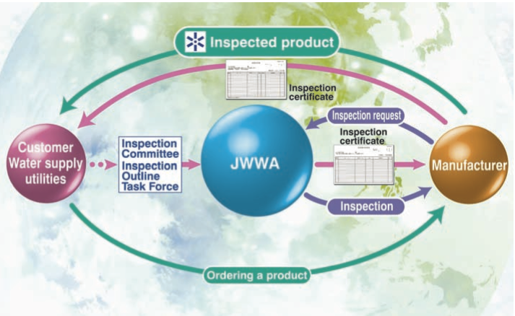
5. Standards for Materials and Equipment for Water Supply
Japan Water Works Association (JWWA) conducts inspection of material and equipment for water supply facilities
Japan Water Works Association, "Profile Public Interest Incorporated Association Japan Water Works Association," [Online] Available: http://www.jwwa.or.jp/jigyou/kaigai_file/JwwaProfile2015.pdf [Accessed 11 July 2016]

Slide 19
6. Preventing Deterioration of Source Water Quality
(1) Action taken in response to Changes in Source Water Quality

Slide 20
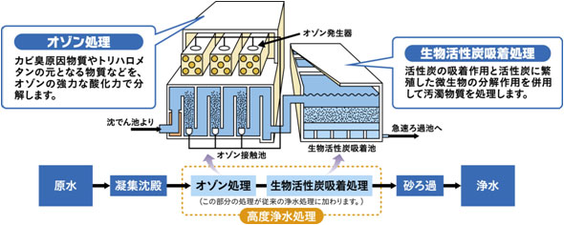
6. Preventing Deterioration of Source Water Quality
Introduction of Advanced Water Treatment Processes for Deteriorated Raw Waters
Biological activated carbon treatment
Ozonation
Ozone generator
Pollutants are treated using both adsorption action of activated carbon and decomposition action of microorganisms breeding in the activated carbon.
Materials causing mold odor or generating trihalomethanes are oxidized by ozone.
From sedimentation
To rapid filtration
Ozone contact basin
Biologically activated carbon adsorption basin
Raw water
Coagulation sedimentation
Ozonation
Adsorption by biologically activated carbon
Sand filtration
Purified water
Advanced water treatment process
(This part is added to the conventional water treatment.)

Slide 21
6. Preventing Deterioration of Source Water Quality
(2) Conservation of Water Catchment Forests
Under the Forest Act water utilities have made efforts to conserve the forests in the catchment area, to improve source water quality and quantity.
In order to protect water sources proactively, water utilities
Procure forests in the upstream area
Call for volunteers to take care of trees
Example of Catchment Forest Conservation by Some Utilities
Water utility | Location | Area
Tokyo Metropolis | Upstream of Tama River (Okutama machi and part of Yamanashi Prefecture), started in 1910 as the first attempt | 23,000ha
Yokohama City (Kanagawa pref.) | Upstream of Doshi River (Yamanashi Prefecture), located outside Kanagawa pref. | 2,873ha
Kagawa Prefecture | Upstream of Yoshino River (Kochi Prefecture) Subsidy for improvement cutting and tree thinning for water source forest. | －

Slide 22
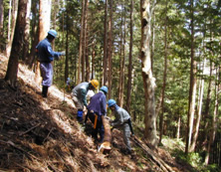
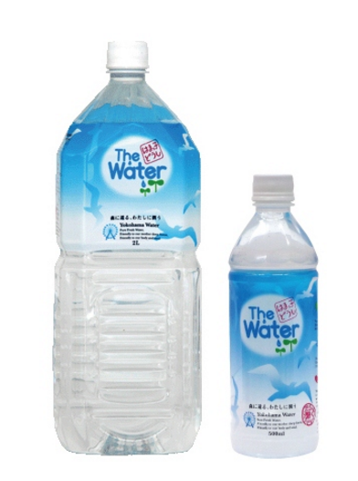
6. Preventing Deterioration of Source Water Quality
Example: Watershed Forest in Doshi
The Doshi River is an important water source for Yokohama City, and its upstream areas belonged to neighboring Yamanashi Prefecture. Yokohama City procured publicly-owned forest lands from Yamanashi Pref. in 1916 and started conservation activities of those lands.
Proactive support of conservation activities by the citizens;
Organize a volunteer group
Establish the Doshi Forest Fund and collect contributions
Use the sales of bottled water “Hamakko Doshi”, this name means “we are citizens of Yokohama city together.”
The forest is very wide, and account for 36% of the area of Doshi Village.
Yokohama Waterworks Bureau
http://www.city.yokohama.lg.jp/suidou/kyoku/torikumi/suigen-hozen/doshivolunteer.html

Slide 23
6. Preventing Deterioration of Source Water Quality
(3) Legislative Framework for Protection of Water Source Quality
Promoting water quality management over the whole river basin was rather difficult in Japan, due to fragmentation of the competent authorities and laws. However, improvement of basin-wide water quality management is expected by better coordination among water utilities and local governments, as well as the enforcement of the newly-enacted the Basic Act on Water Cycle.
Conservation of water quality in Lake Biwa
Wastewater treatment in Kyoto City and many other upstream cities to protect water sources for downstream cities
Lake Biwa
Kyoto city
Necessity of water quality management for the whole watershed
Kobe city
Osaka Bay
Multiple users taking water and discharging treated wastewater
Osaka city

Slide 24
6. Source Water Quality
Formaldehyde Contamination at Tone River
In 2012 a factory located upstream accidentally discharged hexamethylenetetramine. The chemical reacted with chlorine at several downstream water treatment plants to produce formaldehyde. Consequently, the concentration of formaldehyde in treated water increased significantly, almost reaching the limit set by the water quality standard. The following actions were taken to manage the incident;
To find the cause
Increase the frequency of water quality testing of purified water
Strengthen the water quality monitoring system
Communicate closely with other water utilities
To avoid distribution of contaminated water
limit or suspend the intake of contaminated water
Use other water sources including groundwater
Supply from stock and not-affected treatment plants
Urgently release water from the upstream reservoirs to dilute and flush the contaminated water
In such a large basin, a single incident can affect many downstream water utilities. Therefore, the networking system among utilities and local governments has been built to share the information and provide rapid emergency response.

Slide 25
6. Source Water Quality
(4) Practical countermeasures against water source pollution
・ River management
・ Flood control
・ Sewerage
Ministry of Land, Infrastructure, Transport and Tourism
・Waterworks
Ministry of Health, Labour and Welfare
・Industrial water
Ministry of Economy, Trade and Industry
River
・Conservation of water environment
Ministry of the Environment
・Agricultural water
Ministry of Agriculture, Forestry and Fisheries
Two Laws concerning drinking water resources (enacted in 1994)
Ministry of Health, Labour and Welfare
Act on Advancement of Project for Quality Management of Raw Water
Ministry of the Environment
Act on Special Measures concerning Water Quality Conservation at Water Resources Area in Order to Prevent the Specified Difficulties in Water Utilization

Slide 26
6. Source Water Quality
Background of the Basic Act on Water Cycle
Bottom-up movement for legislation from scholars, citizens, and politicians
・Scholars ・Citizens
・ Diet members
Fragmented regulation on water
Insufficient legal framework to control groundwater
Necessity for sound basin-wide water management
legislation by Diet members
Leadership by prime minister to coordinate line ministries
Decision of “Water Cycle Basic Plan” each five years
Enactment of the bill in 2014

Slide 27
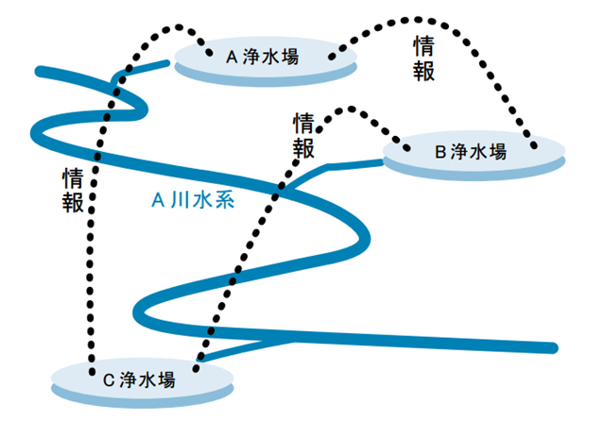
6. Source Water Quality
Necessity of cooperation between upstream and downstream
users
Councils of stakeholders for information sharing and dialogue, assembled in each watershed
Cooperation between environmental administration and water supply administration in Prefecture
Water Safety Plan based on information of watershed
A Water Utility
Information
Information
B Water Utility
Information
Watershed of the A River
C Water Utility

Slide 28
      7. Lessons Learned (1)
  (From Source to Taps) Water quality management is considered as a whole of management procedures to meet the water quality standards of tap water throughout from the water source. The national government and water utilities have been actively involved in periodical review of water quality standards, improvement of water quality testing methods, monitoring by administrative organizations, quality control of materials and equipment, and human resource development.
  (Public Health) Japan has been focusing on epidemiological safety of modern water supply because it experienced outbreak on waterborne diseases. Water quality management is critical to the utilities’ ability to supply safe drinking water; it is very important to public health.
  (Monitoring) Water quality is monitored at the water source, treatment plant, distribution reservoir up to the customers’ tap. Automated systems has been introduced in place of manual tests for daily testing of residual chlorine, color and turbidity. It is important to utilize the data accumulated for water resource conservation, water treatment and emergency response to accidental contamination of source water quality.

Slide 29
      7. Lessons Learned (2)
  (Cost of Water Quality Management) Utilities have made sustained efforts in water quality management by securing necessary budget in their business plan. This is based on the recognition that water quality management requires certain costs for chemicals, electricity and many other expenses.
  (Starting with a Good Quality Water Source) Small-scale utilities with limited technical capacity and funding have utilized a good quality water source and have installed facilities to simplify and economize the treatment process.
  (Designing Water Quality Management) In designing water quality management system, it should comply with the legal requirements prescribed by the relevant Acts and regulations. These include: (1)designating a responsible officer for water quality management; (2)having national nor government oversight; and (3)supporting small and medium scale utilities with limited capacity.

Slide 30
      7. Lessons Learned (3)
  (Setting of Water Quality Standards) The aim of setting drinking water quality standards is the protection of public health from toxic substances and bacteria, and the parameters of our health concern. Water quality standards for contaminants suspected to cause long term health risk (such as cancer), are revised as a result of new knowledge, public concerns, and availability of measurement instruments. It was important to establish the standards considering qualities of water resources and drinking water, the technical levels of water quality testing and measurement instruments in the country.
  (Standards for Materials and Equipment) It is important that utilities use certified materials and equipment. The inspection and certification services of Japan Water Works Association for materials and equipment play an important role in maintaining the high quality of such products. It is essential that water supply system utilize standardized materials and equipment.

Slide 31
      7. Lessons Learned (4)
  (Protecting Water Source) Utilities use advanced water treatment processes to deal with odor caused by quality deterioration of water sources, but those are expensive. Therefore, water resource conservation such as construction of sewage facilities, regulation of industrial wastewater, enhancement of information sharing among surface water users, awareness-raising activities and conservation of water catchment forests. As the water demand saturated and stabled, it became important to conduct water resource conservation with stakeholders around watershed while seeking for cleaner water source, for example moving intake facilities to upstream.
  (Cooperation in Watershed) Utilities in the same watershed cooperate, share information and take prompt action together in case of incidents of pollution. The formal mechanisms for cooperation and coordination greatly facilitate information sharing and water quality management. In this regard, the development of water safety plan is promoted by the national government in Japan.

