Slide 1
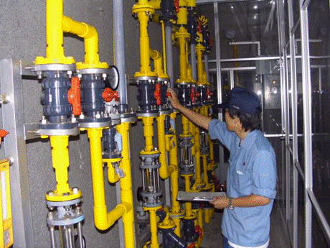
Operation and Maintenance of Facilities
No. T4 Ver. 1
Source: JICA Training Course Material prepared by Sapporo
City Waterworks Bureau (JICA Sapporo, 2015)

Slide 2
Contents
      Introduction
      Importance of Maintenance
      Laws and Institutional Framework
      Best Practices in Japan
      Lessons Learned

Slide 3
1. Introduction
Focus on construction & expansion of water supply facilities
Serious
accidents
Focus on maintenance
of facilities
Regulation & Guidelines
Safe and stable water supply
by good practices in maintenance

Slide 4
1. Introduction
Frequently asked questions from participants of the water supply training courses
Q1. How did Japanese utilities achieve good practices in maintenance?
Q2. How do Japanese utilities manage to share the knowledge on maintenance and benefit from each other’s experience?
Q3. How can best practices be retained in spite of staff turnover? What is Japan’s approach to sharing best practices within a utility and across the water supply sector?

Slide 5
      2. Importance of Maintenance
Why maintenance is important?
  Inadequate maintenance can cause operation fault and service deterioration
  Secondary disaster (e.g. road collapse by pipe burst, chlorine leakage )
  Service breakdown: poor water quality, reduced pressure, perception of reduced reliability, claims from customers.
  Higher life cycle cost: early deterioration of facilities
Schematic of Collective and Preventive Maintenance
Source: This study

Slide 6
      2. Importance of Maintenance
Item | Triggering events | Issues and causes
Water Treatment Facility | Poor disinfection (waterborne diseases spread by water supply) | No standard manuals nor operational procedures for O&M
 | Malfunction of facility and failure of water treatment
Pipelines | Contamination due to negative pressure (waterborne diseases spread by water supply) | No precise information nor drawings on aged pipelines
 | Secondary disaster due to burst pipes
 | Public complaint of rusty/turbid water
 | Dysentery caused by cross connection | Quality control for installation of water service connections

Slide 7
      2. Importance of Maintenance
(1) Disease Outbreaks
  Outbreaks increased when water supply coverage was expanded to rural areas where many small utilities were built (since the 1950s).
  Cases were dramatically decreased by intensive O&M measures promoted by Water Supply Facilities Maintenance Manual in 1953.
Major expansion of water supply
Maintenance Manual
Strengthened assistance
by Health Center
Water Supply Act
Source: The editorial committee of the One Hundred Year History of Modern Water Supply, “One Hundred Year History of Modern Water Supply,” Nihon Suido Shimbunsha, 1988.

Slide 8
      2. Importance of Maintenance
Causes of Outbreaks of Waterborne Diseases
42%: Lack or failure of disinfection facilities
27%: Contamination in pipelines *
1950s~1960s: Focus on Operation and Maintenance
Laws and Regulations
Guidelines
Best practices and dissemination throughout the country
1970s: Outbreaks of waterborne diseases caused by water supply system were suppressed.
* caused by water supply interruption, cross contamination etc.

Slide 9
      2. Importance of Maintenance
(2) Cross Connection
Serious Accident of Cross Connection in1969
It was found that a water distribution pipe had been connected to an industrial water pipe by mistake of pipe installation work. People had been drunk industrial water for one year.
Causes
Drawings and documentation not properly archived
No appropriate construction supervision
No water quality testing after construction
Corrective measures
Strengthening of construction supervision
Records of construction
Registration of drawings
Strengthening of completion inspection
Testing for residual chlorine
Great impact on both the citizens and utilities

Slide 10
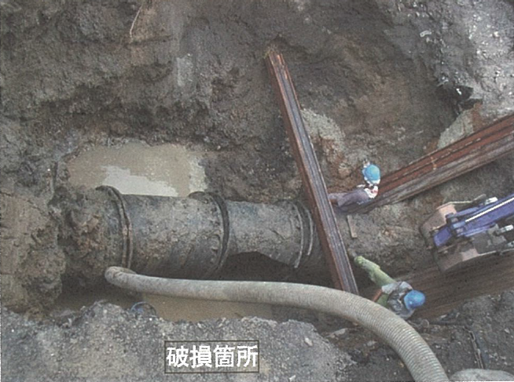
      2. Importance of Maintenance
      2. Importance of Maintenance
(3) Pipe Bursts
Pipe materials deteriorate with age
Causes | Corrosion Deterioration of materials Old lining method
Effect | Water supply interruption Road caving Flooding of homes and roads
Measures | Accelerate scheduled replacement of aging pipes Emergency management
Pipe Breakage
Source: JWWA, “Casebook of Water Supply Accidents for Practical Use,” 2008.
Note: Photo is modified from original (indicated in red)

Slide 11
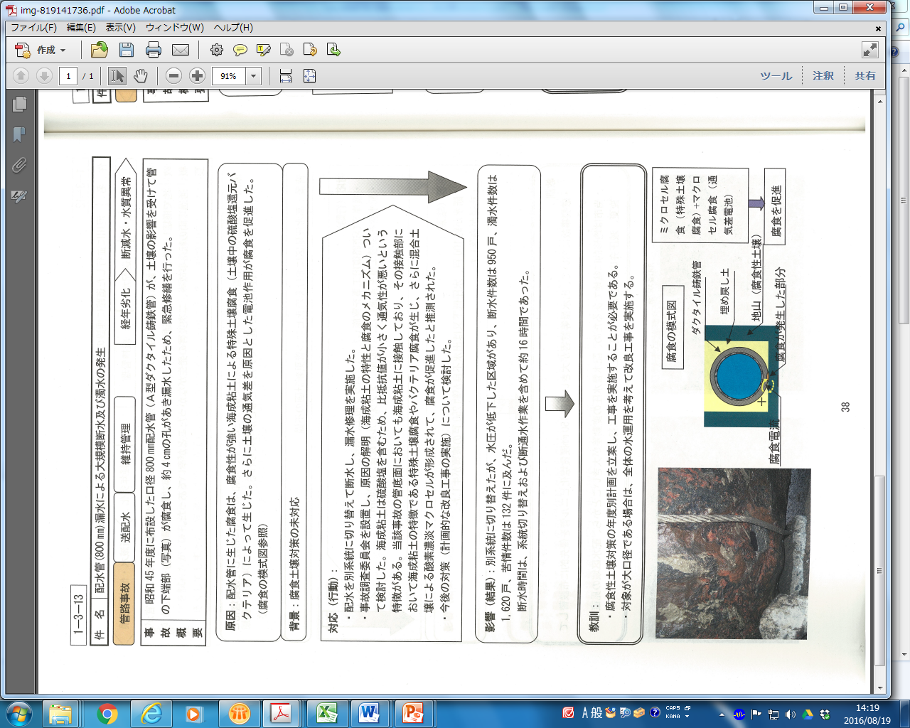
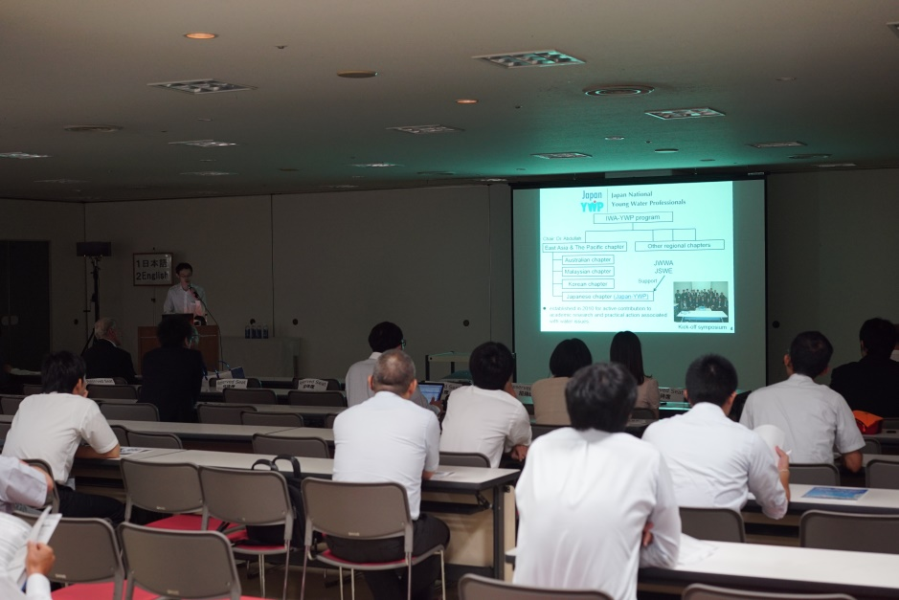
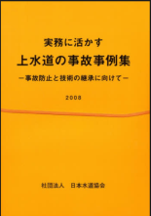
      2. Importance of Maintenance
Information sharing among utilities across Japan
      Annual academic conference held in Japan Water Works Association General Assembly
      Casebook of Water Supply Accidents for Practical Use
JWWA, “Casebook of Water Supply Accidents for Practical Use,” 2008.
Japan Water Works Association General Assembly Meeting

Slide 12
      2. Importance of Maintenance
Improved Management of Pipelines
Laws and regulations were enforced in response to the accident.
Year | Events Related Leakage Control in Japan
1945 | End of World War II (pipeline damage by war)
1946 | Water Leakage Prevention Guidelines (Ministry of Health and Welfare, Japan Water Works Association)
1950s | Aged pipelines installed before the war and deterioration of pipes of poor material manufactured during the war.
1960 | Revision of the Water Leakage Prevention Guideline (Bureau of Waterworks, Tokyo Metropolitan Government water leakage prevention committee)
1960 | Notice of the Ministry of Health and Welfare: on water leakage prevention measures
Around 1970 | Media reports on rusty water causing public concern.
1970 | Notice of the Ministry of Health and Welfare: on pipeline repair and replacement to prevent leakage and removal of rusting pipes
1977 | Guidelines for Water Leakage Preventive Measures

Slide 13
3. Laws and Institutional Framework
Legal Basis on Maintenance
      The Water Supply Act clearly stipulates the importance of abiding by the maintenance and facility standards.
      Japan Water Works Association published Design Criteria for Water Supply Facilities and Water Supply Facilities Maintenance Manual.
Water Supply Act
“Article 5, 2 ... In determining the location and arrangements of water supply facilities, it is necessary to make their construction, operation and maintenance as economically and easily as possible, and to give consideration to assurance of water supply...
Based on the Act, technical standards are developed & regularly updated.
Technical standards

Slide 14
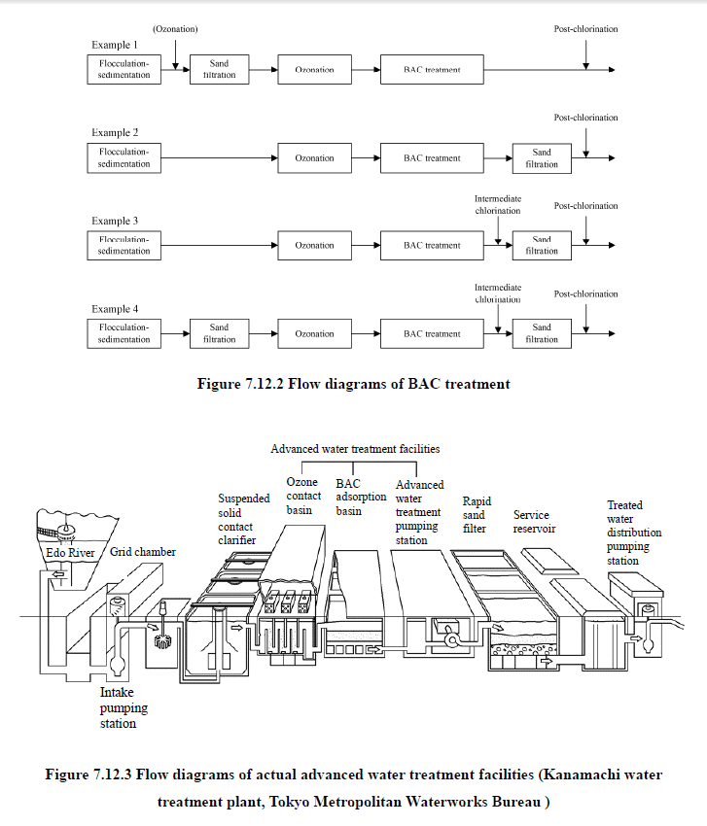
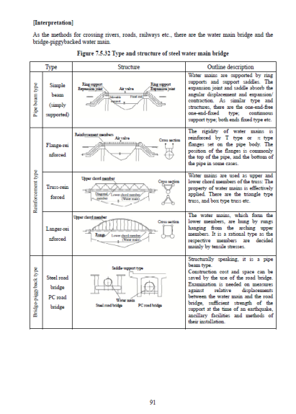
3. Laws and Institutional Framework
Chronology of Laws and Regulations
1953: Water Supply Facilities Maintenance Manual
1955: Water Supply Facilities Standards
1957: Water Supply Act was enacted
1964: Revision
1970: Revision
1982: Revision
1998: Revision
2006: Revision
1966: The Design Criteria for Water Supply Facilities
1977: Revision
1990: Revision
2012: Revision

Slide 15
4. Best Practices in Japan
(1) Corrective and Preventive Maintenance
Corrective Maintenance
Repaired or replaced when the problem was discovered
Preventive Maintenance
Planned renewal of facilities
Asset Management

Slide 16
4. Best Practices in Japan
(2) Maintenance in Water Treatment Plants
Good Operation &Maintenance
OJT
Guidelines
Preparation of Operation Manual
Records of Operation & Maintenance
Periodical Inspection of Equipment
Partnerships to Private Sector

Slide 17
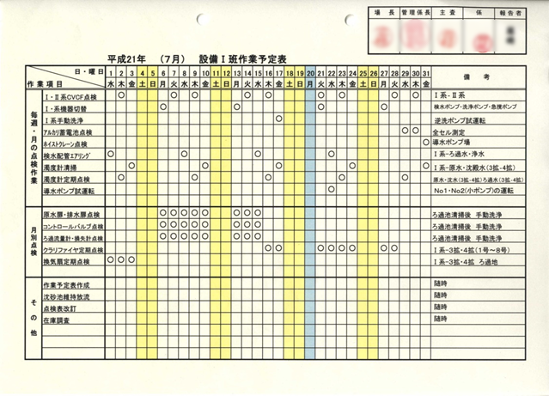
4. Best Practices in Japan
Example of Checklist
Shared and approved by management
Check list of periodical inspection
(Sapporo City)
Items to be checked are identified for each day
Source: JICA Training Course Material prepared by Sapporo City Waterworks Bureau (JICA Sapporo, 2015)

Slide 18
4. Best Practices in Japan
(3) Pipeline Maintenance
Materials for distribution pipelines change as new materials and technologies become available .

Slide 19
4. Best Practices in Japan
(4) Construction Quality Management
Standardization and Replacement of Lead Pipes
      Lead pipes were historically widely used but are now intensively replaced because of negative health effect and leakage problems.
      Intensive replacement and standardization will prevent future problems.
Year | Change in standards for lead pipes
1928 | Standards were set for lead pipes for water supply in Japan.
1990 | Lining of lead pipes with zero elution were added to the standards.
1993 | Based on the revision of the Water Quality Standards, the traditional unlined lead pipes were removed from the standards.

Slide 20
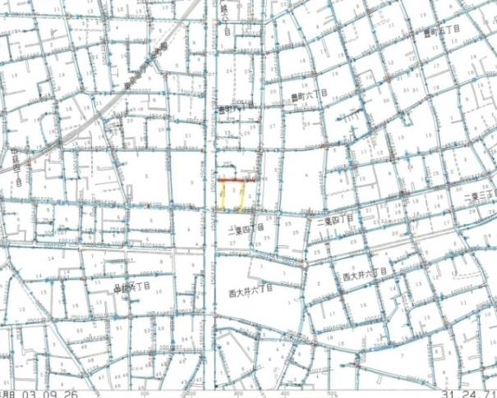
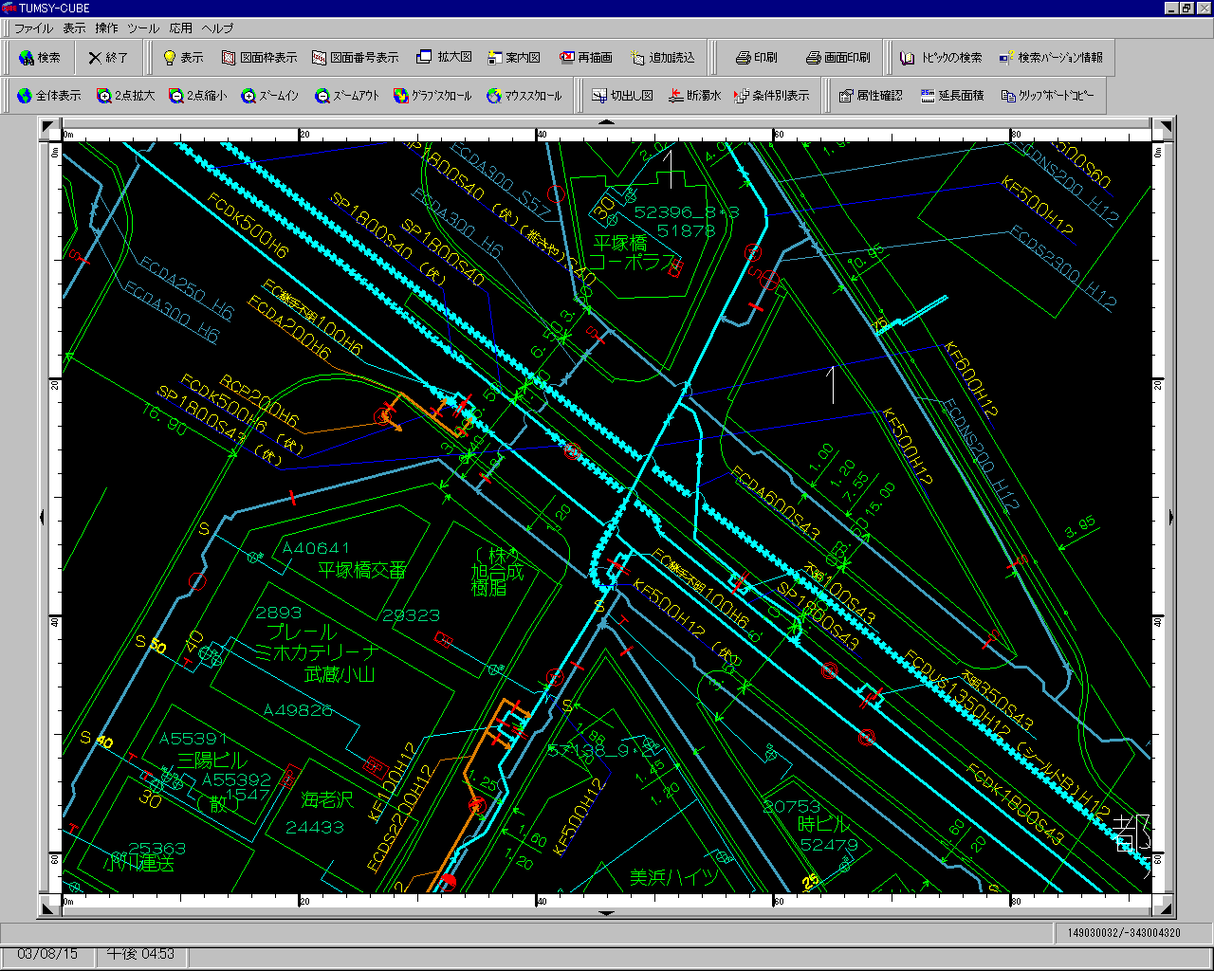
4. Best Practices in Japan
3) Mapping of Distribution Networks
Summarized knowledge and information on pipelines
are incorporated into a mapping system to share the information
internally and with other utilities.
Water Demand
Service Pipe, Plug Valve
弁栓
Distribution Pipe , Plug Valve
Transmission Main
layered
Source: Created from training course material for JICA
Project prepared by Tokyo Metropolitan Government
Waterworks Bureau
地形
Base Map

Slide 21
4. Best Practices in Japan
Asset Management
Leakage management and pipe replacement are dealt with cohesively under “Asset Management.”
Key features of asset management:
(1) Consolidated information on facilities, (2)Facility assessment and evaluation,
(3)Understanding of replacement needs and priorities, and (4) Clear outlook on fiscal balance
Medium to long term perspective (30 to 40 years)
Renewal needs and priority
Fiscal balance
Determination of replacement timing based on asset evaluation
Preparation of a financial plan
Preparation and implementation of the replacement plan backed up by financial resources and technical assessment
Source: MHLW, Guidelines for the Asset Management for Waterworks, http://www.mhlw.go.jp/za/0826/d11/d11-01.pdf

Slide 22
4. Best Practices in Japan
Designated Prequalified Contractors and the Registration System for the Contractors for Service Connection
Construction by
water utilities
  Using inappropriate materials
  Poor construction
  Need for standards to be set for materials and installation of service connections
  Necessity for ensuring rapid repair of burst pipes
Increased construction activities after Great Kanto Earthquake in1923 and the end of WWII in1945
Registered (private) contractors for the installation for service connections

Slide 23
5. Lessons Learned (1)
(Preventive Maintenance) Inadequate operation and maintenance practices lead to serious disease outbreaks and compromise the reliability, safety and quality of the water supply. Preventive maintenance is important both in terms of quality management and reducing life cycle cost.
(Guidelines and Standards) Utilities are strongly supported by national guidelines and standards, enhanced regulations and inspection services by health centers. Water Supply Act, Water Supply Facility Standards and Water Supply Facility Maintenance Manuals were developed which explicitly state maintenance responsibility.
(Concepts and Tools) (1) Preventive maintenance, (2) Standardization of materials, (3) National design criteria, (4) Information sharing have played key roles in maintenance. Introduction of new management tools such as digital mapping and asset management are great opportunities for utilities to work collaboratively.

Slide 24
5. Lessons Learned (2)
(Maintenance of Water Treatment Plant) Each utility or facility has its own manuals in operation and maintenance of water treatment plants, checklists, and handover procedures, all passed on to workers through OJT. Meetings organized by Japan Water Works Association facilitate information sharing across the country .
(Quality Control) Quality of materials and appropriate construction were the keys for maintenance of pipelines. Various kinds of cooperation with private sector was also essential.

