Slide 1
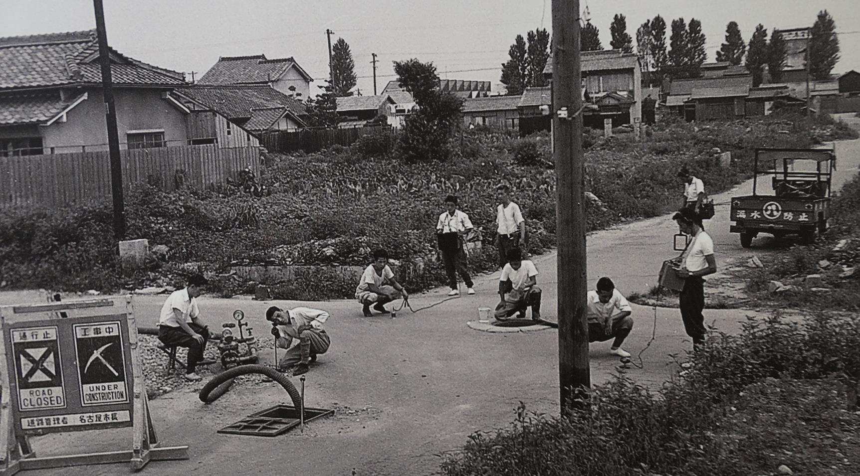
Reducing
Non-Revenue Water
No. T5 Ver. 1
Leakage Survey after World War II
Source: Nagoya City Waterworks and Sewerage Bureau

Slide 2
Contents
      Introduction
      Non-Revenue Water in Japan
      Causes and Control Measures
      Importance of Leakage Control
      Best Practices: Tokyo
      Lessons Learned

Slide 3
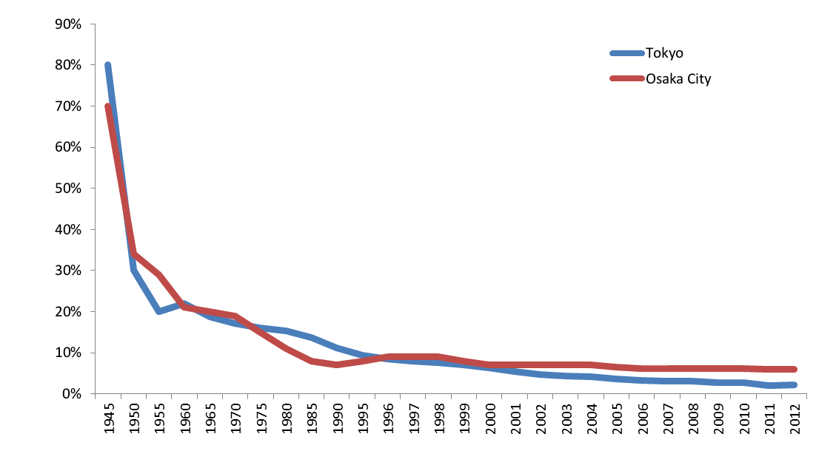
1. Introduction
Drastic reduction in leakage in Japan
80％
Tokyo (1945)
Leakage Percentage
3.1％
Tokyo (2008)
Source: Created from the data of Tokyo Metropolitan Government Waterworks Bureau and Osaka Municipal Waterworks Bureau

Slide 4
1. Introduction
Definition of Non-Revenue Water
Water Balance Table of IWA
System Input Volume | Authorized Consumption | Billed Authorized Consumption | Billed Metered Consumption | Revenue Water
 |  |  | Billed Unmetered Consumption
 |  | Unbilled Authorized Consumption | Unbilled Metered Consumption | Non-Revenue Water (NRW)
 |  |  | Unbilled Unmetered Consumption
 | Water Losses | Apparent Losses | Unauthorized Consumption
 |  |  | Customer Metering Inaccuracies
 |  |  | Systematic Data Handling Errors
 |  | Real Losses | Leakage on Transmission and Distribution Mains
 |  |  | Leakage and Overflows at Utility's Storage Tanks
 |  |  | Leakage on Service Connections up to point of Customer metering

Slide 5
1. Introduction
Frequently asked questions from participants of the water supply training courses
Q1. How did Japan reduce leakage from 80% to 3% in some large cities?
Q2. What are the effective measures for reducing NRW?

Slide 6
2. Non-Revenue Water in Japan
(1) Low NRW across the Country
Lower NRW
/More drought
NRW is particularly low in Tokyo (≤4%*), Okinawa, Aichi, Osaka, and Fukuoka Prefectures (≤9%*).
Higher NRW
/ Less drought
* NRW percentage, average in the prefecture
Areas achieving low NRW are...
(1) Major metropolitan areas:
High population density and water demand
(2) Water-scarce areas
(Islands, no major reservoirs etc.)
Source: Statistics on Water Supply (2014) and the Ministry of Land, Infrastructure, Transport and Tourism website (the impact of drought in the past 30 years
Relationship between NRW and Draught events
Legend: Name of Prefecture: NRW %(Served Population. Million)

Slide 7
2. Non-Revenue Water in Japan
(2) Components of NRW
Illegal connections are rare.
Apparent/meter loss is at the lowest possible level.
Focus is on reducing “leakage.”
NRW
Total Distributed:
4.17M m³/day
NRW ratio: 4.1%
Analysis of Water Distributed in Tokyo (2014)
Source: Personal communication from Dr. Shozo Yamazaki

Slide 8
3. Causes and Control Measures
(1) Importance of Reducing Non-Revenue Water
NRW
Poor Water Quality
Customer
Complaints
Poor
Service
Pressure on Water Resources
Water Quality
Contamination at leakage point
Customer Complaints
Complaints of low water pressure
Low reliability and willingness-to-pay
Water Resources
Public complaints about water shortage caused by drought
High cost for water resource development
Impact on Service Efficiency and Financial Management
Poor service and lost revenue

Slide 9
3. Causes and Control Measures
(2) Causes and Preventive Measures for Leakage
Steps and Categories of the countermeasures for leakage control
Basic measures
  Secure adequate financial sources
  Establish leakage control team
  Conduct surveys, collect & analyze data
  Develop better pipe materials and technology
Corrective measures
  Establish mobile team for prompt repair of burst pipes and other visible leakages
  Schedule for leakage detection and repair
Preventive measures
  Include leakage control as a distinct part of the management plan
  Plan for replacement of old pipes
  Analyze and evaluate pipeline networks
  Implement water pressure control

Slide 10
3. Causes and Control Measures
Quality Control of House Connections
Regulations under the Water Supply Act
Structure and materials for house connections must meet standards. Registration system for the contractors installing service connections.
Quality certification & inspection by third party
Equipment and materials for water supply facilities must meet Japanese Industrial Standards (JIS) and Japan Water Works Association (JWWA) Standards.
Better pipe materials
Changed from lead and galvanized steel to stainless steel, PVC lined steel, 2-layer polyethylene pipes.

Slide 11
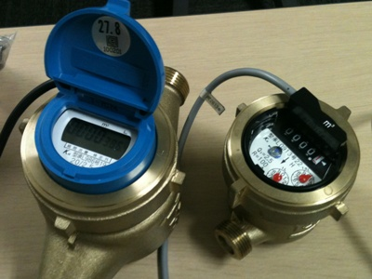
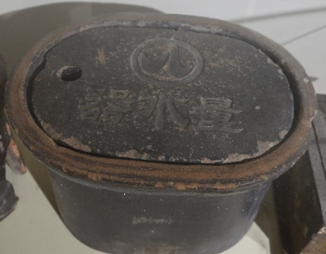
3. Causes and Control Measures
Metering error (apparent loss)
Better meter management
Measurement Act requires certain water meter accuracy and replacement every 8 years.
Water meter is protected in a box on loan to the customer from the water utility. It cannot be tampered with, removed or intentionally destroyed.
Accurate measurement
Less apparent loss
Meters
Old Meter Box
Source: (Photo) Nagoya City Waterworks and Sewerage Bureau

Slide 12
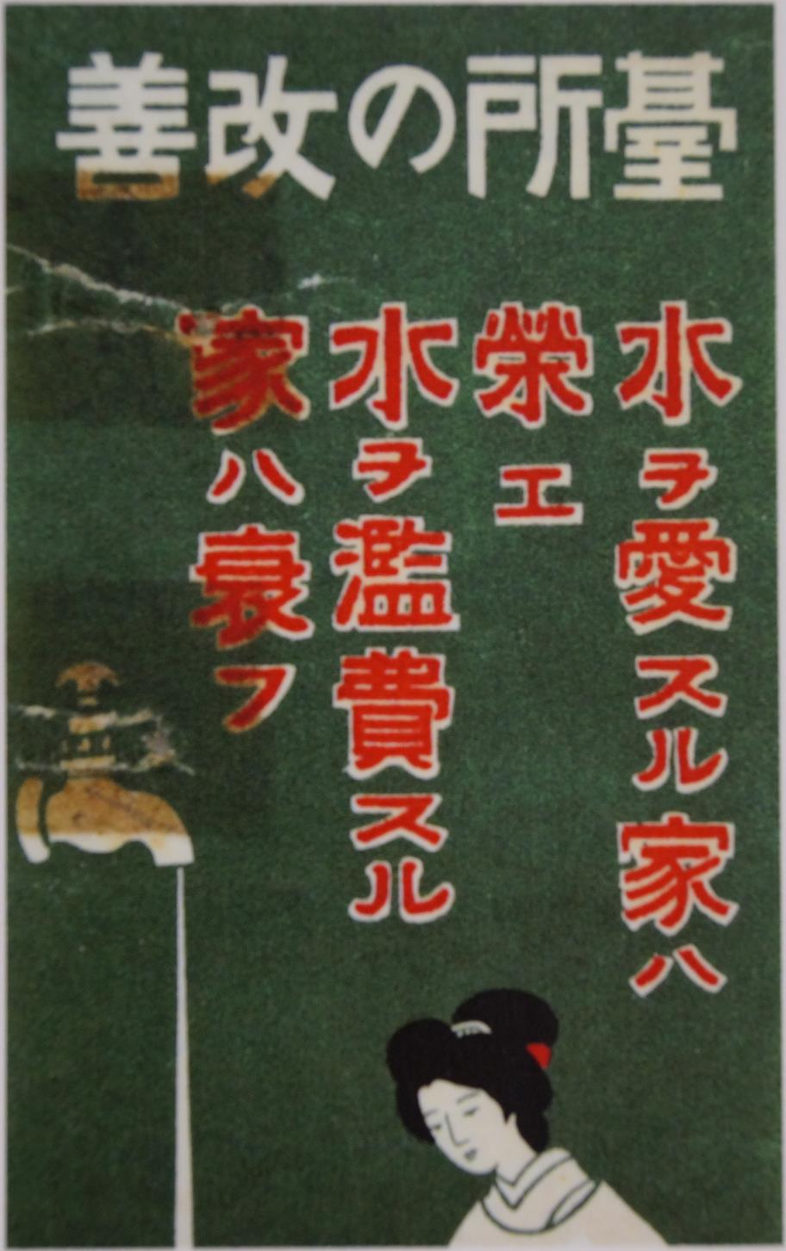
4. Importance of Leakage Control
(1) Metering Practices
Water shortages due to increasing demands were common problems for utilities.
Example in Nagoya
  Flat-rate tariff was the main cause of water wastage because there was no incentive to save water.
  Started to install meters at all households.
  Started to manufacture domestic meters .
Importance of metering was fully recognized.
Supply of quality meter was established before the period of major expansion.
“Measurement Act” (1951) requires appropriate management of meters.
Resulted in low apparent losses
Public Awareness Poster
“Make your kitchen better: A household that values water prospers.
A household that wastes water suffers.”
Source: Nagoya City Waterworks and Sewerage Bureau

Slide 13
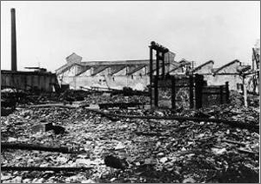
4. Importance of Leakage Control
(2) WW II Destruction of Infrastructure
“Leaking like a sieve”: 80% leakage in Tokyo water supply networks.
90 cities were damaged by air raids, and 1.67 million of 3.13 million km of service pipes were destroyed.
Importance of leakage control was recognized by all water utilities in Japan.
Source : Ministry of Internal Affairs and Communications
Ichinomiya City, Aichi Prefecture After WWII

Slide 14
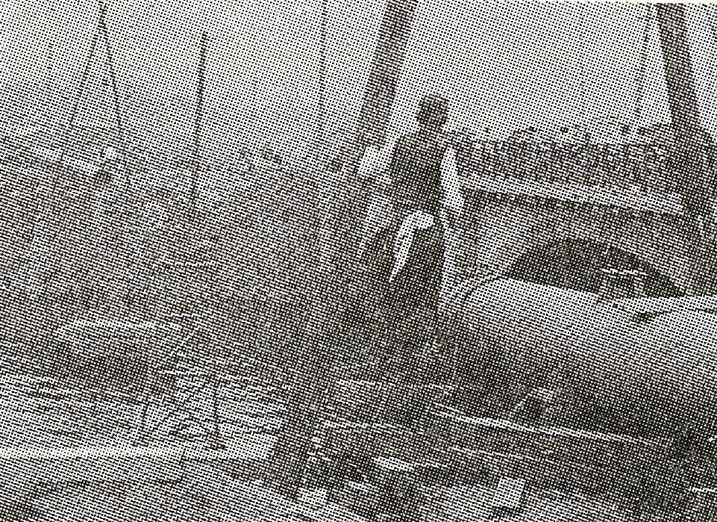
4. Importance of Leakage Control
(2) WW II Destruction of Infrastructure
Post war reconstruction
Immediate efforts by utilities
National subsidies (1/3 of expenditures)
Leakage Percentage
Repair work by utilities
(partly subsided by national fund)
Source: Photo from "100 years history of modern water supply"

Slide 15
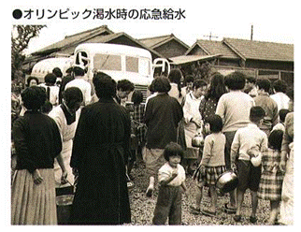
4. Importance of Leakage Control
(3) Water Demand Increase and Water Shortage
Rapid growth of population and economy from 1950’s to late 1970’s.
Severe droughts occurred during the course of demand growth. Strict water supply restrictions were imposed.
Year | Drought Events
1961~65 | Tokyo endured close to 5 years of water supply restrictions
1964 | Over 8 months of water supply restrictions in Nagasaki
1967 | 278 utilities rationed water supply due to wide spread drought
1973 | 393 cities under water supply rationing due to wide spread drought
Emergency water supply during severe drought in 1964
(Tokyo Olympic year)
Utilities and customers are well aware of the scarcity of water. Importance of leakage control is clearly recognized.
Source: Bureau of Waterworks,
Tokyo Metropolitan Government

Slide 16
4. Importance of Leakage Control
(4) National Policy for Leakage Control
Year | Major Event | Average NRW % (Year)
1960s – 1970s | Guideline for Leakage Control (JWWA) (1960) “Leakage Prevention for Water Supply” (1960) Notice by Ministry of Health | 22.4% (1970)
1970s – | Leakage Prevention Guideline (1977) by JWWA | 16.4% (1980)
1980s – | Enforcement of Leakage Prevention (1990) (Enforce 90% – 95% of effective water ratio) | 11.0% (1990)
Guidelines and Notices from National Government promoted leakage prevention

Slide 17
5. Best Practices: Tokyo
(1) Staged Approach to Leakage Management
Leakage ratio
Staged approach drastically reduced the leakage ratio in Tokyo.
Source: Mr. Shozo Yamazaki

Slide 18
5. Best Practices: Tokyo
(1) Staged Approach to Leakage Management
Stage | Leakage ratio | Leakage control work | Method
1 | >30% | Decrease aboveground visible leakage | Intensive repair activities
2 | 30%-20% | Decrease underground leakage | Zoning, accurate piping maps, training & utilizing good quality equipment for detection
3 | 25%-20% | Prevent recurrence of leakage | Increase in leakage control work, starting replacement of deteriorated pipes, use of DCIP
4 | 20%-12% | Carry out thorough leakage control work | Revision of working method & acceleration of pipe replacement work
5 | 12%-5% | Improve service pipes | Introduction of stainless steel service pipes which are strong and durable
6 | <5% | Maintain low NRW | Systematic pipe replacement and leakage control work based on cost and benefit analysis
Source: Personal communication from Dr. Shozo Yamazaki

Slide 19
5. Best Practices: Tokyo
(2) Early Detection and Repair: Planned and Corrective Work
Leakage Control
Program
Corrective
Measures
Mobile (Corrective) Work *
*
Planned Work
Classification Work
**
(Measurement of leakage amount)
Patrol Work**
Preventive
Measures
Replacement of old distribution pipe with
Ductile Cast Ion Pipe (DIP)
Material improvement work of service pipes
Improvement of service pipe arrangement
installed in the private road
Source: Training course
material for JICA Project prepared by Tokyo Metro- politan Government
Waterworks Bureau
Technological
Development
* Corrective repair of damaged pipes mainly by customers report
** Scheduled patrol including repair work for underground leakages
Corrective and preventive measures - pillars of leakage control

Slide 20
5. Best Practices: Tokyo
(2) Planned Work for Leakage Prevention
Planned work consists of 6.8% of total repairs but fixes 60% of the leakage.
Source: Training course
material for JICA Project
prepared by Tokyo
Metropolitan Government
Waterworks Bureau
Planned work is an efficient measure for leakage prevention

Slide 21
5. Best Practices: Tokyo
(3) Selective Measurement by Distribution Block
District Meter Chamber
Distribution area is divided into blocks with 1,100 households in each block.
Each block is remotely monitored by district flow meter.
Minimum Night Flow (MNF) is recorded.
Schematic of distribution block and picture of district meter with telemetering function
Source: Based on training course material for JICA Project prepared by Tokyo Metropolitan Government Waterworks Bureau

Slide 22
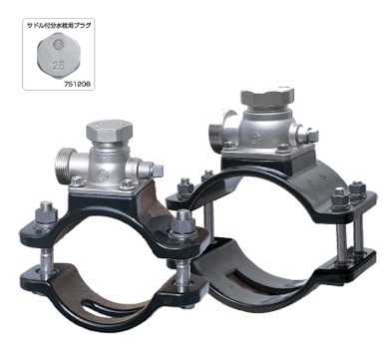
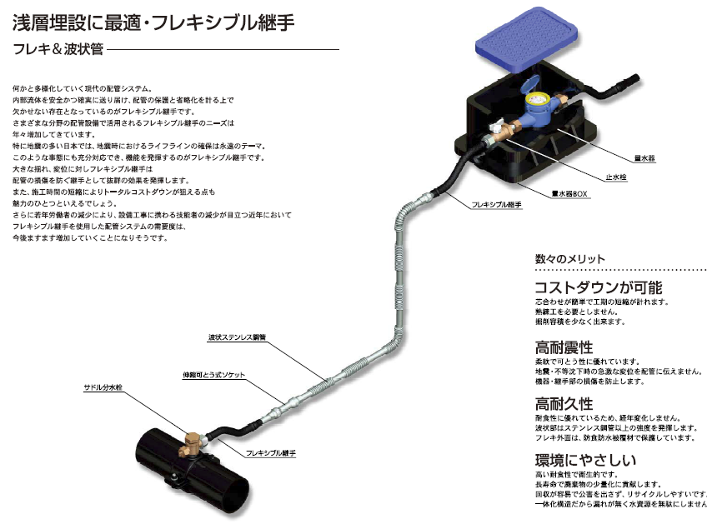
Ferrule with stainless steel saddle
5. Best Practices: Tokyo
(4) Planned Pipeline Replacement and Improved Pipe Materials
More than 95% leakage occurred at service pipes
Planned pipe replacement and improved pipe materials
Flexible service connection
Source: Based on training course material for JICA Project prepared by Tokyo Metropolitan Government Waterworks Bureau

Slide 23
6. Lessons Learned (1)
(Need for Leakage Prevention) Japanese water utilities recognize the importance of leakage control and prevention because of their experience with infrastructure destruction during the war, severe droughts, and water restrictions.
(Leakage Control for Reducing NRW) The major cause of NRW in Japan is leakage. Utilities have dramatically improved NRW by reducing leakages. It is important to install meters and analyze water flow, locate leaks and develop control measures. This requires a coordinated effort among various work units within the utility.
(Accuracy of Meters) The Measurement Act requires replacement of water meters every 8 years and utilities are obliged to keep them in good working order under the Water Supply Act. Metering errors can be kept to a minimum with a strong legislative framework.

Slide 24
6. Lessons Learned (2)
(Progressive Leakage Control) An active leakage control program can start with improved response to repairing visible leaks. Then the activities can shift to early detection of leaks not yet visible above ground, and eventually to systematic planned replacement of aging pipes. Planned pipeline replacement and improved pipe materials is effective for NRW reduction.

